Slide 1
Service Learning in the Geosciences
Examples and Lessons Learned
Presenters:
Prof. Leah Joseph – Ursinus College
Prof. Lori Weeden – University of Massachusetts Lowell

Slide 2
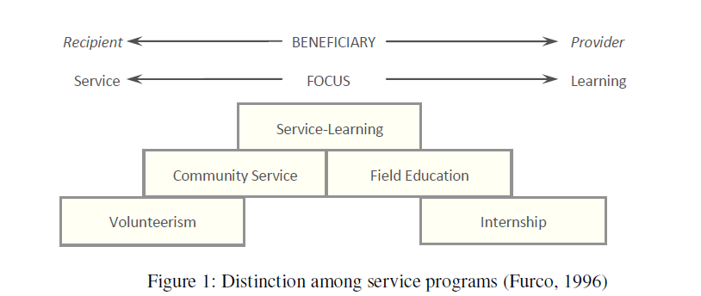
What is Service Learning?
A commonly utilized definition of service-learning is “a credit-bearing, educational experience in which students participate in an organized service activity that meets identified community needs and reflect on the service activity in such a way as to gain further understanding of course content, a broader appreciation of the discipline, and an enhanced sense of civic responsibility.” (Bringle & Hatcher, 1995).
Notes:
Beyond Volunteerism/community service
Often incorporates reflection about the experience

Slide 3
How can we employ service learning in the Geosciences effectively?
You must identify a local community organization (partner) that could benefit from work completed by students.
You must find a course suitable to pair with the community need.
You must be able to fit the service learning component into your academic schedule.
You must require the students to actively participate in the service learning project such that it will be reflected in their overall grade.

Slide 4
Who can be a partner?
Campus
General surrounding community
Local non-profit organization
The amount of input/involvement from partners can vary.
  Sometimes, partners do not always know that they are partners, depending on the project.
    e.g. Feasibility of a campus green roof.
    Affects project design/communication necessary.
Partners may be relying on product or it may be an added bonus.

Slide 5
What are the benefits to students?
Many past studies (e.g. Eyler and Giles, 1999) have shown service learning to result in positive outcomes in cognitive and affective measures for students as well as benefits to the community, faculty, and institution.
Our experiences have been that:
  Students tend to take project very seriously.
    More deliberate with measurements and evaluations.
    Reports are more polished and complete.
  Students appreciate the real-world aspect of the service learning component.
  Student appreciate the ability to contribute.
  Students develop valuable skills related to geoscience and/or general professional development.

Slide 6
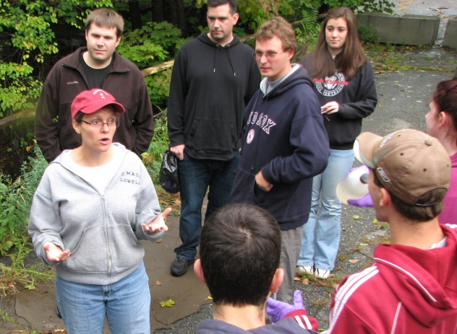
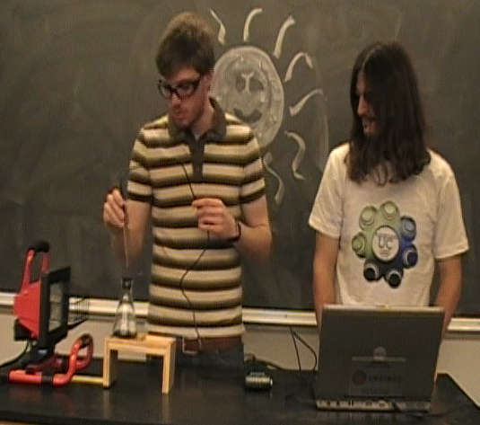
What are some examples of service learning in the geosciences?
Chemical analysis of River Meadow Brook for the Lowell Parks and Conservation Trust.
Developing a climate science lab for use in high schools.

Slide 7
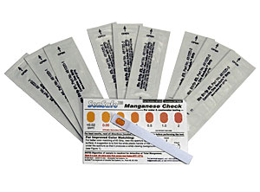
What was my motivation for adding a service-learning component to Environmental Geochemistry?
At UMass Lowell, Environmental Geochemistry had historically been taught without a laboratory component. The students were required to attend a weekly recitation to address homework issues, but there was no hands-on activities to accompany the lecture material.
The introduction of laboratory exercises started in 2009 with a minor field trip to a local old lime quarry and water
chemistry evaluation with dip-strips.

Slide 8
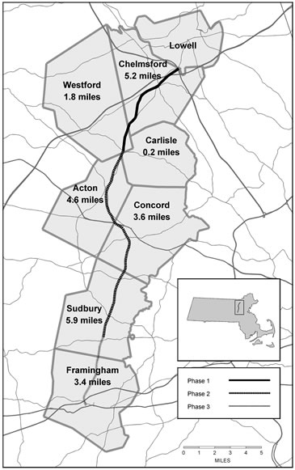
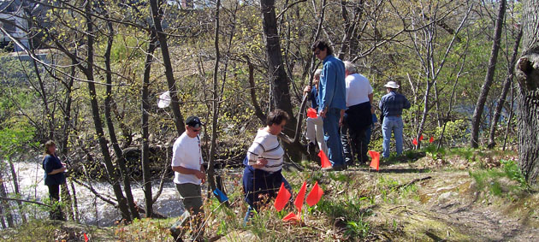
With the 2010 class, we started working with the Lowell Parks & Conservation Trust. Our students were tasked with evaluating the water chemistry from a historically-polluted tributary to the Concord River in Lowell. If the water proved to be relatively safe, the trust could make a stronger case for extending the Bruce Freeman rail trail alongside the brook through Lowell.
Bruce Freeman Rail Trail

Slide 9
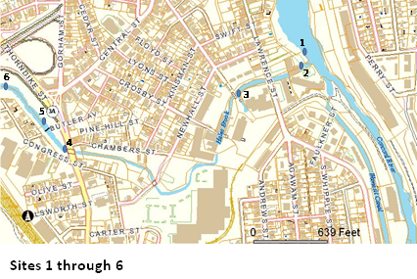
The original test sites were picked by relative historical context and accessibility

Slide 10
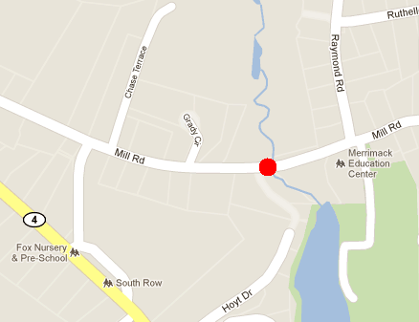
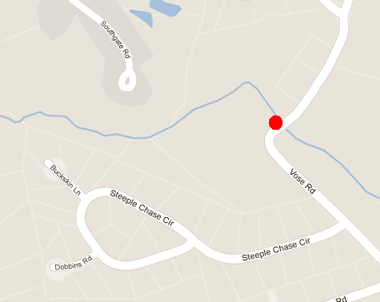
New sites were added in 2011. Both of these sites were upstream from Lowell and were picked as comparative sites. Mill Road in Chelmsford lies in a residential area and Vose Road in Westford is near a marsh close to the headwaters of the brook.

Slide 11
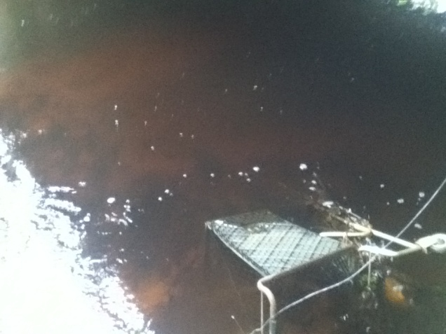
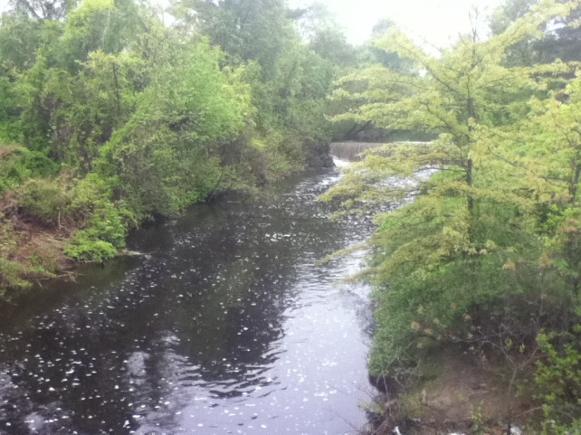
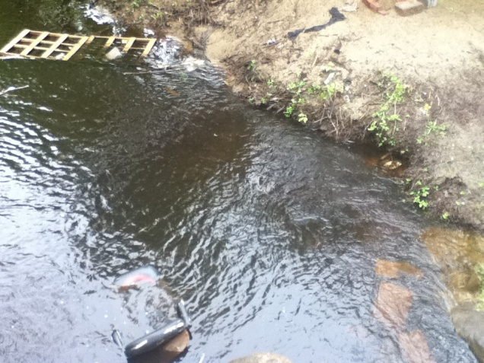
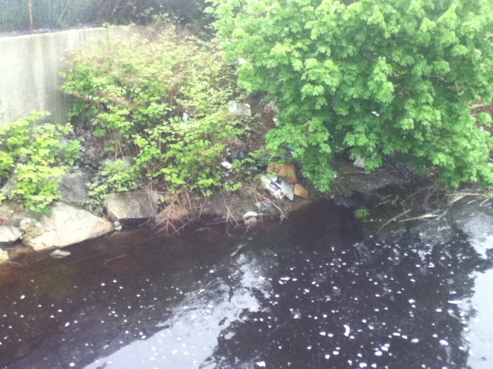
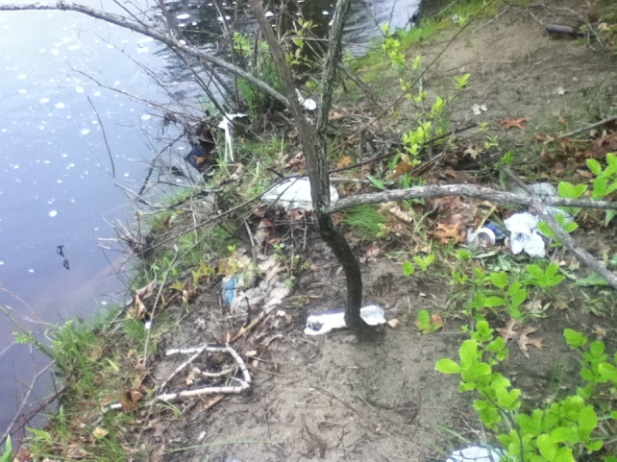
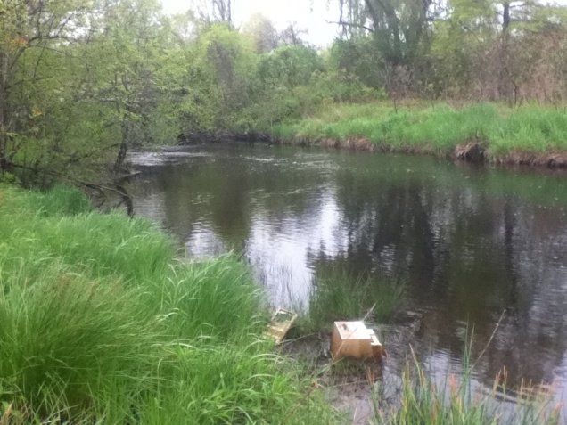
It soon became apparent that I was in over my head….

Slide 12
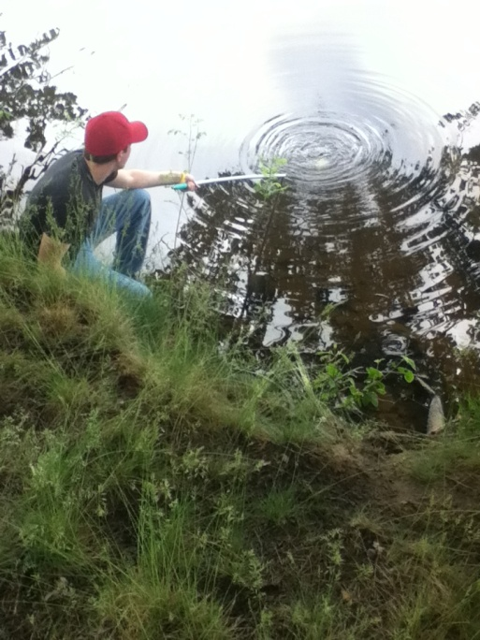
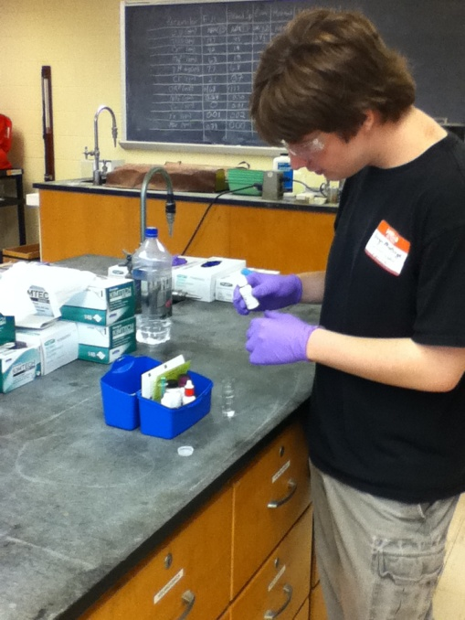
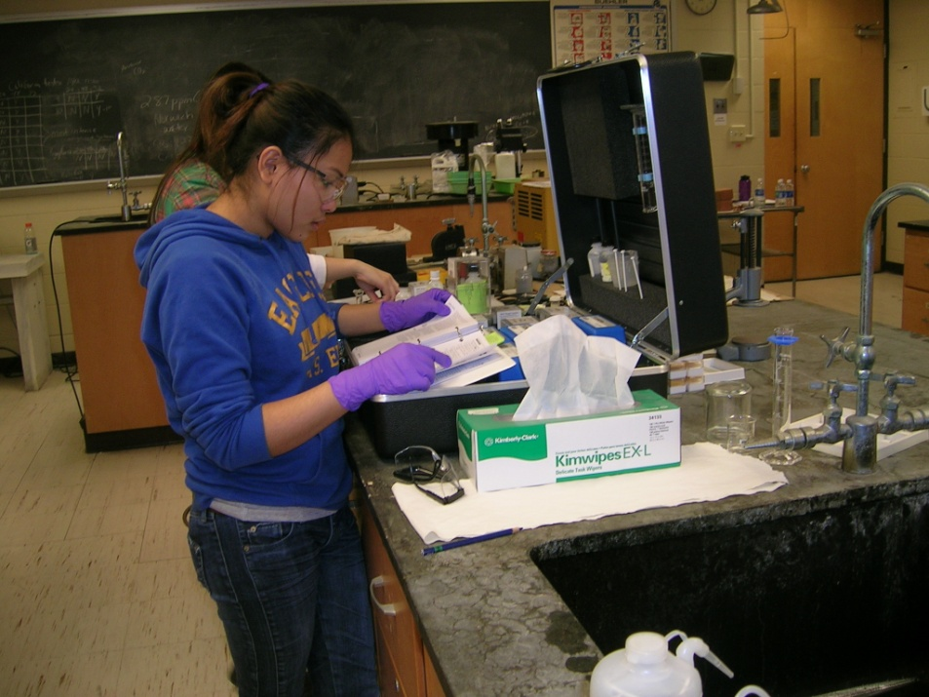
SO… we collected our water samples and headed into the lab for evaluation…..

Slide 13
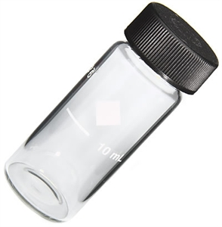
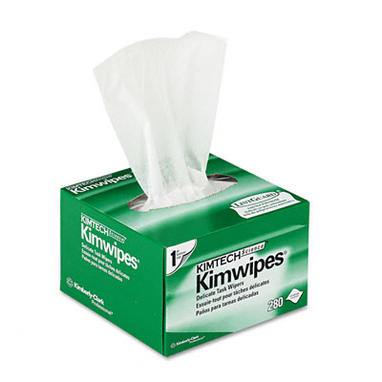
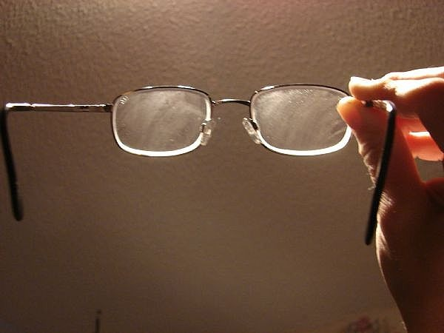
What were the results?
Sample # | NH₃-N | Cu | Cr | SO₄ | Fe | PO₄ | NO₃ | NO₂ | Si | Mg | Ca | Alkalinity | Cl⁻ | CO₂ | S²⁻ | F⁻ | Total Cation | Total Anion | Chg balance?
1 | 0.73 | 0.06 | 0.57 | 48 | 0.03 | 0.5 | 0.55 | 0.12 | 5.05 | 32 | 44 | 24 | 132 | 8.5 | 0.06 | 0.25 | 0.00486 | -0.00514 | Y
2 | 0.32 | 0.03 | 0.01 | 19 | 0.17 | 0.17 | 0.09 | 0 | 7.3 | 12 | 41 | 28 | 100 | 6 | 0.03 | 0.26 | 0.00304 | -0.00368 | ?
3 | 1.2 | 0.05 | 0.05 | 22 | 0.22 | 0.44 | 0.07 | 0 | 6.55 | 20 | 20 | 20 | 116 | 4 | 0.02 | 0 | 0.00266 | -0.00407 | N
4 | 0.37 | 0.03 | 0.19 | 27 | 0.17 | 0.33 | 0.05 | 0.011 | 6.15 | 26 | 48 | 36 | 112 | 16 | 0 | 0.02 | 0.00455 | -0.00432 | Y
5 | 0.31 | 0.1 | 0.01 | 46 | 0.29 | 0.04 | 0.19 | 0.014 | 5.55 | 30 | 40 | 25 | 120 | 5 | 0 | 0.07 | 0.00448 | -0.00476 | Y
6 | 0.188 | 0.03 | 0.01 | 21 | 0.81 | 0.27 | 0.2 | 0.012 | 4.15 | 33 | 92 | 21 | 136 | 7.2 | 0.02 | 0.14 | 0.00734 | -0.00463 | N
7 | 0.69 | 0.03 | 0.03 | 24 | 0.06 | 0 | 0.19 | 0.012 | 5.8 | n/a | n/a | 24 | 137 | 4 | 0.02 | 0.04 | 0.00000 | -0.00476 | N
8 | 1.27 | 0.1 | 0.01 | 27 | 0.26 | 0.19 | 0.12 | 0.017 | 9.05 | 16 | 48 | 29 | 112 | 16 | 0.04 | 0.03 | 0.00373 | -0.00420 | ?
9 | 0.42 | 0.04 | 0.03 | 9 | 0.07 | 0.22 | 0.25 | 0 | 10.7 | 46 | 64 | 37 | 278 | 4 | 0.02 | 0.13 | 0.00699 | -0.00865 | N
10 | 0.29 | 0.04 | 0.01 | 22 | 0.48 | 0.12 | 0.21 | 0.014 | 8.15 | 24 | 44 | 38 | 128 | 7.5 | 0 | 0.07 | 0.00419 | -0.00470 | ?
The 2010 group’s results were inconclusive. Many of the tests needed to be rerun. For most of the students, this was the first time they had used such tests and were not always careful to use best lab practices.

Slide 14
In 2011, sites 1, 5, 6 and 8 were eliminated and Mill Road, Chelmsford and Vose Road, Westford were added.
Site 1 was originally taken from the Concord River at the mouth of the brook. It was too difficult to take a sample away from the river bank without putting a student in harm’s way.
Sites 5 and 6 were near, and/or in the middle of a homeless encampment. Although the examination of the waters was interesting, I found it another unnecessary risk.
Site 8 was directly upstream from site 7 and didn’t seem a worthwhile sample to take.
The addition of the two sites was to examine the same waters—as they coursed through a marsh near the headwaters and through a residential area before they enter Lowell.

Slide 15
The Group from 2011 seemed to better understand the process and took the whole exercise more seriously, but…..
Sample # | NH₃-N | Cu | Cr | SO₄ | Fe | PO₄ | NO₃ | NO₂ | Si | Mg | Ca | Alkalinity | Cl⁻ | CO₂ | S²⁻ | F⁻ | Total Cation | Total Anion | Chg balance?
2 | n/a | 0.1 | n/a | 0.73 | 0.35 | 0.02 | 0.04 | n/a | n/a | 44 | 24 | 28 | 60 | n/a | n/a | n/a | 0.00484 | -0.00217 | N
3 | n/a | 0.05 | n/a | 6 | 0.47 | 0.03 | 0.26 | n/a | n/a | 6 | 38 | 42 | 100 | n/a | n/a | n/a | 0.00241 | -0.00364 | N
4 | n/a | 0.09 | n/a | 14 | 0.22 | 1.38 | 0 | n/a | n/a | 0 | 42 | 20 | 122 | n/a | n/a | n/a | 0.00211 | -0.00410 | N
7 | n/a | 0.07 | n/a | 10 | 0.47 | 0.16 | 0.31 | n/a | n/a | 14 | 37 | 30 | 102 | n/a | n/a | n/a | 0.00302 | -0.00359 | Y
9 | n/a | 0.01 | n/a | 10 | 0.23 | 0.15 | 0.29 | n/a | n/a | 30 | 50 | 36 | 152 | n/a | n/a | n/a | 0.00498 | -0.00510 | Y
10 | n/a | 0.15 | n/a | 0.04 | 0.23 | 1.13 | 0.3 | n/a | n/a | 8 | 32 | 40 | 120 | n/a | n/a | n/a | 0.00227 | -0.00408 | N
Mill Rd. Chelmsford | n/a | 0.09 | n/a | 2 | 0.39 | 0.07 | 0 | n/a | n/a | 15 | 21 | 28 | 90 | n/a | n/a | n/a | 0.00230 | -0.00304 | N
Vose Rd. Westford | n/a | 0.06 | n/a | 16 | 0.22 | 2.71 | 0.1 | n/a | n/a | 32 | 32 | 24 | 190 | n/a | n/a | n/a | 0.00424 | -0.00617 | N
There was still an issue of charge balance not adding up. When it comes down to it, the data is of no scientific value. There are too many students and no way to predict how well they will perform the necessary tests. That’s the bad news.

Slide 16
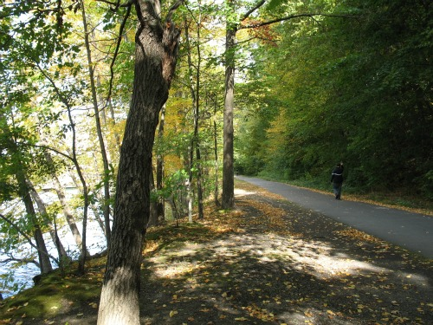
The good news is the Lowell Parks and Conservation Trust was still able to use the data to show student involvement. Additionally, although the results were inconclusive, none of the tests indicated dangerous waters. All of the tests were re-run at different times of year and the results were fairly consistent. The best news? The city of Lowell is considering the expansion of the rail trail into Lowell.

Slide 17
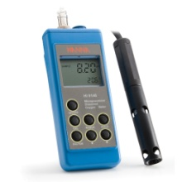
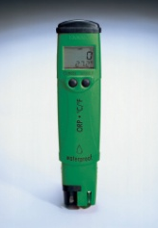
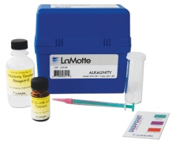
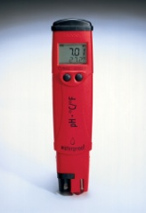
What is in the works for 2012?
In the future, we are hoping to be of greater assistance to the LP&CT. We are starting a monitoring program with help from the department club: Society of Environmental Scientists. They will be conducting monthly tests on several sites along the brook. The tests will include:
TDS, DO, ORP, pH and Alkalinity
We think of these tests as checking your gas mileage. If there is an anomaly, we look closer and conduct a more detailed analysis.
To keep the service learning component going, I was awarded an University grant to purchase additional meters; ones so easy, even an undergrad can use them correctly!
The next crop of Environmental Geochemistry students will still be required to test for copper, iron, sulfide, chloride, phosphate, nitrate and hardness in addition to the tests mentioned above.
With the addition of the new equipment and the consistent monitoring, we will finally be giving some valuable information—help– to the Lowell Parks and Conservation Trust.

Slide 18
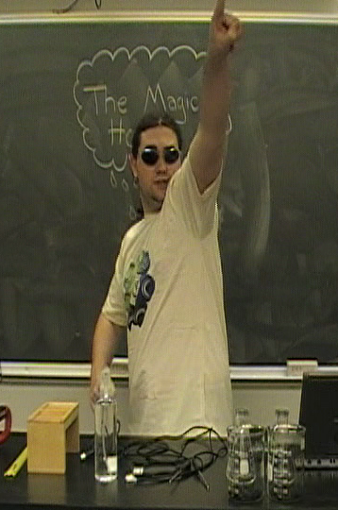
Climate Lab Development at Ursinus College
Lack of action on global climate change (GCC) issues often cited as being related to lack of training in scientific thought (e.g. Pollack, 2007, GSA Today, pgs 28-29)
Many colleges integrating climate concerns within school functioning and/or curriculum
Reaching students at college
  Increase exposure to science
  Increase exposure to critical thinking
  Number of students reached
Opportunity for service learning projects to extend beyond college to encourage informed decision-making later in life beyond college

Slide 19
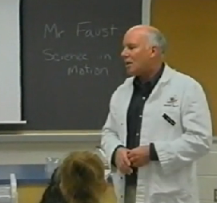
Service Learning in Global Climate Change Class
Stewardship part of Env Studies curriculum
Project complexity/commitment increases with advanced classes
Advanced Env Studies class in GCC (F08)
  Varied science background in students
Communication about GCC outside of the
classroom seemed important
Partner with Science in Motion:
  A state-supported outreach program that is “dedicated to the development of sustained collaborative partnerships in promotion and support of excellence in basic science education” (http://academic.ursinus.edu/scienceinmotion/About/About_Mission.html)
Few labs for Environmental Science classes
  No GCC lab (Potential lab, but no time to adapt it)

Slide 20
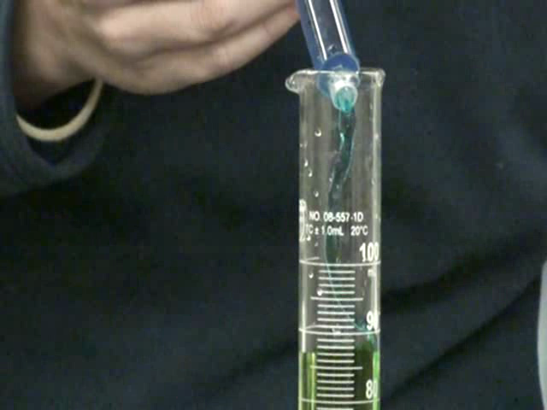
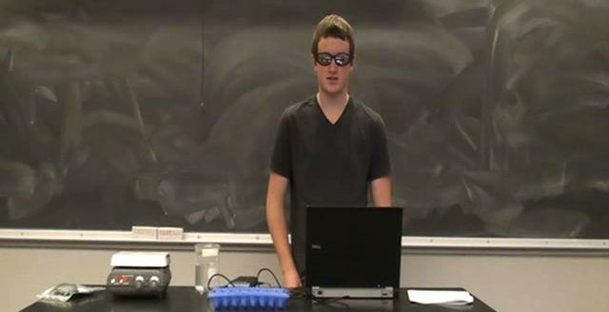
Project Goals
GCC class will create a lab activity to be utilized in high schools that will:
  Promote science education
  Provide a background in GCC concepts
  Be interesting and fun
Notes:
So a project idea has formed:
Sounds easy, huh?

Slide 21
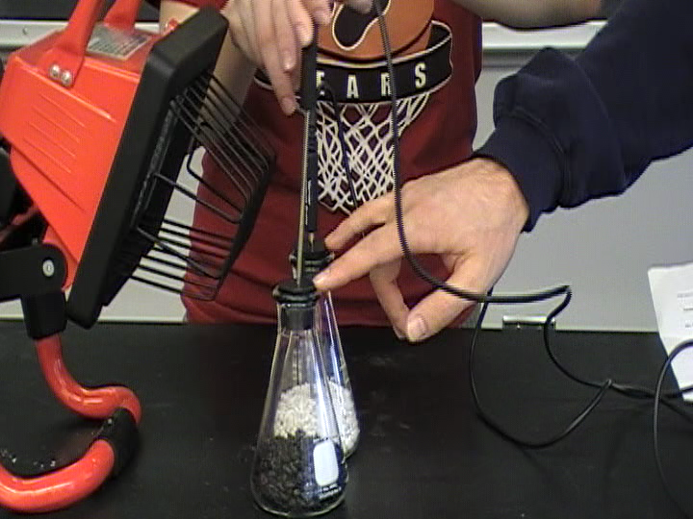
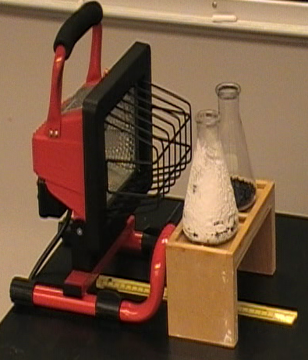
Teaching Goals
Overarching:
    College students:
      Gain knowledge through teaching/creating assignments
      Increase familiarity with lab procedures & technologies
      Enhance skills in group work, setting & achieving stepwise goals towards project completion
      Practice communication of complex ideas to public
      Provide high school students with interesting way to learn science skills & GCC concepts
Notes:
Overarching goals:
Students gain more intimate knowledge of some aspects of climate change through teaching
Become more familiar with lab procedures and instructional technologies
Establish group work techniques as well as practice independence in setting and achieving stepwise goals towards project completion
Gain experience in communication of complex ideas to the public
Provide high school students with an interesting and fun way to learn science skills and certain aspects of GCC science
Practical goals:
Increase individual knowledge/ability by completing lab sections and attempting others lab sections
Improve the written lab, teachers notes, etc. from the technical (typos, errors) to practical (distance between light and samples) to conceptual (looking at different potential experiments)
Educate high school students through a created video (long term impact) as well as class visit(s)

Slide 22
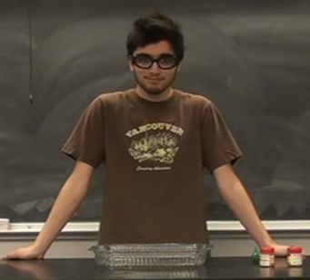
The Assignment
Collect materials to run original labs
Test labs and edit/fix as necessary*
Edit instruction sheet to match
Run high school classroom trial and edit
Create:
  Teachers notes
  Background information
  Coherent lab packet
  Matching instructional video*
Write self & peer evaluation/reflection
Notes:
They actually did everything on this list.
The star are to remind me of a few things:
This is on top of “normal” class: lecture/discussion, problem sets, weekly labs, writing assignments, etc
Most of this done out of class time
Testing labs & making them work…invaluable from the perspective of my teaching goals…they spent much time trying to get these to work..in order to do that, you have to think about the scientific concept behind it PLUS brings up topics such as ethics in the scientific process (is it not working b/c I’m doing something incorrectly? Or is the science wrong & I’m just trying to force it to be the way it “should” be)
Video was what Ron felt was very important for HS
Labs: Water vapor, cloud cover, solar output, albedo, co2

Slide 23
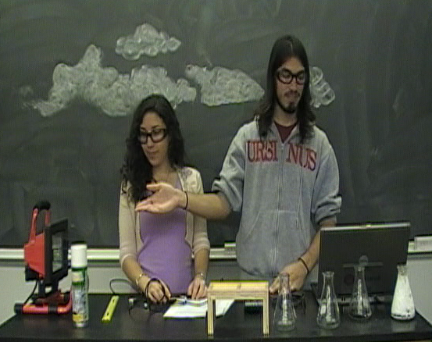
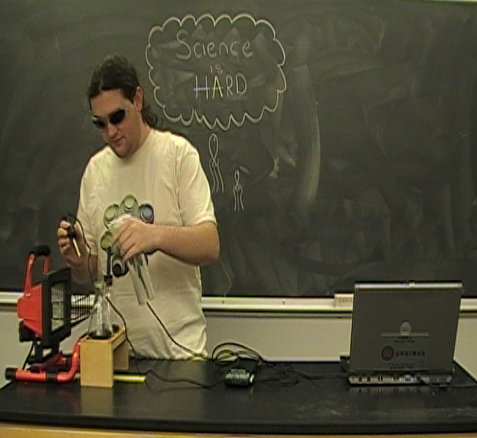
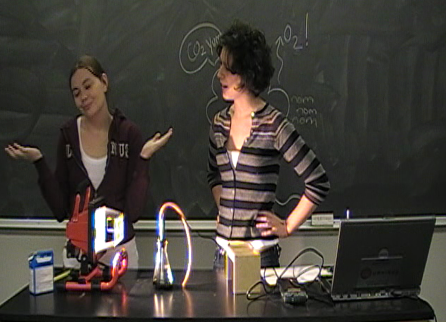
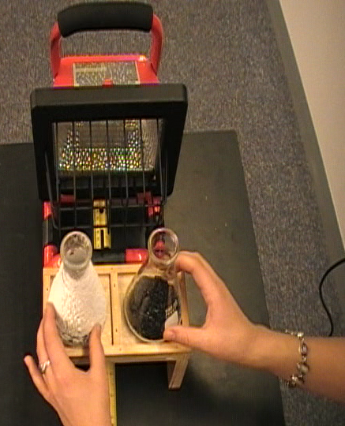
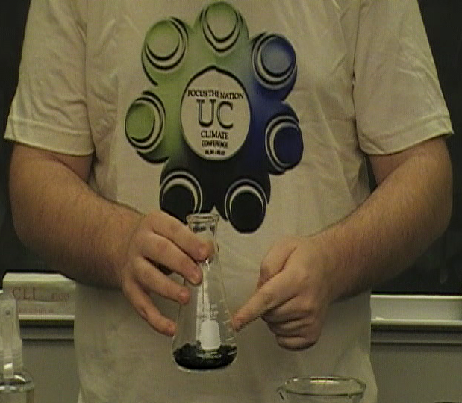
Video Clips (F08)
Notes:
- Just stills of some of the videos that they created. (have videos with me…find me later if you’d like to see htem)
Shots of them walking through the concepts behind the process
Let’s take a closer look….

Slide 24
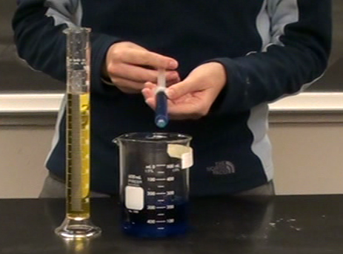
Project Utility & Feedback
Utilized in at least 5 different schools.
  Reached over 1000 students.
  Chemistry, Biology, Env Science.
Feedback (Faust & Wilkins)
  Kids & teachers loved video.
  High school students became familiar with GCC terminology.
  High school students saw relationship of GCC factors.
  Would love to see more labs in a similar style.
Notes:
So, how did it work? From the SIM/HS perspective:
- Utilized in five different schools, reaching over 500 students (even with SIM funding delay). Now a total of over 1100 kids!!
Classrooms include Chemistry, Biology, and Environmental Science; mixed levels and abilities (fight over which class gets to utilize it)
Feedback (Faust & Wilkins):
Kids and teachers loved video
High school students became familiar with GCC terminology
High school students saw relationships of various factors to GCC concepts
Would love to see us create additional labs in a similar style
From my perspective,
They hit on all of my teaching goals
Particularly the scientific knowledge and processing gained through trying to get their labs to work

Slide 25
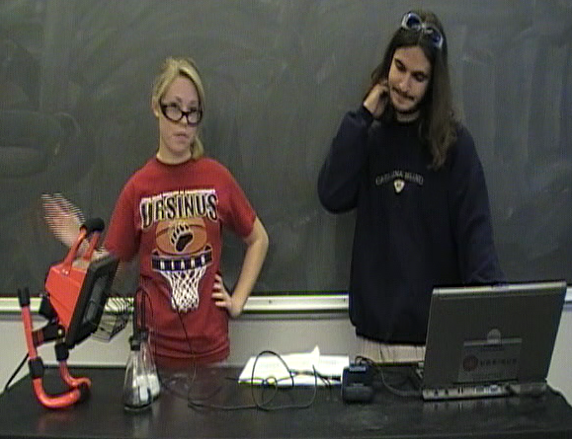
Student Reflections (F08)
“I assigned goals…and became a leader. Somehow.”
“We did a lot, and we came out with a useable final product. I find this amazing.”
“I thought in an
innovative manner
in order to improve
the Water Vapor Lab.”
Notes:
From the college students perspective?
Self-deprecating humor..
Proud of how they problem-solved their labs
Proud of how they figured out how to communicate about a complex subject

Slide 26
Student Reflections (F08)
“..overall I feel as though not only did we accomplish a very weighty task, every member of the group grew through the work we did. I felt as though we all were forced to innovate and think outside the box in order to improve our individual experiments, and we were required to collaborate on our own without teacher instructor in order to work on the project. I believe that every member of the group showed large amounts of maturity, professionalism and skill in completing this project and I would definitely work with any and all members of the class again on other projects. I believe this project will be an important tool in future environmental education and I feel that without our participation to the level at which we worked, the project would not have come out as great as it did.”

Slide 27
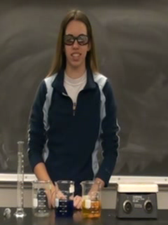
Specific Lessons Learned
Start students on project early in semester.
Have flexible syllabus.
Create checkpoints/goals for students.
Partner interaction (and enthusiasm) throughout semester is important (and vice versa).
Class personality influences experience.
Science education utility for college students primarily through necessary revision/rethinking of experiments.
  Science communication utility present regardless.
Creating videos can be time-consuming.
Plan for time after the end of project to “clean up.”
Create assessments to go along with project.
Teach group work and project management skills.

Slide 28
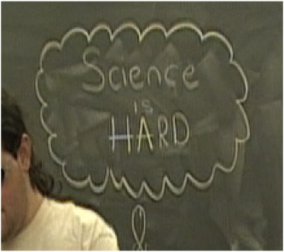
Be Aware!
SL projects include risks not present in more traditional style lecture- or discussion- based classes.
  Uncertainties inherent and not always anticipatable
    Students may not understand/deal with changes/uncertainties.
    Projects can grow as learn, shrink as meet dead-ends, shift as needs changes, be challenged by bad weather or tensions via group member personality conflicts or members not pulling their own weight.
  Students face individual challenges:
      Large scale group work.
      Individual responsibility.
      Lack of small deadlines as projects develops/changes.
      Answering to partner, peers, and instructor.
      Taking initiative and ownership of their portion.
      Learning complex ideas in regard to project.
      Professional product development and need for iterative editing.
Notes:
Less is in your control as soon as you step out of the classroom

Slide 29

Be Aware!
SL projects often take more time for faculty member than traditional class activities.
  Before, during, and after the course.
  Communication and design (emails take time!).
  Clean-up of final product.
May affect student evaluations of course.
  Protect newer faculty.
  Protect yourself, particularly if not tenured.

Slide 30

Be Aware!
Personalities can affect project “success.”
  Individual, class, instructor, partner.
Communicate the purpose and skills development related to project to students.
Grading/Assessment can be complicated.
  Peer/self evaluations.
  Feedback from partner.
  Gradable materials (group and/or individual).
  Effort and/or product and/or process?
  Can students be “fired” from project?
Notes:
Less is in your control as soon as you step out of the classroom

Slide 31
Be Aware!
Frequent interactions with enthusiastic partner who communicates the value of their work very helpful
Important to communicate with partners
Partners may need some “training” too:
  Their expectations of students (time frame, style of engagement, quality of product at end)
  Their responsiveness to student questions or class needs/student expectations of their partners
  Memorandum of Understanding
  (UVM: http://www.uvm.edu/~partners/?Page=slexamples.html)
Notes:
Less is in your control as soon as you step out of the classroom

Slide 32
With all of this, is it worthwhile?
YES!
Notes:
Less is in your control as soon as you step out of the classroom

Slide 33
Works Cited & Image Sources
General Service Learning:
Barrington, L & Duffy (2010), Maximizing Benefits of Service-Learning in Engineering: American Society for Engineering Education Conference Proceedings
Bringle, R. & Hatcher, J. (1995), A service-learning curriculum for faculty. Michigan Journal of Community Service Learning, 2, 112-122.
Eyler, J. & Giles, D. E. (1999), Where’s the learning in service-learning? San Francisco, CA: Jossey-Bass.
Furco, A (1996), Service-learning: A balanced approach to experimental education. Expanding Boundaries: Service and Learning. pp. 2-6
Image Sources:
River Meadow Brook Project
http://www.nefa.org/artists_projects/artmaking_public_realm
http://www.drugstoresource.com/store/m/22-Kimberly-Clark.aspx?pi=2
http://www.camlab.co.uk/10ml-round-glass-sample-cell-with-cap-for-hach-colorimeter-pack-of-6-p13189.aspx
http://jvaudio.wordpress.com/2009/03/16/the-mystery-of-dirty-glasses
http://www.fieldandfacility.com/
http://www.filterwater.com/p-211-manganese-check-water-test-kit.aspx
http://essentialeducator.org/?p=8227
http://penigma.blogspot.com/2011/04/and-now-factcheckorg-fails-donald-trump.html
Climate Lab Development
Pollack, H.N. (2007), Scientific uncertainty and public policy: Moving ahead without all the answers, GSA Today,v.17 no. 3 pgs 28-29.
http://www.ursinus.edu/netcommunity/page.aspx?pid=1370
Stills from student videos from GCC classes in F08 and F10.

Slide 34
Acknowledgements (River Meadow Brook Project)
Lowell Parks and Conservation Trust:
Jane Calvin and Gwen Kozlowski
City of Lowell:
Sarah Brown
University of Massachusetts Lowell:
Nelson Eby
Arnold O’Brien
John Duffy
Gray Fitzsimons
Linda Barrington
Phyllis Proctor
Environmental Geochemistry Class of 2009, 2010 & 2011
Lab assistants:
Sheila Wilhelmi
Samantha Roddy
Chloe Schneider
Special thanks to:
The Commonwealth of Massachusetts for supporting the Lowell Parks and Conservation Trust
The University of Massachusetts Lowell for the Service Learning Mini-grant that made possible the acquisition of new equipment.

Slide 35
Acknowledgements (Science Lab Development)
Science in Motion:
  Ron Faust
  Amy Beadle
  Vic Tortorelli
Local Teachers:
  Mr. R. Maxwell, Perkiomen Valley SD (F08) & his students
  Mrs. R. Paul, Perkiomen Valley SD (F10) & his students
  Mrs. P. Wilkins, Bowertown
  Others who have used our lab!
Ursinus College Students
  F08 GCC Class
  F10 GCC Class
Advancing Science & Karen York at Gettysburg College
Ursinus College
Downloadable materials found at:
  http://academic.ursinus.edu/scienceinmotion/Experiments/Experiment_Intro.html
  http://academic.ursinus.edu/scienceinmotion/Experiments/Complexity %20of%20Global%20Warming.htm

