Slide 1
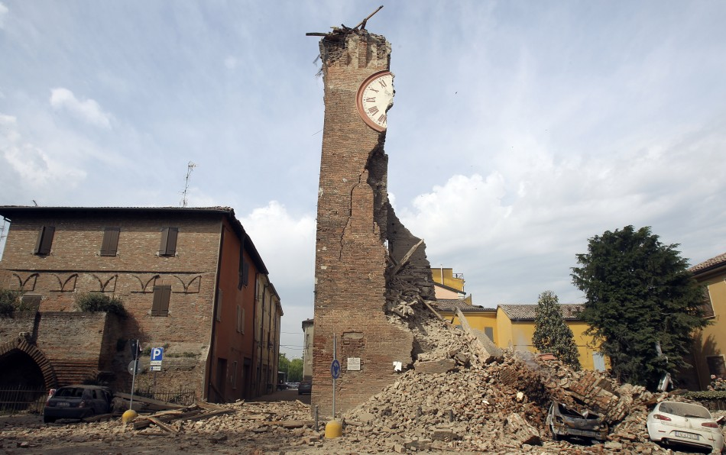
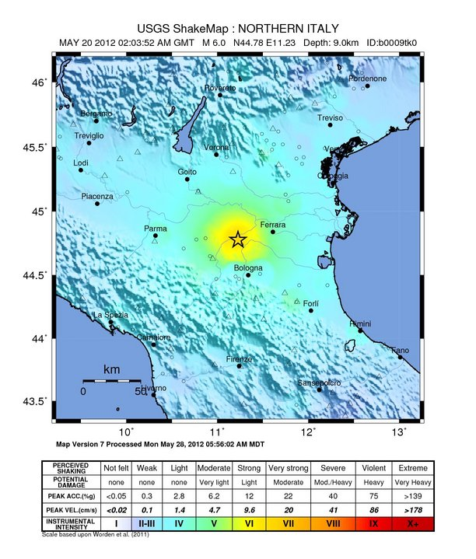
Earthquake damage near Modena, northern Italy
Magnitude and Intensity: M_{w} 6.0 & 5.8; MMI VI-VII
Date: May 20th and 29th 2012

Slide 2
Today’s Presentation:
A short lecture activity sequence designed to engage students in learning about EQ epicenter location
  Activity works for any class size
  Incorporates three separate activities:
    Slinky demonstration of EQ waves
    Think-Pair-Share
    Physical activity
      Generation of seismic energy by students

Slide 3
Learning about Earthquakes
Two learning objectives for students undertaking E&PS 101 at UNM-VC are:
  Students will be able to describe earthquakes;
    how they occur,
    what the three types of seismic waves are, and
    how these waves differ.
  Students will be able to determine an earthquake’s epicenter from seismic wave data
Notes:
In order to address the first of these I find it is important to help students visualize what is essentially invisible (in the case of body waves). While animations that demonstrate the motion do exist, a physical demonstration allows me to retain written information on the screen emphasizing the alliterative nature of this particular topic.

Slide 4
Seismic Waves with a Slinky
p waves
  p for primary as they arrive first (they are fastest)
  Compressional wave (“push-pull” motion)
s waves
  s for secondary as they arrive second
  Shear wave (“side-to-side” motion)
  Speed = approx. 60-65% of p-wave speed
L waves
  Love and Rayleigh waves
  Large amplitude, Long duration, Low frequency
  Speed = Last to arrive
Body Waves
Students really appreciate the alliteration here
Surface Waves
Notes:
Using a slinky you can demonstrate p and s waves pretty easily. Furthermore, with taught and slack slinky variations you can adjust wave speed and longevity.

Slide 5
Learning about Earthquakes
Two learning objectives for students undertaking E&PS 101 at UNM-VC are:
  Students will be able to describe earthquakes;
    how they occur,
    what the three types of seismic waves are, and
    how these waves differ.
  Students will be able to determine an earthquake’s epicenter from seismic wave data

Slide 6
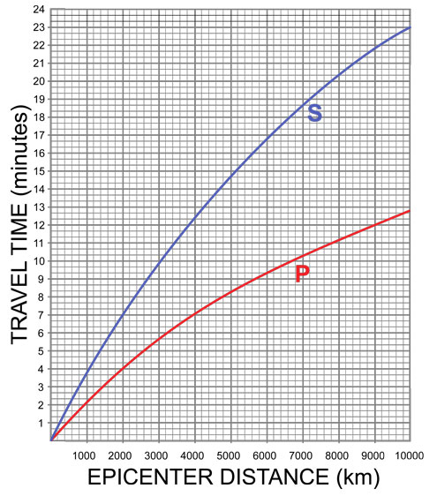
Locating an Earthquake’s Epicenter
Think-Pair-Share
Study the graph on the right.
Make two observations about the two lines labeled P and S.
Notes:
The graph shows the time it takes for p waves (red line) and s waves (blue line) to travel from the epicenter to various distances from the epicenter.
The two observations I’m most interested in the students making are: the lines diverge, and they curve (for the time being we will only discuss the first of these observations). Discuss with students how the diverging lines could be useful.

Slide 7
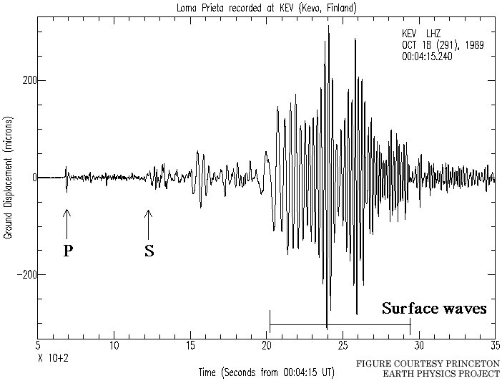
Locating an Earthquake’s Epicenter
It is necessary to measure the amount of time between the arrival of P and S waves on a recording
We can use the time to read off a distance using our graph
Notes:
This slide gets students looking at an actual seismograph, identifying p, s and L wave signatures, and a feel for how far (body) waves can travel. Example shown is a seismic station in Finland measuring energy from the Loma Prieta earthquake in California.

Slide 8
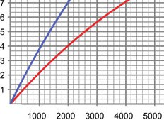
Think-Pair-Share
For the Loma Prieta earthquake, the P-minus-S interval at the Albuquerque seismic station was 2 minutes and 18 seconds (or 2.3 minutes).
How far had the seismic waves traveled to reach Albuquerque?
Is this enough information for us to determine the epicenter of the Earthquake?
S
P
Travel Time (min)
Epicenter Distance (km)
Hint: Each square on vertical axis is 20 seconds, and each square on horizontal axis is 200 km
Notes:
http://www.classzone.com/books/earth_science/terc/content/investigations/es1003/es1003page02.cfm
The trickiest part of this exercise for students is realizing what each one square increment represents on both x and y axes. Note on the y axis that each square is 20 seconds.

Slide 9

One Station is not enough…
With two we can narrow it down…
Notes:
I use this animation to demonstrate why one seismic station is helpful but not enough to locate an earthquake. The first station I use is Albuquerque and we use the data from the previous think-pair-share. Then I include a circle centered on Vancouver to show that in the vast majority of cases even two seismic stations are not enough (the exception – theoretically – being when two seismic stations plus the EQ epicenter form a perfect line).

Slide 10
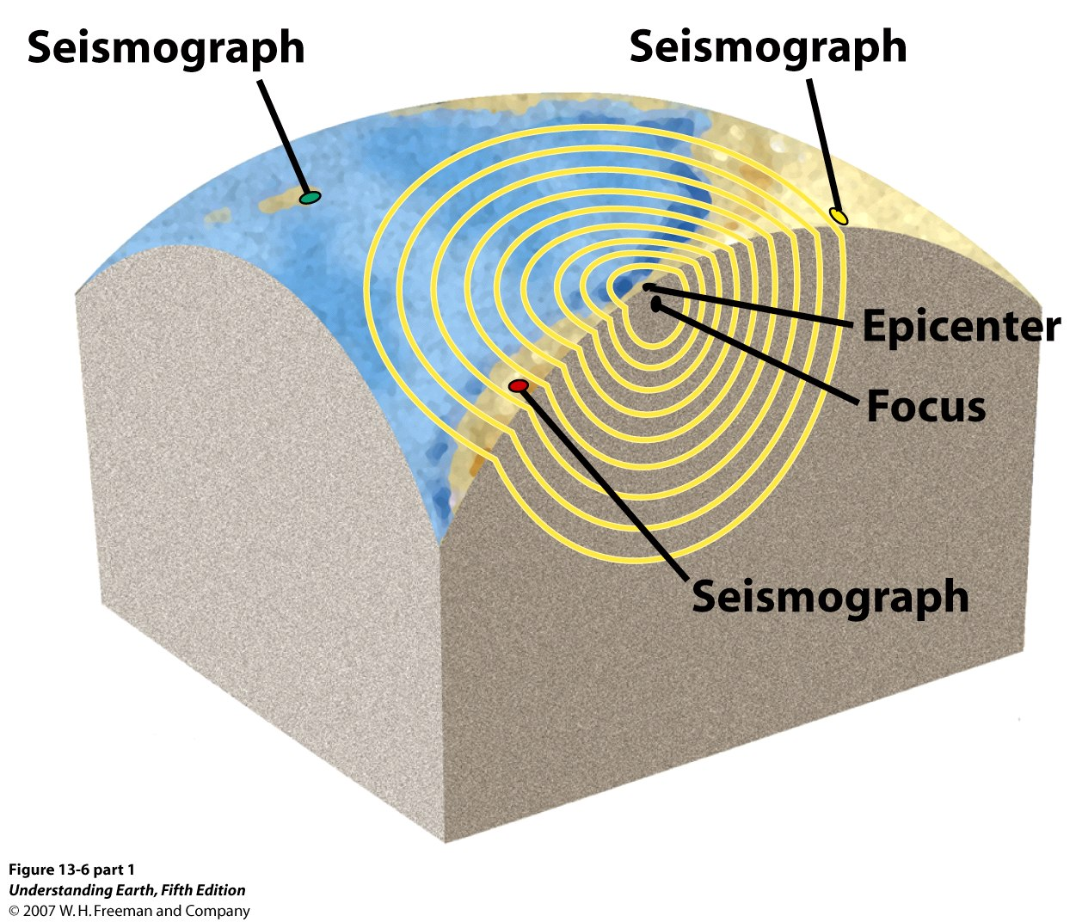
Locating an Earthquake Epicenter
1
2
We need at least 3, widely spaced places where we can record an earthquake’s energy.
3
Notes:
This slide is possibly redundant.

Slide 11
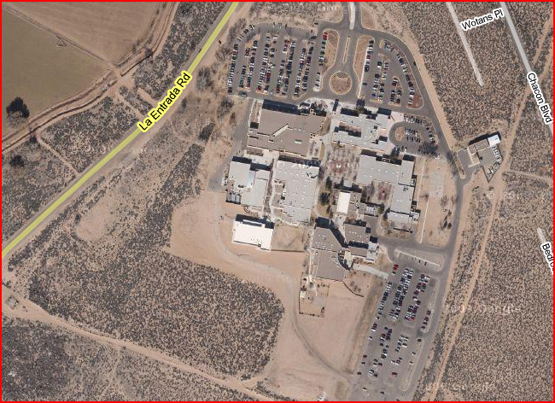
Locating an Earthquake Epicenter
Seismograph A
Seismograph B
Seismograph C
Notes:
The purpose of this slide and those following is for students to see what it means for where they live. This is a GoogleEarth view of the UNM-Valencia campus. I tell my students that before class I set out three seismic stations around the campus. I purposefully omitted scale as I want the upcoming data analysis to be qualitative not quantitative. If you want to make it quantitative then of course GoogleEarth does indeed provide a scale.

Slide 12
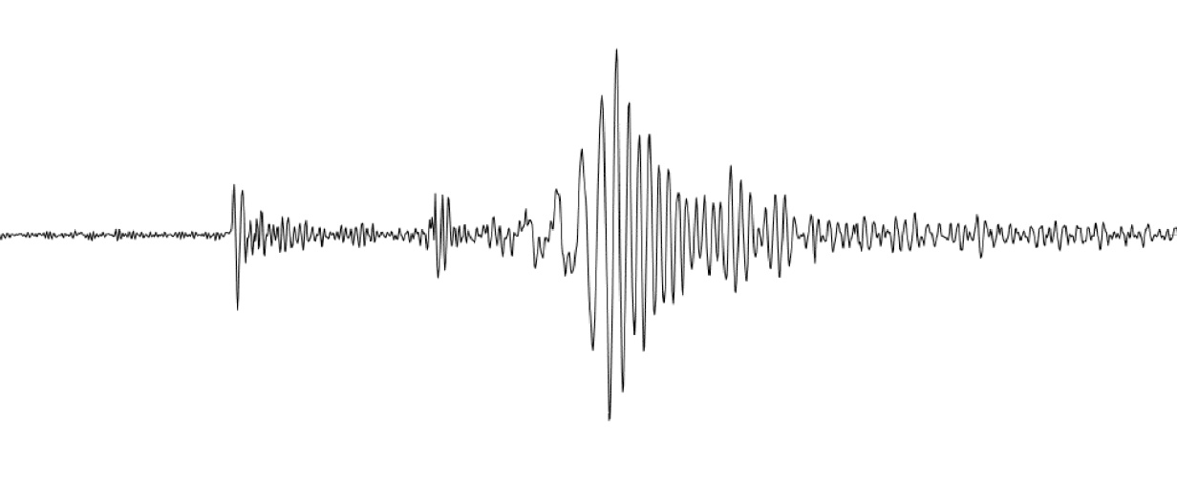


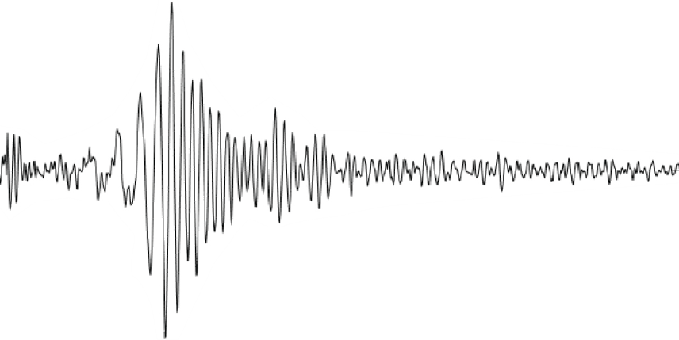


Live Seismic Data
Seismogram A:
Seismogram B:
Seismogram C:
Time (milliseconds)
Notes:
Now that students understand there is equipment out there to measure seismic energy I get them to make seismic energy. To do this I ask the class to stand up and, on the count of 3, jump. When they jump I left-mouse-click and start the animation on this slide and pretend it is real data. This is not real data. The idea then is to have students identify the three types of wave in the seismograms and then identify relative differences in p-s intervals.

Slide 13
Locating an Earthquake Epicenter
Seismograph A
Seismograph B
Seismograph C
Notes:
Using those relative p-s intervals I make circles around each seismograph of corresponding size, and ensure that the three circles intersect directly above the classroom we are currently in.

Slide 14
SmartPhone Accelerometers
Smart phones measure motion
  E.g. Turn phone to turn picture feature
That means they can also measure seismic energy
Search “Earthquake App” on the internet for more info
Notes:
This is something that I think has great potential for enhancing classroom activities. Unfortunately I do not own such a phone and have not thoroughly investigated what can be achieved with this technology.

Slide 15
Let’s see what’s happening around the world…
http://www.geonet.org.nz/earthquake/drums/
http://www.ees.nmt.edu/Geop/eworm-heli//
http://earthquake.usgs.gov/monitoring/spectrograms/24hr/
http://earthquake.usgs.gov/
Notes:
Just a few links to seismic networks in New Mexico and New Zealand as well as the USGS material. While the link is not provided I have used the Stanford Telescope seismic observatory to show when folks arrive on campus for the day, and when they leave. The amount of noise in the signal increases noticeably between roughly 7:30am and 5:30pm before entering relative quiescence through the night.

Slide 16
“The Muddiest Point”

