Slide 1
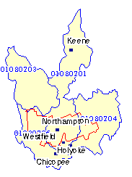
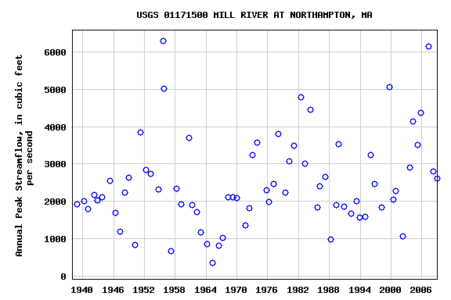
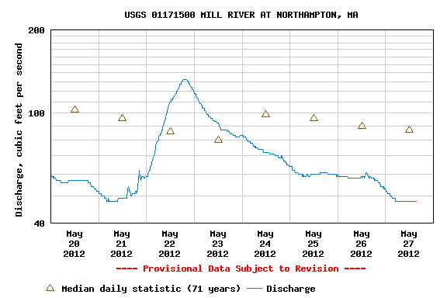
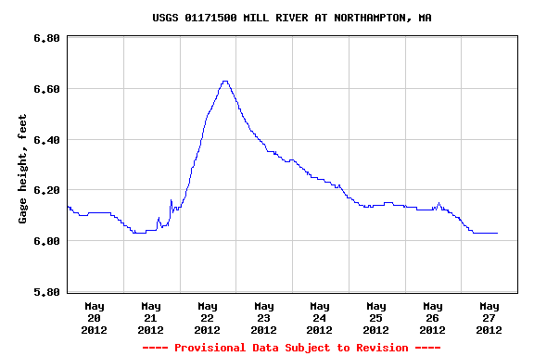
Surf Your Watershed: Investigating Flow & Water Quality of a Local Waterway
Find your watershed (begin at EPA site)
Steps 1 &2) Pick & enter geographic unit: Zip Code
(see table below graph)
Q5: What are the lowest (22cfs 1941), mean (87 cfs), and highest discharge rates (414 cfs 2001)?
Search Results: 01027
There is more than one watershed found for: 01027 .Please select:
01080201 Middle Connecticut; state(s): MA, NH, VT
01080206 Westfield; state(s): CT, MA
Q7 & 8: Peak streamflow (range of years, high/low,
evidence of hurricanes/floods)
Q1: Watershed’s name Middle Connecticut,
covers W Central MA, SW NH, SE VT
Q2: County Hampshire, crossed by 4 watersheds:
Middle CT, Deerfield, Chicopee, Westfield
Go to Stream Flow (Source: USGS): Choose a gage #
Q3: Choose a waterbody
No dam since 2002 (an upstream dam).
Station Number | Date/Time | Gage height, ft | Discharge, ft³/s
011701500 Mill River at Northampton | 05/27 15:15 | 6.03 | 48
Q9-12: Investigating Water Quality Impairments (Mill River)
Q4: Compare precipitation events to discharge rates.
Scroll down to the gage height graph.
Q6: Interpret gage height graph (high/low/compare to precipitation events)
www.epa.gov/owow/surf/
T. Weiss WSU 5/12

