Slide 1



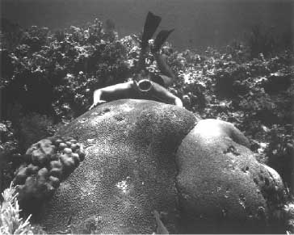

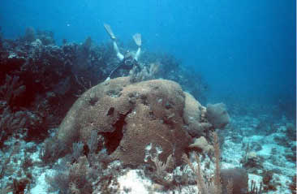
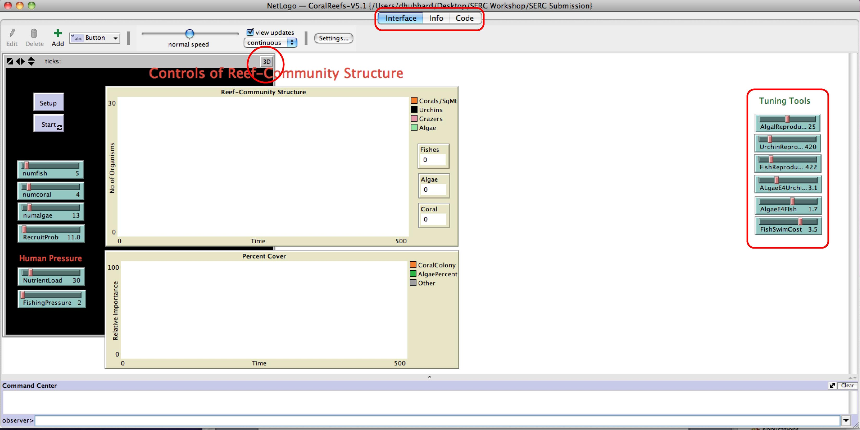

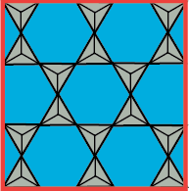
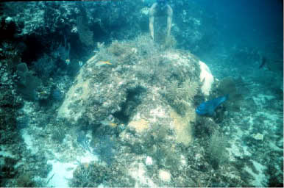
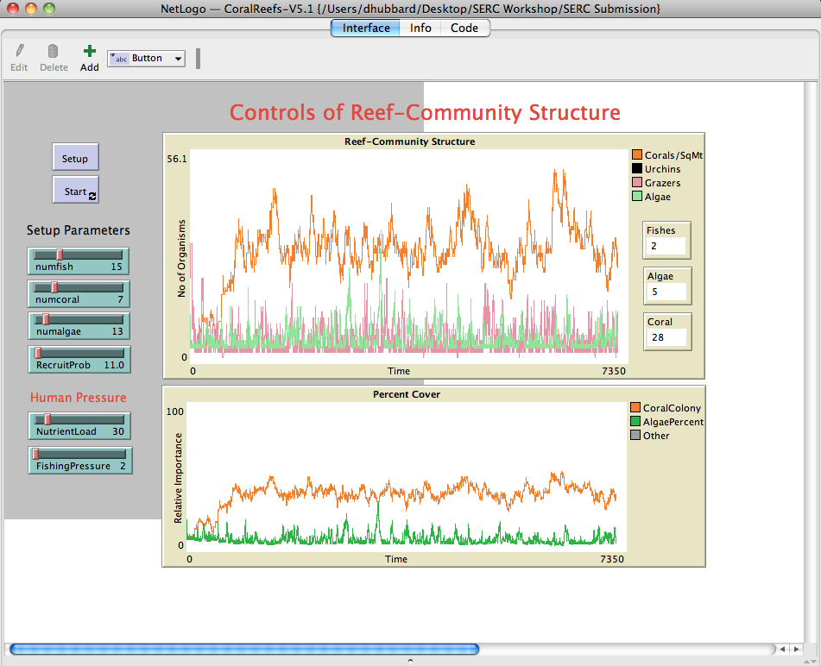
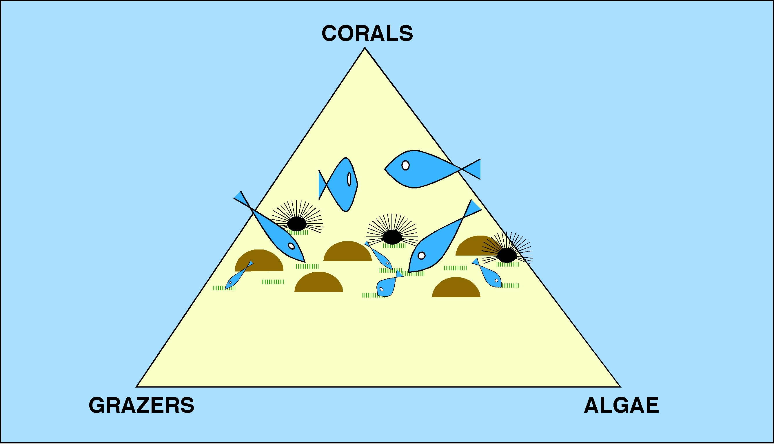
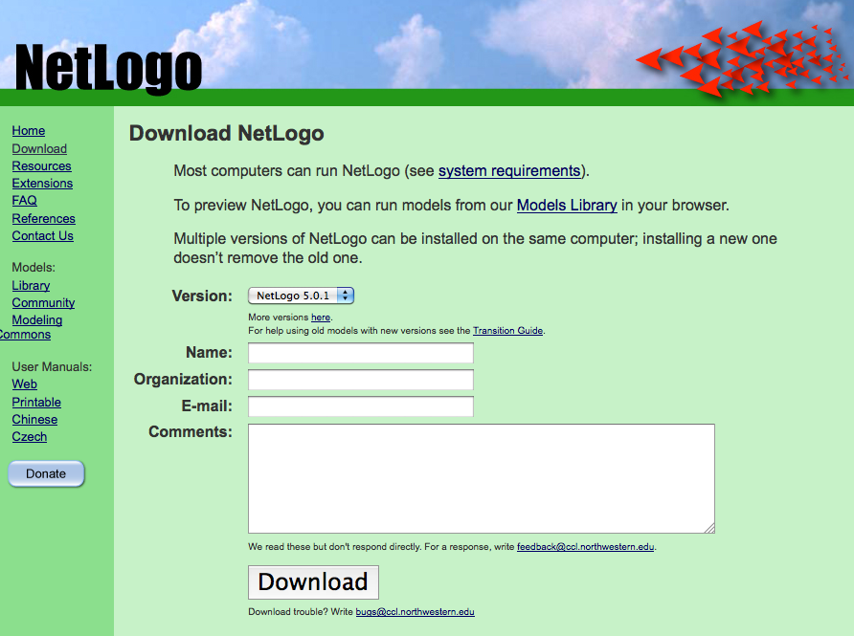
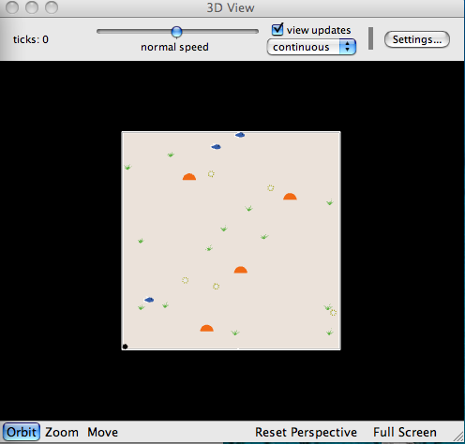
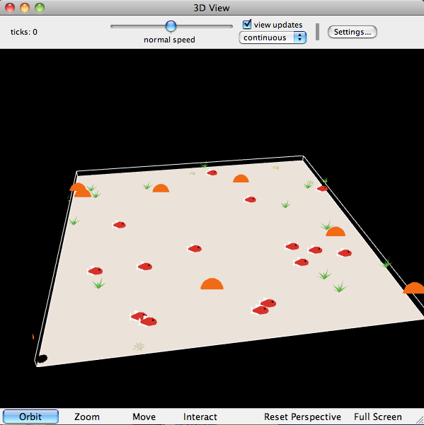
A Free Computer Model
Understanding Environmental Change
in Coral Reefs and Other Natural Systems
Intuitive Model Interface
Lesson Plan provided
Powerpoint provided
URLs & other SERC sites
“Normal” Simulation
“Stress” Simulations
Model Set-Up:
Change fish, corals, etc
Change stresses
Instructor “tuning”
Simulation 4 - Homo-stupidus gone mad:
Copy your critical NutrientLoad from Simulation Set 2: 70-80
Copy your critical FishingPressure value from the box above: 80-100
Stop and reset the model as follows:
NutrientLoad = 50
FishingPressure = 60
Click on Setup
Set the speed slider to the maximum and run the model a few times through 10,000 time steps.
Click on Start
Watch coral cover (remember that you can get actual numbers in the white boxes to the right of the top graph.
Photos by Gene Shinn (USGS)
Implementation:
Download Software & Model for FREE
Background Lecture
  Powerpoint
  Web resources
  Other SERC sites
In-class Demo
Exercise
Discussion
Variable Output
Main Lessons:
Stress → Change
  Overfishing → algae
  Nutrification → algae
  Algae → fewer corals
Response is non-linear
It’s cheaper not to “break it” in the first place
Templates for Recording Output
G
R
A
P
H
I
C
N
U
M
E
R
I
C
Run Coral Average Coral Range Algae Average
Instructor: In the discussion, ask for "overall averages based on all six runs. Then, ask for any outcomes that are significantly different from what is already up there. Ask the class to come up with a consensus for "typical" values and how often the odd outcomes occurred. At this point, "normal" runs should account for >90% of the student data, but thee may be a few really odd outcome - talk about these too.
1.
2.
3.
4.
5.
6.
Exercise Questions (with Key)
What has happened? How do the Human Pressure settings relate to the thresholds you listed above? Coral cover is almost always low and algal cover is high. The threshold values are lower than the critical values recorded above for each individual stress.
What is going on? In combination, the two stresses are causing the system to decline at levels lower than what either stress would create individually.
2D or 3D “video”
Main Strengths:
Uses Netlogo (NSF)
Software is free
Runs on any platform
Intuitive and visual
No programming skills
Try it out on this computer
Download it to yours & try it here
Pick up resources
Leave email or card
http://ccl.northwestern.edu/netlogo/download.shtml

