Slide 1

ORIENTATION

Slide 2
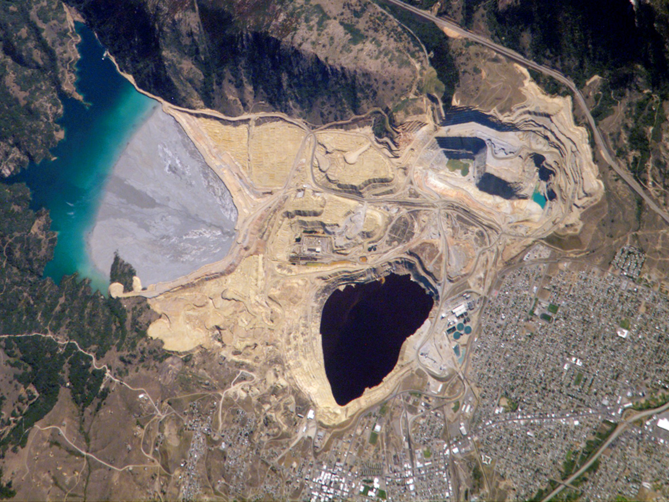
START WITH SCALE

Slide 3
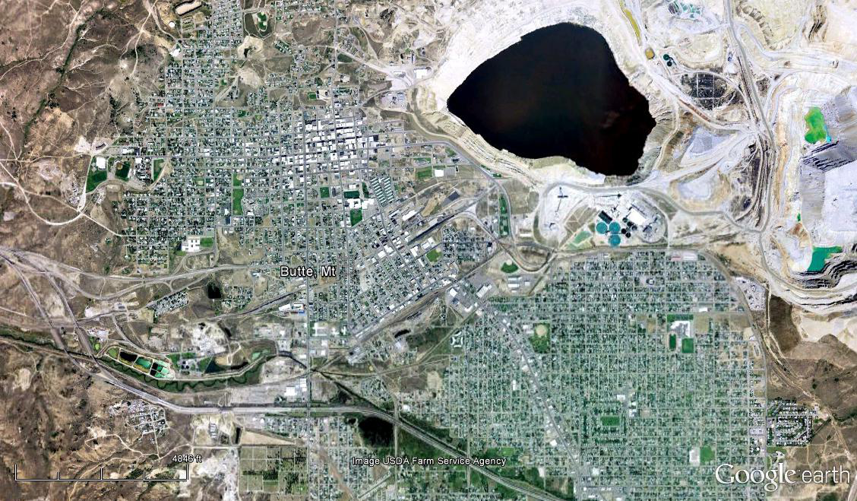
2009

Slide 4
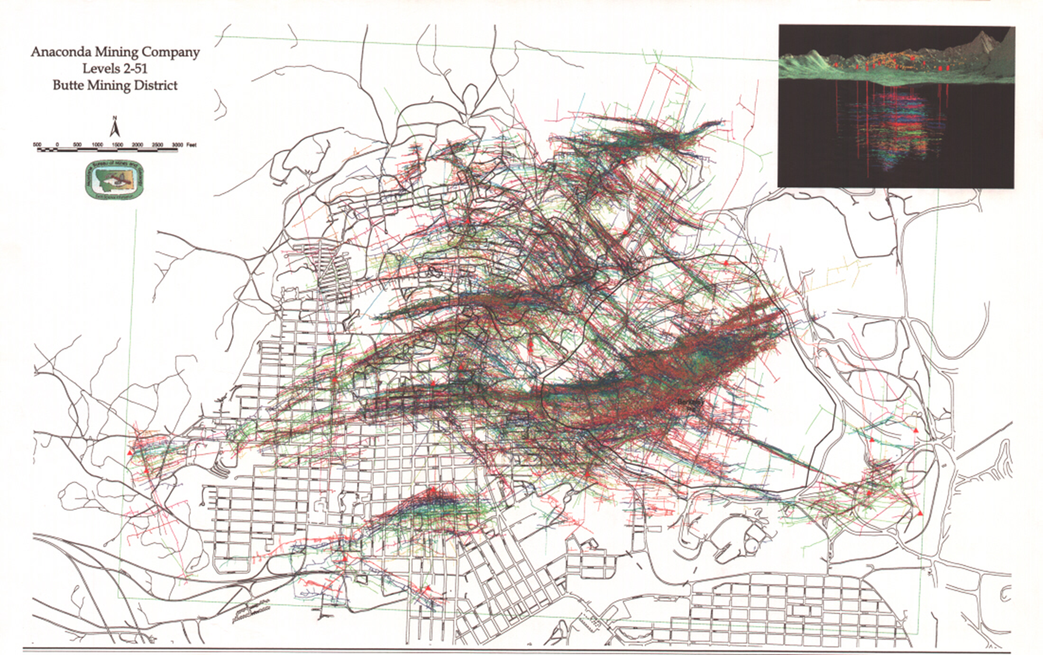
WHAT YOU CAN’T SEE

Slide 5
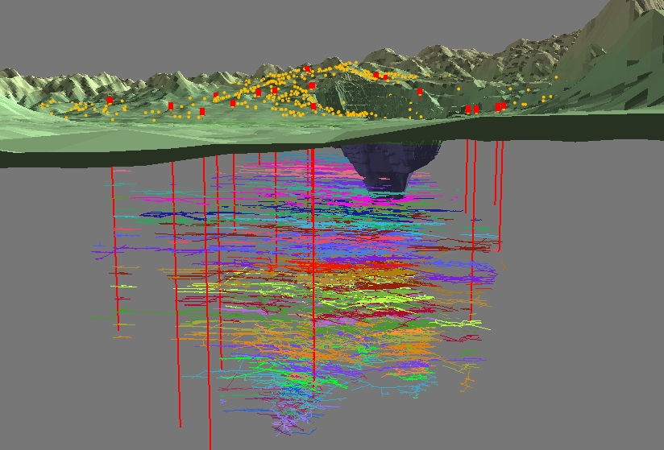

Slide 6
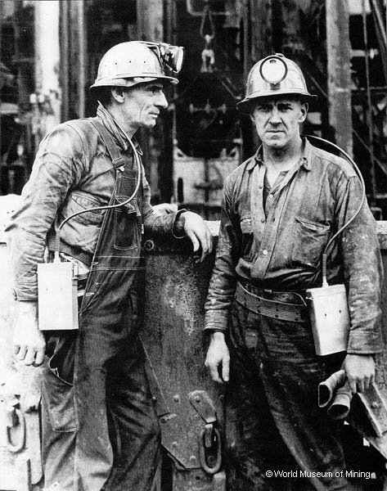
WHY BUTTE?
23 BILLION LBS COPPER
4 BILLION LBS MANGANESE
5 BILLION LBS ZINC
1 BILLION LBS LEAD
300 MILLION LBS MOLY
700 MILLION OZS SILVER
3 MILLION OZS GOLD

Slide 7
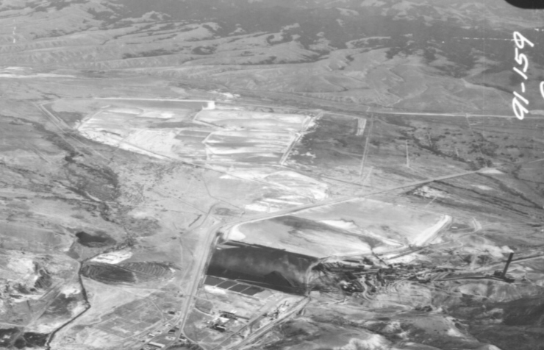
WHAT ABOUT WASTES?
Underground Mining – They’re in Anaconda

Slide 8
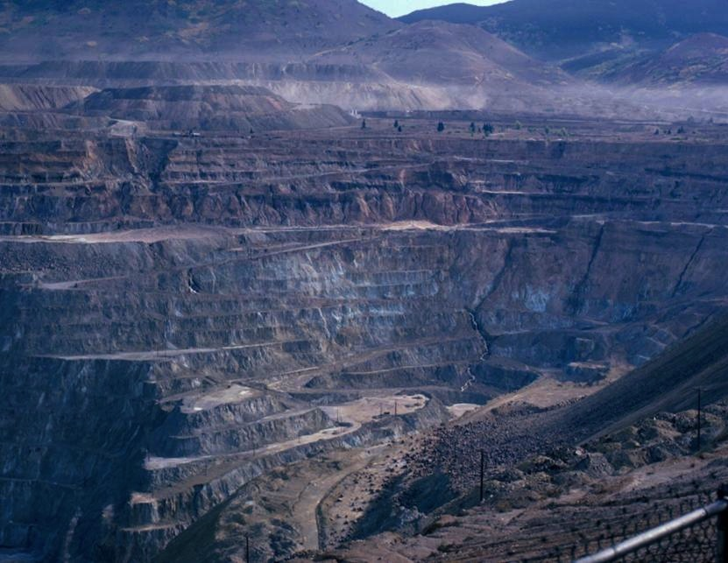
FROM THE BERKELEY PIT?

Slide 9
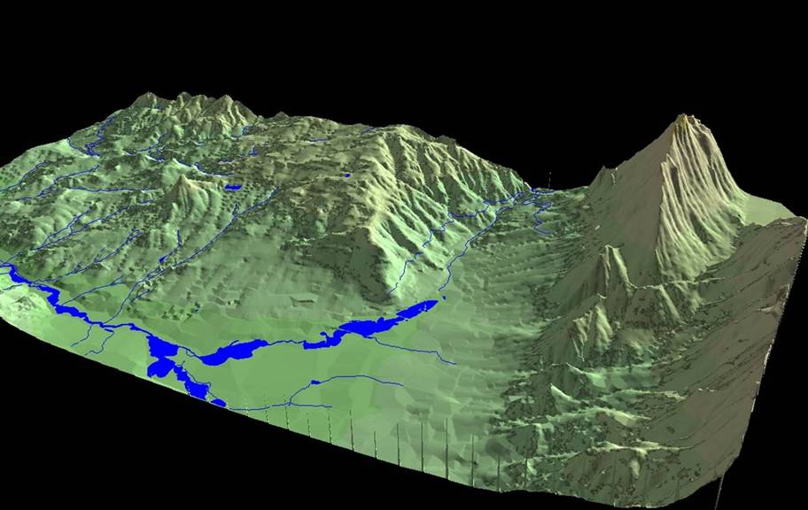

Slide 10
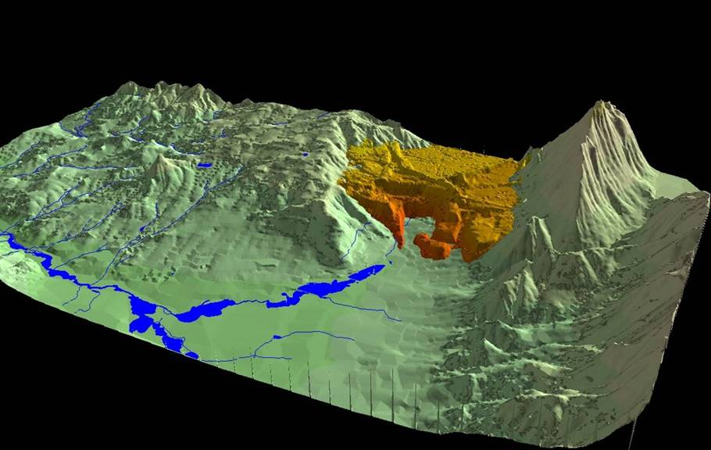
They Fill Upper Silver Bow Creek Valley

Slide 11
WHAT IS THE PROBLEM
40 BILLION GALLONS OF TOXIC WATER IN LAKE BERKELEY CONNECTED TO…..
…CONTAMINATED GROUNDWATER IN OVER 10,000 MILES OF FLOODED UNDERGROUND WORKINGS
2. CONTAMINATED GROUNDWATER IN THE ALLUVIAL AQUIFER – DISCHARGES TO SILVER BOW CREEK

Slide 12
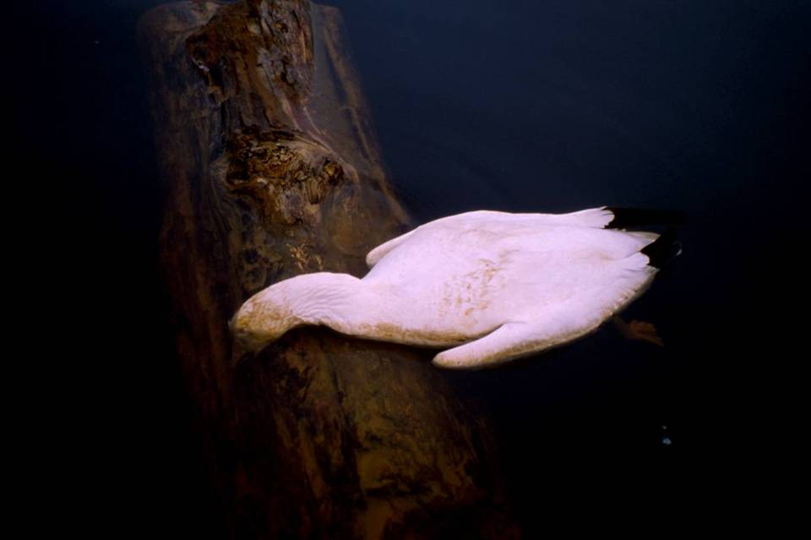
But Really – IT’S TOXIC

Slide 13
WHAT IS THE FIX
CAPTURE CONTAMINATED GROUNDWATER
TREAT CONTAMINATED GROUNDWATER TO AQUATIC LIFE STANDARDS AND RELEASE TO SILVER BOW CREEK
MAINTAIN OVER GEOLOGIC TIME

Slide 14
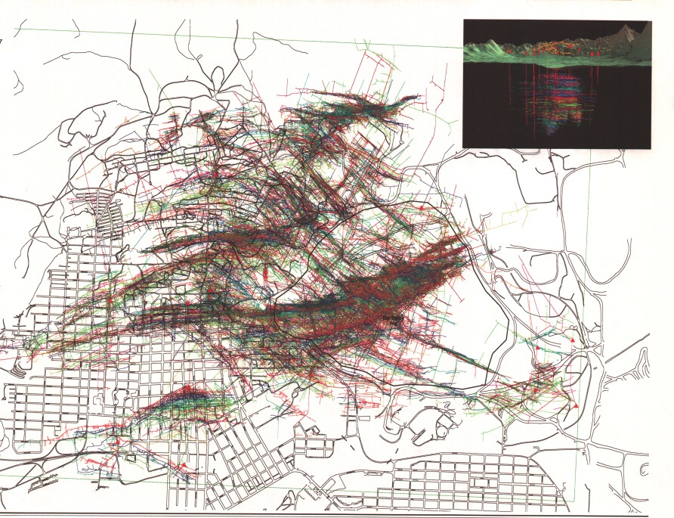
TWO GROUNDWATER SYSTEMS
TO MANAGE
TO SILVER BOW CR

Slide 15
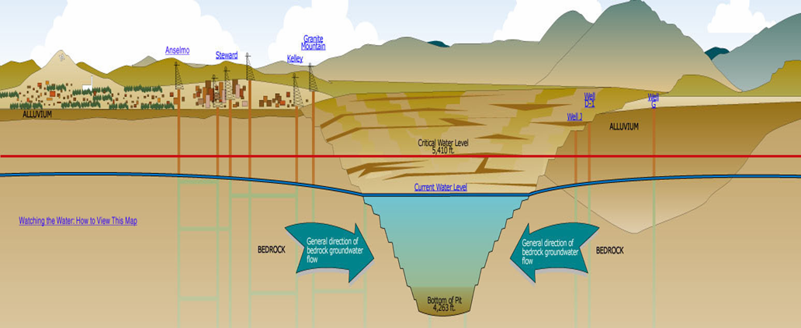
Berkeley Pit Acts Like A Large Well
Captures Groundwater From Underground Mine System
Includes Bedrock and Alluvial Groundwater
Notes:
Basis of Remedy (ROD) is to protect Butte aquifer (and risks to human health from exposure to contaminated drinking water) and to prevent contaminated GW discharge to SBC (threat to aquatic life).
Groundwater flow is based differential head pressure (from higher pressure to lower) so GW flow doesn’t follow surface topography. But it probably did in pre-mining conditions.
CWL will be in highest point in east camp system (not in the pit itself).
Anselmo currently has highest water level and is ~25 feet higher than water in Berkeley Pit.

Slide 16
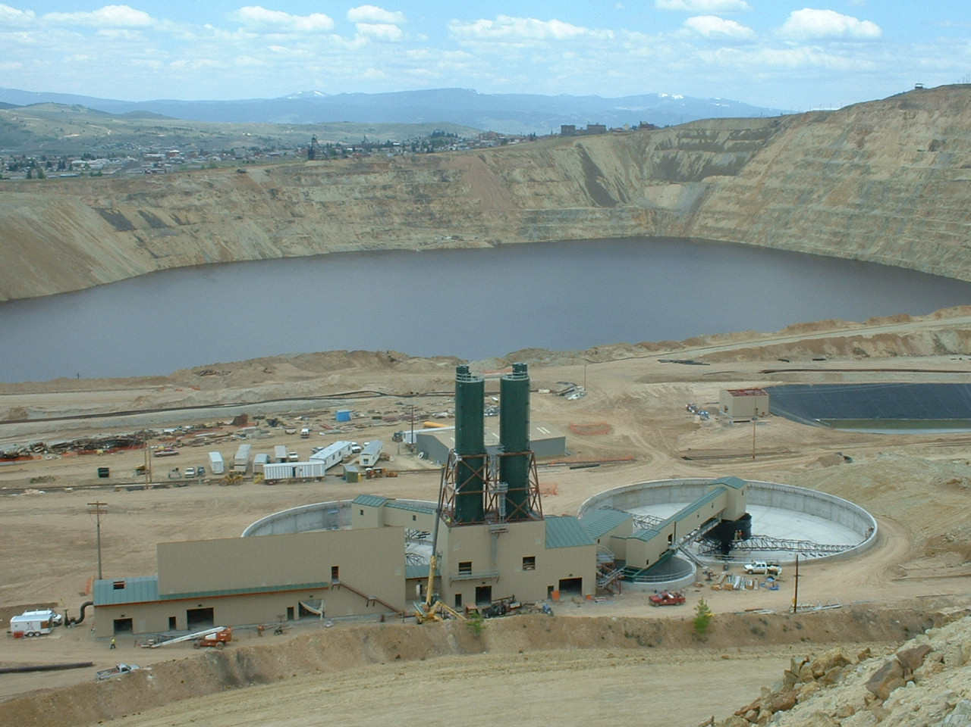

Slide 17
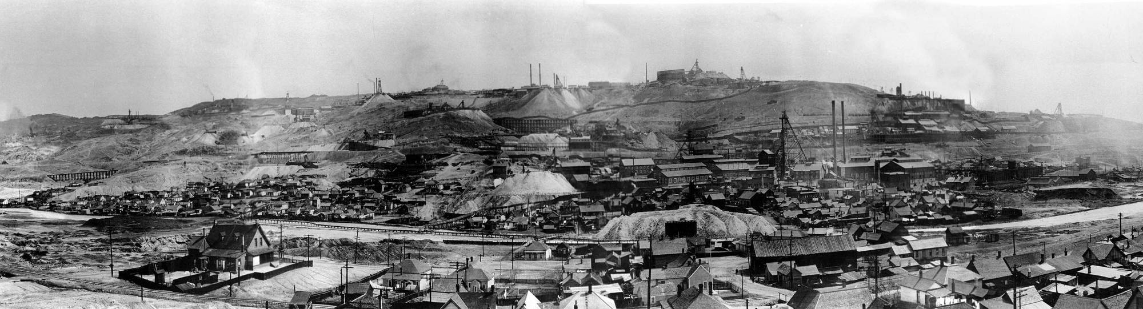
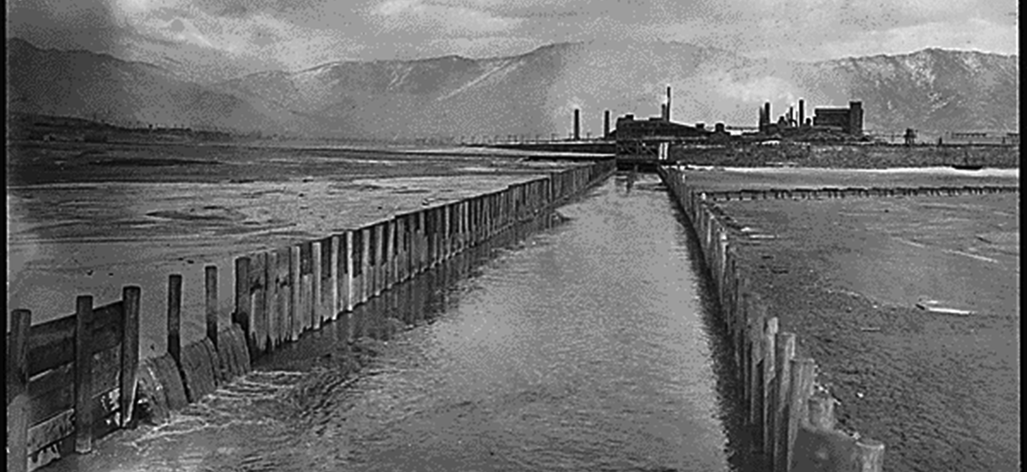
The Other Side of the Ground Water Divide

Slide 18
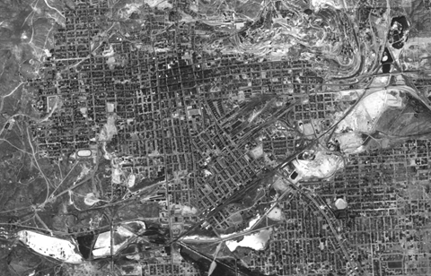
1954

Slide 19
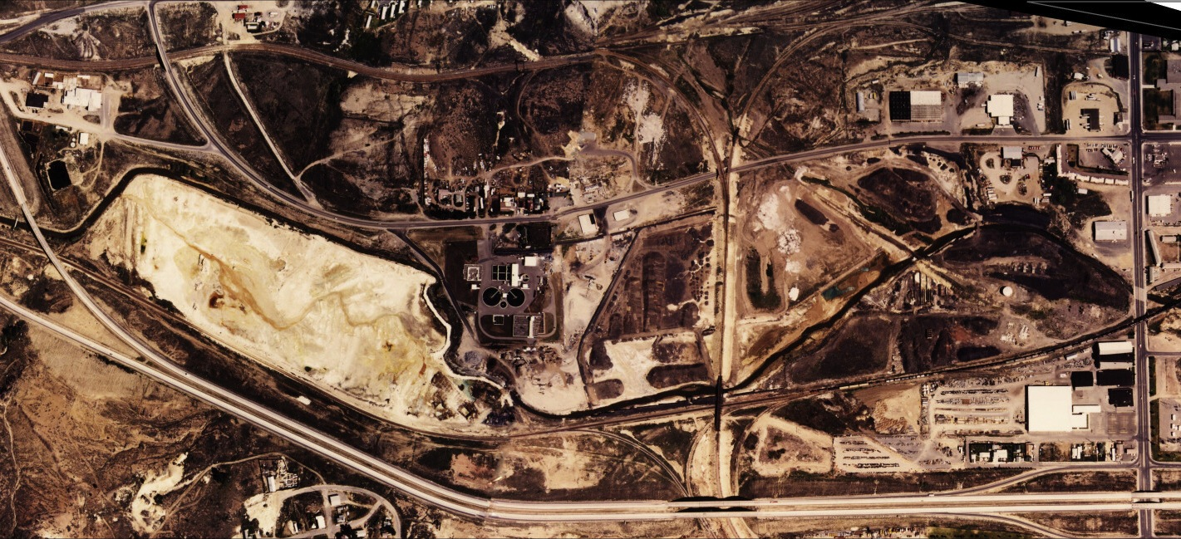
GROUNDWATER – STREAM INTERACTION
Loading Analysis

Slide 20
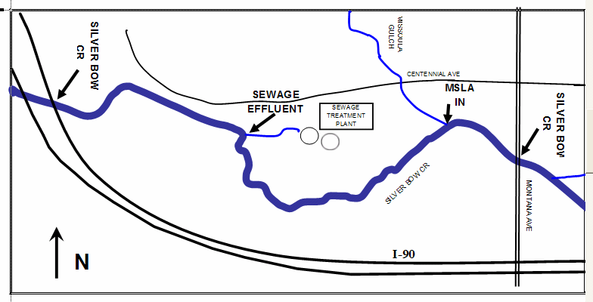
Notes:
SW and GW

Slide 21
LOAD CALCULATION
LOCATION |  | FLOW FT³/sec | ZINC mg/L |  |  | ZN LOAD mg/sec
SBC @ MONTANA (IN) |  | 14.3 | 0.232 |  |  | 94
MISSOULA IN |  | 0.3 | 1.055 |  |  | 9
SEWAGE EFFLUENT |  | 9.1 | 0.097 |  |  | 25
SBC @ I-90 (OUT) |  | 25.3 | 0.639 |  |  | 458
GROUND WATER INFLOW |  | 1.6 | 7.3 |  |  | 330
MASS BALANCE
GW_{in} = SBC_{out} - SEWAGE_{in} - MSLA_{in} - SBC@MT_{in}
Zn Load from GW = 72%
Based on Mean Values
NOTE: Alternate Method – Synoptic

Slide 22
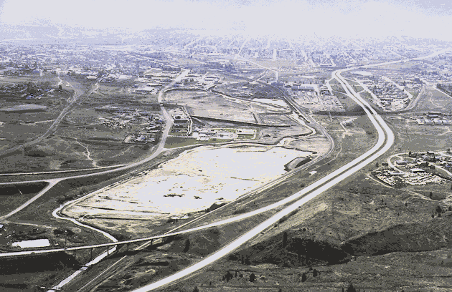

Slide 23
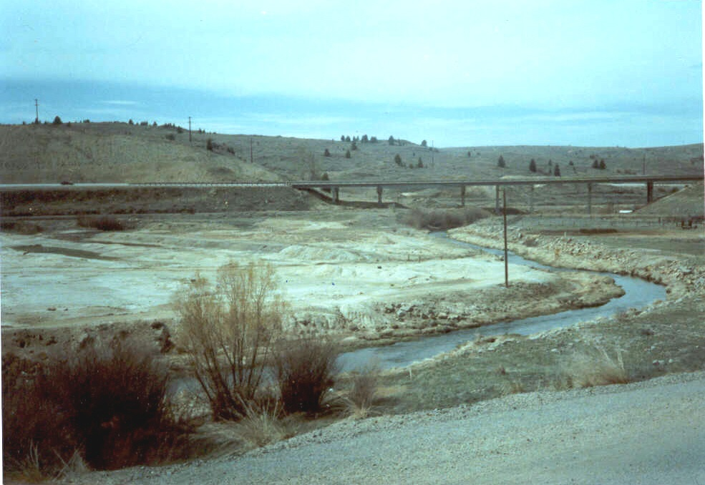
What Are You Going To Do?

Slide 24
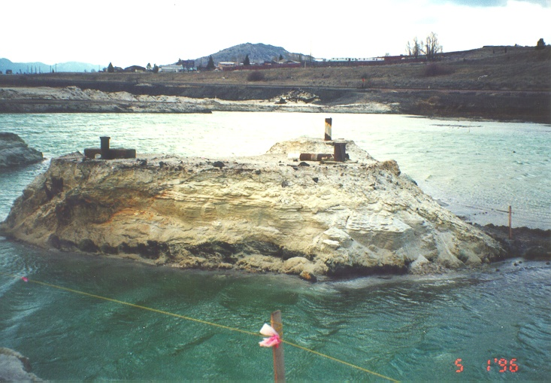

Slide 25
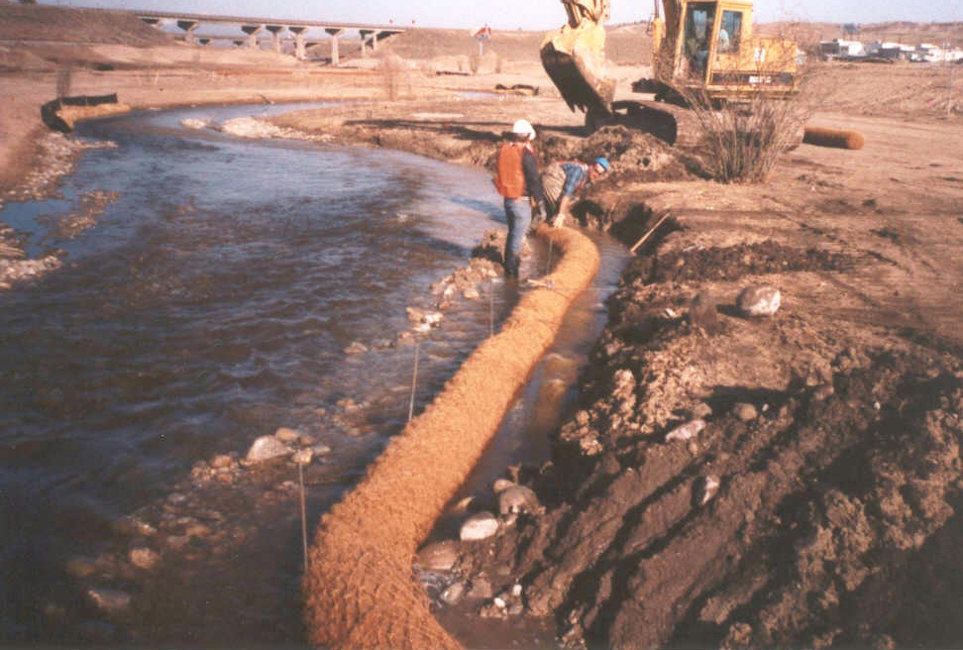

Slide 26
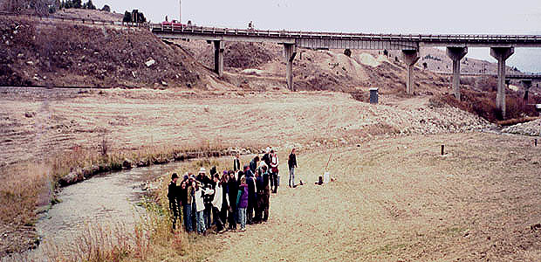

Slide 27
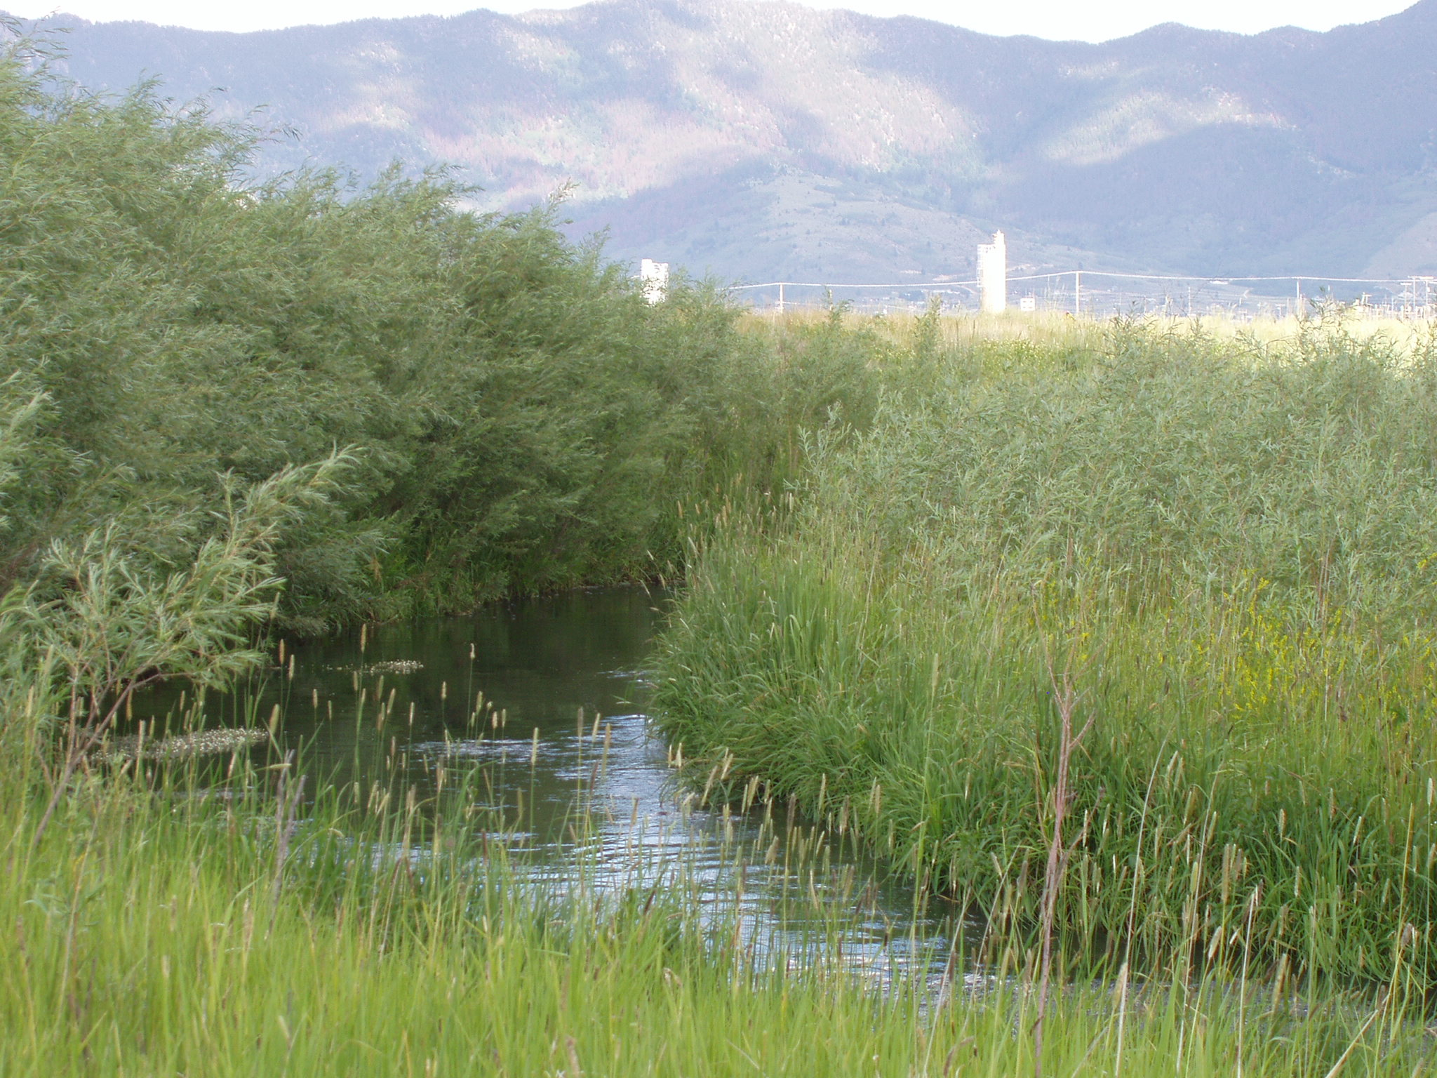

Slide 28
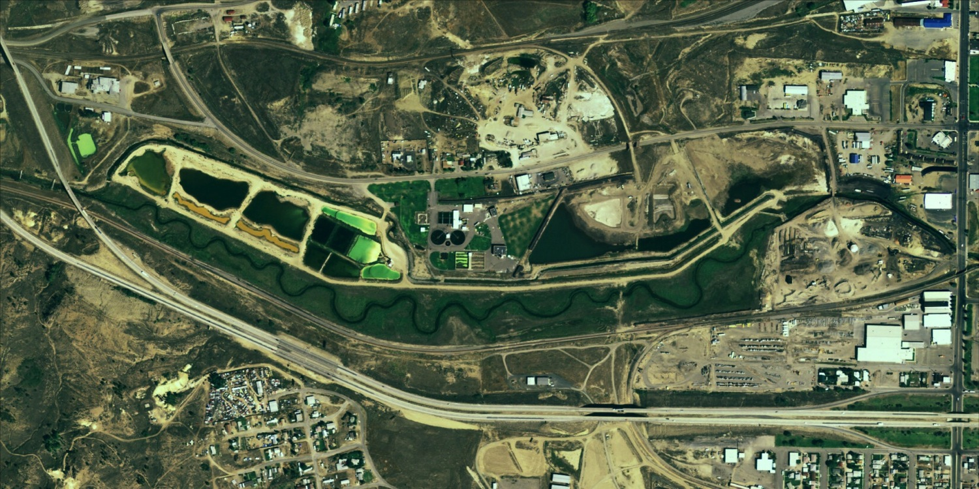

Slide 32
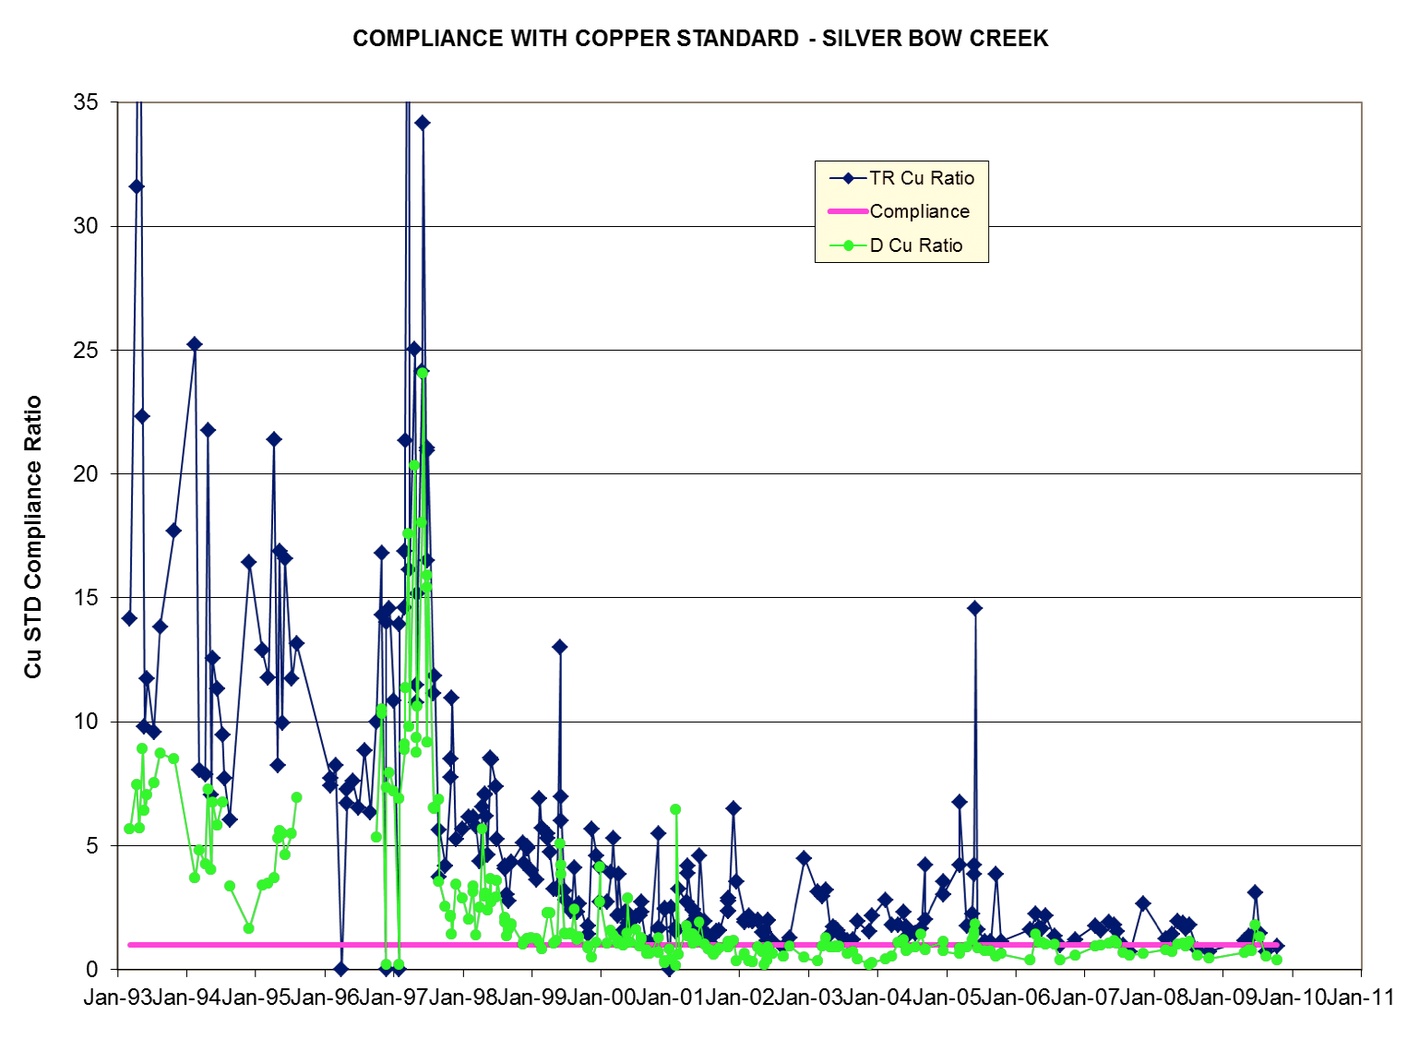

Slide 33
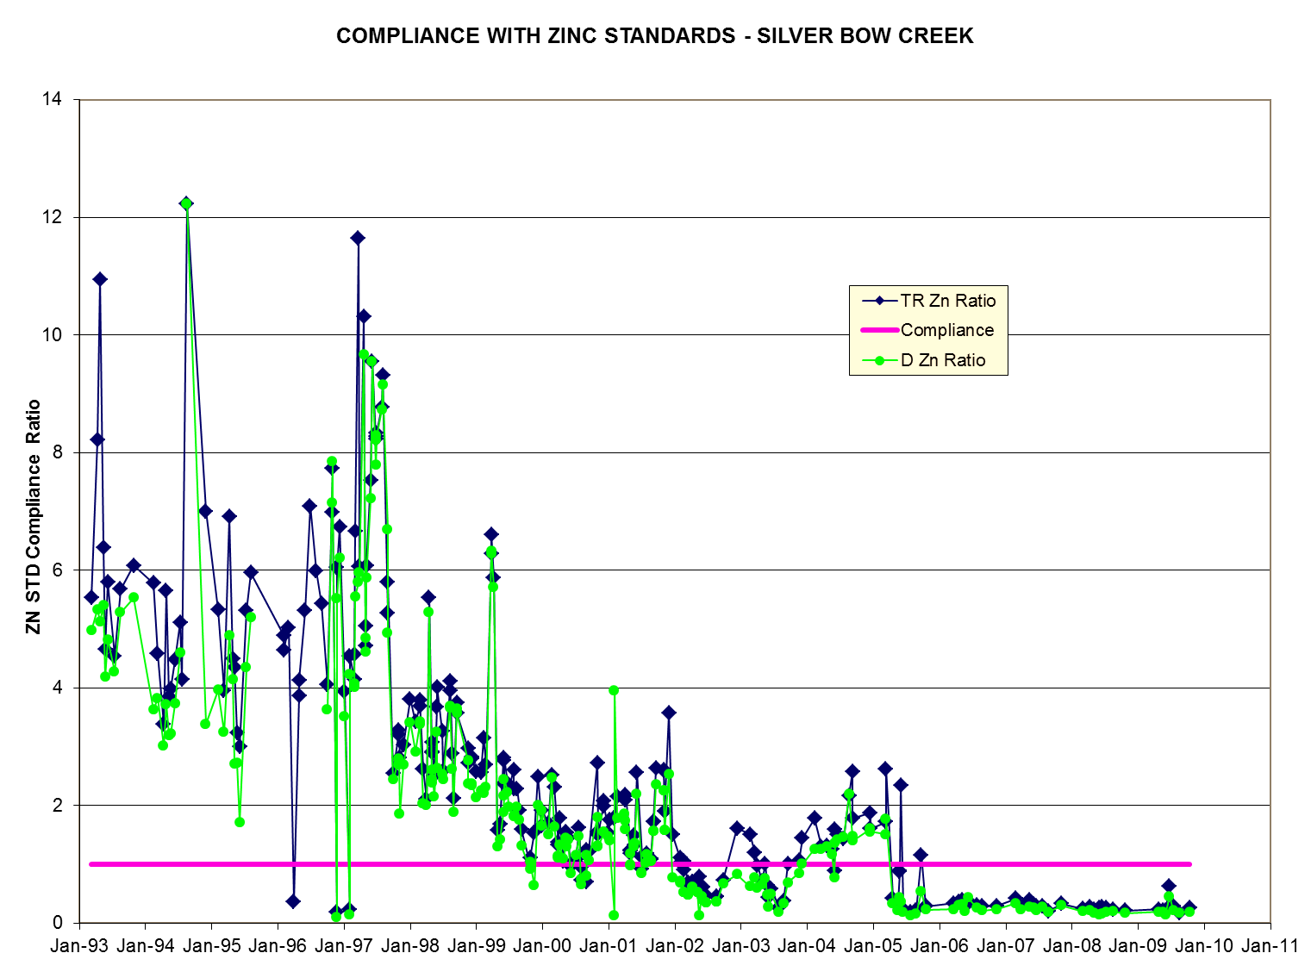

Slide 34
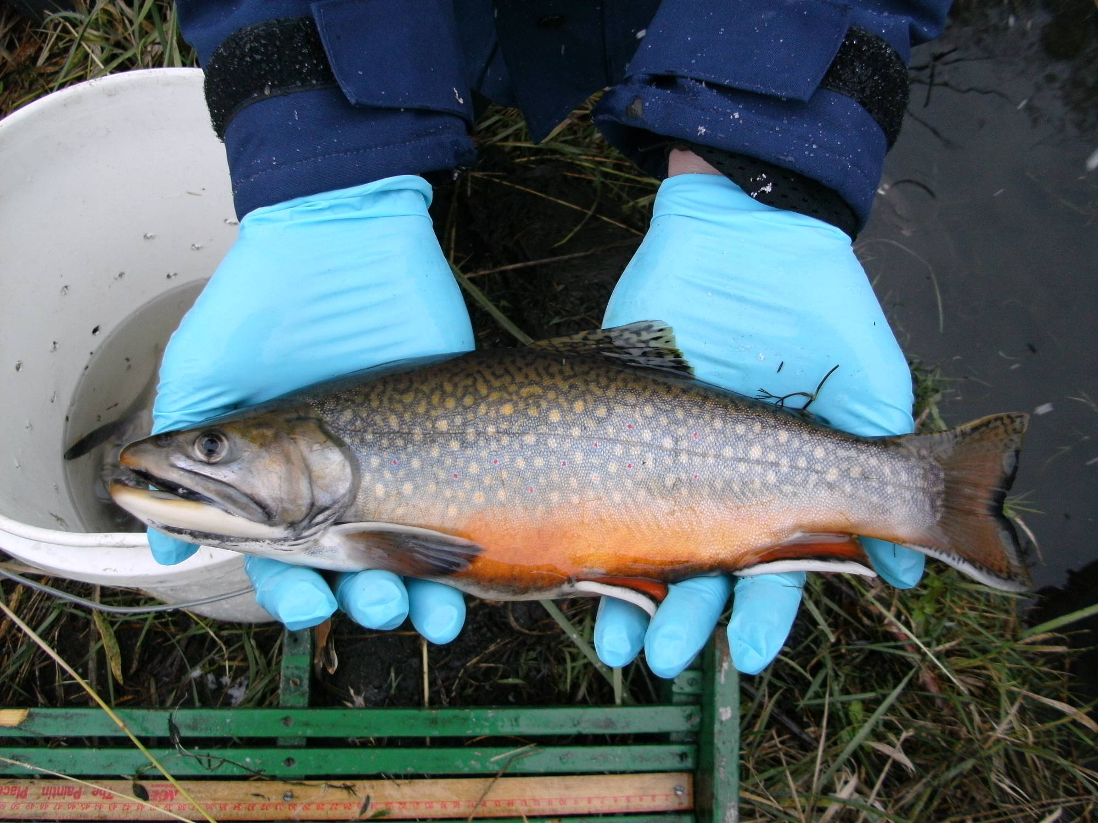

Slide 35
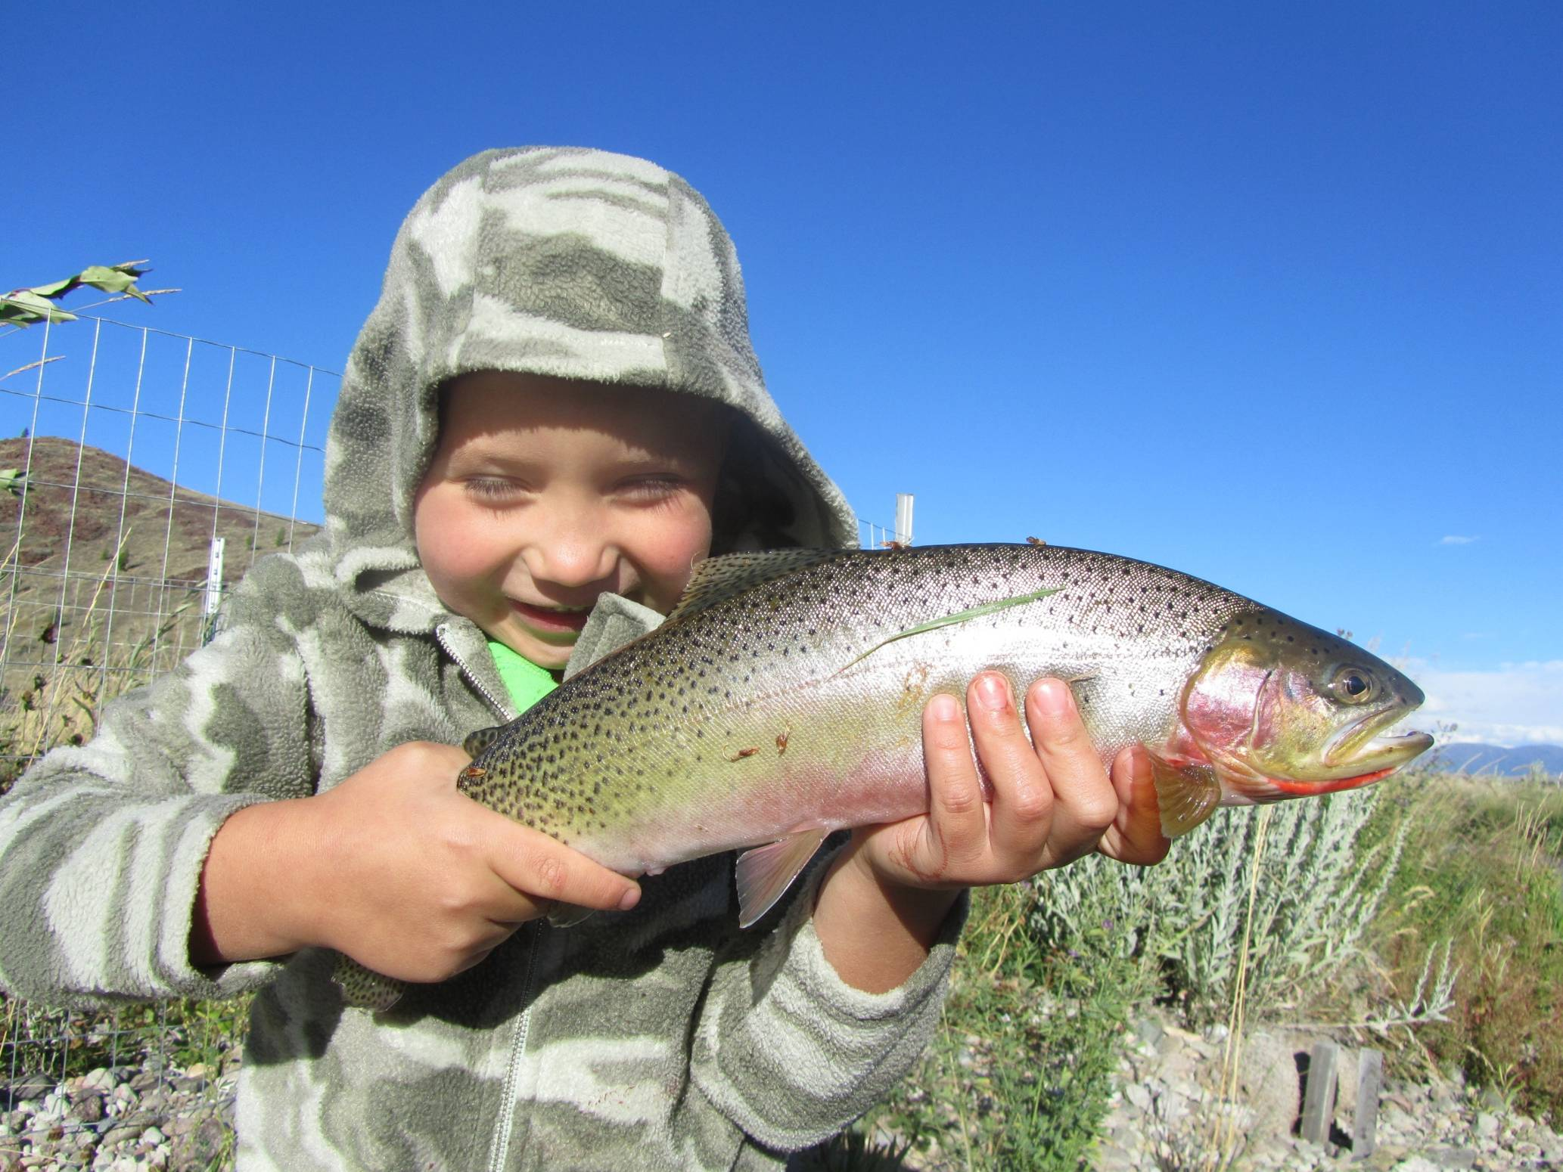

Slide 36
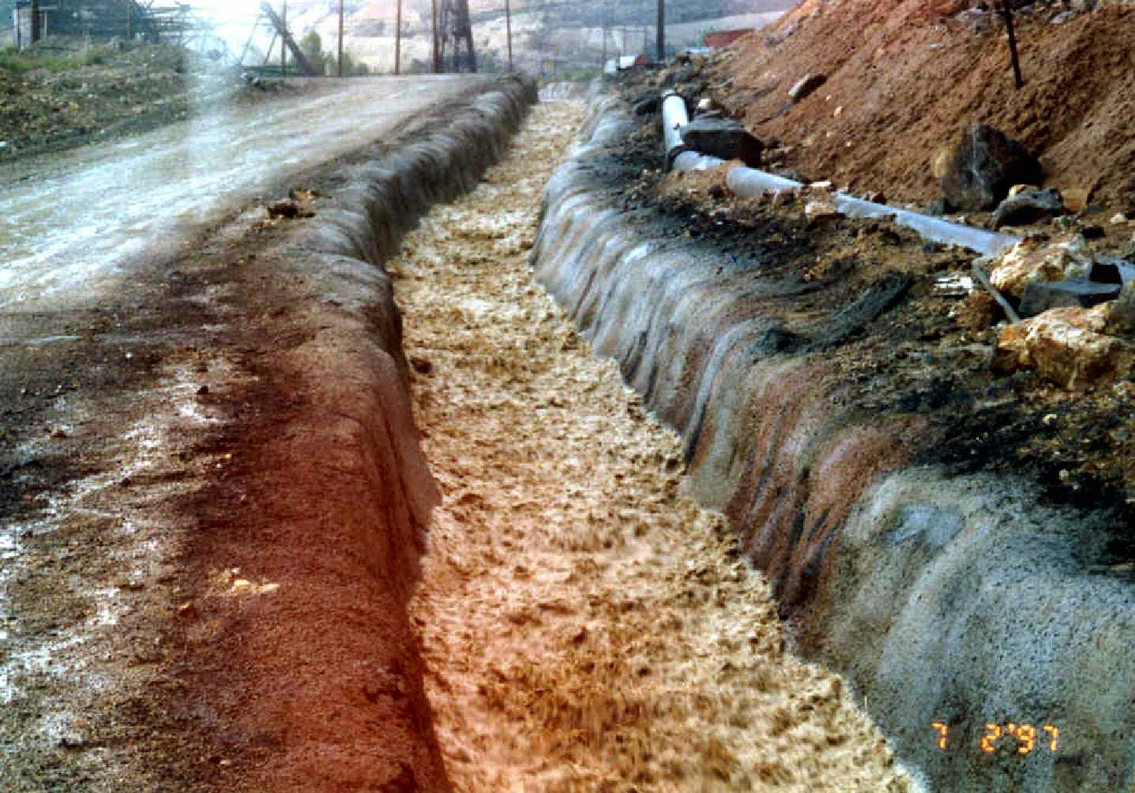
BIGGEST REMAINING PROBLEM
STORM WATER RUNOFF

Slide 37
Dissolved Copper since 2000

Slide 38
In Perpetuity is a long time

Slide 39


Slide 40


