Slide 1
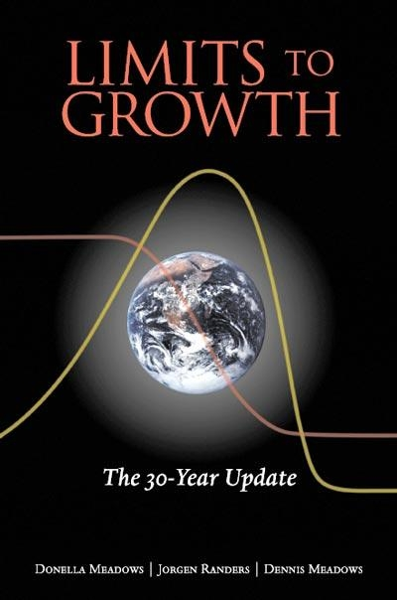
Roundtable Discussion on
Limits of Growth;
The 30-Year Update
Donnella Meadows, Jorgen Randers & Dennis Meadows
Chelsea Green Publishing Company (2004)
On the Cutting Edge
Environmental Geology
Workshop 2012
Notes:
Wanted to address population growth, the root of cause of anthropogenic environmental geology issues. Yet, rarely addressed by politicians or media. Contraceptive debate between the Whitehouse and the Catholic Church. Testimony of Georgetown student and response by Rush Limba, Dennis Meadows recommended as an excellent speaker on this topic presentation to the national academy of sciences. He graciously declined our invitation due to a prior commitment.

Slide 2

Objectives:
Discuss causes and solutions to population growth and resource limits
Formulate strategies to teach this material
Model a jigsaw activity

Slide 3
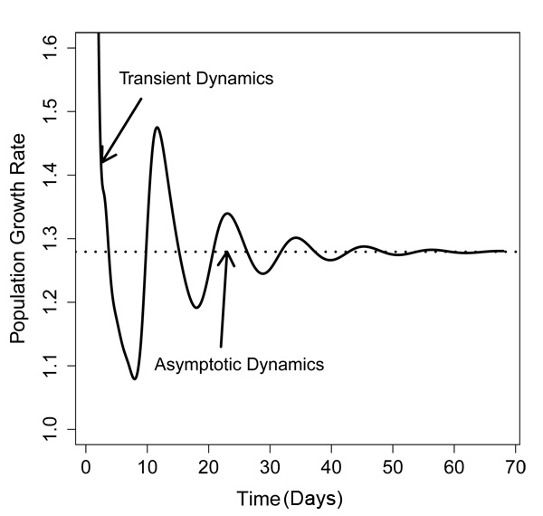
Outline
PowerPoint presentation
  Overview of the book
  Overshoot
  Growth
Roundtable discussion on limits
Roundtable discussion on pedagogy and solutions
Report back whole-group discussion

Slide 4
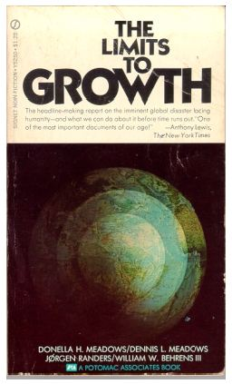
Book History
1972 –Limits of Growth
  World3: System Dynamics Model from MIT
1992 – Beyond the Limits, 20 year update
2004 – Limits of Growth; The 30-year update

Slide 5
Book Chapters
Overshoot
The Driving Force: Exponential Growth
The Limits: Sources and Sinks
World3: The Dynamics of Growth
Back from Beyond the Limits: The Ozone Story
Technology, Markets, and Overshoot
Transitions to a Sustainable System
Tools for the Transition to Sustainability

Slide 6
Overshoot
To go beyond limits accidentally
Causes
  Rapid growth; rapid change
  Limit or barrier to growth/change
  Errors or delays in perceiving the limits and responding to limits
Possible results
  Collapse
  Deliberate turnaround and correction

Slide 7
Ecological Footprint
Land area required to provide resources and adsorb emissions of a global society
Carrying Capacity: available land on earth
  Wackernagel, M. et al., 1997. “Ecological Footprints of Nations: How much nature do they use? How much do they have?” Center for Sustainability Studies, Xalapa, Mexico.
  Wackernagel, M. et al., 2002. “Tracking the ecological overshoot of the human economy,” Proceedings of the National Academy of Sciences 99, no, 14:9266-9271, Washington DC. www.pnas.org/cgi/doi/10.1073/pnas.142033699
  World Wide Fund for Nature 2002, Living Planet Report 2002, Gland, Switzerland.

Slide 8
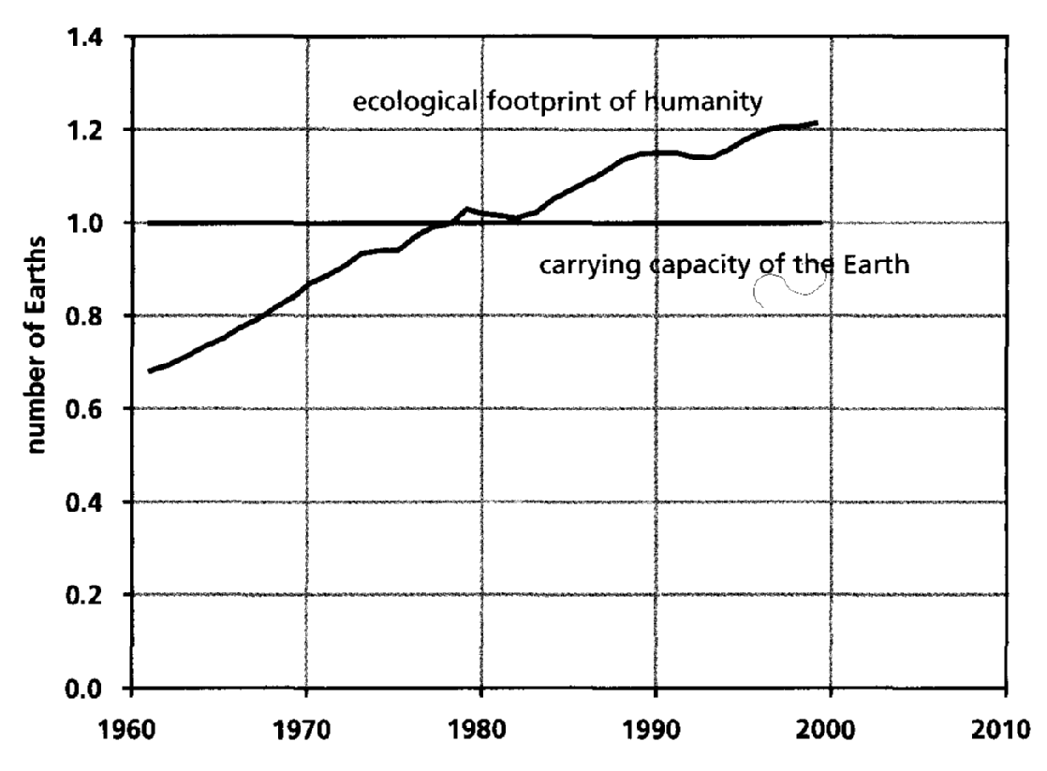
Ecological Footprint verses Carrying Capacity

Slide 9
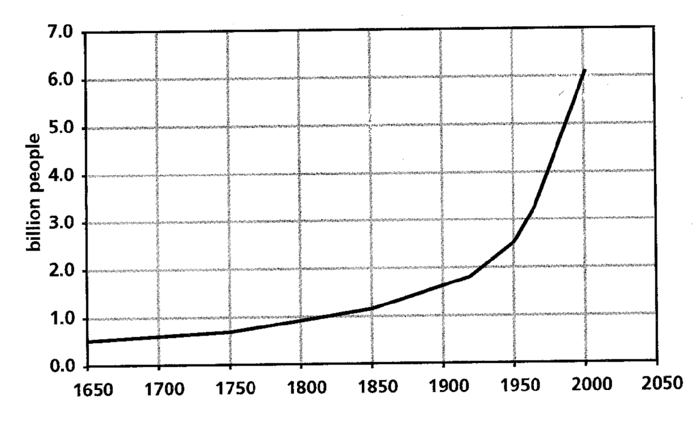
World Population
Notes:
7.0 billion

Slide 10
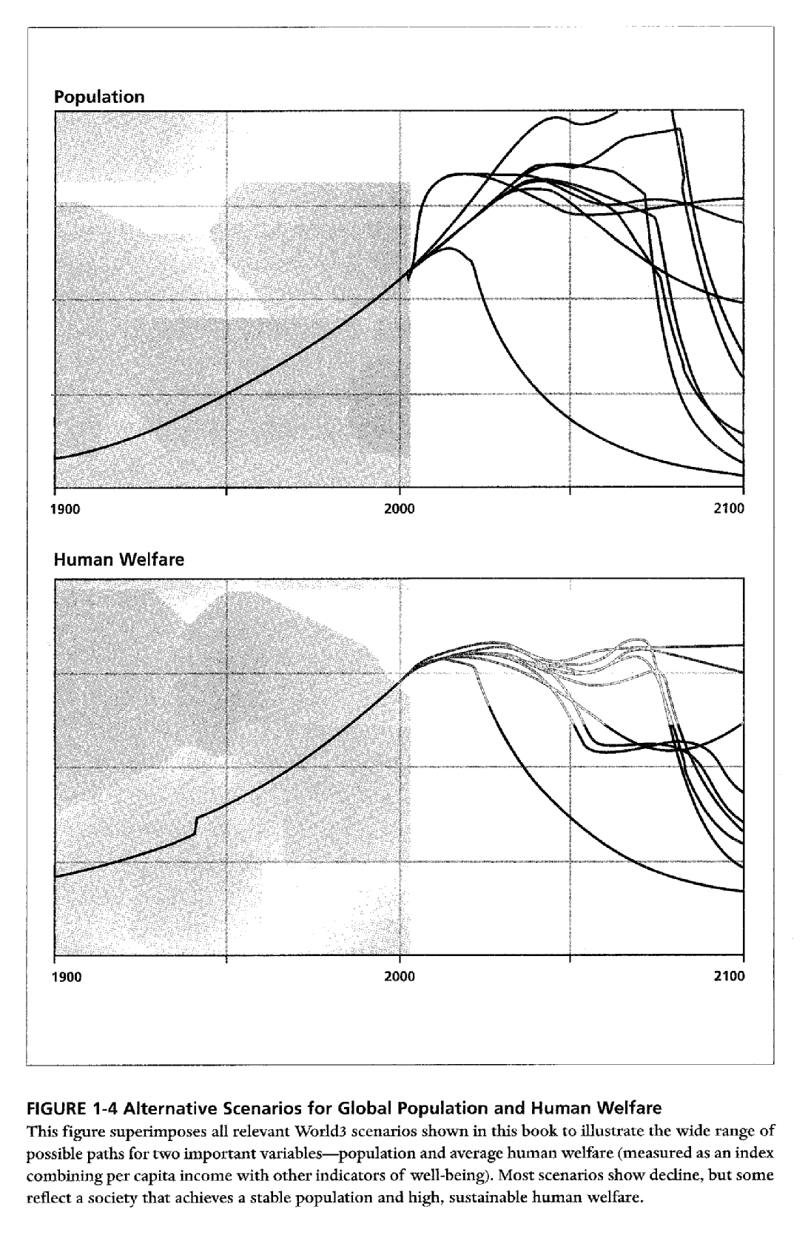
Predictions of World3 Model

Slide 11
Model Interpretation
Potential for abrupt collapse
  Lack of food, energy, materials
  Unhealthy environment
Potential for smooth transition to sustainability
  Bring throughput that support human activities to a sustainable level through human choice, human technology, and human organization
Indefinite growth is not an option

Slide 12
Growth
A quantity grows exponentially when its increase is proportional to what is already there
Doubling Time
  At first, growth appears insignificant
  Suddenly, change comes faster and faster until, with the last doubling, there is no time to react
Population and economy exhibit exponential growth

Slide 13
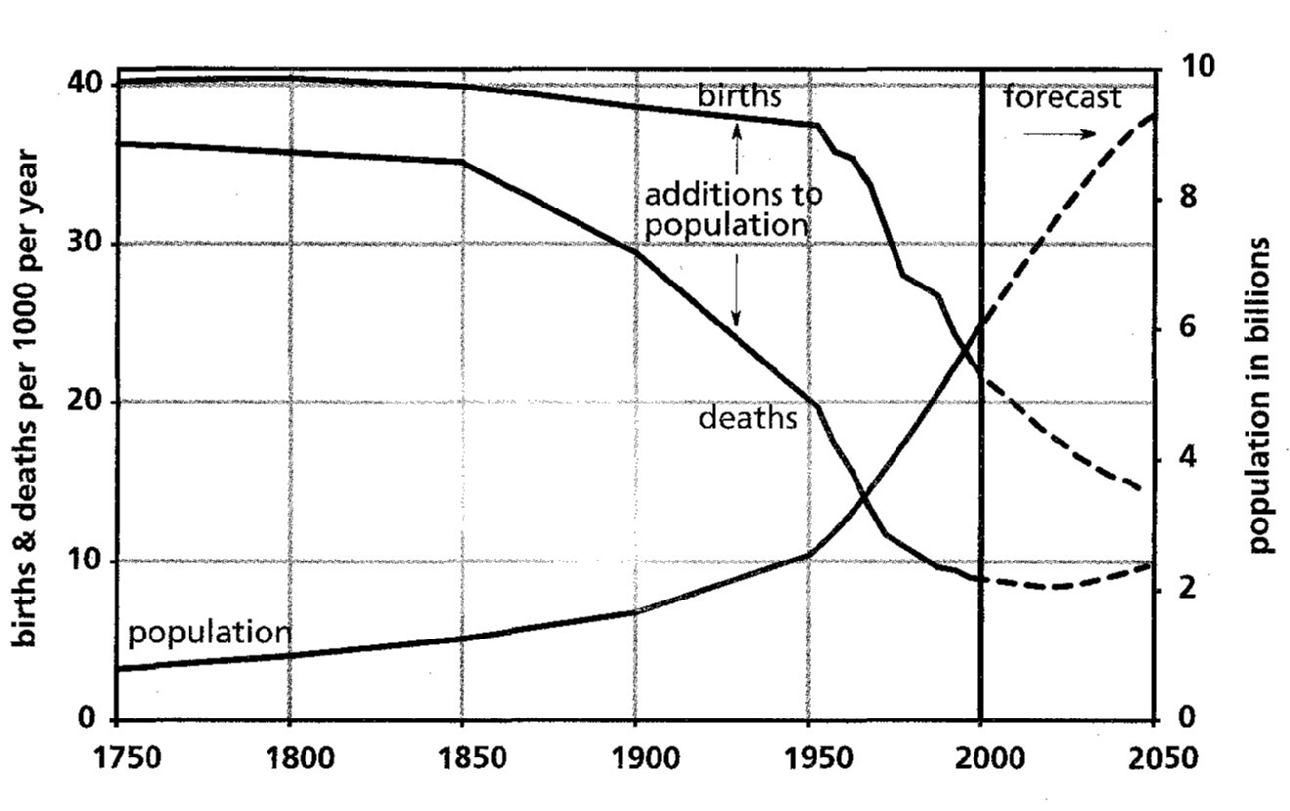
World Population Growth

Slide 14
Interpretation
Birth rates have dropped
Growth rate has decreased
  2.03% per year in 1965
  1.23% per year in 2000
Doubling time has increased
  36 years at 2%
  60 years at 1%
Growth is still exponential; smaller growth rate multiplied by larger population

Slide 15
Demographic Transition
Pre-industrial societies
  High birth rate
  High death rate
  Slow population growth
Transition to industrial
  Improved health care and nutrition
  Death rate decreases
  Birth rates lags by two generations
  High population growth
Fully industrial societies
  Birth rates decrease
  Slow population growth

Slide 16
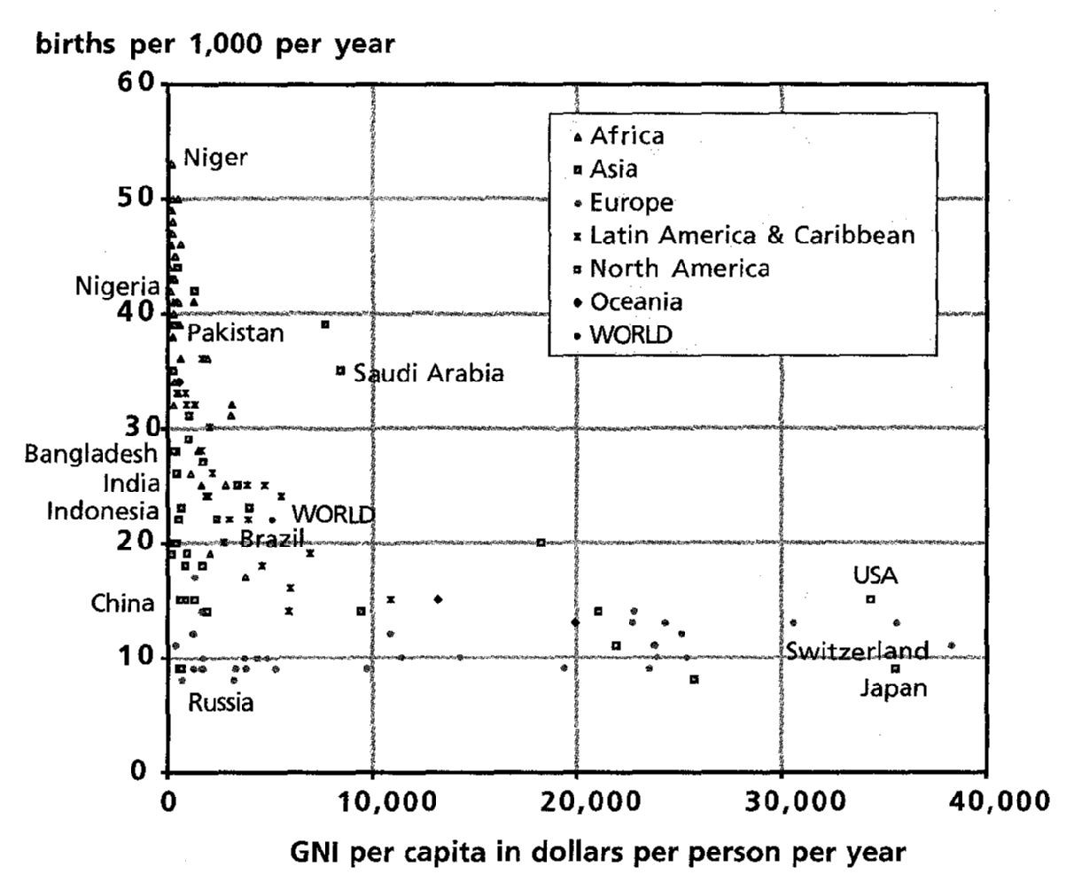
Birth rates vs. Gross National Income per Capita
2001

Slide 17
Factors Influencing Industrial Societies
Low death rate
  Nutrition
  Health Care
Low birth rate
  Education (especially for women)
  Employment (especially for women)
  Family planning
  Low infant mortality
  Egalitarian distribution of income and opportunity
  Reduced desire for a large family due to cost
Relationship between growth and income

Slide 18
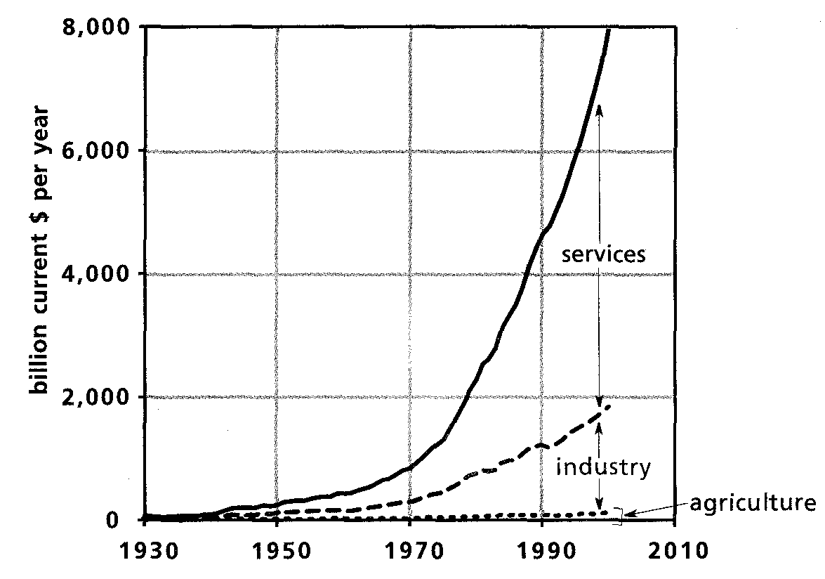
U.S. Gross National Income by Sector

Slide 19
Economy Growth Patterns
Pre-industrial
  Agriculture
  Service
Toward industrial
  Growth in all sectors
  Industry grows fastest (high ecologic footprint)
Industry base built
  Service sector grows fastest
  Hospitals, banks, schools, stores, restaurants, hotels
High ecologic footprint
    More stuff; more waste

Slide 20
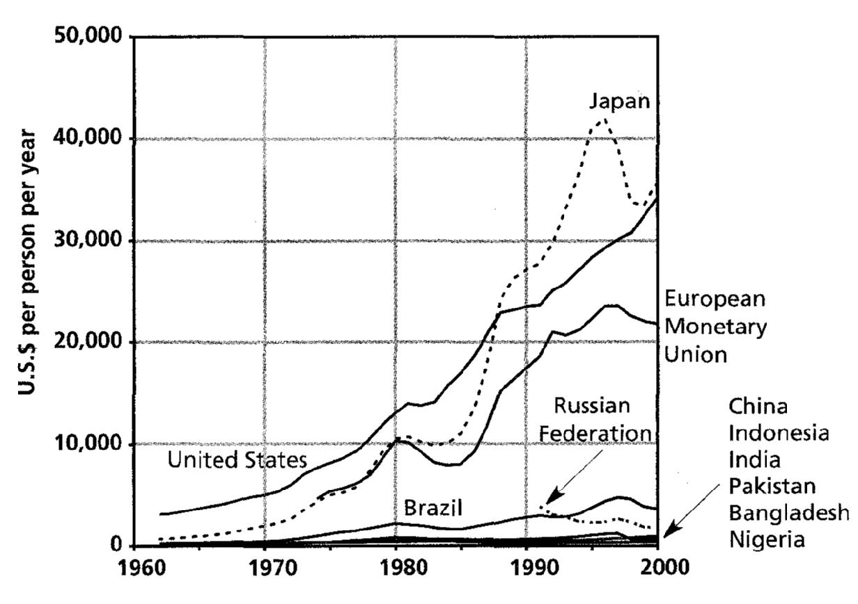
Per Capita GNI of ten most Populous Countries

Slide 21
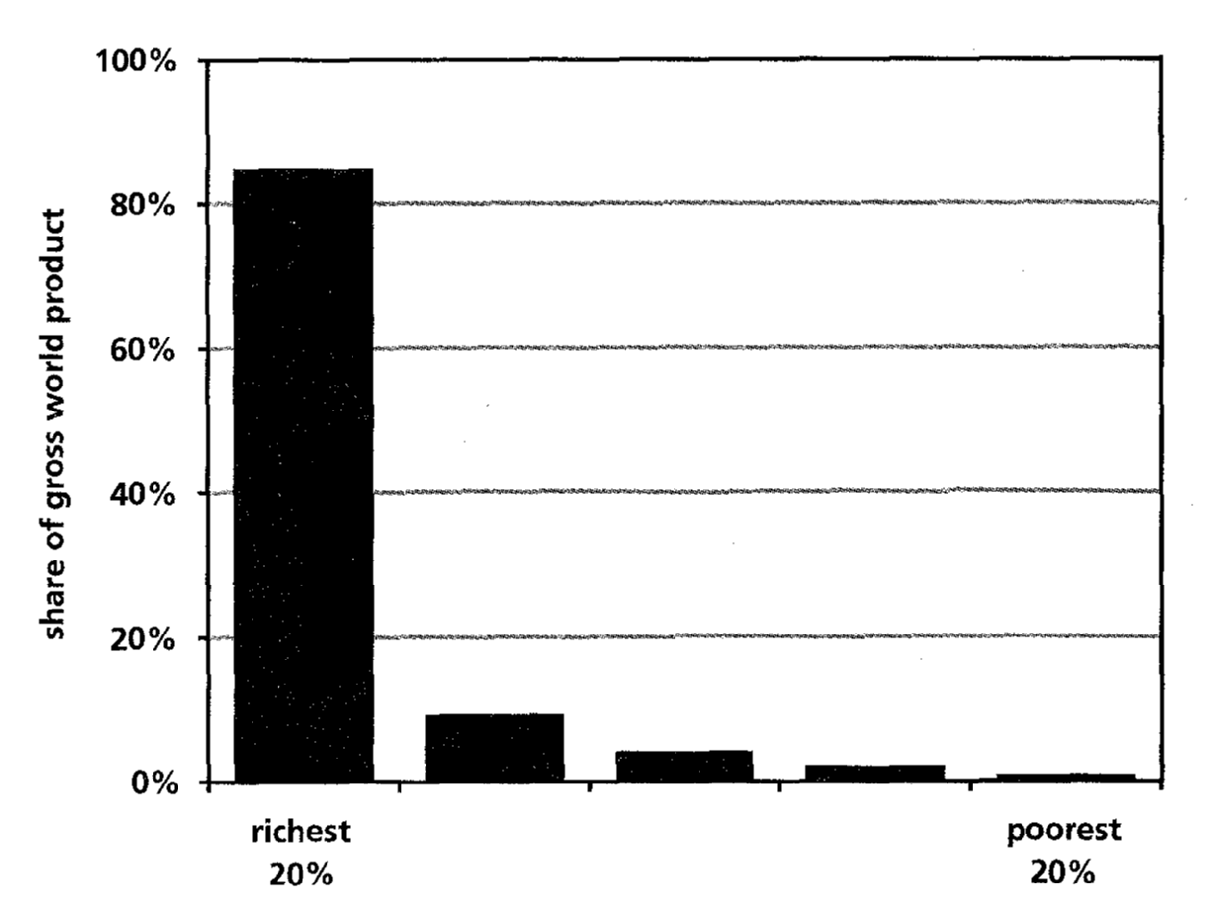
Global Disparities

Slide 22
Conclusions on Growth
Population and Economy are currently growing exponentially
“The rich get richer; the poor get children”
  For Rich: growth in capital benefits those with capital
    Low population growth rate
    High ecological footprint
  For Poor: more people, more poverty, more population growth, more people
Is this sustainable?

Slide 23
Limits of Growth
Food, Land, Soil – Kathryn Szramek
Water – Lori Weeden
Forests – Cathy Connor
Fossil Fuels – Julie Maxson
Materials – Katryn Wiese
Sinks of Pollution/Waste – Suki Smaglik

Slide 24
Roundtable 1
Introduce yourself
Assign a note taker
What is the nature of each limit?
Given growth in population and capital, what adaptations can be made to avoid hitting this limit?
What are the causes of delay and misperception that impede action as this limit is approached?

Slide 25
Roundtable 2
Introduce yourself and your limit
Assign a note taker
How do we teach this material without depressing or de-motivating our students?
Critique these arguments: Do you think global society is moving towards collapse, sustainability, or status-quo?
What should be done to avoid collapse?

Slide 26
Whole-Group Discussion
How do we teach this material without depressing or de-motivating our students?
Critique these arguments: Do you think global society is moving towards collapse, sustainability, or status-quo?
What should be done to avoid collapse?

Slide 27
Teaching Resources
Calculate their ecological footprint and compare to available land
  Environmental Footprint: http://serc.carleton.edu/quantskills/activities/14009.html
Explore alternatives to their lifestyle
  The Lifestyle Project: http://serc.carleton.edu/NAGTWorkshops/publicpolicy/activities/12517.html
Calculate population growth
  Population growth:
  http://serc.carleton.edu/quantskills/methods/quantlit/popgrowth.html

Slide 28
Acknowledgements
Kathryn Szramek
Lori Weeden
Cathy Connor
Julie Maxson
Suki Smaglik
Katryn Wiese

