Slide 1
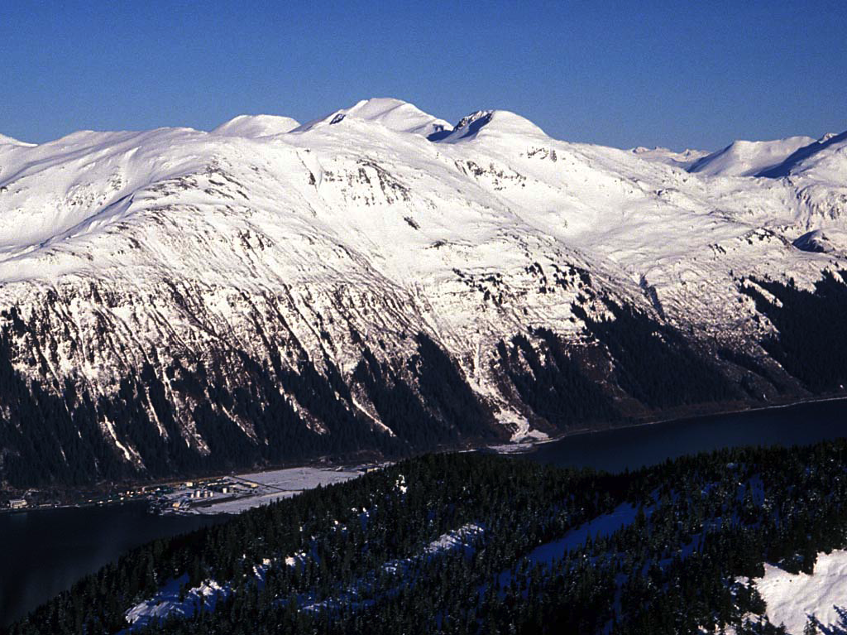
Avalanches and how an Alaskan Avalanche Encouraged Short-Term Electricity Conservation in Juneau
Dr. Cathy Connor- University Alaska Southeast 02-03-2012

Slide 2
Thinking About Avalanches
The Mass Movement Process
Tilt board demonstration
GOOGLE Earth Slope calculations for Juneau Slide paths
Case study of energy reduction in Juneau.

Slide 3
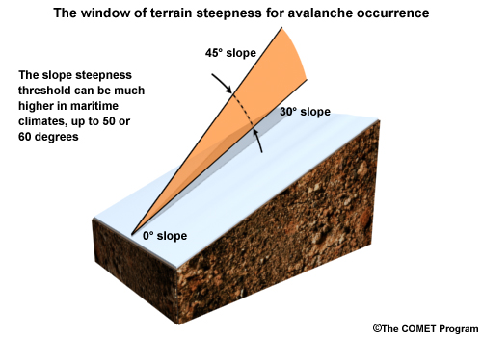
http://www.meted.ucar.edu/afwa/avalanche/media/graphics/window.jpg

Slide 4
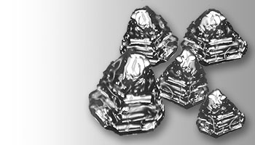
Modeling depth hoar-faceted snow crystals (sugar layer) which create weak layers in the snow pack
Video of depth hoar formation
http://www.fsavalanche.org/encyclopedia/depth_hoar.htm

Slide 5
Juneau Demographics and Geology
Juneau is Alaska’s Capital City with a population of 31,000 out of 722,718 in the entire state. Downtown winter snowfall can be over xx inches in the winter
Located at the intersection of the Fanshaw and the Silverbow faults along Gastineau Channel, the mountains surrounding the city rise to 3,000’ directly above sea level, producing steep slopes, and mass wasting hazards including avalanches.

Slide 6
Google Earth Path Tool
Find Downtown Juneau Alaska 58°18′07″N 134°25′11″W
Create paths down Chop Gully, Behrends Ave (Mt. Juneau) Slide Path, and Snowslide Gulch in Thane
Use Profiling tool to measure slope of each
How do these compare to tilt board angles for
Flour/sugar releases?
How do slope angles for maritime avalanches compare with those of inner mountain west/

Slide 7
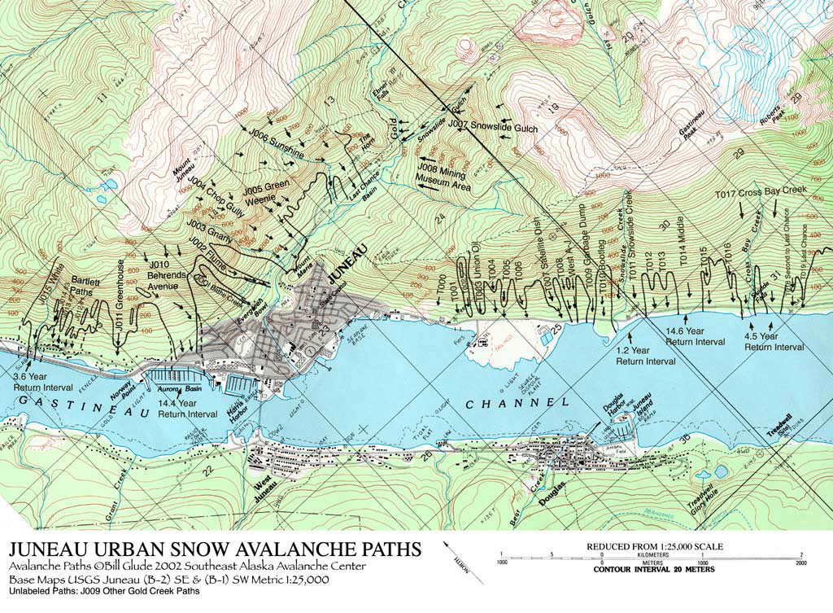

Slide 8
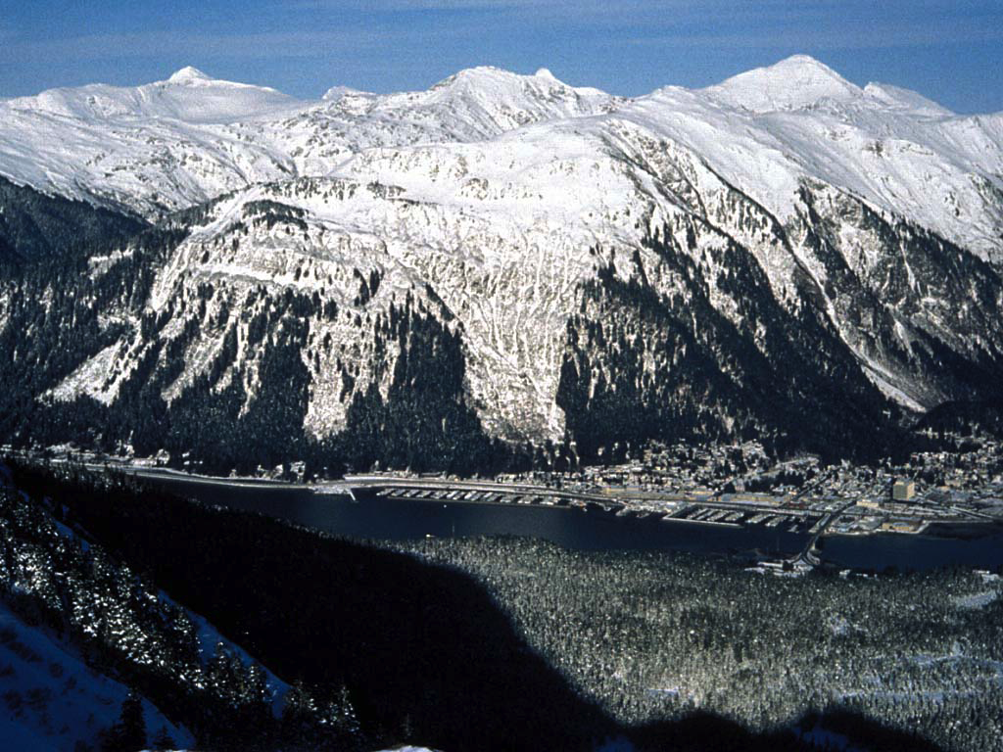

Slide 9
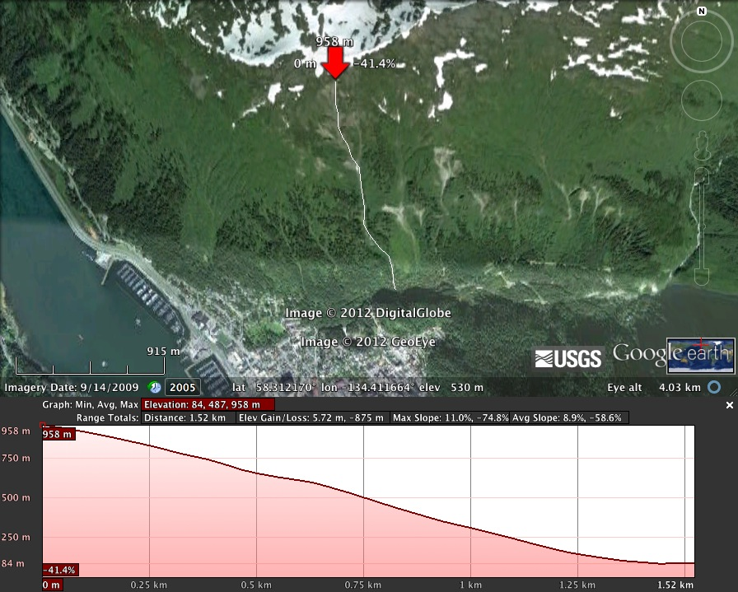
Chop Gully above Gold Creek

Slide 10
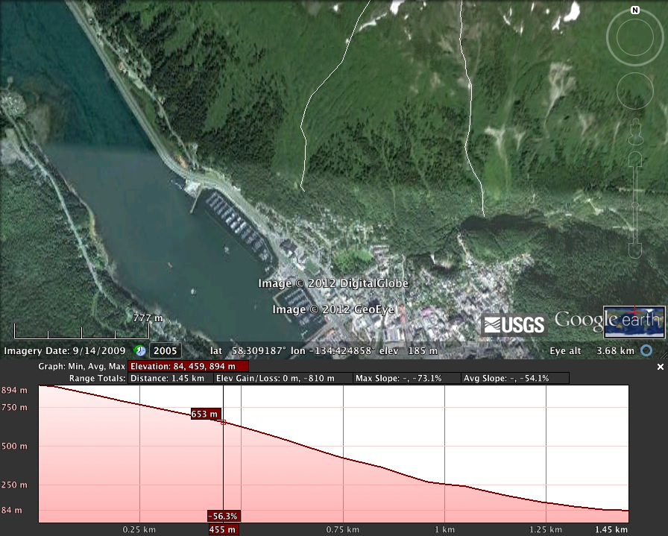
Mt Juneau
CHOP GULLY
Behrends Ave Avalanche path profile

Slide 11
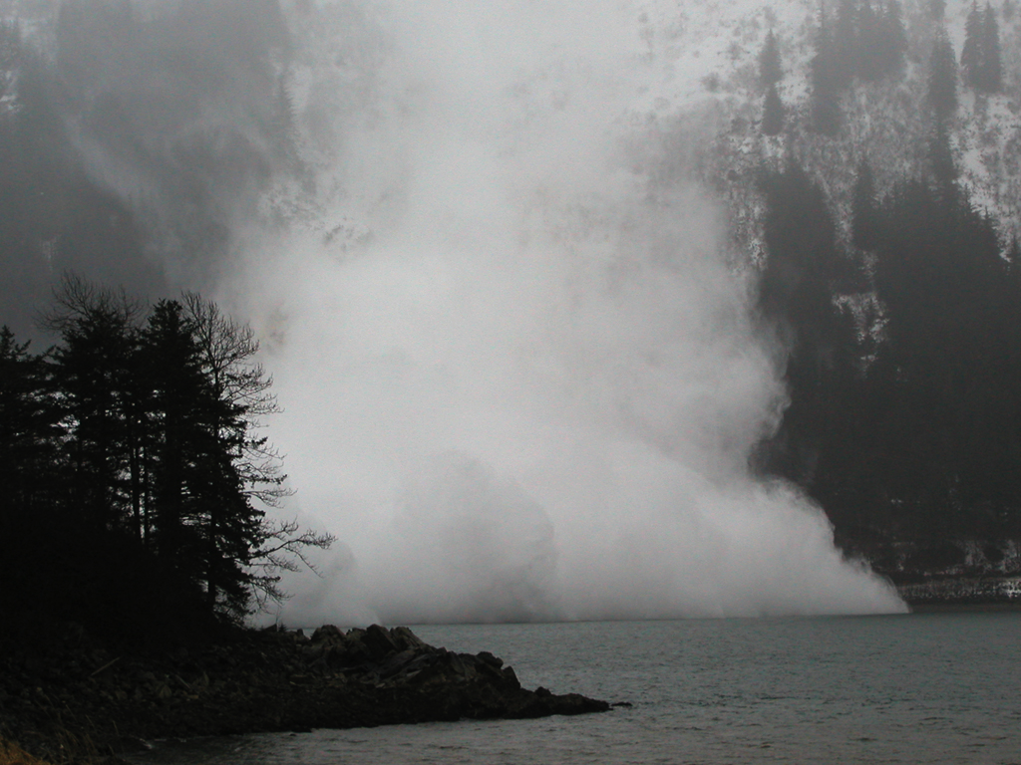

Slide 12
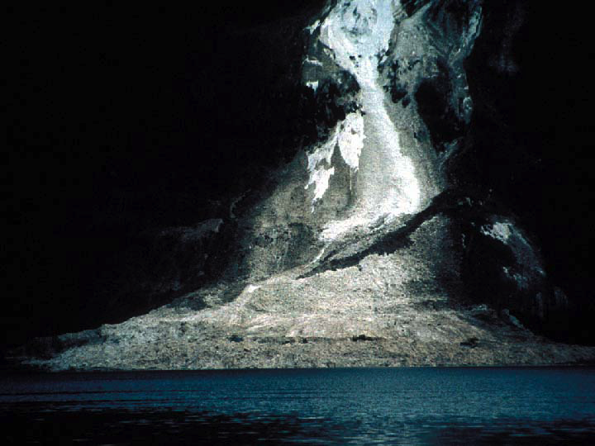

Slide 13
Juneau Avalanche Videos
Video of downtown Juneau Chop Gully slide
http://www.youtube.com/watch?v=yxCqUQI1PEw
Video of avalanche down Snowslide Creek Gulch
http://www.youtube.com/watch?v=W2h7q8Ln01I
Video of slab avalanche off metal roof
http://www.youtube.com/watch?v=z8h_77S7Z8I

Slide 14
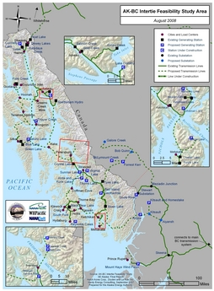
Hydropower in Southeast Alaska Figure 1: Southeast Alaska â€“ Canada regional transmission interties and selected power generation facilities (both existing and proposed). All power generation sites shown on the map are hydroelectric, unless otherwise noted http://www.waterpowermagazine.com/graphic.asp?sc=2053893&seq=3

Slide 15
LAKE TAP HYDROPOWER
Southeast Alaska is blessed with abundant water and steep terrain, resulting in a huge hydro power resource. The total theoretical hydro potential of SE Alaska is probably in excess of 10,000MW of capacity, with only about 200MW of this potential already tapped. Much of this potential will not be developed due to environmental concerns, or is located in protected wilderness areas or national parks. However, hundreds of remaining hydro power sites (mostly small-scale) could be developed with minimal environmental impact.

Slide 16
Find Snettisham Hydropower Plant
Use GOOGLE Earth to find Juneau’s Lake Tap Hydropower
58.133349N, -133.715822W
Transmission lines from the generator connect turbine with Juneau ~46 miles to the north.

Slide 17
Most of the region’s existing and proposed hydroelectric sites are lake-tap developments, on relatively small drainage basins with heavy runoffs. These lakes, typically formed by glaciers which receded after the last ice age, are perched at higher elevations, with tunnels or penstocks leading to powerhouses at lower elevations. Lake-tap projects often do not require a dam, and thus tend to have relatively low environmental impacts.

Slide 18
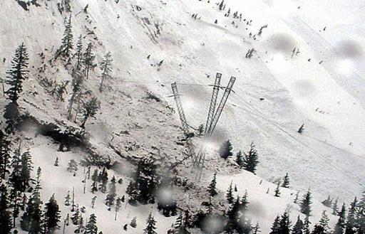
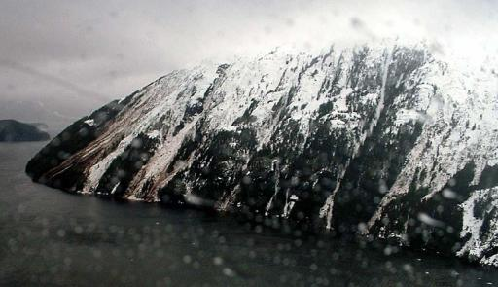

Slide 19
Avalanche Destroys AK Capital City Power Supply April 16, 2008
An avalanche destroyed a section of the main hydroelectric transmission line to Juneau, Alaska on April 16, 2008. Backup generators replaced the lost capacity but the use of diesel fuel for generation caused electricity prices to increase 500 percent for a 45-day period. These equated to $1.5 million per week.
Juneau citizen response to this electricity “crisis” included electricity conservation that began within two days of the event and reduced electricity use by 25% over the period of supply disruption relative to the same period in 2007. Conservation of about 8% relative to 2007 persisted after the transmission line was repaired and electricity rates returned to normal.

Slide 20
A second avalanche on January 9, 2009 damaged the same section of transmission line and caused a second supply disruption, albeit shorter in duration (19 days) and magnitude of price increase (200 percent).
This time observed conservation during the disruption was less (12% relative to 2007) while persistent conservation after the event increased by two percentage points to 10% relative to 2007.

Slide 22
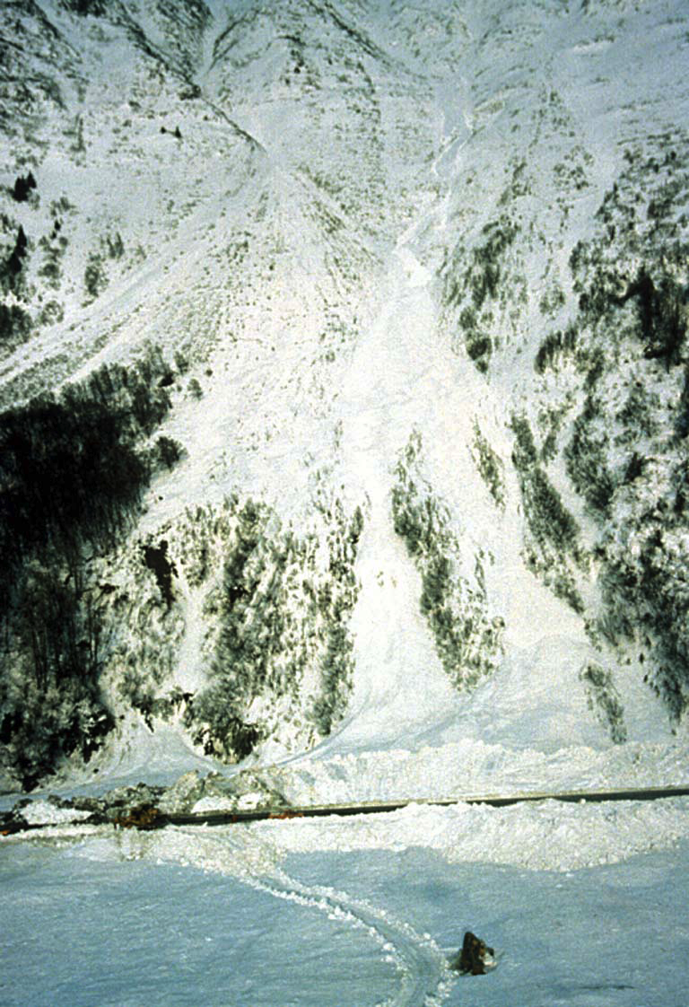
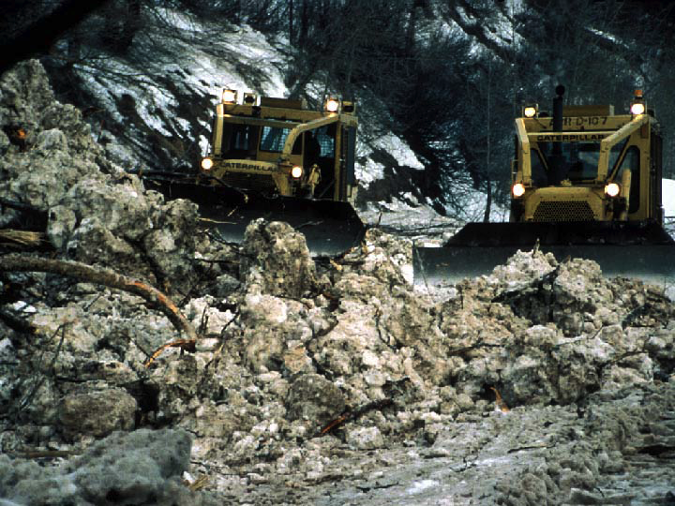

Slide 23
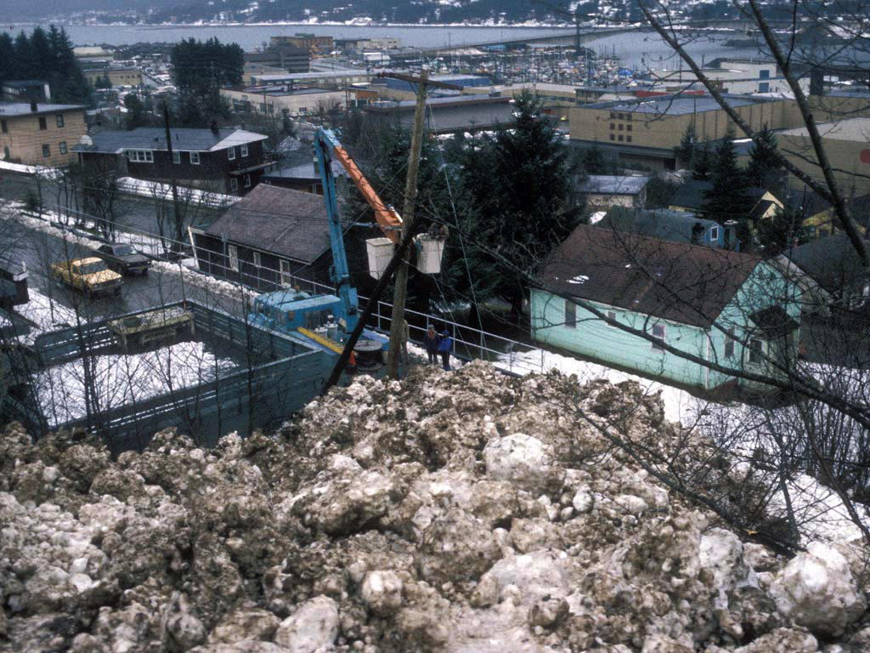

Slide 24
A Study of Household Activities
Wayne Leighty, University of California, Davis Alan Meier, Lawrence Berkeley National Laboratory
http://www.aceee.org/files/proceedings/2010/data/papers/2131.pdf

Slide 25
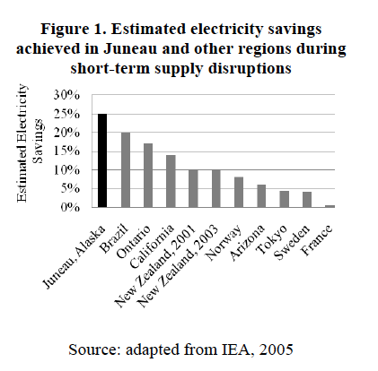

Slide 26
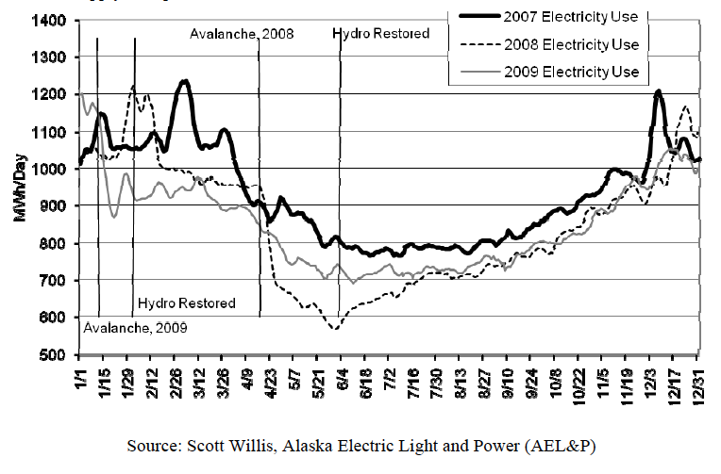

Slide 27
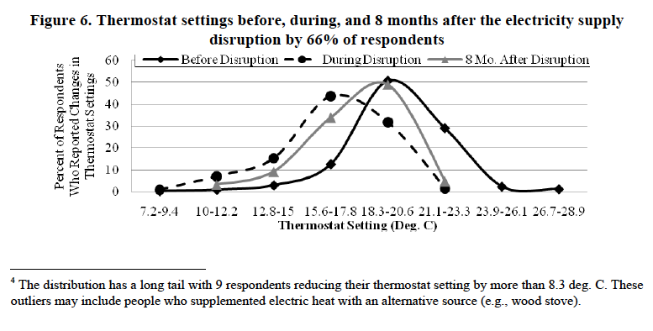

Slide 28
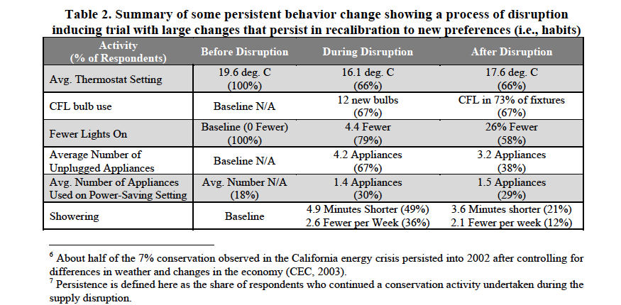

Slide 29
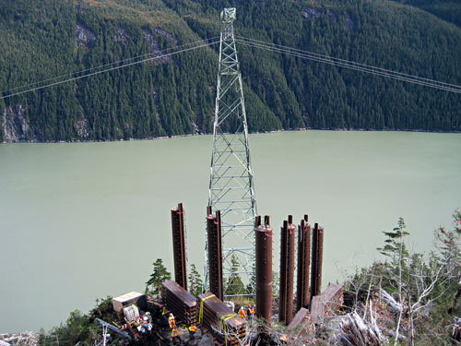
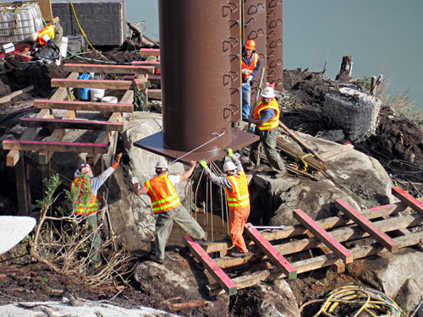
Restoring and strengthening
Reinforcement structures around the Snettisham towers.
http://images.morris.com/images/juneau/mdControlled/cms/2009/10/02/500171608.jpg
http://images.morris.com/images/juneau/mdControlled/cms/2009/10/02/500171542.jpg

Slide 30
References
Alexander, Rosemarie. 2009. “Avalanche a Year Later.” KTOO Radio, April 16,
http://www.ktoo.org/audiofile.cfm?clip=3819.
[CEC] California Energy Commission. 2003. Revised Energy Conservation Impact
Assessment. Sacramento, CA: California Energy Commission.
Eriksen, Eric, Dan Zacharda, and Jim Multerer. 2009. “After the Avalanche.” Transmission and
Distribution World, March 1, http://tdworld.com/overhead_distribution/avalanche-pronetransmission-
lines-0903/index2.html.
Forgey, Pat. 2009. “City Gets Some Protection For its Power Lines.” Juneau Empire, October
2, http://www.juneauempire.com/stories/100209/loc_500171488.shtml.
Golden, Kate. 2008. “Avalanche Knocks Out Hydro Power.” Juneau Empire, April 17,
http://juneauempire.com/stories/041708/loc_269314122.shtml.
[IEA] International Energy Agency. 2005. Saving Electricity in a Hurry: Dealing with
Temporary Shortfalls in Electricity Supplies. OECD/IEA, online,
http://www.iea.org/publications/free_new_Desc.asp?PUBS_ID=1481.
Jaffe, Adam B. and Robert N. Stavins. 1994. “Energy-Efficiency Investments and Public
Policy.” Energy Journal 15 (2): 43-65.
[JEDC] Juneau Economic Development Council. 2009. 2009 Juneau and Southeast Alaska
Economic Indicators. Juneau, AK: Juneau Economic Development Council,
Leighty, W. and Meier, A.,2010, Short-Term Electricity Conservation in Juneau, Alaska: A Study of Household Activities in: ACEEE Summer Study on Energy Efficiency in Buildings
http://www.jedc.org/forms/Juneau%20and%20SE%20Indicators%202009%20FINAL.pdf.

