Slide 1
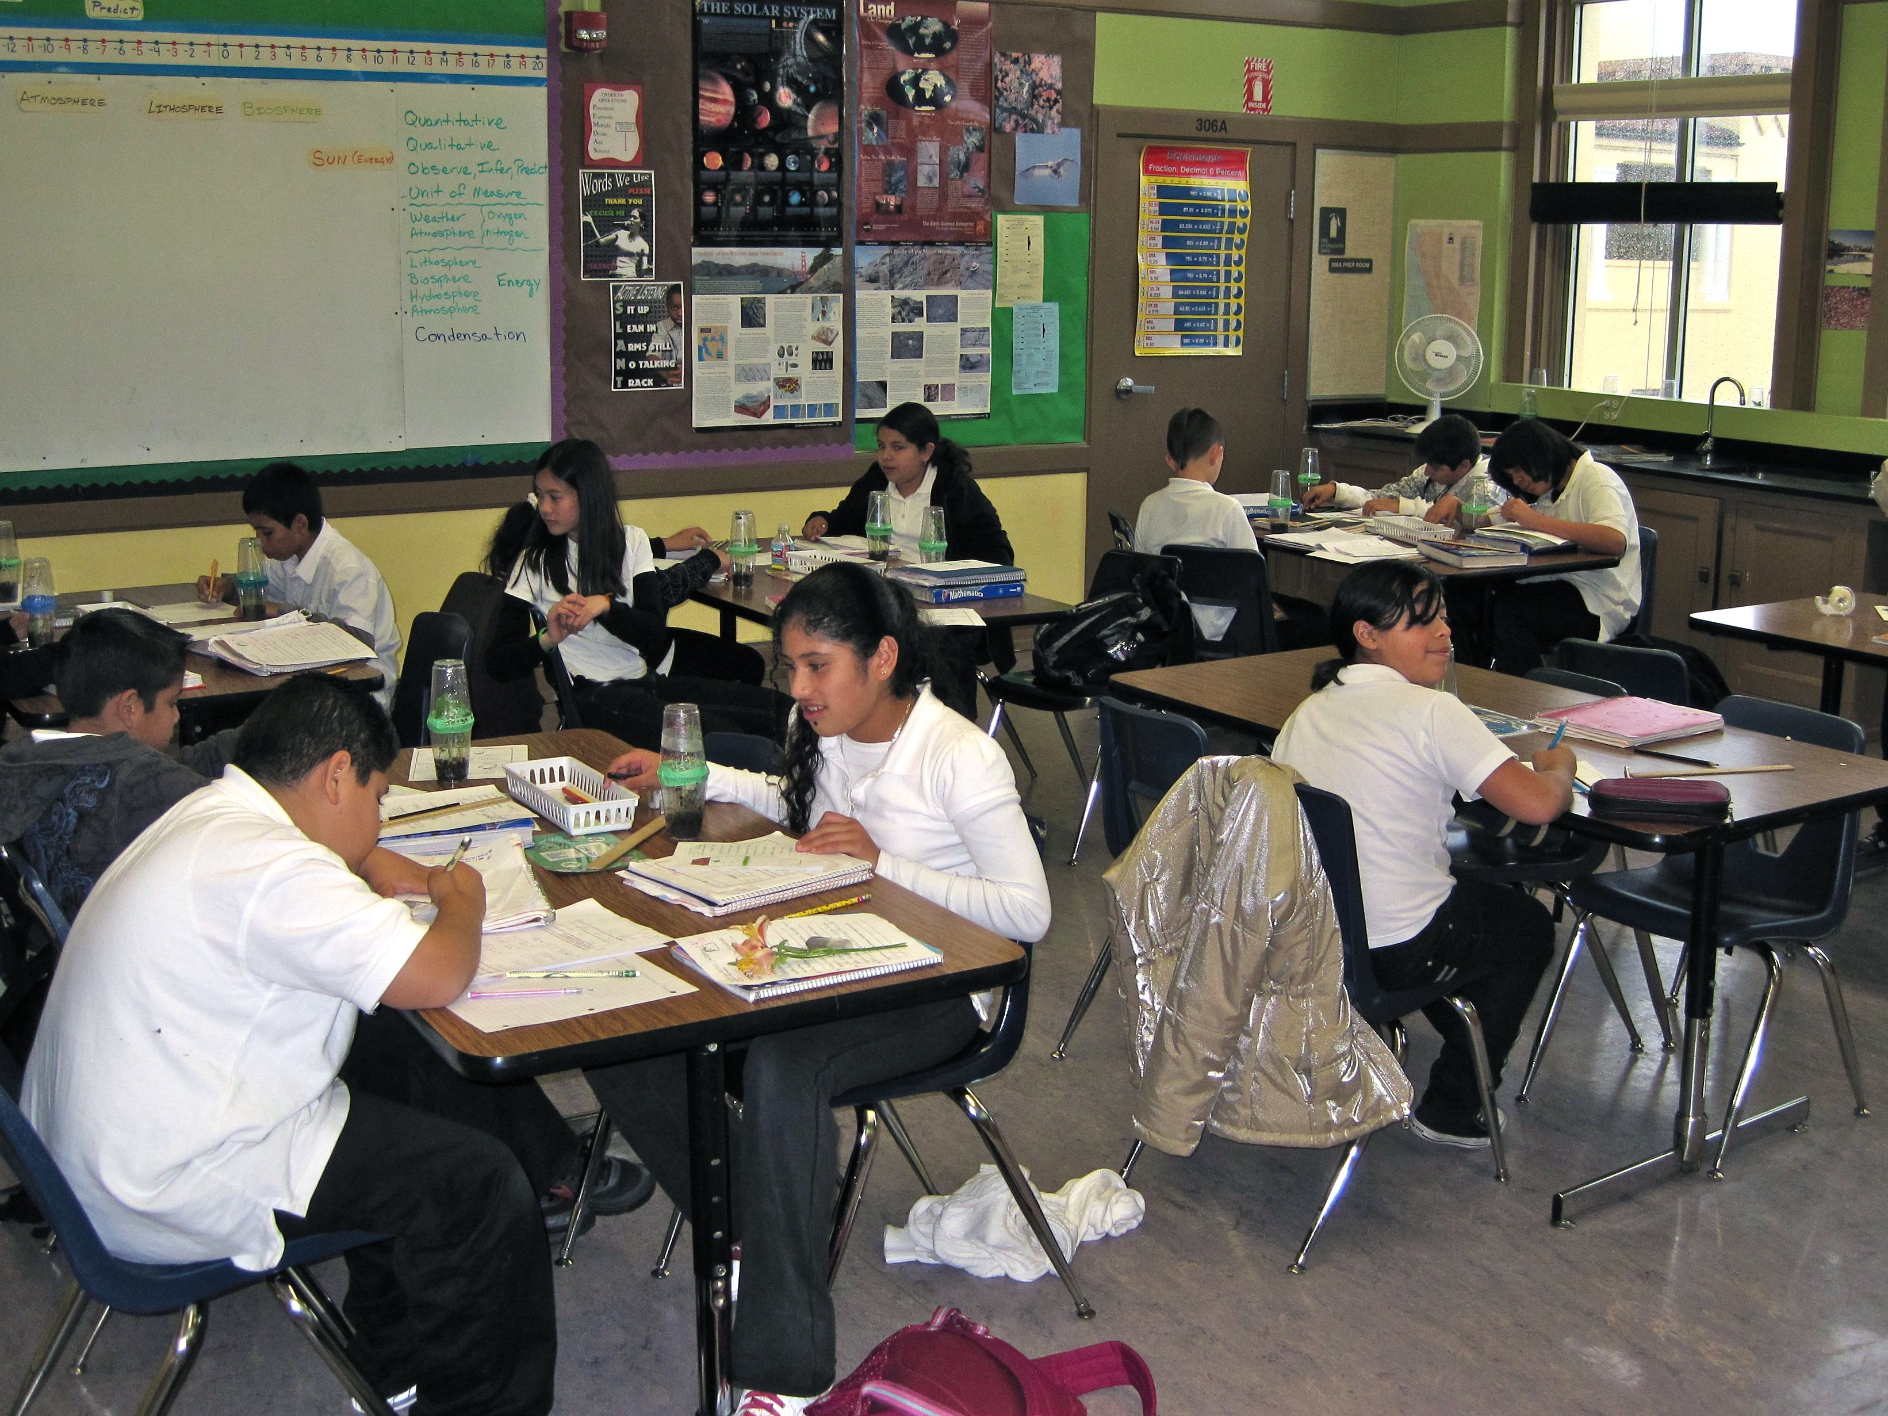
Developing Interactive Lectures
Teaching Environmental Geology
June 2012
Chris Lewis
City College of San Francisco

Slide 2
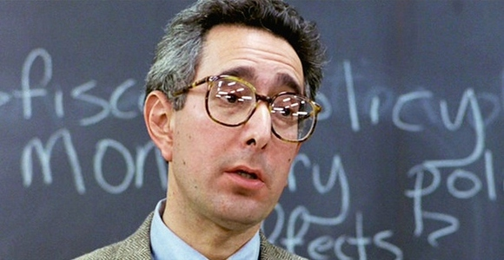
Why make lectures interactive?
When the bum is numb, the mind is soon to follow…
Ben Stein, Economics professor.
Ferris Bueller’s Day Off (1986 – Paramount Pictures)
Notes:
Ben Stein, Economics professor. Ferris Bueller’s Day Off (1986 – Paramount Pictures)

Slide 3
Interactive Lecture Toolbox
Vocabulary Cocktail Party
Think-pair-share
8 Hands up
Give one/get one
Concept Tests
Demonstrations, predictive demonstrations, interactive demonstrations
Jig-Saw
4-Color Posters
Gallery Walk
Exit Ticket
Start with one or two, add more as you master them or see fit
Notes:
Short and sweet – we have a toolbox, we’ll discuss some of them – all discussed in more detail online.

Slide 4

Vocabulary Cocktail Party
Make a list of key terms along with definitions (or copy from the end of a chapter)
Cut into strips – one term and definition per strip
Pass out strips to students
Model activity with a student
Have students mingle, reading and listening, trading slips.
For an attendance option, have them write their name on the slip they end with and collect.

Slide 5
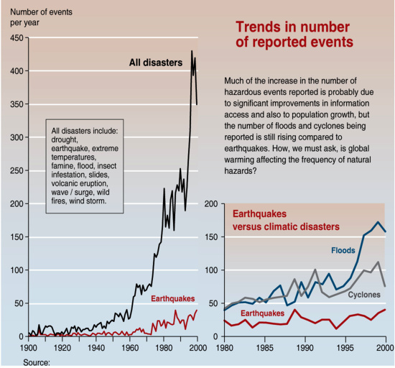
Use proximity – get out into the class and join the discussion!
Think-Pair-Share
Instructor asks a question related to an image, graph, demonstration, etc.
Students think (write, calculate) a response.
In pairs (or small groups), students discuss their responses.
Solicit pair or group response
Instructor can use to guide instruction.
Emmanuelle Bournay, UNEP/GRID-Arendal
http://www.grida.no/graphicslib/detail/trends-in-natural-disasters_a899
Notes:
Images are examples of what others have used.

Slide 6
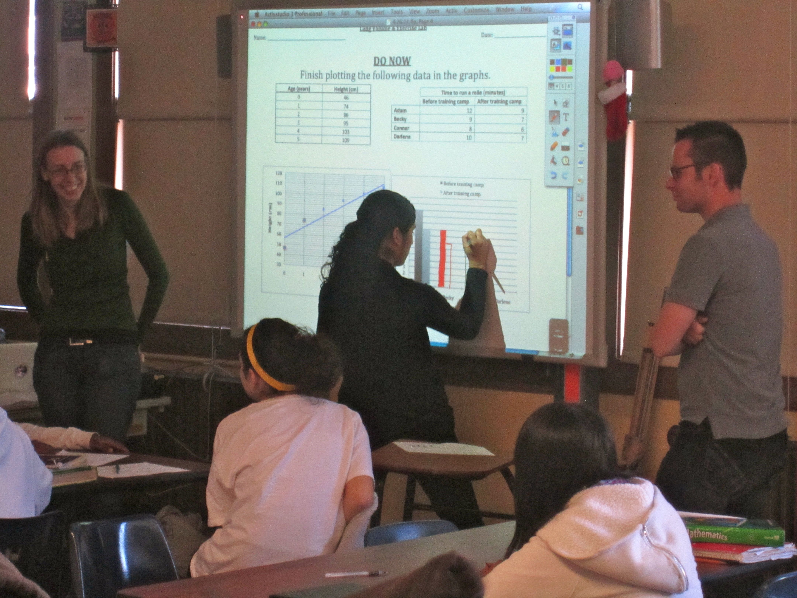
Think-Pair-Share
What does an interactive lecture sound/look like?
8 Hands Up:
Often when instructors solicit hands for answers, the same few people raise their hands.
Rather than being satisfied with that, tell the class you need to see eight hands. You won’t go on until more people raise their hands. Be patient, more hands will go up.
Tell everyone to keep their hands up and call on all of them.
Learning is about redundancy.
Notes:
2-3 minutes?

Slide 7
Think-Pair-Share
What does an interactive lecture sound/look like?
Students are talking with each other and teaching one another
Students are offering up answers and ideas
Students are engaged in thinking through concepts
Students are getting hands-on experiences with concepts
Students are collaborating with each other – brainstorming
Students are engaging with the material in multiple ways and instructors are assessing understanding in multiple ways at multiple levels.
Notes:
2-3 minutes?

Slide 8

Concept Tests
Multiple choice questions embedded in the lecture
Focus attention on key concepts
Identify prior knowledge and misconceptions
Formative exercises during class used to assess student progress
Often includes peer interaction
Frequently used with an electronic Personal Response System (PRS) “clicker”

Slide 9
Ocean waves are caused by…
gravitational pull of the moon.
rotation of Earth.
water density differences between warmer and cooler water.
water density differences due to changes in salinity.
friction from air moving over the water (wind).

Slide 10
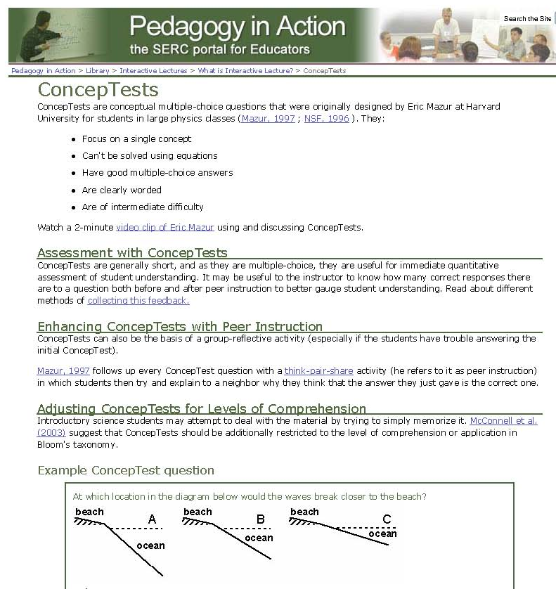
http://serc.carleton.edu/introgeo/interactive/conctest.html

Slide 11
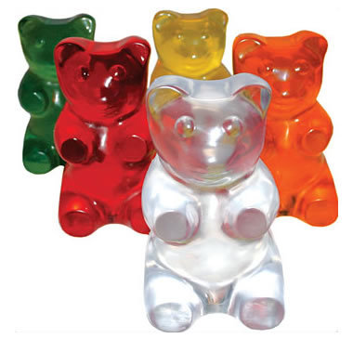
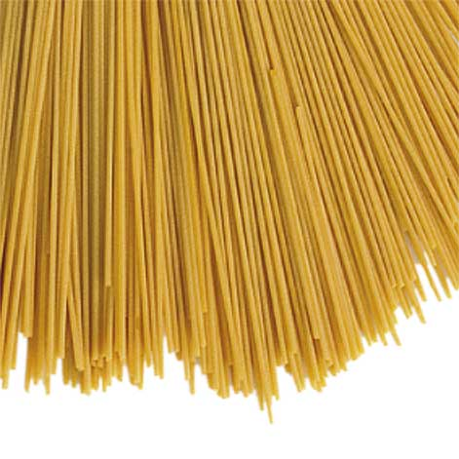
Interactive Demonstrations
Resonance Demo
Find the resonant frequency of your gummi bear.
Compare your result with others.
Is there a pattern?
Notes:
I’d like to demo this specifically – if I can get materials. Will take 2-3 minutes if results anticipated then performed then reviewed.

Slide 12
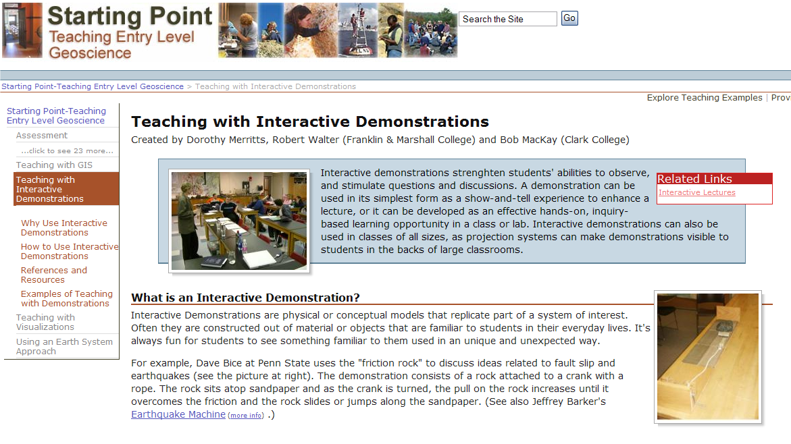
Interactive Demonstrations
Make a prediction
Observe
Review/Re-test
http://serc.carleton.edu/introgeo/demonstrations/index.html

Slide 13

Jigsaw
“Chunk” text into smaller sections within a single lecture period. Assign each group a section.
Assign separate articles to be read by groups in advance.
Assign a specific guiding question or “lens” for each group to use in reading the same section of an article or text.
Groups summarize their findings verbally or through a poster format, followed by a gallery walk (see following).

Slide 14
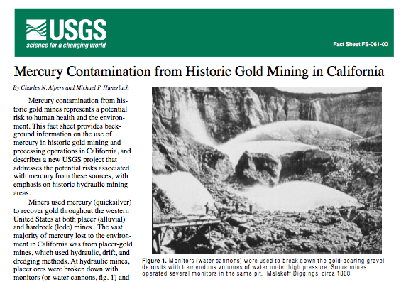
Jigsaw Example – Mercury contamination in California
Guiding Questions:
What form of mercury is most toxic to humans?
What controls the process that creates this form from elemental [Hg(0)] mercury?
What can you say about the correlation between fish size and mercury concentration (refer to figure 7)?
What does this trend say about the rates of input versus output in fish?
Notes:
I will only describe this jigsaw NOT do it.

Slide 15
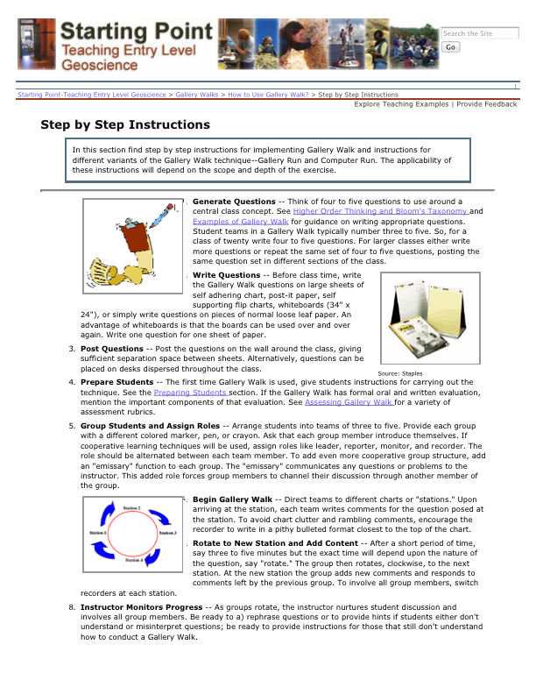
Gallery Walk
Focus attention on key concepts
“Chunk” larger texts or contrasting points of view
Analyze a set of graphs or figures
Review and assess work from groups
Use colored post-its or stickers to allow students vote or rank artifacts anonymously – for example: Red = concerns, Green = approval.
Have students gather next to the article or poster they agree the most with at end of activity.
http://serc.carleton.edu/introgeo/gallerywalk/step.html

Slide 16
4-Color Poster
Class breaks into groups of four.
Each group receives a problem, a section of text or a graphic.
Each student chooses a colored marker. Everyone contributes.
One student = One color
Groups solve problem or summarize key points.
Students sign the poster with their marker.

Slide 17
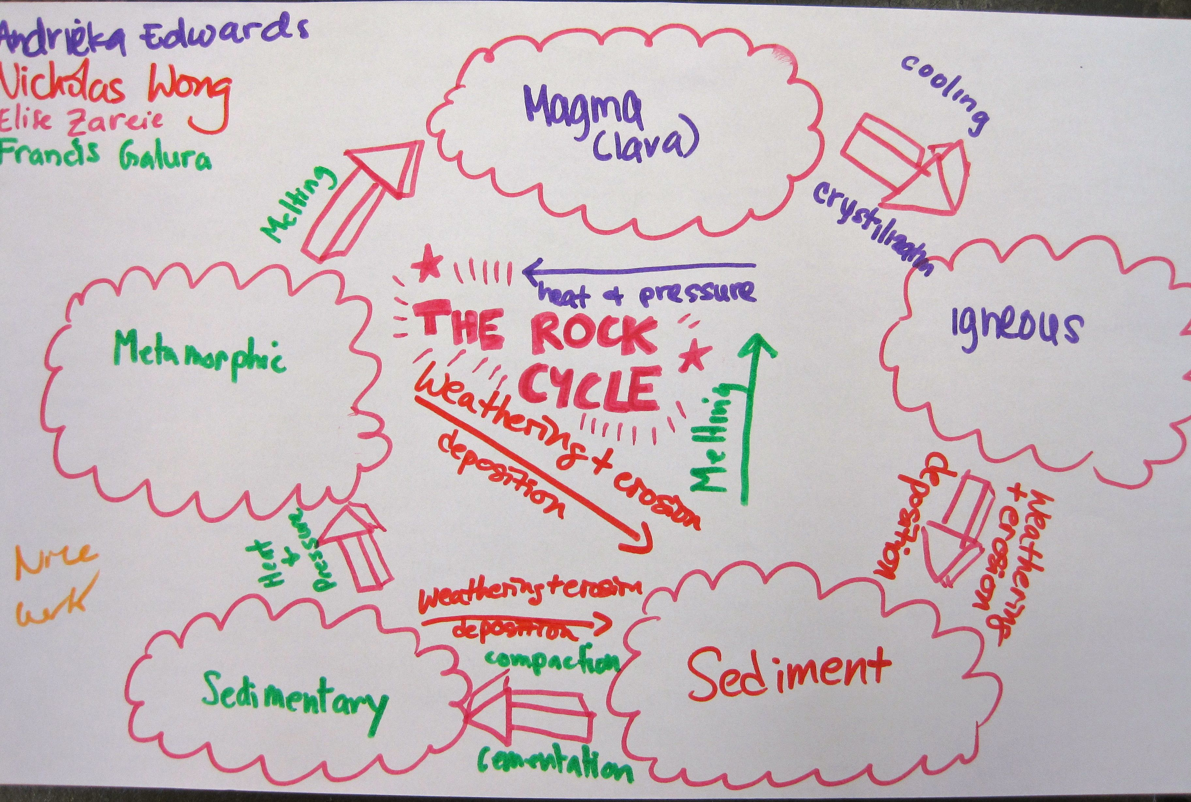
4-Color Poster Example

Slide 18
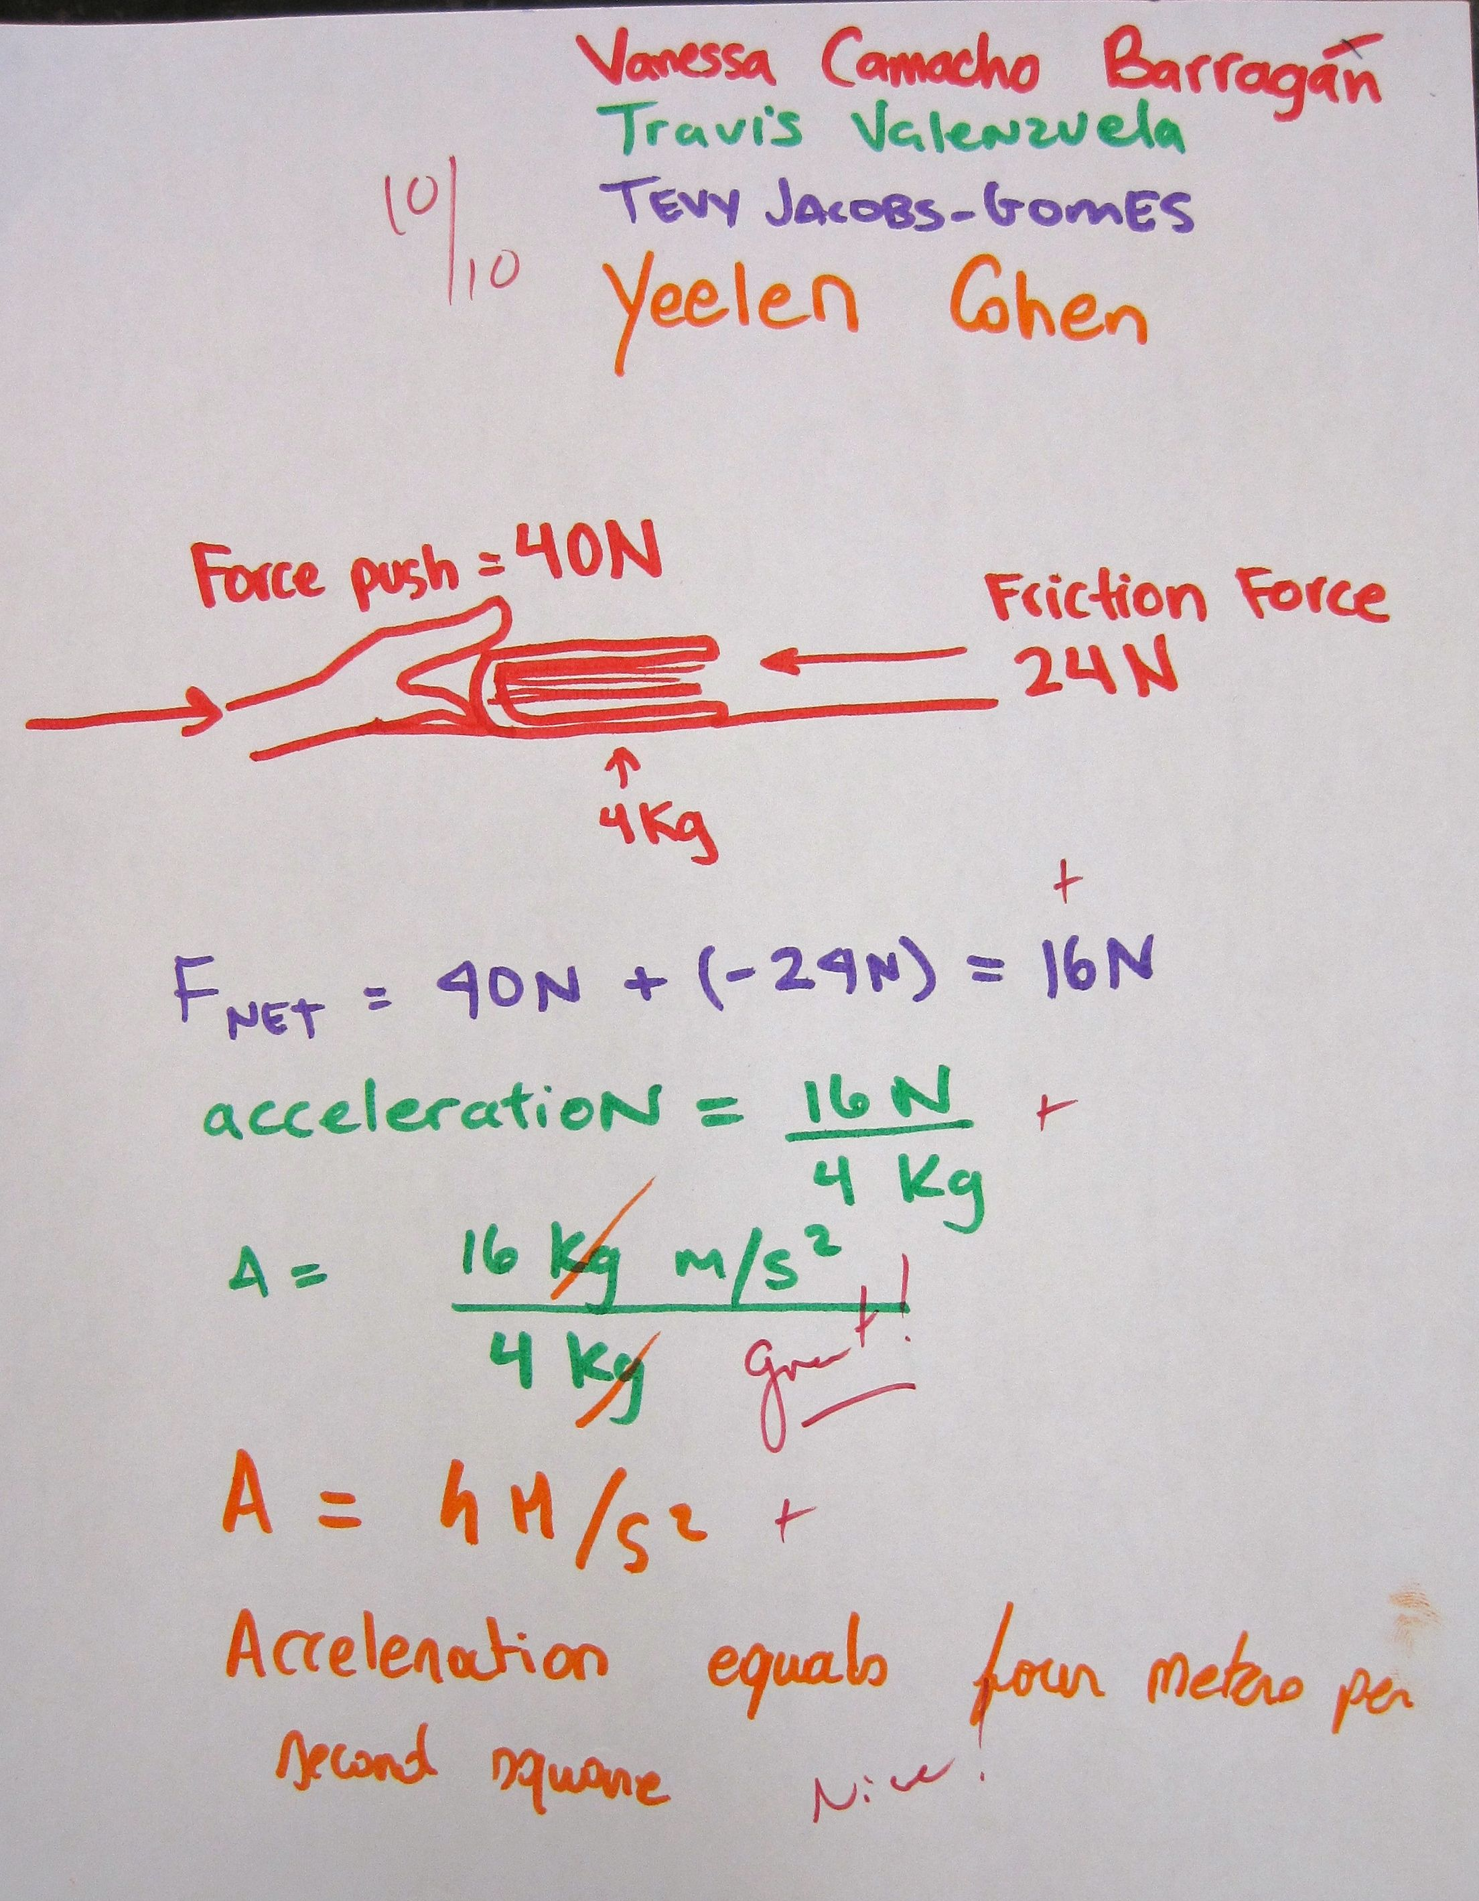
4-Color Poster Example

Slide 19
Exit Tickets
Potential topics:
  The muddiest point of today’s class
  The most important point(s) you learned from today’s class
  Checking for understanding of key point(s)
  KWLs (see next slide)
A classroom assessment technique
  Involves students in their own learning, promotes metacognition
  Can show class-wide trends
  Makes a natural starting point for the next class

Slide 20
KWL
At the start of class, pass out a half sheet of paper and ask students copy the table below and fill in first two columns.
At the end of class, have them complete the chart by describing something significant they learned.
Know
Want to Know
Learned

Slide 21
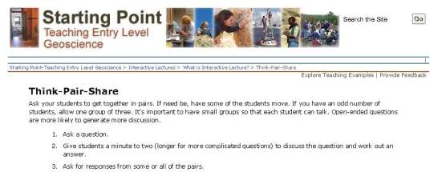
For More Information…
Think-Pair-Share:
http://serc.carleton.edu/introgeo/interactive/tpshare.html
ConcepTest:
http://serc.carleton.edu/introgeo/interactive/conctest.html
Predictive/Interactive Demo:
http://serc.carleton.edu/introgeo/demonstrations/index.html

