Slide 1


Coal-fired Power Plants, Superfund Sites and Residential Neighborhoods
Environmental Justice Field Trips: an experiential learning opportunity for undergraduates
Dr. Katherine Bulinski Mr. Tim Darst

Slide 2
What do students know about the environmental health of their community?
May know about household hazards like cleaning products or lead paint
May know to not dispose of chemicals down sewer drains
May be vaguely aware of air pollution
  E.g., summer air quality alerts, problems with asthma

Slide 3
What do students NOT know about the health of their community?
Environmental health can range widely from neighborhood to neighborhood
Some of the most vulnerable members of our community (minorities, economically depressed) live in the most hazardous environmental conditions
Industry, energy generation and waste disposal are likely actively polluting their community

Slide 4
Objectives of Exercise
To expose college students to areas of their community that are environmentally damaged
To explore social justice issues related to the location of these environmental hazards
To have students respond to the experience through discussion and writing activities

Slide 5
The Environmental Justice Tour
Environmental Justice Tour developed by Mr. Tim Darst, environmental activist in Louisville, Kentucky
Run as a public educational outreach tool for schools, church groups, or the general public on a regular basis
This tour is offered each semester for my introductory geology courses

Slide 6
Bus Tour Includes
Trip to the “West End” of Louisville
  Neighborhoods in close proximity to major highways (air pollution and litter)
  Neighborhoods and parks in close proximity to coal-fired power plants
  Polluted lakes and streams
  A Superfund Site
  An industrial park “Rubbertown”
  A coal ash landfill

Slide 7
We begin with a presentation…
Establish some context for the students of what they will be observing
Engage them in a conversation about their own preconceptions
Students will identify how their experiences might be similar or different to the people living in these polluted communities
Students have an opportunity to ask questions before the bus tour begins

Slide 8
What does Environmental Social Justice Mean to You?
Healthy air, soil, lakes and rivers for all people
Equality in the health of the environment in every neighborhood
Equal access to healthy foods and clean drinking water

Slide 9
Environmental Justice
“ Environmental Justice is the fair treatment and meaningful involvement of all people regardless of race, color, national origin, or income with respect to the development, implementation, and enforcement of environmental laws, regulations, and policies… It will be achieved when everyone enjoys the same degree of protection from environmental and health hazards and equal access to the decision-making process to have a healthy environment in which to live, learn, and work. “
http://www.epa.gov/environmentaljustice/

Slide 10
What’s in Your Neighborhood?
Many college students come from privileged backgrounds and may not have hazards in their communities (and if they do, may not be aware of them)
In urban areas, these problems may be more prevalent.

Slide 11
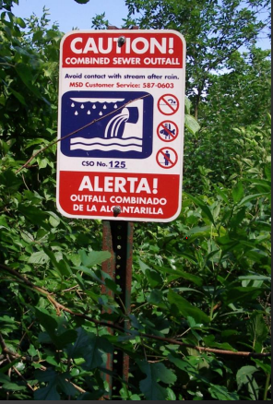
What are the environmental problems in your community?
Polluted streams and lakes?
Polluted soil?
Coal-fired power plants?
Mining damage?
Superfund sites?
Industry?
Waste treatment plants?
Large-scale agriculture runoff?

Slide 12
Environmental Hazards and Racial Social Justice
71% of Latinos live in counties that violate federal air pollution standards and are twice as likely as black or whites to live in areas with elevated air pollution levels.
  (The Southern Organizing Committee for Economic and Social Justice, 2002)

Slide 13
Environmental Hazards and Racial Social Justice
60% (15 million) African Americans live in communities with one or more abandoned toxic waste sites.
  (Toxic Wastes and Race in the United States, 1987)

Slide 14
Environmental Hazards and Racial Social Justice
~68% of African Americans live within 30 miles of a coal-fired power plant, compared to 56% of white Americans.
  (The Southern Organizing Committee for Economic and Social Justice, 2002)

Slide 15
Other information presented to students
History of the development of social justice inequalities in Louisville, Kentucky
-”White Flight”
-Development of working-class neighborhoods immediately adjacent to highly-polluting industrial complexes
-Demographics correlating higher instances of respiratory diseases and cancer with poverty and proximity to environmental hazards

Slide 16
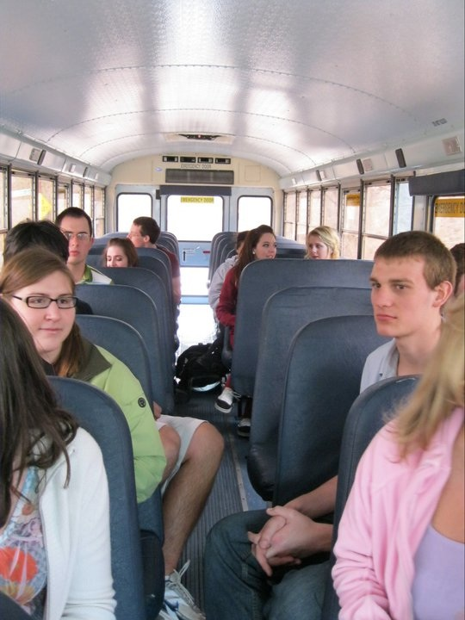
On The Bus

Slide 17
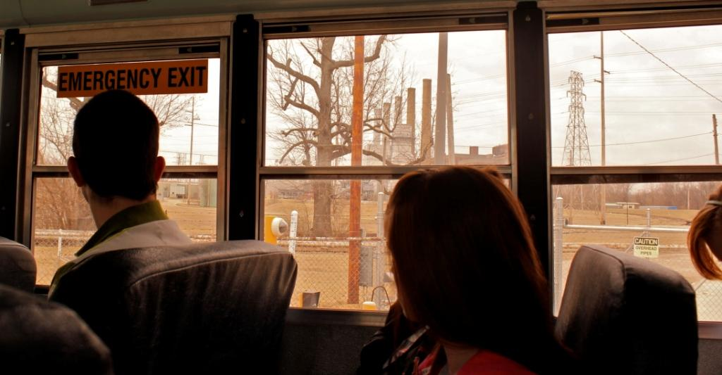
Industry

Slide 18
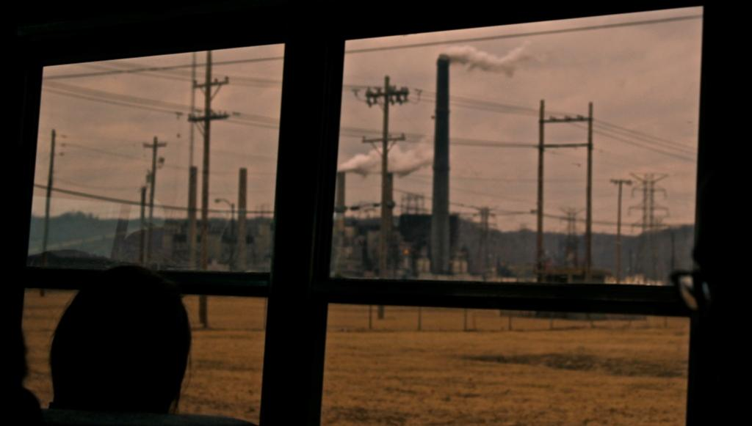
More Industry…

Slide 19
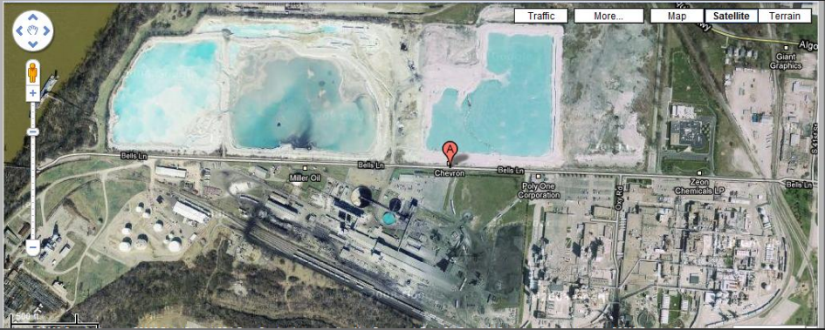
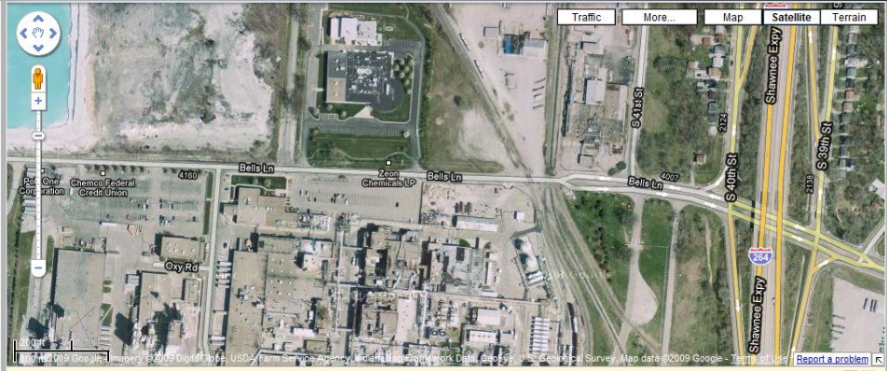
Rubbertown

Slide 20
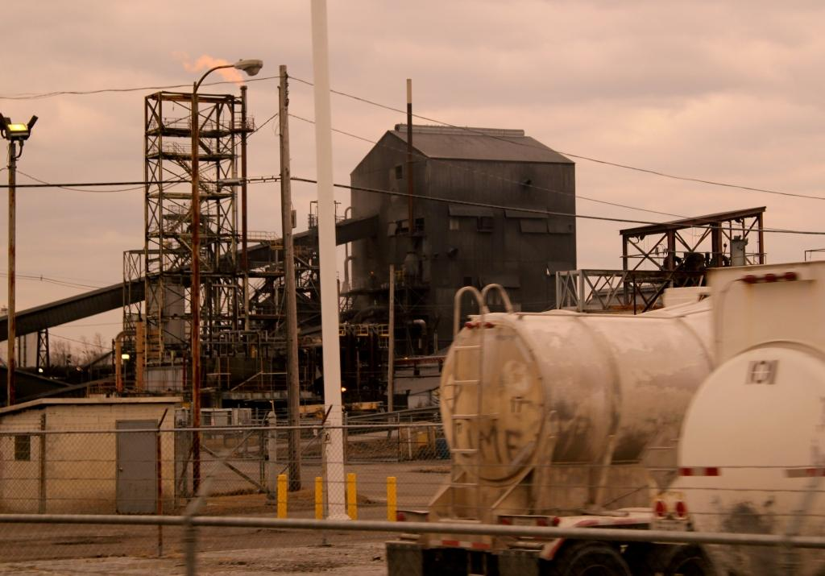
Even More Industry…

Slide 21
Lees Lane Superfund Site
Sand and gravel quarry converted to landfill in 1940’s
In 1980, 400 exposed drums of hazardous materials discovered on the Ohio River bank immediately adjacent to neighborhood
More than 50 chemicals including a variety of heavy metals
Listed on the National Priority List for Superfund in 1982
Mid 1980s capped and surface cleaned.

Slide 22
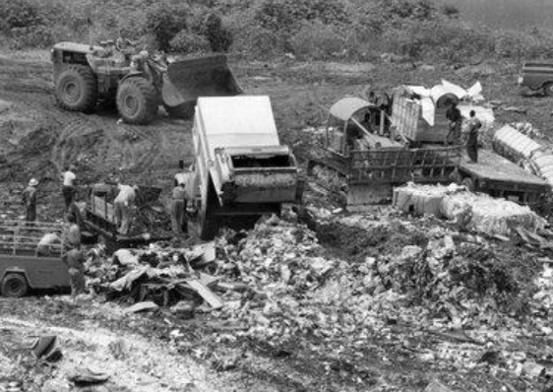
Lees Lane Landfill

Slide 23
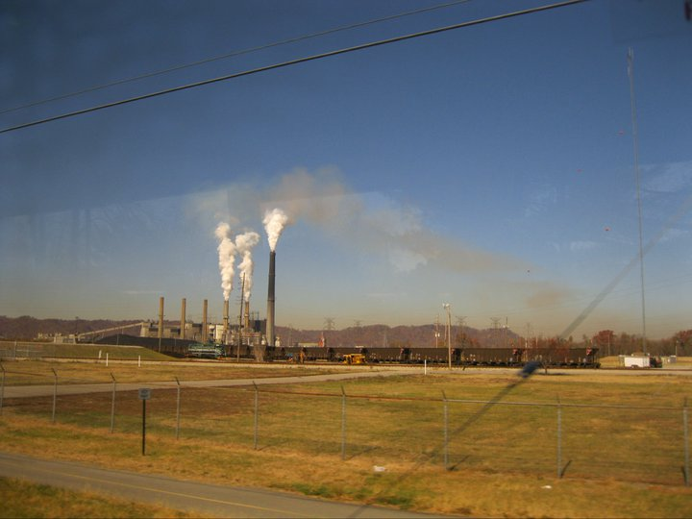
Coal-Fired Power Plants

Slide 24
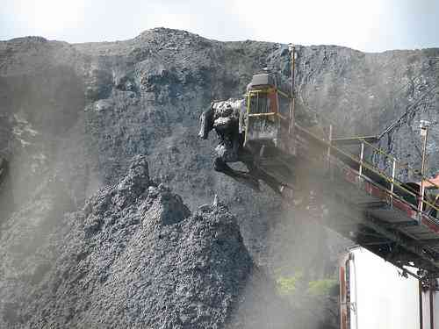
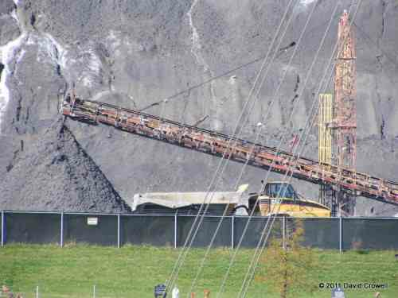
Coal Ash Landfill
A hazardous hill of particulate matter immediately adjacent to neighborhoods

Slide 25
Student Entrance and Exit Surveys
Before the presentation began and after it concluded, students filled out a survey where they were asked to comment on the following
How they felt about the environment
How well they thought Louisville addresses environmental concerns
What the most pressing environmental problems were in our city and nation

Slide 26
Typical Responses for Entrance Surveys
Biggest environmental problem in Louisville
  Water pollution
  Waste disposal
  I don’t know
  Air pollution
  Litter
  Perceptions of Louisville’s response to Stream and Lake Pollution, Soil Pollution, Air Pollution, Waste Disposal, Proximity of Toxic Sites to Neighborhoods, Overall Environmental Health: Average to Poor

Slide 27
Student Responses on Exit Surveys
Based on what you observed on the tour, what did you find the most surprising?
  How close the landfills are to homes
  Close proxmity of industrial areas to residential areas
  Our lakes are full of chemicals
  That environmental problems are actually happening
  The poverty
  That we have so much industry in Louisville

Slide 28
Exit Survey Results
  Perceptions of Louisville’s response to Stream and Lake Pollution, Soil Pollution, Air Pollution, Waste Disposal, Proximity of Toxic Sites to Neighborhoods, Overall Environmental Health: Poor to Very Poor

Slide 29
Student Response Papers
Students are asked to write a short (750-word) response paper highlighting what they learned on the tour and to research potential solutions.
“I feel there is some kind of environmental injustice…in Louisville...people are not being fully considered when factories are built or when they are dumping waste”
“A lot of people do not know that these factories are harmful because of their poverty level…people who live in generational poverty rarely escape it”

Slide 30
Student Response Papers
“in the west end of Louisville, many residents…suffer from physical illnesses like cancer caused by pollutants in their water and in the air. Many of these residents are poor and people of color, and due to the location of their property are now unable to sell and get away from the area even though their homes are making them ill”
“If no one can help these people, caught by a net of circumstances that they cannot change, how is the environment ever going to get the help it needs?”

Slide 31
A Point of Discussion
If achieving environmental justice requires all people to have equally environmentally healthy neighborhoods, ask yourself--would you trade places with someone living in another place?
What would need to be done to level the playing field?

Slide 32
Effectiveness of Experience
Students enter the exercise thinking they understand the degree to which their community is polluted.
They leave the experience equipped with a deeper understanding and a first-hand experience of what environmental injustice really looks like and how difficult it is to fix.

Slide 33
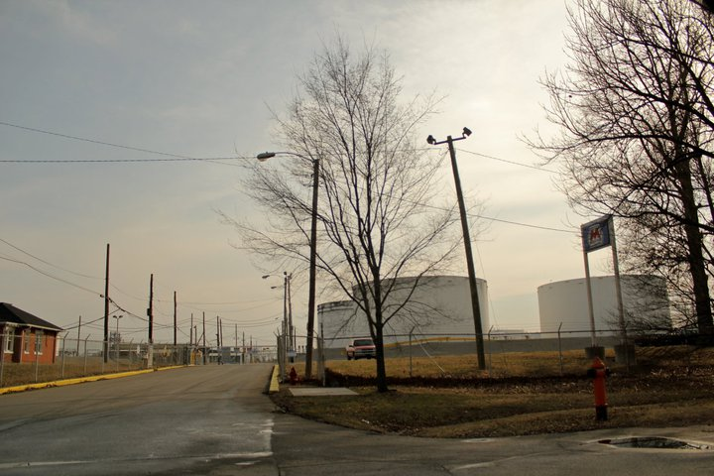
Questions?

