Slide 1
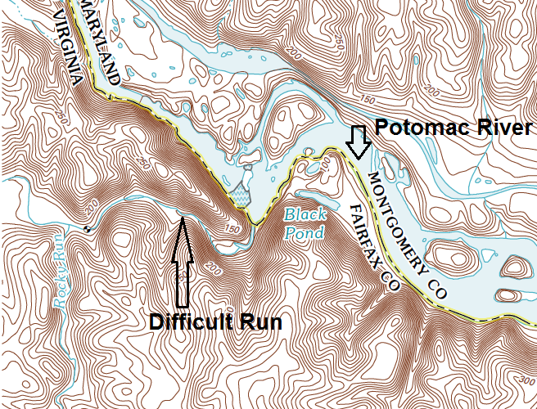
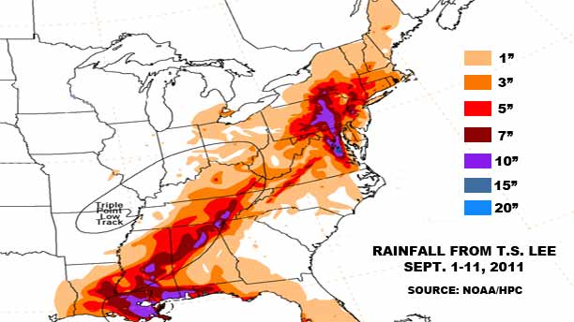
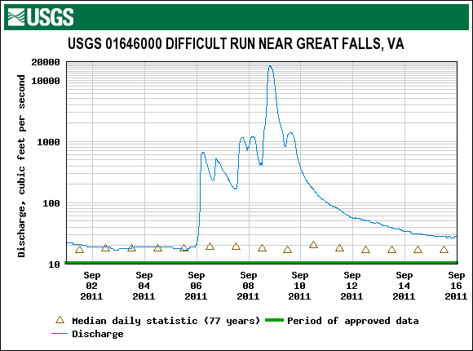
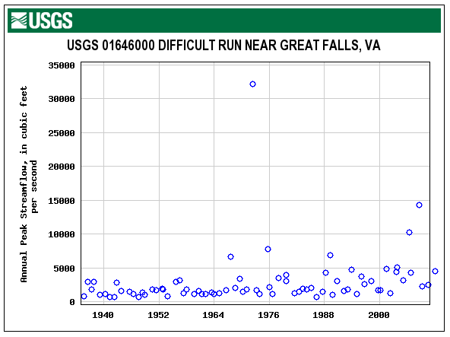
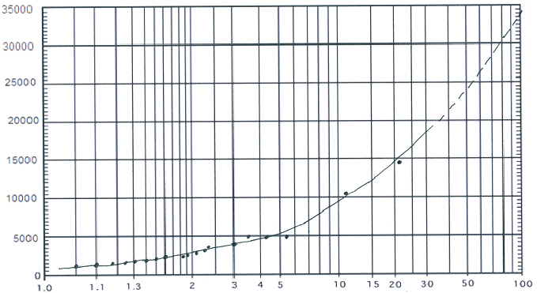
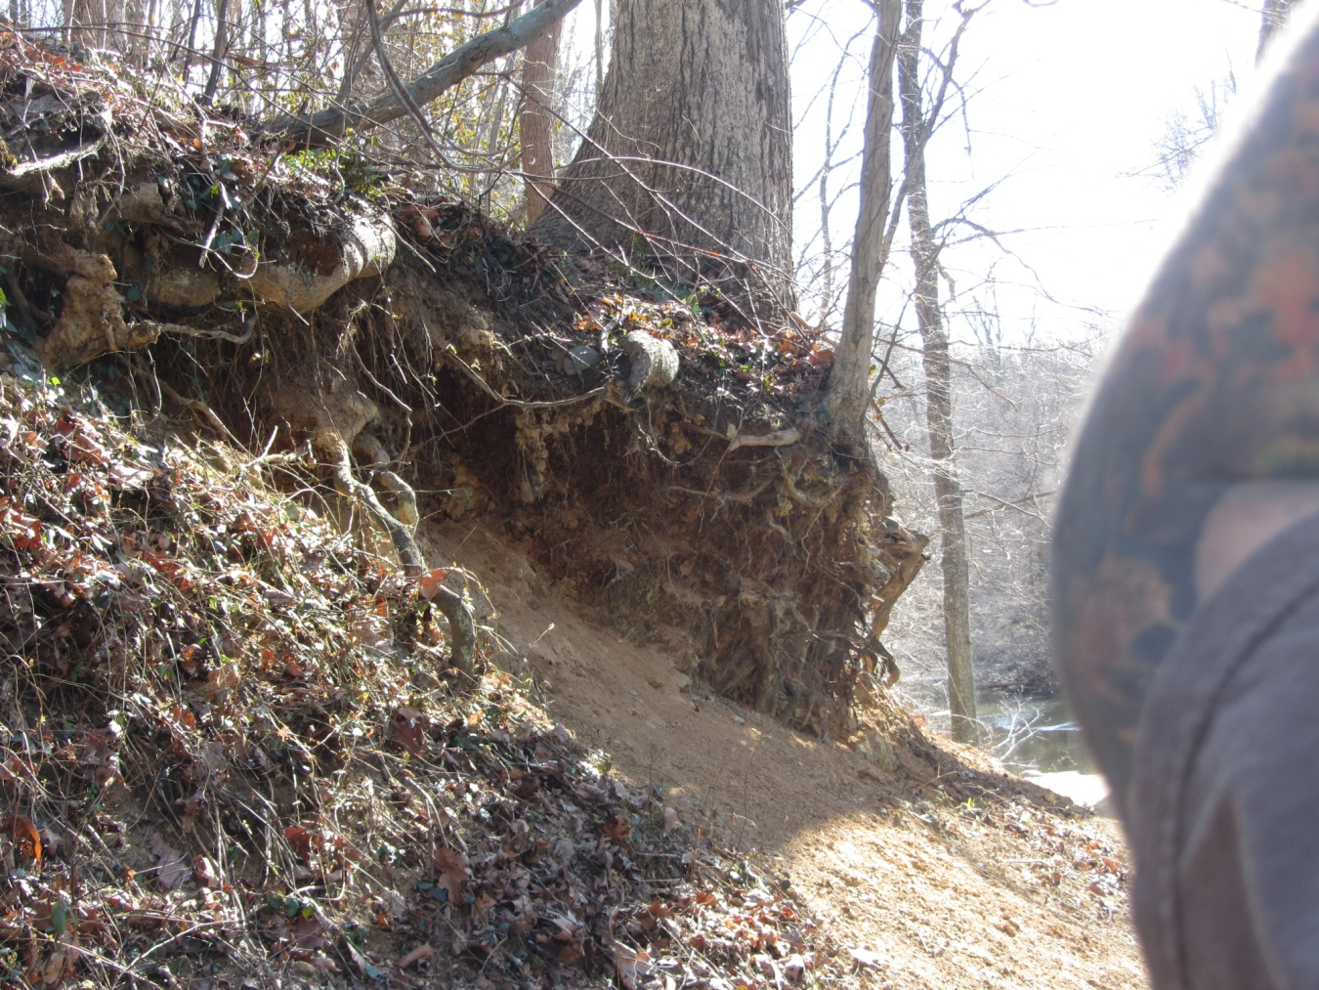
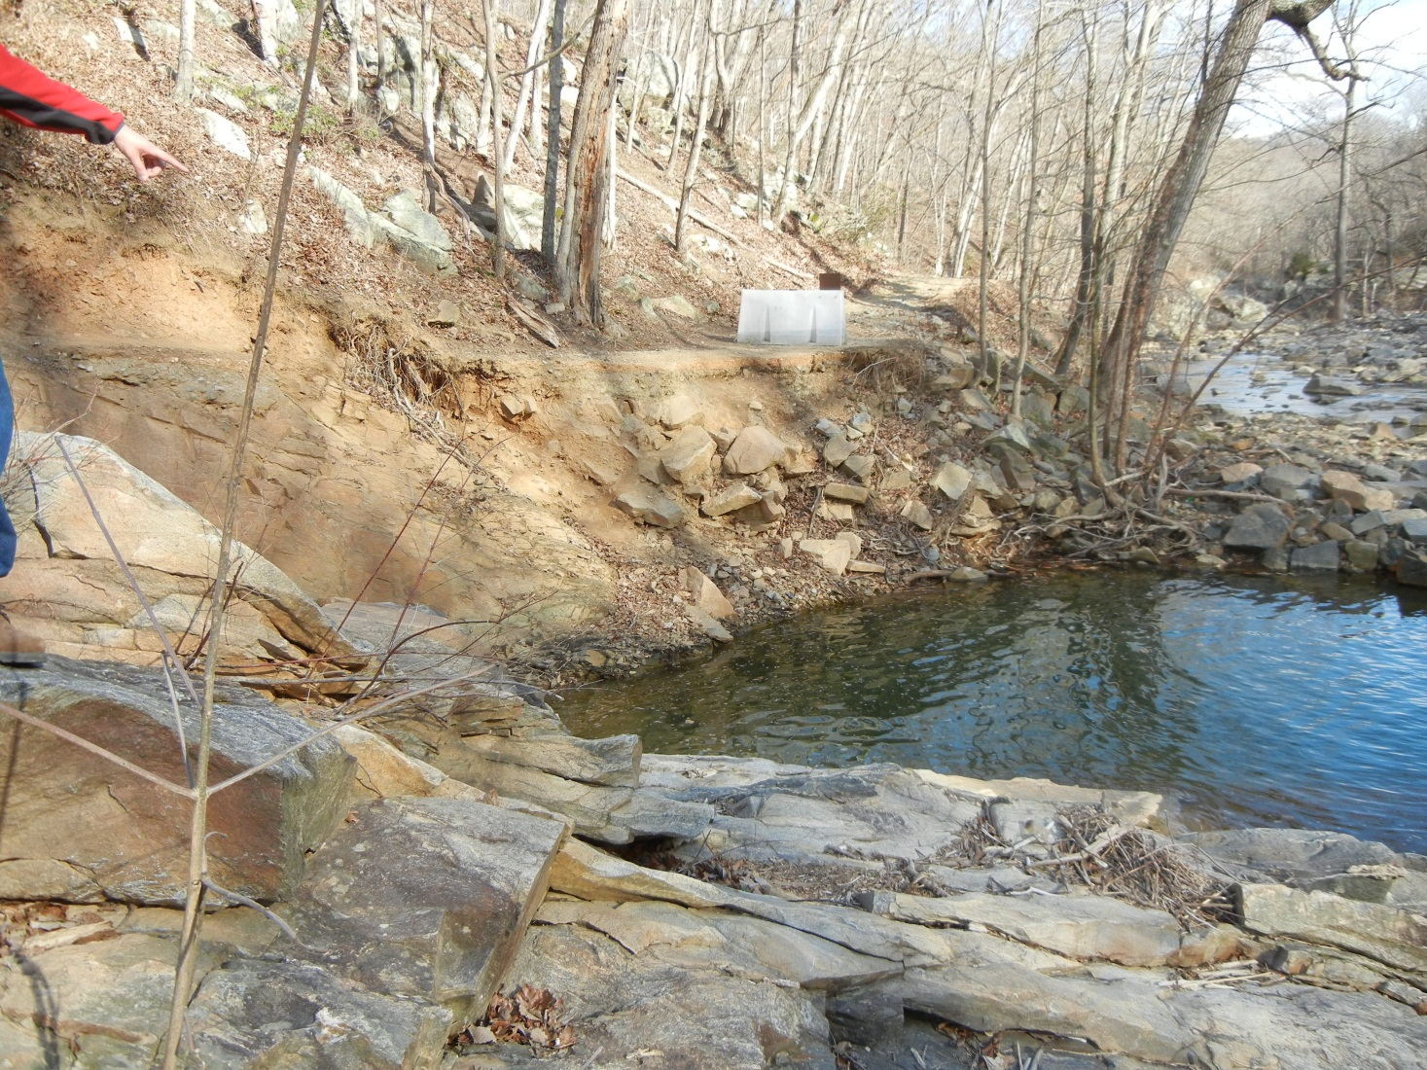
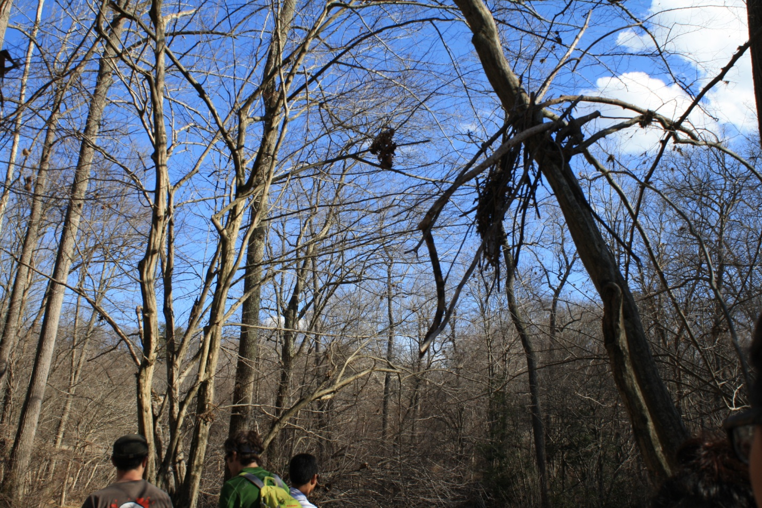
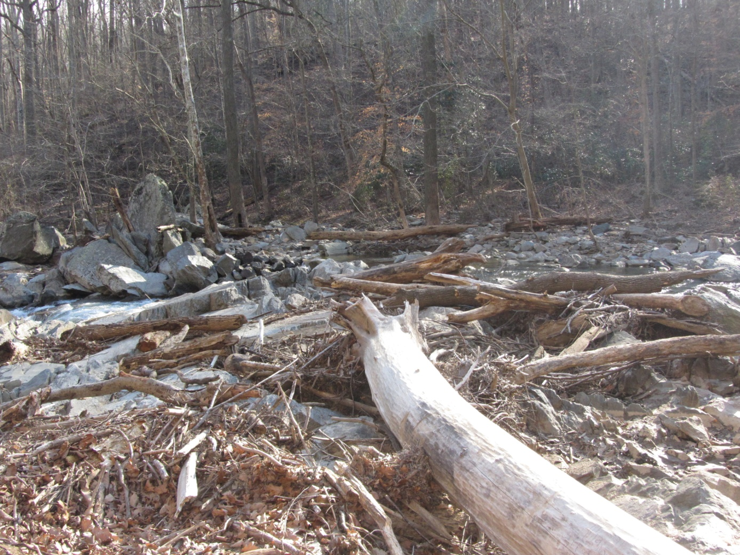
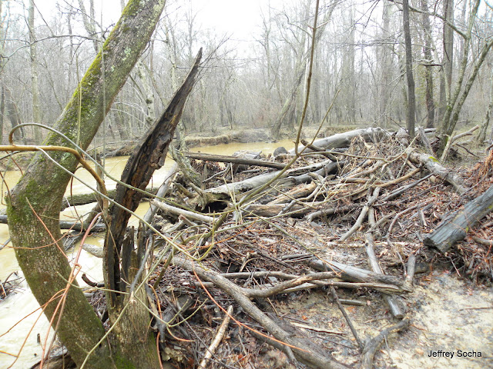
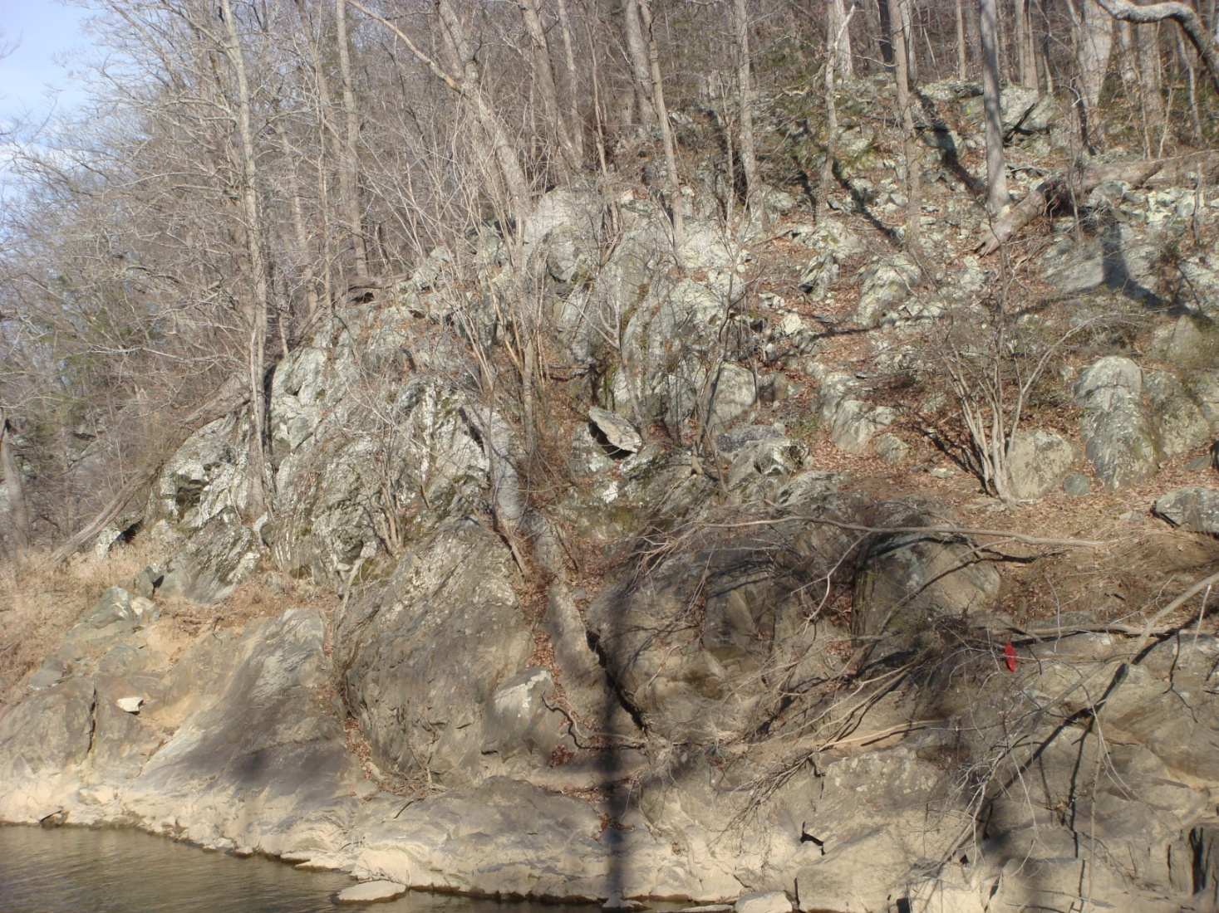
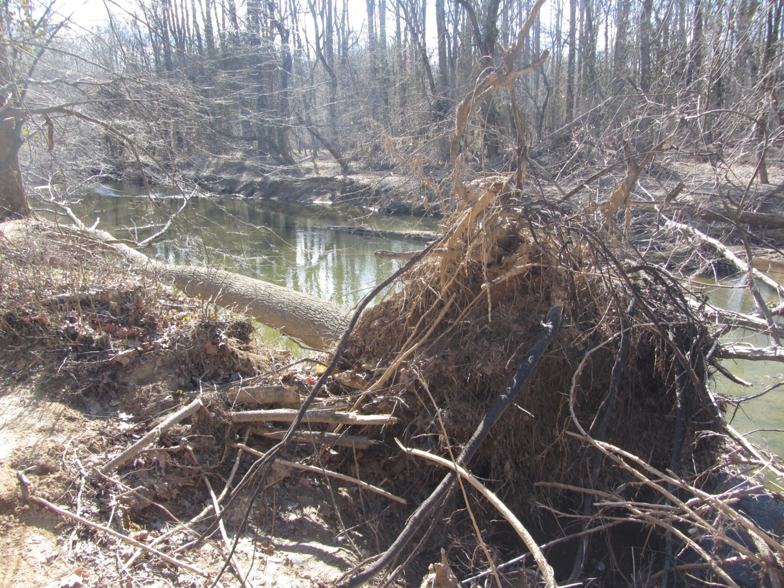

Difficult Run Photo Journal
Flooding Caused by Tropical Storm Lee
Great Falls,
VA
Difficult Run is a tributary of the Potomac River located near Great Falls, VA. The tributary channel is cut through very resistant late Pre-Cambrian age meta-sedimentary rocks. The stream periodically floods as it did in September, 2011 when Tropical Storm Lee moved through the area. Significant erosion resulted which the students captured in a photo journal during a field trip to the stream. The project included the incorporation of different types of data and field observations including:
NOAA weather data
USGS digital topographic map data
USGS Stream Gauge information
  Daily Statistics
  Historical Peak Flow
Calculation of Flood Recurrence Interval
Final comparison with historical flood data
Flood Frequency
Calculations
 | Peak Date | Discharge cfs | Rank | Recurrence Interval (Years)
 | 4/22/1992 | 1560 | 18 | 1.17
 | 03/04/1993 | 1840 | 15 | 1.40
 | 11/28/1994 | 4720 | 6 | 3.50
 | 1/20/1995 | 1110 | 20 | 1.05
 | 1/19/1996 | 3660 | 9 | 2.33
 | 10/19/1997 | 2570 | 12 | 1.75
 | 3/21/1998 | 3030 | 11 | 1.91
 | 9/16/1999 | 1680 | 16 | 1.31
 | 4/17/2000 | 1650 | 17 | 1.24
 | 8/11/2001 | 4830 | 5 | 4.20
 | 4/28/2002 | 1240 | 19 | 1.10
 | 9/23/2003 | 4400 | 7 | 3.00
 | 12/11/2004 | 5070 | 3 | 7.00
 | 3/28/2005 | 3170 | 10 | 2.10
 | 6/26/2006 | 10200 | 2 | 10.50
 | 11/16/2007 | 4270 | 8 | 2.60
 | 9/6/2008 | 14300 | 1 | 2.10
 | 5/26/2009 | 2270 | 14 | 1.50
 | 8/18/2010 | 2520 | 13 | 1.62
 | 9/8/2011 | 4860 | 4 | 5.25
Tropical Storm Lee
Discharge (cfs)
Tropical Storm Lee
Severe Erosion
Trail is washed out
Recurrence Interval (years)
All photos taken by students in NOVA
Environmental Geology, Spring 2012
Large tree down
Debris
In a tree! Indicates water level.
Trees Vertical
Flood level
Debris Pile
Trees Horizontal
Trees bent –
Debris Pile
Shelley Jaye

