Slide 1
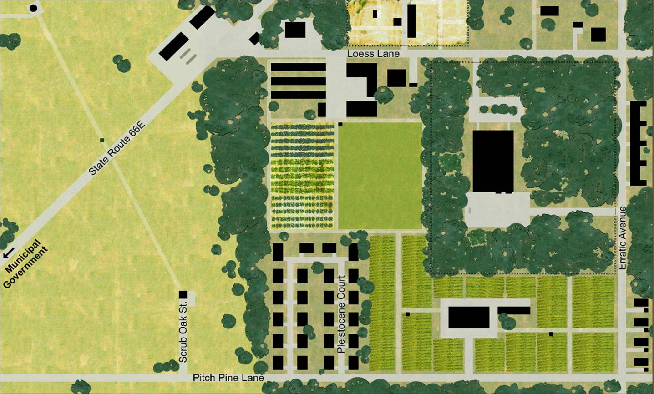
Using Brownfield Action:
A Virtual Tool for Environmental Site Assessment
Larry Lemke
Wayne State University
Acknowledgements:
Dr. Peter Bower, Barnard College
Columbia University Center for New Media Teaching and Learning
Gianluca Sperone, Wayne State University

Slide 2
Brownfield Action Overview
Web-based Simulation
  Virtual Town of Moraine
  25 locations, 45 characters, >2 million subsurface data points
Subsurface Investigation
  seismic reflection and refraction,
  ground penetrating radar
  magnetometry and metal detection
  drilling and direct push
  soil gas, groundwater, and sediment sampling

Slide 3
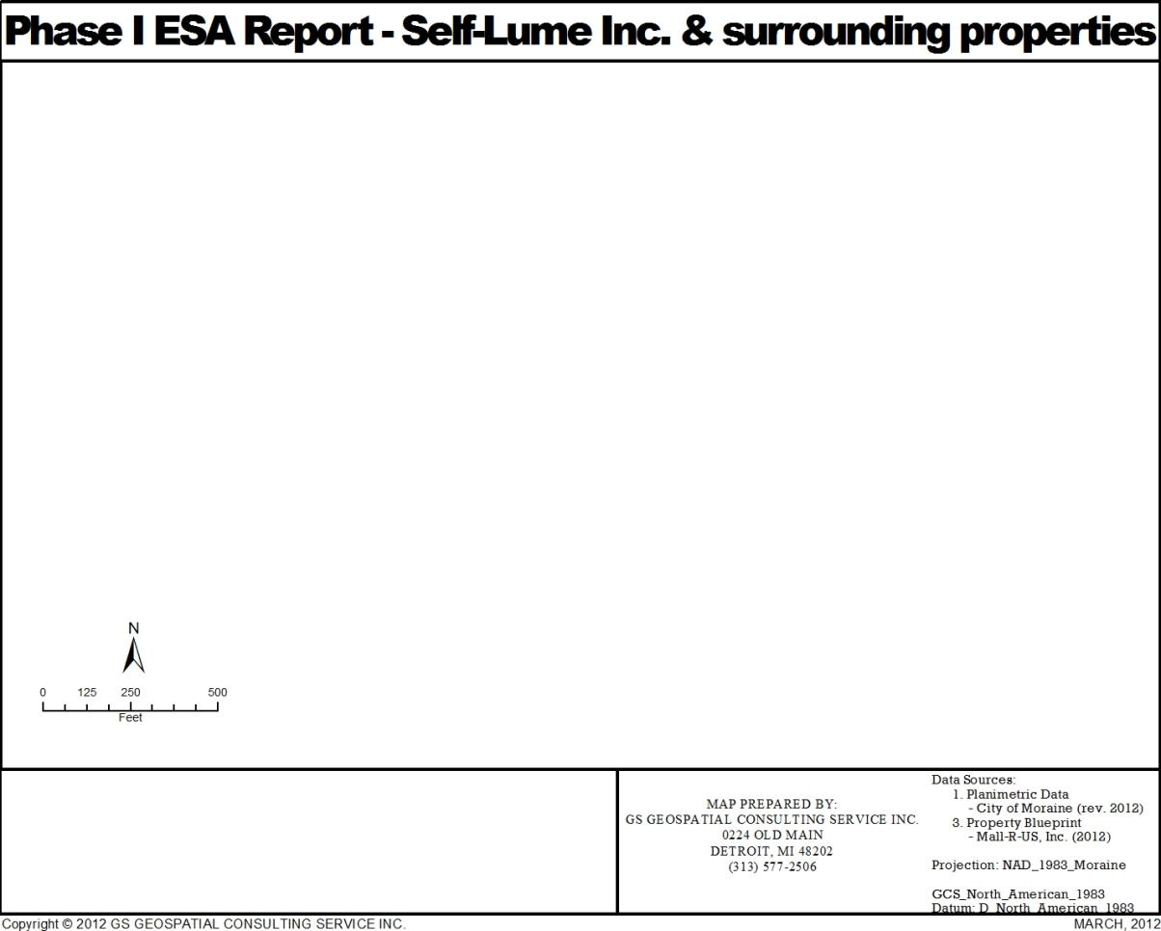
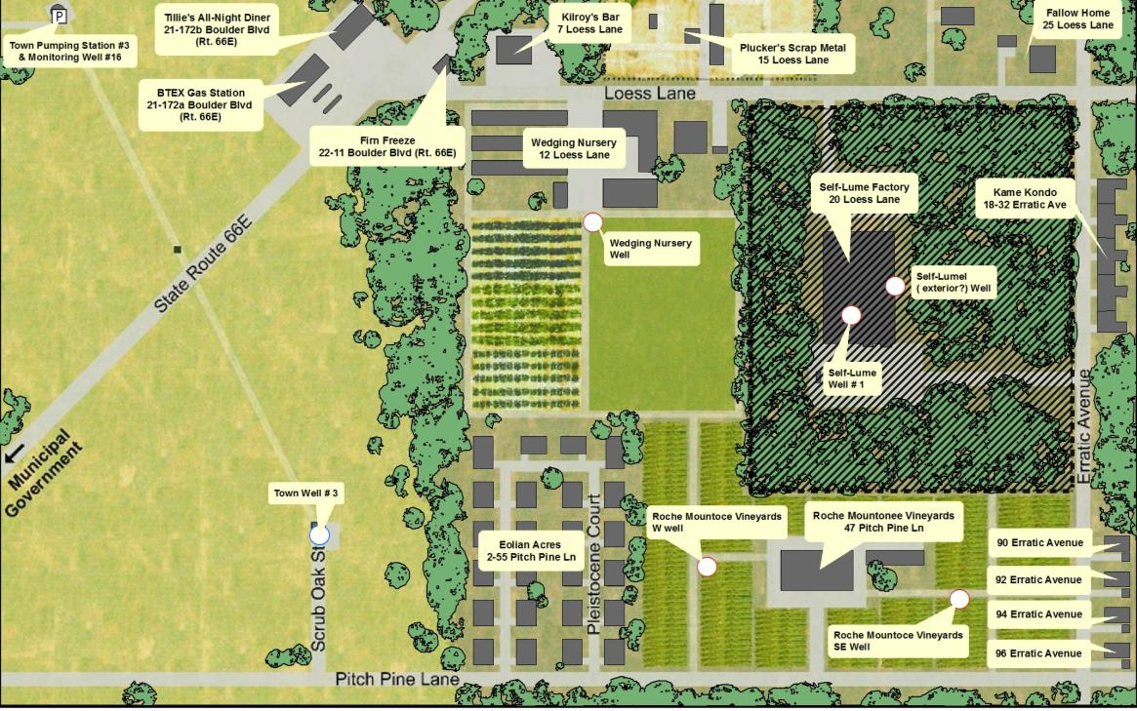

Self-Lume Investigation
0
125
250
500
Feet

Slide 4
BA Potential Uses
Problem-based Learning
Environmental Site Assessment
  Undergraduate Environmental Science Courses
  Graduate Level Geologic Site Assessment
Groundwater Hydrology
  Undergraduate Hydrology
    Porosity, Permeability, Hydraulic Conductivity
    Three point problems
  Contaminant Fate and Transport
High School Environmental Science

Slide 5
Phase I ESA (ASTM E1527-05)
Objectives:
  Identification of RECs
  All Appropriate Inquiry → CERCLA liability defense
Formal Procedure
  Site Reconnaissance, Document Review, Interviews
  No Subsurface Testing Allowed!
Maps:
  Surface Topography
  Water Table Elevation
  Bedrock Elevation

Slide 6
Phase II ESA (ASTM E1903-11)
  Objectives: To be determined! (Role Play)
    User Goals and Objectives
    Identification of RECs to be investigated
    Specific questions to be answered
    Conceptual model for target analytes
    Hypotheses to be tested
    Sampling plan
    Budget
  Subsurface Investigation
Scientific Method

Slide 7
Demonstration
www.brownfield.org

Slide 8
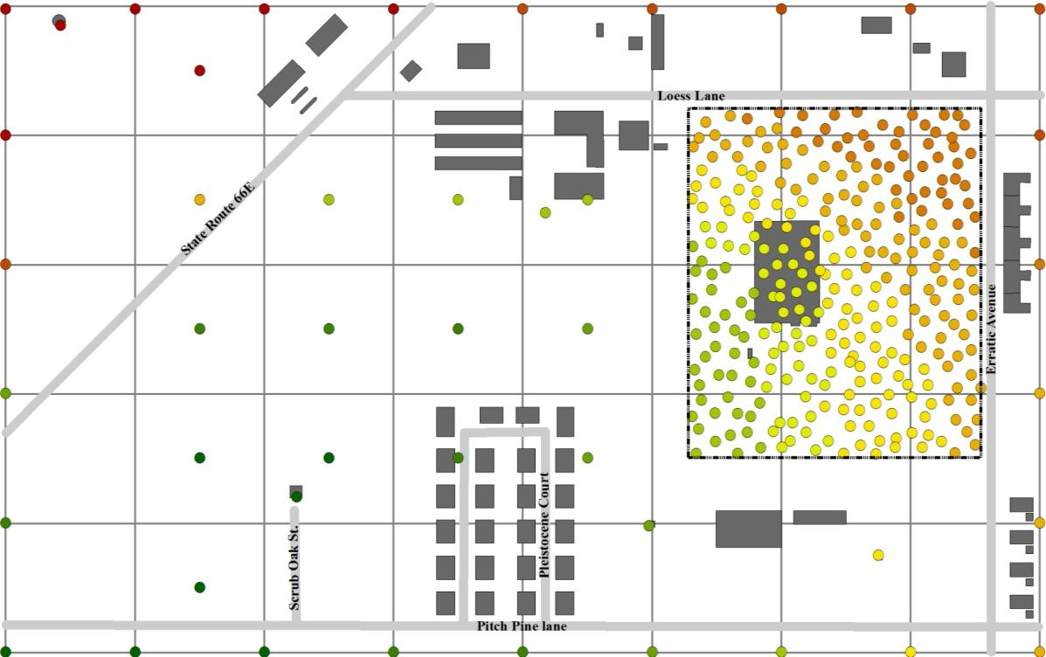
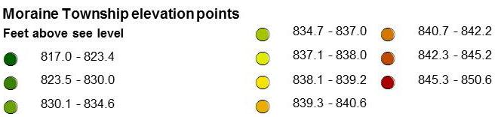
Topography
Topographic Map Construction
400ft

Slide 9
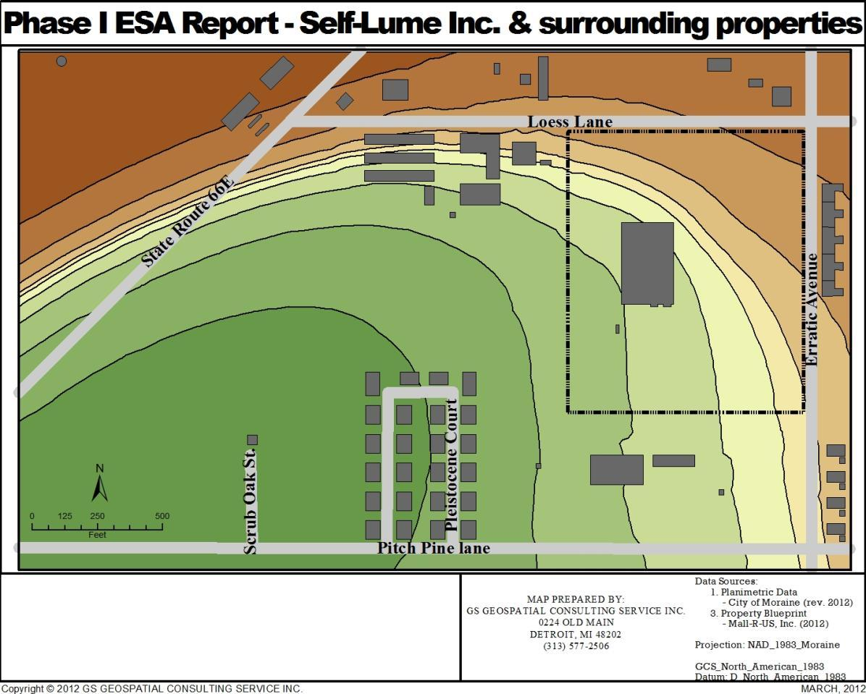
Topography
Morain Township Elevation
834.1 - 837.1
839.7 - 840.4
Feet above see level
837.1 - 838.5
840.4 - 841.9
817 - 828.4
838.5 - 839.3
841.9 - 844.8
828.4 - 834.1
839.3 - 839.7
844.8 - 850.6

Slide 10
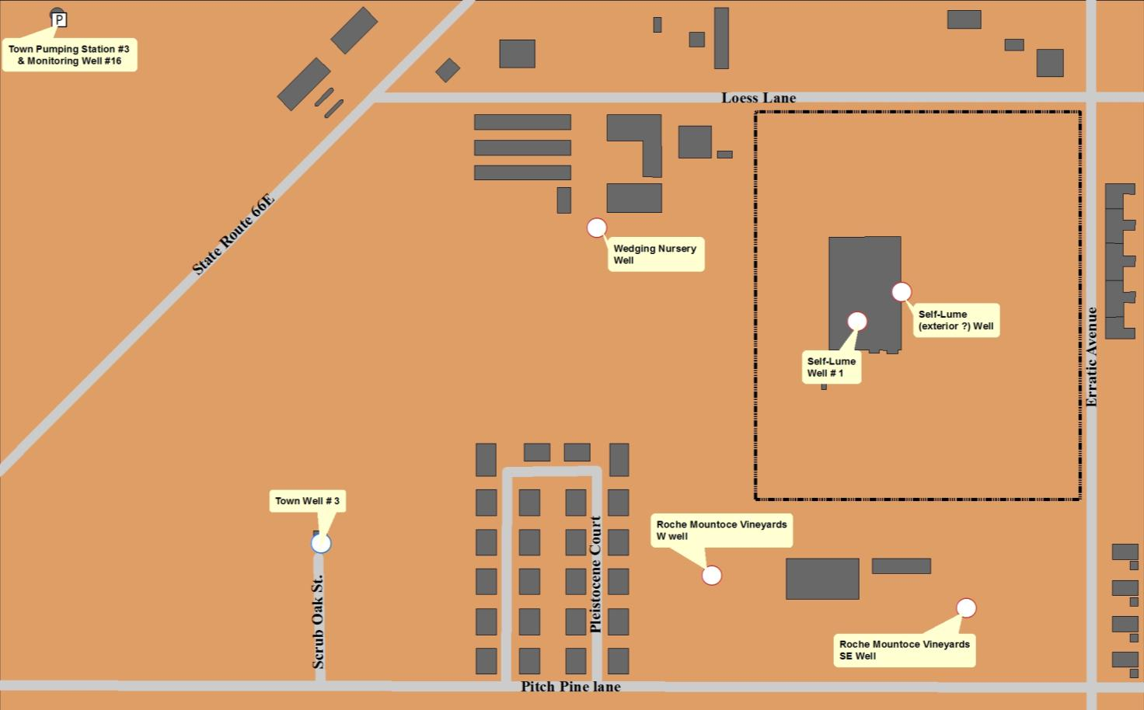
Water Well Data
Name | Elevation | Bedrock | Water Table | X | Y
Town Pumping Station #3 & Monitoring Well #16 | 850.2 | 719 | 807.28 | 169.999976 | 1940.000108
Town Well # 3 | 821.8 | 639.5 | 805.99 | 900.000157 | 480.000075
Wedging Nursery Well | 835.6 | 670.5 | 806.86 | 1669.999929 | 1359.999955
Roche Mountoce Vineyards W Well | 834.4 | 685 | 806.79 | 1989.999945 | 389.999927
Roche Mountoce Vineyards SE Well | 838.4 | 702 | 807.32 | 2699.999837 | 300.000107
Self-Lume( exterior?) Well | 838.4 | 670.5 | 807.2 | 2519.999869 | 1179.999987
Self-Lume Well # 1 | 837.4 | NA | 807.8 | 2396.233057 | 1099.463403

Slide 11
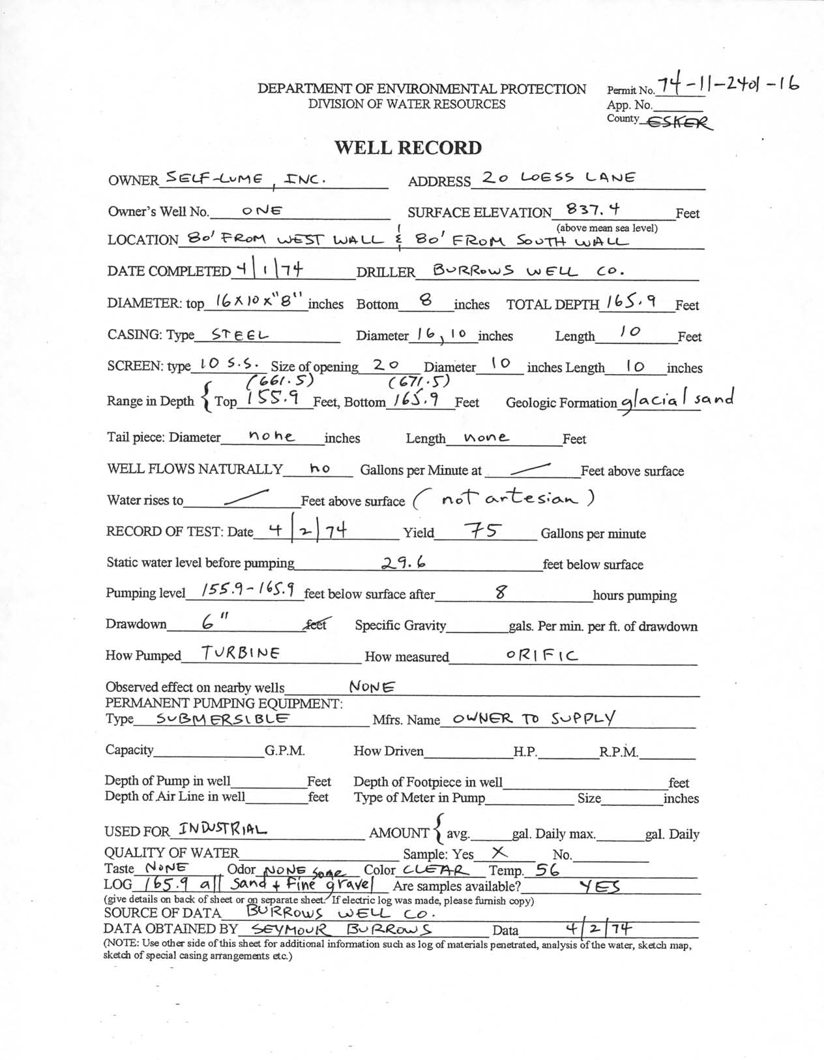
Subsurface Description
Sand & Gravel Observed Thickness Range

Slide 12
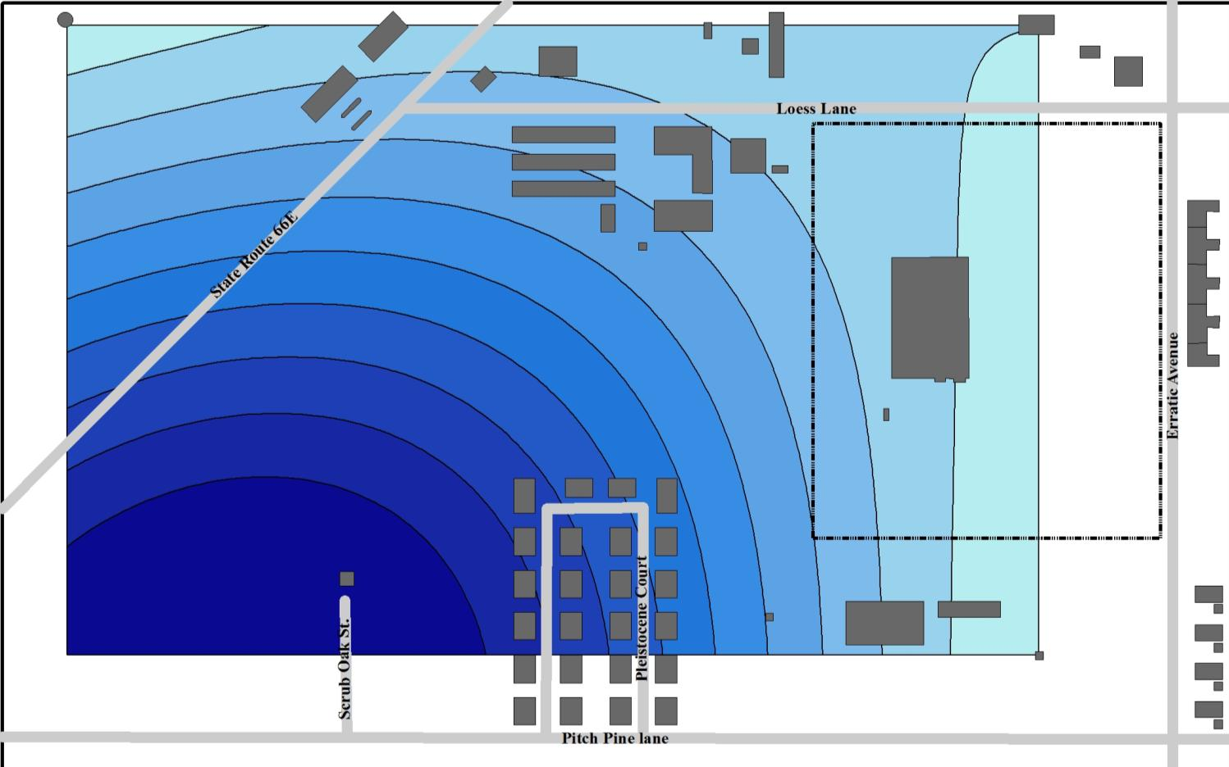

Aquifer description
Water Table Map
Morain Township
Water Table Elevation
806.3 - 806.4
806.8 - 806.9
Feet
806.4 - 806.5
806.9 - 807.1
0
125
250
500
806 - 806.1
806.5 - 806.7
807.1 - 807.2
Feet
806.1 - 806.3
806.7 - 806.8
807.2 - 807.3

Slide 13
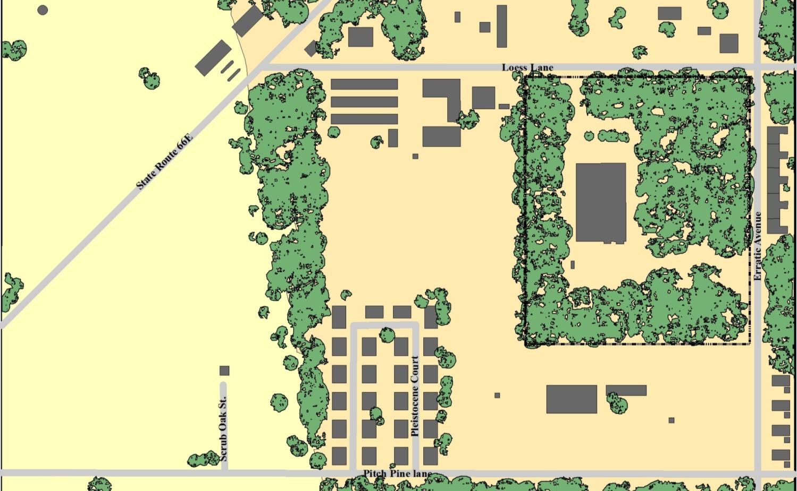
Potential Recognized Environmental Conditions
Barrels
BTEX UST
?
Oil UST
Gasoline UST
Landfill
Pesticides use

Slide 14
Potential Recognized Environmental Conditions
Barrels
BTEX UST
?
Oil UST
Gasoline UST
Landfill

Slide 15
Areas for potential Recognized Environmental Conditions

Slide 16
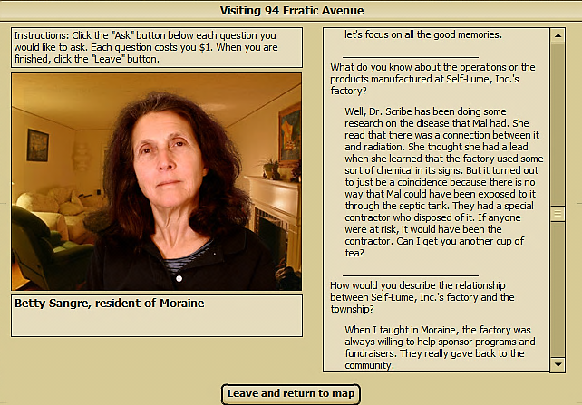
Of Particular Attention
Possible
Septic Tank

Slide 17
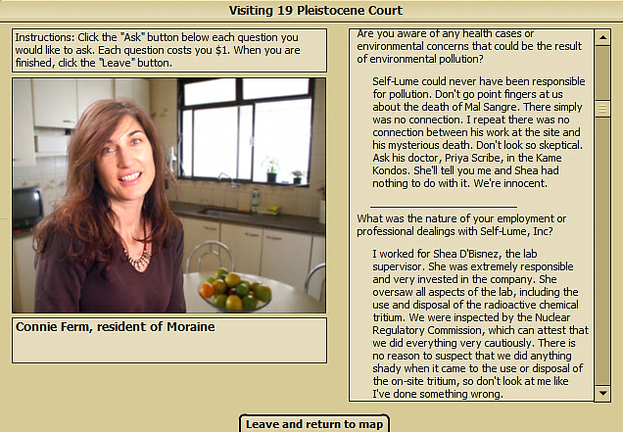
Of Particular Attention
Possible
Septic Tank

Slide 18
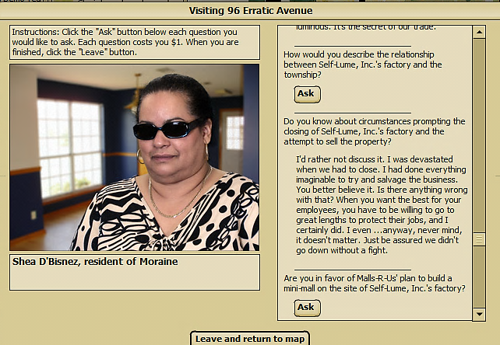
Of Particular Attention
Possible
Septic Tank

Slide 19
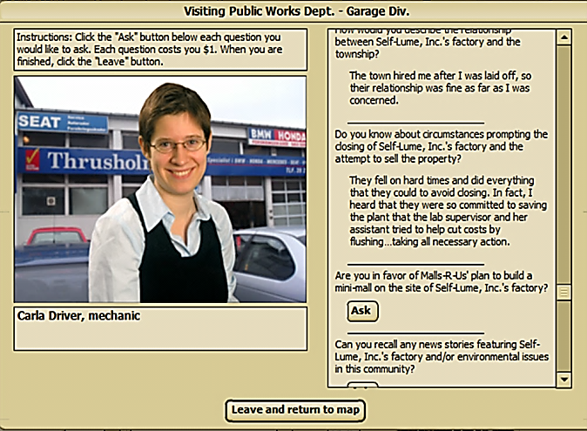
Of Particular Attention
Possible
Septic Tank

Slide 20
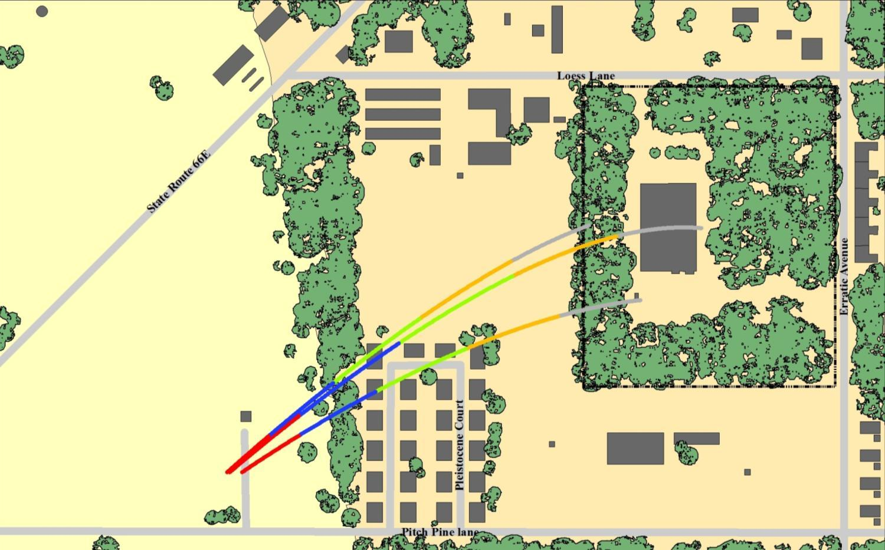
Rationale for Phase II ESA
Potential Tritium release
time path
Potential Oil release
time path
Potential Gasoline release
time path
Years
Years
Years
0.05 - 4.20
0.07 - 6.17
0.04 - 3.81
4.21 - 8.35
6.18 - 11.58
3.82 - 7.44
8.36 - 12.50
11.59 - 16.55
7.45 - 11.06
12.51 - 16.65
16.56 - 21.66
11.07 - 14.94
16.66 - 20.81
21.67 - 27.64
14.95 - 19.38
0
125
250
500
Feet
Notes:
A quick view of the ArcGIS Platform…
Desktop GIS
spatial data management occurs here
analysts and designers work on GIS datasets and author maps that can be printed or published
Server GIS – allows analysts to make the GIS datasets accessible to other parts of the organization
Online GIS
provides a resource of ready-made services that can be leveraged in Desktop or Server applications
authored and served using Desktop and Server applications
We’ve been able to publish services for a # of years, but at 9.2 we’ve made this process much more accessible.
Many of these improvements have been based on client feedback.

Slide 21
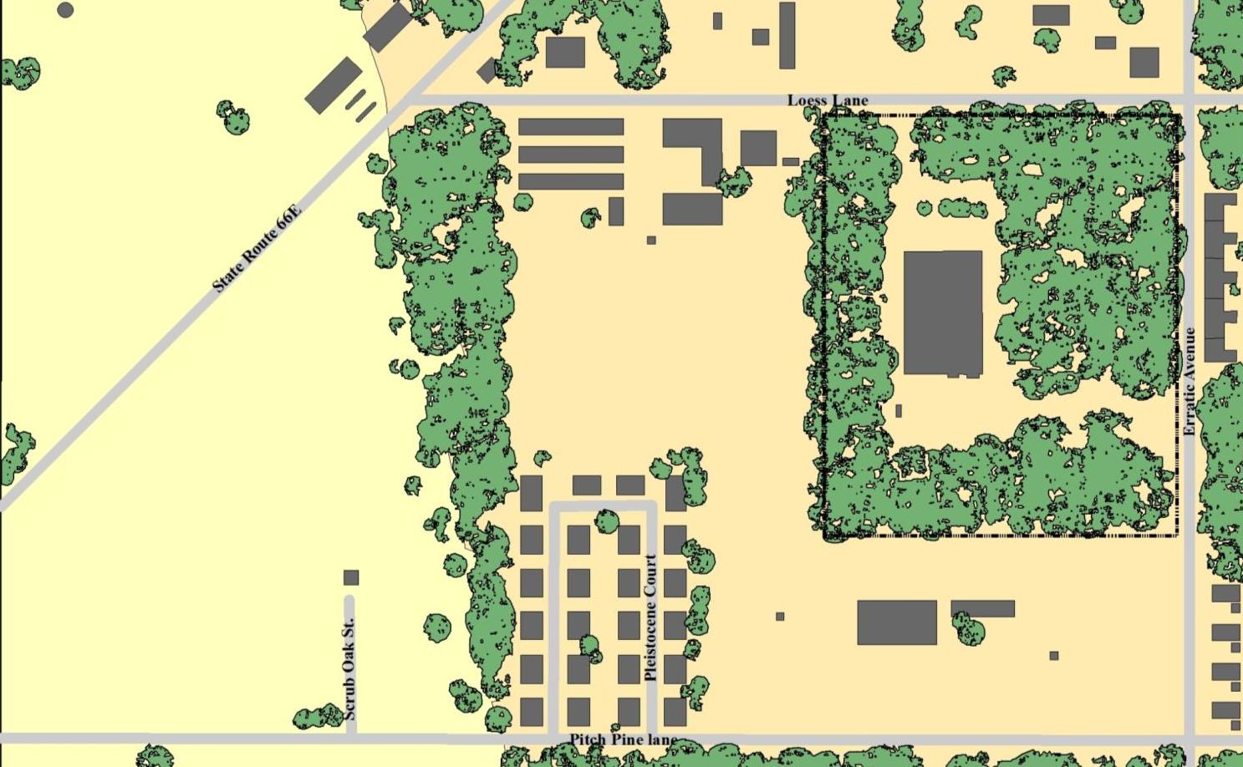
Rationale for Phase II ESA
0
125
250
500
Feet

Slide 22
Nuts and Bolts

Slide 23
Resources
http://brownfieldaction.org
Peter Bower, Barnard College
Khoi Nguyen Truong
Educational Technology Project Manager
Columbia Center for New Media Teaching and Learning
Tel: (212) 854-1851
Email: ccnmtl-bfa@columbia.edu

