Slide 1
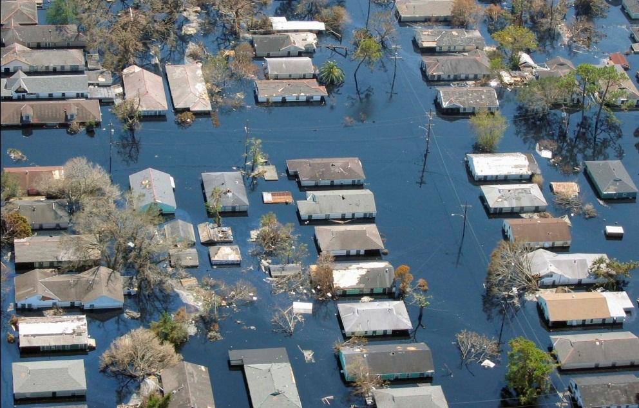
A Tale of Two Cities (and two hurricanes)
Part 2: New Orleans
SSCAhaz.TCJ.11
How Miami and New Orleans suffered Andrew and Katrina
Close
×
The module you are viewing is a Powerpoint slide presentation.
Navigate from slide to slide using the up/down arrow keys, or, if available, the scroll bar on your mouse
Use the mouse to select hyperlinks (underlined, in blue type) or to pass through embedded flash animations
When done, use the escape key to exit the presentation.
You can and probably should have a spreadsheet open in a separate window, so you can try out things that are explained in the presentation.
Powerpoint applications use lots of memory, so you may want to exit other programs while running this presentation, especially if it starts to act slowly or sluggishly.
Close this window to proceed with the slide show.
Photo from NOAA
Core Quantitative Issues
Rate, Cumulative rate
Supporting Quantitative Issues
Unit conversion
Core Geoscience Issues
Hurricanes, Subsidence
Thomas Juster
Department of Geology, University of South Florida
© 2011 University of South Florida Libraries. All rights reserved.

Slide 2
How this works
This PowerPoint presentation provides the instructions for an auto-grading Excel spreadsheet requiring you to complete several tasks. The spreadsheet is a separate companion file you should open and complete while you are viewing this slideshow. When you’ve successfully finished the spreadsheet you’ll be given a secret code that contains your name and score, which you’ll submit to your instructor to receive a grade.
The companion spreadsheet file is an Excel 2007/2010 macro-enabled spreadsheet file. The file may or may not work with earlier versions of Excel (e.g., 2003)—so use these at your own risk. Note that you must agree to enable macros in order to run the spreadsheet (you will be prompted when you first try to run it). If you do not agree to run macros, or your computer for some reason prevents them from running, you will not be able to complete this activity. The spreadsheet file will not work on Apple computers or iPads.
In order to receive any credit for this activity you must complete the preliminary tasks in order, must complete each one perfectly, and must complete all of them. The spreadsheet helps you succeed by giving feedback on wrong answers. Once you have completed the preliminary tasks you will be presented with one final task and given the opportunity to submit your grade to the code generator. You can submit your grade at any time during the final task, but of course you’ll probably want to wait until you’ve completed it perfectly and earned 100%.

Slide 3
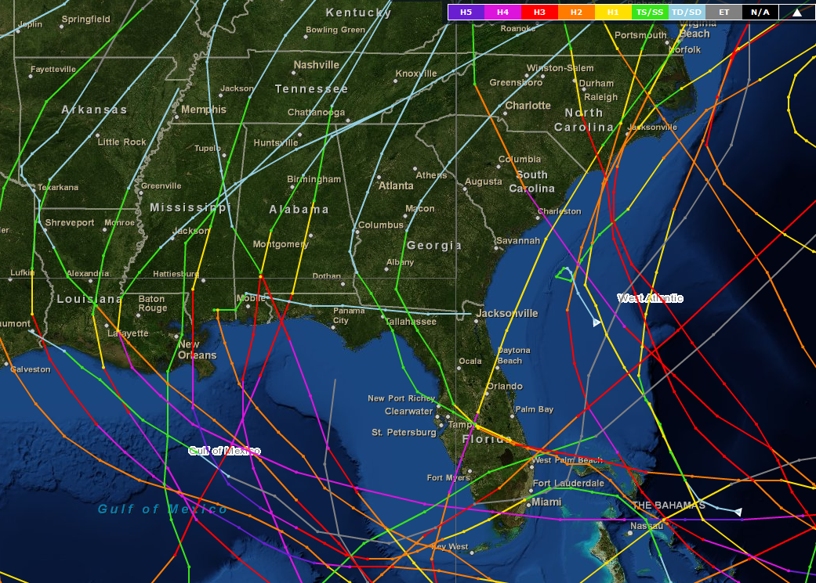
Hurricanes and the southeastern US
Hurricanes are a fact of life in the southeastern US, as residents of Atlantic and Gulf of Mexico coastal communities know all too well. These tropical systems, which develop over the warm waters of the southern Atlantic, Caribbean, and Gulf of Mexico, are most active during the months of August through October.
This map, from the National Oceanic and Atmospheric Administration (NOAA) shows the tracks of all major hurricanes (Cat-3 and above) in the southeastern US from 1888-2008 (only 20 years of data!).
Notice there are three places were the hurricane tracks converge: the southern Gulf coast, south Florida, and coastal North Carolina. In this module you will learn about why hurricanes pose such a threat to New Orleans.
Hurricanes are graded in intensity by the Saffir-Simpson intensity scale, from Cat-1 (sustained winds 74-95 mph) to Cat-5 (sustained winds > 155 mph). Notice the hurricane tracks on this figure are color-coded by their intensity.

Slide 4
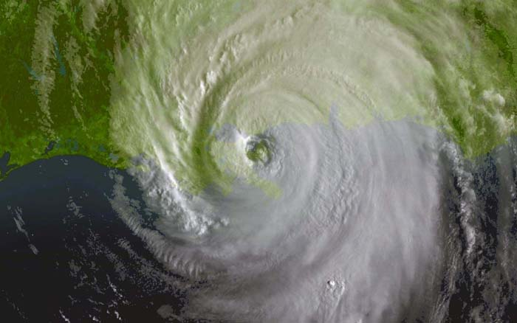
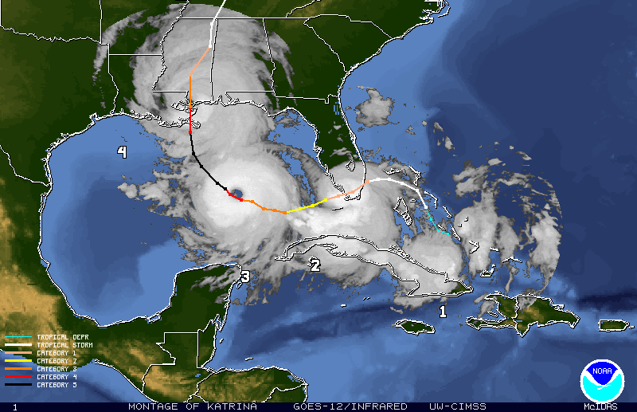
New Orleans and Katrina
Hurricane Katrina in 2005 was the most costly natural disaster in US history. Unlike Andrew, there was ample warning that a ferocious hurricane was building at sea and was predicted to make landfall new Orleans. It became a hurricane on August 25th, made landfall in the Bahamas, and then entered the Gulf of Mexico where it intensified from a Cat-3 to a Cat-5 hurricane in only nine hours. Fortunately, the hurricane weakened from its peak strength as it drove north, and made landfall as a Cat-3 hurricane early in the morning on August 29th just east of New Orleans—nearly exactly where it was predicted to strike.
Unlike Andrew, Katrina was a giant, with hurricane-force winds extending over 120 miles from the center.
Images from NOAA

Slide 5
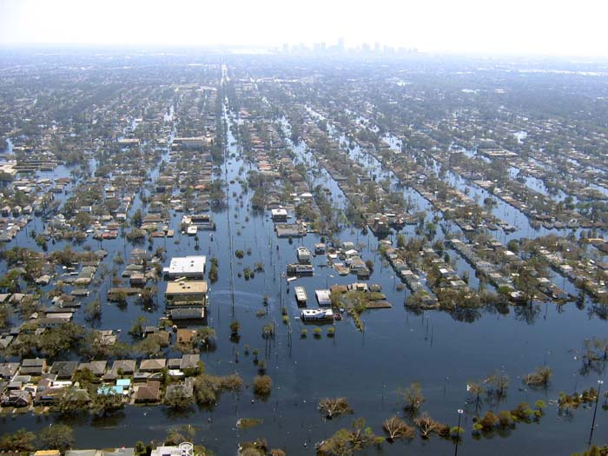
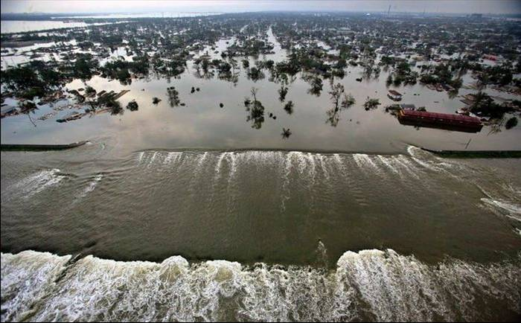

New Orleans and Katrina
Although Katrina made landfall as a weakening Cat-3 hurricane, the damage was devastating, as levees protecting the city from rising waters failed. The storm surge was estimated at over 8 meters (25 feet)! Over 1,800 people lost their lives, and property damage exceeded $81 billion dollars. Over 80% of the city was flooded, and 75% of its homes were damaged.
Photos from NOAA and Tuilane University

Slide 6
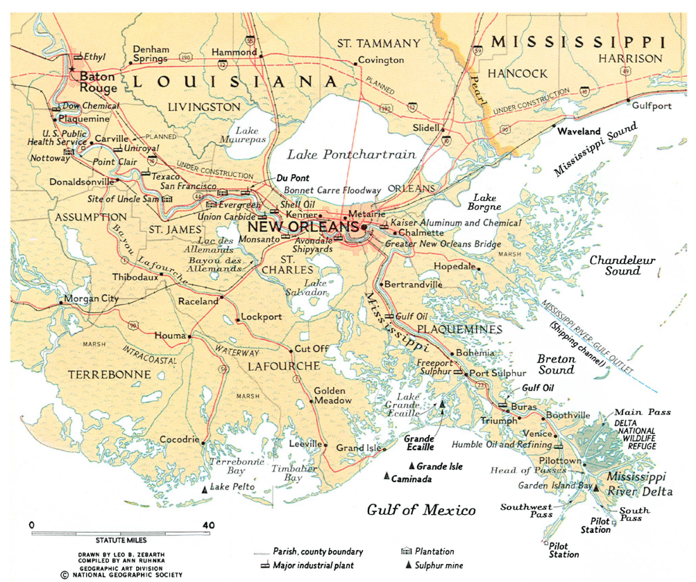
New Orleans, stuck between a rock and a hard place!
Such flooding had happened before. New Orleans is at risk at flooding from two sources: the Mississippi River, to the south and Lake Ponchartrain, to the north.
The Mississippi River has the largest watershed of any US River, and all of the water passes by New Orleans.
Lake Ponchartrain is connected to the Gulf of Mexico through Lake Borgne. Storm surges from the Gulf are immediately felt here.
from Rodgers (2008)

Slide 7
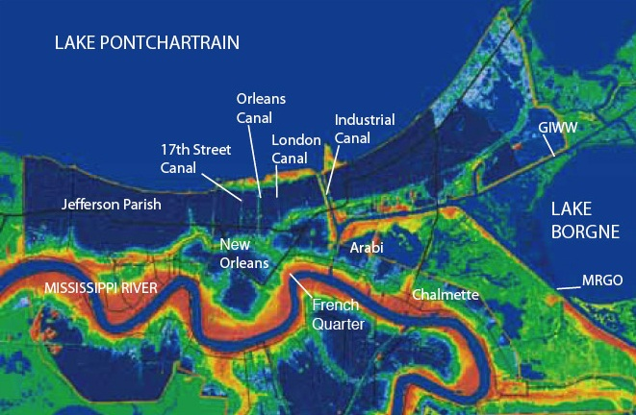
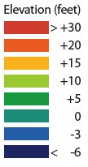
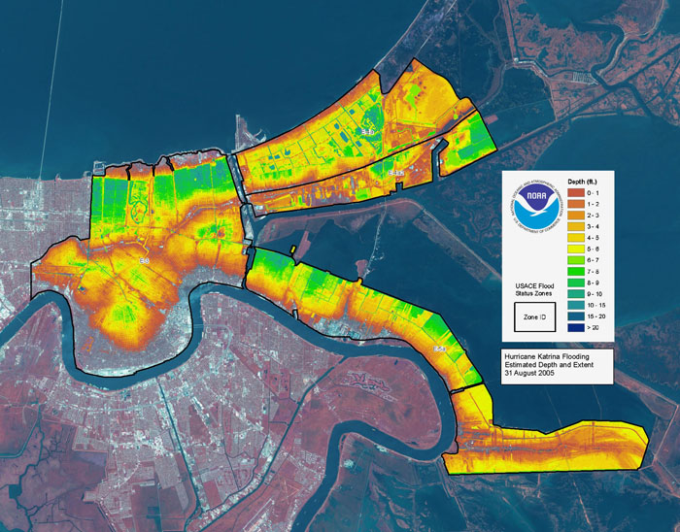
New Orleans, the city below sea level
As should now be obvious, New Orleans is prone to flooding damage because much of the city lies below sea level—in fact, pumps are needed constantly to keep it dry. Click on the boxes to toggle between an elevation map of New Orleans and a map showing the amount of flooding during Katrina.
Images from LSU, NOAA
Elevation map
Flooding map

Slide 8
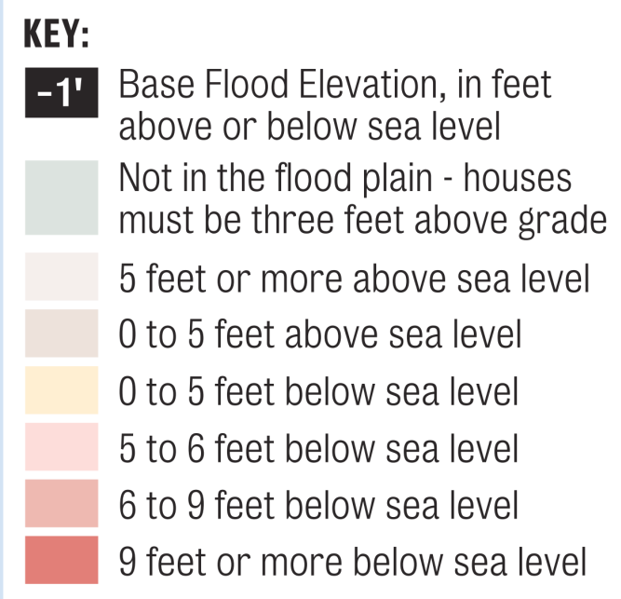
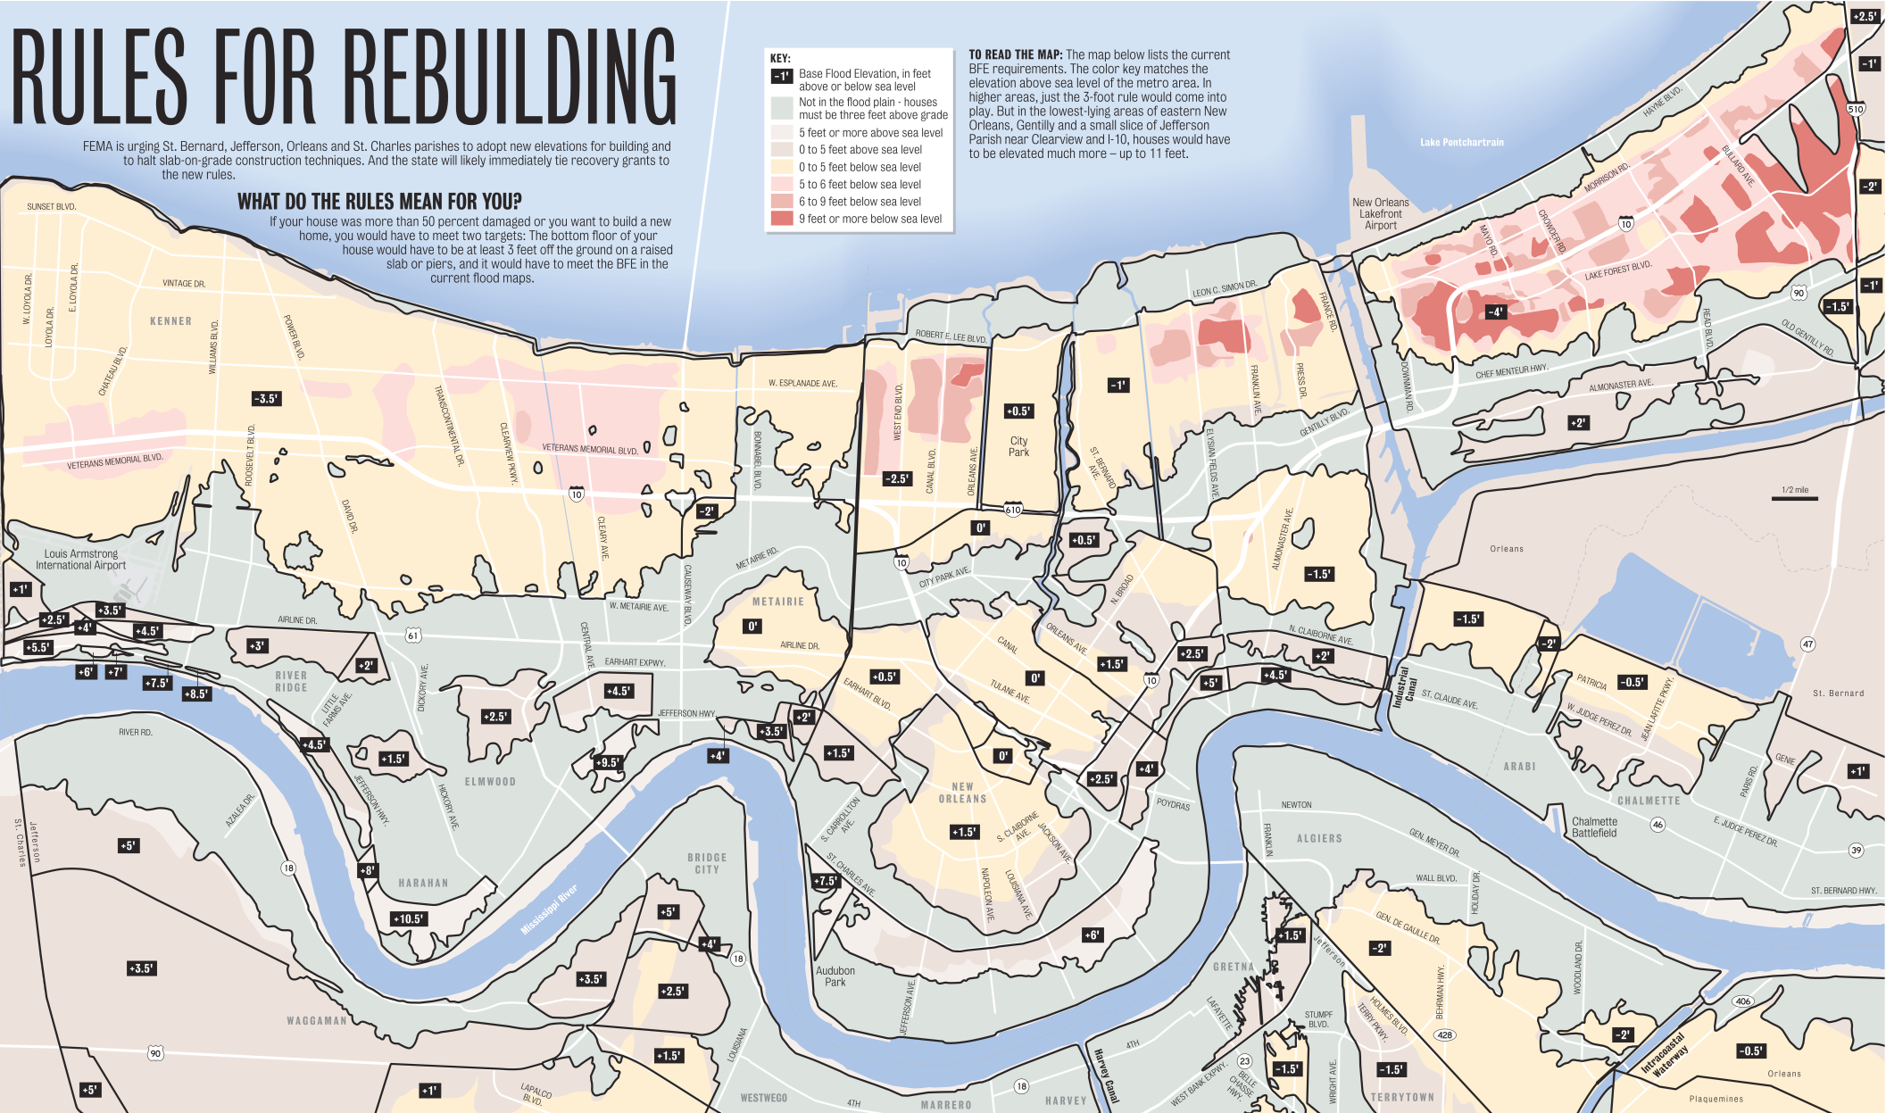
Elevations in the city of New Orleans
This map, from FEMA, shows the elevations in New Orleans in 2005. Which areas are lowest?

Slide 9
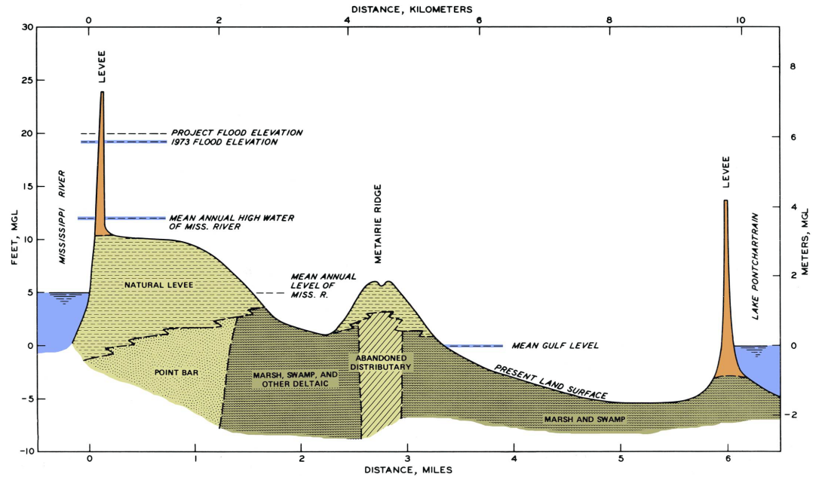
A cross section through New Orleans
Here’s a cross-section through New Orleans, from the Mississippi River on the left to Lake Ponchartrain on the right.
Notice the vertical scales are different: in feet on the left, and meters on the right.
The natural levees are formed during flooding events, when the river deposits sediment as it overflows its banks.
from Rodgers (2008)
All of this area is below present sea level. When it floods the water can’t drain on its own, and needs to be pumped out.

Slide 10
The Big Question: Why is New Orleans so low?
The big question you will answer in this module is: why is New Orleans so low, and therefore at such great risk from flooding? The short answer is much of the land has subsided, or sunk, in the past 250 years, especially the last 50. The original elevations of the city prior to development probably looked much like the red line in the figure below:
Elevation in 1718
from Rodgers (2008)
So here’s the big question: What has caused New Orleans to sink?

Slide 11
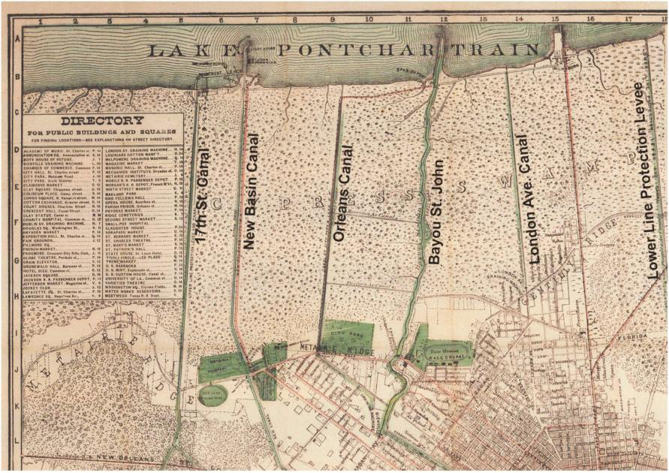

Draining the swamps
When the French founded New Orleans in 1718 they built on the natural levees, because these were the only areas high enough to settle. By 1890, however, the desire for new land to accommodate the growing population led the city to drain the surrounding swampy areas. This was accomplished by digging canals, which drained the water into Lake Ponchartrain.
This map, drawn in 1878, shows the locations of the early drainage canals.
Levees were also built along Lake Ponchartrain to keep its waters out of the new neighborhoods
All of this area was swamp
Image from USGS
Swamp south of New Orleans
from Rodgers (2008)

Slide 12
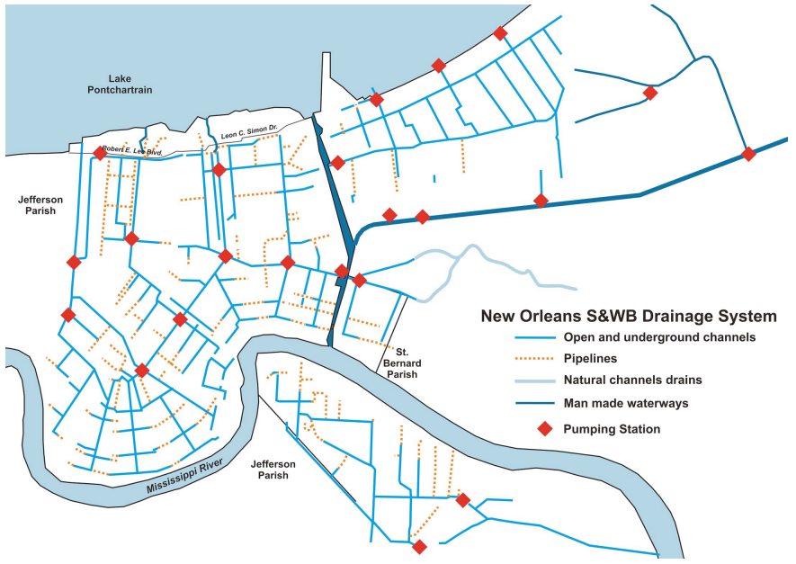

Pumps and canals
The newly created land required constant pumping to keep it dry. As a result, New Orleans has developed one of the world’s most elaborate systems of pumps and leveed canals that continuously shifts water from the center of the city to the lake. Without these pumps, the center of New Orleans would fill with water.
from NY Times (2005)
A.B. Wood pump, designed in 1928 and still in use, can pump over 400 million gallons of water per day!
from Rodgers (2008)

Slide 13
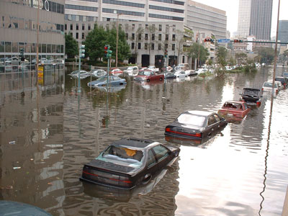
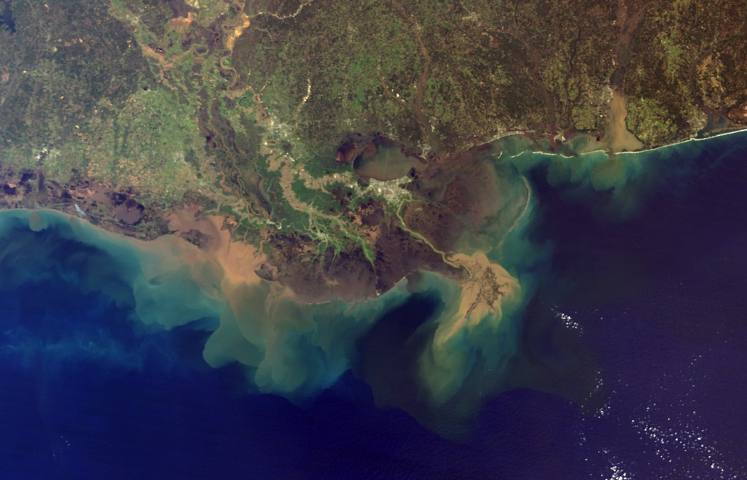
Why does New Orleans subside?
The elevation of New Orleans is so low because it continues to subside. Scientists agree on the three main reasons for this subsidence, though they disagree about which is most important:
  New Orleans is part of the Mississippi delta, a thick accumulation of sediment that naturally subsides under its own weight when water is expelled and the sediment compacts;
  New Orleans is located on a block of the Earth’s crust that is slowly sliding downward along a normal fault;
  Desiccation and oxidation of the organic rich soils that were exposed due to draining has caused them to shrink.
  Note that the first two processes affect all parts of New Orleans, while the third only affects soils that were once covered and saturated with water, and are now dry and exposed.
Photos from FEMA
Mississippi delta, from NASA

Slide 14
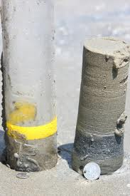
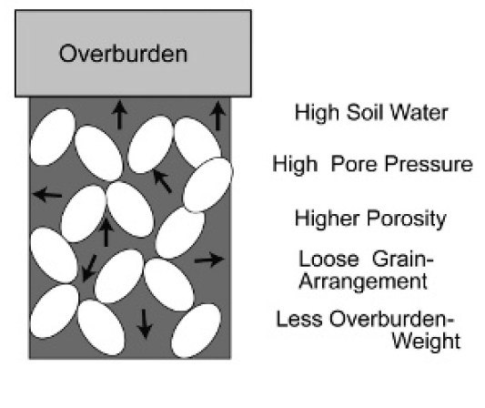
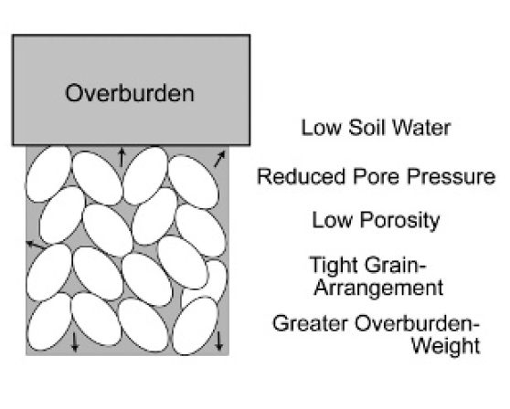
1. Compaction of deltaic sediments
The sediments deposited in the Mississippi Delta consist of fine silts, clays, along with variable amounts of organic material. When buried, these sediments slowly squeeze together, forcing out some of the water in the pores. This process causes the sediments to become more compact, and causes subsidence on the surface.
Here is a core taken from the Grand Isle region of the Mississippi delta. It consists of muddy silts and clays with a high water content.
Subsidence
(photo from the USGS)
(Figures from Yuill et al., 2009)
The ‘overburden’ is the weight of the overlying sediments, which may reach several kilometers in some places. This weight forces the sediments together and squeezes the water out, causing subsidence.

Slide 15
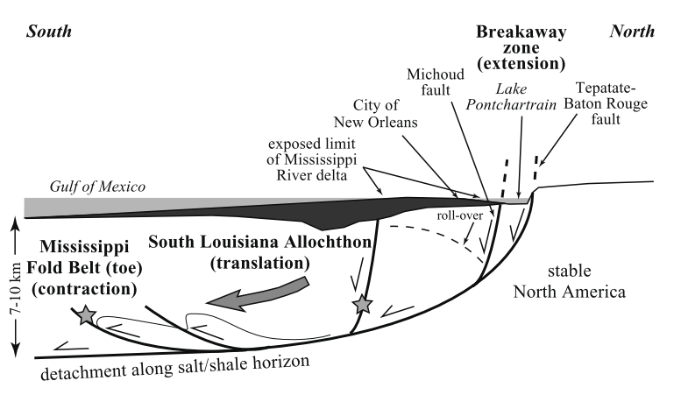
2. Tectonic subsidence
Recent studies suggest that southern Louisiana is part of a large fault block that is sliding down and to the south along a curved fault plane. This kind of normal fault is called a listric normal fault. The motion on the fault is caused by the weight of the deltaic sediments, which accumulate near the head of the fault and force the block downward.
As you’d expect, movement along this fault is episodic—it happens in spurts. Some recent data suggest it may have caused up to 17mm/year of subsidence in recent years, though the long-term average rate of subsidence is certainly much less.
(Figures from Yuill et al., 2009)

Slide 16
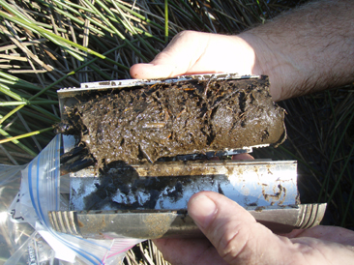
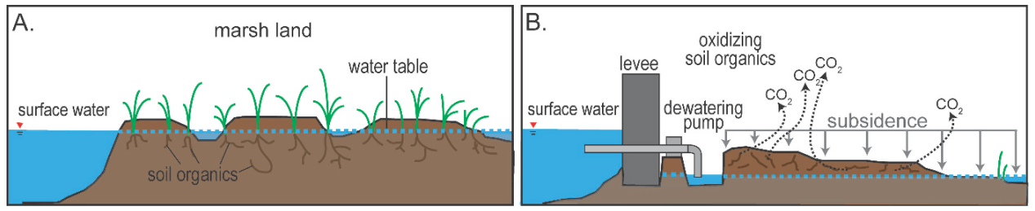
3. Compaction and erosion of organic soils
Organic soil (especially peat) is subject to rapid compaction and erosion when it is exposed to the atmosphere, resulting in subsidence. Two main changes occur:
Peaty soils contain up to 80% water, and when this water is removed the solid structure collapses, reducing the volume. This is the same thing that happens to other deltaic sediments, except the effect is more pronounced because the organic soils have such a high initial water content;
While inundated with water, organic soils in swamps and marshes are protected from oxidation. This protection is removed when the soils are drained, and the organic carbon quickly oxidizes to produce CO₂. In addition, biologic processes may accelerate the conversion of organic carbon to CO₂.
Image from USGS
Small core of peaty soil, composed of nearly 100% organic matter.
(Figures from Yuill et al., 2009)
The amount of subsidence that occurs depends on the amount by which the water table is lowered.

Slide 17
Quantifying subsidence rates
There have been many attempts to quantify the rates of subsidence caused by the three main factors, but the results are widely variable. The table below summarizes these estimates:
Cause | Range of subsidence values (mm/y) | Typical (mm/y) | Comments
Compaction of deltaic sediments | 0.4 – 5 | 2
Tectonic subsidence | 0.1 – 18 | 5 | Episodic (high values clearly can’t be sustained)
Compaction and erosion of freshly exposed organic soils | 10 - 25 | 15 | Depends on amount of water table lowering; faster at first, then slows down
The “Typical” values in red represent a subjective best guess estimate that that you will use to calculate the total subsidence in New Orleans over the past 250 years.

Slide 18
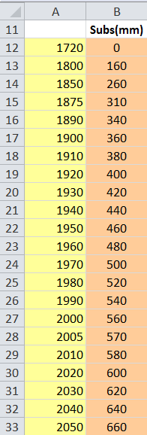
Calculating Subsidence of New Orleans since 1720
Your main task for this module is to calculate the total subsidence rate in New Orleans since 1720 based on estimates of the rates for the three main processes described earlier. You will do this by filling in the table found on your worksheet. Here is an example for compaction subsidence.
We start in 1720 because that’s about when New Orleans was settled. Although the area was certainly subsiding before this time, subsidence was probably balanced by accumulation of organic sediment, so the net change in elevation was negligible.
The numbers shown here are cumulative subsidence rates. In other words, by 1850 we calculate that 260 mm of subsidence had occurred.
You’ll calculate cumulative subsidence at each of these dates. Note that they are not spaced equally.
We can compare the calculated amount of subsidence in 2010 with what we observe today . . .
. . . and also see what the future is predicted to bring.

Slide 19
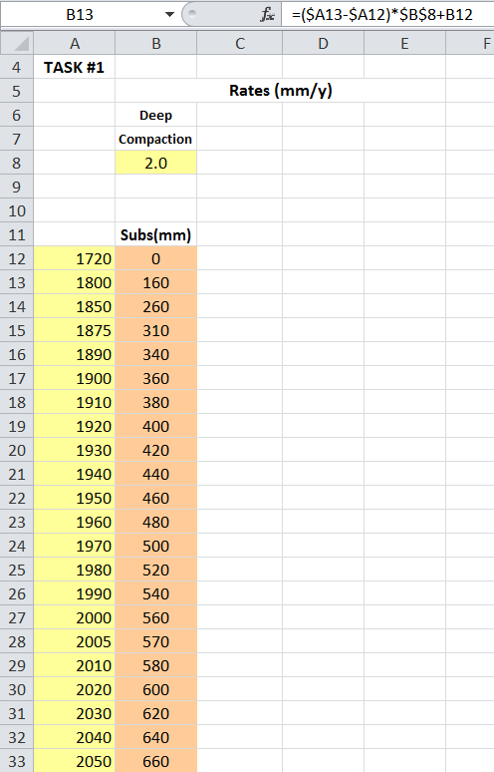
Task #1: Calculating subsidence due to compaction of deltaic sediments
Task #1: The first thing you’ll do is compute the subsidence caused by compaction of deltaic sediments alone. Notice that all the formulas that calculate this kind of subsidence will reference call B8 where you enter the subsidence rate.
The formula for cell B13 is shown. Study it carefully. The formula tells Excel to “calculate the subsidence that occurred between the current date and the previous date, and add it to the previous subsidence total.”
The rate of subsidence caused by compaction of deltaic sediments from Slide 17 (in mm/year) is inserted here.
Assume there was no subsidence as of 1720
All the correct values are shown so you can check that you’re doing it right. Make sure your formula reproduces the numbers displayed before copying it all the way down to row 33 to complete the calculation.

Slide 20
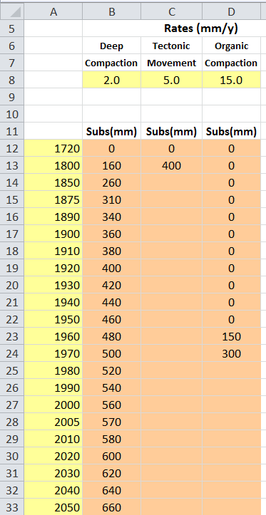
Task #2: Calculating subsidence from tectonics and organic soils
Task #2: Now do the same thing for tectonic subsidence and subsidence caused by exposure of organic soils.
Once again, enter the subsidence rates from Slide 17 in cells C8 and D8.
Draining of the low-lying swamps started in the 1890’s, but didn’t happen in earnest until the middle of the 20th century. For the purposes of calculation, assume that the swampy soils were exposed in 1950. As a result, enter 0 for the amount of subsidence caused by this factor for 1950 and earlier.
Again, some of the correct values are revealed. Make sure your formula can reproduce them before you copy it to the rest of the cells in the table.
If you’re not sure what to enter, study the formula for cell B13 again, and think about what it tells Excel to do.

Slide 21
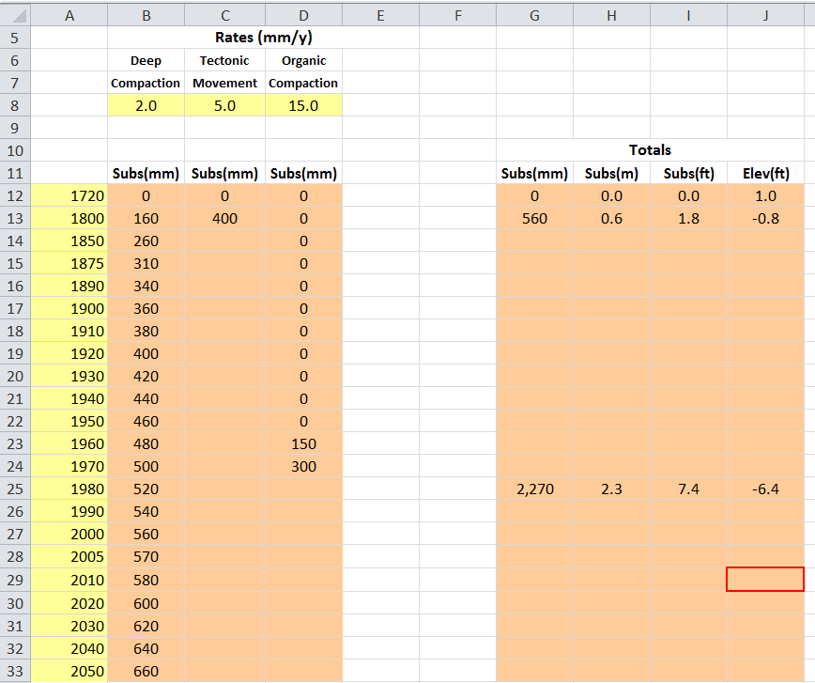
Task #3: Calculating the total subsidence rate from all factors
Task #3: Now you just sum them up to get the total subsidence caused by all three factors.
There are 1,000 mm in one meter; use that conversion to calculate the subsidence in meters.
The formula in this cell should use Excel’s SUM function and a range of cells
The correct values in rows 12 and 13 are revealed. Make sure your formula can reproduce them before you copy it to the rest of the cells in the table.
You can either figure out the conversion factor from meters to feet, look it up, or use Excel’s built-in conversion function CONVERT. (For the arguments CONVERT takes click on function help.)
The numbers in column J are calculated as the 1720 elevation minus the total subsidence
The elevation starts out at 1.0 feet in 1720 and then will decrease due to subsidence, becoming negative. Negative elevation means that the land is below sea level.
For comparison with today’s observations, here’s what your spreadsheet calculates for 2010:

Slide 22
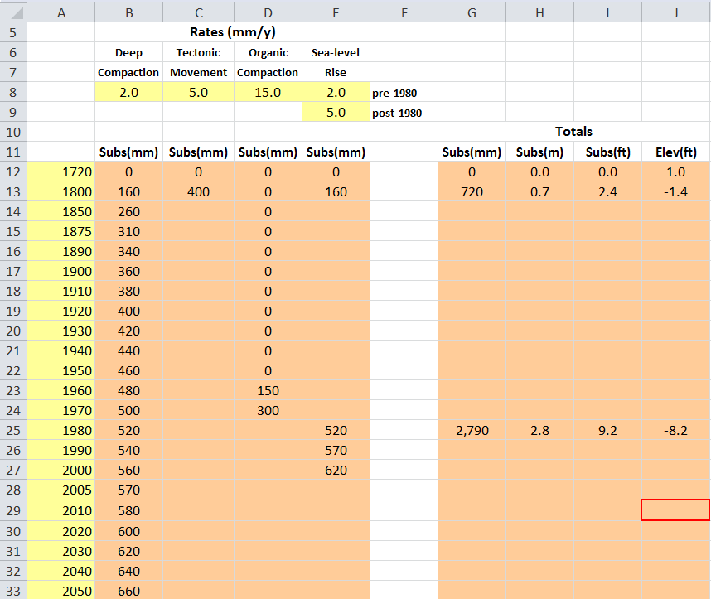
Task #4: Adding in the effect of sea-level rise
As far as flooding from hurricanes is concerned, what matters is the elevation of New Orleans relative to sea level. Your spreadsheet calculates how much the city has sunk relative to sea level but doesn’t take into account the fact that sea level itself has changed! In fact, sea level has risen at about 2 mm/year since the 1800’s, and has likely accelerating to approximately 3 mm/y since 1980. You can consider sea level rise to be “effective subsidence” and need to take it into account too.
Some of the values both in Column E and in Columns G-J are revealed so you can check your work.
You’ll have to recalculate the total subsidence caused by all four factors. Remember that the sum in column G now includes sea-level rise.
Task #4: Account for sea level rise by calculating the ‘effective subsidence’ caused by sea level rising in column E of your spreadsheet. You do this exactly like you did with columns B, C, and D. Assume that sea level rise prior to 1980 was 2 mm/year, and since that time is 3 mm/year.
Again, you can compare the calculation for 2010 with what’s observed today.

Slide 23
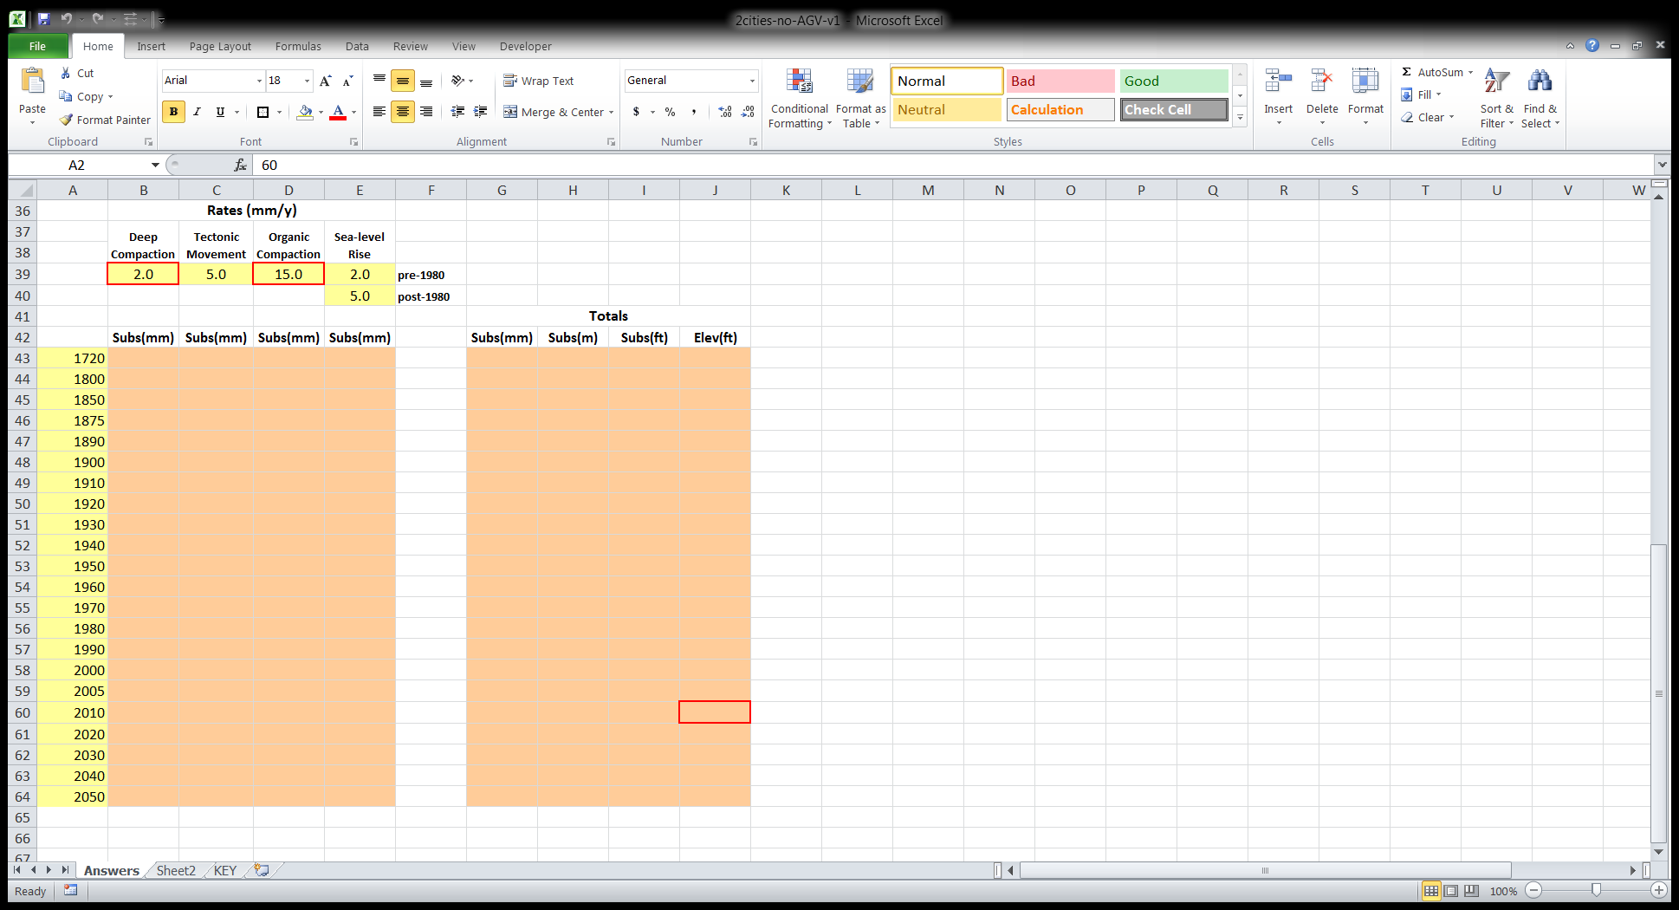
Final Task: How many ways you can you make New Orleans subside?
The total subsidence you’ve calculated depends on the subsidence rates of the three main processes, plus the rate of sea-level rise. Suppose a new study proves that tectonic subsidence is only 0.40 mm/year averaged over the last 200 years. Can you adjust the values for compaction of deltaic sediments and organic compaction within their reported ranges to create the total amount of subsidence as of 2010 you found in Task #4, cell J29?
Input the new value for tectonic subsidence in cell C39, the accepted values for sea-level rise in cells E39 and E40, and then adjust the values for deep compaction in cell B39 and organic compaction in cell D39 within their accepted ranges (Slide 17) to create a total subsidence for 2010 in cell J60 equal to the total subsidence for 2010 you calculated in Task #4 (cell J29).
Leave these values alone; they are very well constrained
Input 0.40 here
Then adjust the values in these cells within their accepted ranges (Slide 17) so that . . .
. . . the total subsidence calculated here is the same as the value you calculated in Task #4 in cell J29

Slide 24
How to convert units
The trick to converting units is to remember that multiplying a number by one leaves it unchanged; e.g.,
When we convert units, we just multiply by one in the form of a fraction in which the top and bottom are the same amount. For example, since there are 5,280 feet in one mile, we can write that 5,280 feet = one mile. Therefore, if we create a fraction with one of these quantities on the top and the other on the bottom; e.g.,
then this fraction must be one! Since the fraction is one, we can multiply it by any number without changing the number.
Why would we want to do this? We do it because by canceling common units in the top and bottom of the fractions we can change the units. For example, look what happens with 5 feet:
Since the units of “feet” appear in the numerator of one fraction and denominator of the other, we can cancel them out:
The only unit that’s left is “miles”:
(con’t. on next page)
24

Slide 25
How to convert units (con’t.)
Remember, you can multiply a number by one as many times as you want without changing it. So when you have to convert the units of both the top and bottom of a ratio (like km/s → mph) you simply multiply by one as many times as you want for the numerator and then as many times as you want for the denominator.
Study the following example closely, which shows how to convert 3.2 gallons per hour (gph) to liters per second (l/s):
Back to Slide 21
This part converts
gal → liters
This part
converts
hours → seconds
25

