Slide 1

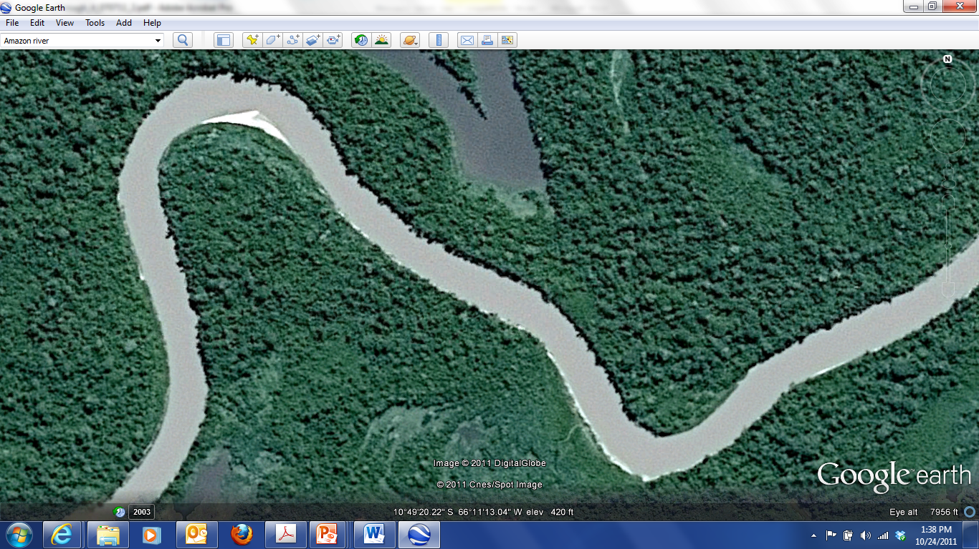
Google Earth Imagery: 2011 Digital Globe
2011 Cnes/Spot Image
A

Slide 2
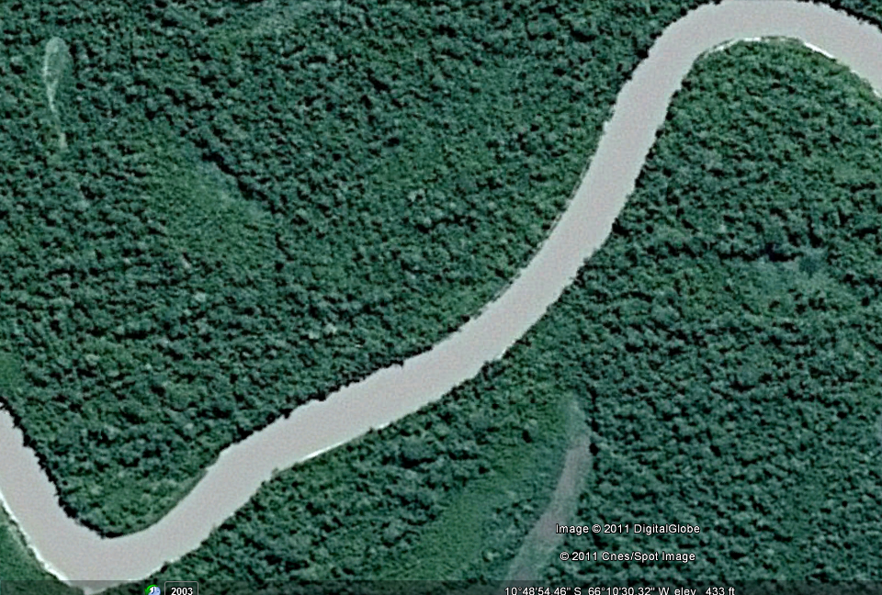
Google Earth Imagery: 2011 Digital Globe
2011 Cnes/Spot Image
M

Slide 3
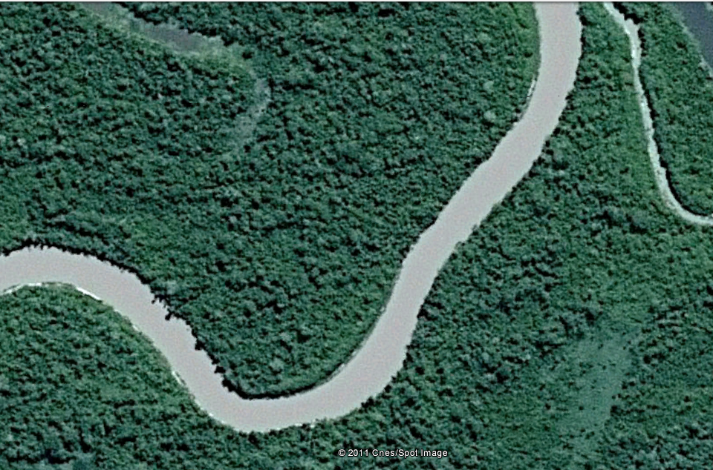
Google Earth Imagery: 2011 Digital Globe
2011 Cnes/Spot Image
AZ

Slide 4
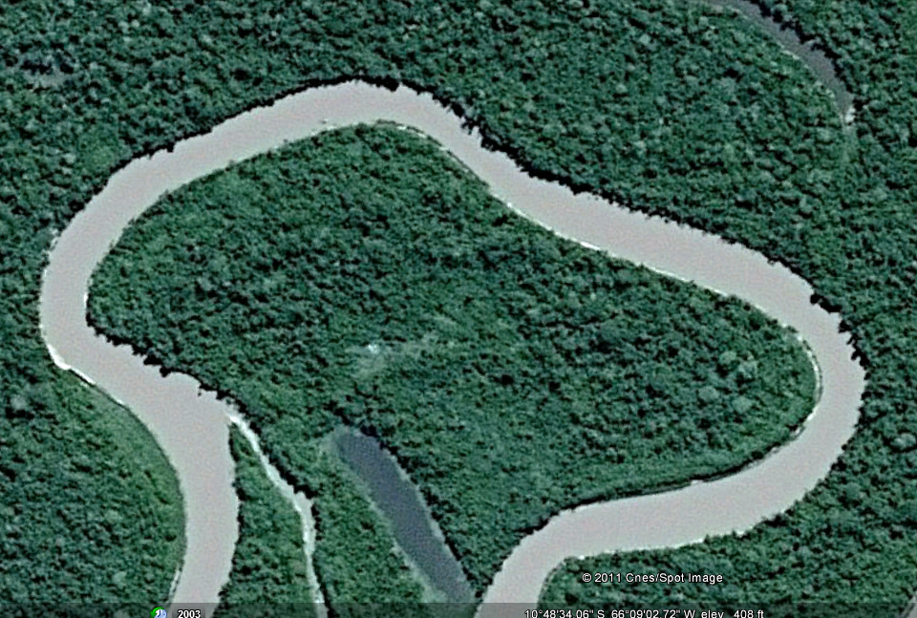
0
Google Earth Imagery: 2011 Digital Globe
2011 Cnes/Spot Image

Slide 5
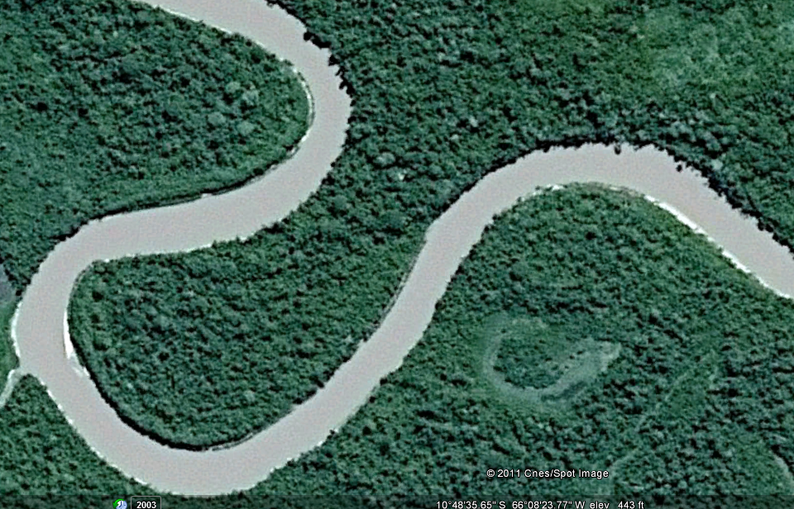
Google Earth Imagery: 2011 Digital Globe
2011 Cnes/Spot Image
N

Slide 6
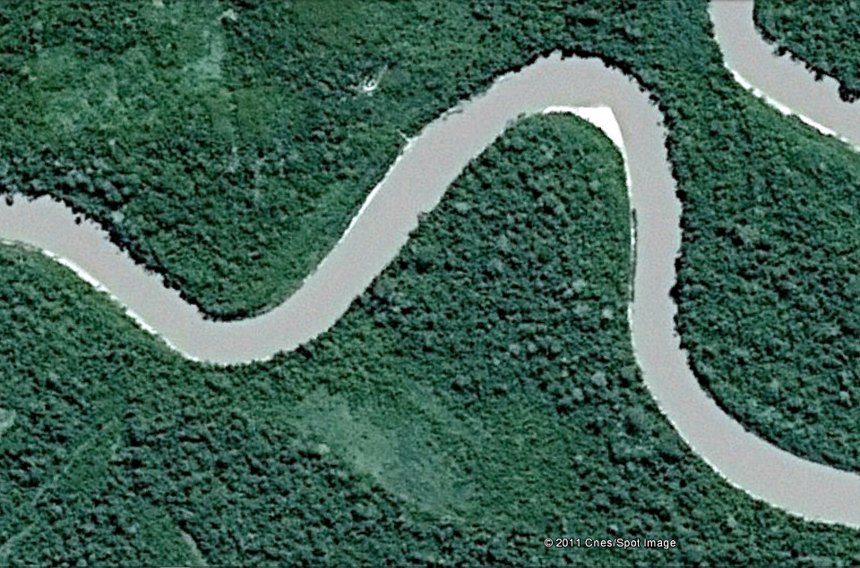
Google Earth Imagery: 2011 Digital Globe
2011 Cnes/Spot Image
RI

Slide 7
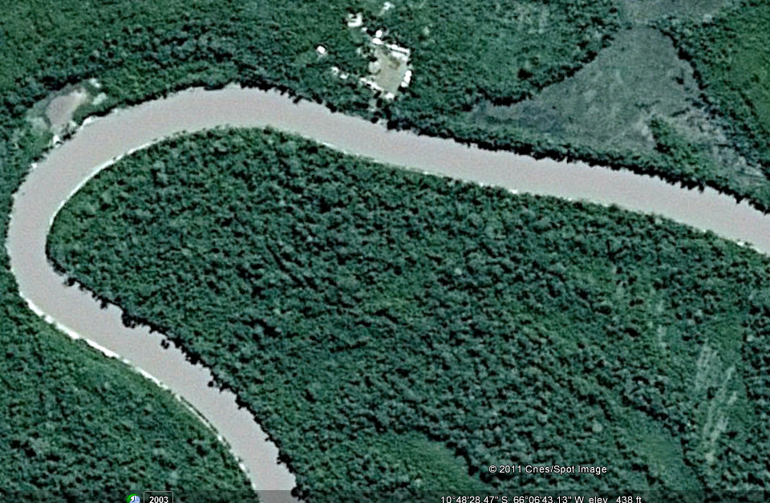
V
Google Earth Imagery: 2011 Digital Globe
2011 Cnes/Spot Image

Slide 8
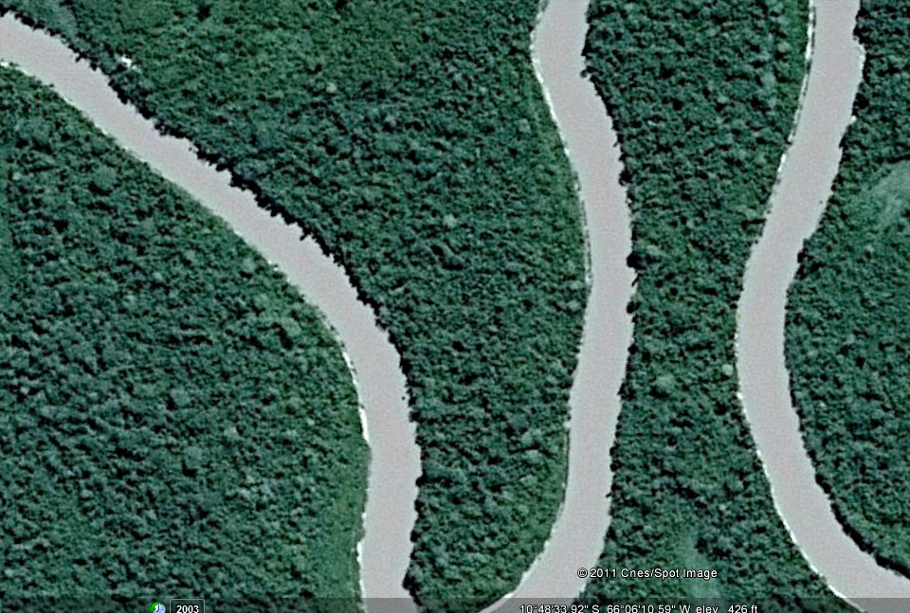
ER
Google Earth Imagery: 2011 Digital Globe
2011 Cnes/Spot Image

