Slide 1
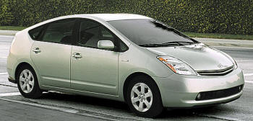

On the Road to Energy Independence:
Hybrid vs. Electric Vehicles
Fred Loxsom
Environmental Earth Science Department
Eastern Connecticut State University

Slide 2

US Cars and Drivers
US Population
311 million
Licensed drivers
190 million
Cars and light trucks.
210 million

Slide 3
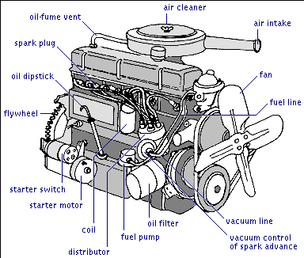

Internal Combustion Engine (ICE)

Slide 4

ICEs emit CO2
Notes:
World Resources Institute http://www.wri.org/wri/wr-98-99/airpoll.htm

Slide 5
ICE CO2 Emission
200 million cars & light trucks
14,000 miles/year ➔ 2.8 trillion miles
22 mpg ➔ 2.8 trillion miles ÷ 22 mpg
➔ 130 billion gal gasoline
20 lb CO2 / gal ➔ 2.6 trillion lb CO2
1.2 billion tons CO2
= 20 % US total CO2 emission

Slide 6
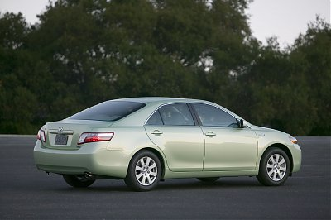
HEVs
Gasoline Engine
Electric motor
Does not need to be plugged in

Slide 7
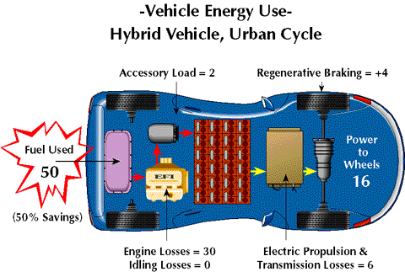
HEVs are fuel efficient

Slide 8
HEV CO2 Emission
Assume 200 million HEVs
14,000 miles/year ➔ 2.8 trillion miles
50 mpg ➔ 2.8 trillion miles ÷ 50 mpg
➔ 56 billion gal gasoline
20 lb CO2 / gal ➔ 1.1 trillion lb CO2
0.50 billion tons CO2
= 9 % US total CO2 emission

Slide 9

EVs
Electric Vehicles have had drawbacks:
  Large heavy batteries
  Short driving range
  Slow refueling (recharging) process

Slide 10
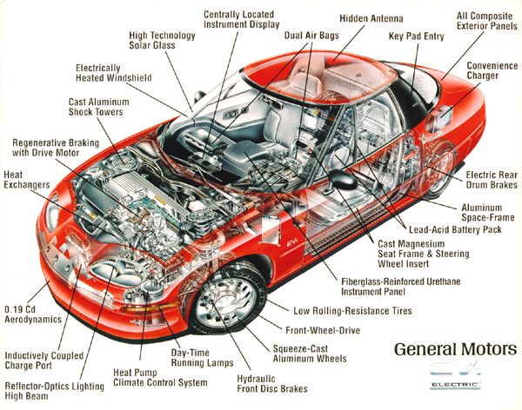
GM EV-1
Produced by GM from 1996-1999

Slide 11
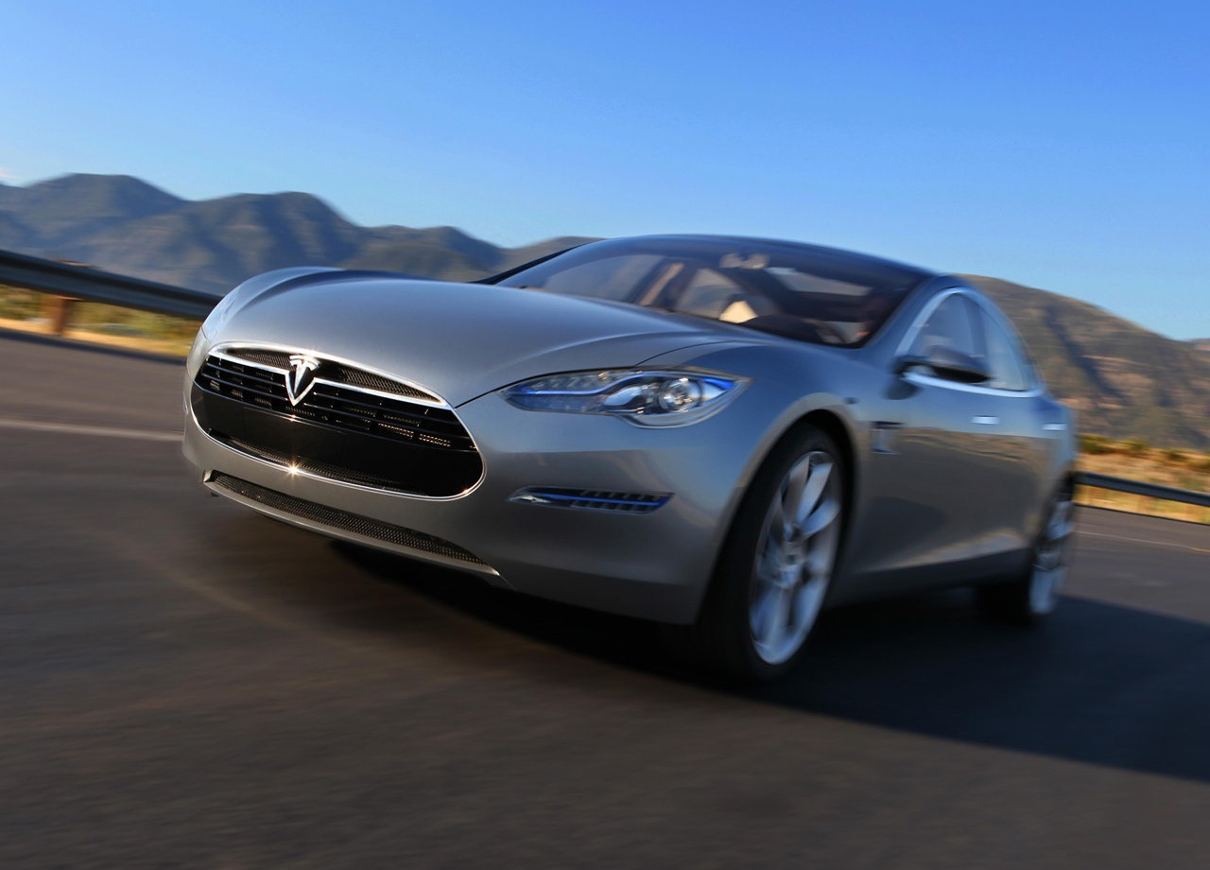
Tesla
Tesla Model S
  Uses Li-ion batteries
  Expensive
  200 mile range
  Lower-price
  model in 2014

Slide 12
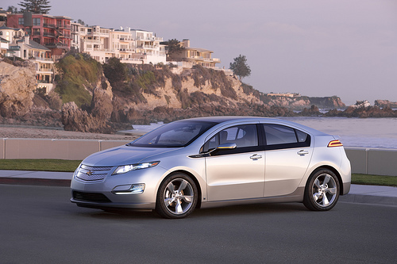
GM Volt
10 kWh usable electric battery
40 mile range
Gasoline engine back-up
Plug-in Hybrid
5-door liftback
$33,500 after tax break

Slide 13
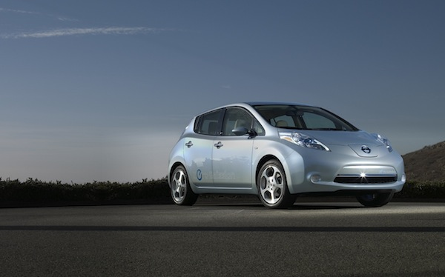
Nissan LEAF
24 kWh electric battery
100 mile range
All-electric
5-door hatchback
$25,300 after tax break

Slide 14
LEAF Electric Energy
Assume 200 million LEAFs
14,000 miles/year ➔ 2.8 trillion miles
4 mi/kWh ➔ 2.8 trillion miles ÷ 4 mi/kWh
700 billion kWh
(US total electric use is 4000 billion kWh)
Requires: 100 million PV installs or 500 Cape Wind farms or 90 nuclear reactors or 200 coal plants

Slide 15

From Oil

Slide 16

to Solar

Slide 17

to Wind

Slide 18

to Nuclear Power

Slide 19

to Coal?

Slide 20
LEAF CO2 Emission
Assume average CO2 emission per kWh:
700 billion kWh x 600 g CO2/kWh➔
0.42 billion ton CO2 = 7% US total CO2
Assume electricity from coal plants:
700 billion kWh x 1000 g CO2/kWh➔
0.70 billion ton CO2
= 11% US total CO2 emission

Slide 21
CO2 Emission Comparison
420 MtCO2 -- Electric Cars with electricity vvvvvvvvfrom typical mix of generators
500 MtCO2 -- HEV or Very Efficient ICE
700 MtCO2 -- Electric Cars with electricity vvvvvvvvvfrom Coal
1,200 MtCO2 -- Typical ICE
So EVs and HEVs both reduce CO2.

Slide 22
Fuel Cost
ICE
14,000 miles ÷ 22 mi/gal = 640 gal
640 gal x $3/gal = $2000/year
LEAF
14,000 miles ÷ 4 mi/kWh = 3,500 kWh
3,500 kWh x $0.15/kWh = $500/year

Slide 23

Issue: Range

Slide 24
Issue: Lithium
Is a lithium shortage likely?
"Lithium batteries are being touted as a way forward for electric cars, but according to William Tahil, director of research for Meridian International Research this could result in the world's lithium supply drying up really fast.”
- Hybrid Car Blog

Slide 25
Changing the US auto fleet
210 million cars and light trucks in US
19 million new cars and trucks each year
Vehicles last 140,000 miles or 10 years
Changing rolling stock takes at least10 years.
Nissan expects to reach 500,000 global LEAF production capacity.

Slide 26

Questions?
Comments?

