Slide 1
Nuclear Power:
Reviewing the Science, Technology and Policy
James D. Myers
Director, Wyoming CCS Technology Institute
Professor, Department of Geology & Geophysics
University of Wyoming

Slide 2
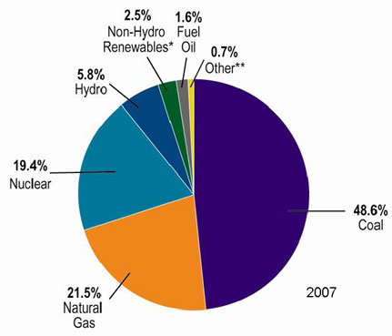
A Quick Look at Nuclear Power
U.S. Electricity Sector - Nuclear
nuclear power is major player in U.S. electricity industry
  19. 4 % of electricity
third major source behind:
  coal: 46.6 %
  natural gas: 21.5 %
characteristics:
  despite no new plants since 1970s, percentage of electricity it produces has been growing
  many plants being re-licensed for another 20-30 years
  U.S. safety record has been stellar
    no fatalities, no injuries

Slide 3
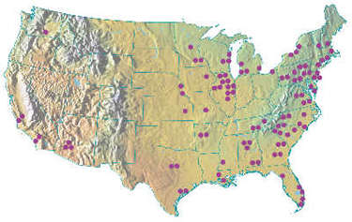
A Quick Look at Nuclear Power
U.S. Electricity Sector

Slide 4
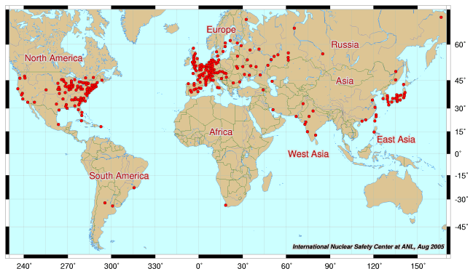
A Quick Look at Nuclear Power
Global Electricity Sector

Slide 5
A Quick Look at Nuclear Power
Global Electricity Sector

Slide 6
A Quick Look at Nuclear Power
Global Electricity Sector

Slide 7
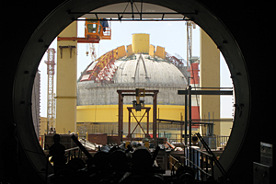
A Quick Look at Nuclear Power
Global Electricity Sector
61 new reactors (NEI, 2010)
Taiwan – 2; Iran -1; Pakistan -1

Slide 8
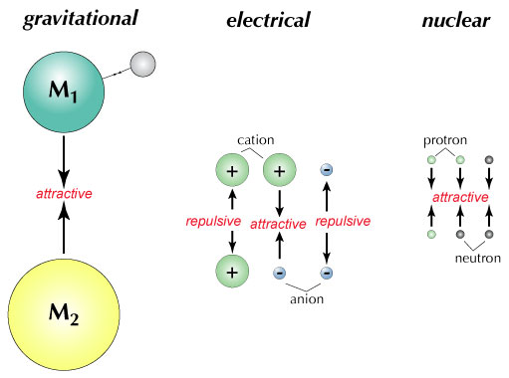
Nuclear Physics
Fundamental Forces

Slide 9
Nuclear Physics
Balancing Nuclear Forces

Slide 10
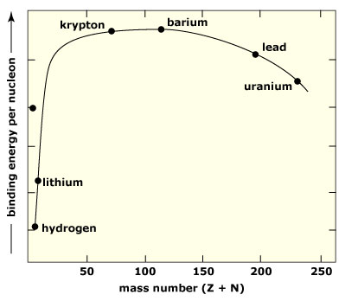
Nuclear Physics
Binding Curve

Slide 11
Nuclear Physics
Nuclear Transformations
the nuclear structure of atoms is changed by three different mechanisms:
  fission: splitting of heavy nuclei into two lighter ones with the releases of neutrons and energy
    spontaneous
    neutron-induced
  fusion: combining of two nuclei to make a new, heavier nuclei
    new nuclei has less mass than sum of two original nuclei
  radioactive decay: spontaneous emission of either particle or electromagnetic radiation by nuclei
    particle: alpha, beta, electron capture
    electromagnetic: gamma
these processes are not influenced by physical conditions, e.g. pressure, temperature, etc.

Slide 12
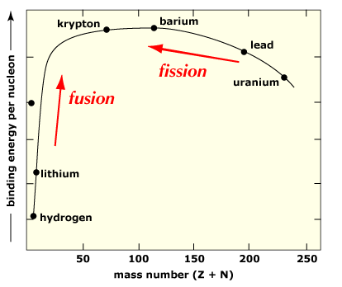
Nuclear Physics
Nuclear Transformations & Binding Curve

Slide 13
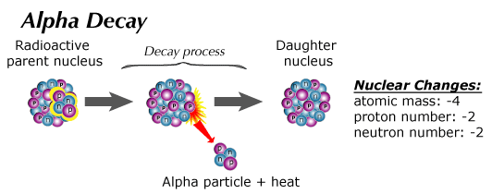
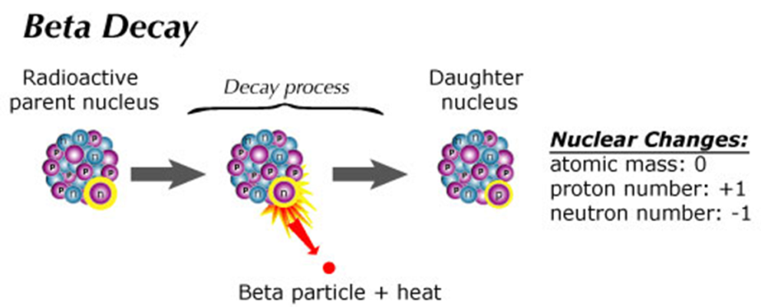
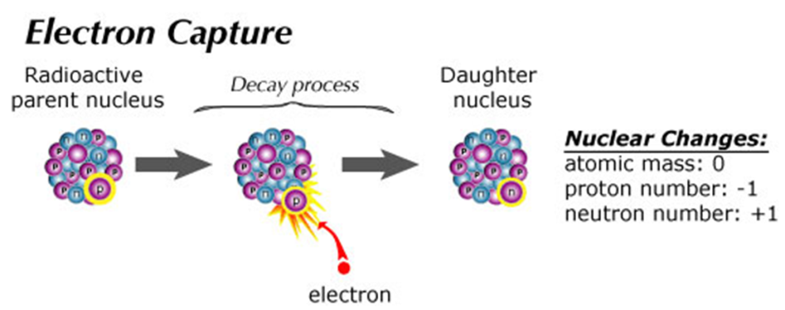
Nuclear Physics
Particle Radiation: Radioactive Decay

Slide 14
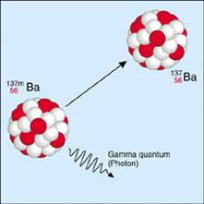
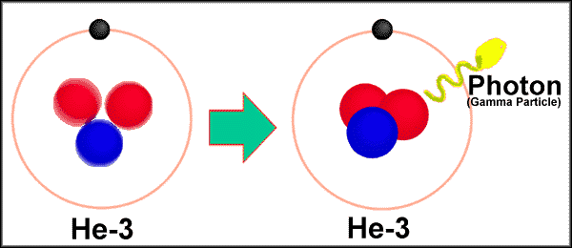
Nuclear Physics
Electromagnetic Radiation: Gamma Radiation

Slide 15
Nuclear Physics
Periodic Table: Nuclear Help?

Slide 16
Nuclear Physics
Nuclide Chart

Slide 17
Nuclear Physics
Nuclide Chart
Notes:
The nuclide shows the 254 naturally-occurring stable isotopes (black) that form the stable band. In addition, there are another about 46 radioactive isotopes with relatively long lives. In all the, nuclide chart depicts the 3,000 or so known isotopes. Of these the vast majority are human produced with very short half-lifes.

Slide 18
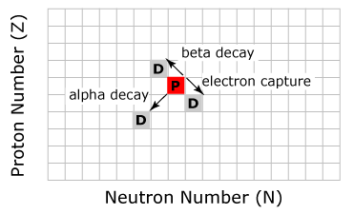
Nuclear Physics
Nuclide Chart: Decay Mechanisms

Slide 19
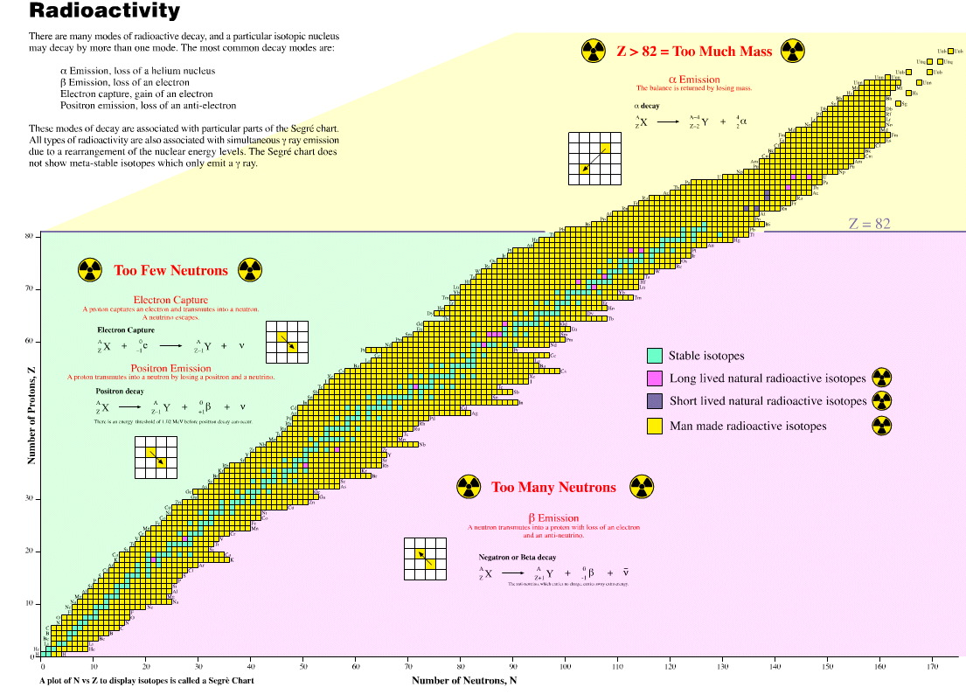
Nuclear Physics
Nuclide Chart: Stability Regions & Decay Mechanisms

Slide 20
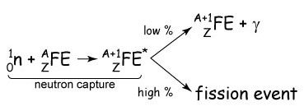
Nuclear Physics
Fission: Neutron Capture

Slide 21
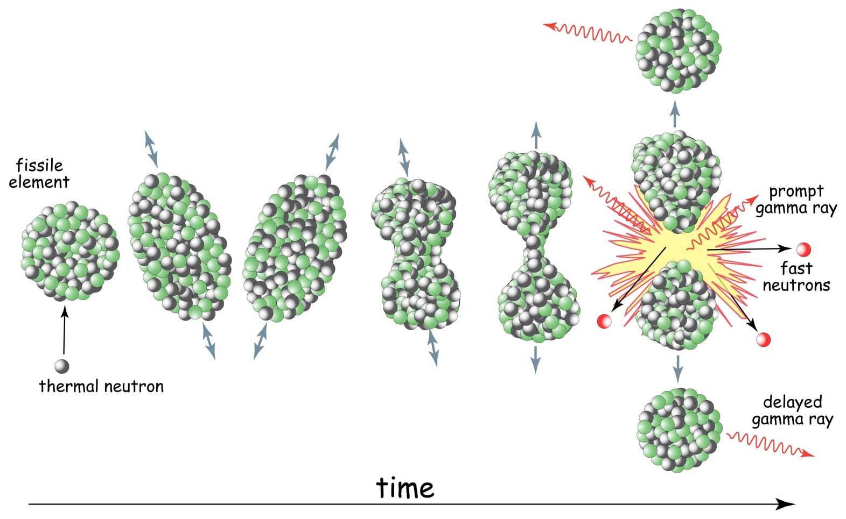
Nuclear Physics
Fission: Liquid Drop Model

Slide 22
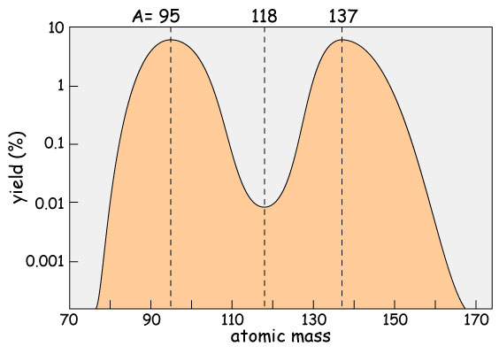
Nuclear Physics
Fission: Fission Product Yield

Slide 23
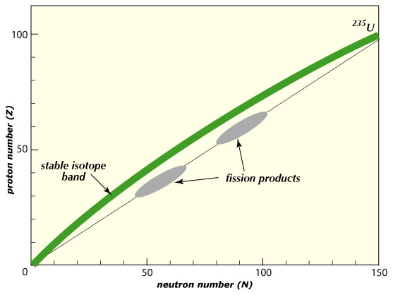
Nuclear Physics
Fission: Fission Products
Notes:
Lise Meitner and Otto Frisch

Slide 24
Nuclear Physics
Fissile vs. Fertile Isotopes
fissile: isotopes that can sustain a chain reaction through fissions induced by thermal neutrons
  ²³⁵U: naturally-occurring
    0.7 % of natural U
  ²³³U: not naturally-occurring
  ²³⁹Pu : not naturally-occurring
fertile: isotope that can be converted to fissile isotope by neutron capture of a thermal neutron
  ²³²Th: naturally-occurring
    only thorium isotope
  ²³⁸U: naturally-occurring
    99.3 % of natural U

Slide 25
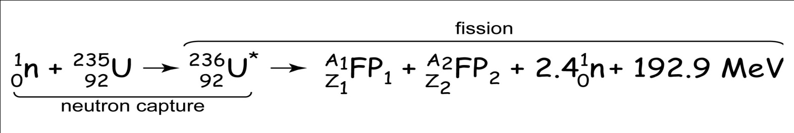
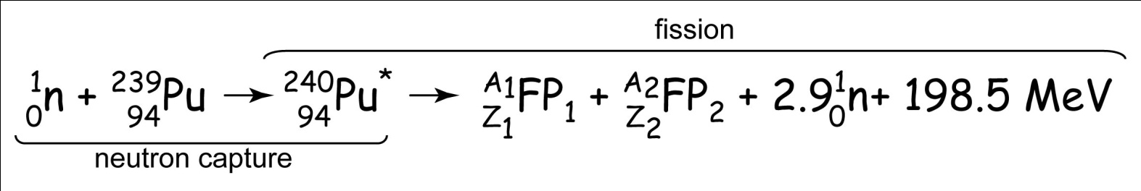
Nuclear Physics
Fission Reactions
two primary fission reactions occurring in a light water reactor are:

Slide 26
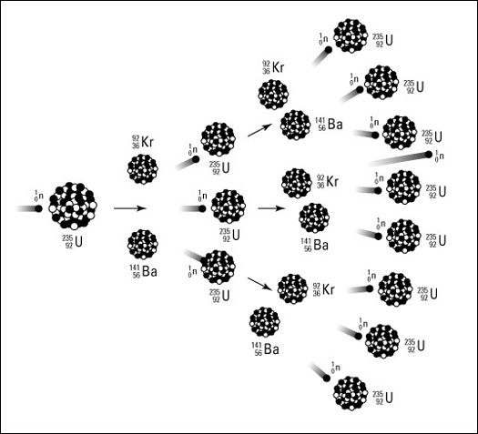
Nuclear Physics
Chain Reaction

Slide 27
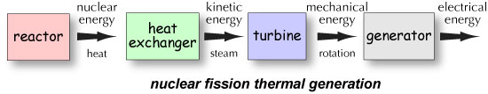
Reactor Design
Thermal Electricity Generation

Slide 28
Reactor Design
Component Systems
all reactors are characterized by fairly standard group of systems or components:
  moderator: slows fast neutrons to slow (thermal) neutrons (more efficient at fissioning ²³⁵U)
  coolant: liquid/gas circulated through reactor core to remove the heat
  control rods: neutron-absorbing cylinders to control chain reaction
  pressure vessels/tubes: steel vessel encapsulating reactor core, coolant or moderator
  steam generator: heat exchanger where the coolant heats water to steam and drives turbine
  contaminant system: reactor core housing to contain radioactive material in event of accident
  fuel: pellets of enriched or natural uranium or uranium /plutonium mix

Slide 29
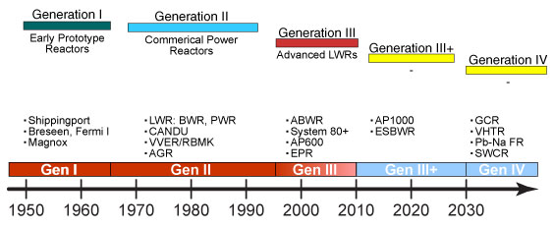
Reactor Design
Reactor Timeline

Slide 30
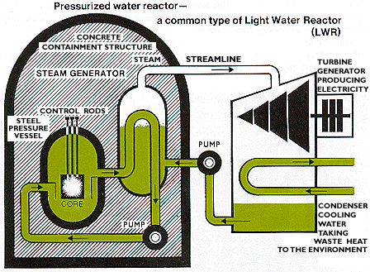
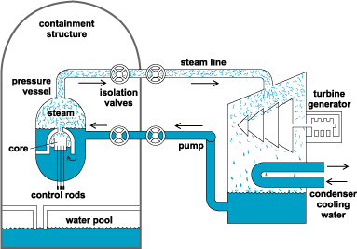
Reactor Design
Commercial GEN II Reactors
pressurized water reactor
boiling water reactor

Slide 31
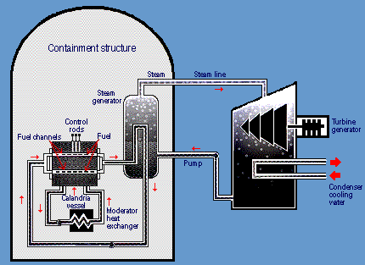
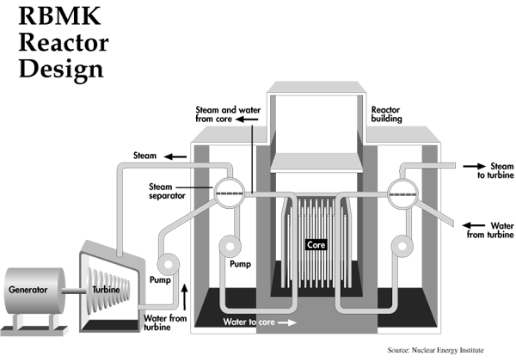
Reactor Design
Commercial GEN II Reactors
CANDU reactor
RBMK reactor

Slide 32
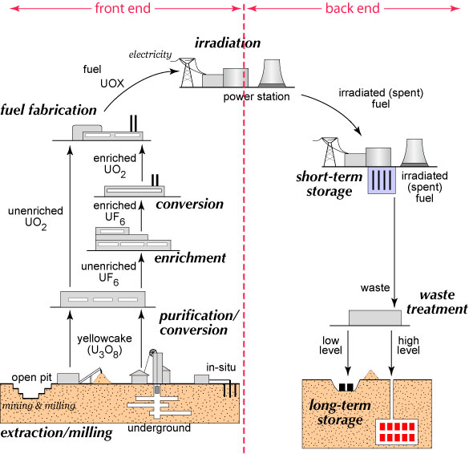
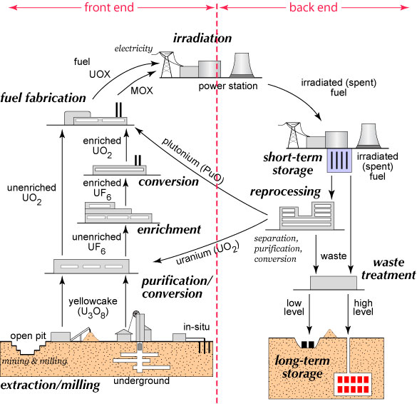
Nuclear Fuel Cycles: U-Pu
Types
Once Through
Reprocessing

Slide 33
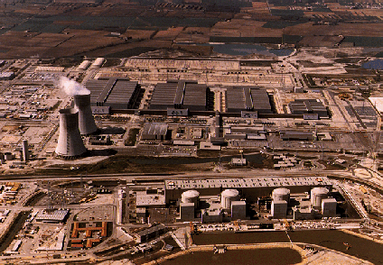
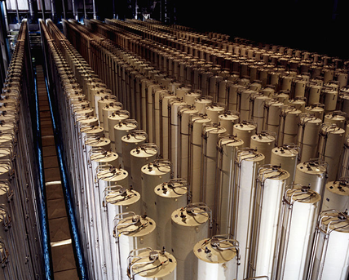
Nuclear Fuel Cycles: U-Pu
Enrichment
because fissile ²³⁵U is only 0.7 % of natural U, for many reactor designs must be enriched
  low-enriched uranium: < 20% ²³⁵U
    reactor grade: 3-4 %
  highly-enriched uranium: >20 % ²³⁵U
    weapons grade: >90 %
enrichment methods
  gaseous diffusion
  high-speed centrifuges
  dynamic separation
  laser enrichment

Slide 34
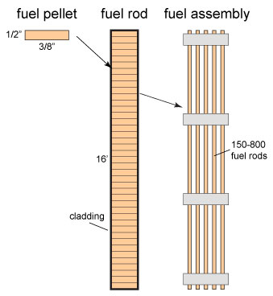
Nuclear Fuel Cycles: U-Pu
Fuel Fabrication
enriched uranium converted to UO₂
  fabricated into fuel pellets, which must:
    conduct heat
    contain fission products
  pellets assembled into fuel rods and rods combined to make fuel assemblies
  exact configuration depends on reactor
all of these elements can be handled safely without shielding

Slide 35
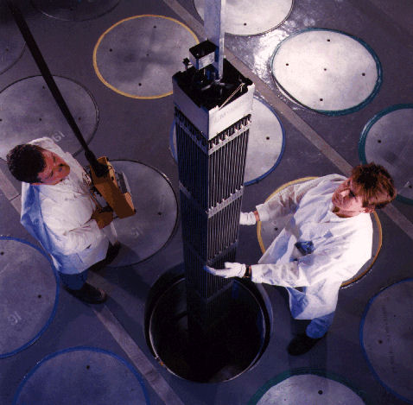
Nuclear Fuel Cycles: U-Pu
Irradiation
fuel assemblies put in reactor for irradiation
  light-water reactors:
    shut down for refueling
    1/3-1/2 of assemblies replaced
    fuel stays in reactor on average 54 months
  heavy water reactors:
    refueled during operation
    fuel assemblies removed when burned up
    assemblies are removed and charged independently

Slide 36
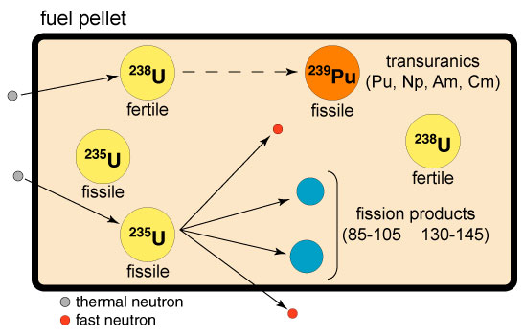
Nuclear Fuel Cycles: U-Pu
Irradiation
now contains:
    fission products
    transuranics (Z > 92)
    unfissioned ²³⁵U
    ²³⁸U (lots)
    new uranium isotopes: ²³³U
  when come out of reactor, pellets are:
    highly radioactive
    very hot

Slide 37
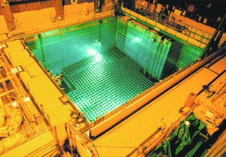
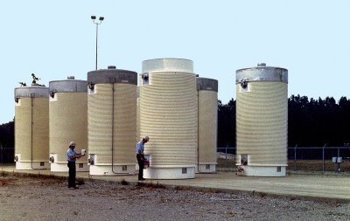
Nuclear Fuel Cycles: U-Pu
Storage
Once Through

Slide 38
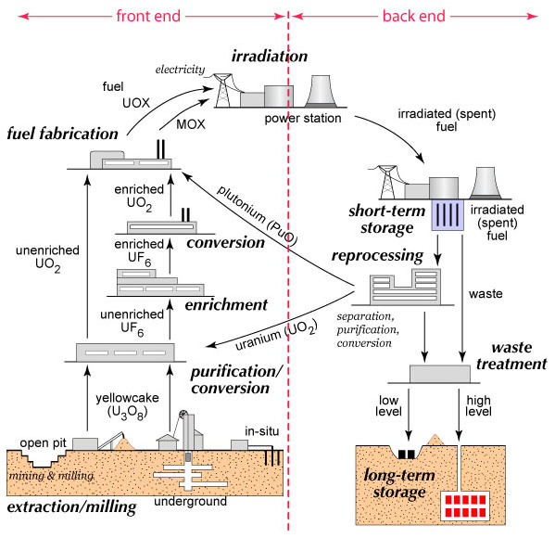
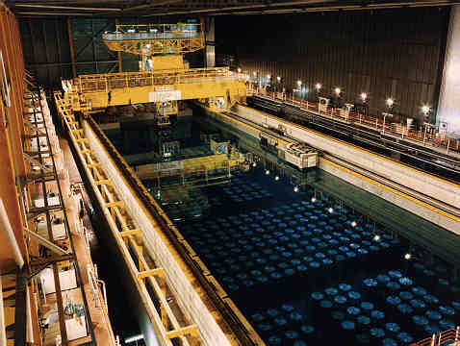
Nuclear Fuel Cycles: U-Pu
Reprocessing
Reprocessing
UK reprocessing facility

Slide 39
Issues and Concerns
Introduction
waste disposal
accidents
proliferation
terrorism
radiation
decommissioning

Slide 40
Issues and Concerns
Waste Disposal
several important characteristics about nuclear waste that distinguish it from other types of industrial waste
  radioactivity of radioactive waste decays with time until transmuted to non-radioactive elements
    other types of waste remain hazardous indefinitely
  radioactivity is a function of half-life
    short half-life: more radioactive the material, but faster decay
      gamma rays - difficult to handle because more penetrating
    long half-life: elements decay by
      alpha and beta decay - easier to handle because less penetrating
  volume of radioactive waste is small
    OECD, there are 300x10⁶ tonnes of toxic waste produced
    81,000 m³ of radioactive waste (<1% of a nation's industrial waste)
  major objective is to protect biosphere from radiation
    primary mechanisms are isolation and dilution

Slide 41
Issues and Concerns
Accidents
major consequence of nuclear reactor accident include potential release of:
  radioactive material
  radiation
lots of potential sources of failure
  most serious is loss of coolant accident (LOCA)
  can lead to meltdown

Slide 42
Nuclear’s Future
GIF
Generation IV International Forum (GIF)
13 nations
collaboratively development of next generation of reactors and power and safety systems

Slide 43
Nuclear’s Future
GIF: Reactor Missions
three primary missions envisioned for Gen IV reactors:
  electricity production: produce electricity by converting thermal energy from fission to kinetic energy to rotational to electrical energy
  nonelectricity missions:
    produce freshwater through desalination
    hydrogen production for energy
    process heat for a range of energy intensive industries
  actinide management:
    extend uranium supplies
    reduce amount of nuclear waste

Slide 44
Nuclear’s Future
GIF: Future Reactor Designs
systematic review produced six, innovative reactor designs for future development
these are:
  gas-cooled fast reactor (GFR)
  lead-cooled fast reactor (LFR)
  molten salt reactor (MSR)
  sodium-cooled fast reactor (SFR)
  supercritical-water-cooled reactor (SCWR)
  very-high-temperature reactor (VHTR).
intended to be deployable in 20-30 years
different nations focused on different designs

Slide 45
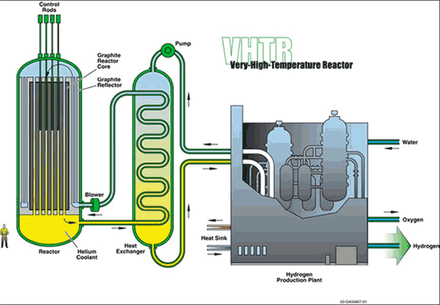
Nuclear’s Future
GIF: U.S. Focus
very-high-temperature reactor (VHTR)
missions:
  electricity generation
  hydrogen production
also viewed as path to reduced carbon emissions

Slide 46
Summary
nuclear power supplies 19. 4 % of U.S. electricity
  even higher for other nations
expanding outside U.S. particularly in Asia
only significant major primary energy source with low carbon emissions
form of thermal generation of electricity
  reactor is only different component
current reactor technologies well-established and robust
future trends:
  evolving public attitudes
  increased building and licensing GEN III/III+ reactors
  new fuel cycles being investigated, e.g. Th fuel cycle
  new radical reactor designs being explored, e.g. traveling wave, pebble bed, GEN IV

