Slide 1
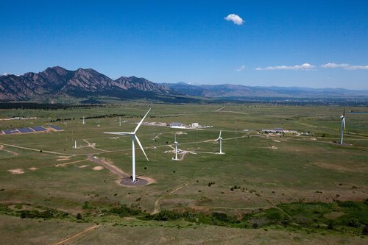


Harnessing the Wind: Recent Developments in Wind Energy
Julie K. Lundquist
Prof., University of Colorado at Boulder &
Scientist, National Wind Technology Center, National Renewable Energy Laboratory
Teaching About Energy in Geoscience Courses: Current Research and Pedagogy
30 October 2010

Slide 2
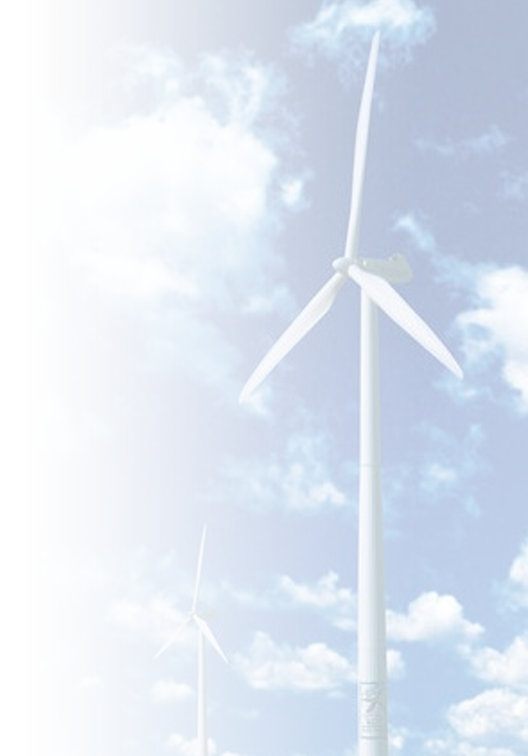
Why wind energy?
Wind is renewable domestic resource
Minimal CO₂ emissions
No water requirements
Wind turbines/farms are mature technology
Wind technology scales
Potential to generate jobs locally

Slide 3
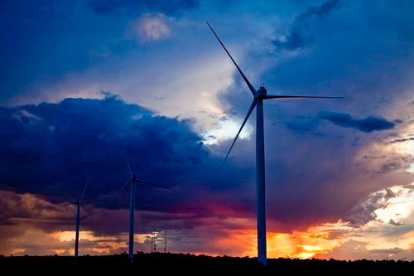
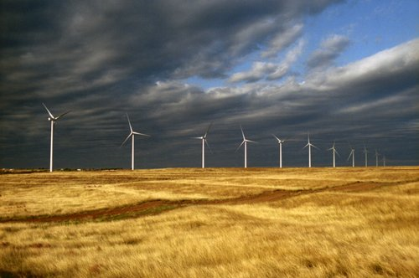
Today’s discussion on harnessing the wind…
Recent historical developments
Domestic wind resources and how we use them
Exciting technical challenges
CODA: A few suggestions for exercises

Slide 4
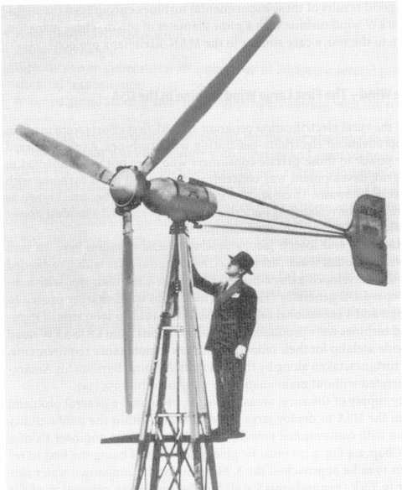
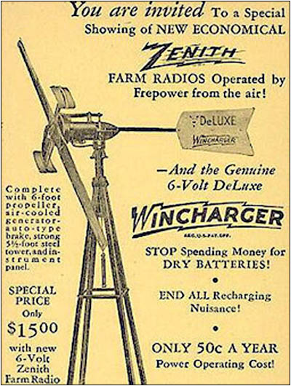
Early electric wind turbines helped electrify remote farms in the early 1900’s
Figure courtesy Richard Lawrence & Joe Rand, www.kidwind.org
Notes:
In 1888, Charles F. Brush invented a large wind turbine which created electricity. This enormous windmill produced enough electricity for about 10 homes. Brush’s invention was soon adapted and copied all over the world. Electricity generating wind turbines spread throughout Europe in the early 1900’s, and they soon appeared in the United States as well. In the 1930s Marcellus Jacobs producing an affordable small turbine called the Jacobs that provided electricity for homes and farms throughout rural America. However, these small American turbines faded away with the widespread installation of power lines through the end of the 1930s.

Slide 5
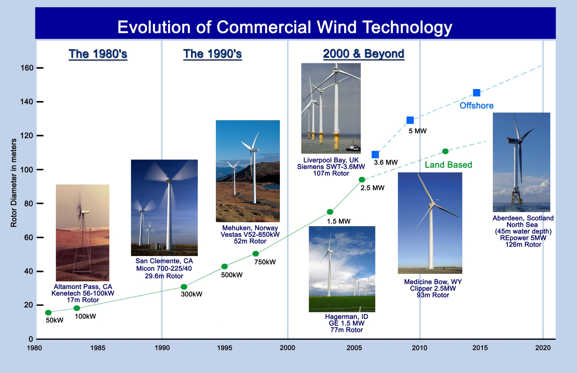
Mike Robinson, NREL NWTC

Slide 6
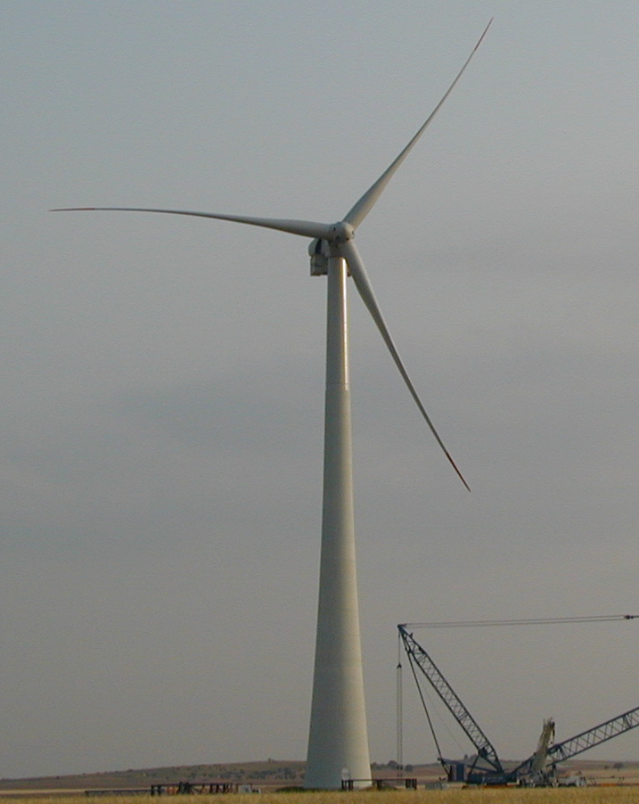
Today’s Wind Turbine Technology
2.5 MW - typical commercial turbine Installation
5.0 MW turbines being installed offshore in Europe
Many manufacturers have a 5-10 MW machines in design
Large turbine development programs targeting offshore markets
Boeing 747-400
Mike Robinson, NREL NWTC

Slide 7
Growth of Wind Energy Capacity Worldwide
Actual
Projected
Jan 2009 Cumulative MW = 115,016
Rest of World = 23,711
North America = 27,416 MW
  U.S 25,170
  Canada 2,246
Europe = 63,889 MW
Pacific
Pacific
Rest of the World
Rest of the World
Asia
Asia
North America
North America
Europe
Europe
MW Installed
EU
US
Asia
Rest of the World
Pacific
Sources: BTM World Market Update 2007; AWEA, January 2009; Windpower Monthly, January 2009

Slide 8
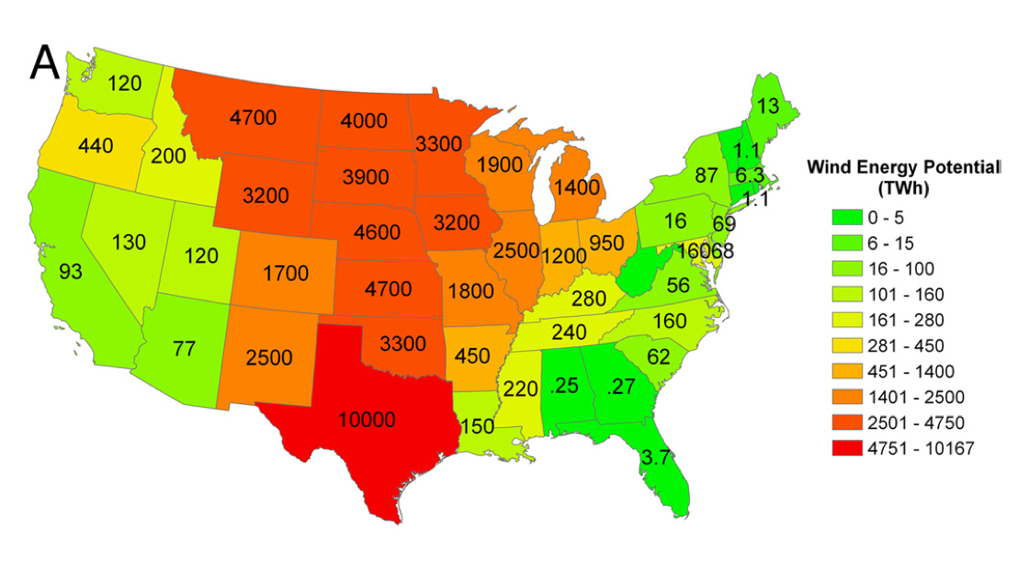
US enjoys tremendous wind resources
Lu et al., 2009, PNAS
Annual onshore wind energy potential on a state-by-state basis for the
contiguous U.S. expressed in TWh

Slide 9
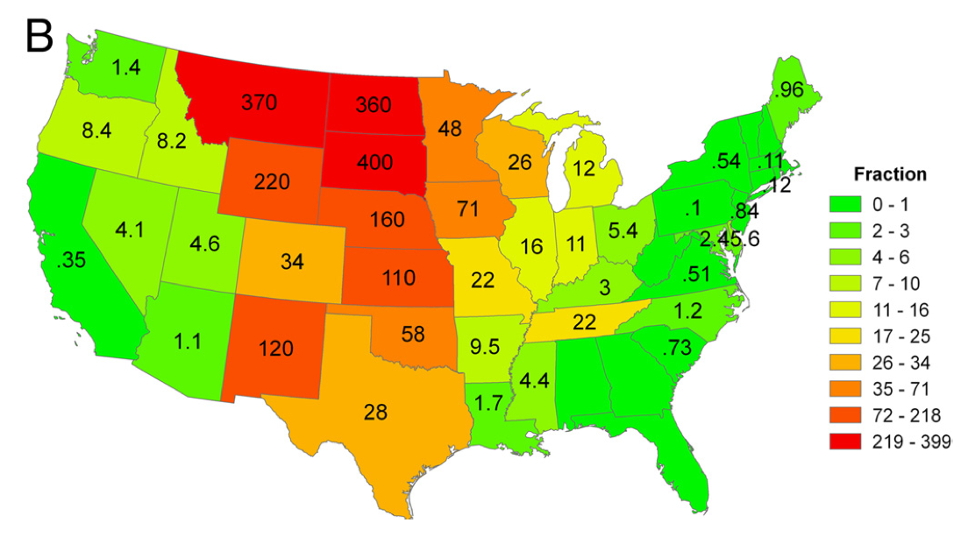
US enjoys tremendous wind resources
Lu et al., 2009, PNAS
Annual onshore wind energy potential on a state-by-state basis for the
contiguous U.S. expressed as a ratio with respect to retail sales in the
states in 2006.

Slide 10
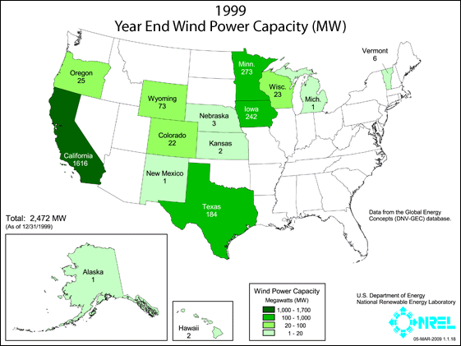

Slide 11
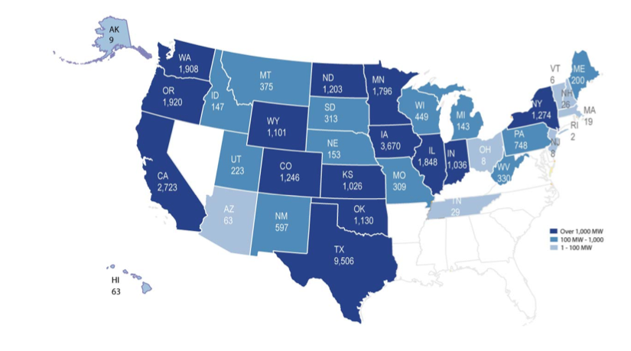
US has deployed > 36 GW of wind-generated electricity
> 1 GW
100MW – 1 GW
1-100 MW
AWEA, May 2010

Slide 12
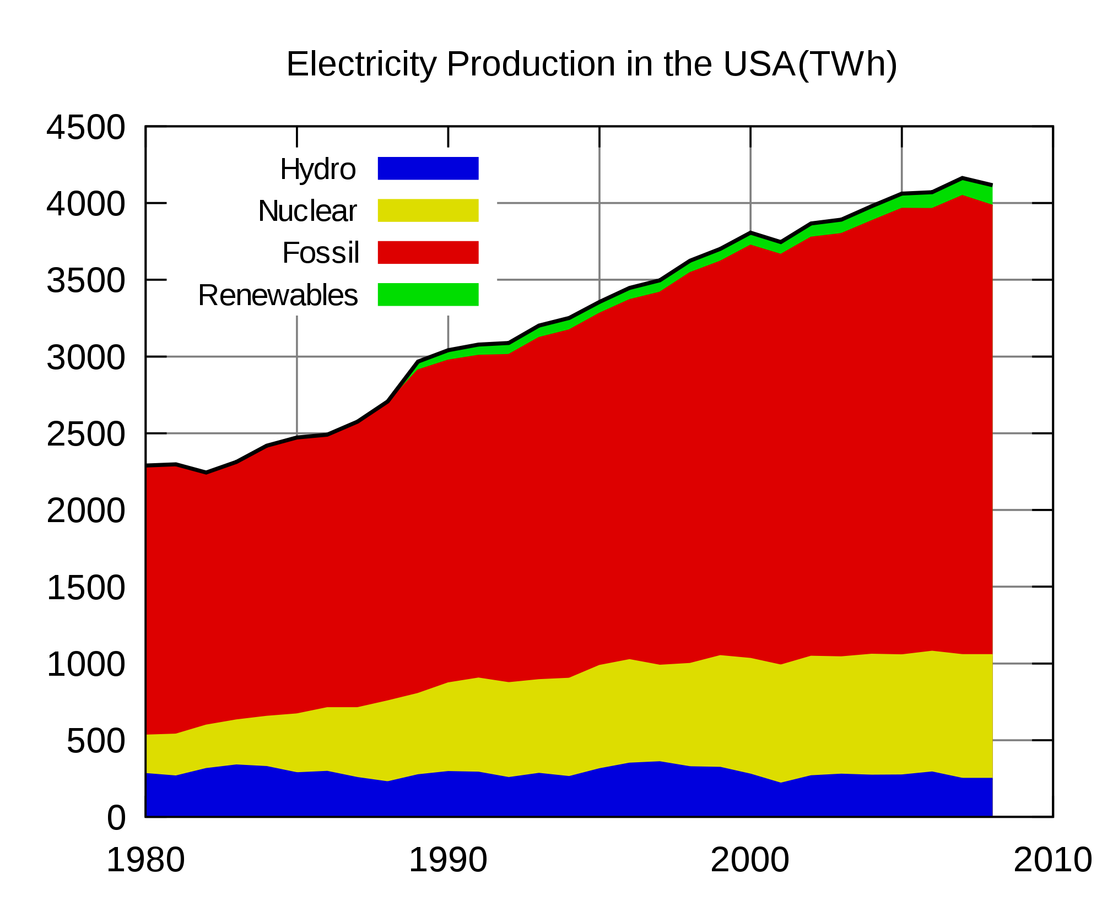
Wind is responsible for ~ 2% of US electricity production
TWh
http://tonto.eia.doe.gov/cfapps/ipdbproject/IEDIndex3.cfm?tid=2&pid=2&aid=12

Slide 13
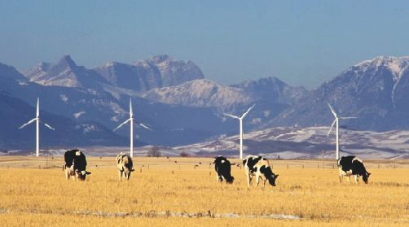
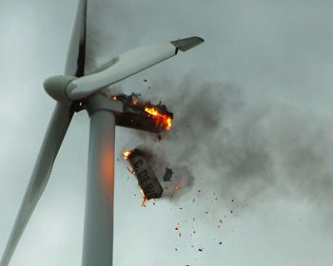
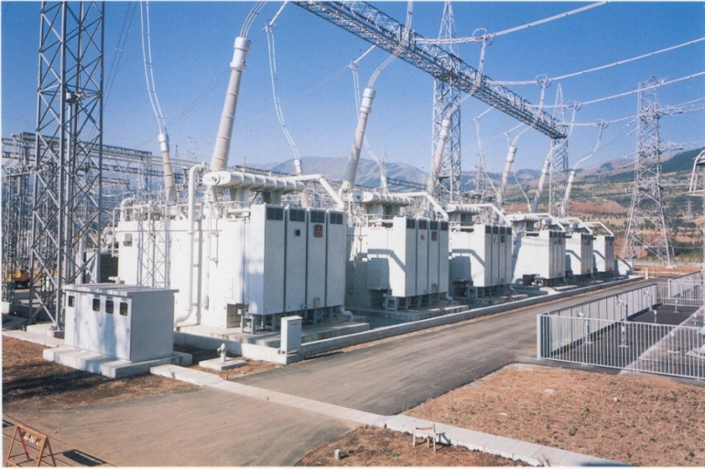
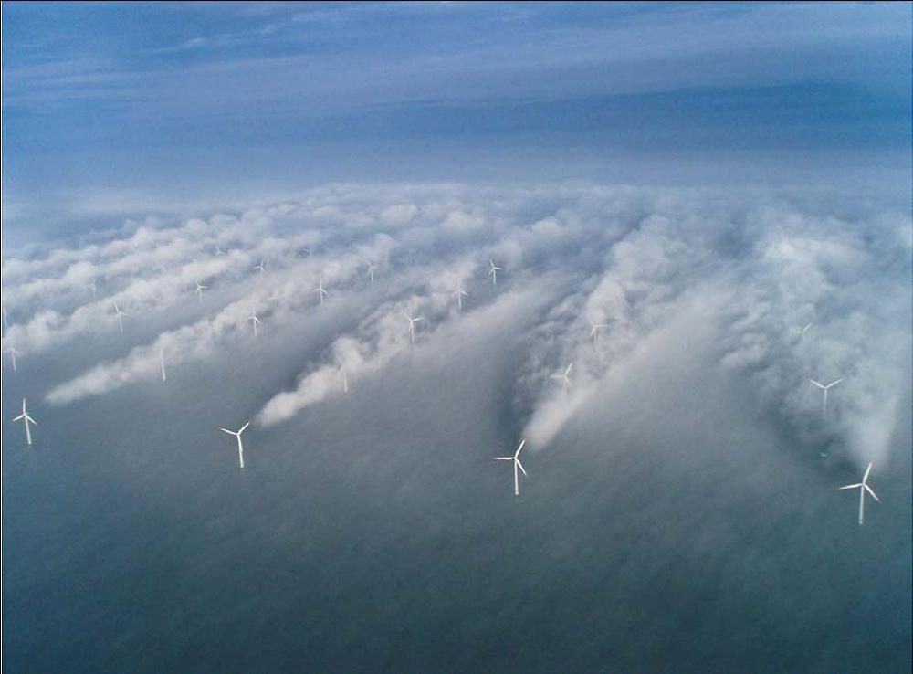
Advance of wind energy requires resolution of several exciting technical challenges
Rugged terrain features
affect winds – which site
is an optimal site over 20 years?
Fluctuating power from renewables must be integrated
into a constrained power grid built for scheduled power production: accurate forecasts + optimization
Turbine wakes lessen
power collected in large
arrays
Atmospheric turbulence & shear induce premature fatigue on gears & blades, increasing maintenance and replacement
costs

Slide 14
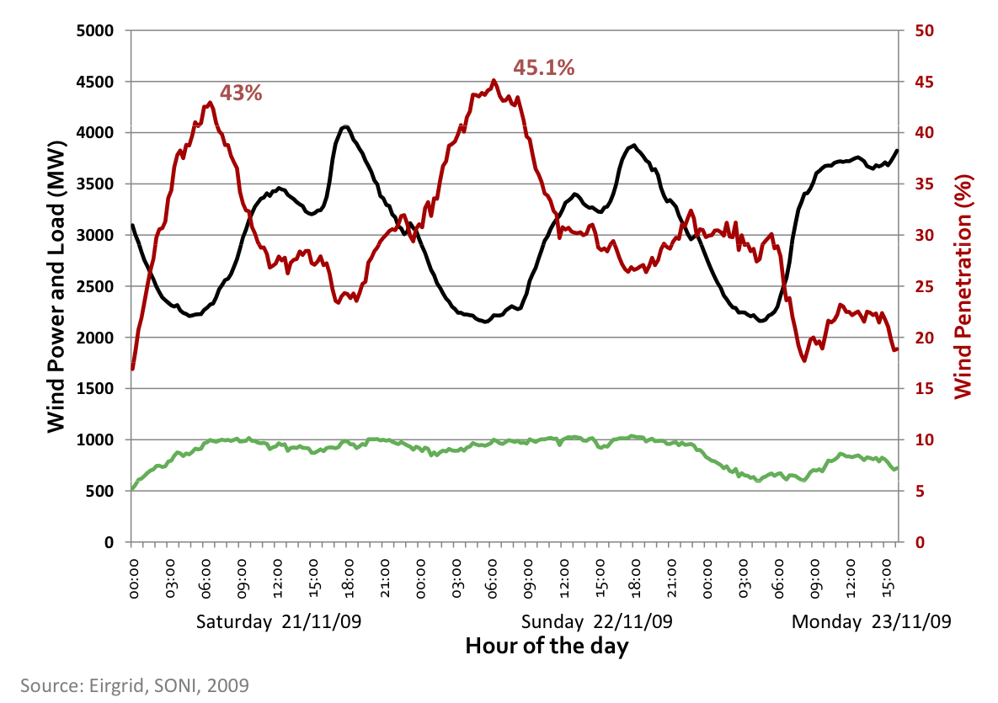
Though both demand and supply fluctuate, robust predictions of wind availability are required to balance load
An example from Ireland, where wind penetration is now ~ 15- 45%:
Total Load
Wind Generation
Courtesy Mark O’Malley, Director, Electricity Research Centre,
University College Dublin mark.omalley@ucd.ie http://www.ucd.ie/erc

Slide 15
Though both demand and supply fluctuate, robust predictions of wind availability are required to balance load
An example from Ireland, where wind penetration is now ~ 15- 45%:
Total Load
Difference must be anticipated to be met by
other power sources (coal, natural gas, solar)
Wind Generation
Courtesy Mark O’Malley, Director, Electricity Research Centre,
University College Dublin mark.omalley@ucd.ie http://www.ucd.ie/erc

Slide 16
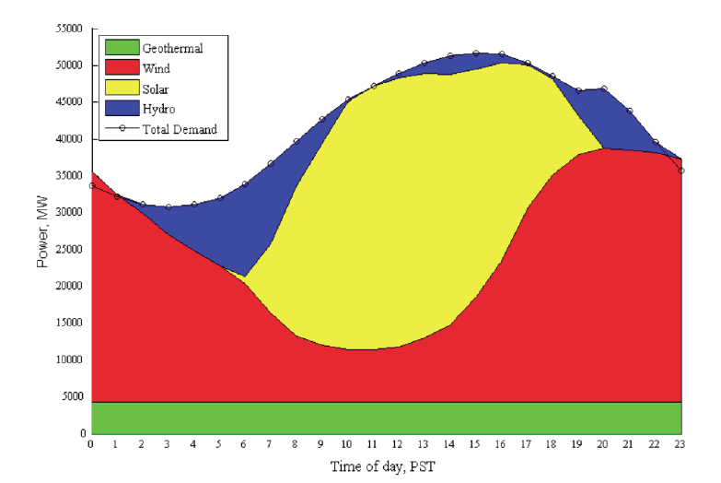
Could the grid be balanced with only renewables?
Modern wind turbines have rated power
of 2MW, hub height of 80 m and rotor
diameter of about 80 m
Mark Z. Jacobson and Mark A. Delucchi, 2009: Evaluating the Feasibility of a Large-Scale Wind, Water, and Sun Energy Infrastructure.” Scientific American, October 26, 2009.

Slide 17
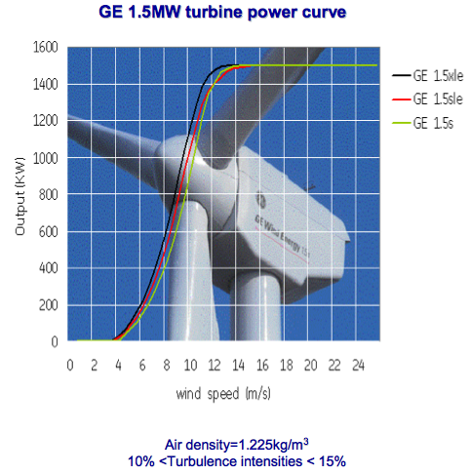
Turbine manufacturers provide power curves to quantify expectations for turbine performance
Cut-out speed
Power generated
Cut-in speed
Wind Speed, usually measured at hub height
Notes:
Power generated can be expressed in terms of kW, MW, or % of capacity. For example, if a Siemens 2.3 MW turbine was generating 1.15 MW, it would be at 50% capacity. If it was generating 2.3 MW, it would be at 100% capacity.

Slide 18
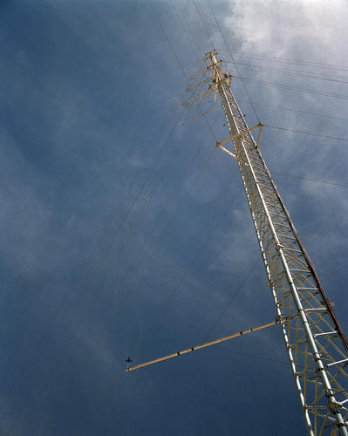
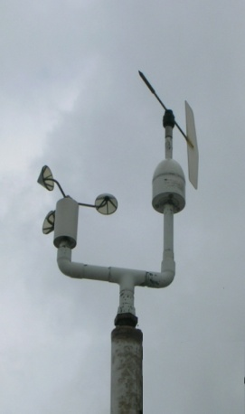
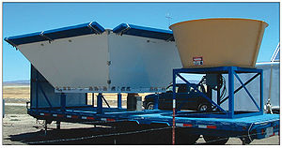
Power forecasting requires data – How is meteorology measured at a wind farm?
Meteorological data:
2 met towers w/ cup anemometers (u, v) at 5 heights (30, 40, 50, 60, 80 m), 10 min. avgs; (T, p measurements unusable)
RECENT DEVELOPMENT: SODAR observations (u, v, w) for 19 heights (20 m to 200 m, 10 m resolution), 10 min. avgs.
sonic anemometer
Vertical profile of
cup anemometers
Doppler Sound Detection and Ranging (SODAR)

Slide 19
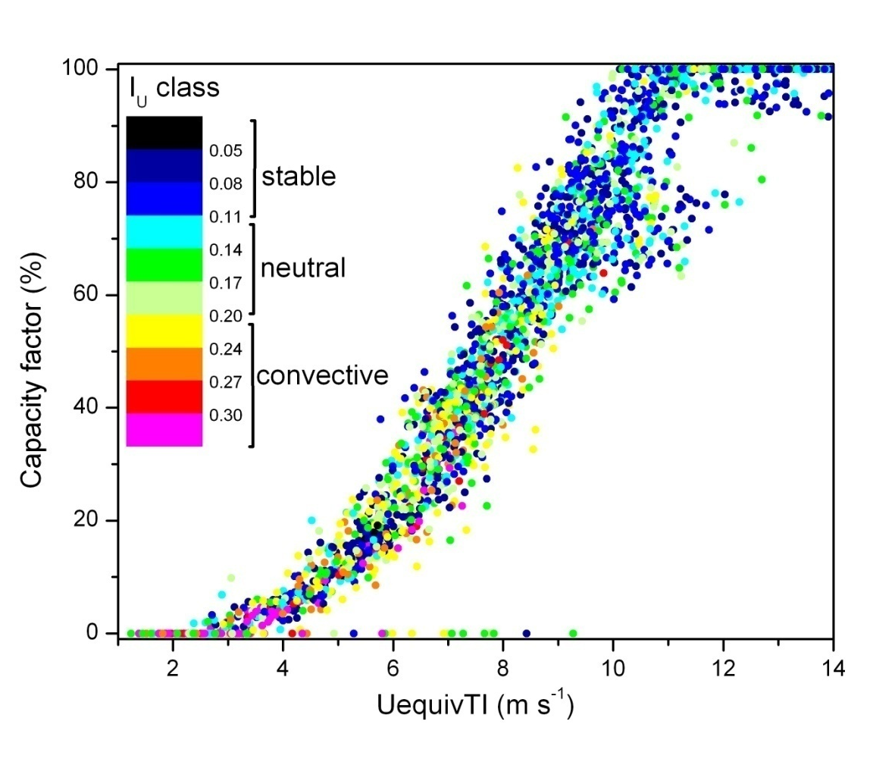
Power curves show tremendous variability – can we gain insight by considering atmospheric turbulence?
Capacity factor, CF (%)
P_{actual} : actual power yield of the individual turbine
P_{rated} : maximum power yield of the turbine as determined by the manufacturer
At 8 m s⁻¹ the CF ranges from 35% to 70%!
Wind Speed at hub height (ms⁻¹)
Wharton and Lundquist, 2010: “Atmospheric stability impacts on
wind power production”

Slide 20
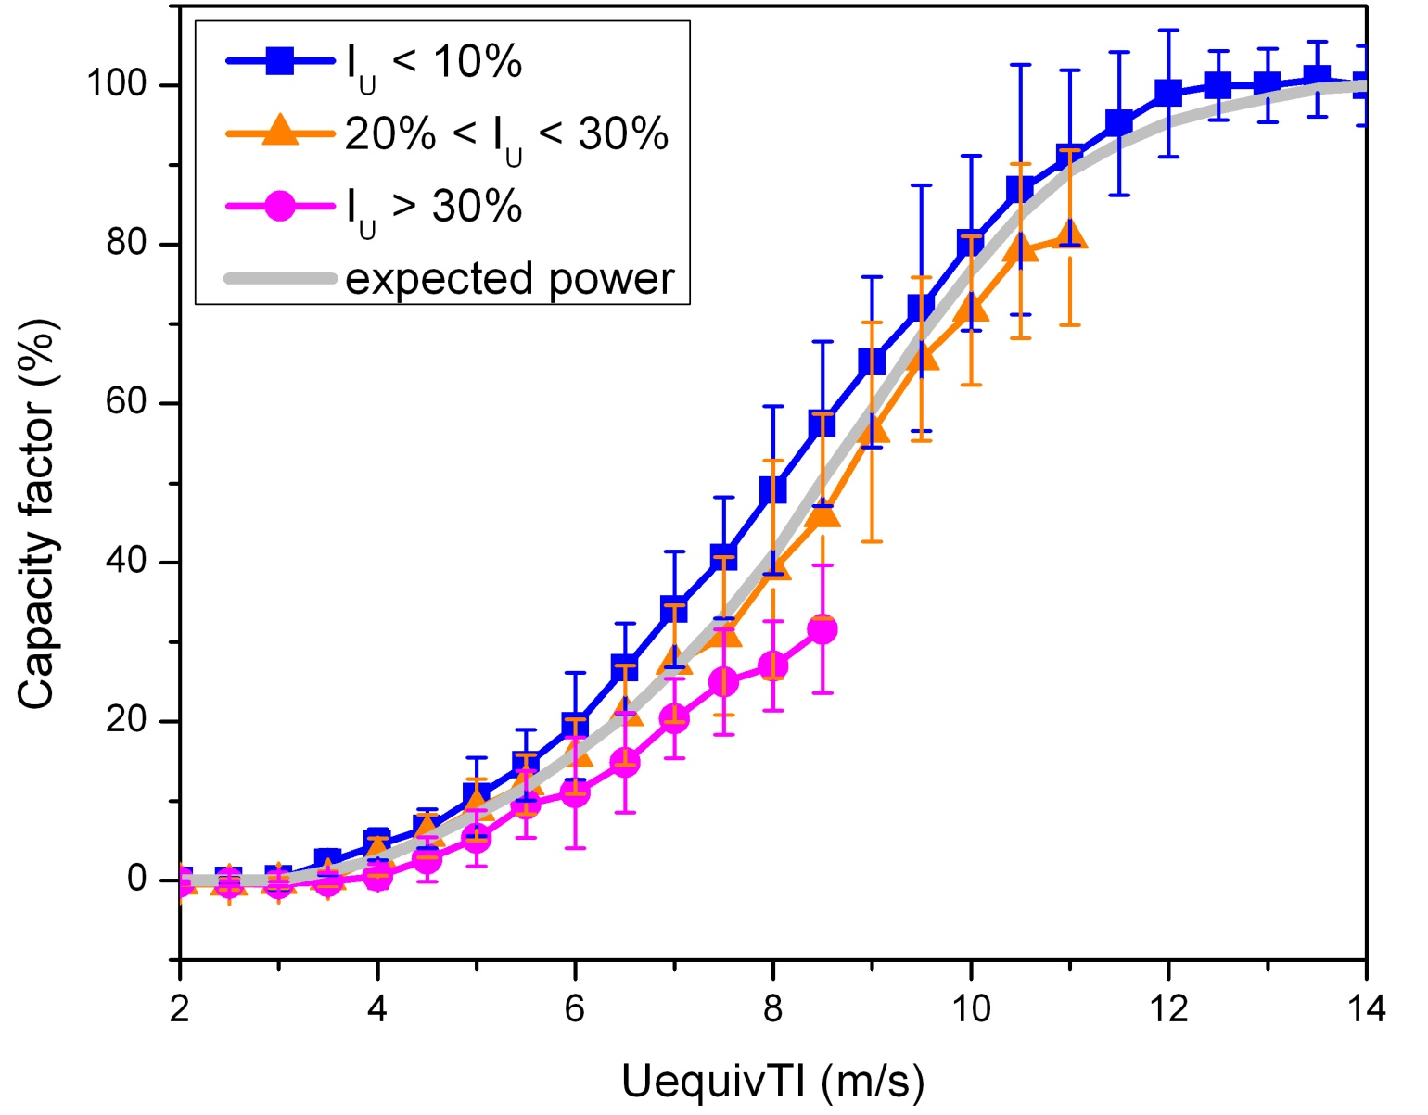
Stratification of power curves reveal atmospheric influences on power output
Stable
Neutral
Turbulent .
Wind Speed at hub height (ms⁻¹)
Wharton and Lundquist, 2010

Slide 21
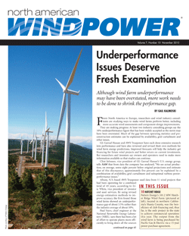
Wind farm “underperformance” can in part be explained due to incomplete resource assessment
Industry must upgrade resource assessment instruments:
  SODAR stability parameters segregate wind farm data into stable, neutral and convective periods in agreement with research-grade observations
  Cup anemometers inaccurate for turbulence
Power output correlates with atmospheric stability:
  Enhanced performance during stable conditions
  Reduced performance during convective conditions
North American Windpower, Nov. 2010

Slide 22
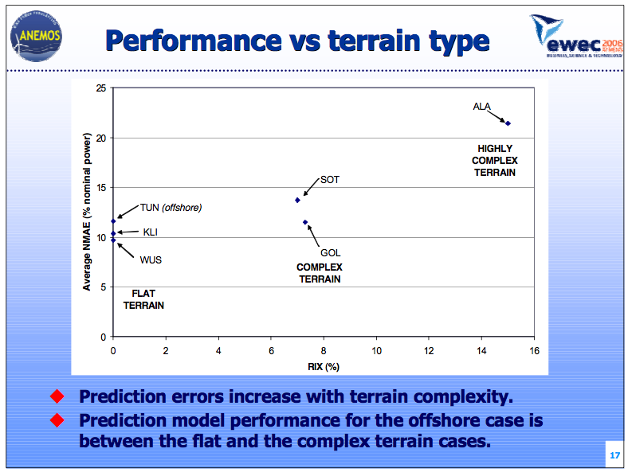
Forecasting wind power becomes very difficult in complex terrain
Marti et al., 2006; EWEC presentation, imarti@cener.com

Slide 23
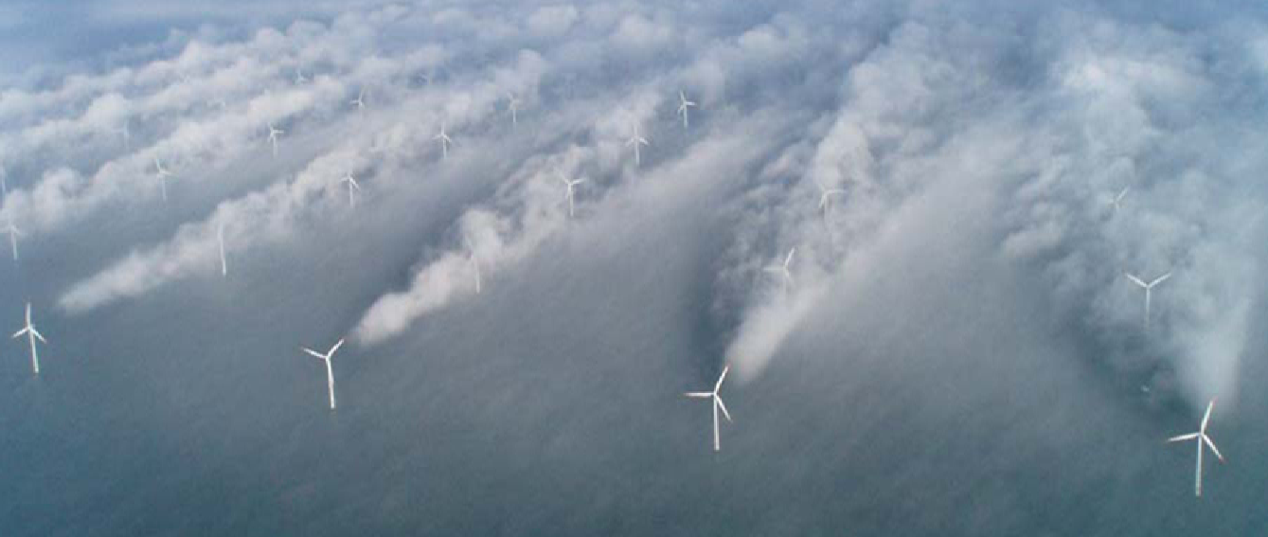
Turbine wakes undermine downstream power production and increase maintenance costs
Source: UniFly A/S
Horns Rev 1 owned by Vattenfall. Photographer Christian Steiness.

Slide 24
buoyant plume:
entraining dryer air, as a result of
downward momentum, temperature, and moisture fluxes
and stronger winds near the surface
significant lateral
wake growth likely
due to weaker
winds at right
Vertical velocity in wake
cools air forming cloud.
Latent heat release is
creating vertical buoyant
plumes and wave motions.
strong 3-D turbulent
mixing region
moist area near sea surface
capped by marine inversion
just above turbine rotors
stronger winds
horizontal wind speed gradient?
weaker winds
Annotation by Neil Kelley, NREL NWTC

Slide 25
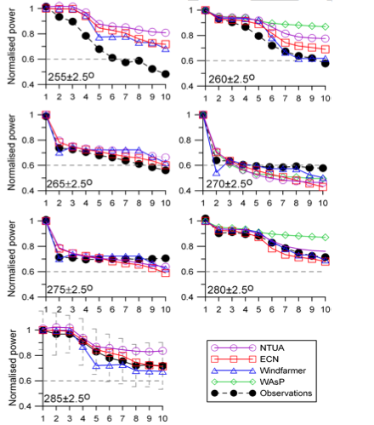
Turbine wakes have a severe impact on power production, depending on inflow angle relative to turbine orientation
1 2 3 4 5 6 7 8 9 10
Turbine Number in the Row
Models have a hard time matching
the observations!
Barthelmie R.J., et al. Modelling the impact of wakes on power output at Nysted
and Horns Rev. In EWEC, Marseille (2009).

Slide 26
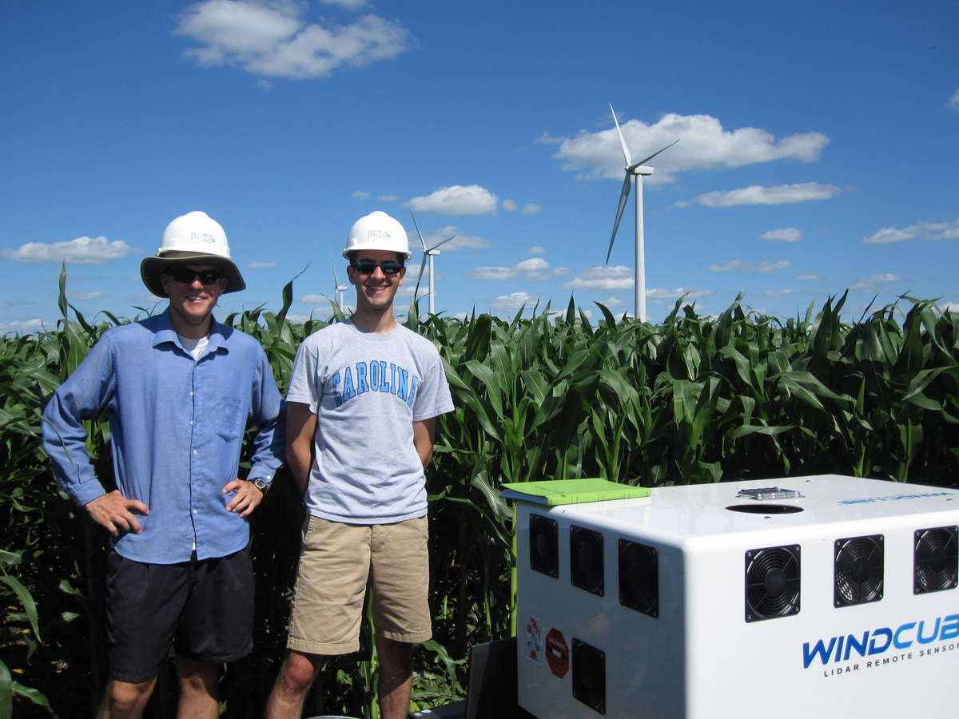
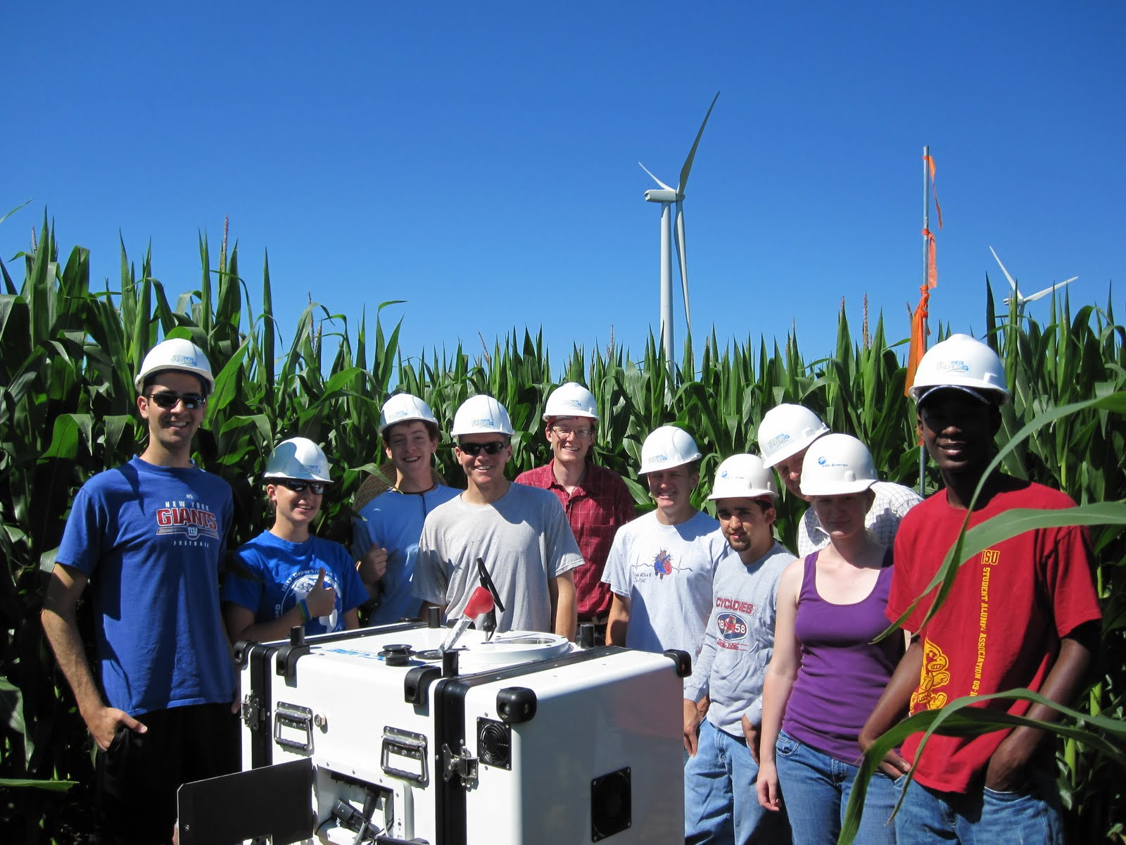
What are the downwind impacts of large wind farms?
BLADE – summer 2010, University of
Colorado collaboration
with Iowa State University
Rhodes et al., 2010:
Can turbine wakes be detected at
the surface? Do they impact crops?
Rotor Disk

Slide 27
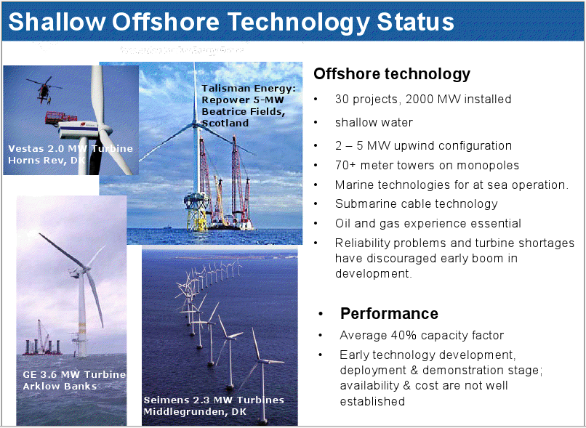
Modern wind turbines have rated power
of 2MW, hub height of 80 m and rotor
diameter of about 80 m
Mike Robinson, NREL NWTC

Slide 28
Why wind energy?
Wind is renewable domestic resource
Minimal CO₂ emissions
No water requirements
Wind turbines/farms are mature technology
Wind technology scales
Potential to generate jobs locally

Slide 29
This is an exciting time for wind energy!
Turbine wakes can be studied with
remote sensing equipment and
simulated to quantify impact
Power production issues can be
unraveled with new instruments
and new focus on atmospheric science
Forecasting skill can support
high grid penetration of wind energy
Julie K. Lundquist
Julie.Lundquist@colorado.edu
http://atoc.colorado.edu/~jlundqui

Slide 30
A few wind-related exercises
Define and understand “capacity factor” – a 1.5MW turbine does not always produce 1.5MW
How many turbines of a given size and a given capacity factor would need to be deployed to provide a given percentage of US electrical needs?
What would be the impact of introducing electric cars onto the utility of wind-generated electricity?
Map the evolution of a wind turbine wake and define the “optimal” downwind location of turbine #2

