Slide 1

energy and Energy policy in the classroom
James D. Myers
Professor, Department of Geology & Geophysics
Director, Wyoming CCS Technology Institute
University of Wyoming
Notes:
Supplying energy to an expanding global population with a rising standard of living while maintaining human and natural systems is an increasingly difficult task. Yet, it is a task that will largely determine the quality humanity’s future.

Slide 2
Energy: Increasing Awareness
in the past two decades, energy has grown from a topic that was occasionally reported in the media to one that is constantly in the news
  locally, nationally and internationally
witness:
  the last U.S. presidential election
  the continuing debate about alternative energies, i.e. solar, wind, biofuels/biomass, etc.
  the rush to “green” energy in the U.S.
  mandated moves away from electricity generated by fossil fuels, especially coal, by some states, e.g. California & Washington
Notes:
The importance of this task and the public’s awareness of its importance is evident in the way energy has been portrayed in the media in recent years. Over the past two decades, energy has grown from a topic that was occasionally in the news to one that is virtually front and center always. This change in media coverage is evident at all levels. Local, national and international media outlets all report more frequently on energy issues and their ramifications for different segments of the human population.
Evidence for this shift in focus are particularly easy to cite in the last year or so. Witness, for example, the

Slide 3
Energy: A Grand Challenge
energy is perhaps the most pressing of the grand challenges facing humankind
  tied to:
    water: both for energy production and water as a resource itself
    mineral resource utilization: mining is especially energy intensive
    social & human development: requires energy of all forms
associated concerns and challenges are many, complex and multifaceted
  vary spatially: local to regional to national to (increasingly) international
  vary temporally: short-term (days/weeks) to long-term (decades)
are not isolated, but closely interrelated
  requiring multiple perspectives

Slide 4
Energy: Concerns & Challenges
energy concerns can be broadly grouped into three categories:
  supply: Is there enough to supply a growing world marked by increasing demand, e.g. Peak Oil? Peak Natural Gas?
  access: How do political, social and cultural factors influence or control availability of energy supplies, i.e. energy independence?
  environmental impact: How does the production and use of different energy sources impact the environment?

Slide 5
Energy Solutions
solutions to energy issues must be multifaceted as well
historically, based on energy science, technology & economics
  not always the most just solutions
solutions are more sustainable, equitable and effective when additional perspectives are considered
  environment, social institutions, culture, politics, etc.
  demonstrated many places and times
  usually only considered when there is excess wealth
symbolically, this condition can be expressed as:

Slide 6
Energy Solutions
the additional perspectives of energy issues, i.e. economics, environment, social, etc., are defined by social context
to illustrate, consider the following cases:
  hydrocarbons: Norway and Nigeria
  coal: U.S. and China
recognizing the importance of social context, our symbolic representation becomes:
Notes:
The economics, environmental, social and other perspectives of energy solutions are determined by social context. For example petroleum production has had vastly different impacts in Norway and Nigeria. In Norway, the discovery of the oil and gas fields of the North Sea have been an economic boon for the country. In addition to carefully guarding their environment as well as social and political institutions, Norway has set aside a portion of its hydrocarbon wealth for future generations. Few would argue against the overall good of hydrocarbon production in this nation.
Conversely, Nigeria’s hydrocarbon reserves have had a much less positive impact. They

Slide 7
Energy: Preparing Citizens
all citizens will be increasingly required to make decisions about:
  their personal use of energy & its impacts on their environment
  whether to support or oppose various regional/national/international polices on energy
to make effective, equitable and just decisions on these types of issues, the nation will need a public conversant with the many aspects of energy
  thus, energy education at all levels is of paramount importance for building a sustainable and just energy future

Slide 8
Energy Education: Geosciences
historically, energy debates required knowing and understanding:
  conventional fossil fuels (petroleum, coal, natural gas)
  nuclear power
  hydroelectric power
these topics, particularly the fossil fuels, routinely found themselves into geoscience courses and curricula
  thus, there was a sound connection between the geosciences and energy
  geoscience faculty were generally well versed in these topics

Slide 9
Energy Education: Other Views
with the evolving energy debate, citizens are faced with a host of new energy sources and technologies:
  unconventional fossil fuels: oil sands, heavy oil, shale gas, LNG
  alternative energies: solar, wind, biofuels/biomass, hydrogen fuel cells
other associated technologies/issues:
  carbon capture and storage, e.g. geologic sequestration, ocean sequestration, biological sequestration
  importance of energy return on investment (EROI)
  life cycle assessment of the environmental impacts of energy production/use
science, including geoscience, faculty generally are not necessarily well versed in these topics

Slide 10
Energy Instruction (EI)
energy instruction must be multi-dimensional
  energy science/context and technology are critical - defined by subject area
  social context necessary to connect subject and student - determined by instructor’s interest
effective learning requires, however, another dimension - pedagogy
  ensures student success in the classroom
  facilitates transfer of classroom knowledge to real world

Slide 11
Energy Instruction (EI)
our earlier symbolic representation of energy solutions fails to capture this important component:
must be modified to explicitly recognize the role of pedagogy in teaching energy
  with this addition, representation for teaching energy becomes:

Slide 12
EI: Energy Science: The Need
energy discussions involve:
  large number of primary energy sources (PES)
  different array of trading units
  variety of units to express energy density
PES have different physical states, e.g. solid, liquid, gas
  determines usefulness for different applications
read/hear about these all the time in the media
  to contribute to the discussion need to understand this background material

Slide 13
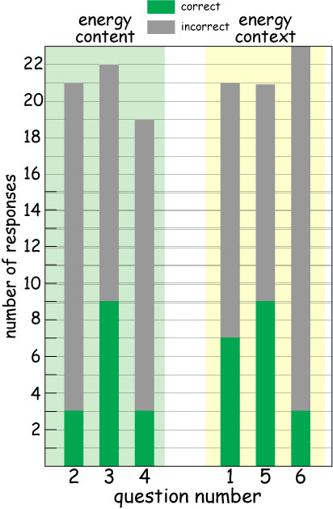
EI: Energy Science: Grasp
  Which thermodynamic quantity is a measure of the quality of energy?
  The thermodynamic efficiency of a heat engine is determined, in part, by what factor?
  The zeroth law of thermodynamics defines what thermodynamic quantity?
Notes:
Unfortunately, the general public’s understanding of energy science can be rudimentary. Even individuals actively engaged in teaching science may have gaps in their understanding of the science of energy. In May, we asked individuals attending a SERC workshop on teaching energy in Wyoming these three questions about energy science. Surprisingly, out of approximately 21-23 respondents the vast majority did not answer the questions correctly. Similar results were found for middle and high school teachers engaged in a Wyoming MSP project on energy and the environment.

Slide 14
EI: Energy Science: Scope
multidimensional: biology, chemistry, Earth science, physics
  requires explicit integration
some key subject areas are absent in most undergraduate science courses:
  thermodynamics
uses a language in which every day words have special meanings, e.g. heat, work, energy, etc.
  potential source of confusion for students (Solomon, 1983)
Notes:
Given its broad and diverse character, energy science is multidimensional in nature. It encompasses biology, chemistry, Earth science and physics to name just a few disciplines. Dealing with energy science requires explicitly integrating these disciplines to illustrate the richness and complexity of energy. In addition, some key subject areas important in understanding energy are commonly absent from undergraduate science courses. One that immediately comes to mind is thermodynamics, which describes and explains virtually all phenomena involving heat and matter. Additional barriers to energy instruction are created by the use of everyday words that have special, precise meanings with respect to energy. This co-mingling of vocabularies is often a major source of confusion for students.

Slide 15
EI: Energy Context: Impact
energy discussions always have a context
  What country? What is the environment like?
energy context provides information about energy systems/issues’:
  scale
  technology(ies)
  economics
information critical to evaluating different solutions
  choosing most viable energy solution
Notes:
In addition to being constrained by scientific principles, energy issues/problems also have a particular context. This context provides information about energy systems and/or issues that are relevant to a particular discussion. Context determines scale (temporal and spatial), the technologies involved as well as the relevant economics. These types of information are critical to evaluating different energy scenarios and solutions. In large part, they determine which energy solution is most viable and likely of success.

Slide 16
EI: Energy Context: Grasp
Which nation exports the most petroleum to the United States?
Which nation is the third largest producer of petroleum in the world?
Which nation has more nuclear reactors?
Notes:
Like energy science, energy context is a subject few people have a good and reliable grasp of. In addition to the energy science questions, the participants at the SERC energy workshop were asked these three questions about energy content. Most people did not answer these questions correctly either. And yet this type of information is important in addressing some of the most pressing issues facing our nation as we have seen in the previous slide.

Slide 17
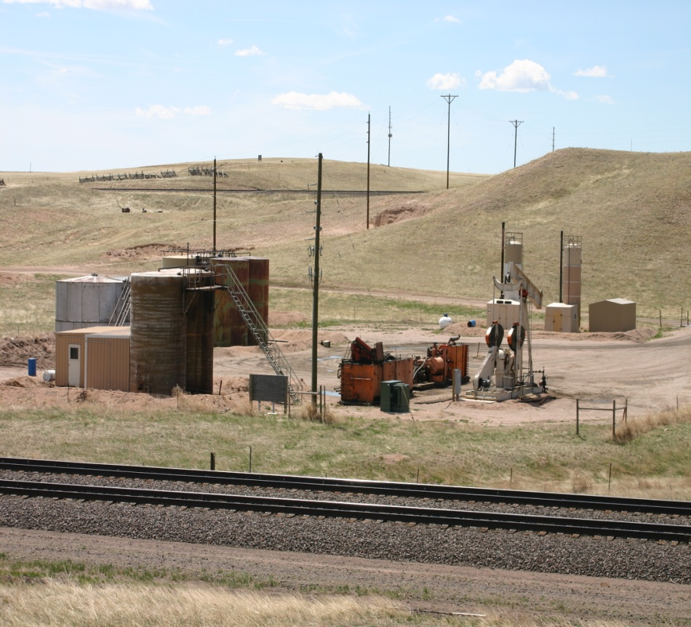
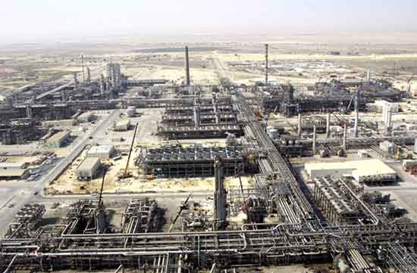
EI: Energy Context: An Example
How can the U.S. achieve energy independence with respect to petroleum?
U.S. oil production
Saudi oil production

Slide 18
EI: Technology
indicates what is physically possible
increasingly important as we reach the end of fossil fuel era and look for a new energy future
  debates about wind and solar, all have key technological components
switch to “green” energy will be heavily influenced by technology, e.g. biofuels
these types of discussions are critical if we are to make a successful transition from fossil fuels
  didn’t get it right for nuclear
  can’t afford to make a similar mistake with green energy

Slide 19
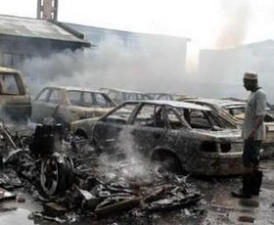
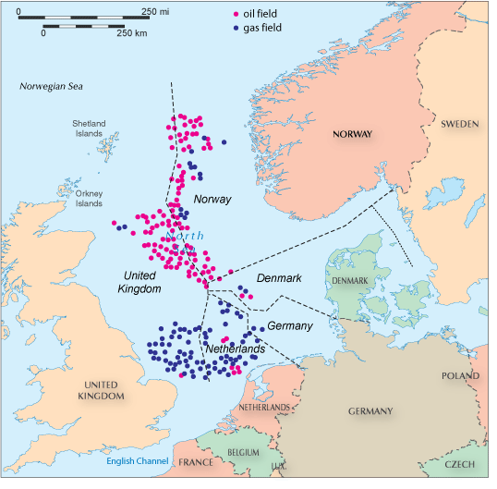
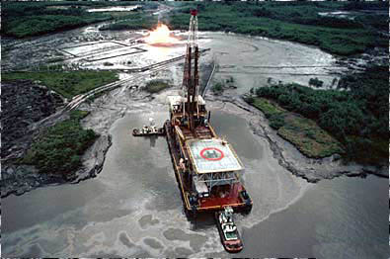
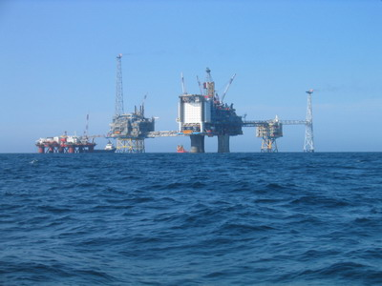
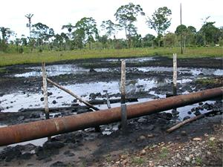
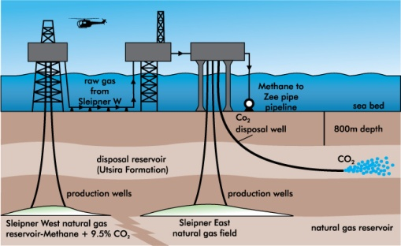
EI: Other Perspectives
the additional perspectives of energy issues, i.e. economics, environment, social, etc., are defined by social context
to illustrate, consider the following cases:
  coal: U.S. and China
  petroleum/gas: Nigeria and Norway
Nigeria
Norway
Notes:
The economics, environmental, social and other perspectives of energy solutions are determined by social context. For example, petroleum production has had vastly different impacts in Norway and Nigeria. Production of Nigeria’s hydrocarbon reserves has produced many negative social, political, economic and environmental impacts. The vast wealth flowing into the country has funded massive corruption, inequitable distribution of wealth and pity various ethnic factions against each other. Political unrest has characterized the Niger Delta where various groups routinely capture foreign and domestic oil workers and hold them for ransom. Acts of vandalism and terrorism against the country’s oil infrastructure has produced serious environmental damage as well as loss of life. In addition, lax environmental laws and their enforcement have resulted in significant damage to the wetlands of the delta.
In Norway, the discovery of the oil and gas fields of the North Sea have been an economic boon for the country. Production from the fields has made Norway one of the world’s biggest exporters of oil and gas. The country has protected its environment with strict laws. For example, they have required the sequestration of carbon dioxide produced from natural gas production at Sliepner, the first such operation in the world. In addition to carefully guarding their environment as well as social and political institutions, Norway has set aside a portion of its hydrocarbon wealth for future generations. Few would argue against the overall good of hydrocarbon production in this nation.

Slide 20
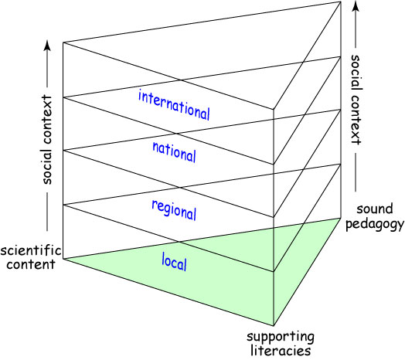
EI: Social Context
social context provides relevancy for science
context provided by:
  addressing topical issues in the news
  varying scope from local to international
social context introduces:
  different viewpoints & perspectives
  a connection to students’ lives

Slide 21
EI: Pedagogy
includes, but goes beyond, classroom techniques
addressing student mis/pre/naïve conceptions
  abundant educational literature that shows students (at all levels) have many problems with understanding energy
pedagogy must be aimed at developing a particular student skill set:
  mastery of scientific literacy
  ability for critical thinking and problem solving
  capacity to handle uncertainty and ambiguity
  proficiency with a specialized skill set:
    quantitative reasoning
    discipline specific toolkit, i.e. reading maps
    capacity to transfer knowledge from classroom to “real” world

Slide 22
EI: Pedagogy
includes, but goes beyond, classroom techniques
addressing student mis/pre/naïve conceptions
  abundant educational literature that shows students (at all levels) have many problems with understanding energy
pedagogy must be aimed at developing a particular student skill set:
  mastery of scientific literacy
  ability for critical thinking and problem solving
  capacity to handle uncertainty and ambiguity
  proficiency with a specialized skill set:
    quantitative reasoning
    discipline specific toolkit, i.e. reading maps
    capacity to transfer knowledge from classroom to “real” world

Slide 23
EI: Pedagogy: Conceptions
students enter classes with energy
  preconceptions
  misconceptions
  naïve conceptions
need to probe them to impact this conceptions
three especially important areas to probe are:
  energy science
  energy context
  quantitative literacy (fundamental literacies)
variable amount of literature on each topic

Slide 24
EI: Pedagogy: Conceptions
different audiences studied
  many at K-12
subject area dominated by physics
  What is energy?
  What is work?
  Is heat the same as internal energy or thermal energy?
  How are fossil fuels generated?
literature also talks about how to teach the content of energy
need research on the impacts of energy context

Slide 25
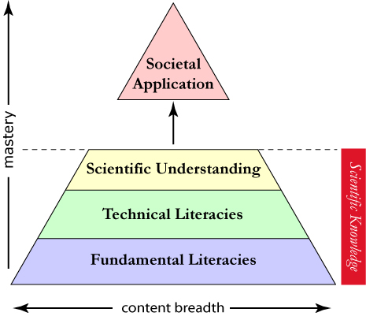
EI: Skill Set - Literacies
Mastering science and applying it to everyday decisions and issues requires a set of specialized skills that are often overlooked. These are literacies, i.e. the skills, competence and knowledge necessary to produce meaning.
fundamental literacies: ability to read & interpret data and make computations
technical literacies: skills specific to a scientific discipline
Notes:
Investigating the natural world through the application of science and scientific principles requires making sense of large amounts of data, assessing qualitatively the importance of different factors and performing simply calculations. These skills constitute the fundamental literacies. They are crucial to working in the real world as well as the scientific realm. These skills are important in nearly all professions, e.g. social sciences, humanities, etc., as well as in everyday activities, e.g. selecting the best cell phone plan. It is likely that you were introduced to many of these skills at some point in your educational career. However, the lack of practice may have dulled your ability to apply these skills.
Understanding and using scientific content requires mastering a series of technical literacies. Although some of them vary from one scientific discipline to another, other technical literacies are shared by a number of scientific disciplines. Unlike with the fundamental literacies, many individuals will have had limited, if any, experience with these types of skills. Yet, a quick perusal of any introductory science textbook will demonstrate clearly the importance of these literacies in understanding and applying scientific content.
Combining the fundamental and technical literacies with scientific content produces scientific understanding, i.e. the ability to use scientific knowledge in new settings and to draw correct inferences and conclusions from scientific reasoning. Most introductory science courses are designed to go only this far in their instruction. They assume students can apply what they have learned in the course to societal applications without further assistance. In addition, many assume students have mastered the two literacies or will learn them on their own during the course. They rarely provide systematic and meaningful practice with these critical tools.

Slide 26
EI: Skill Set - Literacies
combined with scientific content, produce scientific understanding
most science courses assume students:
  have adequate fundamental & technical skills
  will independently get help if they don’t
Notes:
Investigating the natural world through the application of science and scientific principles requires making sense of large amounts of data, assessing qualitatively the importance of different factors and performing simply calculations. These skills constitute the fundamental literacies. They are crucial to working in the real world as well as the scientific realm. These skills are important in nearly all professions, e.g. social sciences, humanities, etc., as well as in everyday activities, e.g. selecting the best cell phone plan. It is likely that you were introduced to many of these skills at some point in your educational career. However, the lack of practice may have dulled your ability to apply these skills.
Understanding and using scientific content requires mastering a series of technical literacies. Although some of them vary from one scientific discipline to another, other technical literacies are shared by a number of scientific disciplines. Unlike with the fundamental literacies, many individuals will have had limited, if any, experience with these types of skills. Yet, a quick perusal of any introductory science textbook will demonstrate clearly the importance of these literacies in understanding and applying scientific content.
Combining the fundamental and technical literacies with scientific content produces scientific understanding, i.e. the ability to use scientific knowledge in new settings and to draw correct inferences and conclusions from scientific reasoning. Most introductory science courses are designed to go only this far in their instruction. They assume students can apply what they have learned in the course to societal applications without further assistance. In addition, many assume students have mastered the two literacies or will learn them on their own during the course. They rarely provide systematic and meaningful practice with these critical tools.

Slide 27
EI: Skill Set - Literacies
a liberal education is founded on concept of transfer
  use of information/skills of one domain in another domain (Robins, 1996)
many studies show little transfer between classes
yet, introductory science courses assume implicitly transfer of science knowledge to real world
  rare, even for best students

Slide 28
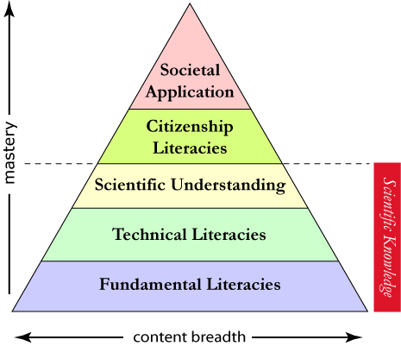
EI: Skill Set - Literacies
to facilitate classroom to real world transfer, Myers & Massey (2008) defined the citizenship literacies
skills necessary to apply scientific understanding and knowledge to a variety of complex societal problems

Slide 29
EI: Skill Set - Literacies
three citizenship literacy classes:
  critical thinking
  understanding social context
  informed engagement
designed to:
  help students connect science to real problems in meaningful and effective way
  enable them to be effective spokespersons

Slide 30
Summary
energy is one of the fundamental grand challenges facing humankind
  tied to many other grand challenges, e.g. water, climate change
just, equitable and sustainable energy schemes require knowledge from multiple perspectives
  energy science (chemistry, physics, life sciences, earth sciences), energy context, technology, multiple perspectives (social, political, cultural, economic)
in the future, U.S. citizens will increasingly face energy questions
  surveys show they are ill-prepared for these debates
  general public’s understanding of energy issues is limited and imprecise

Slide 31
Summary
in light of these trends, teaching energy will be increasingly important
we can prepare students better, but not by teaching only energy content
better preparation requires addressing:
  energy science
  energy context
  technology
  multiple perspectives, e.g. economic, political, legal, etc.
    established by a particular energy issue’s social context

Slide 32
Summary
other instructional changes we must make include:
  integrating energy instruction across multiple courses
  using multidisciplinary teams to create energy courses that address multiple perspectives
difficult challenge, but one that is crucial for the nation’s as well as humankind’s sustainable future

