Slide 1
Strategic Decisions:
Elements of a Satisfying Life
Richard Yuretich

Slide 2
The Productive Environment Scorecard™
Adapted from Meggin McIntosh, The Productivity Professor™
Complete the survey honestly.

Slide 3
The Productive Environment Scorecard™
105 -117: Congratulations! You’re a model for the rest of us!
79-104: You’re on the right track, but there’s room for improvement.
53-78: You’re frequently stressed and have a sense that you’re not being as effective as you want to be (and need to be).
27-52: Disaster is looming if changes are not made soon!
< 26: Get help immediately!

Slide 4

Time and Task Management
CALM
Clear your clutter (physical and mental)
Admit and announce that you can’t do it all
Learn to let go
Maximize what is most meaningful

Slide 5
Dealing with Clutter
Clutter is anything that has no current value, merit, or use.
Clutter is clutter no matter where it is.
Clutter is postponed decisions.
80-90% of paper in a file cabinet will never be accessed again (for computer files, it’s more like 99%)!

Slide 6

Dealing with Clutter
“What is the worst possible thing that could happen if I get rid of this?”
“Can I get this information somewhere else?”
Time spent on organizing will be repaid with interest.

Slide 7
Interruptions
Self-Interruption is the greatest distraction
Don’t do it now – write it down!
Close your door when you want to work in peace.
You don’t have to answer that phone or respond to that email message!

Slide 8
Managing E-mail
Turn off the automatic notification!
Check e-mail a few times a day – schedule it!
You get less if you send less.
Don’t respond to trivia.
Wait 24 hours for replying
Keep in-box EMPTY!
“Never check email in the morning”
by Julie Morgenstern

Slide 9
Use Time Well
Focus on the task at hand = mindfulness
Take advantage of short time periods
Work mindfully; take a break.
Schedule your thinking, planning, writing time and stick to it!

Slide 10
Multitasking Myths
Human brain not wired for it.
Wastes more time than gains.
Leads to mindlessness
Successful people are not multi-taskers, but those who can focus for short intervals.

Slide 11
Margins
Get to the airport early: 90 minutes!
Arrive at meetings 10 minutes ahead of time.
Leave spaces in your calendar before and after events.
Build in preparation time.
Build in follow-up and clean-up time.
Always keep some time unstructured.

Slide 12
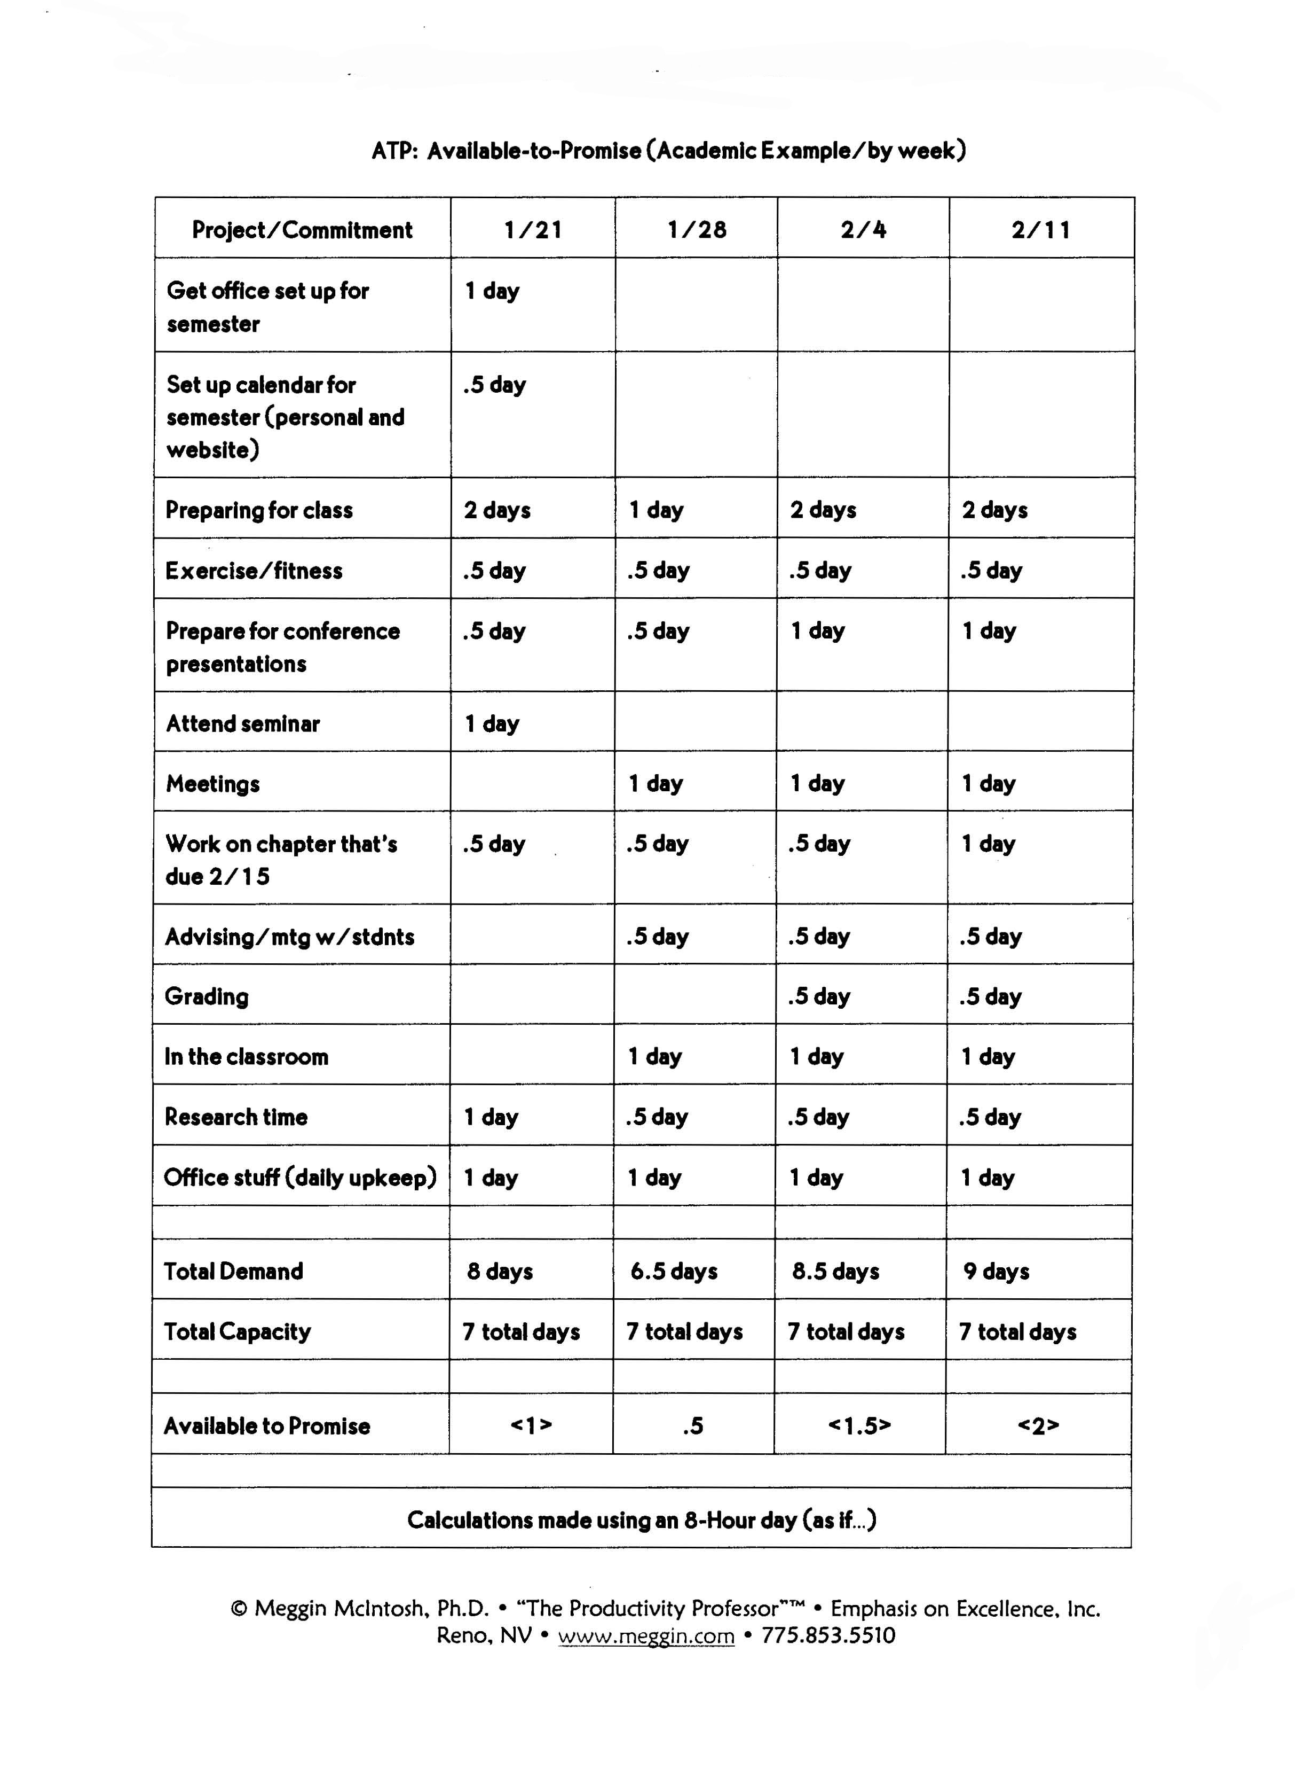

“Available to Promise”

Slide 13

Work, Life, Tenure
Work is an integral part of your life, but only part. Treat it as such.
Tenure is part of a natural trajectory of success.
Use plans to guide you in achieving your goals.

