Slide 1
Topics for lessons are on each table.
Please sit at a table with a topic for which you could see yourself designing a lesson.
Atmospheric circulation
El Niño
River floods
Eutrophication
Climate change
Cycles and residence time
Minerals
Earthquakes
Mass extinction

Slide 2

Lesson Design: Preparing for a Class Period
Rachel Beane and Heather Macdonald

Slide 3
Lesson Design
Approaches to preparing to teach a lesson
Key elements of lesson design
Examples of interactive activities
Sequential activities in which you will work on designing a lesson you might teach
Framework for review

Slide 4
Imagine Next Year
The syllabus gives ABC as the topic of the day.
How will you prepare for that class?
Notes:
Take a few minutes and make a list of the steps, the process. Just for you (not to share).

Slide 5
One Example of Preparing for Class
Do I really want students to learn about this topic/concept?
Why is the topic important?
How does the topic fit into the overall course context?
What are the 2-5 main points?
Can I teach students this topic in a ways that will help them learn other other course concepts and skills?
What do I want the students to be able to do by the end of this class period?
What graph, figure, equation, or example is key to this class?
What will students do?
Script the lesson from beginning to middle to end.
Prepare slides, handouts, etc.
Review in the hour before class.
Notes:
Show this as one approach (not included in handout but will be in ppt) and then some questions about how many thought of these things. Other things one might consider? Table discussions with a few call out points at the end. What are the questions for the table discussions.

Slide 6
What will students do?
Design activities
Students learn when they are actively engaged in practice, application, and problem solving
(NRC, 1999 How People Learn)
Goals
Assessment & Feedback
Activities
course context
Notes:
Students learn when they are actively engaged in practice, application, and problem solving (NRC, 1999 How People Learn)
What examples of activities have YOU learned today? – reflect on prior learning of day

Slide 7
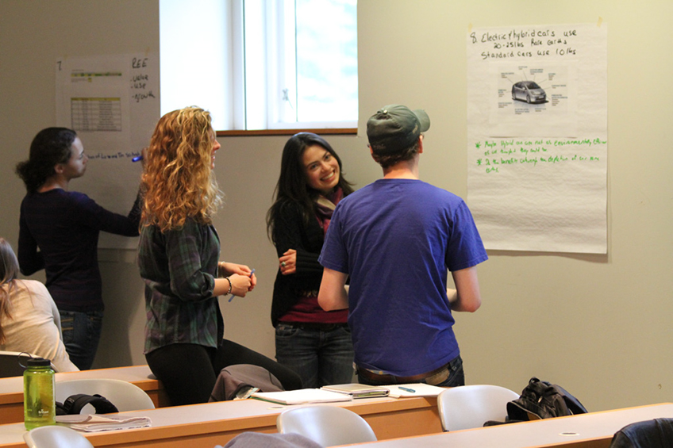
Interactive Activities
Gallery Walk
Think-pair-share
ConcepTest
Lecture Tutorial
Debate
Jigsaw
Concept Map
…
Gallery Walk introducing REE in 30 person, non-majors course.
Photo by Kevin Travers, Bowdoin College.
http://serc.carleton.edu/NAGTWorkshops/earlycareer/teaching/toolkit.html
Notes:
First 4 covered this morning in various sessions. Want to briefly introduce concept Maps and Jigsaws now.

Slide 8
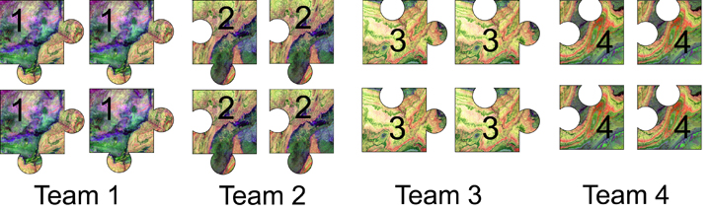
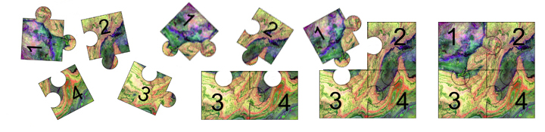
Jigsaw
From Barbara Tewksbury http://serc.carleton.edu/NAGTWorkshops/teaching_methods/jigsaws/index.html
Notes:
/9746 /31620 In a jigsaw, the class is divided into several teams, with each team preparing separate but related assignments. When all team members are prepared, the class is re-divided into mixed groups, with one member from each team in each group. Each person in the group teaches the rest of the group what he/she knows, and the group then tackles an assignment together that pulls all of the pieces together to form the full picture, hence the name jigsaw

Slide 9
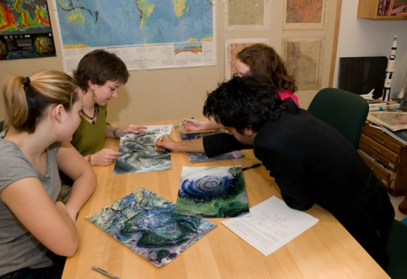
Jigsaw Examples
Plate tectonics. Teams analyze earthquake, volcano, seafloor age, and topography data maps, then combine to draw plate boundaries and interpret processes.
Google Earth. Each team analyzes different locations that show similar features (e.g., barrier islands, folds, valley glaciers, etc.), then combine to discuss similarities and differences of the feature.
Earthquake epicenter location. Each team receives a different set of seismograms. After each team determines the P-S time differential and distance to the earthquake, mixed groups compare data to locate the earthquake.
http://serc.carleton.edu/sp/library/jigsaws/examples.html
Notes:
Emphasize power of peer teaching as a learning tool

Slide 10
Concepts
2 D diagrams
and
with
are
Named Links
Concept Maps
Allow faculty to
Allow students to learn by
Assess student learning
Synthesizing
and
Integrating
By seeing how
Students connect topics
http://serc.carleton.edu/NAGTWorkshops/assess/conceptmaps.html
Notes:
Faculty can use to plan lesson and see how parts connect. Faculty can demonstrate in class to summarize how parts of lecture connected. Students can complete individually or in groups to reflect on what they’ve learned and to help us know what they’ve learned.
Angelo and Cross (1993) indicate that concept maps help develop student abilities.
The ability to draw reasonable inferences from observations.
The ability to synthesize and integrate information and ideas.
The ability to learn concepts and theories in the subject area.

Slide 11
Planning Your Lesson 1
Start your planning
Why is this topic important?
What do you want the students to be able to do by the end of the lesson?
What are some activities you might have students do?
Notes:
Sort by topic group of 3-4

Slide 12
Planning Your Lesson 2
Outline your lesson
Beginning
  Engage students, connect to what they know, set the stage for the lesson…
Middle
  Include an activity that involves students doing science
End
  Leave time for students to discuss, synthesize, and/or reflect
Notes:
I’m ok with the how will it do these things, but I think we will need to ask for specifics – so how will I do this might be through a TPS. But what we would like is what the activity will be or at least some possibilities.

Slide 13
Planning Your Lesson 3
Review your lesson plan
Is the framework clear to students?
Does the lesson use/assess prior knowledge?
Is there an activity in which students explore or investigate?
Will students interact with each other about course content?
Will you have an opportunity to listen to students?
Are students asked to reflect on their learning?
Notes:
Some questions to consider after the initial lesson plan is drafted.

Slide 14
Reviewing your Lesson Plan
Is the framework clear to students?
(Question of day, outline, learning outcomes, concept map …)
Does the lesson use/assess prior knowledge?
(ConcepTest, everyday experiences, previous lessons)
Is there an activity that allows students to explore or investigate?
(predict, hypothesize, assess, represent/interpret data…)
Will students interact with each other about course content?
(Think-pair-share, gallery walk, jigsaw)
Will you have an opportunity to listen to students?
(question-response, listening to group discussions, …)
Are students asked to reflect on their learning?
(minute paper, knowledge survey, how do you know?, concept map)

Slide 15
Reflecting on Lesson Design
What is the most important concept that you learned about lesson design?
What aspect of this session was most helpful in your learning?
How will you approach planning for your next class?

