Slide 1
Assessing the Effectiveness of our Teaching
Rachel Beane, Bowdoin College
On the Cutting Edge Workshop
for Early Career Faculty
June 2012

Slide 2
Assessing the Effectiveness of our Teaching
Why are you interested in assessing your teaching?

Slide 3

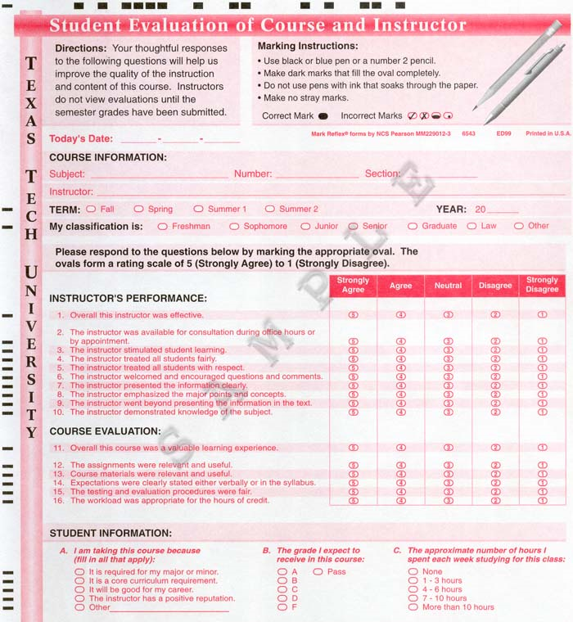
Assessing the Effectiveness of our Teaching
Why are you interested in assessing your teaching?
http://www.primaluniversity.com/20120406/sleep-an-infographic/
http://www.irim.ttu.edu/FacultyEvalGuide/StudentEvaluation.html

Slide 4
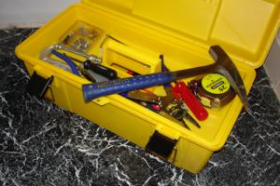
Assessing the Effectiveness of Our Teaching
Formative assessment tools
Summative assessment tools
Strategies for improving
Photo courtesy of Carol Ormand. http://serc.carleton.edu/NAGTWorkshops/assess/types.html

Slide 5
Formative assessment tools
Minute-Paper
ConcepTests
Ongoing Learning Evaluation
Video recording
Mid-semester Evaluations
In-class observation
Student Reaction
Teaching Journal

Slide 6

Formative assessment tools
Minute-Paper/
Muddiest Point/
Daily Check-In
Assesses gaps in student comprehension
Facilitates student reflection which increases retention
What was the most important point?
What was the muddiest point?
What would you like to learn more about?

Slide 7
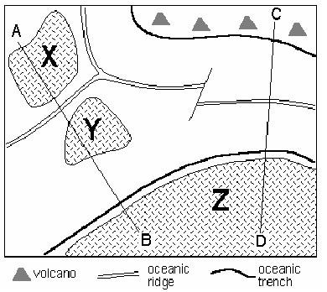
Examine the map and answer the question that follows. X,Y, and Z represent continental lithosphere, the blank areas represent oceanic lithosphere. How many plates are present?
a. 3
b. 4
c. 5
d. 6
http://serc.carleton.edu/NAGTWorkshops/teaching_methods/conceptests/examples/numbers.html

Slide 8
Formative assessment tools
ConcepTest
Conceptual multiple-choice question
Focuses on one key concept of lesson
Rapid formative assessment
Can be paired with peer-instruction
http://serc.carleton.edu/NAGTWorkshops/teaching_methods/conceptests/index.html

Slide 9

Formative assessment tools
Ongoing
Learning
Evaluation
20-30 minute facilitated student discussion
Instructor is not present
Facilitator presents summary to instructor
What supports your learning in this class?
What hinders your learning in this class?
What suggestions do you have for changes?

Slide 10
Formative assessment tools
What have you used?
Minute-Paper
ConcepTests
Ongoing Learning Evaluation
Video recording
Mid-semester Evaluations
In-class observation
Student Reaction
Teaching Journal

Slide 11
Summative assessment tools
End-of-course evaluations
Knowledge Surveys
Peer review
Teaching Portfolios
Tenure narrative

Slide 12
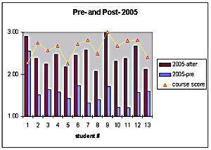
Summative assessment tools
Knowledge
Surveys
Series of questions covering course content
Students complete at beginning of course
And again at end of class
Can be formative – students complete relevant sections prior to each exam.
Notes:
This plot shows knowledge survey results for 13 students enrolled in a Mineralogy class. The blue bars show their "knowledge" prior to taking the course. The purple bars show their knowledge after completing the course. To show that Knowledge Surveys actually do measure learning, the yellow line with triangles shows the overall course score (grade) of each student at the end of the course. - Karl Wirth Macalester college

Slide 13
Knowledge Survey Questions – Oceanography examples
Bloom's Taxonomy Level - 1
What is ENSO?
Describe the chronology of events leading to an El Nino event.
Is a planula a plant or animal?
What is the extent of the global tsunami warning/buoy system?
Bloom's Taxonomy Level - 4
What is the role of limestone formation in climate change?
Describe the stability of ocean salinity over time.
What is the fate of the Great Lake shorelines in the near future?
Bloom's Taxonomy Level - 6
Synthesize the use of oxygen and hydrogen isotopes in fossils preserved in marine sediments to changes in global climate over time.
Provided an image of global continent and ocean basin locations, interpret the surface and deep water currents and their effects on global climate.
http://serc.carleton.edu/NAGTWorkshops/assess/knowledgesurvey/questions/oceanography.html

Slide 14
Summative assessment tools
Your tenure narrative
Will include a teaching section that may
Describe your teaching philosophy
Summarize the courses you have taught
Highlight strengths in your teaching
Address weaknesses
Notes:
This plot shows knowledge survey results for 13 students enrolled in a Mineralogy class. The blue bars show their "knowledge" prior to taking the course. The purple bars show their knowledge after completing the course. To show that Knowledge Surveys actually do measure learning, the yellow line with triangles shows the overall course score (grade) of each student at the end of the course. - Karl Wirth Macalester college

Slide 15
Summative assessment tools
Your tenure narrative
Will include a teaching section that may
Describe your teaching philosophy
Summarize the courses you have taught
Highlight strengths in your teaching
Address weaknesses
If your evaluations were weak, what did you learn from them or do to improve your teaching?
What challenges have you faced with teaching?
How do you think your teaching is improving?
Notes:
This plot shows knowledge survey results for 13 students enrolled in a Mineralogy class. The blue bars show their "knowledge" prior to taking the course. The purple bars show their knowledge after completing the course. To show that Knowledge Surveys actually do measure learning, the yellow line with triangles shows the overall course score (grade) of each student at the end of the course. - Karl Wirth Macalester college

Slide 16
Assessing the Effectiveness of Our Teaching
Formative assessment tools
Summative assessment tools
Strategies for improving
Photo courtesy of Carol Ormand. http://serc.carleton.edu/NAGTWorkshops/assess/types.html

Slide 17

Self assessment / reflection
Discovery Education’s Clip Art Gallery
What concerns do you have about your own teaching?
What do you think an in-class observation or OLE might show you about your teaching?
For what teaching issues do you want help?

Slide 18
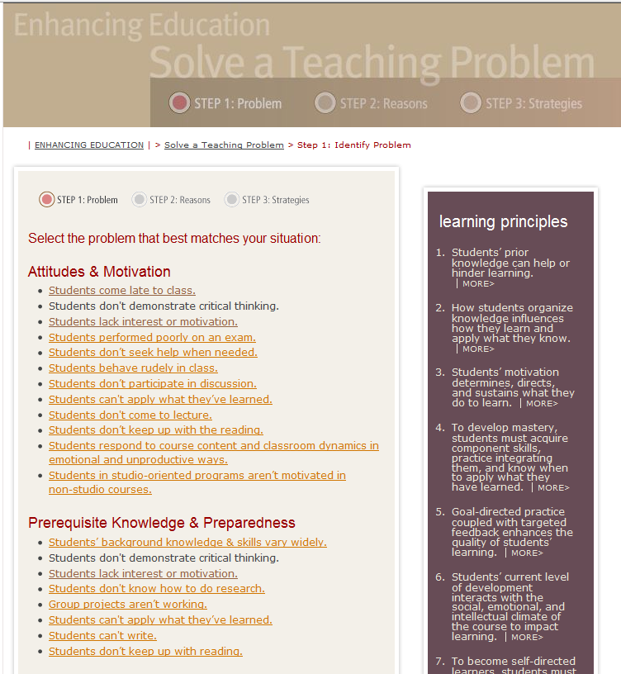
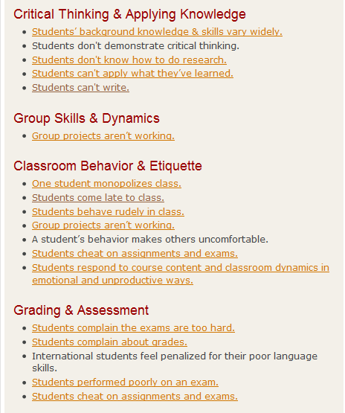
http://www.cmu.edu/teaching/solveproblem/index.html

Slide 19
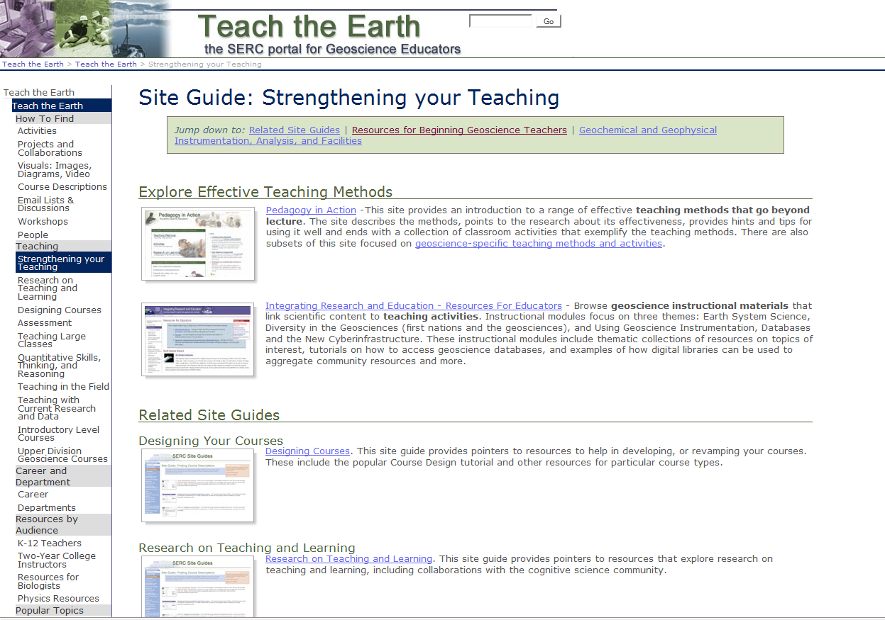
http://serc.carleton.edu/teachearth/site_guides/strengthen_teach.html

