Slide 1
Engaging Students in Large General Education Courses
Randy Richardson, Univ. Arizona
Michael Wysession, Washington Univ.
Early Career Workshop
13 June 2011
College of William and Mary

Slide 2
Session Outline:
Short Intro/Recap: “Interactive Lectures”
Two Examples:
  Stripes on the Seafloor
  20-Minute Breakouts with Ranked Responses
Thinking about your own activity …
Sharing your reactions: what works, what concerns, what experiences …

Slide 3
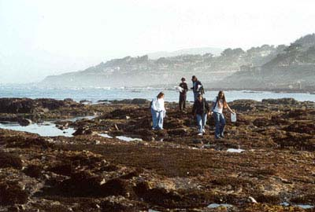
“Interactive Lecture” means many things (recall Greg’s session)
    Think/Pair/Share
    Discussion versus lecture
    Concept Tests
    Question of the day
    Jigsaw activities
    Group activities
    Individual activities
    Cooperative exams
    Other …
    See also: http://serc.carleton.edu/introgeo/interactive/index.html

Slide 4
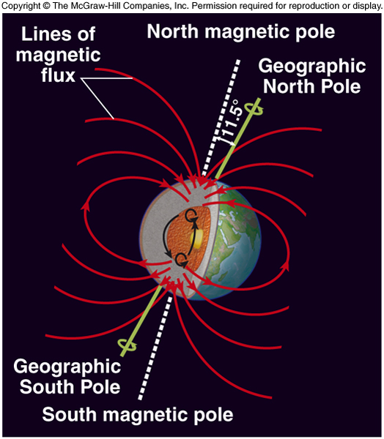
Example 1: Stripes on the Seafloor
A traditional way to cover this topic …
Earth has a magnetic field because it has:
Molten rock in the outer core
Heat to generate currents in outer core
Rotation to mix the currents
The Good Earth/Chapter 4: Plate Tectonics

Slide 5
Traditional approach, con’t:
Atoms in magnetic minerals aligned parallel to the magnetic field when magma cooled to form seafloor rocks
  Preserves ancient magnetic field – paleomagnetism
  Analysis reveals the inclination of the field where they formed – a proxy for latitude
Inclination: parallel to flux lines:
Horizontal at equator
Vertical at pole
The Good Earth/Chapter 4: Plate Tectonics

Slide 6
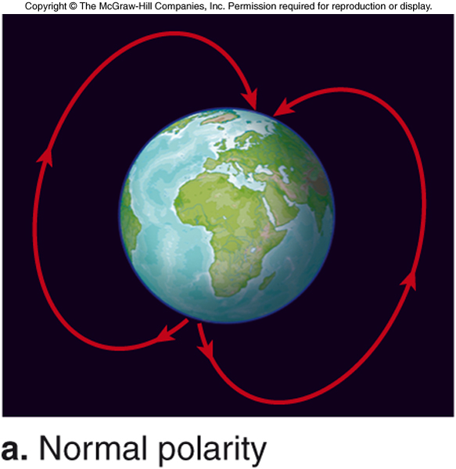
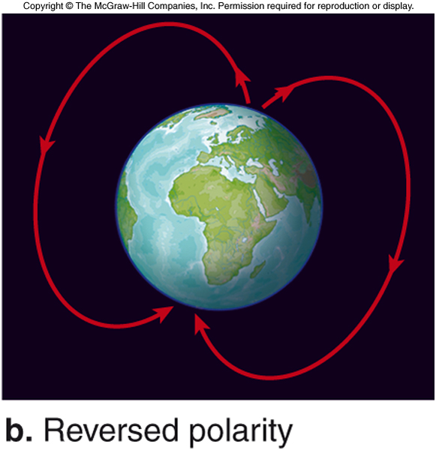
Magnetic Field Reversals
Normal polarity when negative magnetic pole is near geographic North Pole (current status)
Reverse polarity when positive magnetic pole is near geographic North Pole
Each period of normal or reversed polarity averages 250,000 years
Longest = 10’s of millions of years
Shortest = 10’s of thousands of years
Few thousand years to change polarity (normal → reverse or reverse → normal)
The Good Earth/Chapter 4: Plate Tectonics

Slide 7
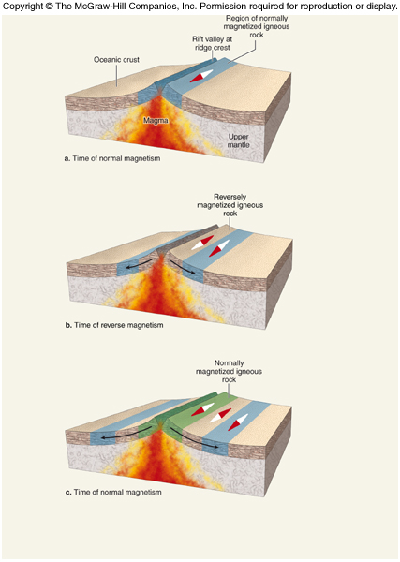
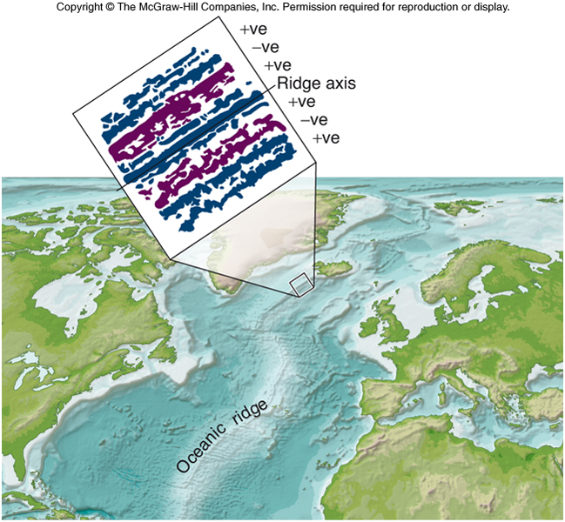
Evidence from the Seafloor
Polarity of seafloor alternates between normal (+) and reverse (-) on either side of oceanic ridge
The Good Earth/Chapter 4: Plate Tectonics

Slide 8
A Different Approach: In-Class Activity
Assemble ~20 students at front of room as a magma chamber beneath the continent.
Two students at the top of the magma chamber represent continental crust above a future mid-ocean ridge.
The continent rifts apart: these two students each take one step sideways, allowing out two new students (oceanic crust).
The new ones out face forwards because they formed when the Earth's magnetic field is in its normal polarity.
Now all four students outside the magma chamber again take a step sideways letting two new students out.
All six students take a step sideways and let two new students out. This time, however, I tell them that the Earth's magnetic field has reversed, and the two new students come out facing backwards.

Slide 9
In-Class Activity, continued …
I let the process continue, sometimes reversing the magnetic field, but in the end producing 'stripes' of students facing opposite directions representing crust that was created during normal and reversed polarity times.
We continue until the students run into a wall or until I feel that they understand the process.
An added benefit of this demonstration is that students can see why the oldest sea floor is next to the continents and farthest from the mid-ocean ridge (they were the first ones out).
Finally, it also leads naturally into a discussion of recycling of oceanic lithosphere when the students run into the wall at the edge of the classroom.

Slide 10
Plate Tectonics Conceptest
#6 – The youngest seafloor is found (1pt)
at the edges of the continents
at places where seafloor is returned to the mantle (subduction zones)
in the abyssal plain portion of the seafloor
at mid-ocean ridges
The Good Earth/Chapter 4: Plate Tectonics

Slide 11
In-Class Activity 2
In a 20 minute breakout:
Break into groups of 4-5 (works even in auditorium seating)
Provide a set of questions where responses can be quantified (like, on a scale of 1-10, or with a list)
  Example:
    Rank which are the most likely to cause civilization to collapse (megavolcano, giant impact, climate change, virus, war, etc.)

Slide 12
In-Class Activity 2, continued …
Each group independently discusses the question and negotiates a group answer.
Groups call out, in turn, their numerical answers.
  If two groups are far apart, then I have them explain and debate their reasons.
If there is a definite answer to a question, consider making it a contest, and the winners get some kind of small prize.

Slide 13
Interactive Lectures
Individual work
    Please spend the next few minutes on an activity that you’d like to use in your class.
    What concept do you want students to better understand?
    How will you engage the students?
    How will you know it is working?

Slide 14
Interactive Lectures
Group Brainstorm and Sharing
Now share your idea with a partner and provide each other with feedback.

Slide 15
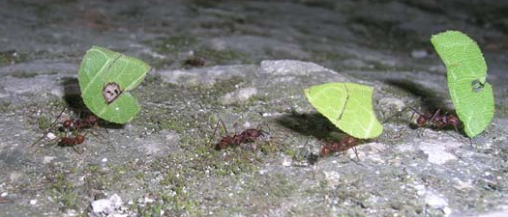
Interactive Lectures
Group Brainstorm and Sharing
  What are some of the potential problems or concerns you do, or will, face using these and other interactive activities in the classroom?
  How can you overcome them?

Slide 16

The literature is clear: students learn more when they are actively engaged in their learning.
Again, look at some of the supporting materials we have provided and visit http://serc.carleton.edu/introgeo/interactive/index.html
(or http://serc.carleton.edu/ in general)
Finally:

