Slide 1
Time Management and Balance
Heather Macdonald & Richelle Allen-King
Our presentation incorporates
selected material from former leaders:
Katryn Wiese,
Richard Yuretich,
& Ann Bykerk-Kauffman

Slide 2
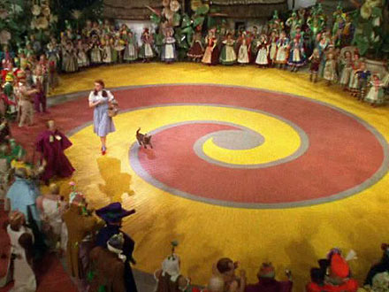
Guiding Principles
Identify and set YOUR priorities
Link regular actions to priorities over multiple time scales

Slide 3
Setting Priorities
Set your own priorities
One example
  #1 My mental, spiritual, physical health
  #2 My family
  #3 My job
    a) the students
    b) my future career desires
    c) my own academic education
    d) my department
    e) the college as a whole
  #4 My friends, home, etc.

Slide 4
Setting Your Priorities
Questions to Ponder
  Shouldn’t everyone’s #1 priority be their own health?
  Is your career more important than your health?
  How much good are you to others if you are not taking care of yourself
Priority Review
  Make an ordered list of your priorities

Slide 5

Time and Task Management
CALM
Clear your clutter (physical and mental)
Admit and announce that you can’t do it all
Learn to let go
Maximize what is most meaningful

Slide 6
Multitasking Myths
Human brain not wired for multitasking
Wastes more time than gains
Successful people are not multi-taskers, but those who can focus for short intervals

Slide 7
Use Time Well
Focus on the task at hand
Take advantage of short time periods
Work mindfully; take a break
Schedule your thinking, planning, writing time and stick to it!

Slide 8
Managing E-mail
Check e-mail a few times a day – schedule it.
You get less if you send less.
Don’t respond to trivia.
Wait 24 hours for replying
Keep in-box EMPTY!
“Never check email in the morning”
by Julia Morgenstern

Slide 9
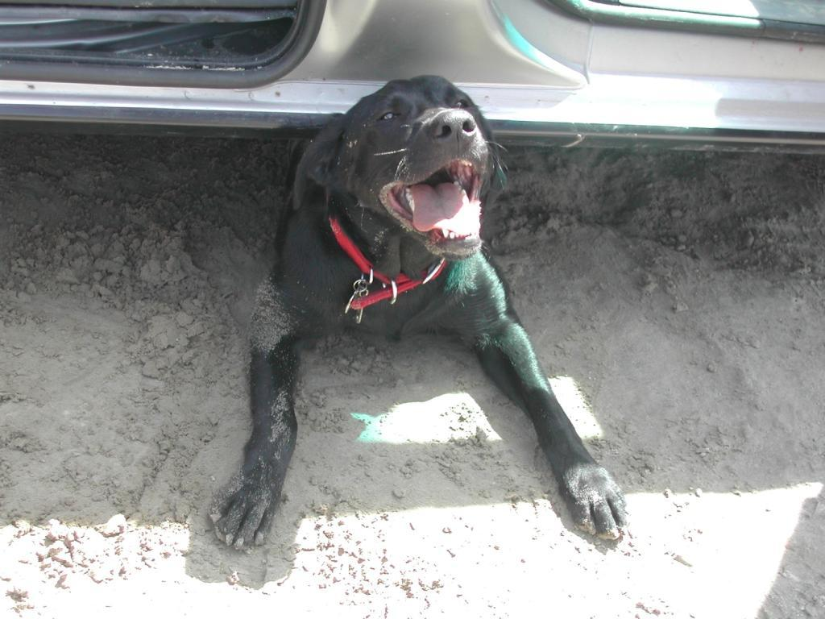
Take a positive approach
Working in a positive emotional state facilitates effective mental function.
Conversely, negative feelings (anxiety, guilt, etc) are draining, reduce the capability to do good work and make that work take longer.
Daisy approaches daily activities
with enthusiasm.

Slide 10

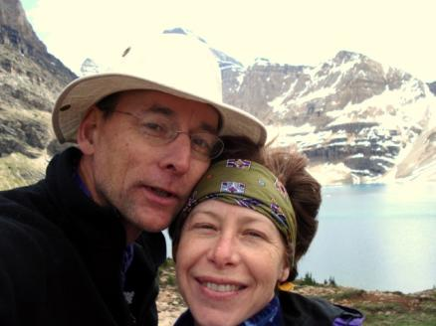
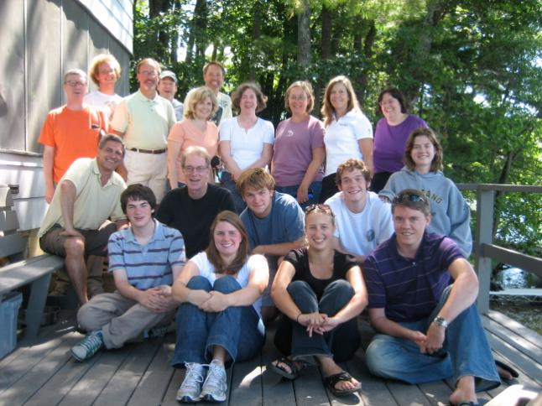

Reap the benefits of taking time to do joyful things that sustain you.

Slide 11
Linking Actions to Priorities
Over multiple time scales
Schedule regular time for each category of activity that is important
Take time regularly to re-evaluate priorities (e.g. annually or per semester, weekly or so)
If it isn’t working, analyze it to find the problem and try again!

Slide 12
What’s Your Ideal Schedule?
Aim high!
Include personal, family, and work activities
Don’t overbook yourself (include some unscheduled time)
Be honest
Schedule time for your #1 priority first, then move to the next priority
If you finish early, consider sharing and reviewing schedules with someone else

Slide 13
Schedule Review
Look at your schedules. Did you include time for
  Emergencies
  Friends
  E-mail
  If left out intentionally, that’s fine

Slide 14
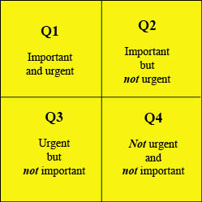
More Suggestions
Evaluate tasks re 4 quadrants
Do the highest priority tasks first
Break projects into small steps and goals and schedule each
The 24 hour rule (when asked to do something)
Two-fers
Don’t work weekends (Richard Yuretich)

Slide 15
Challenges and Suggestions
Discuss and make a list of the biggest challenges you face in making your schedule a reality and suggestions for overcoming these challenges

