Slide 1
Initiating Graduate Students Into the Culture of Research
Jennifer A. Roberts
University of Kansas
Liz Ritchie
University of Arizona

Slide 2
Training Graduate Students
We can use teaching as a means of training our graduate students.
  Core concepts and knowledge
  Data generation and analysis
    Field
    Lab
  Research skills
    Proposal writing and review
    Manuscript writing and review
    Oral presentation and examination

Slide 3
Teaching the Principles of Geomicrobiology and the Process of Scientific Inquiry to First Year-Graduate Students
Learning Goals:
increase their understanding and application of the scientific method
practice experimental analysis of a complex system using an original research experiment, and
develop topical knowledge in geomicrobiology.
Course Design
Preparation (6 weeks)
Topical lectures Defining & testing a hypothesis Experimental design | Tiered topical research and writing assignments Initial proposal for experiment Field trip
Experimental Work (7 weeks)
Topical lectures | Tiered topical research and writing assignments
Culmination (4 weeks)
Topical lectures Elements of a research proposal Final data discussions | Group research presentations and discussion of results Proposal for future experiment

Slide 4
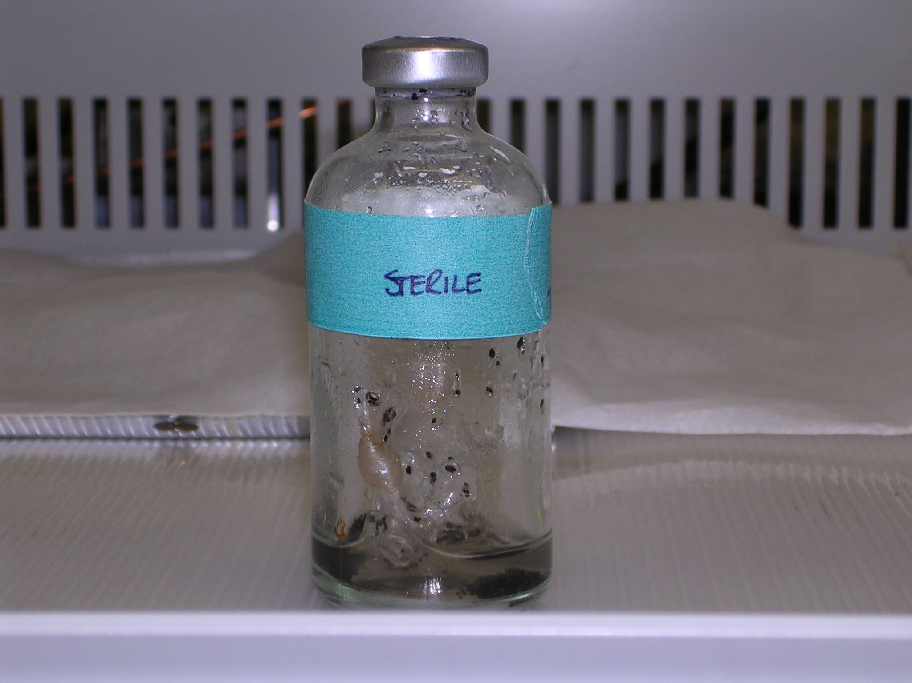
Batch Laboratory Microcosms
Native
groundwater
Native consortium
Groups of three were assigned a specific treatment (in triplicate + sterile control)
Silicate rock

Slide 5
Skills Obtained through Experimentation
Component | Measurement | Sampling | Techniques | Concepts
Gas (closed system) | CO₂ and CH₄ | Weeks 1, 3, 5, 8 | Gas chromatography | Henry’s Law Respiration
Liquid | pH, alkalinity, SiO₂, Fe (T) | Weeks, 1, 2, 4, 6 | pH meter Titrations Spectrophotometric determinations | Sources/sinks H⁺ Carbonate speciation Dissolution kinetics Redox
Solid | Biomass Surface pitting | Weeks 1 and 14 | SEM | Surface reactions between bacteria and mineral surfaces

Slide 6
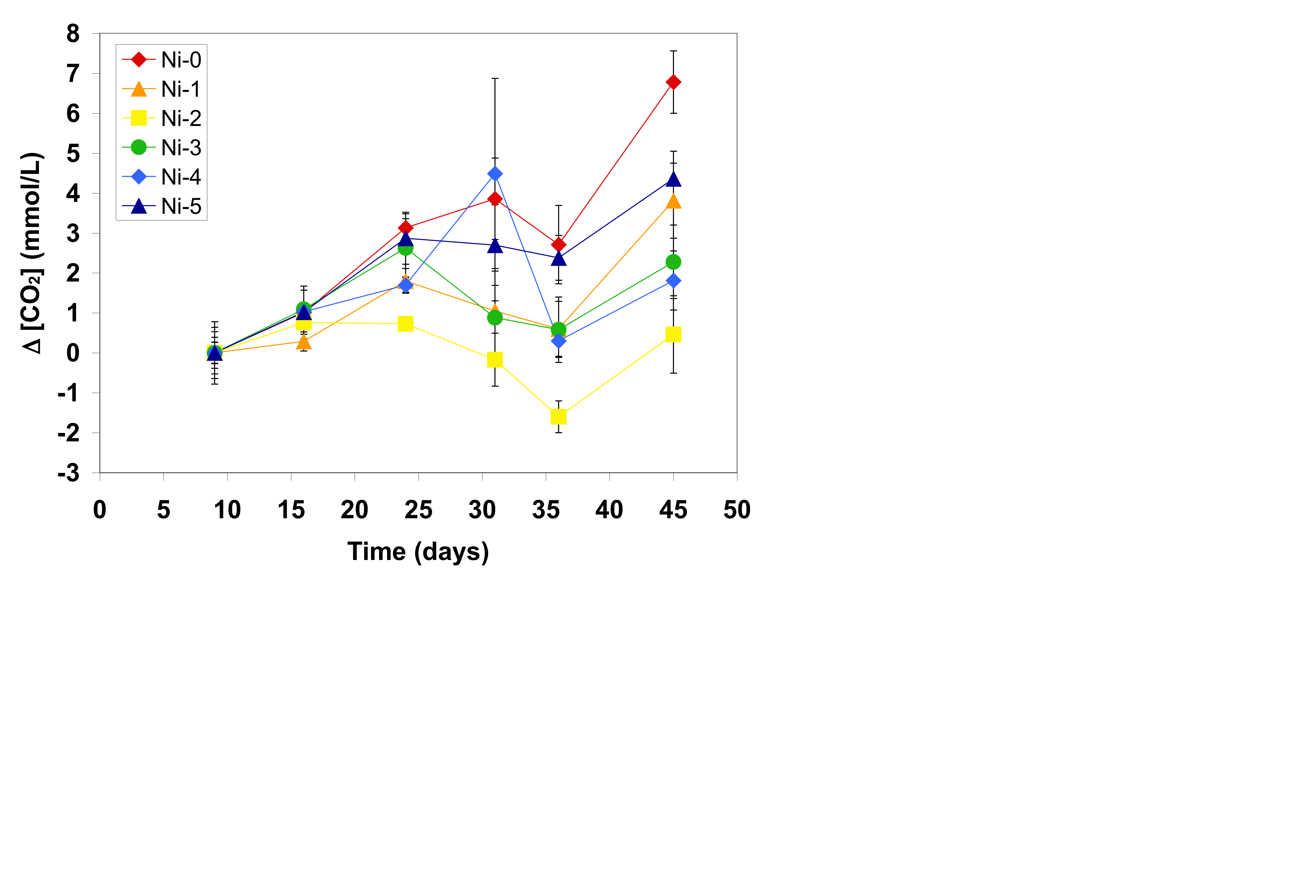
Data Generated
Example of data collected by students. Plot shows the increase in solution CO₂ over the length of the experiment (taken from final presentation by KU students).
Data was analyzed as a group in “Data Discussion” periods.

Slide 7
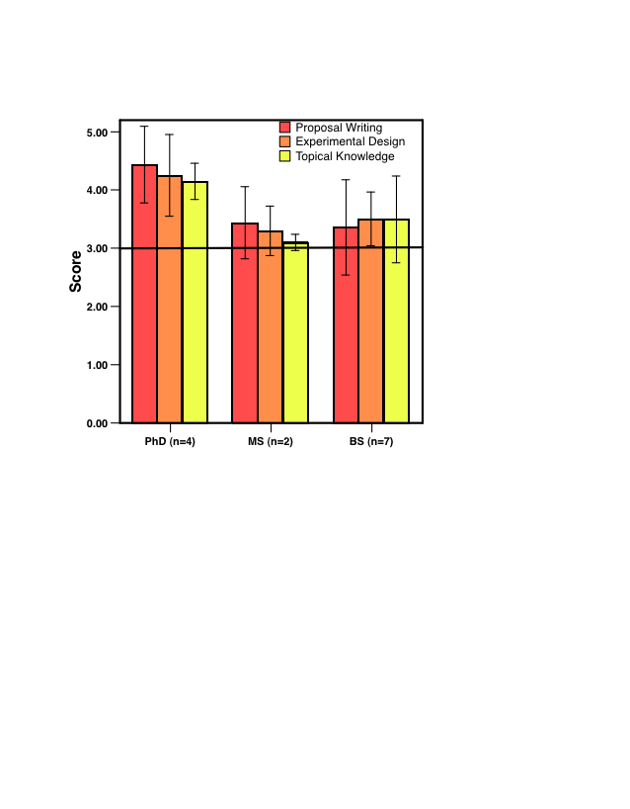
Performance Assessment
Proposal for future work
  Primary assessment tool
  10-15 page profession focusing on two distinct tasks:
    Write a proposal for future experiments based on preliminary results to assess:
      Proposal writing
      Critical thinking
      Evaluation of scientific questions and hypotheses
    Make predictions about the current experiment if it were to continue to assess:
      A deep understanding of topical material.

Slide 8
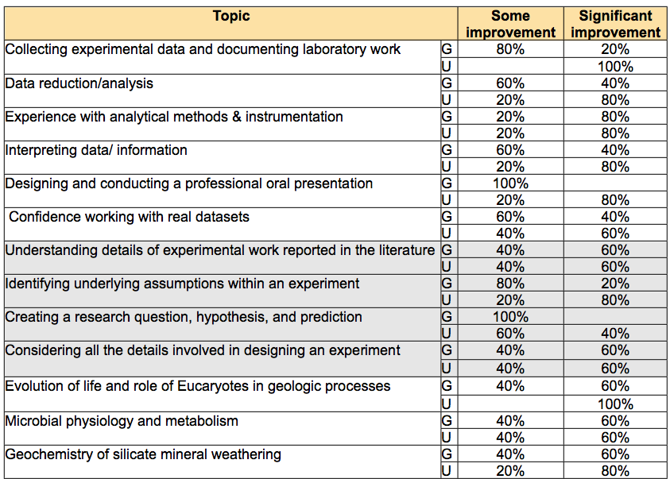
Student Self-Assessment

