Slide 1
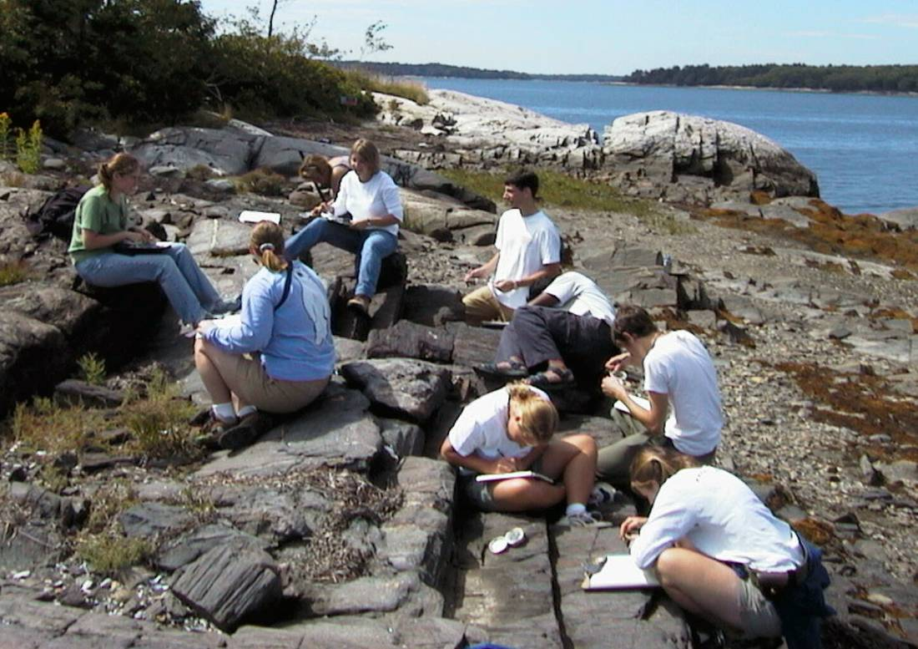
Designing A Course
Course Design, Learning Styles, Teaching Styles
Heather Macdonald
Rachel Beane

Slide 2
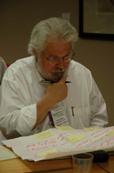
Focus on one of your courses
Viewpoint
Content-centered
  What will I cover?
Learner-centered
  What will they learn?
Notes:
HM

Slide 3
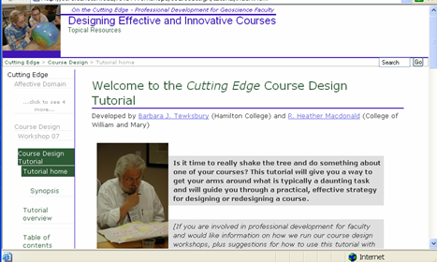
One Course Design Process
Consider course context and audience
Articulate course goals
Design activities and assignments
Plan assessment
http://serc.carleton.edu/NAGTWorkshops/coursedesign/tutorial/index.html
Notes:
HM

Slide 4
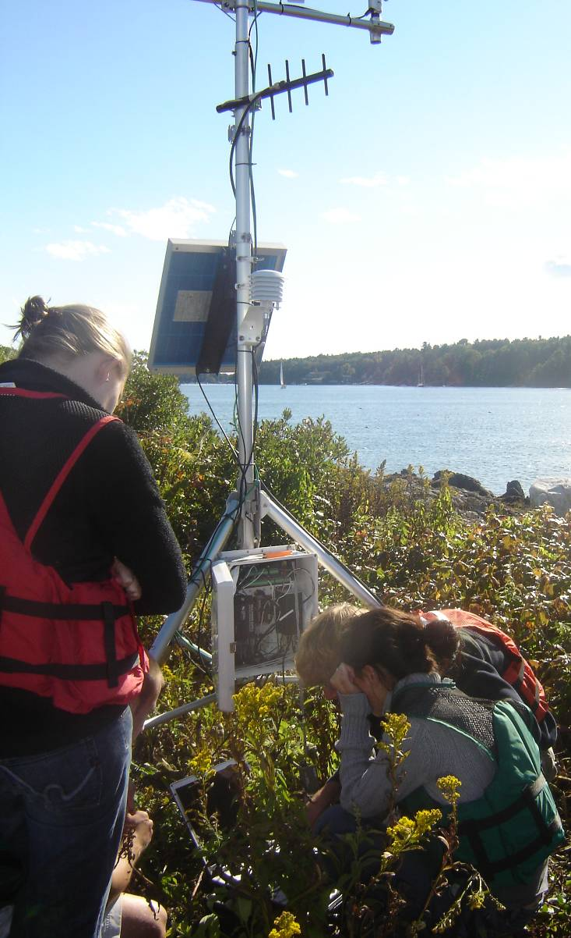
Consider Course Context and Audience
General education course? Majors course?
Required? Elective?
What size is the course?
Who are the students?
What do they want to learn?
How do they learn?
Notes:
HM
(photo of weather station)

Slide 5
Learning Styles
How does the student prefer to process information?
Actively – through engagement in physical activity or discussion
Reflectively – through introspection
Questionnaire - Barbara Soloman & Richard Felder
http://www.engr.ncsu.edu/learningstyles/ilsweb.html
Notes:
HM (learning styles as insights into how students learn)

Slide 6
Your Learning Styles (n=37)
Active Reflective
For comparison: Active 60%; Reflective 40%
Notes:
HM

Slide 7
Learning Styles
What type of information does the student preferentially perceive?
Sensory – sights, sounds, physical sensations, data …
Intuitive – memories, ideas, models, abstract …
Notes:
HM

Slide 8
Your Learning Styles (n=36)
Sensing Intuitive
For comparison: Sensing 65%; Intuitive 35%
Notes:
HM

Slide 9
Learning Styles
How does the student most effectively perceive sensory information?
Visual – pictures, diagrams, graphs, demonstrations, field trips
Verbal – sounds, written and spoken words, formulas
Notes:
HM

Slide 10
Your Learning Styles (n=36)
Visual Verbal
For comparison: Visual 80%; Verbal 20%
Notes:
HM

Slide 11
Learning Styles
How will the student progress toward understanding?
Sequentially – in logical progression of small incremental steps
Globally – in large jumps, holistically
Notes:
HM

Slide 12
Your Learning Styles
Sequential Global
For comparison: Sequential 60%; Global 40%
Notes:
HM

Slide 13
Learning Styles
Different students will learn most effectively in different ways
We can teach in ways that address a broad spectrum of learning styles
2007 workshop participants
Notes:
HM

Slide 14
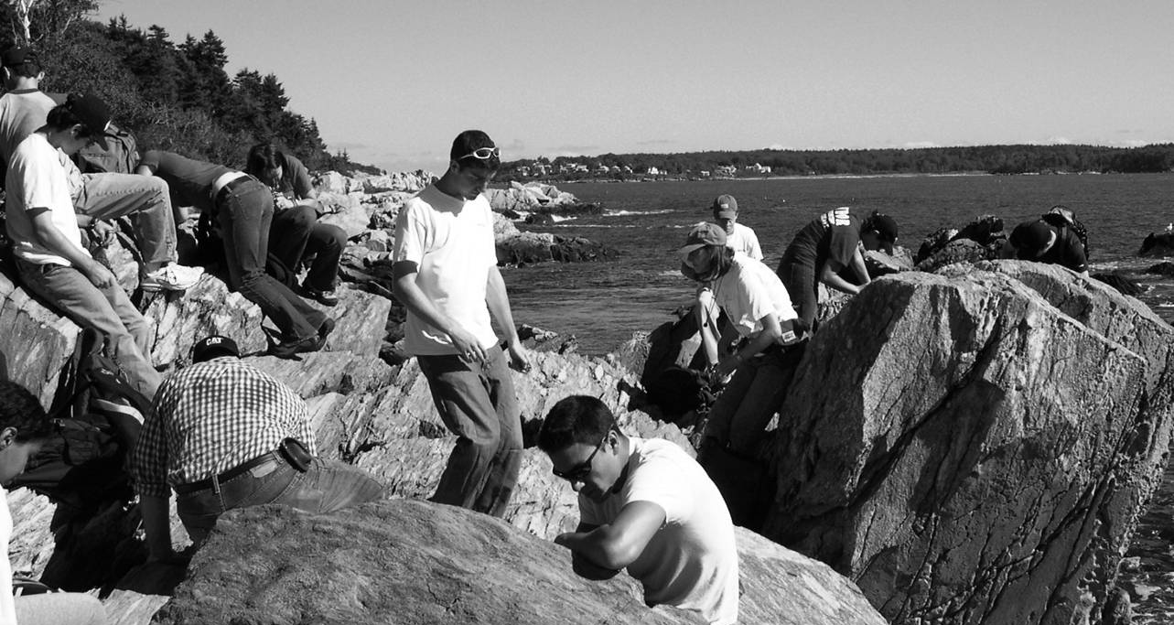
Teaching Styles: Who are you?
How do you like to teach? Why do you teach?
How do you want to interact with your students?
What do you find most satisfying when you teach?
How flexible are you?
Notes:
RB - You can be an effective teacher in different ways. 5’ discuss within table Why do you teach? How do you like to teach?

Slide 15
Designing a Course
Consider course context and audience
Articulate course goals
  Overarching goals
  Ancillary goals
    Writing, oral communication, working in a team, quantitative, research, field, lab…
Design activities and assignments
Plan assessment
Notes:
HM

Slide 16
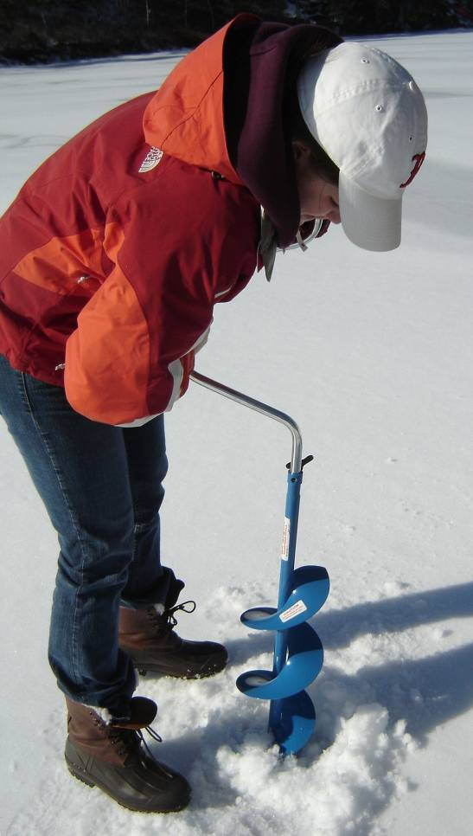
Overarching Goals
What do you want students to be able to do as a result of having taken your course?
  What do you do?
  What kinds of problems do you want students to be able to tackle?
  How might students apply what they have learned?
  How will they be different at the end of the course?
Notes:
HM

Slide 17
Evaluate overarching goals
Does the goal focus on higher-order thinking (e.g. derive, predict, analyze, design, interpret, synthesize, formulate, plan, correlate, evaluate, create, critique and adapt)?
Is the goal student-focused, rather than teacher-focused?
Does the goal have “measurable outcomes?” Could you design activities/assignments that would allow you to determine whether students have met the goal?
Example: I want students to synthesize the geologic history of Maine’s coast.

Slide 18
Evaluate overarching goals
Does the goal focus on higher-order thinking (e.g. derive, predict, analyze, design, interpret, synthesize, formulate, plan, correlate, evaluate, create, critique and adapt)?
Is the goal student-focused, rather than teacher-focused?
Does the goal have “measurable outcomes?” Could you design activities/assignments that would allow you to determine whether students have met the goal?
Example: I want to provide students with an introduction to the geology of environmental issues.

Slide 19
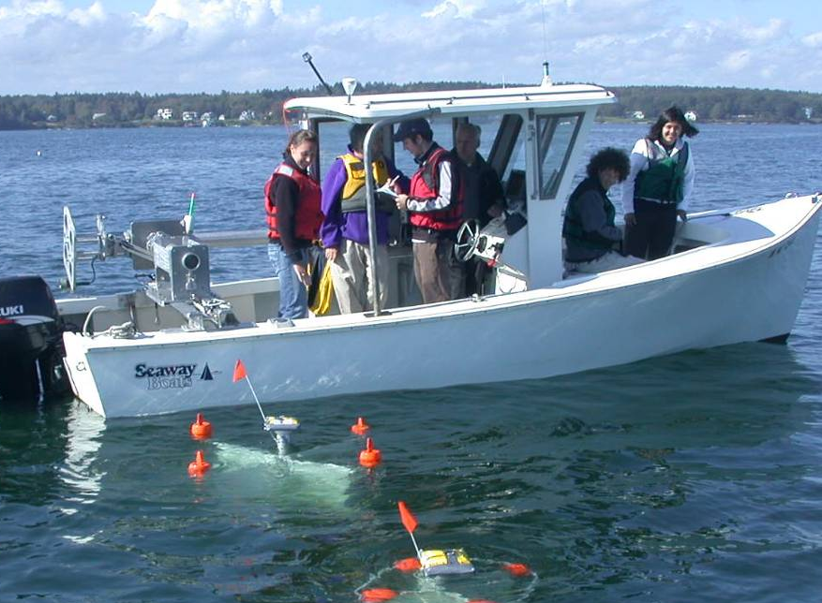
Consider a course that you will be teaching…
What are your overarching goals?
Please write your course title and 1-2 goals.
For the goals, consider “When students have completed my course, I want them to be able to…”
Notes:
HM

Slide 20
Course goals
After you have written your course title and goal, please pass your paper to the person on your right.
Please write comments next to the written goal.
Consider whether the goal is higher order? is student centered? has a measurable outcome?
If you think of another possible goal, write it down.
Repeat: pass, comment, write.
Pass the paper back to the original person.
Please write the course title and one goal on the card.
Notes:
Share that goal of this exercise is to help us generate goals for our courses and to compile a list of course goals to share with each other.

Slide 21
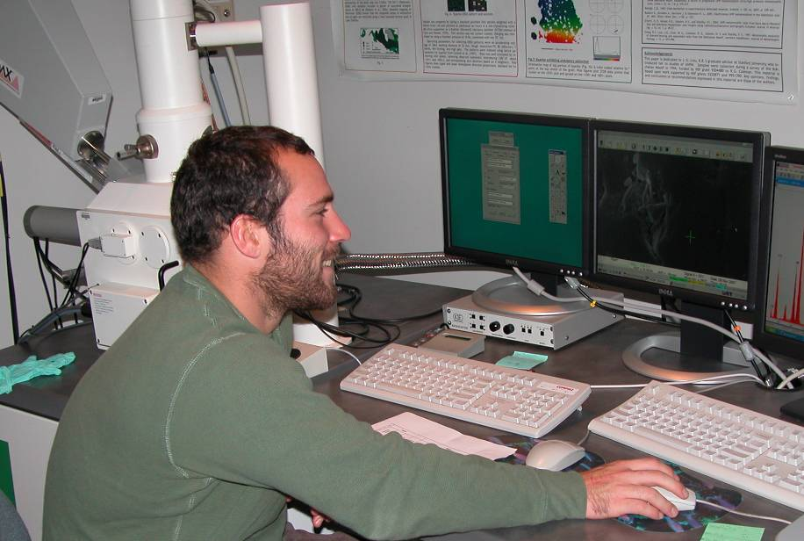
Designing a Course
Consider course context and audience
Articulate course goals
Design activities and assignments
  Session this afternoon!
Plan assessment

Slide 22
Designing Activities
Often many ways to design an activity to meet a goal.
If I want students to be able to analyze map data, I might:
Prepare a Gallery Walk of maps around the classroom
Ask a series of directed questions about a map (in lecture or as homework)
Have students prepare clay models of topo maps and share them with the class
Ask students to complete an interpretative cross-section during lab
Have students prepare a map of their hometown using GIS and identify possible hazards
…
Notes:
RB – can you think of three ways that you might design an activity or assignment to meet one of the overarching goals you thought of for your course? How would you decide which of these to pursue? (in addition to review criteria, consider preparation time, material availability, course context and audience…)

Slide 23
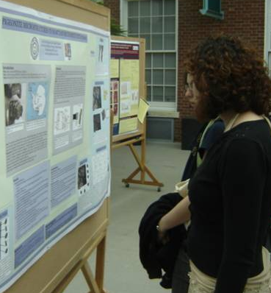
Designing a Course
Consider course context and audience
Articulate course goals objectives
Design activities and assignments
Plan assessment
Notes:
RB-All the pieces of designing a course that we have discussed are integrated. For example, as you articulate course goals you consider whether these are goals that can be assessed. And as you design an assignment you consider how you might assess this.

Slide 24
Assessment
Formative Assessment
  Can enhance learning by:
  Determining what is understood
  Providing feedback to student and professor
  Allowing for intervention
Summative Assessment
  Evaluates what a student has attained at the end of an activity or course
  Offers little opportunity for intervention
Notes:
RB-Consider what you shared. Was it a formative assessment or a summative assessment? Most of us need to assign grades, and summative assessments can be very useful for this. At other times, we might find formative assessments useful. Let’s first look at some examples of formative assessments.

Slide 25
Assessment: Bloom’s Taxonomy
Bloom’s Taxonomy (original) | Learning Skill
Remembering (Knowledge) | Recognizing and recalling
Understanding (Comprehension) | Interpreting, classifying, summarizing, inferring, comparing, explaining
Applying (Application) | Executing and implementing
Analyzing (Analysis) | Differentiating, organizing, attributing
Evaluating (Synthesis) | Checking, critiquing, reorganizing, making judgments, synthesizing
Creating (Evaluation) | Generating, planning, producing, evaluating
Bloom’s taxonomy of educational objectives (Bloom et al., 1956); Revised framework (Pohl, 2000); figure modified from Steer (2008) revised from King, 1995
Notes:
RB - (from David Steer)

Slide 26

Assessment: many possibilities
http://serc.carleton.edu/NAGTWorkshops/assess/types.html
Notes:
http://www.wordle.net/ word clouds

Slide 27
Context for Today’s Sessions
Students have different learning styles
Active engagement is important for learning
Articulate learning goals when designing courses
Design and adapt activities with learning goals in mind
Expand your “toolbox” of teaching and assessment strategies
Most students Most students
passive active
Notes:
HM

