Slide 1
The Plume Controversy:
Getting Students Engaged with Science and the Conduct of Science
Brennan T. Jordan
University of South Dakota

Slide 2
Outline
Introduction to mantle plumes
Current status of mantle plume hypothesis
Arguments against mantle plume hypothesis
The “Great Plume Debate”
Classroom: Presenting the plume hypothesis
Classroom: Plume hypothesis & the process of science

Slide 3
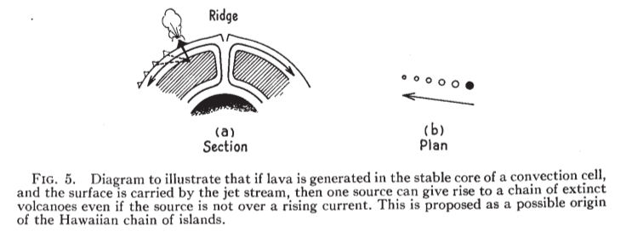
Intro to Mantle Plume Hypothesis
Generic “hotspots” proposed by Wilson (1963) to explain age progression of volcanic islands
Wilson (1963)

Slide 4
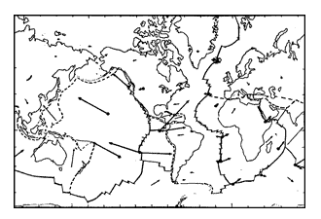
Intro to Mantle Plume Hypothesis
Morgan (1971) proposed mantle plumes arising from thermal boundary layer at core-mantle boundary
Morgan (1971)

Slide 5
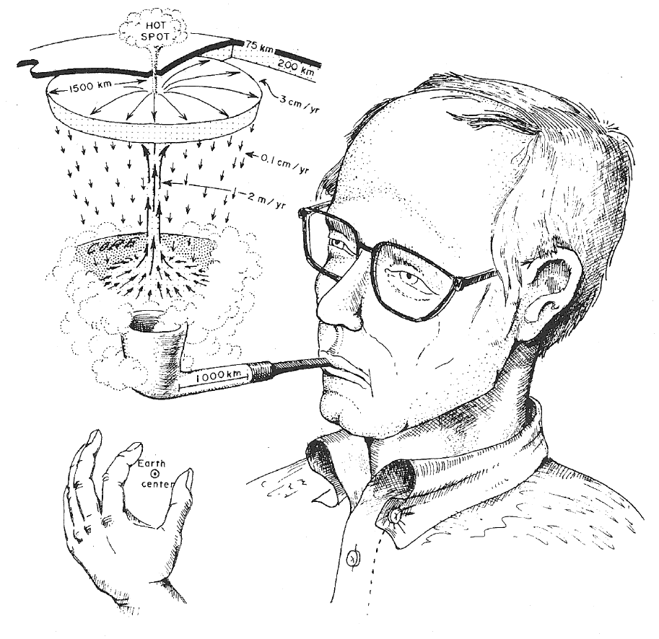
Intro to Mantle Plume Hypothesis
Morgan (1971)
Holden and Vogt (1977)

Slide 6
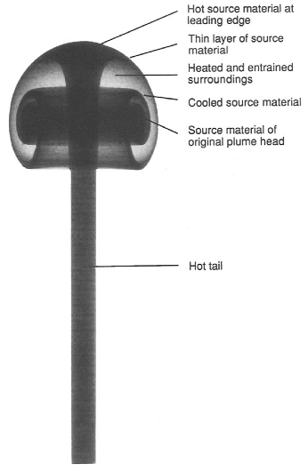
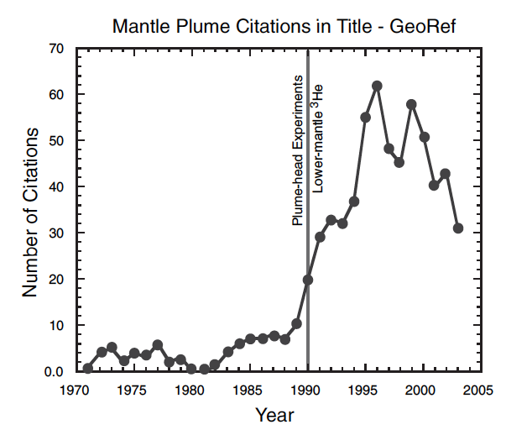
Intro to Mantle Plume Hypothesis
Fluid dynamics experiments by Campbell and Griffiths (1990) etc.
  Plume head-tail link
  with flood basalts and
  hotspot tracks energizes
  plume research
Anderson &
Natland (2005)
Campbell & Griffiths (1990)

Slide 7
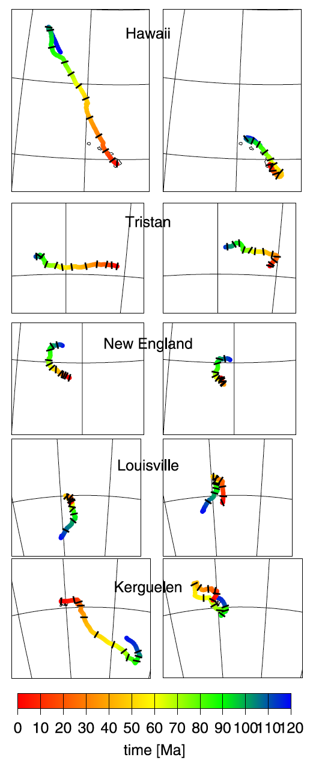
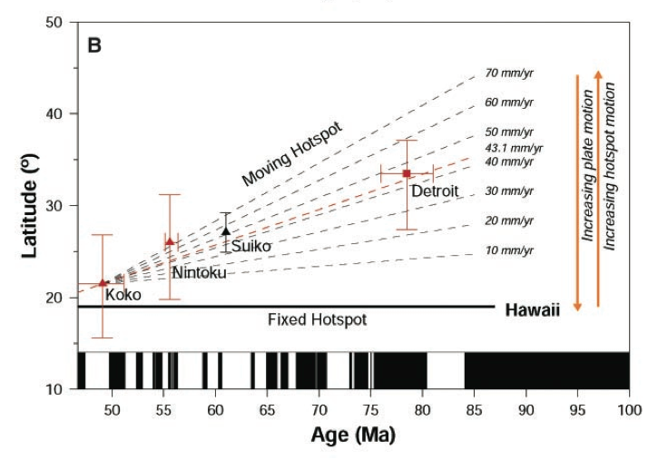
Current Mantle Plume Hypothesis
Current plume theory features critical addenda of the Morgan hypothesis:
  Plumes deflected by mantle flow, and thus not fixed with respect to one another or external reference frames (see work of Steinberger, Tarduno, and others)
Steinberger & Antretter (2006)
Tarduno et al. (2003)

Slide 8
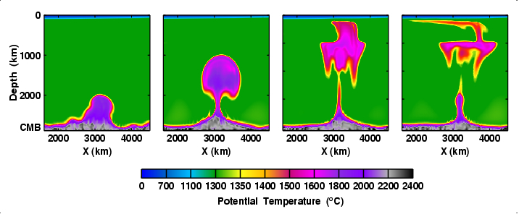
Current Mantle Plume Hypothesis
Current plume theory features critical addenda of the Morgan hypothesis:
  Thermo-chemical plumes & diverse morphologies (e.g. Farnetani & Samuel, 2005)
Farnetani & Samuel (2005)

Slide 9
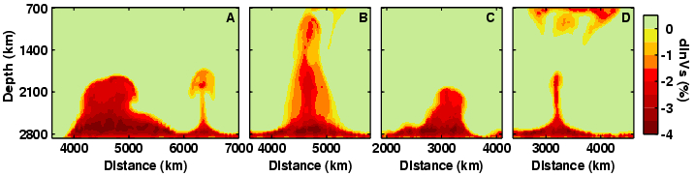
Current Mantle Plume Hypothesis
Current plume theory features critical addenda of the Morgan hypothesis:
  Thermo-chemical plumes & diverse morphologies (e.g. Farnetani & Samuel, 2005)
Farnetani & Samuel (2005)

Slide 10
Current Mantle Plume Hypothesis
Proponents of the plume hypothesis argue that it is supported by a spectrum of observations:
  Age-progressive volcanic chains
  High ³He/⁴He in some hotspot volcanics
  Other geochemical signatures
  Seismic tomography (esp. finite-frequency)
  Numerical and analog models
  Petrologic evidence of high T
  Geoid anomalies
  LIP emplacement preceded by uplift

Slide 11
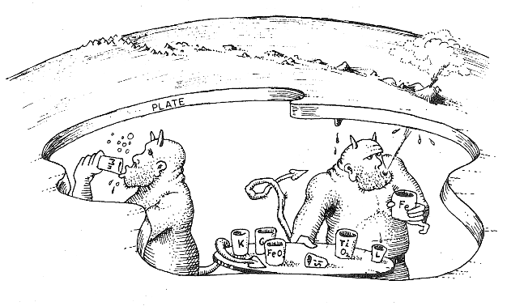


Arguments Against Plume Hypothesis
Some opposition to plume theory from the beginning (Don Anderson & others)
Rejuvenated in early 2000’s: www.mantleplumes.org
Holden and Vogt (1977)

Slide 12
Arguments Against Plume Hypothesis
Some arguments:
  Hotspots (melting anomalies) don’t meet plume criteria
  Site-specific ad hoc modifications of plume theory
  Tomography inconclusive and sometimes misrepresented
  Lack of evidence for high T
  High ³He/⁴He & other geochem more easily explained by shallow processes

Slide 13
The Great Plume Debate
Wait a minute… aren’t both sides arguing opposite directions based on same kinds of data?
Yes. See Jordan (2007) poll results from AGU Chapman Conference “The Great Plume Debate”
  Poll not scientific, small n (66)
  29%, pro-plume, 25% plume-skeptic,
  46% middle

Slide 14
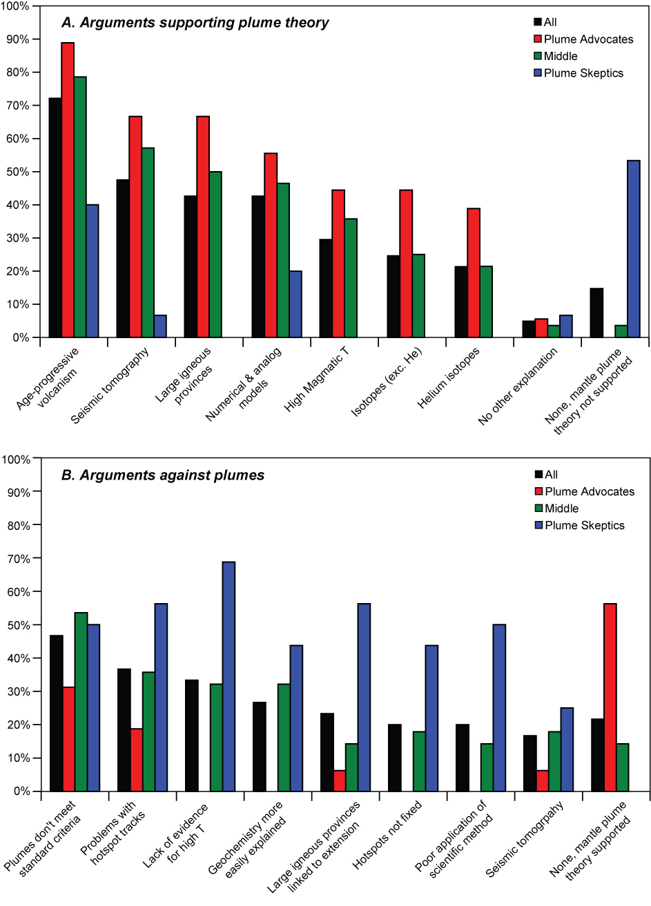
The Great Plume Debate
Arguments that support plume theory

Slide 15
The Great Plume Debate
Arguments against plume theory

Slide 16
The Great Plume Debate
Experts in each relevant field disagree about fundamental interpretations!
Resolution of the debate requires resolution of basic issues in these fields
  More data?
  Different kinds of data?
  New techniques?

Slide 17

The Great Plume Debate
Critical questions:
  Mantle plume paradigm has been useful for interpreting
  wide range of
  phenomena. Does
  that validate it?
  Can the plume
  hypothesis be
  disproven?
  If the answer is no,
  is it really science?

Slide 18
Alternative Hypotheses
One of the least satisfying defenses from the pro-plume community is, “what else could they be?”
This is however a critical and productive question to consider
Alternatives are generally shallow processes (the “plate model”)
Most are controversial
See www.mantleplumes.org for details and references

Slide 19
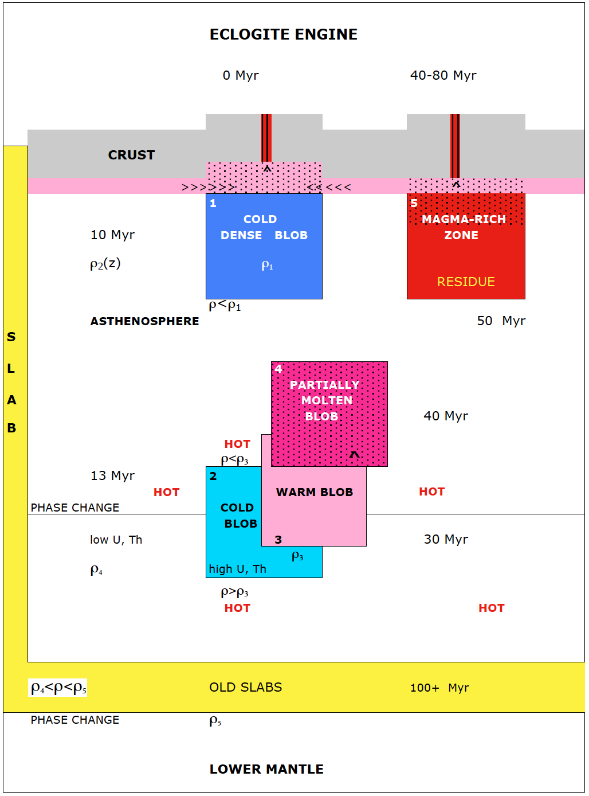
Alternative Hypotheses
Fertility anomalies
  Wet spots
  Eclogite
Anderson (2007)

Slide 20
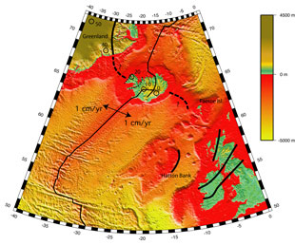
Alternative Hypotheses
Site specific example: Iceland (Foulger, 2002; Foulger & Anderson, 2003)
  Subducted slab at Caledonian suture provides fertile eclogite for Iceland melting anomaly
Foulger (2002)

Slide 21
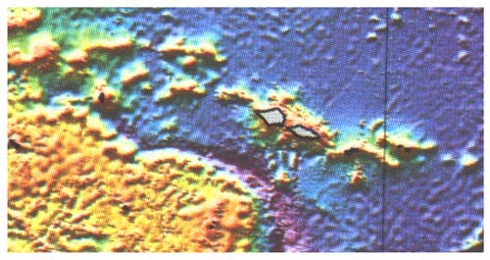
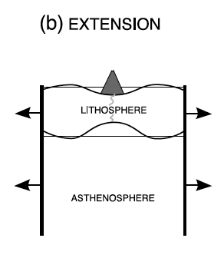
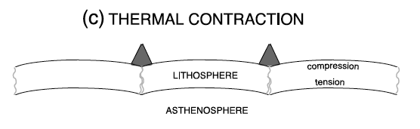
Alternative Hypotheses
Crack it! Lithospheric fractures (e.g., Natland & Winterer, 2005)
Somoan Chain, Natland, mantleplumes.org
Gans et al. (2003)
Sandwell & Fialko (2004)

Slide 22
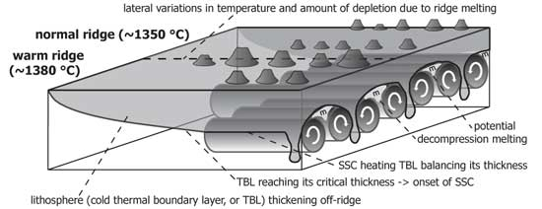
Alternative Hypotheses
Small-scale convection (particularly good for minor non-age-progressive seamount chains)
Ballmer et al. (2007)

Slide 23
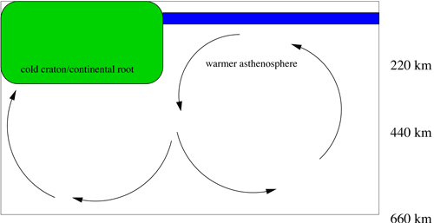
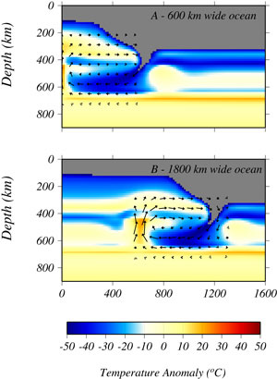
Alternative Hypotheses
Edge driven convection (King & Anderson collaboration)
King and Anderson (1998)

Slide 24
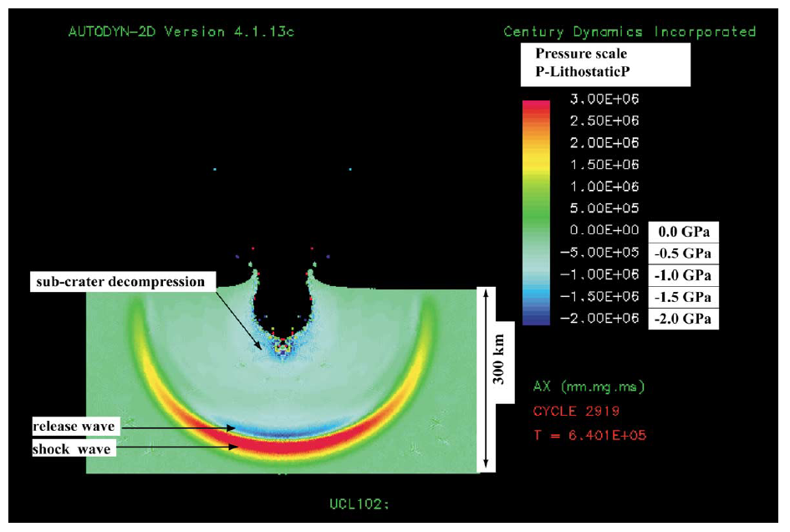
Alternative Hypotheses
Bolide impacts (particularly for LIPs)
Antipodal hotspots? (Hagstrum, 2005)
Jones et al. (2002)

Slide 25
Classroom: Presenting Plume Hypothesis
The plume debate is ideal exposing students to active debate in science
This should be exciting, not a source of skepticism regarding science
We are still addressing first order questions of how Earth works
A future of discovery awaits them!

Slide 26
Classroom: Plume Hypothesis & the Process of Science
A question for all levels: is the plume explanation for melting anomalies a…
  Hypothesis?
  Theory?
  Law?

Slide 27
Classroom: Plume Hypothesis & the Process of Science
Depending upon one’s perspective, the tenor of the plume debate can be off-putting or fun
  Negative: can be akin to creation-evolution debate with deceptive argumentation and name-calling
  Positive: this reflects a vigorous debate of intelligent and passionate scientists
See back and forth in post-Chapman volumes

Slide 28
Classroom: Plume Hypothesis & the Process of Science
For “ugly” side see back and forth in post-Chapman volumes
  Campbell & Kerr editorial intro to special volume of Chemical Geology (v. 241)
  Kerr P⁴ book review in Marine Geophysical Researches (2008, v. 29 p. 217-218)
  Foulger & Jurdy response to review (2008, v. 29, p. 219-220)

Slide 29

Classroom: Plume Hypothesis & the Process of Science
More productively, consider scientific back and forth of some Plates, Plumes, and Planetary Processes chapters
Good example: Hooper et al. (2007) on CRBs – 8 comments and 5 replies in discussion

Slide 30
Classroom: Plume Hypothesis & the Process of Science
Students (upper division) could be assigned different perspectives in the such a dialog and asked to articulate the scientific points

Slide 31

Classroom: Plume Hypothesis & the Process of Science
Students (upper division) could be assigned different sides of the plume debate with specific provinces or hypotheses (plume & otherwise)
Reports
In-class debate

Slide 32
Classroom: Activities?
What I have presented is perspectives on the plume debate and a few ideas for presenting it in the classroom.
Could we develop activities?

