Slide 1
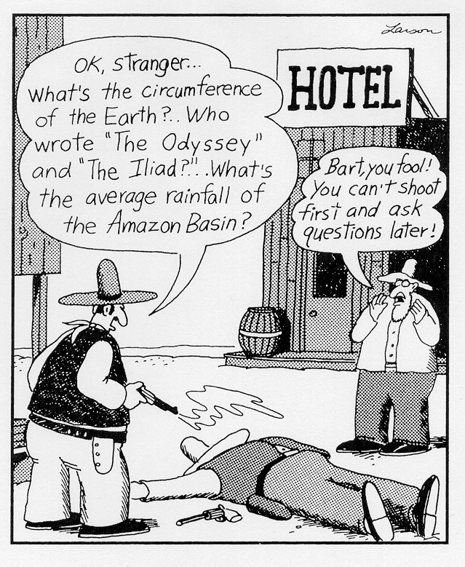



What 2000 students have to tell us about Their learning in Introductory Geoscience Classes
David A. McConnell
Marine, Earth and Atmospheric Sciences,
North Carolina State University
John
This material is based upon work supported by the National Science Foundation under grants 0914404 and 1022917.
Katherine
Laura

Slide 2
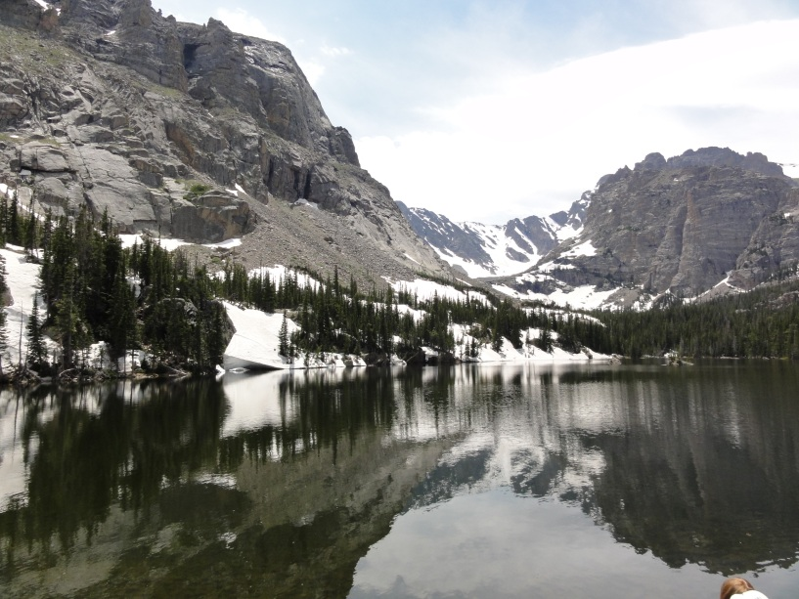
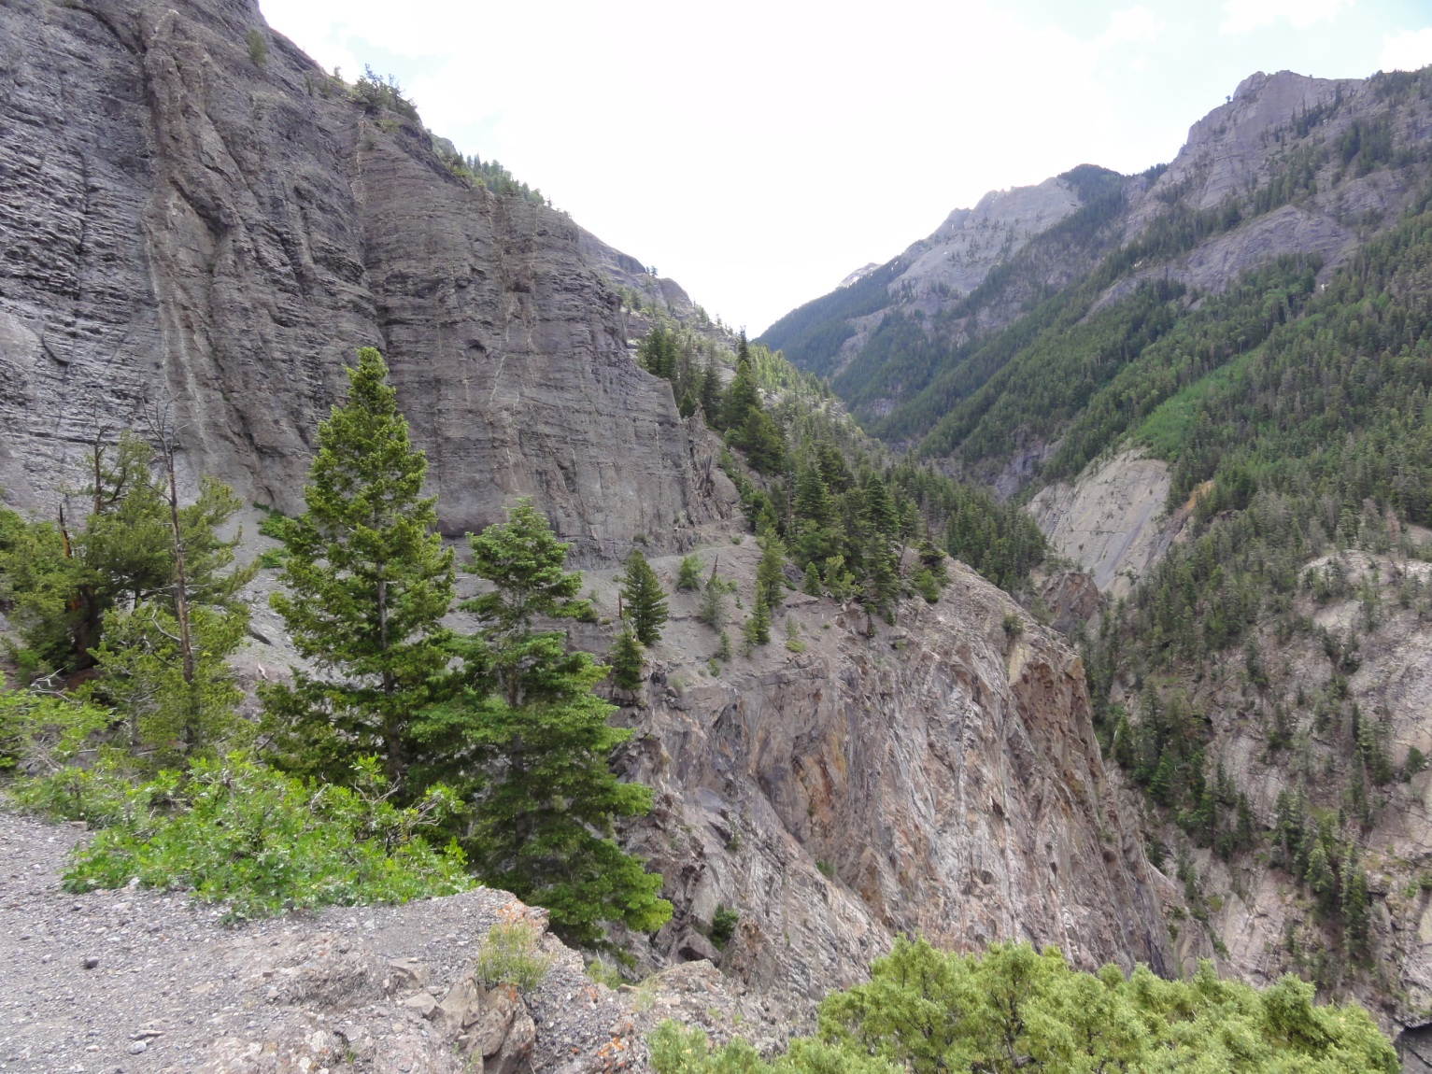
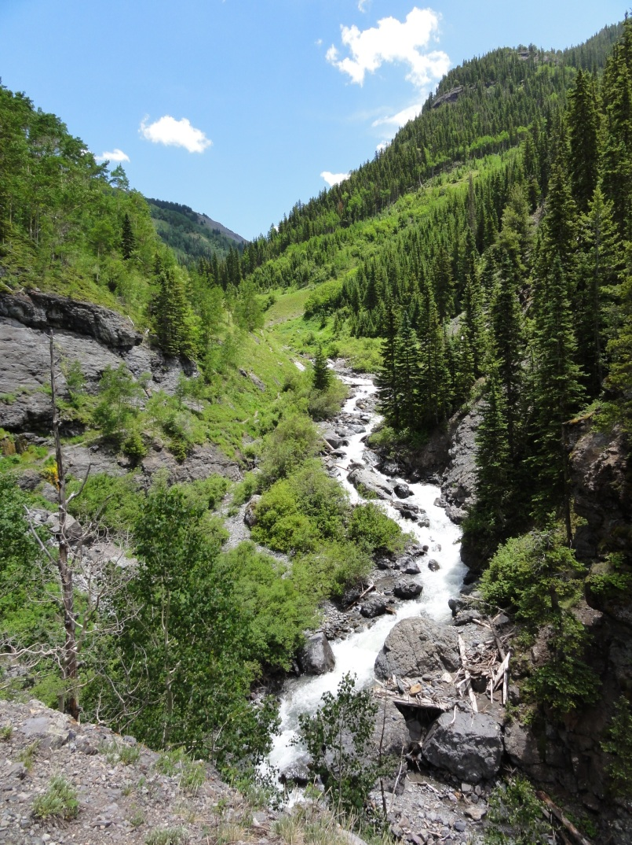


Slide 3
Student Retention and Science Classrooms
Future demand for STEM majors¹:
  US needs to produce 1 million more STEM graduates in the next decade than projected
  <40% of students intending to major in STEM, complete a STEM degree
Principal reason students leave STEM disciplines²:
  Students lost belief that STEM disciplines were interesting, became disconnected from culture of science in introductory classes
  Students became more interested in other majors.
¹PCAST: Engage to Excel report (2012); ²Seymour and Hewitt (1997);

Slide 4
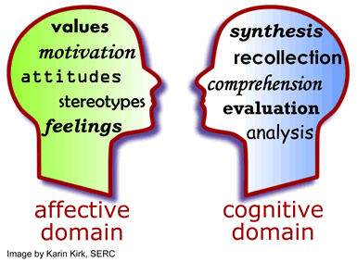
Affective Domain
The feelings, emotions, and general moods a learner brings to a task or that are generated in response to a task¹.
Cognitive Domain
Student conceptions and understanding of content.
Addressed through a variety of pedagogical interventions.
Educational psychology research reveals that student adoption of cognitive strategies may be influenced by affective factors such as motivation, attitudes, feelings and emotions.
Students leaving STEM fields often cite affective factors such as loss of motivation or interest in topic or development of interest in another field².
¹ Ormond, J., 2006, Essentials of Educational Psychology; ² Seymour & Hewitt, 1997, Talking about leaving: Why undergraduates leave the sciences.

Slide 5
Factors that influence learning
Personal Characteristics of Student
(age, gender, academic rank, experience)
Course Outcomes
(effort, interest, performance)
Course Context
(tasks, grading policy, pedagogy, instructional resources)
adapted from Pintrich and Zusho (2007)

Slide 6
Factors that influence learning
Student motivations
(things that drive learning, e.g., task value, self-efficacy)
Personal Characteristics of Student
(age, gender, academic rank, experience)
Course Outcomes
(effort, interest, performance)
Course Context
(tasks, grading policy, pedagogy, instructional resources)
Student self-regulation of learning
(studying and/or learning behaviors, e.g., planning, monitoring, reflection)
Instructional Design
Learning Process
Mastery
adapted from Pintrich and Zusho (2007)

Slide 7

GARNET (Geoscience Affective Research Network)
Hypothesis:
  What we do in our classrooms can change students’ affective behavior, specifically their self-regulation.
Goals:
  To use a common instrument (MSLQ) to investigate how aspects of the affective domain vary for students in physical geology courses at multiple institutions.
  Identify if and how those aspects vary with institution, instructor, learning
GARNET: Geoscience Affective Research Network
First study to compare student values, beliefs, and learning strategies across multiple general education geoscience courses.
Original Participating Institutions: University of Colorado, Boulder; University of North Dakota; North Carolina State University; California State University, Chico; Maricopa Community College (AZ); North Hennepin Community College (MN); Macalester College. [currently 15 total institutions]

Slide 8
MSLQ Instrument
Motivated Strategies for Learning Questionnaire (MSLQ) used to investigate how aspects of the affective domain varied for students.
Motivated Strategies for Learning Questionnaire
Categories
Subcategories
Subscales (# of questions)
Motivation Scales
Value
Intrinsic goal orientation (4)
Extrinsic goal orientation (4)
Task value (6)
Expectancy
Control of learning beliefs (4)
Self-efficacy (8)
Affect
Test anxiety (5)
Cognitive Scales
Cognitive strategies
Rehearsal (4)
Elaboration (6)
Organization (4)
Critical thinking (5)
Metacognitive strategies
Metacognitive Self Reg (12)
Resource Management
Time/study management (8)
Effort regulation (4)
Peer learning (3)
Help seeking (4)
Pintrich, P.R., Smith, D.A.F., Garcia, T., and McKeachie, W.J., 1991, NCRIPTL Report 91-B-004

Slide 9
Metacognitive Self-Regulation
For each subscale, students are asked to rate the subscale statements on a 7-point scale where 1 = Not at all true of me to 7 = Very true of me.
The example below shows part of the Metacognitive Self-Regulation subscale. Higher scores indicate an approach to learning with emphasis on planning, monitoring activities, and regulation of learning effort.
When I study for this class, I set goals for myself in order to direct my activities in each study period. | 1 2 3 4 5 6 7
I try to think through a topic and decide what I am supposed to learn from it rather than just reading it over when studying. | 1 2 3 4 5 6 7
When I become confused about something I’m reading for this class, I go back and try to figure it out | 1 2 3 4 5 6 7
When studying for this course I try to determine which concepts I don’t understand well. | 1 2 3 4 5 6 7

Slide 10
Factors that influence learning
Who are the students enrolling in introductory geoscience classes (motivations, interests, demographics)?
1
Student motivations
(things that drive learning, e.g., task value, self-efficacy)
Personal Characteristics of Student
(age, gender, academic rank, experience)
Course Outcomes
(effort, interest, performance)
Course Context
(tasks, grading policy, pedagogy, instructional resources)
Student self-regulation of learning
(studying and/or learning behaviors, e.g., planning, monitoring, reflection)
Instructional Design
Learning Process
Mastery
adapted from Pintrich and Zusho (2007)

Slide 11
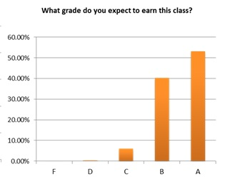
Most students report that they are taking a physical geology course to fulfill a requirement . . .
. . . and expect to do well in the class and earn a good grade.

Slide 12
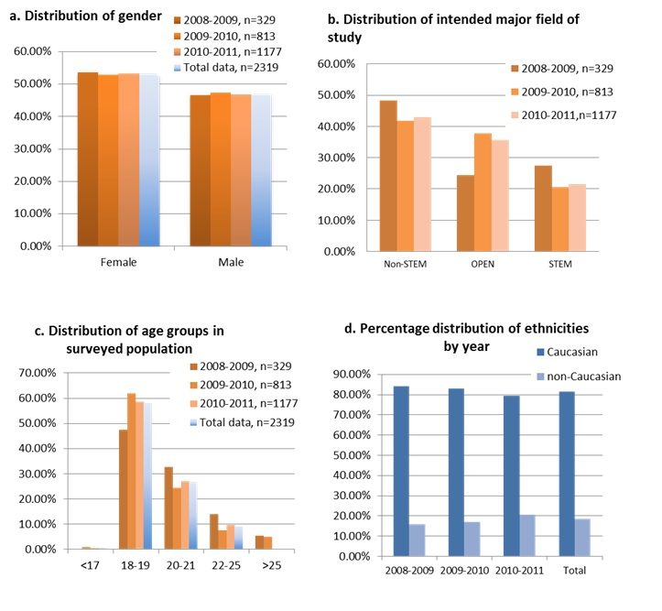
STUDENT demographic summary

Slide 13
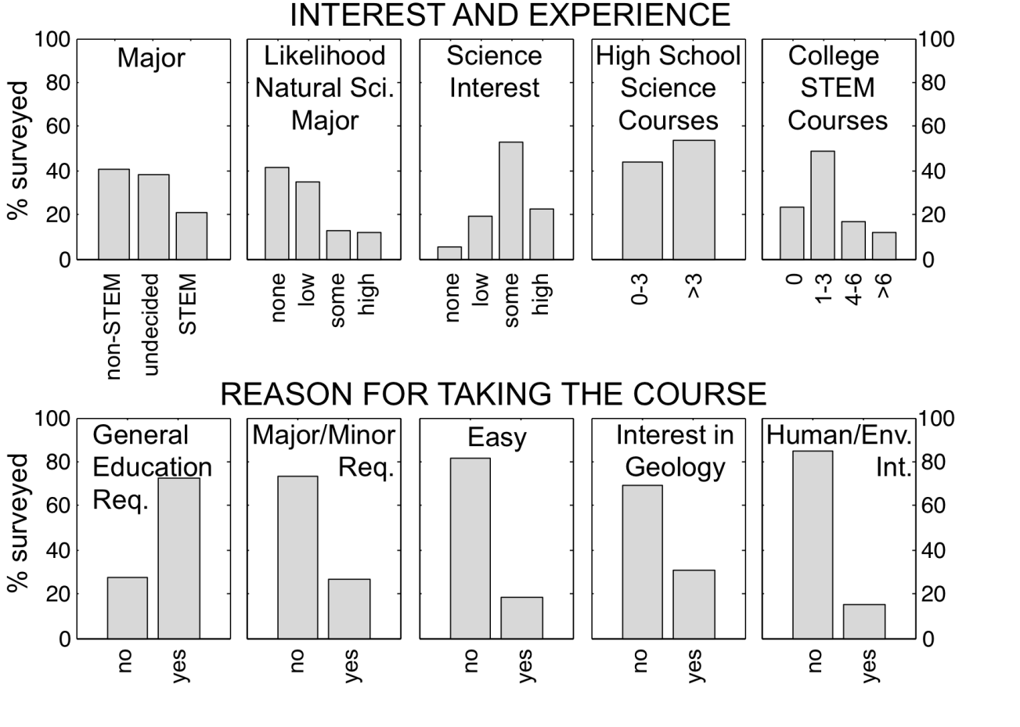
STUDENT demographic summary
Is this the profile of a “rocks for jocks” course?
Do different populations report different motivations?

Slide 14
STUDENT demographic summary
Is this the profile of a “rocks for jocks” course?
Do different populations report different motivations?
Significantly lower scores on 6 MSLQ subscales
Significantly higher scores on 10 MSLQ subscales

Slide 15
MSLQ subscales with significant variance
 | Gender | Age | Major | Science Interest | Likely Sci Degree | # of HS Sci Courses | # Coll Sci Courses | %
p values | <0.0001 | <0.0001 | <0.0001 | <0.0001 | <0.0001 | <0.0001 | <0.0001
IntGoal | x | x | x | x | x | x | x | 100%
ExtGoal |  |  |  |  |  | x |  | 14%
Task Value |  | x | x | x | x | x | x | 86%
ContLearning |  | x | x | x | x | x | x | 86%
Self Efficacy | x | x | x | x | x | x | x | 100%
Test Anxiety |  |  |  |  |  |  |  | 0%
Rehearsal | x |  |  |  |  |  |  | 14%
Elaboration | x | x |  | x | x |  |  | 57%
Organization | x |  |  |  |  |  |  | 14%
CritiThinking | x |  | x | x |  | x | x | 71%
Metacognition |  |  |  | x |  |  |  | 14%
Timestudy | x | x |  |  | x |  |  | 43%
Effortregul | x | x |  | x |  |  |  | 43%
Peerlearn |  | x |  |  | x |  |  | 29%
Helpseeking |  | x |  |  | x | x | x | 57%
MSLQ subscales significant | 8 | 9 | 5 | 8 | 8 | 7 | 6
Notes:
MANOVAs performed
15

Slide 16
MSLQ subscales with significant variance
Motivation “Pie”
Key Determinants in whether students choose to engage and persevere with learning
Goal
Orientation
Self-
Efficacy
Goals that drive how a student responds to the task/content
A student’s belief in their ability to be successful in a given task or course
{
}
Internal Drive
Self-beliefs
Task Value
Control of Learning
Valuing of a task or course based on connections to a student’s personal goals
Attribution of a student’s success (and failures) to controllable factors
Notes:
MANOVAs performed
16

Slide 17
MSLQ subscales with significant variance
 | Gender | Age | Major | Science Interest | Likely Sci Degree | # of HS Sci Courses | # Coll Sci Courses | %
p values | <0.0001 | <0.0001 | <0.0001 | <0.0001 | <0.0001 | <0.0001 | <0.0001
IntGoal | x | x | x | x | x | x | x | 100%
ExtGoal |  |  |  |  |  | x |  | 14%
Task Value |  | x | x | x | x | x | x | 86%
ContLearning |  | x | x | x | x | x | x | 86%
Self Efficacy | x | x | x | x | x | x | x | 100%
Test Anxiety |  |  |  |  |  |  |  | 0%
Rehearsal | x |  |  |  |  |  |  | 14%
Elaboration | x | x |  | x | x |  |  | 57%
Organization | x |  |  |  |  |  |  | 14%
CritiThinking | x |  | x | x |  | x | x | 71%
Metacognition |  |  |  | x |  |  |  | 14%
Timestudy | x | x |  |  | x |  |  | 43%
Effortregul | x | x |  | x |  |  |  | 43%
Peerlearn |  | x |  |  | x |  |  | 29%
Helpseeking |  | x |  |  | x | x | x | 57%
MSLQ subscales significant | 8 | 9 | 5 | 8 | 8 | 7 | 6
Notes:
MANOVAs performed
17

Slide 18
MSLQ subscales with significant variance
 | Gender | Age | Major | Science Interest | Likely Sci Degree | # of HS Sci Courses | # Coll Sci Courses | %
p values | <0.0001 | <0.0001 | <0.0001 | <0.0001 | <0.0001 | <0.0001 | <0.0001
IntGoal | x | x | x | x | x | x | x | 100%
ExtGoal |  |  |  |  |  | x |  | 14%
Task Value |  | x | x | x | x | x | x | 86%
ContLearning |  | x | x | x | x | x | x | 86%
Self Efficacy | x | x | x | x | x | x | x | 100%
Test Anxiety |  |  |  |  |  |  |  | 0%
Rehearsal | x |  |  |  |  |  |  | 14%
Elaboration | x | x |  | x | x |  |  | 57%
Organization | x |  |  |  |  |  |  | 14%
CritiThinking | x |  | x | x |  | x | x | 71%
Metacognition |  |  |  | x |  |  |  | 14%
Timestudy | x | x |  |  | x |  |  | 43%
Effortregul | x | x |  | x |  |  |  | 43%
Peerlearn |  | x |  |  | x |  |  | 29%
Helpseeking |  | x |  |  | x | x | x | 57%
MSLQ subscales significant | 8 | 9 | 5 | 8 | 8 | 7 | 6
Note: Race was not significant at p<0.05
Notes:
MANOVAs performed
18

Slide 19
Factors that influence learning
Instructional Design
Learning Process
Mastery
Student motivations
(things that drive learning, e.g., task value, self-efficacy)
Personal Characteristics of Student
(age, gender, academic rank, experience)
Course Outcomes
(effort, interest, performance)
Course Context
(tasks, grading policy, pedagogy, instructional resources)
Student self-regulation of learning
(studying and/or learning behaviors, e.g., planning, monitoring, reflection)
2
Is there a relationship between learning environments and learning outcomes? (Instruction vs. Content learning)
adapted from Pintrich and Zusho (2007)

Slide 20
Measuring Geoscience learning
Geoscience Concept Inventory (GCI)
Libarkin & Anderson (2006)
  Series of conceptual multiple choice questions on range of common introductory course topics
Comparison of gains on pre vs. post scores on common concept inventory assigned near start/end of semester
Learning gains = (Post %– Pre%)/(100 – Pre%)
Example:
Pre = 50%; Post = 75%
Learning Gain = 25/50 = 0.5 or 50%

Slide 21
Classroom Observation
Reformed Teaching Observation Protocol (RTOP)
RTOP has 5 categories:
  Lesson Design & Implementation (What the teacher intended to do)
  Propositional Knowledge (What the Teacher knows)
  Procedural Knowledge (What the students did)
  Classroom Culture (Student-Student Interactions)
  Classroom Culture (Student/Teacher Relationships)
0-4 for each item, total of 100 possible points
High RTOP scores → a more reformed classroom (more student activity during class)
Sawada, D., Turley, J., Falconer, K., Benford, R., and Bloom, I., 2002, School Science and Mathematics, v. 102, p.245-252.

Slide 22
Course Context
The more student-centered the classroom ( RTOP), the greater the learning gains
38% of the variance in student learning gains are explained by the nature of instruction in the classroom
Notes:
Student level with mslq, classrom level at rtop, student levelnof content with gci– general graph here…

Slide 23
Course Context
The more student-centered the classroom ( RTOP), the greater the learning gains
38% of the variance in student learning gains are explained by the nature of instruction in the classroom
National average
PCAST recommendation #1
Catalyze widespread adoption of empirically validated teaching practices.
¹PCAST: Engage to Excel report (2012)
Notes:
Student level with mslq, classrom level at rtop, student levelnof content with gci– general graph here…

Slide 24

Graduate Student Teaching Observations
Katherine Ryker
*
*
*
*
*
*
*
*
*
Note: Single asterisk (*) denotes statistical significance at p < 0.05. Double asterisks (**) indicate p < 0.01.
PCAST recommendation #2
Advocate and provide support for replacing standard laboratory course with discovery-based research courses
¹PCAST: Engage to Excel report (2012)

Slide 25
Factors that influence learning
Is there a relationship between learning environments and student motivation?
3
Student motivations
(things that drive learning, e.g., task value, self-efficacy)
Personal Characteristics of Student
(age, gender, academic rank, experience)
Course Outcomes
(effort, interest, performance)
Course Context
(tasks, grading policy, pedagogy, instructional resources)
Student self-regulation of learning
(studying and/or learning behaviors, e.g., planning, monitoring, reflection)
Instructional Design
Learning Process
Mastery
adapted from Pintrich and Zusho (2007)

Slide 26
MSLQ Instrument
Motivated Strategies for Learning Questionnaire (MSLQ) used to investigate how aspects of the affective domain varied for students.
Motivated Strategies for Learning Questionnaire
Categories
Subcategories
Subscales (# of questions)
Motivation Scales
Value
Intrinsic goal orientation (4)
Extrinsic goal orientation (4)
Task value (6)
Expectancy
Control of learning beliefs (4)
Self-efficacy (8)
Affect
Test anxiety (5)
Cognitive Scales
Cognitive strategies
Rehearsal (4)
Elaboration (6)
Organization (4)
Critical thinking (5)
Metacognitive strategies
Metacognitive Self Reg (12)
Resource Management
Time/study management (8)
Effort regulation (4)
Peer learning (3)
Help seeking (4)
Pintrich, P.R., Smith, D.A.F., Garcia, T., and McKeachie, W.J., 1991, NCRIPTL Report 91-B-004

Slide 27
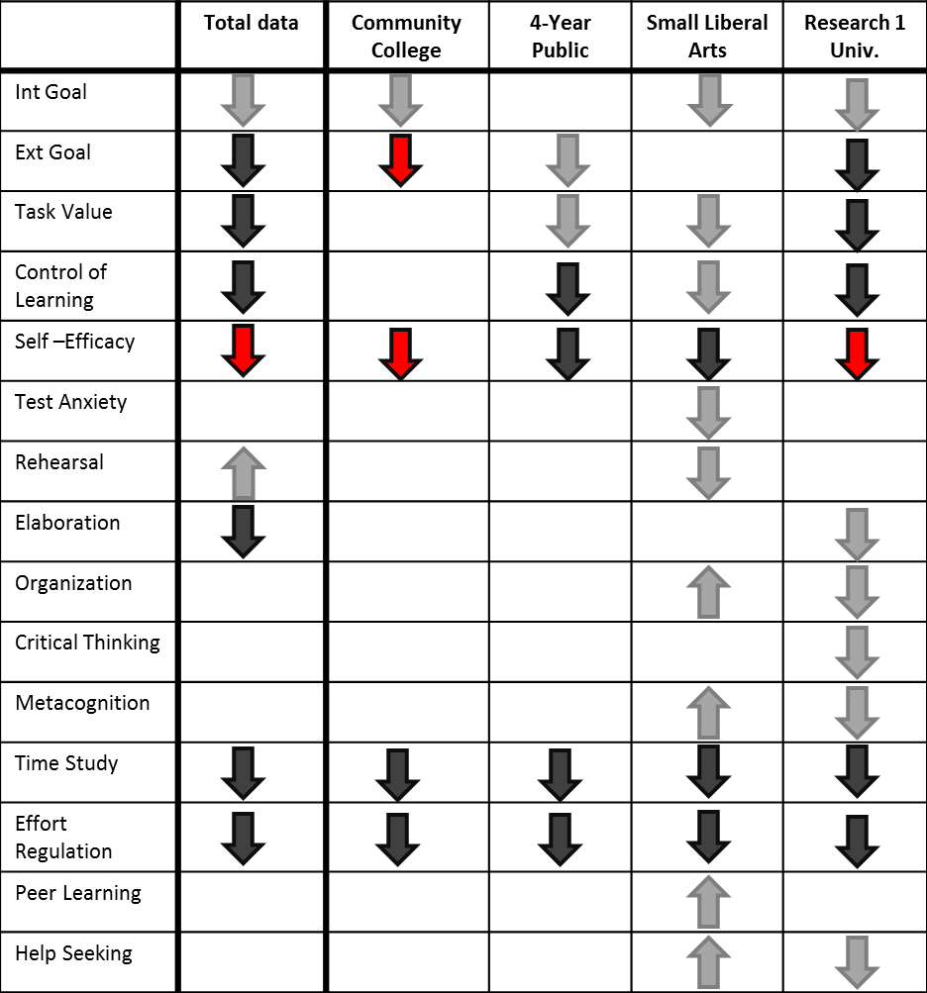
Key Finding 1
Overall trends are similar across institutions, especially institutions of similar type
Shift in student motivations and learning strategies over a single semester.
Presence of arrows indicate a significant paired t-test at α=0.05, Color indicates Effect size; Grey- negligible (d<0.2), Black- Small (0.2<D<0.35), and red – Medium( D>0.35)..

Slide 28
Key Finding 1
Overall trends are similar across institutions, especially institutions of similar type
Shift in student motivations and learning strategies over a single semester.
Either no change or decline in multiple subscales, including 5/6 motivation scales.
Increases in few subscales
Results consistent with previous research on science courses.
Presence of arrows indicate a significant paired t-test at α=0.05, Color indicates Effect size; Grey- negligible (d<0.2), Black- Small (0.2<D<0.35), and red – Medium( D>0.35)..

Slide 29
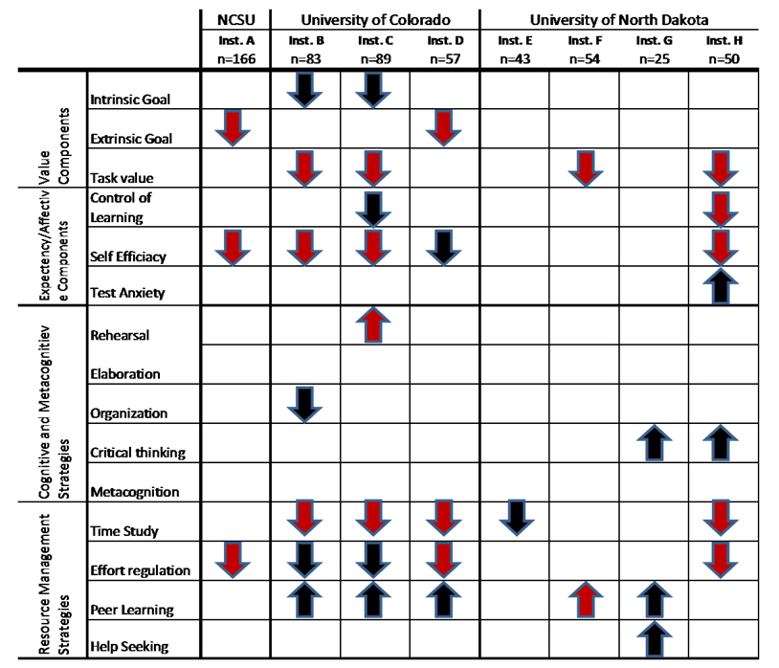
Key Finding 2
Differences occur between different instructors at the same institution
Summary of the shift in student scores over a single semester, for individual instructors at research institutions.
More student-centered classes have fewer declines
Black arrow indicate significant with alpha of 0.05, red arrows indicate strongly significant with alpha of 0.01. Direction of arrow indicate direction of shift in MSLQ score (down= decrease in score; up=increase in score)

Slide 30
Student Motivations
Constructs | % Increase | % Decrease | % Decrease High RTOP | % Decrease Low RTOP
Intrinsic goals & Task Value (Internal Drive) | **45.5 | **55.5 | *53.3 | 58.9
Control Beliefs & Self-Efficacy (Self-beliefs) | **42.5 | **57.5 | *49.1 | *60.7
Effort & Metacognition (Executive Functioning) | **44.9 | **56.1 | *49.1 | 58.9
** p < 0.001, *p < 0.05
Students who reported increased motivation and use of more effective learning strategies were:
More likely to be interested in geology at the end of the course
More likely to enroll in another geology course

Slide 31
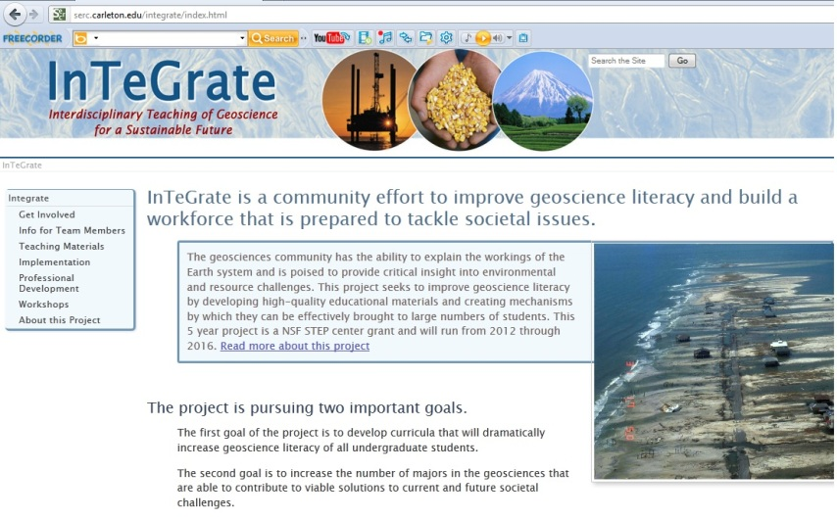

MSLQ subscales with significant variance
Motivation “Pie”
Key Determinants in whether students choose to engage and persevere with learning
Find interesting topics
Goal
Orientation
Self-
Efficacy
{
}
Internal Drive
Self-beliefs
Task Value
Control of Learning
http://serc.carleton.edu/integrate/index.html
Notes:
MANOVAs performed
31

Slide 32
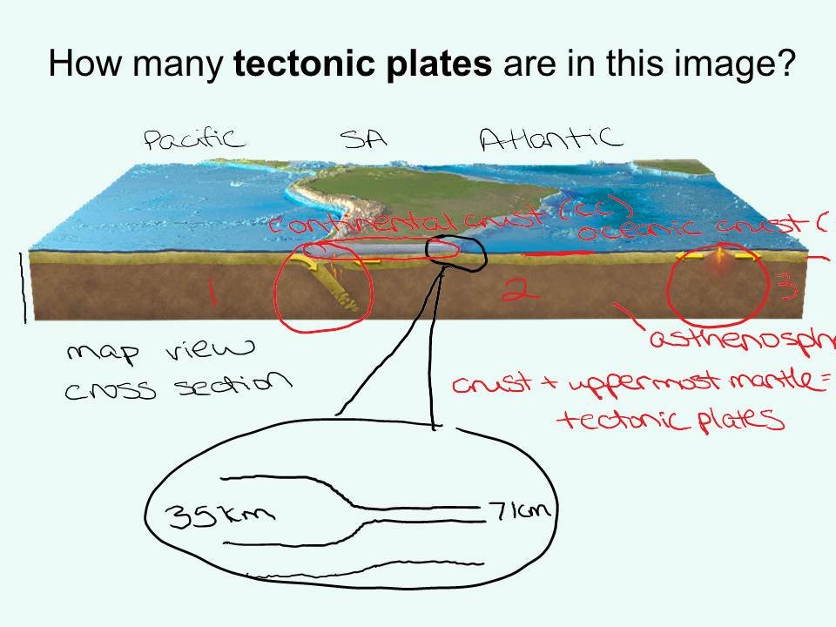
MSLQ subscales with significant variance
Motivation “Pie”
Key Determinants in whether students choose to engage and persevere with learning
Give Students some control of their learning
Goal
Orientation
Self-
Efficacy
{
}
Internal Drive
Self-beliefs
Task Value
Control of Learning
Notes:
MANOVAs performed
32

Slide 33
Factors that influence learning
Instructional Design
Learning Process
Mastery
Student motivations
(things that drive learning, e.g., task value, self-efficacy)
Personal Characteristics of Student
(age, gender, academic rank, experience)
Course Outcomes
(effort, interest, performance)
Course Context
(tasks, grading policy, pedagogy, instructional resources)
Student self-regulation of learning
(studying and/or learning behaviors, e.g., planning, monitoring, reflection)
4
Is there a relationship between learning
environments and student attention to their thinking/learning?
adapted from Pintrich and Zusho (2007)

Slide 34
What is a self-regulated learner?
Academic self-regulation refers to self-generated thoughts, feelings and actions intended to attain specific educational goals, such as analyzing a reading assignment, preparing to take a test or writing a paper.
Zimmerman et al., 1996
Self-regulated learning is . . “an active, constructive process whereby learners set goals for their learning and then attempt to monitor, regulate, and control their cognition, motivation and behavior, guided and constrained by their goals and the contextual features in the environment.”
Pintrich, 2000
Better student self-regulation → Better student performance

Slide 35
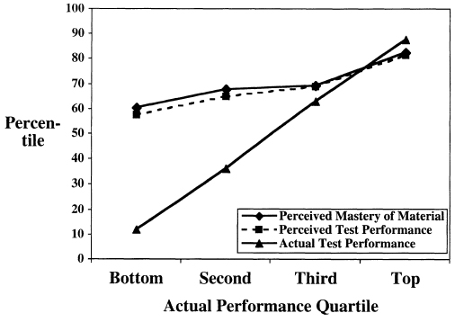
Student Recognition of their Learning
Low scoring students
overestimated their own skill level
Dunning et al., 2003. Current directions in psychological science, v.12 #3, p.83-87

Slide 36
Student Recognition of their Learning
Low scoring students
overestimated their own skill level
failed to recognize skill in others
failed to recognize the degree of their insufficient knowledge
recognized their lack of skill, only if they were trained to improve
Dunning et al., 2003. Current directions in psychological science, v.12 #3, p.83-87

Slide 37
Exam wrappers for Physical Geology
Student prediction of their exam performance
Most students within 10 pts of actual score
Predicted Score
Actual Score
Active learning class with multiple opportunities for learning assessment through clicker questions, in-class exercises, mastery quizzes and learning journal exercises.

Slide 38
Exam wrappers for Physical Geology
Student prediction of their exam performance
Most students within 10 pts of actual score
  Several low scoring students unable to predict their performance
    Poor preparation
    Poor study habits
    Poor assessment of understanding
Predicted Score
Actual Score
Active learning class with multiple opportunities for learning assessment through clicker questions, in-class exercises, mastery quizzes and learning journal exercises.

Slide 39
Key Finding 3
Small to no changes for learning strategies measures compared to motivation scales
Students leave our courses using the same learning strategies that they had when they entered (elementary school)
. . self-generated thoughts, feelings and actions intended to attain specific educational goals . . .

Slide 40

Laura Lukes
Best (lowest) ranking, 3.58: Reviewing PowerPoint lecture slides - students use class resources that are made available by the instructor for each class.
Second best rankings (3.92-4.12): 3 categories that require students to be reflective of their learning - Creating your own outline or study guide, "Quizzing" yourself using notes, book, or study guide, and "Quizzing" yourself using teacher outlined learning objectives.

Slide 41
Exam wrappers for Physical Geology exam
What, if anything, will you do differently in preparing for the second exam?
Study More
Study Differently
No change
other
I will study more, a lot more.
I will take the learning journals more seriously and read them when it comes to studying.
Make sure I understand the visuals.
I might try to study earlier than the night before.
I will definitely study more by reading something then try to write it.
I will use more charts and organizers . . .
Study longer and actually practice drawing things out.
Quiz myself instead of just looking over notes.
I will try to study more, as well as stopping as I study to test myself on the material I am reviewing.
Study differently. Summarize more.
I will make a better outline and study more in small increments.
Spend more time preparing and reading over the notes.
I have to study more and actually know what material to study.
I will make sure I understand the learning objectives better.

Slide 42
Summary
Students enter introductory STEM classes with a range of motivations and learning strategies. When we address motivation and learning in our classes, students . . .
  . . . learn more content.
  . . . leave class more interested in geoscience and more likely to take another class.
  . . . adopt more effective learning strategies that can be applied in other classes.

