Slide 1
Shoreline Analysis
Shelley Whitmeyer
James Madison University

Slide 2
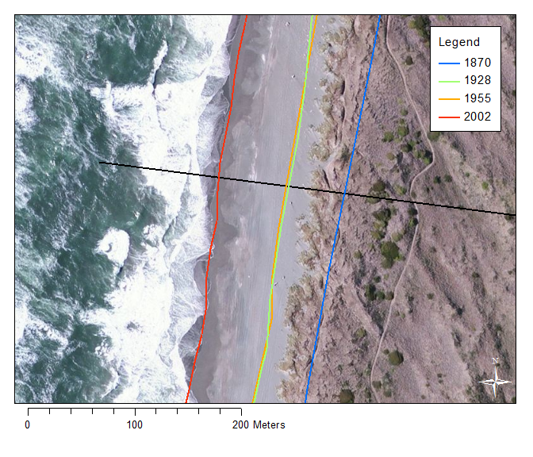
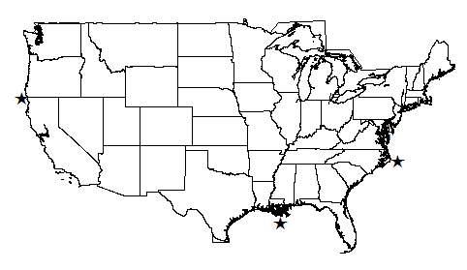
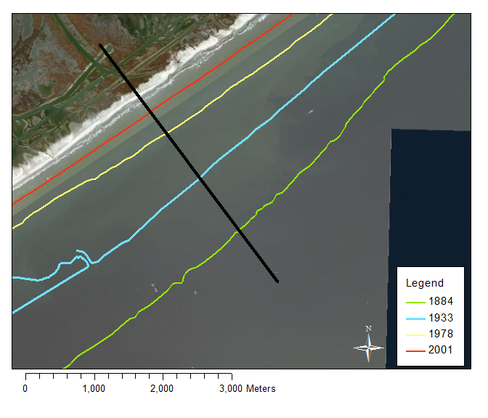
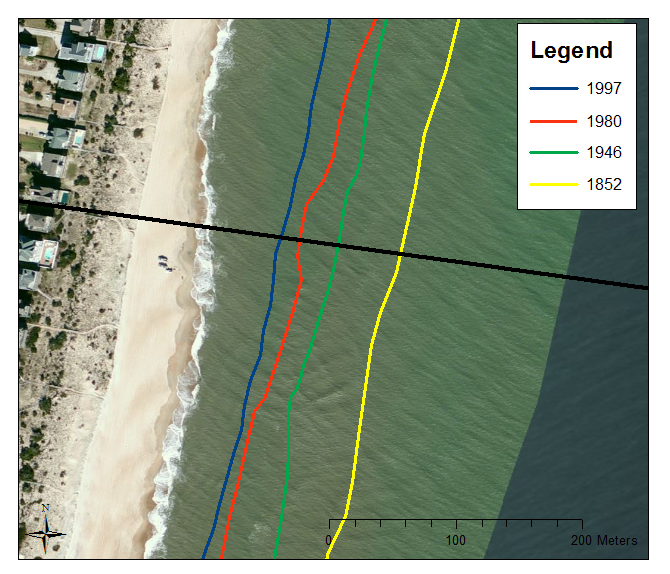

Slide 3
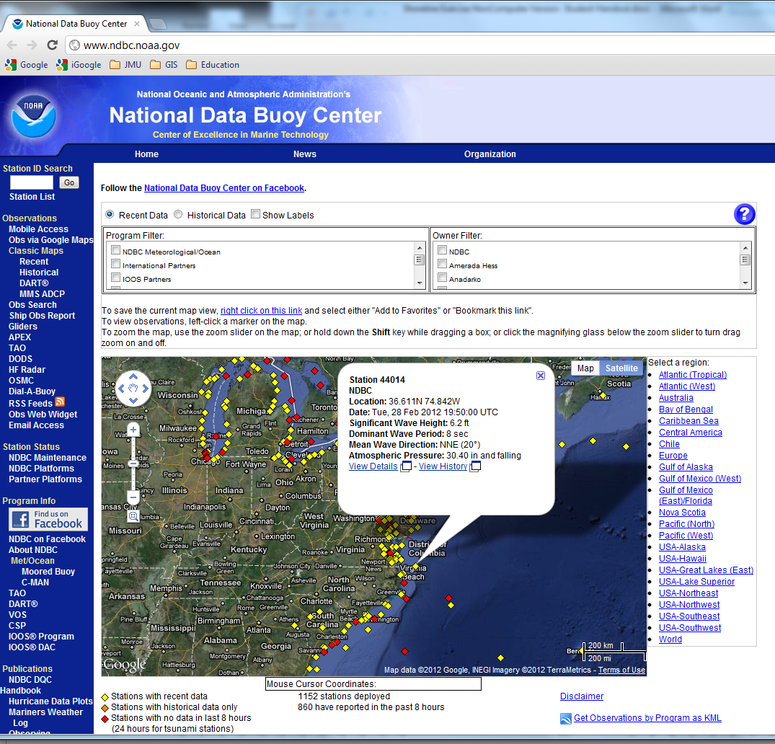
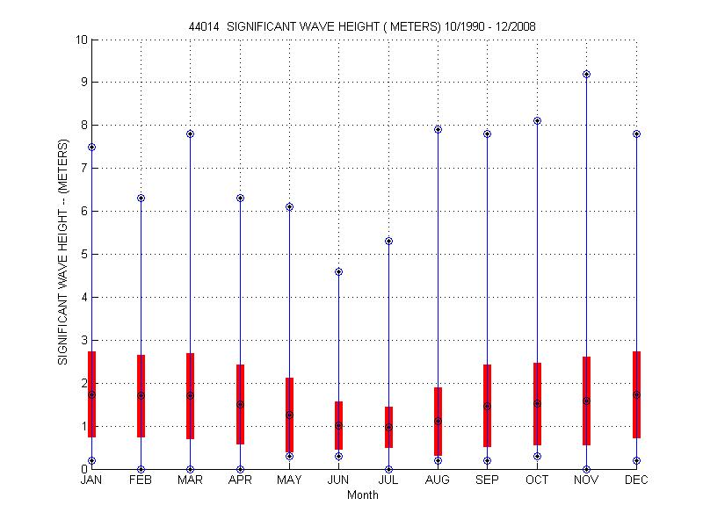

Slide 4
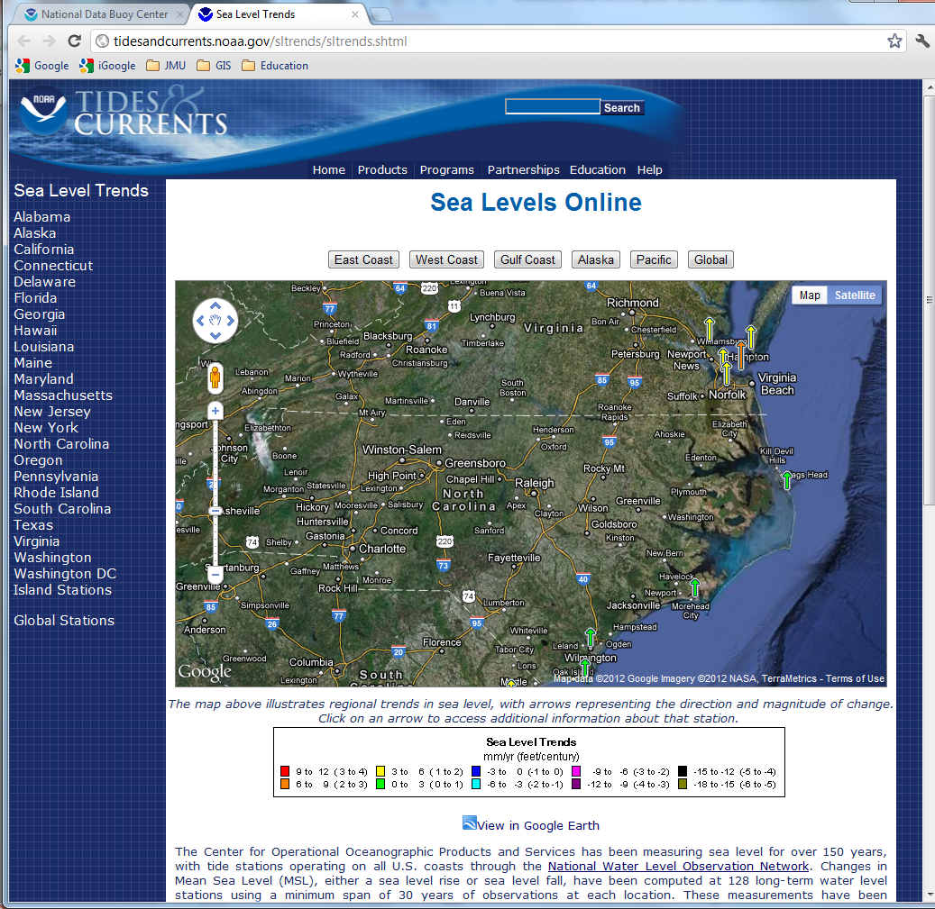
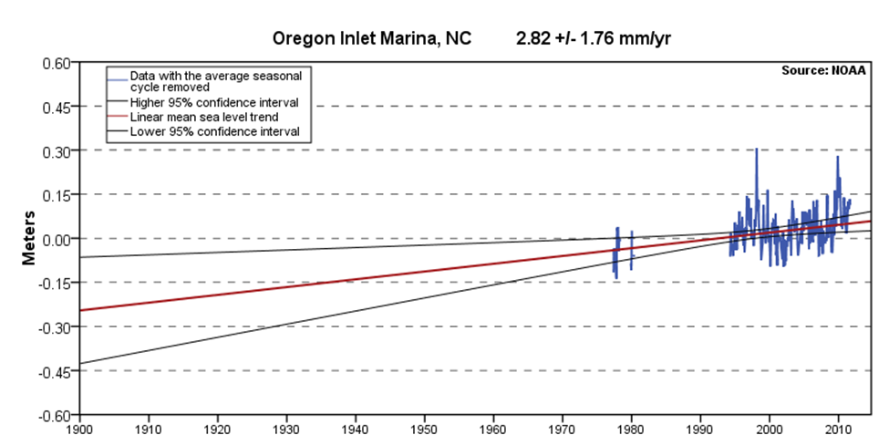

Slide 5
Table 3. Summary Table
 | North Carolina | Louisiana | California
Rate of Change | 0.7 m/yr | 18 m/yr | 0.9 m/yr
Wave Conditions | Max: 9.2 m/yr Avg: 1.4 m/yr | Max: 11.2 m/yr Avg: 1.1 m/yr | Max: 10 m/yr Avg: 2.3 m/yr
Sea Level Rise | 2.82 mm/yr | 9.24 mm/yr | -0.65 mm/yr
Tectonic Setting

Slide 6
Summary
Goals
  Use spatial and numerical methods to analyze and interpret natural phenomena.
  Formulate hypotheses and identify relevant variables.
    Waves/Sea Level Rise/Underlying Geology control the morphology of the shoreline.
Evaluation
  Assignment has been used to facilitate and direct class discussion on coastlines.

