Slide 1
Geomorphology
Change Monitoring
Landsat Data Archive

Slide 2
The Assignment
Research current global coastline change hazards (flooding; sea level rise; coastal subsidence; tsunamis; storm surge; permafrost melting; ice shelf collapse)
Evaluate the impact of anthropogenic activities (damming of river systems; climate change impacts; coastal construction/development; deforestation; etc.)
Find and download image data documenting change over time for a specific type of change, and prepare it for use in remote sensing analysis
Carry out a change analysis using remote sensing software
Prepare and present the results as both a poster and as an oral presentation

Slide 3
What course goal(s) does this assignment/activity address?
By focusing on change, this activity will enable students to understand geomorphology as a living science and to recognize both natural and human impacts on geomorphic features. Coastline changes for both ocean and lacustrine bodies of water record natural hazards and human-induced events in immediate and dramatic ways.

Slide 4
Geomorphology Fall 2011
Presentation
Captain Sea near Kazakhstan and Uzbekistan
Path/ Row:
/ 28
Lat/Lon:
46.0 52.2

Slide 5
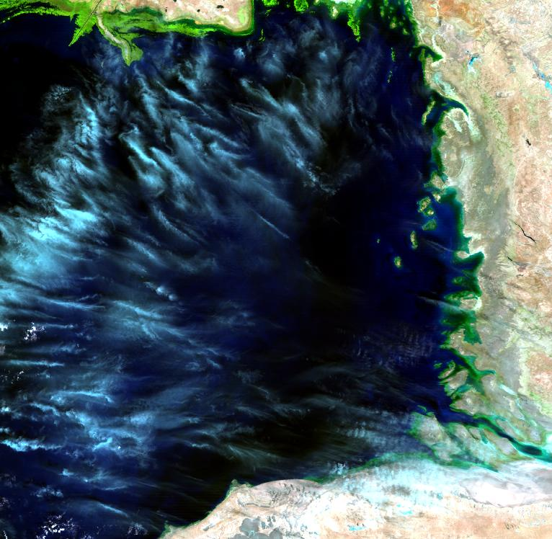
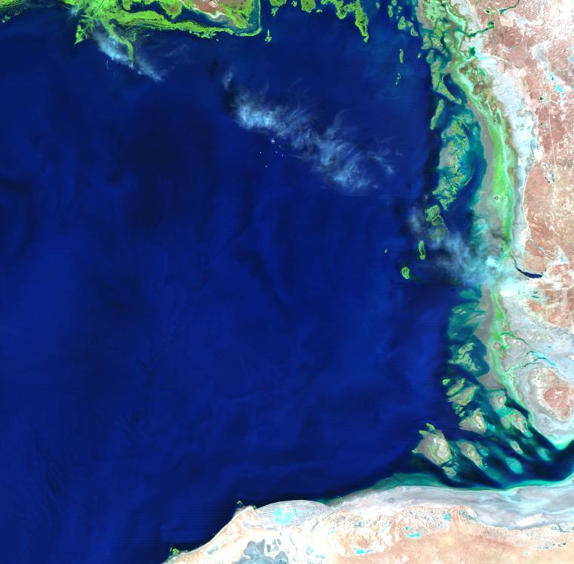
July 1984
ID:LT51660281984210AAA04
Cloud Cover: 10% Qlty: 9
Date: 1984/7/28

Slide 6
Geomorphology
Satellite Images Over Time
China’s Wetlands

Slide 7
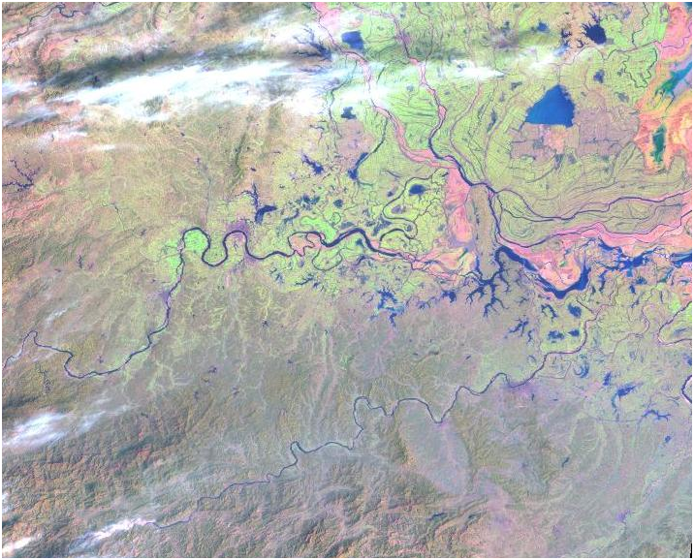
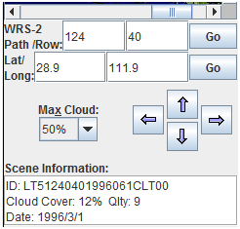

Slide 8
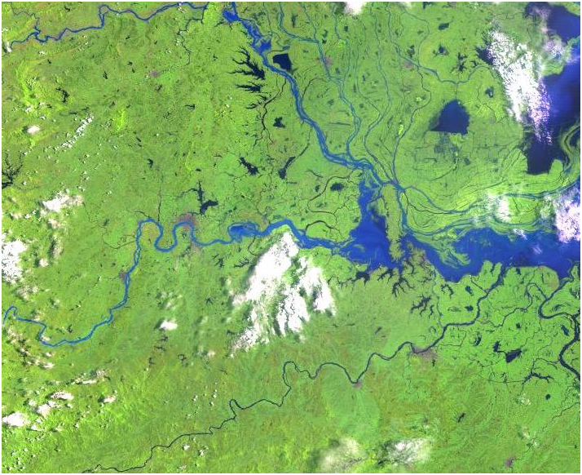
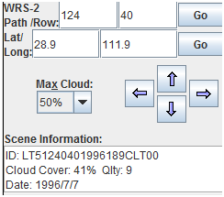

Slide 9
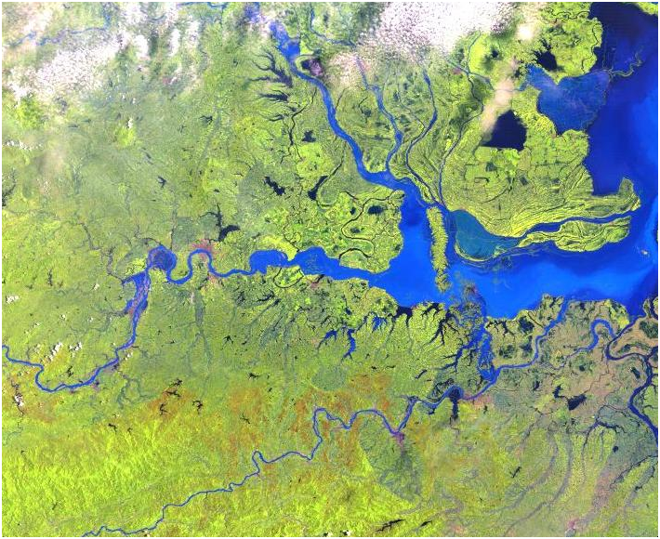
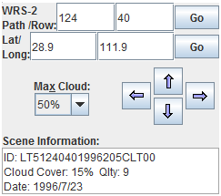

Slide 10
