Slide 1
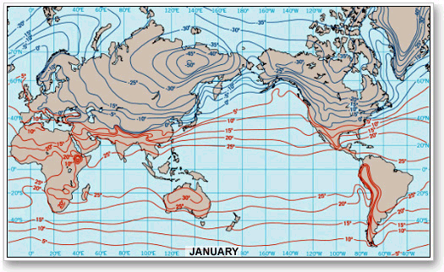
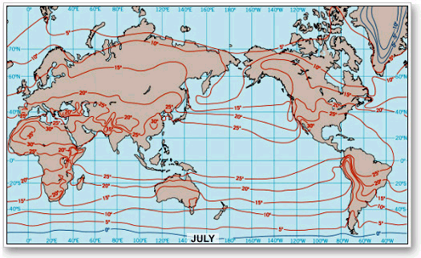
To address my class goal of helping students distinguish between observation and interpretation of images, I posted an image as example (see below), and asked them first list what they saw (description) and then to describe what information they can derive from the image (interpretation/analysis).
We did one example together as a class, another in small groups and then subsequently, they were asked to locate and select images themselves and asked to set up the questions and criteria for each other (we started in groups but abandoned them when not enough students were participating).

Slide 2
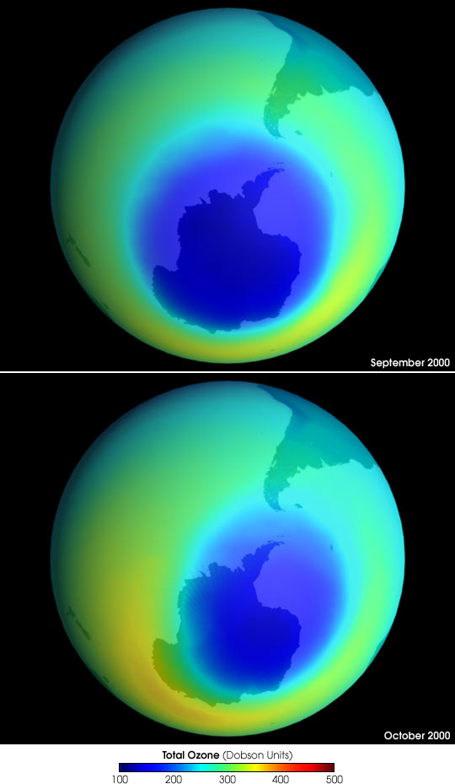
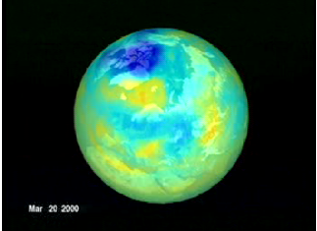
As a follow up to the previous assignments/activities I also used the same technique in an exam question with the images below. They were asked to describe the differences they observed in the images of the N and S poles and then to try and provide a possible explanation for what they observed. They were told that the image on the left was taking in Oct 1999, and the ones on the right in Sept/Oct 2000. Images are from Http://Earthobservatory.nasa.gov.

Slide 3
This exercise was only partially successful. This class was a ‘hybrid’ class which meant it met once a week in person and once online. Students had online groups and group work, but only a handful of students actually did any of the online work requiring several sets of readjustments and moving of people in groups. Even in class, students struggled to do the more independent types of activities (such as finding images), often responding that they just ‘couldn’t get it’ which I have learned is often a proxy for ‘I don’t want to do this’. Students who did do the work I think did much better over all in class, and will likely retain more information over time in part because of the more consciously ‘threaded’ nature of activities, assignments, and goals.

