Slide 1
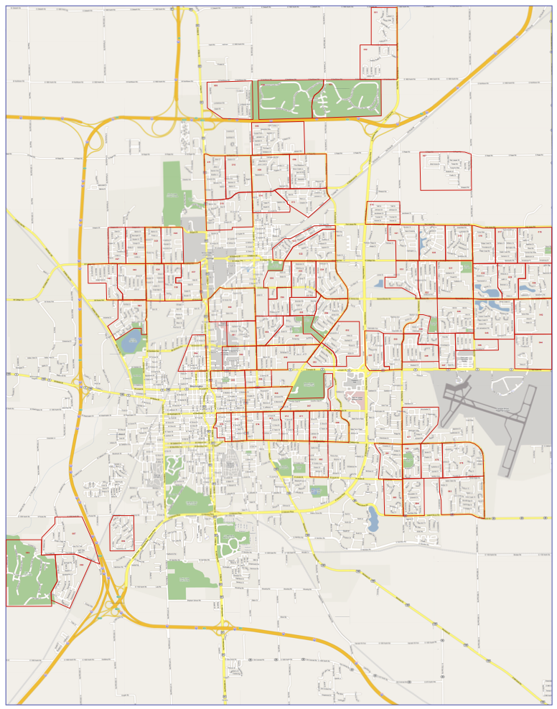
Define old neighborhoods & assess old maps
Find data about neighborhoods
Organize data & change projections
Introduction to GIS software & making a map
Obtain & evaluate datasets
Digitize houses & sidewalks
Geocode apartments & crimes
Spatial analysis: homes in an area & walking/driving distance
Synthesize data & spatial references
Obtain, create & synthesize data
Create & spatially reference information
Analyze spatial data for decision making
Habitat for Humanity
Trick or Treat Fundraiser
Neighborhood Maps

Slide 2
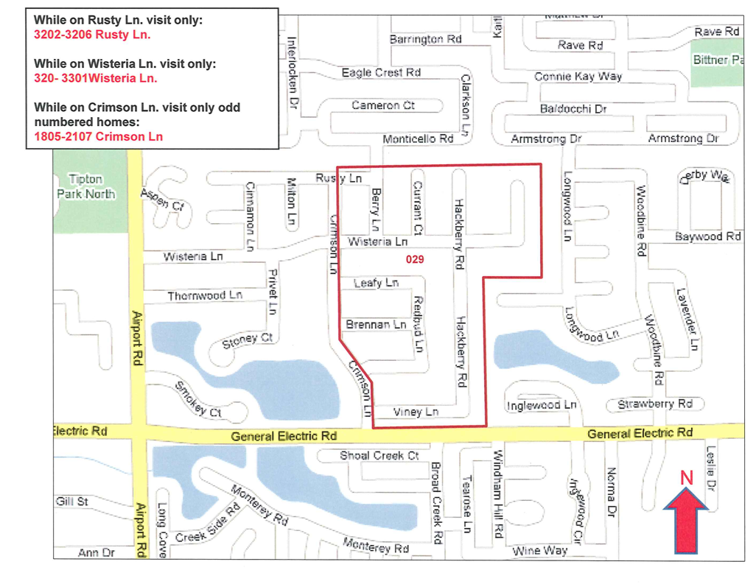
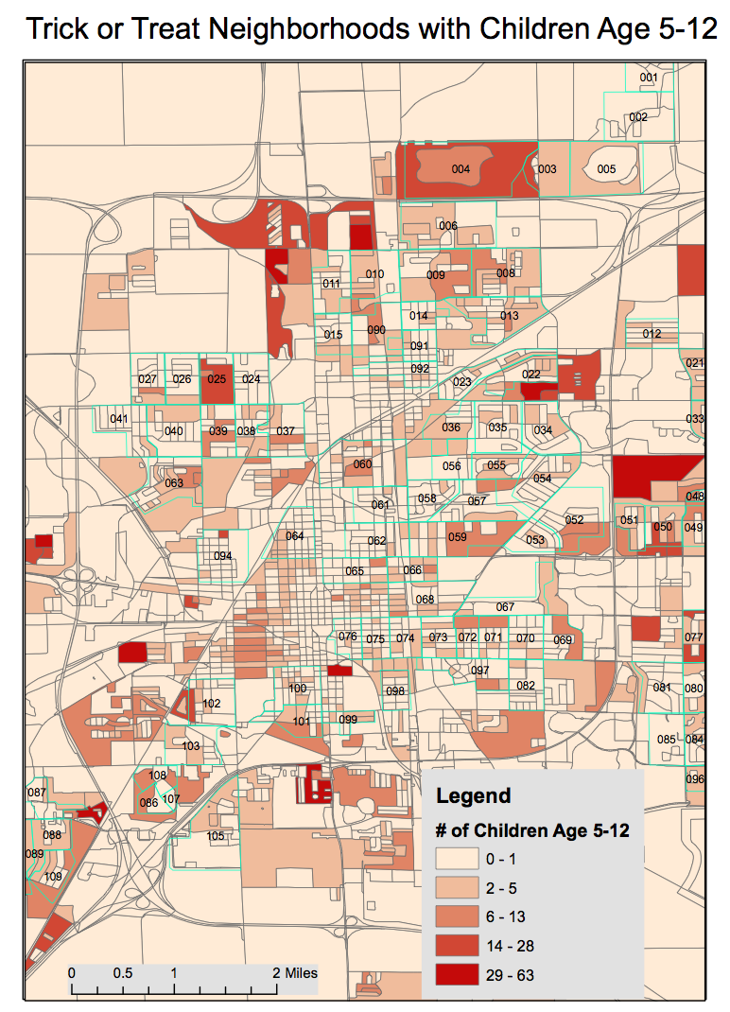
Additional course goals:
Create effective visual presentations
Communicate spatial problems
Interpret results
Critique applications of GIS
Project goals:
Improve map information & clarity
Improve efficiency of fundraising
Evaluation:
Map of tasks each week
Weekly short answer & reflection questions

