Slide 1
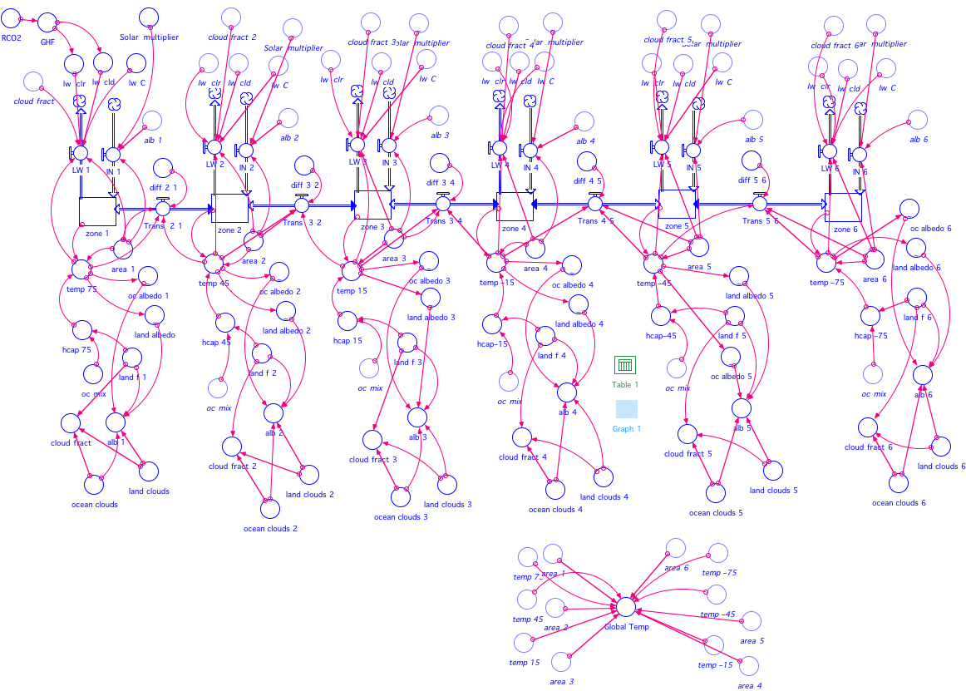
Modeling as a Way of Learning About Complexity in Earth Systems
Dave Bice
Dept. of Geosciences
Penn State University

Slide 2
What do I mean by complexity?
  Systems whose behavior is non-linear and thus difficult to predict.
  Multiple stable states
  Hysteresis behavior
  Strong sensitivity to initial conditions
  Chaotic (non-periodic) oscillations
Hysteresis and Snowball Earth
Why should we care about complex systems?
Our climate system is a complex system
Global Temperature
What are the barriers to teaching and learning about complex systems?
Need to first understand the dynamics of simple systems & feedbacks
Need to be able to construct and then experiment with systems to see how they work
Greenhouse Forcing

Slide 3
Learning about Complexity with STELLA models
The Modeling Process
Starts with observations of interesting real world dynamics
Definition of conceptual model of relevant system
Translation of conceptual model into model diagram
Adding numbers and equations to express the processes
Testing model, comparing with known behavior of the real world system
Experimenting with model — iteration between question asking, prediction, running the model, analysis of data, more questions, etc.
Writing and talking about results and their implications for the real world system.

Slide 4
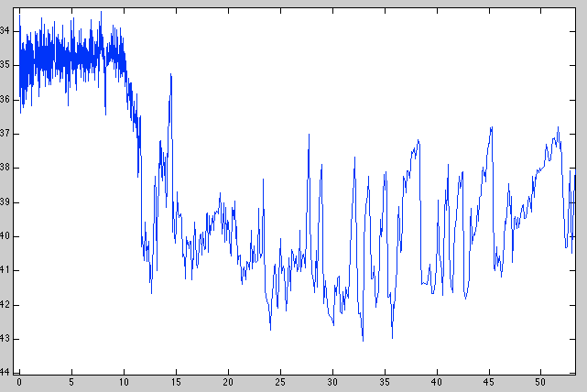
Starts with observations of interesting real world dynamics
Greenland Ice Core Record back to 50 kyr
Younger Dryas Event
Oxygen isotope ratio of Greenland Ice
Time (kyr BP)

Slide 5

5

Slide 6
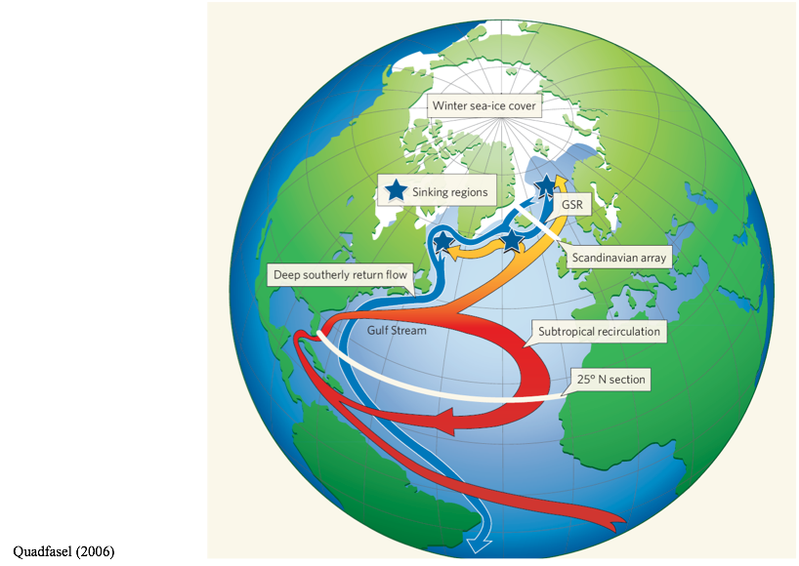

Slide 7
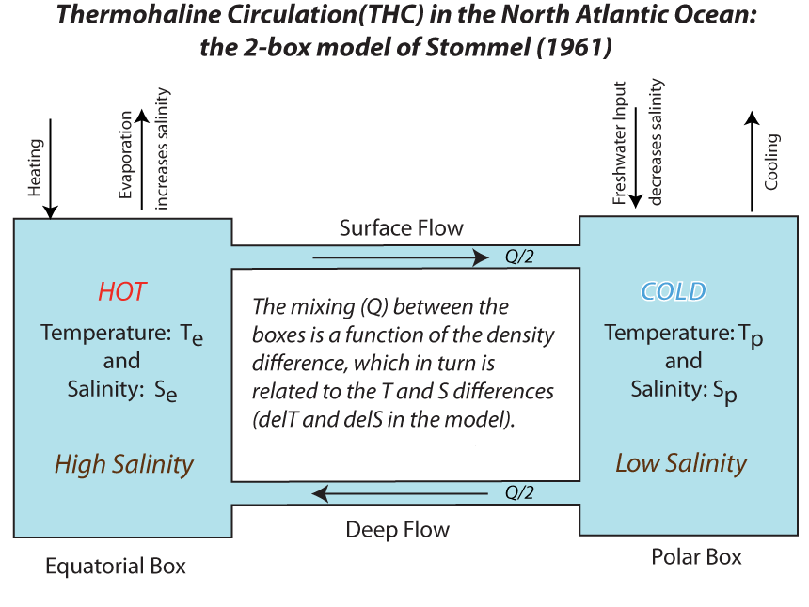
Definition of conceptual model of relevant system
del T = T_{e}-T_{p} del S = S_{e}-S_{p}

Slide 8
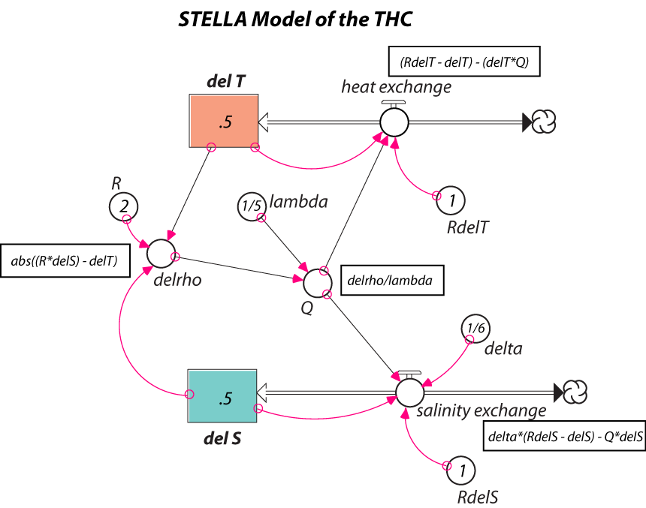
Translation of conceptual model into model diagram
del T = T_{e}-T_{p} del S = S_{e}-S_{p}
Adding numbers and equations to express the processes and initial conditions

Slide 9
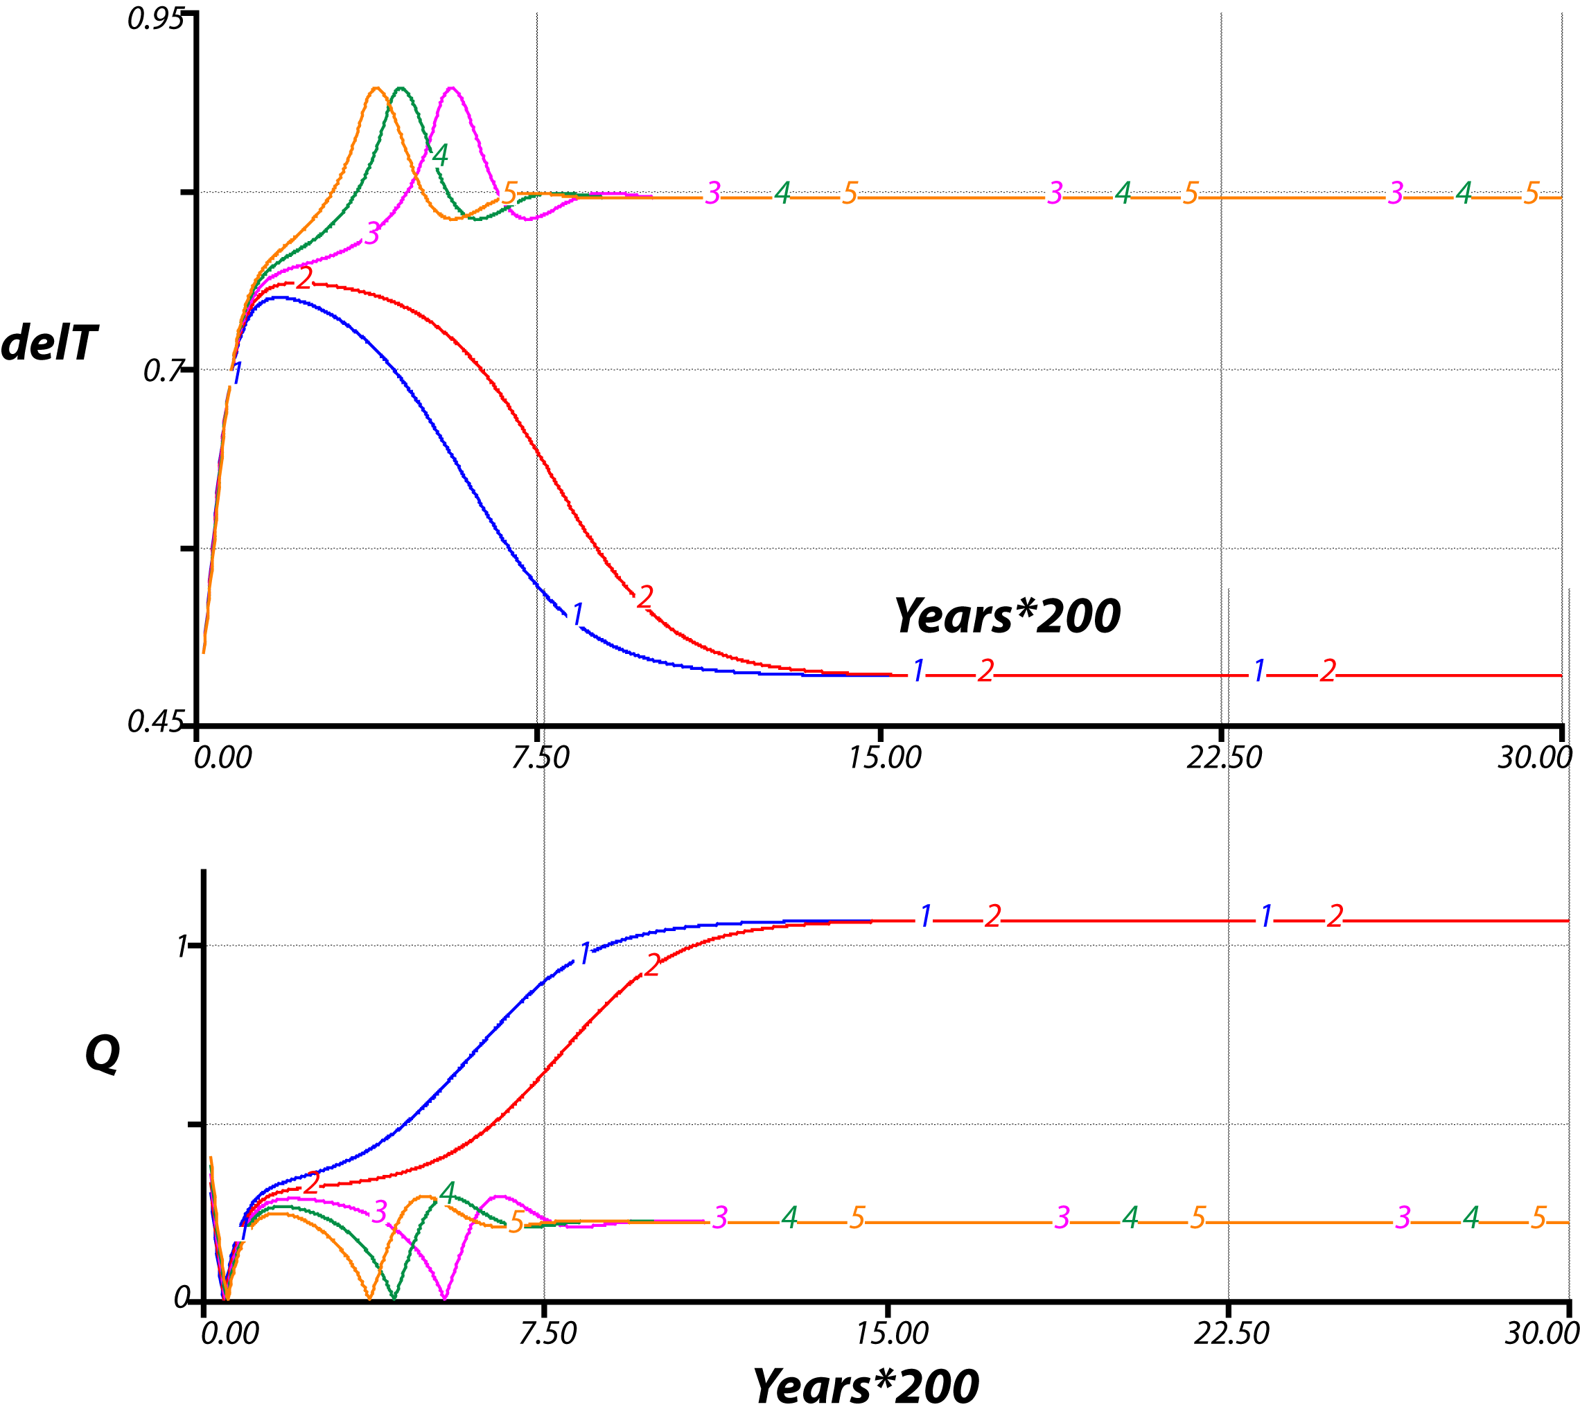
Experimenting with model — iteration between question asking, prediction, running the model, analysis of data, more questions, etc.
5 simulations with small changes in the starting delS value
Sensitivity to initial conditions and 2 stable states

Slide 10
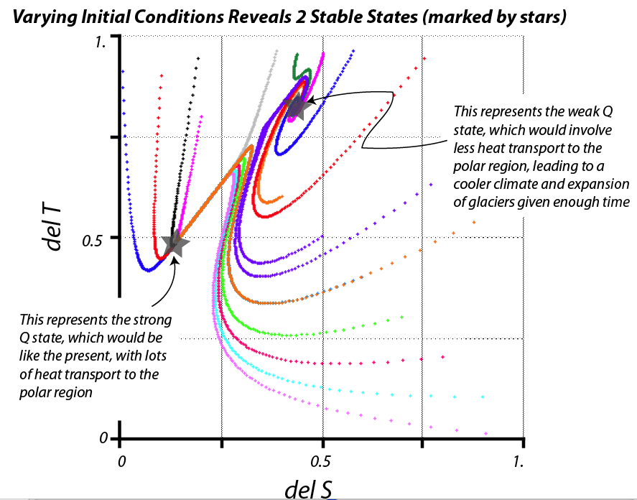

Slide 11
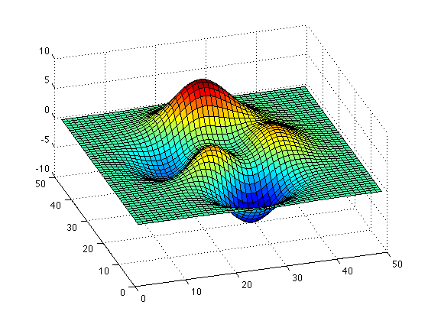
A topographic analogy for the stable states seems to help some of the students think about the this system

Slide 12
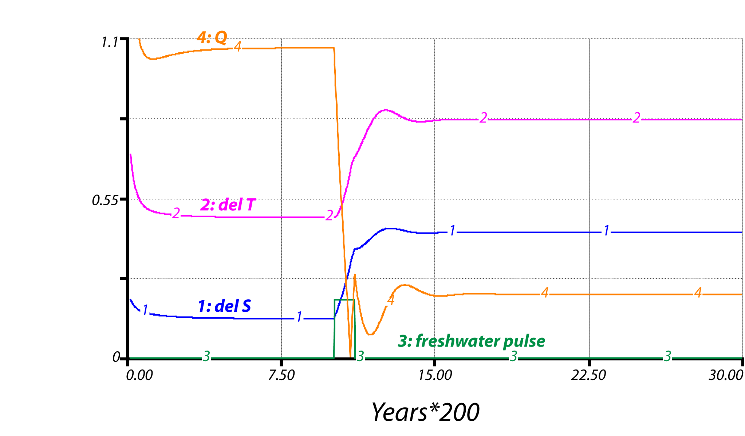
Simulating the Younger Dryas…
Steady state with weak mixing, cold polar region
Steady state with vigorous mixing, warm polar region
A brief pulse of freshwater into the northern Atlantic pushes the system into the other steady state

Slide 13
So… does it work?
I think so, and at the very least, they have a model to help guide their thinking and questioning about the system that has given us this record.
Greenland Ice Core Record
Younger Dryas Event
Oxygen isotope ratio of Greenland Ice
Time (kyr BP)

