Slide 1
Exploring Complex Systems in Social Science
Greg Marfleet
Carleton College
Department of Political Science

Slide 2
Issues for Political Science Students
Concept of Politics: Elite-driven or Institutionally Shaped (top-down causal thinking)
Bias toward stability, order, equilibrium (negative feedback)
Methods: linear, additive (Econometrics)
Y = b0 + b1x1+ ..+ bnXn + e
Models: statistical or qualitative ‘narratives’
Analysis: Cross-sectional, not dynamic
Limited macro-micro linking
Orthodoxy in game theory (always with fixed exogenous preferences –fixed environment)
No common ontology of agents

Slide 3
Complexity concepts
Bottom-up generative
Roots in chaos, perpetual novelty
Self-organization and Criticality
Systems can be dynamic with positive and/or negative feedback
Non-linear processes
Models are process oriented: you must ‘grow it’ to show it
Micro to Macro links – emergent properties
Agents can be adaptive (not fixed)
Models require an explicit ontology of agents

Slide 4
Classic Poli-Sci Voting Model
Median Voter Theorem (Anthony Downs)
A
B
L
R
In a two party election (A, B) where voters can be considered as arrayed
on a L-R ideological scale, the optimal position for each party is the ‘Median Voter’ (50%+1). Predicts convergence in policy positions

Slide 5
Complex Voting Model
Political Insitutions and Sorting in a Tiebout Model (Kollman, Miller and Page)
In an N-issue opinion space, voters are arranged as a ‘landscape’ with varying density.
Parties must dynamically position themselves to maximize their share of voters by altering their position (P) for each (i).
Issue1
A
B
Issue2

Slide 6
Classic IR Model
Richardson Arms Race
A system of two linear differential equations
Arms accumulate because of mutual fear (a, b)
There is resistance from society against constantly increasing arms expenditures (m, n)
There are factors independent of expenditures that contribute to the buildup of arms (r, s
dx/dt = ay - mx + r
dy/dt = bx - ny + s

Slide 7
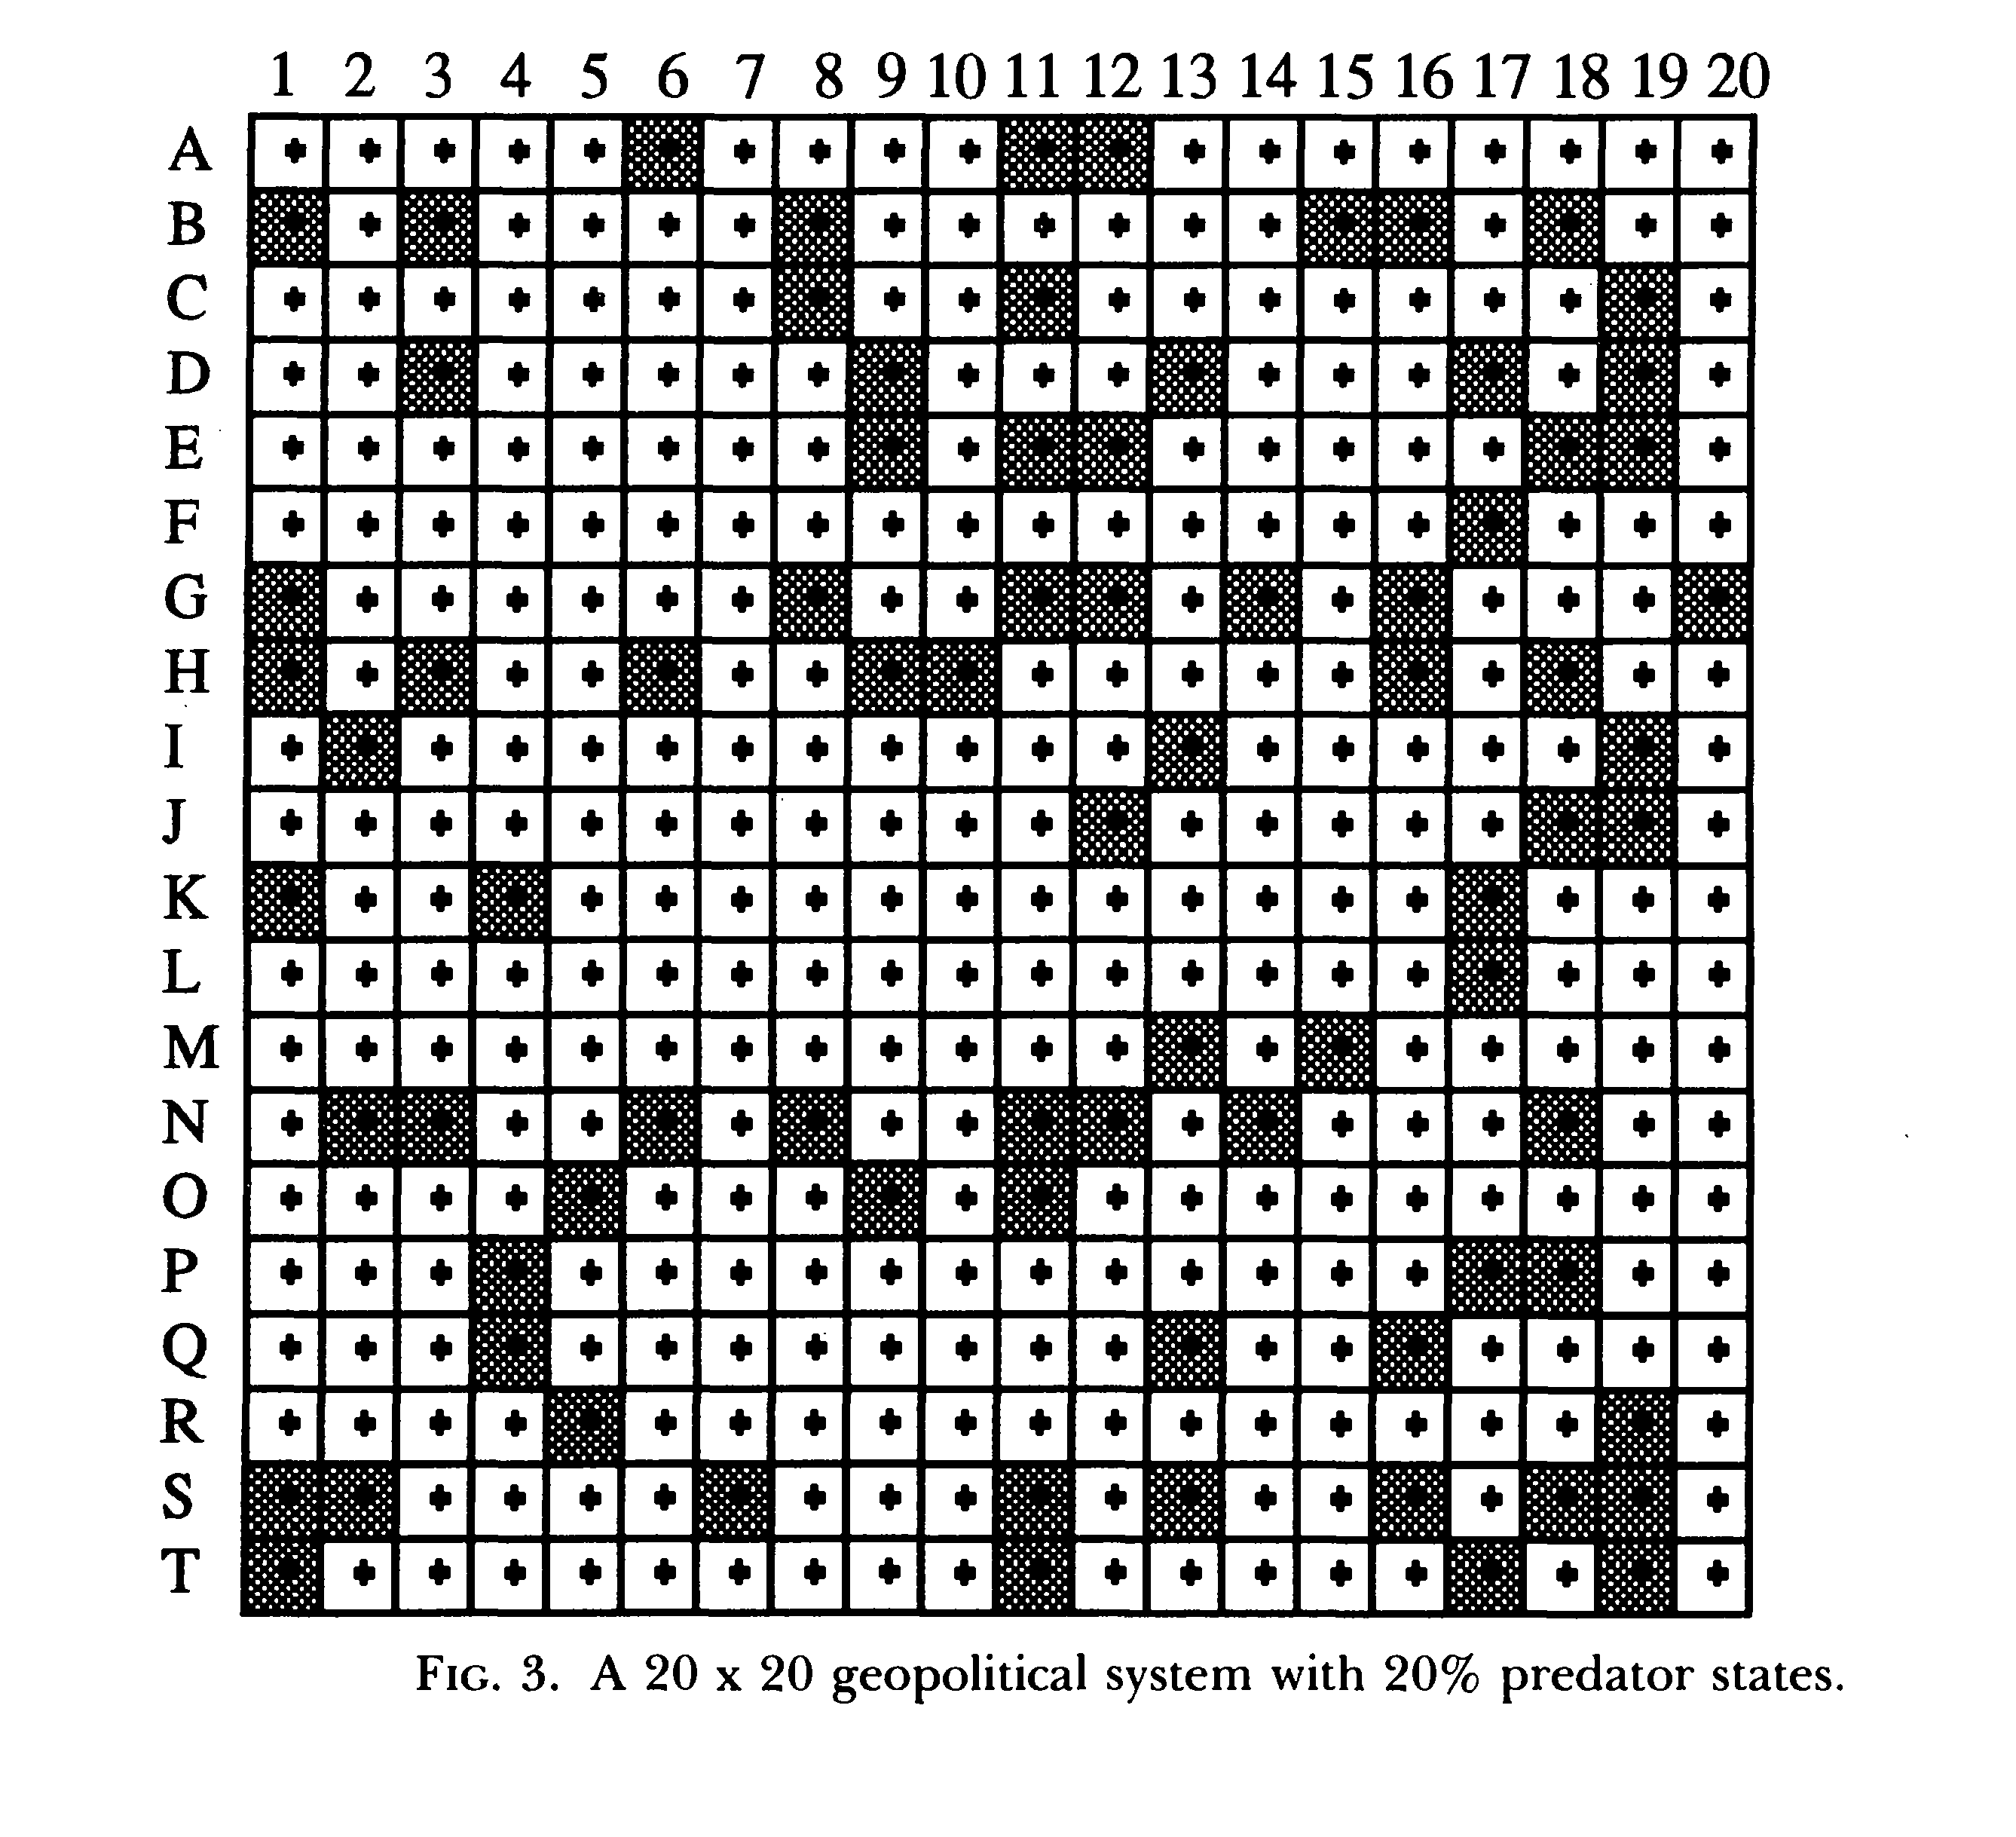
Complex IR Model
Cederman, Emergent Actors in World Politics
States, the main actors in IR, that are often reified in existing theory are themselves the emergent property of security-seeking sub-units. IR is ultimately connected to individuals’ security goals

Slide 8
Teaching Example #1
Thomas Schelling, Micromotives and Macrobehavior (1978)
Segregation Model
Simple rule based agents
The social structure changes as agents make choices
Positive Feedback System
Emergent Macro-level outcome
Computers not required (just helpful)
Questions: What happens if we change the rules? Could we introduce a negative feedback element?
Netlogo Version

Slide 9
Teaching Example #2
Miller and Page (2004): The Standing Ovation Problem
How does a standing ovation propagate through an audience? (cellular automata)
Agents with a simple choice (sit, stand)
Agents are socially influenced (neighbors)
Spatial arrangements matter (information)
Agents may be heterogeneous or homogeneous
Questions: Is there a tipping point? Common binary choices in PS?
Netlogo examples

Slide 10
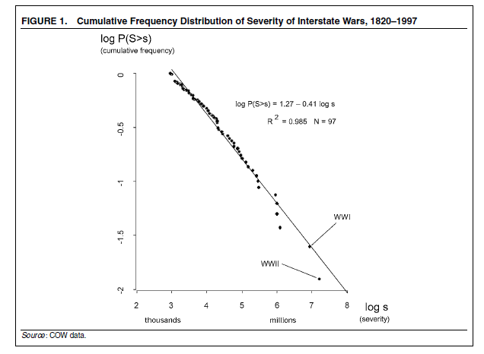
Sandpiles, Avalanches and Wars

