Slide 1

Complex Systems in
Geoscience Learning
Neil Stillings
Cognitive Science
Hampshire College
Notes:
• It’s a great honor to be here at the workshop on Developing Student Understanding of Complex Systems in the Geosciences.
• I can’t tell you what a pleasure it’s been to know and work with Cathy Manduca, Dave Mogk, Kim Kastens, and others in the geoscience learning community over the past 8 or 9 years.
• I want to congratulate Cathy and Dave and their colleagues for receiving the AAAS Science Magazine Prize for Online Resources in Education this year.
• For those of you you don’t know, I have to say, though, that spending time with these indefatigable people can be exhausting. The next slide kind of captures what it was like after spending a week with them at a writing retreat.

Slide 2
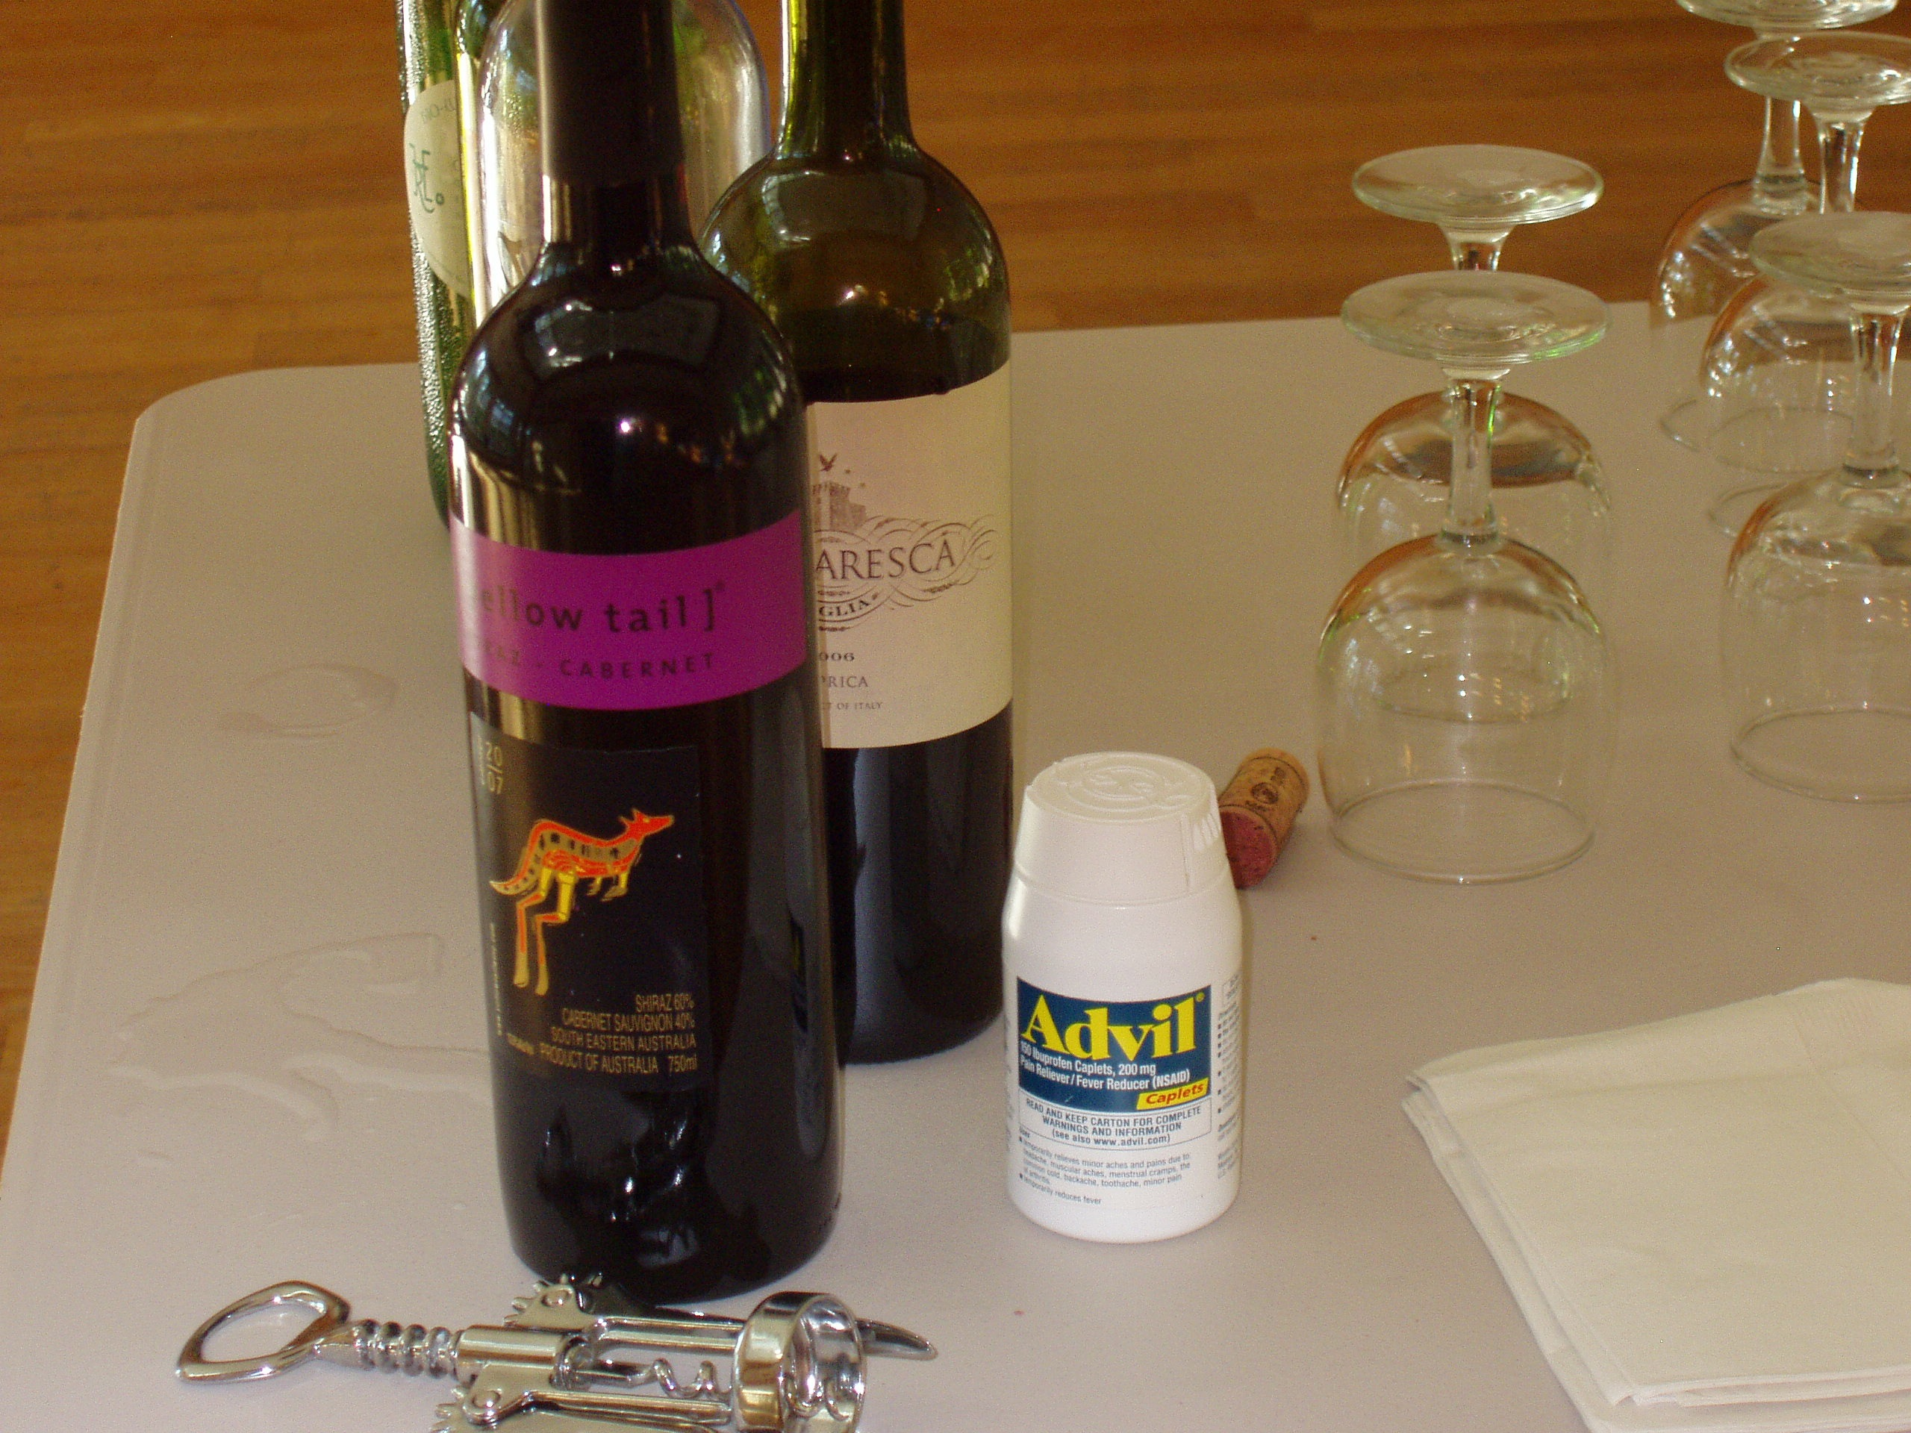
Notes:
• At the end of the week, you had a choice of wine, or Advil, or both. I think beer was available too, but my experience has been that with Geo people around the beer tends to be gone by the time you can get the camera to take a picture.

Slide 3
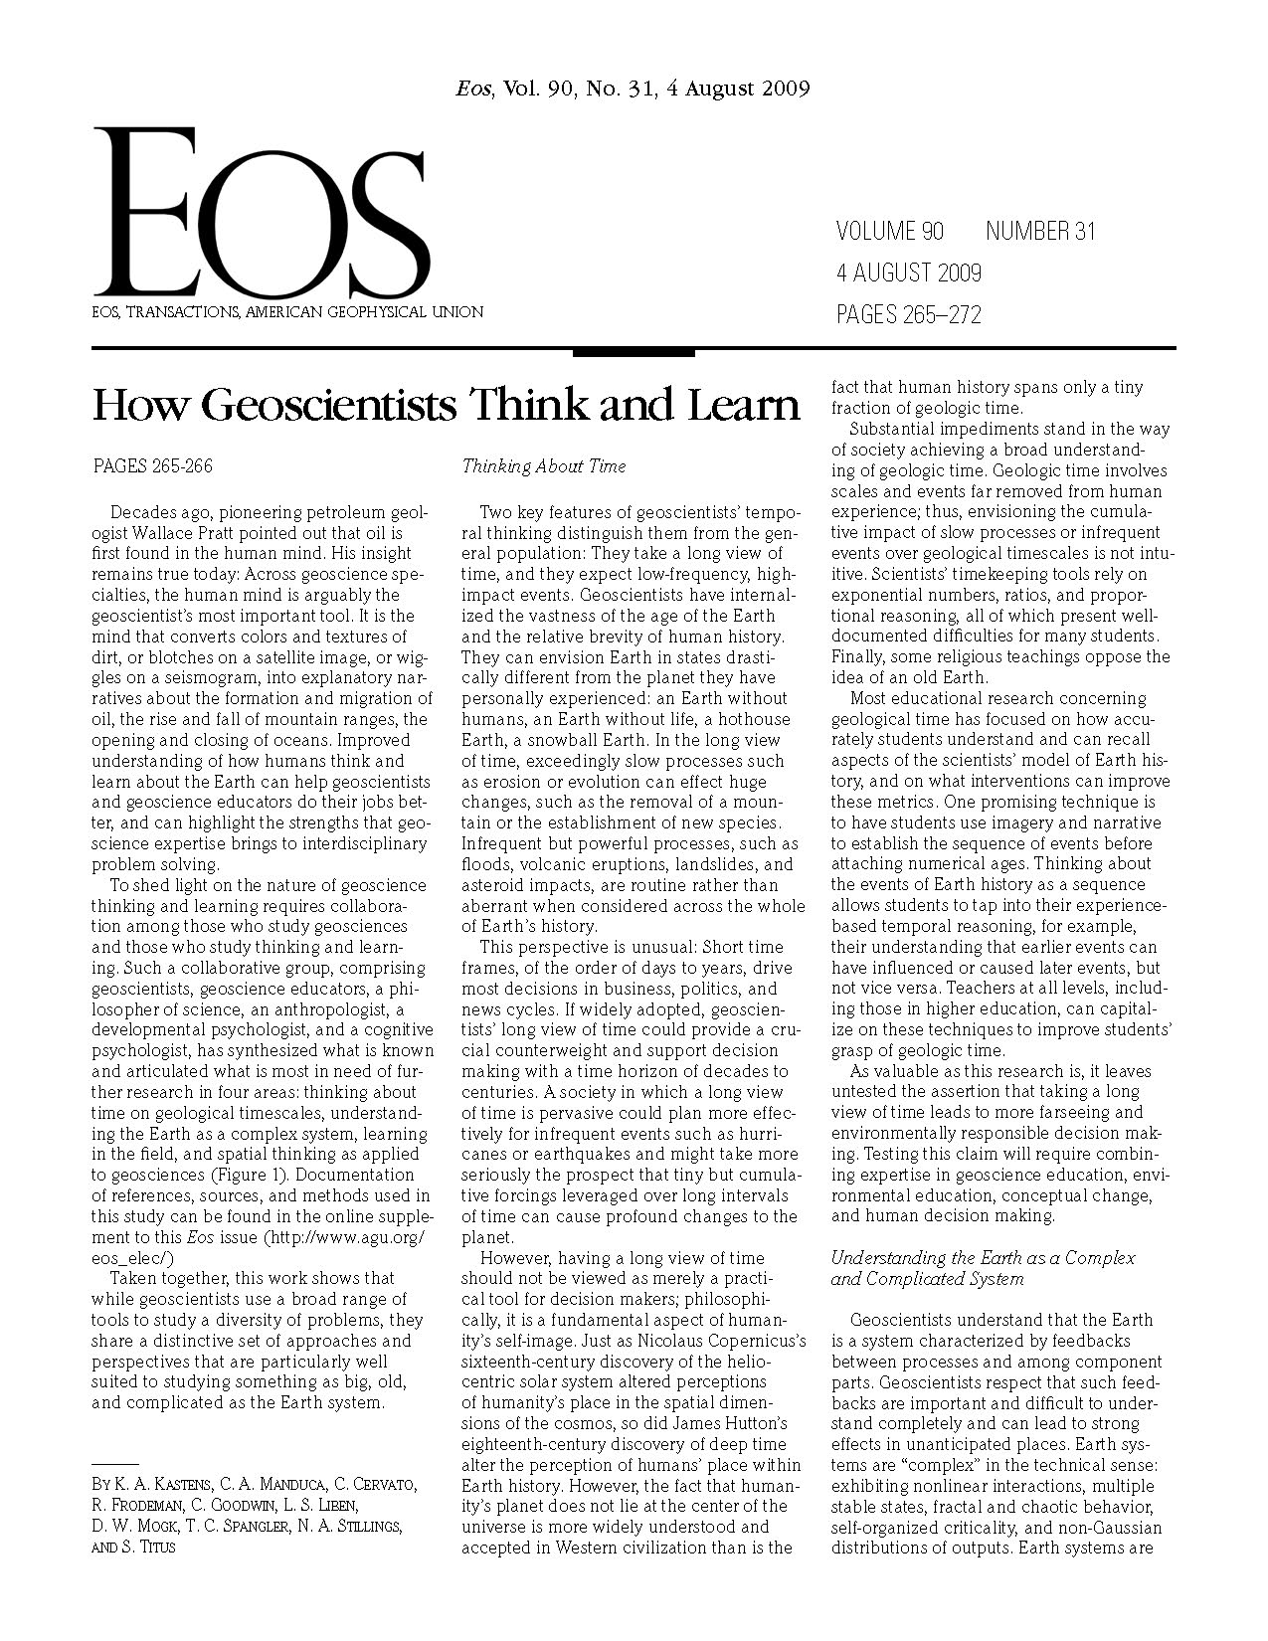
A Framework
For Future
Study
Notes:
• The product of that Advil and wine fueled writing retreat was a series of papers, summarized in this August 2009 piece in EOS.

Slide 4
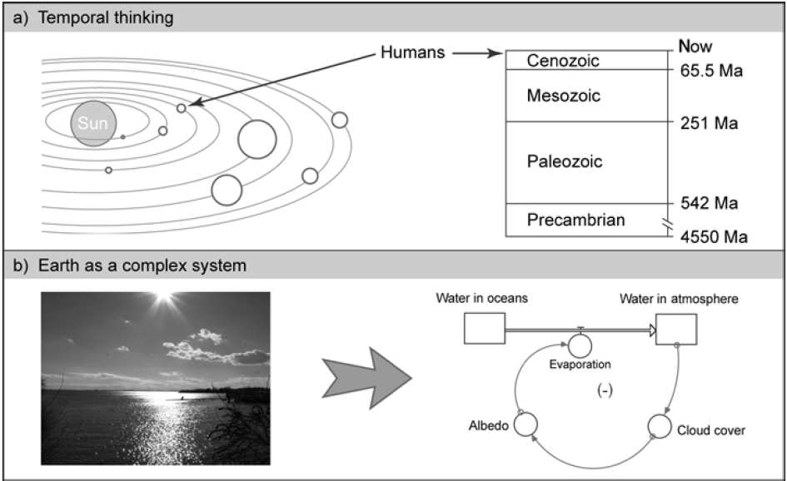
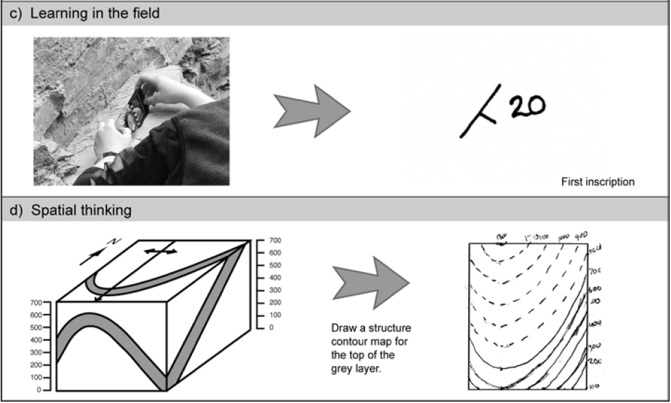
Temporal thinking
Earth as a
complex system
Learning in
the field
Spatial thinking
Notes:
• In that project we identified 4 aspects of thinking and learning in the geosciences and are producing a longer paper on each dimension.
• In writing the draft of the longer paper on complex systems for that project I referred to the work of a number of people at this meeting.
• Dave Bice, Cindy Hmelo-Silver, Federica Raia, Jim Slotta, and Bruce Herbert come to mind. And I’ve probably forgotten someone.
• I have a feeling that starting about Wednesday I will be re-writing that draft to incorporate the work of others in this room.
• So, It’s humbling to be here. All of you have thought deeply about the topic of the workshop. What I can try to do here is raise a few of the issues that might frame our discussion over the next two days.
• I want to say that I am painting with a very broad brush here. “Complexity” and “complex system” have technical mathematical meanings, but I’m not going to stick to those, because at this point it is important to sort out how complexity in the mathematical sense is related to the complexities of the geosciences in a broader more vernacular sense.

Slide 5
People can learn scientific concepts
There are scientists
Some basic cognitive capacities
  Rich concepts
  Causal reasoning
  Number
  Simulation
  Geophilia/biophilia
The challenge
  initial conception → scientific conception
Notes:
• Sometimes cognitive & learning scientists make it sound like science is impossible to learn.
• In fact, cognitive psychologists often seem to be saying “Babies are smart; Grown-ups are stupid.”
• So we need to by start by saying that people can learn.
• Scientists: As a limiting case, or proof of concept, there are scientists.
• Capacities: We have basic cognitive capacities that have supported the development of science as a cultural achievement. Humans are capable of learning/developing rich, novel concepts; we have a natural capacity for causal reasoning; We have a natural capacity for dealing with magnitudes and cardinal numbers;
• Challenge: We know from cross-cultural research on science learning that many more people can make the transition than do in the US

Slide 6
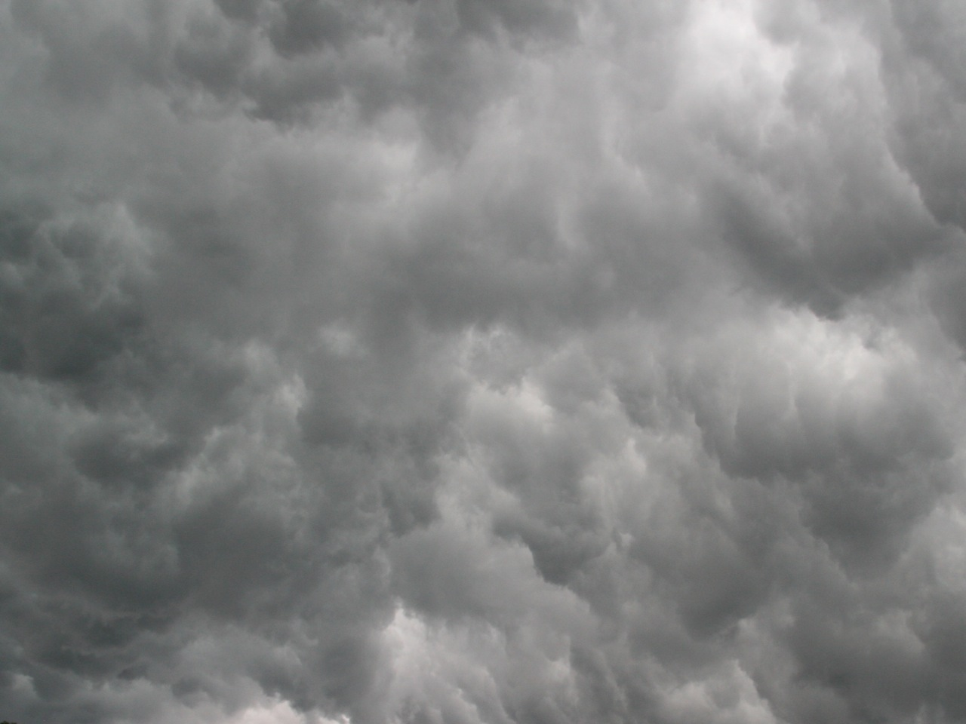
Geoscience learning:
A perfect storm
Complex phenomena & models
Observational/historical science of a unique system
Multi-disciplinarity
Increasing politicization
Notes:
• That said, at first sight geoscience learning looks like a perfect storm of difficulty
• Complex: The phenomena themselves and even basic models of them are complex, challenging instruction and learning
• Observational/historical: Students have to learn that not all science is about replicable, controlled experiments
• Multi-disciplinary: Geoscience draws on other science disciplines—physics, chemistry, biology
• Politicization: Climate change denial now seems strongly coupled with general political orientation and attitude, and associated with young-earth creationism & objections to evolution.
- This

Slide 7

Geoscience learning:
A perfect opportunity
Learn about complex systems
In a context of reflecting on the nature of science
While integrating a lot of the science you took in other courses/grades
To work on issues that really matter!!
Notes:
• On the other hand, we could look at the upside.

Slide 8
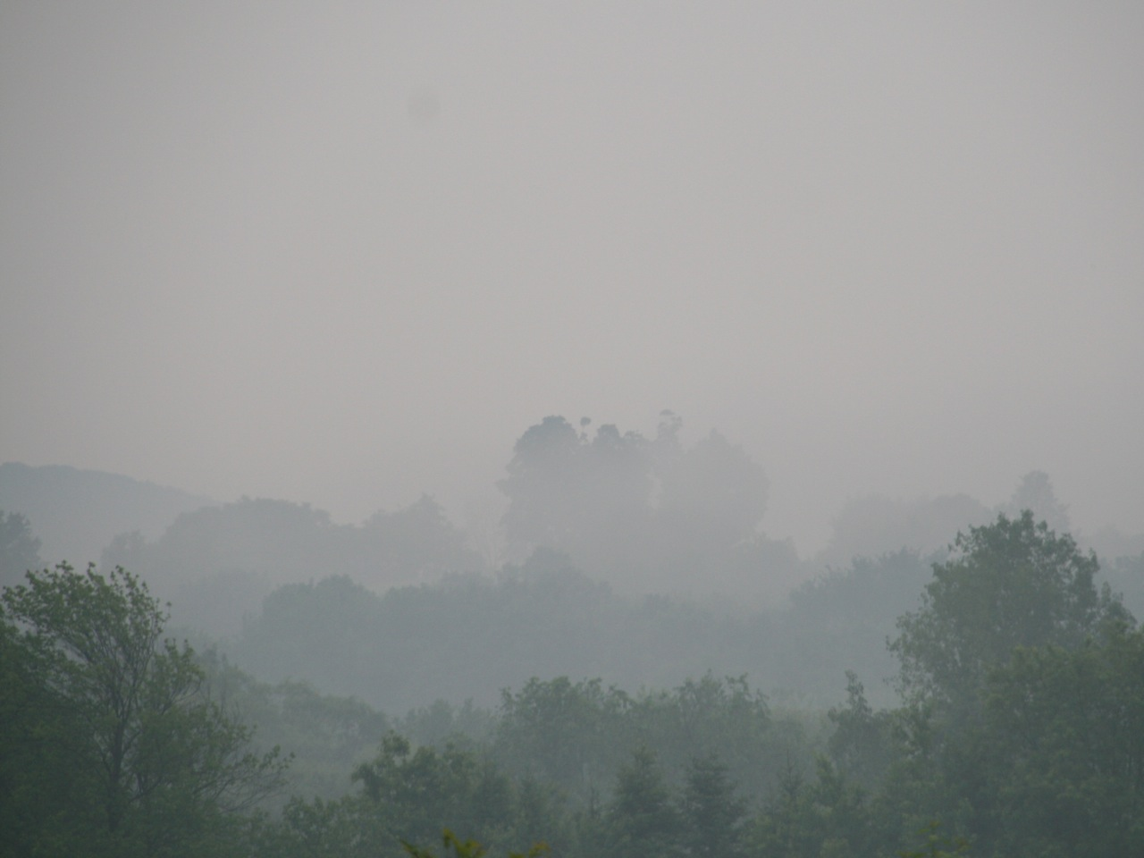
Cognitive/learning science framework
Meaning aids memory
Initial conceptions/conceptual change
Learning for use
Metacognition
Explanatory models
Notes:
• So, how do we confront and take advantage of this opportunity?
• Need a framework.
• Meaning: Organize instruction so that students don’t memorize isolated fragments of material; integrate course material into meaningful wholes.
• Conceptual change: Students enter learning environments with conceptions of the material. These have to be integrated with the new material. This often requires change in the initial conception. Sometimes radical change. You have to be alert to common conflicting or partial conceptions.
• Metacognition: Student learning is often hampered by their conception of the nature of scientific knowledge and inquiry. They can think that scientists just observe facts about nature. That they prove things. That, actually, they don’t know anything.
• Models: Focus on key theories/hypotheses/models as central to understanding both the science and the nature of science.

Slide 9
Model-based reasoning
Explanation is central to science
Reasoning with causal models
  Key expert skill
  Prime target of science education
Inquiry-oriented science instruction often skimps on models
Evidence must be interpreted relative to a model
Notes:
• Put the emphasis on reasoning with scientific models. It’s hugely important in science education generally, and particularly so in the geosciences.

Slide 10

Learners’ initial models
Failure to think causally
General default conceptions of causality
  Unitary or domino-chain causes
  Spatiotemporal proximity
  Deterministic
  Macroscopic, tangible, visible
Common naïve models
  E.g. Impetus theory of motion; blankets are warm; sucking; soil is the source of the mass of a tree
Notes:
• So, our goal is to move the learner from an initial or current model toward a target model.
• Learners’ initial models are often far from the target model. On a statistical basis. A lot of this has to do with expanding students’ conceptions of the causality and explanation
• Failure. Many students think in terms of descriptions and rules. Continents move. Why?
• Default. Default conceptions of causality are to some extent wired into our brains, and also develop from our experience of our immediate environments.
• Naïve models: Generalized default conceptions + our experience of phenomena + plus to some degree ineffective instruction produce many initial student conceptions that are incommensurable with target scientific models.

Slide 11
Contrast with target models
Scientific conceptions of causality
  Multiple, interacting causes, nonlinearity, feedback
  Spatiotemporally distant causes
  Non-deterministic, probabilistic causation
  Microscopic, invisible causal agents & processes
  Multiple levels of analysis, emergent phenomena
Novice-expert mismatch has a fine grain
Geoscience saturated with complexity
Notes:
• Contrast: That students’ initial conceptions are out of whack with science shouldn’t be surprising. In a way the whole point of modern science is to discover stuff that we didn’t know existed and explanations that are new and counter-intuitive. Newton’s laws are mind boggling in terms of folk physics.
• Scientists’ causality.
• Fine grain: This mismatch insinuates itself fractally into the fine grain of any theoretical structure you’re trying to teach. Students often fail the simplest possible assessments of concepts you are trying to teach.
• Geosciene: All of these mismatches are sources of complexity in either the technical systems/mathematical sense or a more informal sense. Geoscience is just saturated with them.

Slide 12
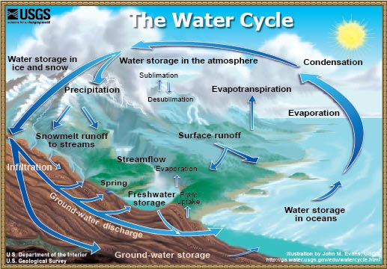
“Simple” model of the water cycle for Elementary/middle school
Notes:
• From the standpoint of a cognitive psychologist, this is like, OMG, 5th graders have to understand THIS!!
• The diagram has 5 reservoirs and 14 flows, roughly. There’s the potential, probably, for >100 misconceptions.
• The processes that determine rates of flow & their interactions are not even represented in the diagram.
• Diagram of the water cycle for students from a USGS education web page. (From: http://ga.water.usgs.gov/edu/watercycle.html)

Slide 13

Confronting initial conceptions
The amount of water in the ocean grows from day to day because rivers are flowing into the ocean continually.
The increased evaporation as result of the Earth’s global warming effect, may lead to a decrease in the amount of water on Earth.
The amount of water that evaporates from the entire surface of the Earth into the atmosphere is not equal to the amount of rain that falls on the Earth’s surface.
Notes:
• You can still find after a carefully prepared water-cycle curriculum for middle-school kids that they are confused about basic issues.
• From Assaraf & Orion (2005). A Study of Junior High Students’ Perceptions of the Water Cycle, Journal of Geoscience Education, 53(4), 366-373

Slide 14
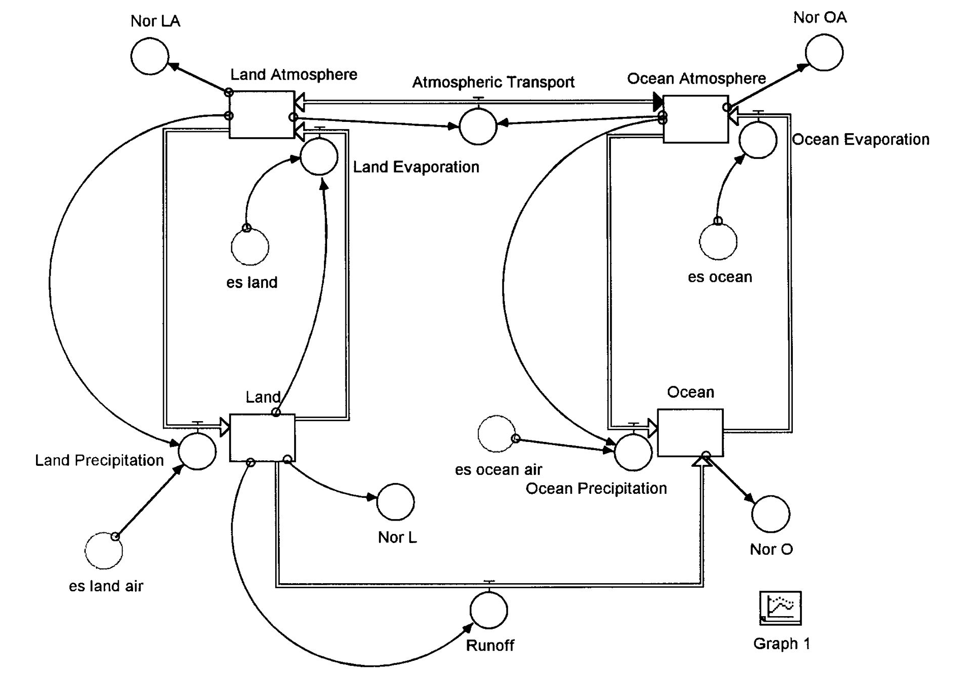
Notes:
• One would like to get to somewhere like this in an undergraduate curriculum.
• The advantage of the STELLA visualization is that it distinguishes between flows and the processes that affect them, through regulators, converters, and connectors. You can dig into these processes. You can RUN the model.
• STELLA model of the water cycle. From John T. Snow, University of Oklahoma College of Atmospheric & Geographic Sciences, Earth System Science Education Website: http://www.esse.ou.edu/main.html. (Slide at http://www.esse.ou.edu/models/presentation/indexmodeling.htm)

Slide 15
Developmental
Pathway?
?
Notes:
• So, we have find a developmental pathway that gets us from here to there.
• Or from something much simpler than here to there.

Slide 16
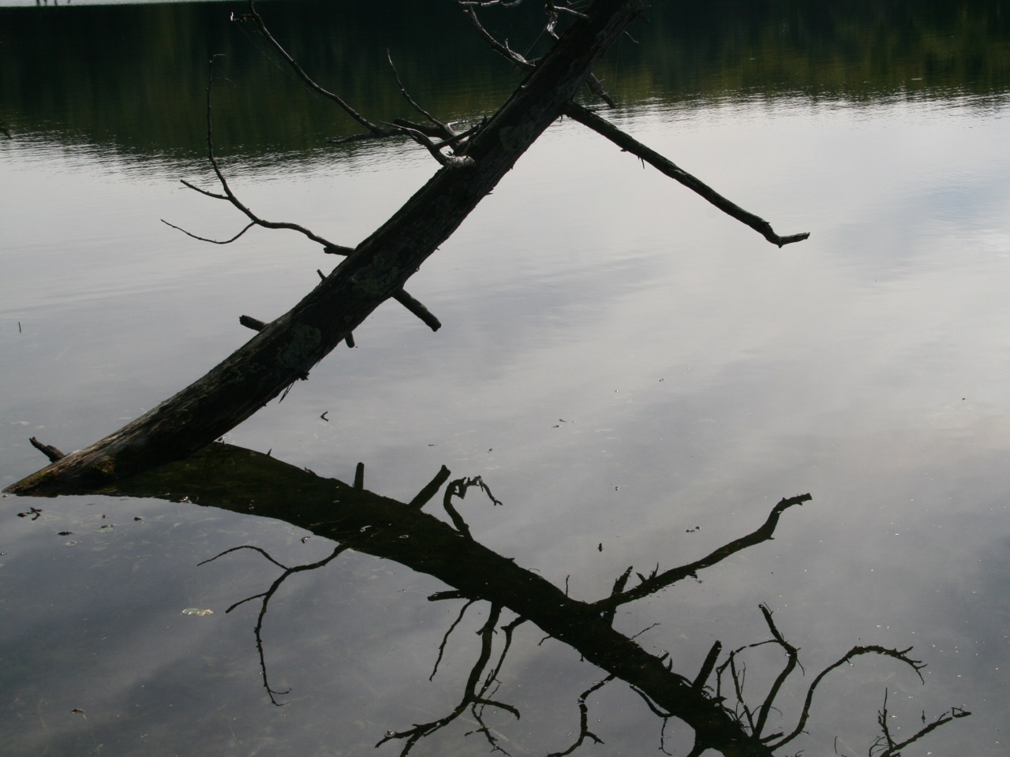
Water
in oceans
Water in
atmosphere
Evaporation
Fragmentary novice conception
Notes:
• Novice conceptions tend to be split up into little un-integrated chunks, that might be represented this.
• Need to get some integration that includes key principles, like conservation of mass.
• Need to get explanatory processes into the model

Slide 17
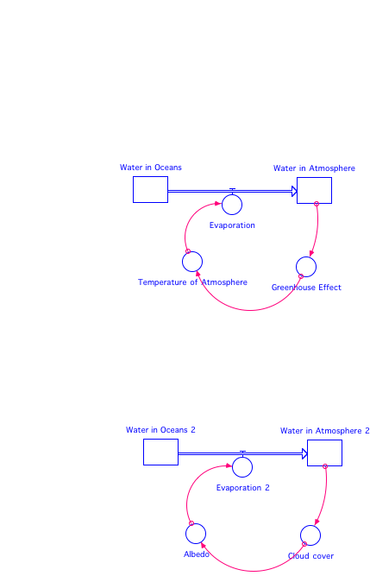
(-)
(+)
Example feedbacks
Notes:
• What affects the rate of flow of water from ocean to atmosphere? How great are the affects? How do they work?
• I’m not necessarily suggesting these, they just happen to connect with the water cycle example.
• STELLA diagrams courtesy of Kim Kastens

Slide 18
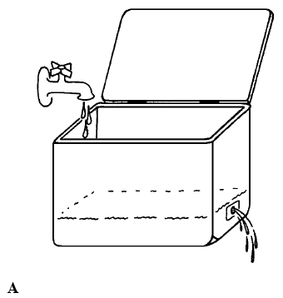
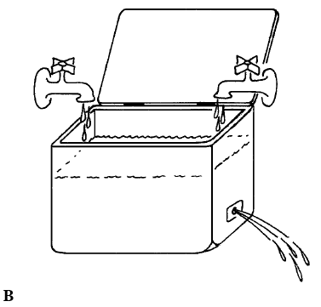
Notes:
Moore & Derry (1995). Understanding Natural Systems through Simple Dynamical Systems Modeling. Journal of Geological Education, 43, 152-7

Slide 19
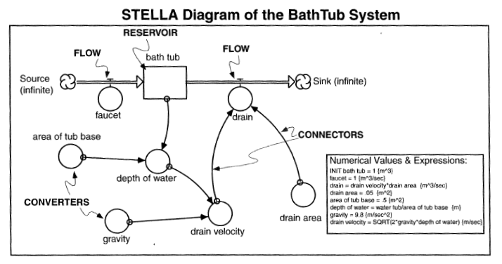
Notes:
Bice, D. M. (2006). STELLA modeling as a tool for understanding the dynamics of earth systems. In C. Manduca & D. Mogk (Eds.), Earth & Mind: How Geoscientists Think and Learn about the Earth. Geological Society of America, Special paper 413.

Slide 20

Classroom & research agenda
Focus on systems thinking: A complexity curriculum
  Study acquisition of particular systems and complexity concepts
  Find the learning trajectories
Nature of science
  Models in science; models vs. reality
Need for robust instructional technology
Policy integration
Notes:
• systems thinking: Build a complexity curriculum. Careful assessment. Get students to stitch the pieces together.

Slide 21
Thanks
Kim Kastens
Cathy Manduca
Dave Mogk
Tim Spangler
Rick Duschl
Stephanie Pfirman
Tina Grotzer
The “Synthesis” group
  Cinzia Cervato
  Bob Frodeman
  Chuck Goodwin
  Lynn Liben
  Sarah Titus

Slide 23
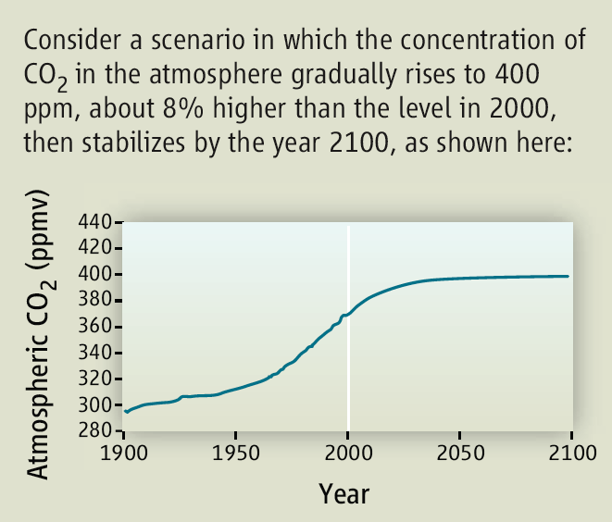
Notes:
• Sterman, John (2008) Risk Communication on Climate: Mental Models and Mass Balance. Science, 322, 532-

Slide 24
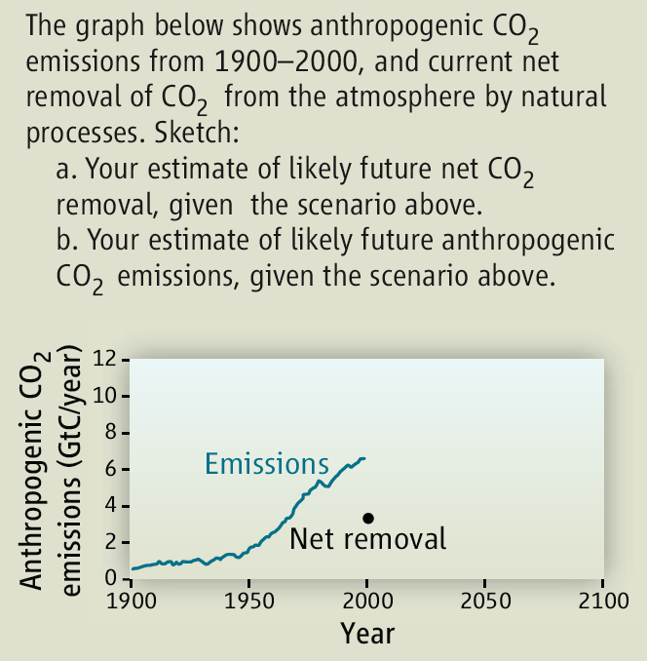

Slide 25
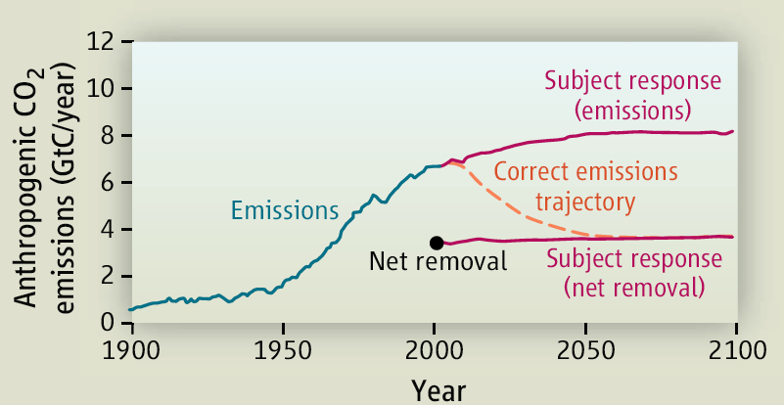

Slide 26
Notes:
Moore & Derry. Understanding Natural Systems through Simple Dynamical Systems Modeling. Journal of Geological Education, 1995, v.43, p. 152-7

Slide 27
Notes:
Bice, D. M. (2006). STELLA modeling as a tool for understanding the dynamics of earth systems. In C. Manduca & D. Mogk (Eds.), Earth & Mind: How Geoscientists Think and Learn about the Earth. Geological Society of America, Special paper 413.

Slide 28
