Slide 1
Visualizations, Mental Models, and Complex Systems
Cindy Hmelo-Silver
cindy.hmelo-silver@gse.rutgers.edu
reptools.rutgers.edu
Notes:
s

Slide 2
Overview
Expert-novice mental-models
Design of Instruction
NetLogo Simulations
Mental Model Results
Creating Structure-behavior-function models with the ACT
Notes:
Simulations as dynamic visualizations

Slide 3
Mental Models in Aquarium System
Expert-novice comparison (Hmelo-Silver, Marathe, & Liu, 2007)
Notes:
Interviewed experts and novices about components of system, draw system while thinking aloud, some what-if problems

Slide 4
Mental model results
Pragmatic experts= hobbyists
Hierarchical experts= scientists

Slide 5
Simulations
Serve as dynamic visualizations
Allow learners to experience complex systems phenomena
Help focus learners on function and behavior
Make invisible phenomena visible and open for inspection
NetLogo as platform for simulations (Wilensky, 1999)
Notes:
Netlogo- low threshold high ceiling- can model range of complex phenomena with relatively easy programming
Agent-based modeling tool
See how local interactions contribute to system behavior

Slide 6
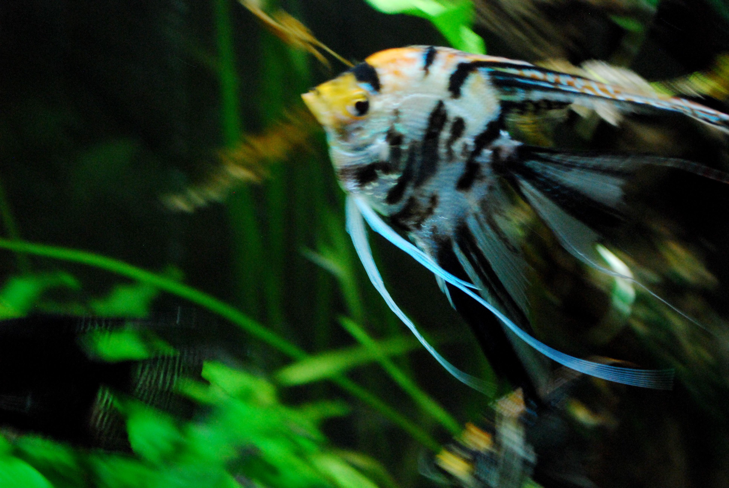
In the Classroom
Providing scaffolding and sequencing that help establish “why” and “how” questions
Mix of hands-on activities, hypermedia resources, simulations, class discussions
Scaffolding needs to encourage mapping:
  Between real world and virtual world
  Between different levels
  Considering how models simplify the world

Slide 7
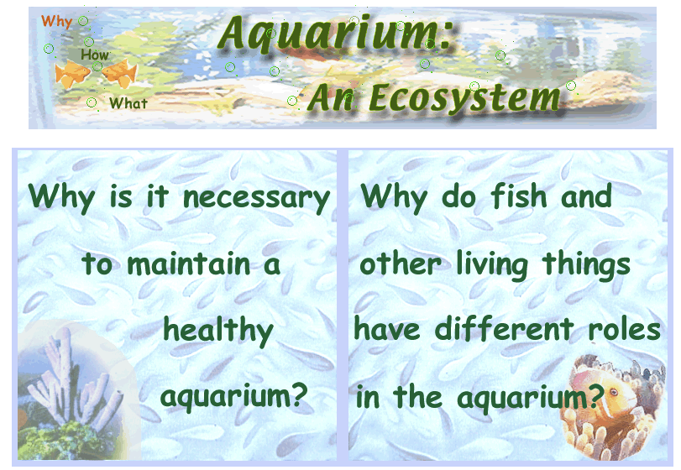
Function-centered Aquarium Hypermedia

Slide 8
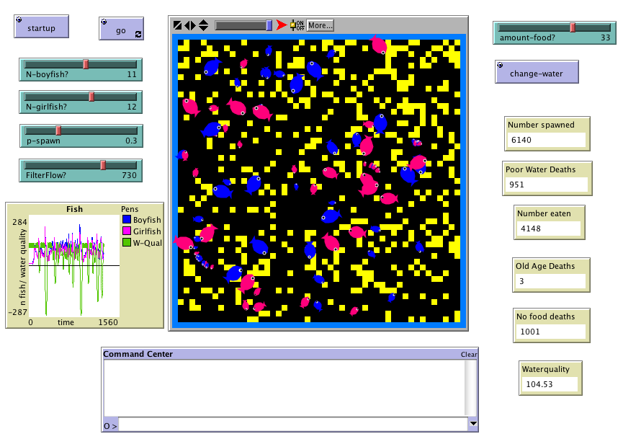
NetLogo Aquarium Macro-Level Model
Notes:
Macrolevel model helps problematize water quality and sets stage for micro level model

Slide 9
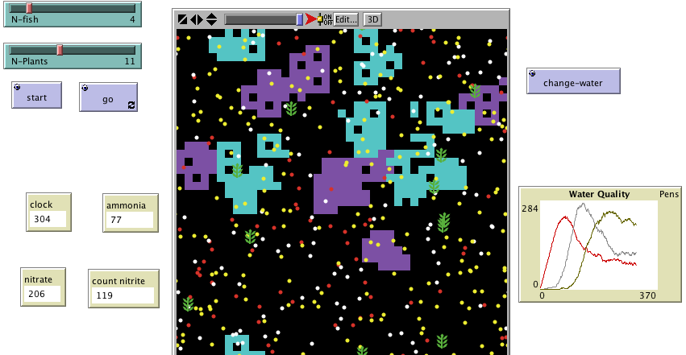
Nitrification model

Slide 10
Research Context
Goal to support middle school science instruction in domain of aquarium ecosystem
Units developed with two collaborating teachers
145 middle school students in 2 public schools for about 2 weeks
  70 7th grade with Teacher A
  75 8th grade with Teacher B
Both classrooms had physical aquaria and 1-2 laptops for each small group

Slide 11
Teaching Contexts
Both teachers experienced, considered experts
Teacher A
  Used worksheets with open-ended questions
  Expected homogeneous progress for whole class
  Focus on content
Teacher B
  Inquiry-oriented norms for classroom
  Scaffolded exploration by asking students to observe and explain, open-ended questioning

Slide 12
Results: Mental Models
Notes:
Hmelo-Silver, Liu, Gray, and Jordan (2010, submitted)

Slide 13
Aquarium Construction Toolkit (ACT; Goel et al, in press)

Slide 14
ACT
(Vattam et al, in press)

Slide 15
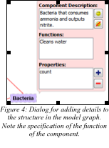
ACT

