Slide 1
Understanding What Students Know about Global Climate Change:
Conceptual Understanding Evaluation using Concept Maps
Based on Stacy Rebich Master’s thesis
under direction of Catherine Gautier

Slide 2
Concept Maps
What they are
  Concept: mental representation of an object (or class of objects) or process
  Structured diagram of a body of knowledge
  Proposition = concept-link-concept
  Focus on relationships between concepts
  Example (instructor’s map about GCC)
Carbon dioxide
is a type of
Greenhouse gas
Sea level rise
can be a threat to
Coastal populations
Notes:
So what is a concept map exactly? Well, basically it’s a network of concepts, and a concept, for our purposes, is a “mental representation of an object (or class of objects) or process”. A concept map is a structured diagram of a body of knowledge, and while the term ‘concept map’ is prevalent in the educational literature, they are also known as semantic networks. A concept map is composed of a network of propositions, and a proposition is a sentence-like unit of meaning that consists of a concept + link + concept. Concepts are typically nouns or noun phrases, and links are verbs or verb phrases. Some examples are shown here… What is novel about concept maps is that they explicitly focus on the importance of the relationships between concepts. To give you an idea of what a concept map looks like, I’ll show you this one…

Slide 3
Notes:
…which shows Catherine’s map about GCC that was used for this study. The details of this concept map are hard to read , but this shows the structure of this type of diagram. The words in the colored boxes are concepts, and the words on the arrows that connect concepts are links. These concepts are all rearranged around the central concept of GCC, which is here in the center.

Slide 4
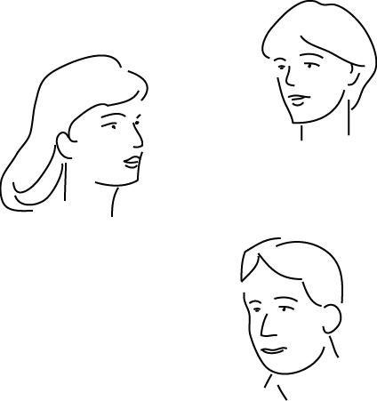

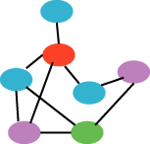

Validity and Reliability
value
Provide detail and quality of information similar to structured interview data
Comparable to assessment through writing, but offer advantage of non-linearity
Facilitate self-monitoring
A number of studies show high inter-rater reliability for concept map evaluation.
Our evaluation based on methods used in these studies; inter-rater reliability not addressed in our study
Notes:
So if we’re going to use concept maps to learn something about what people know, we need to consider several criteria that should be met by all assessment methods. The first of these criteria is validity, in this case construct validity. The question here is, do concept maps allow us to make some valid estimate of what someone knows? A lot of attention has been given to this issue in the literature, and there are numerous studies that establish the validity of the concept mapping approach. They have been found to provide information at a level of detail and quality similar to that obtained through one-on-one interviews, but with the advantage that they require much less effort on the part of the evaluator. They have also been compared to assessment through writing and provide similar results, but with the advantage of non-linearity. Many students, when asked to write a short essay in response to a question, will complete the task in a very linear fashion, starting at the beginning and writing straight through to the end. During concept mapping on the other hand, students can put down concepts in any order, rearrange them, and add or subtract concepts and links at will. This non-linear activity also facilitates self-monitoring, as it provides a mechanism for students to look any two concepts, for example, and consider what the relationship between them is. A second important criterion is reliability, and there are also many studies that establish measures of inter-rater reliability for various concept map construction and evaluation methods. Inter-rater reliability is achieved when a number of individual raters using a particular method converge on the same or similar values. Lots of attention to these topics in the literature; reliability varies with various scoring or evaluation techniques. The approach we used is based on evaluation methods that have demonstrated high validity and reliability in a number of studies.

Slide 5
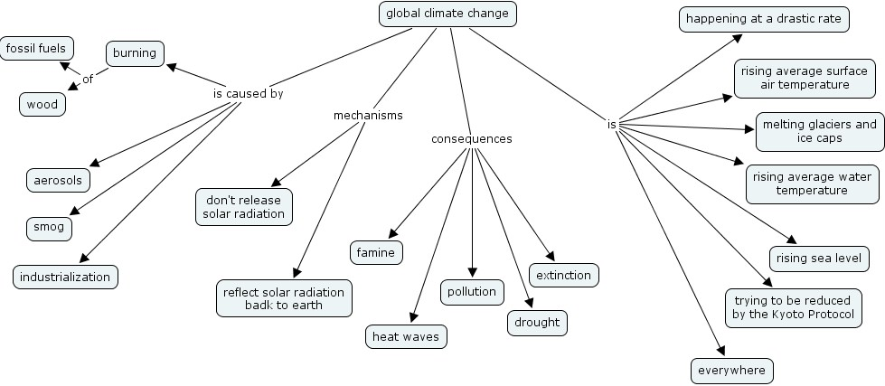
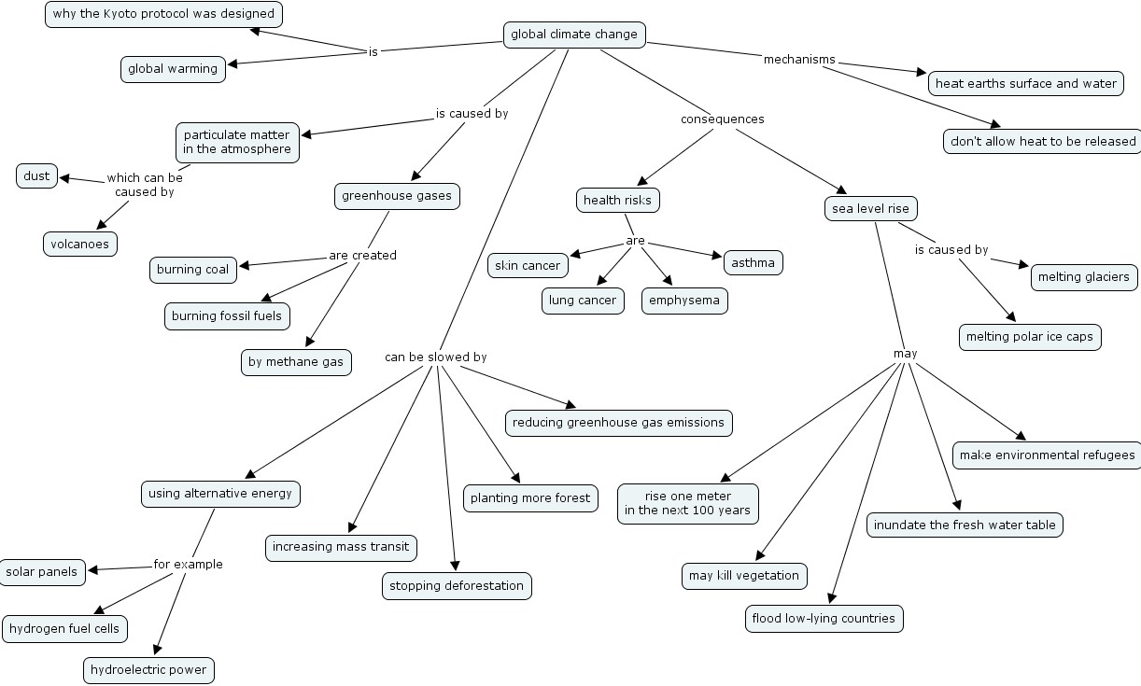
Questions:
What is GCC?
What is/are the:
  evidence?
  mechanisms?
  causes?
  consequences?
pre-course
post-course
Notes:
Here are data we started starting with. These two maps are one student’s pre and post course map pair. Seventeen students participated in the study, so I have 17 such pre and post course map pairs. Students completed a one-hour concept map training session during which they constructed one map on an entirely different topic, so these are the student’s 2nd and 3rd maps. Both maps were created in response to the same question set, which is: “What is global climate change? What is the evidence? What are the mechanisms? What are the causes? What are the consequences?” Students had 45 minutes to complete each of these concept maps.

Slide 6
causes
evidence
mechanisms
predicted
consequences
Notes:
The map showed earlier has been arranged into evidence, causes, mechanisms, and predicted consequences. These categories appeared on most of the student concept maps as well, since they were part of the given questions. These categories are important to the visualizations presented here.

Slide 7
evidence
causes
Pre
ocean heat
atmospheric
industrial
content
temperature
aerosol emissions
activities
increase
increase
pollution
fossil fuel
burning
glaciers
melting
sea level
rise
global climate
mechanisms
change
SW & LW radiative
processes
agriculture
surface SW
reflection
& absorption
biosphere
mitigation
& adaptation
extremes
predicted consequences
droughts
geography
mitigation & adaptation
useful links
useful links-examples
weak links
misconceptions
Notes:
Once the concepts have been analyzed and repositioned and links can be redrawn and the concept map now appears like this. This particular concept map is unique in one important way. This student has linked every concept on the map to the global climate change concept directly. Not all concept maps will look so much like “spokes”. The same student’s post-course map shows a slightly different structure…

Slide 8
evidence
causes
Post
volcanic
ocean heat
aerosols
ice caps
content
aerosol emissions
melting
increase
changes in
temperature
fossil fuel
burning
glaciers
melting
GHG emission
sea level
methane
rise
trapping
global climate
mechanisms
change
human health
biosphere
coastal regions
mitigation
& adaptation
displacement
alternative
transportation
alternative
& renewable
energies
cooperation
fresh water
availability
floods
predicted consequences
mitigation & adaptation
useful links
useful links-examples
weak links
misconceptions
Notes:
…here you can see that there are still a lot of concepts linked directly to global climate change, but there are also links that occur within categories [point] and links that occur between categories [point]. Some of these structural differences will be highlighted in a representation shown below.

Slide 9
evidence
causes
Pre
ocean heat
atmospheric
sun variability
volcanic
industrial
deforestation
snow melting
content
temperature
aerosols
activities
increase
increase
aerosol emissions
land use
population
ice caps
changes in
biomass burning
change
increase
melting
hydrological
changes in
natural processes
urbanization
cycle
temperature
pollution
fossil fuel
sea ice melting
human activities
burning
glaciers
automobile
energy uses
melting
use
observations
causes
GHG emission
evidence
carbon dioxide
sea level
methane
rise
Global
Climate
Change
atmosphere
trapping
ozone layer
greenhouse
effect
LW trapping
mechanisms
ocean circulation
mechanisms
blanket/insulation
water vapor
human health
SW & LW radiative
feedbacks
processes
agriculture
models
surface SW
clouds
reflection
albedo
predicted
& absorption
biosphere
coastal regions
consequences
mitigation
& adaptation
displacement
impacts
alternative
forests
habitability
hydrological
transportation
economic
fisheries
& usability
cycle
alternative
development
wetlands
weather
storm tracks
& renewable
seasons
frequency
energies
economics
evaporation
& intensity
cooperation
precipitation
extremes
of
events
hurricanes
complexity
fresh water
droughts
El Nino
geography
availability
floods
war/conflict
predicted consequences
mitigation & adaptation
Notes:
This diagram shows the relative concept frequencies on all pre-course student maps( dark circles represent use of the exact concepts while light circles represent similar concepts ; amore comprehensive legend is shown on the pre-post map below).

Slide 10
evidence
causes
Post
ocean heat
atmospheric
sun variability
volcanic
industrial
deforestation
snow melting
content
temperature
aerosols
activities
increase
increase
aerosol emissions
land use
population
ice caps
changes in
biomass burning
change
increase
melting
hydrological
changes in
natural processes
urbanization
cycle
temperature
pollution
fossil fuel
sea ice melting
human activities
burning
glaciers
automobile
energy uses
melting
use
observations
causes
GHG emission
evidence
carbon dioxide
sea level
methane
rise
Global
Climate
Change
atmosphere
trapping
ozone layer
greenhouse
effect
LW trapping
mechanisms
ocean circulation
mechanisms
blanket/insulation
water vapor
human health
SW & LW radiative
feedbacks
processes
agriculture
models
surface SW
clouds
reflection
albedo
predicted
& absorption
biosphere
coastal regions
consequences
mitigation
& adaptation
displacement
impacts
alternative
forests
habitability
hydrological
transportation
economic
fisheries
& usability
cycle
alternative
development
wetlands
weather
storm tracks
& renewable
seasons
frequency
energies
economics
evaporation
& intensity
cooperation
precipitation
extremes
of
events
hurricanes
complexity
fresh water
droughts
El Nino
geography
availability
floods
war/conflict
predicted consequences
mitigation & adaptation
Notes:
…and this diagram shows the relative concept frequencies on the post-course maps. Toggling back and forth between them, you should be able to notice some changes. However, a more straightforward way to compare the student’s performance on the pre and post course concept maps is to look at this representation…

Slide 11
evidence
causes
Post - pre
atmospheric
industrial
ocean heat
temperature
sun variability
volcanic
activities
deforestation
snow melting
content
increase
aerosols
aerosol emissions
population
increase
land use
increase
ice caps
changes in
changes in
biomass burning
change
urbanization
melting
hydrological
temperature
natural processes
cycle
pollution
fossil fuel
sea ice melting
human activities
burning
glaciers
automobile
energy uses
melting
used exact or nearly exact concept
use
observations
causes
GHG emission
sea level
evidence
carbon dioxide
used similar or example of concept
rise
methane
atmosphere
Global
Climate
Change
trapping
total concepts on post-course map
ozone layer
greenhouse
effect
mechanisms
LW trapping
ocean circulation
mechanisms
blanket/insulation
human health
concepts from instructor map
water vapor
feedbacks
SW & LW radiative
concepts from student maps that were not on instructor map
models
processes
agriculture
surface SW
clouds
reflection
albedo
predicted
& absorption
concepts from instructor map that were not on student maps
biosphere
coastal regions
consequences
mitigation
& adaptation
alternative
forests
displacement
habitability
impacts
transportation
fisheries
& usability
hydrological
economic
evaporation
weather
cycle
storm tracks
alternative
development
wetlands
seasons
frequency
& renewable
& intensity
energies
economics
precipitation
extremes
of events
cooperation
fresh water
droughts
hurricanes
geography
complexity
availability
floods
El Nino
war/conflict
predicted consequences
mitigation & adaptation
Notes:
This diagram contains a little more information than the others. Like in the other diagrams, dark circles represent use of the exact concepts while light circles represent similar concepts. Instructor concepts are in bold type, and those that are highlighted in gray are ones that did not appear at all on the students’ maps. The dotted circles represent the total number of times a particular concept appeared on the post-course concept maps, and the difference between the dotted circle and the largest solid circle is determined by how often those concepts were also included on the pre-course maps.

Slide 12
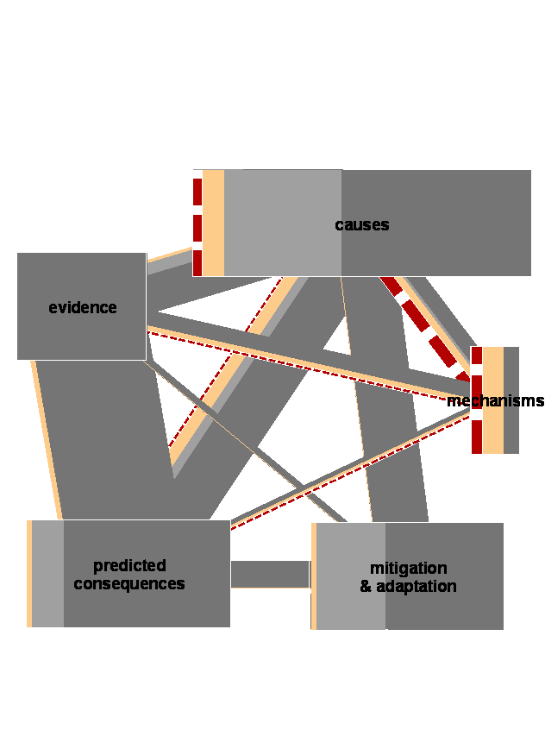
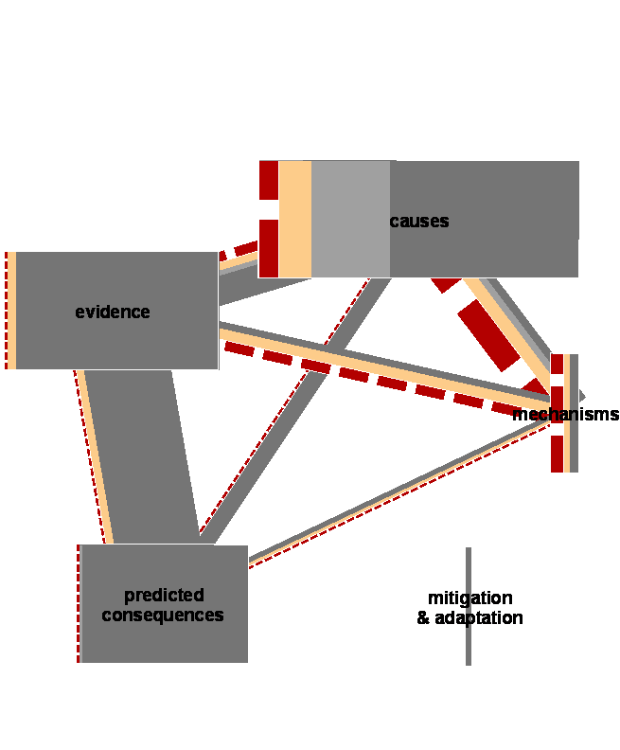
Pre- and post-course proposition quality and distribution (class average)
Pre
Post
Width of this line = 1 proposition
useful links
useful links-examples
weak links
misconceptions
Notes:
These diagrams are analogous to the proposition diagrams showed earlier, but these show aggregate data for the whole class rather than just for one student. The widths of the bars represent the average number of propositions per student in each category and quality class. Notice that this diagram is on a different scale than the previous ones…this width [indicate] corresponds to one proposition. Notice that on the pre-course maps there was approximately one link per student in the category of mechanisms, and a large portion of these links were weak or misconceptions. From these diagrams we can notice several trends: the overall number of propositions increased between the pre and post-course concept maps; the overall number of misconceptions and weak conceptions decreased; there was a significant increase in the linkage between concept categories; and the topic of mitigation and adaptation is the one that saw the most dramatic increase in number of propositions. We can also notice that even after the course, mechanisms is the weakest and least represented area of the students’ knowledge. In her presentation earlier this quarter, Catherine showed some diagrams that give a more detailed picture of the students misconceptions, so since I don’t have time I won’t go into those now.

Slide 13
Common areas of misconception
Shortwave and longwave radiative processes and the greenhouse effect
  Global temperature increase is due to increased solar input through ozone hole
  Greenhouse gases or clouds trap reflected solar energy, causing the greenhouse effect
  Greenhouse effect is the trapping of (warm) greenhouse gases in the atmosphere
  Longwave radiation not mentioned
Notes:
There were a number of misconceptions related to shortwave and longwave radiative processes and the greenhouse effect. A number of students thought that global temperature increase is due to increased solar input through the ozone hole. This inappropriate association of the ozone hole with global warming seems to be very prevalent, as it has been identified by a number of other researchers. The second misconception that I’ve included is related to the first, and this is an idea that greenhouse gases or clouds trap reflected solar energy, causing the greenhouse effect. They seem unaware of the importance or even the existence of the longwave radiation emitted by the Earth and greenhouse gases, and therefore don’t recognize the type of radiation that plays a role in the greenhouse effect. Some students think that greenhouse gases are trapped in the atmosphere, which means that they are applying the trapping idea to the gases rather than to the longwave radiation.

Slide 14
Common areas of misconception
Aerosols
  ‘CFC’ and ‘aerosol’ are synonyms
  Aerosols are a type of greenhouse gas
Pollution, greenhouse gases, greenhouse gas emissions
  Greenhouse gases are “bad”
  Reducing pollution will reduce greenhouse warming
  Reducing greenhouse gas emissions will reduce all types of pollution-related illness
Notes:
There was a lot of confusion about aerosols, including what they are and how they impact climate. Most students treated the terms CFCs and aerosols as synonyms, likely due to the lack of distinction between them in everyday language. Everyone knows that aerosol spray cans are bad and that they release CFCs, right? What is not clear in the minds of many students is that two things come out of the bottle: the CFC gas and the aerosol particles. This difficult distinction is further complicated by the fact that CFCs act as greenhouse gases when in the lower layer of the atmosphere, and catalyze the breakdown of ozone when present in the upper atmosphere. It’s easy to understand how the lack of distinction between CFCs and aerosols can reinforce the misconception of a direct link between ozone depletion and greenhouse warming. Thinking that aerosols are just a type of greenhouse gas also prevents students from understanding how many aerosols, such as sulfate, for example, have a cooling rather than a warming effect.
When it comes to pollution, greenhouse gases, and greenhouse emissions, many students tend to think these are all synonymous. Many consider all greenhouse gases to be bad, when in fact they are necessary for maintaining a habitable temperature on earth. They also think that reducing pollution in general will reduce greenhouse warming, when in fact, pollution reduction strategies are often focused on decreasing aerosol pollution (smog, for example). Reducing sulfate aerosol pollution is likely to have a warming effect, but this distinction is not clear to many students. Many students also sought to find social benefits to reducing GHG emissions, and they were likely to attribute all types of pollution-related respiratory illness to greenhouse gases. While greenhouse gases and illness-causing pollutants are often produced by the same industrial or energy production processes, thinking that the greenhouse gases themselves are responsible for pollution-related health damages can lead to serious errors in judgment about the potential health benefits of carbon sequestration strategies, for example.

