Slide 1
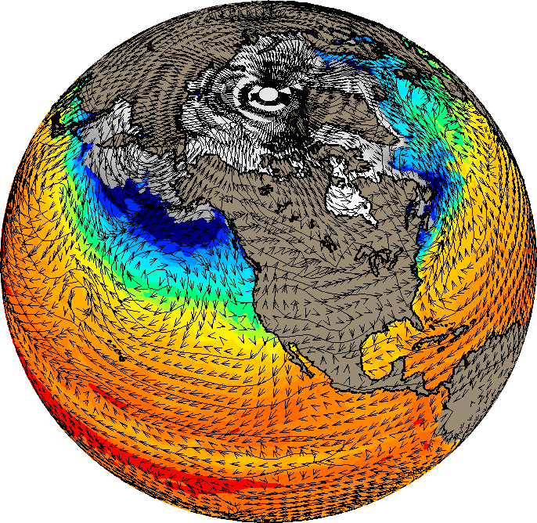

Weather Extremes in a Changing Climate
Gerald A. Meehl
NCAR

Slide 2
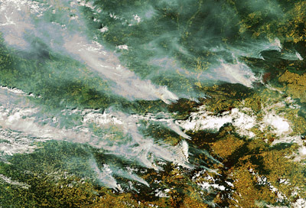
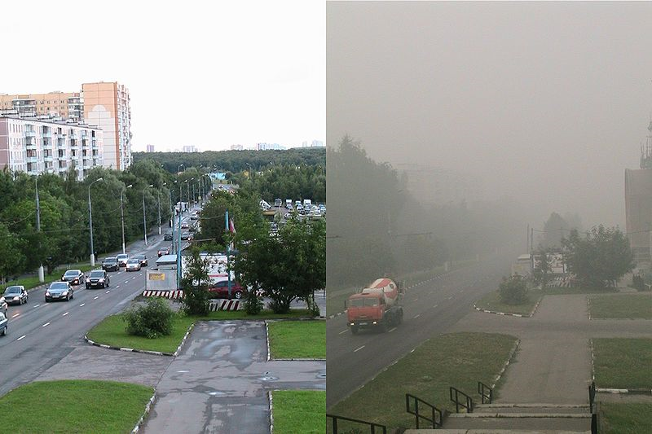
2010 Russian heat wave
Smoke from hundreds of fires over a thousand miles of western Russia, August 2
Over 2,000 houses destroyed by fires and about 4,000 people left homeless, wildfires burned in 17 Russian regions, and a state of emergency was declared
A heavy smog from the wildfires burning around Moscow blanketed the Russian capital, concentration of toxic particles reached dangerous levels.
More than 20 daily temperature records were broken including the absolute maximum temperature in Moscow (101F)

Slide 3
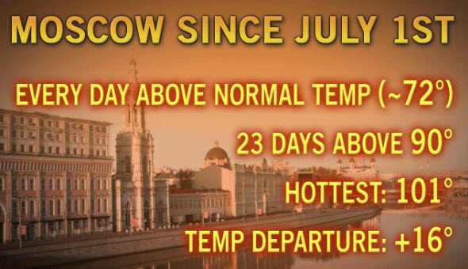
As of August 10, 2010:
(All time record high)
The toll for the nation is being put at about15,000 lives and $15 billion.

Slide 4
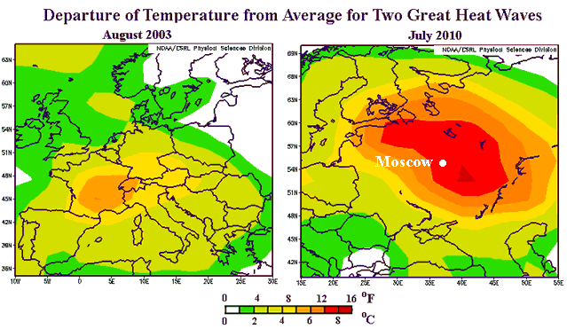

Slide 5
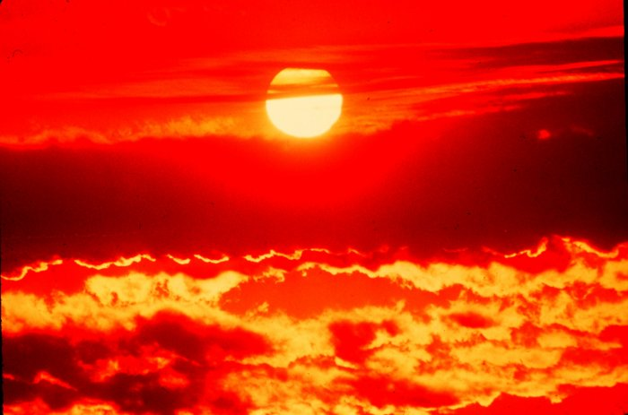
2010 heat wave in Japan
By early September, reports were calling the stubborn heat wave the worst since records began in 1898.
In Tokyo, the mean daily temperature since the start of summer has been 84.5 F, or 8.4 F above normal. For the last four weeks, the temperature departure has been about 10 F above normal.
Since July 17, only 8 out of 43 days have failed to reach 90 degrees as of Tuesday.
The hottest day, Aug. 17, had a high of 99 F in Tokyo
Five other days topped out at 97 F, which is 11 F above the highest normal temperature, which coincides with mid-August.
As of Sunday Sept.5, Kyodo News, quoting government sources, told of adverse health effects including more than 52,000 heatstroke cases necessitating hospital care. At the same time, the death toll was said to be 168.

Slide 6
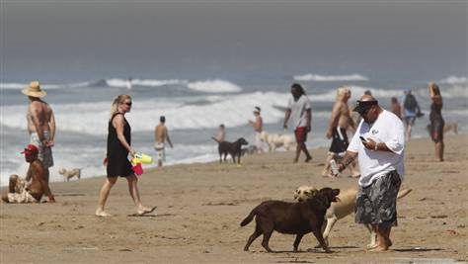
Associated Press headline:
Los Angeles bakes at record 113 degrees
September 27, 2010 LOS ANGELES — California's blistering fall heat wave sent temperatures to an all-time record high of 113 degrees in downtown Los Angeles on Monday, and many sought refuge at the beach. The historic mark was part of an onslaught of temperatures well over 100 degrees Fahrenheit in many cities ranging from Anaheim, home of Disneyland, to San Luis Obispo on the usually balmy Central Coast. The giant Los Angeles Unified School District canceled all outdoor activities, including sports competitions and practices.
Thousands of heat-related power outages were reported.

Slide 7
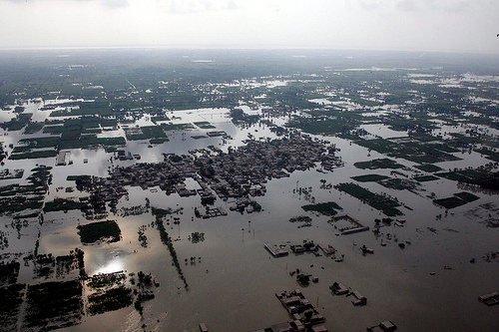
2010 Pakistan floods
More than 15 million across Pakistan affected by the floods, which submerged one-fifth of the country and laid waste to infrastructure and crop land; The monsoon-triggered floods that began late July spread from the north to the south of the country, swelling rivers and submerging hundreds of villages.
Flooding near Multan in Punjab Province, Pakistan, August 15, 2010

Slide 8
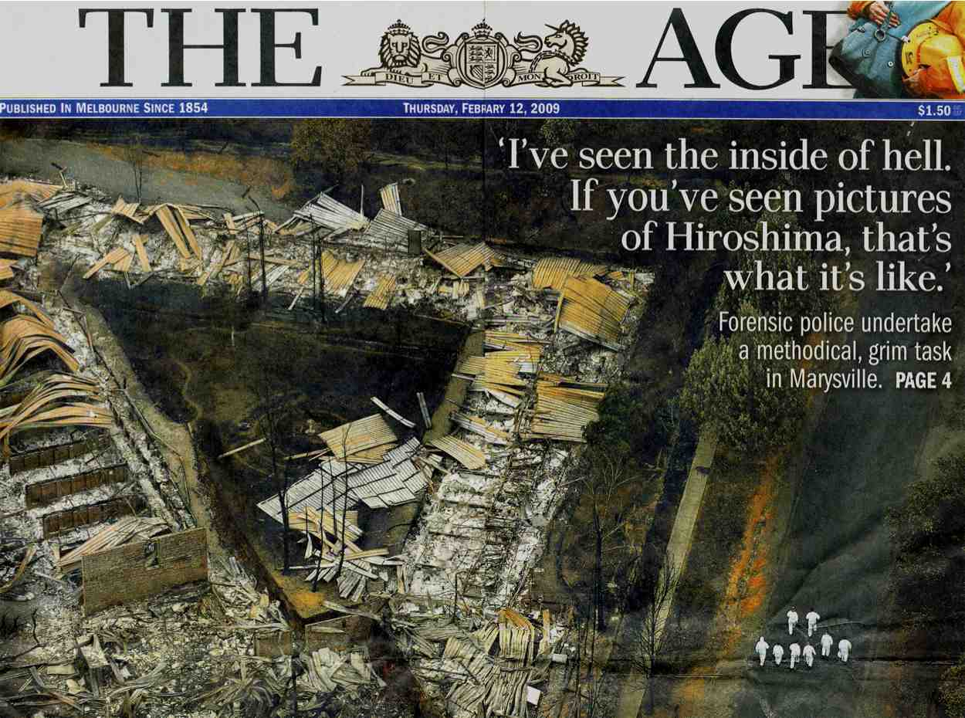
Australian bushfires February 7, 2009: over 240 dead ~1800 houses destroyed, ~200 businesses and other buildings destroyed, largest natural disaster in Australia’s history

Slide 9
Context of the Australian bushfire disaster:
8 years of severe drought in southern Australia
Record-setting heat wave the week before, three days in a row above 43°C (109°F)
The day of the fires, Melbourne set an all-time record high temperature of 46.4°C (115.5°F) associated with strong high pressure and north winds

Slide 10
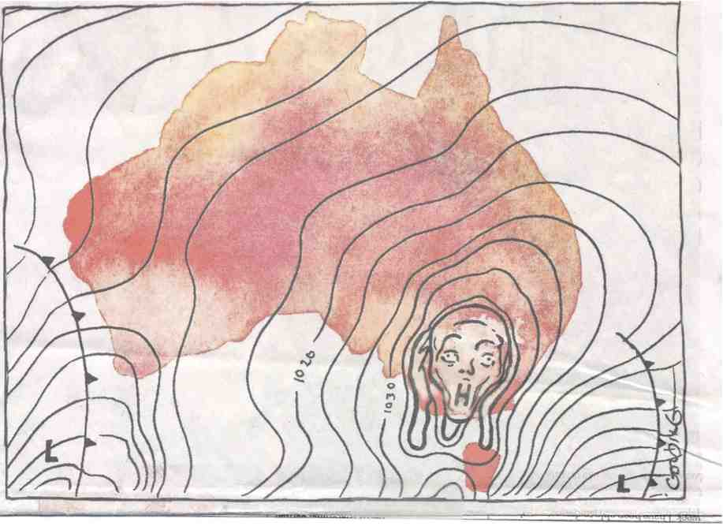
Editorial cartoon in Melbourne newspaper the week after the fires indicating Australians know that high pressure in the summer equals extreme heat that is conducive to fires

Slide 11
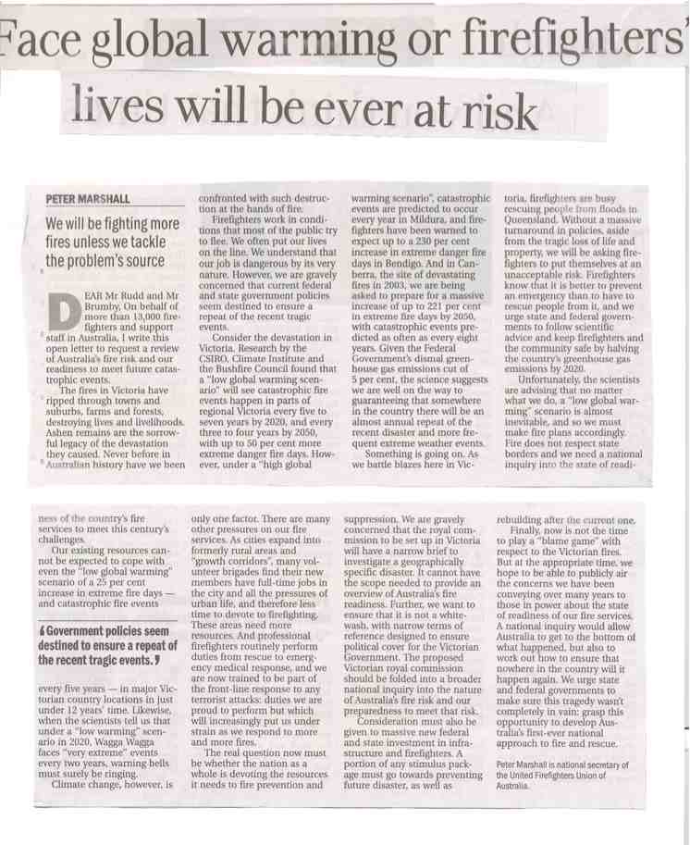
Is it global warming? There is an awareness in Australia that global warming has something to do with it:

Slide 12
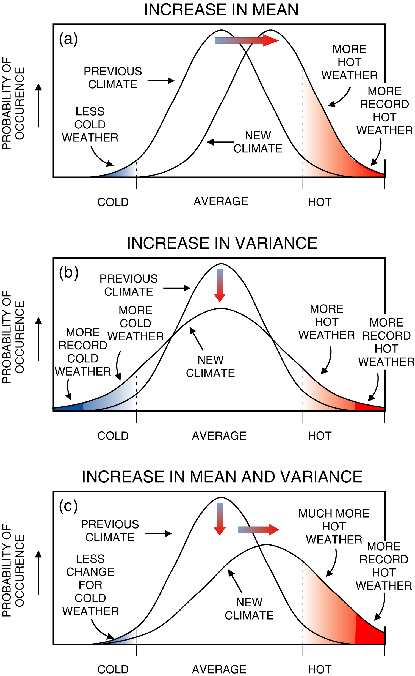
How global warming affects extremes: a relatively small shift in the average temperature produces a very large increase in extreme high temperatures and a decrease in extreme low temperatures

Slide 13
Southern Australia is naturally susceptible to extreme heat and bushfires, but with global warming, there is a shift to drier conditions and warmer temperatures, thus increasing the risk of record-setting extreme heat and record bushfires
Global warming by itself doesn’t cause extreme conditions, but it makes naturally occurring events even more extreme

Slide 14
We quantify possible future changes in weather and climate extremes with climate models

Slide 15
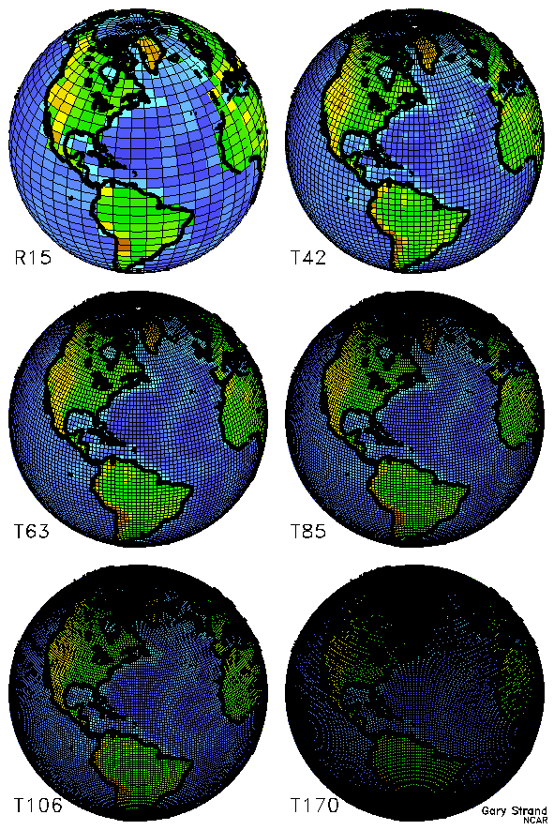
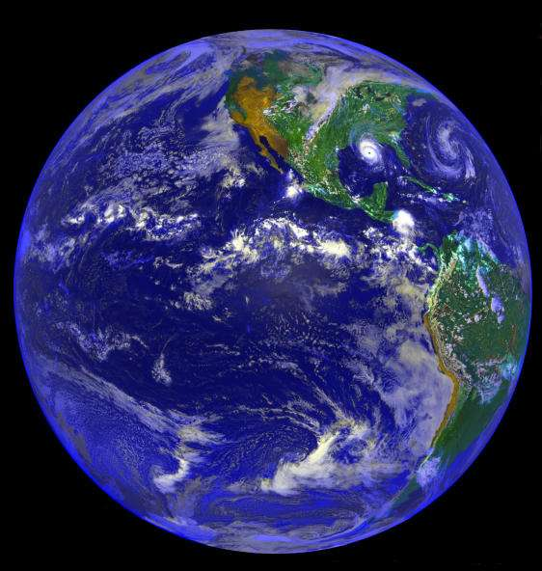
The challenge of simulating the earth’s climate with equations
Resolution of climate models is improving:
1995: about 500 km
2000: about 250 km
2005: about 150 km
2010: about 50 km

Slide 16
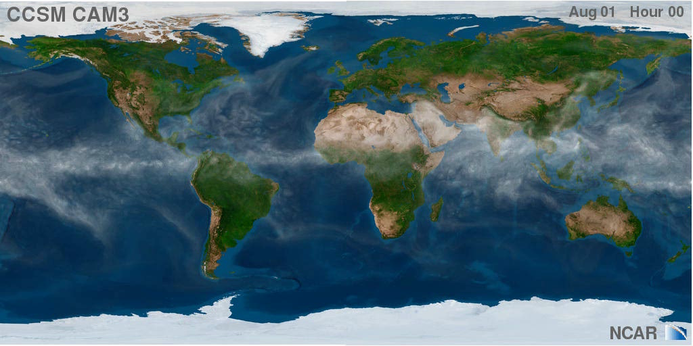
Climate Model Simulation

Slide 17
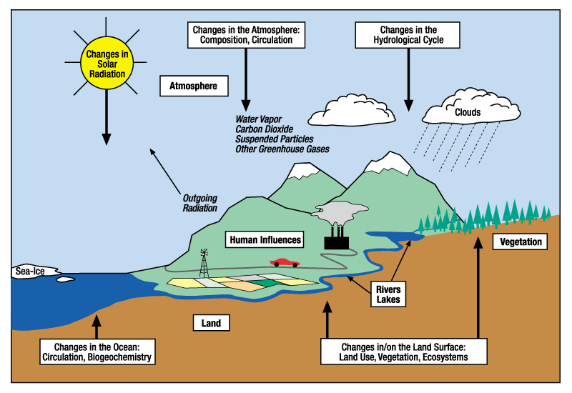
A climate model has an atmospheric component a lot like a weather forecast model, but with lower resolution.
It also includes interactive ocean, land surface, and sea ice models, and accounts for changes in atmospheric constituents like greenhouse gases, changes in solar input, volcanoes, visible air pollution, etc.

Slide 18
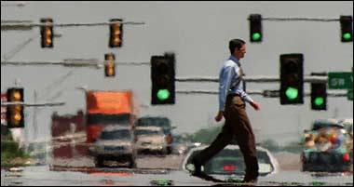
Heat Waves
Impacts on human health and mortality, economic impacts, ecosystem and wildlife impacts

Slide 19
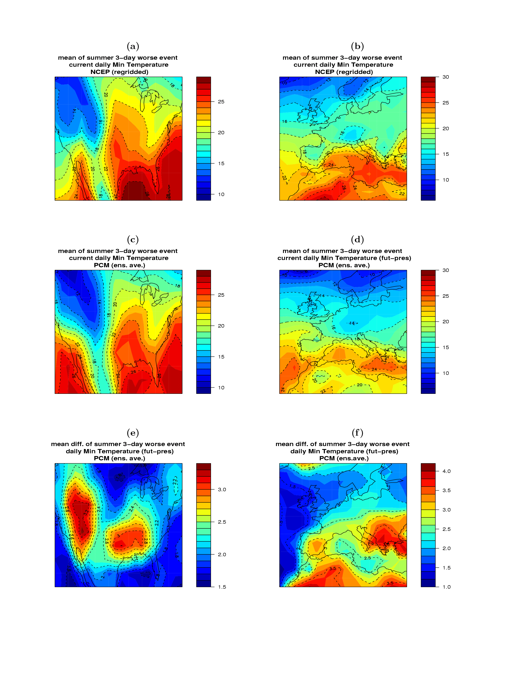
Climate models can be used to provide information on changes in extreme events such as heat waves
Heat wave severity defined as the mean annual 3-day warmest nighttime minima event
Model compares favorably with present-day heat wave severity
In a future warmer climate, heat waves become more severe in southern and western North America, and in the western European and Mediterranean region
(Meehl, G.A., and C. Tebaldi, 2004: More intense, more frequent and longer lasting heat waves in the 21st century. Science, 305, 994--997.)
Observed
Model
Future

Slide 20
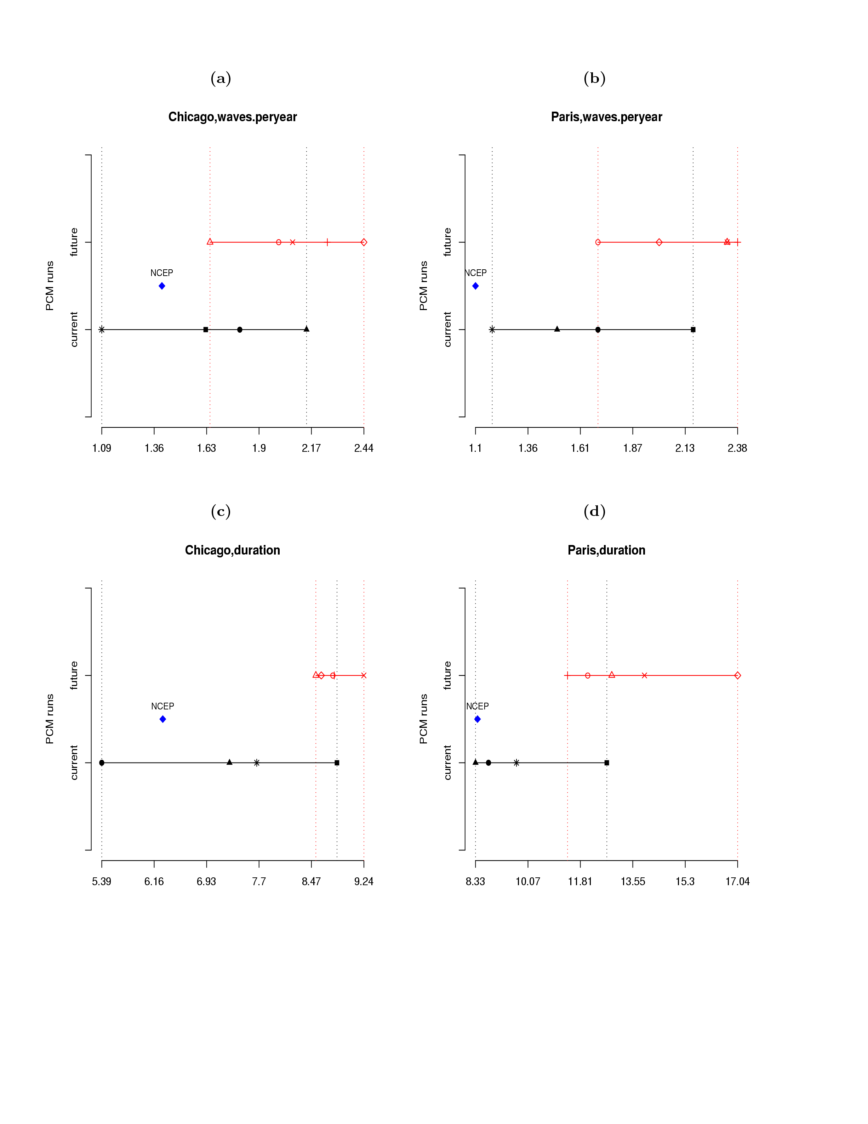
Climate model shows an increase in the average number of heat waves per year in the future (top) and an increase in heat wave duration (bottom)

Slide 21
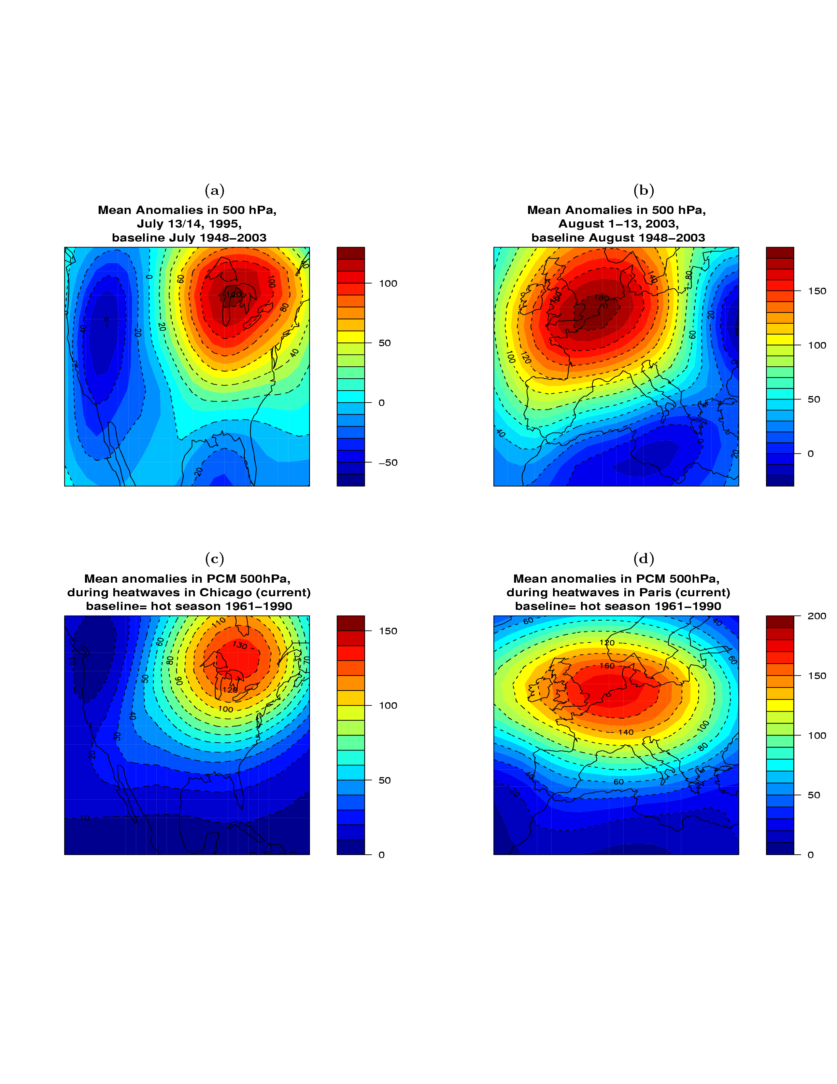
The Chicago (1995) and Paris (2003) heat waves show large positive 500 hPa height anomalies
For present-day heat waves near Chicago and Paris, the climate model also simulates large positive 500 hpa height anomalies

Slide 22
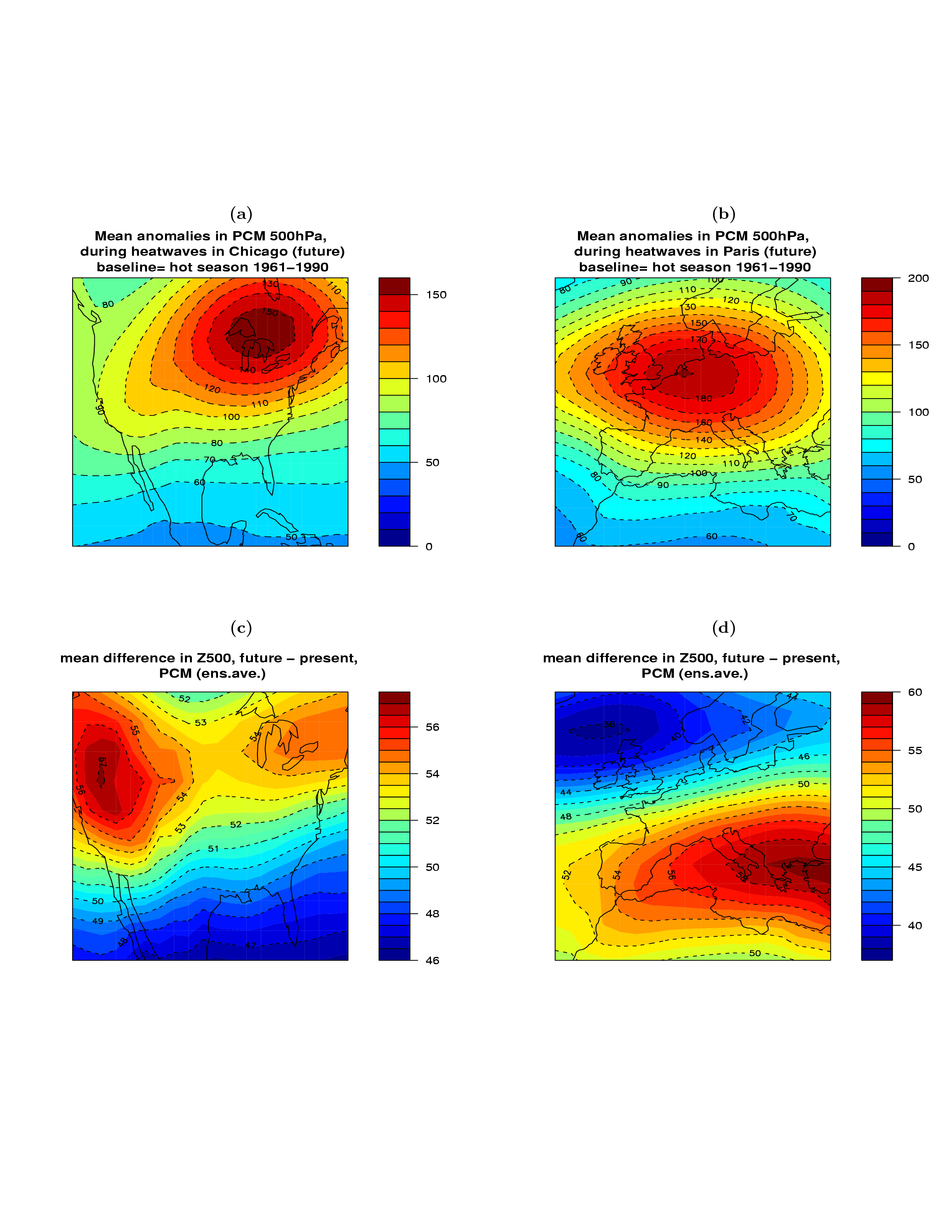
Atmospheric circulation in heat waves becomes more intense for future climate (2080-2099) compared to present-day (1961-1990)
Future change in base state (average) atmospheric circulation due to increased CO2 is conducive to more intense heat waves

Slide 23
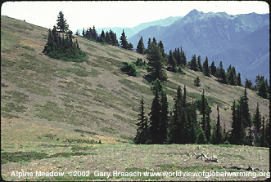
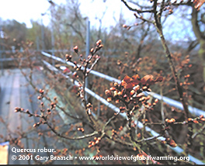

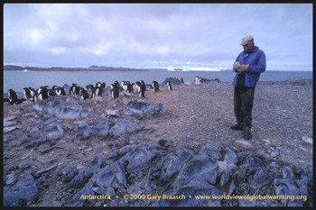
Impacts on Agricultural and Biological Systems related to Frost Days
(Meehl, Tebaldi and Nychka, 2004: Changes in frost days in simulations of twentyfirst century climate,
Climate Dynamics, 23, 495--511)
Changes in frost days affect:
Range shifts (latitudinal or altitudinal)
Change in growing season length
Water resources (change in snow melt season)
Earlier flowering; emergence of insects; earlier mating; loss of habitat, shorter hibernation

Slide 24
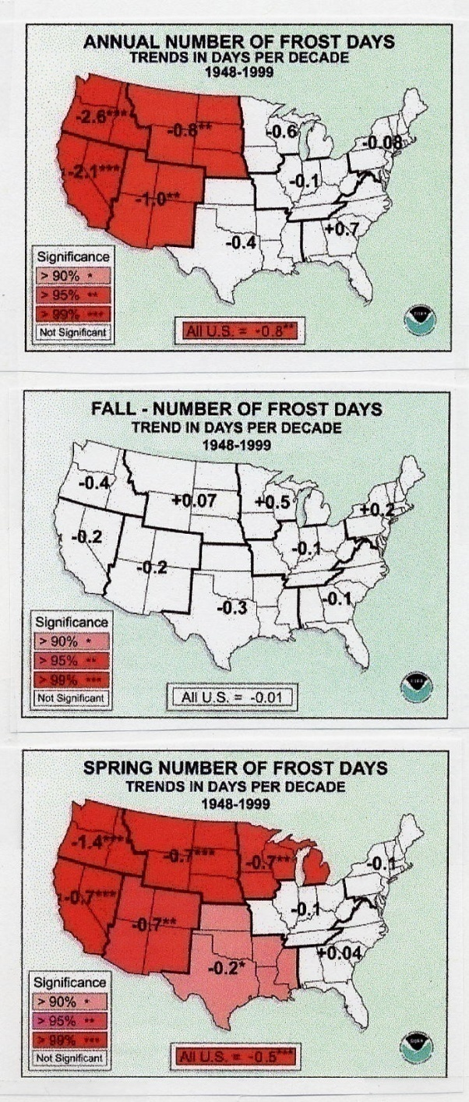
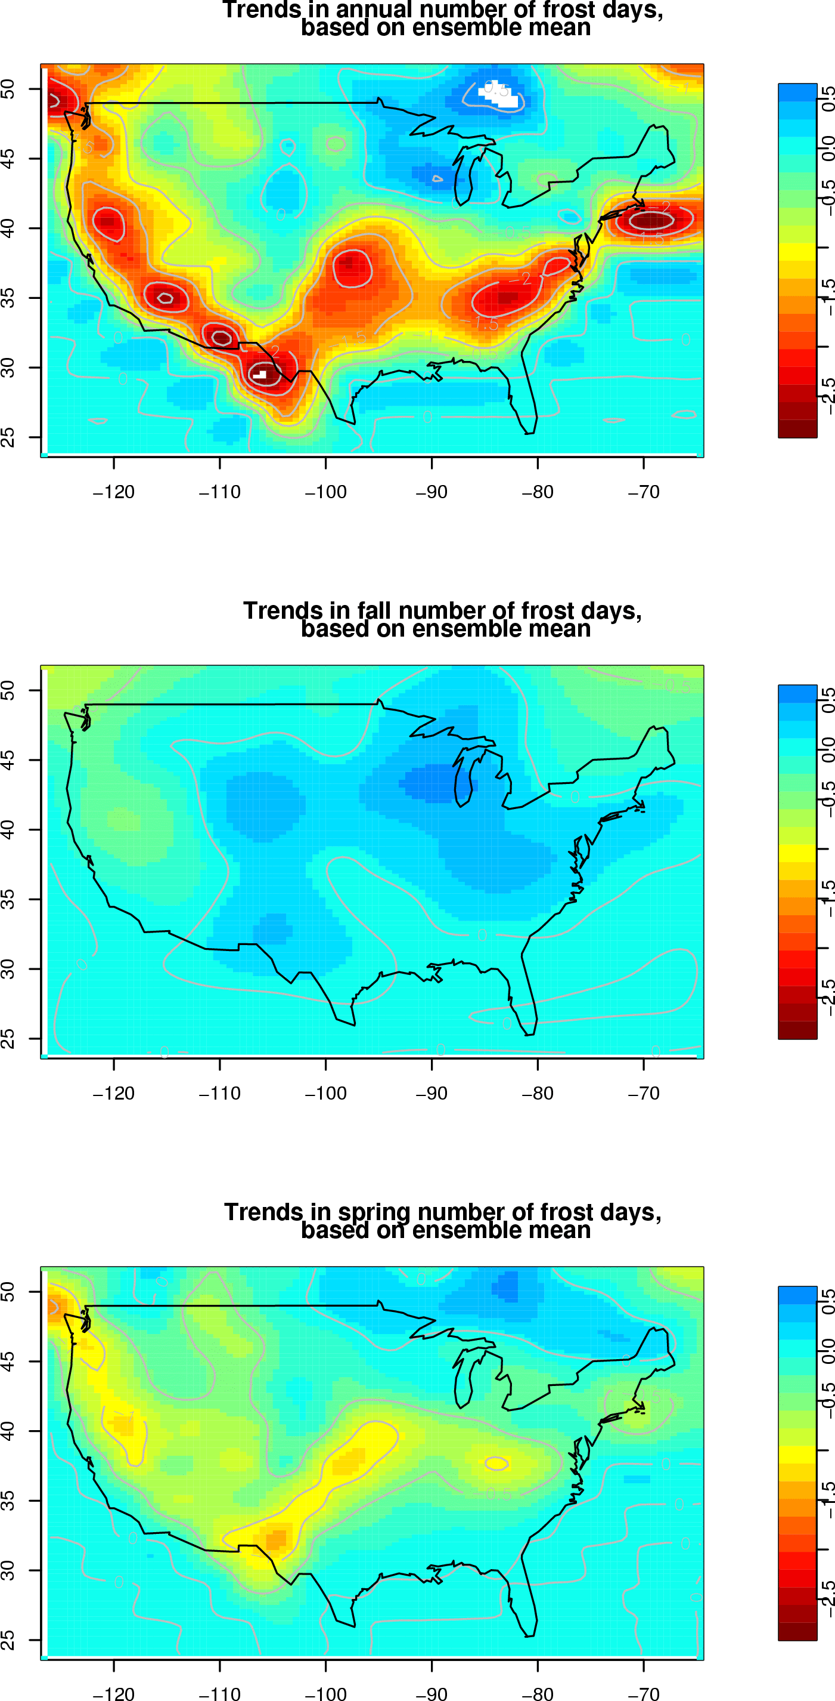
Changes in frost days in the late 20th century show biggest decreases over the western and southwestern U.S. in observations and the model

Slide 25
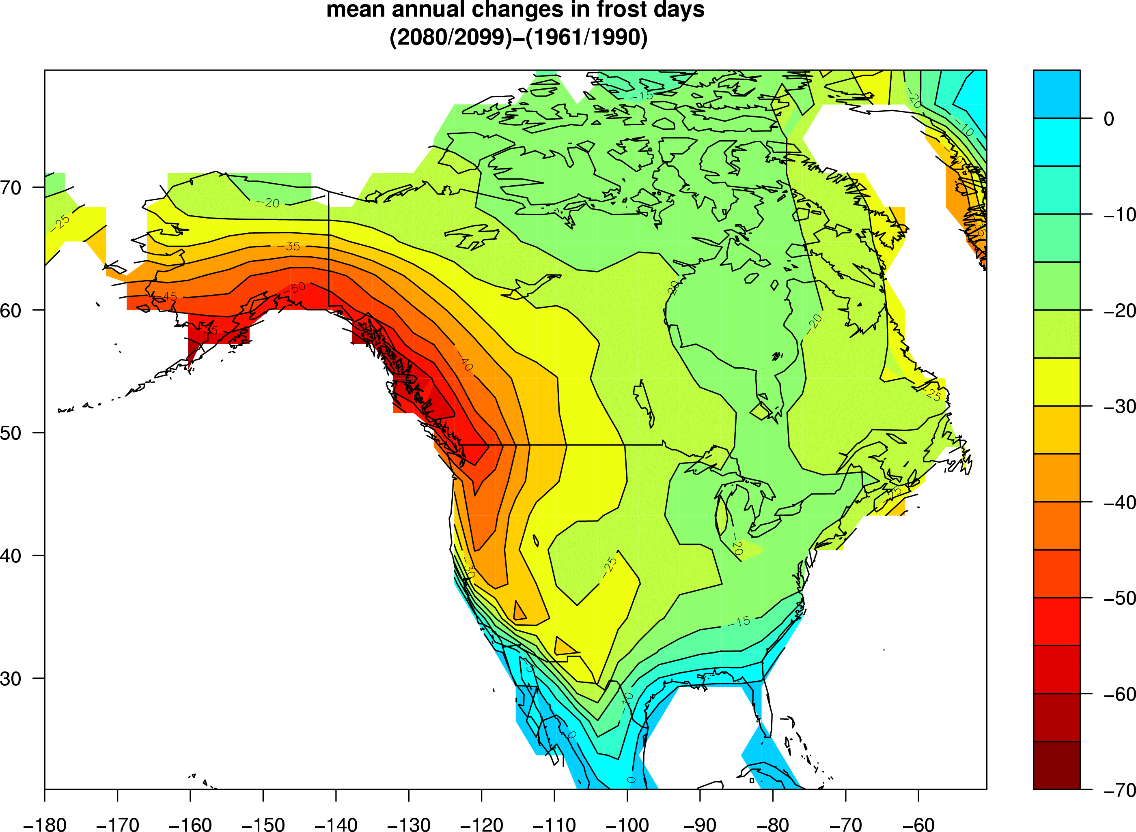
Future changes in frost days from the climate model show greatest decreases in the western and southwestern U.S., similar to late 20th century

Slide 26
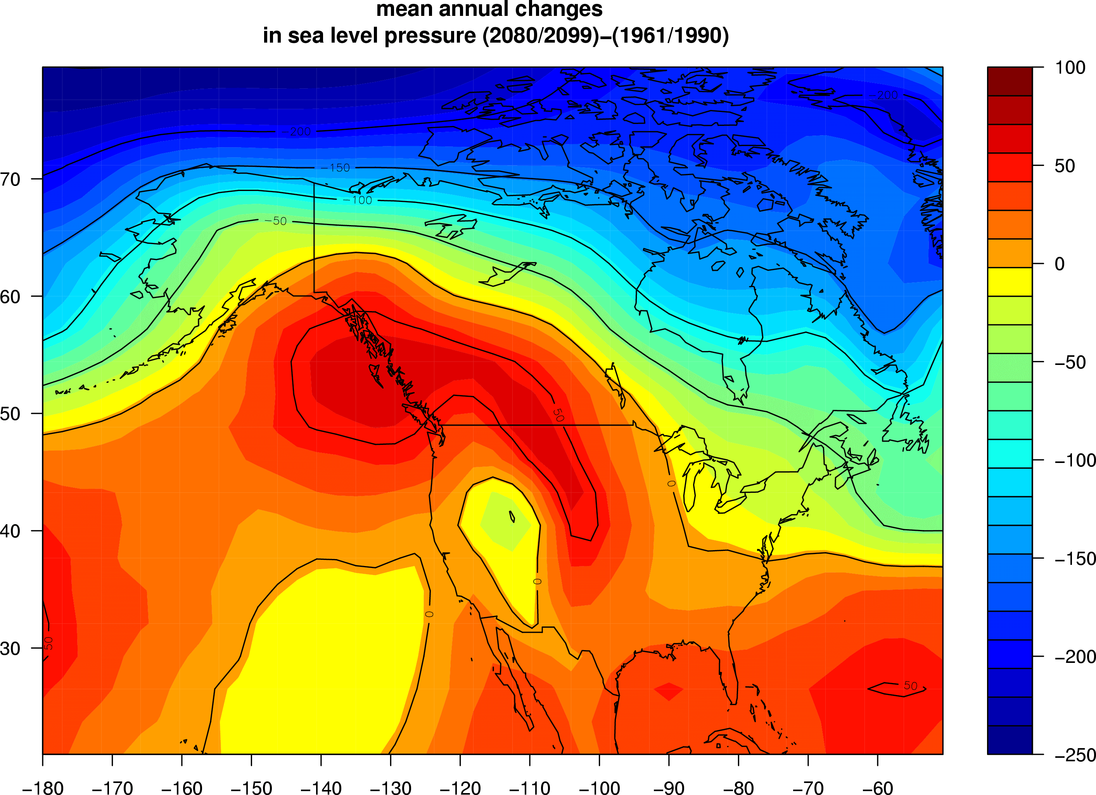
Large-scale changes in atmospheric circulation affect regional pattern of changes in future frost days
Anomalous ridge of high pressure brings warmer air to northwestern U.S.causing relatively less frost days compared to the northeastern U.S. where an anomalous trough brings colder air from north
H
cool
L
warm
(Meehl, Tebaldi and Nychka, 2004: Changes in frost days in simulations of twentyfirst century climate, Climate Dynamics, 23, 495--511)

Slide 27
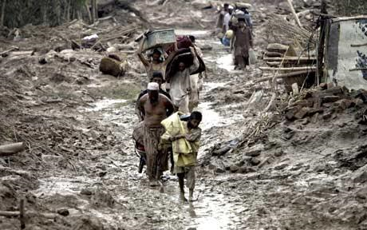
2010 Pakistan floods
Were they natural, or was there a contribution from global warming?

Slide 28
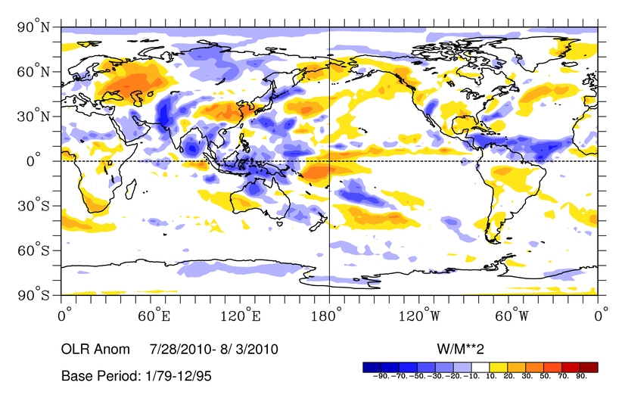
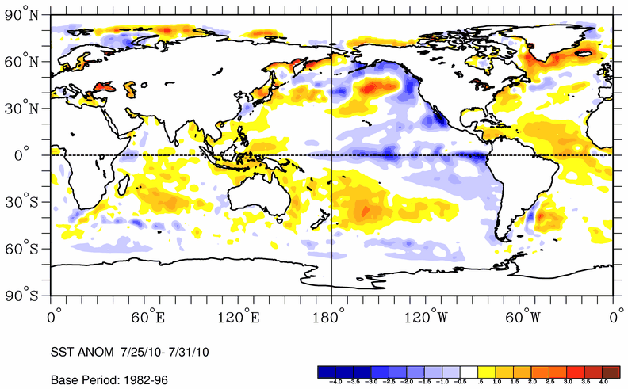
The large-scale context to the Pakistan floods: above normal monsoon rainfall over much of south Asia, and a La Niña event in equatorial eastern Pacific,

Slide 29
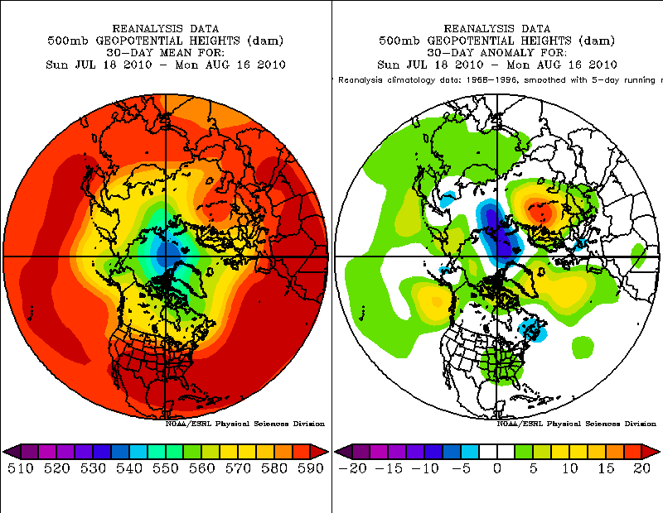
The midlatitude context: ridge over Russia, trough over western China, the latter conducive to excessive rainfall there and in Pakistan; were they connected?

Slide 30
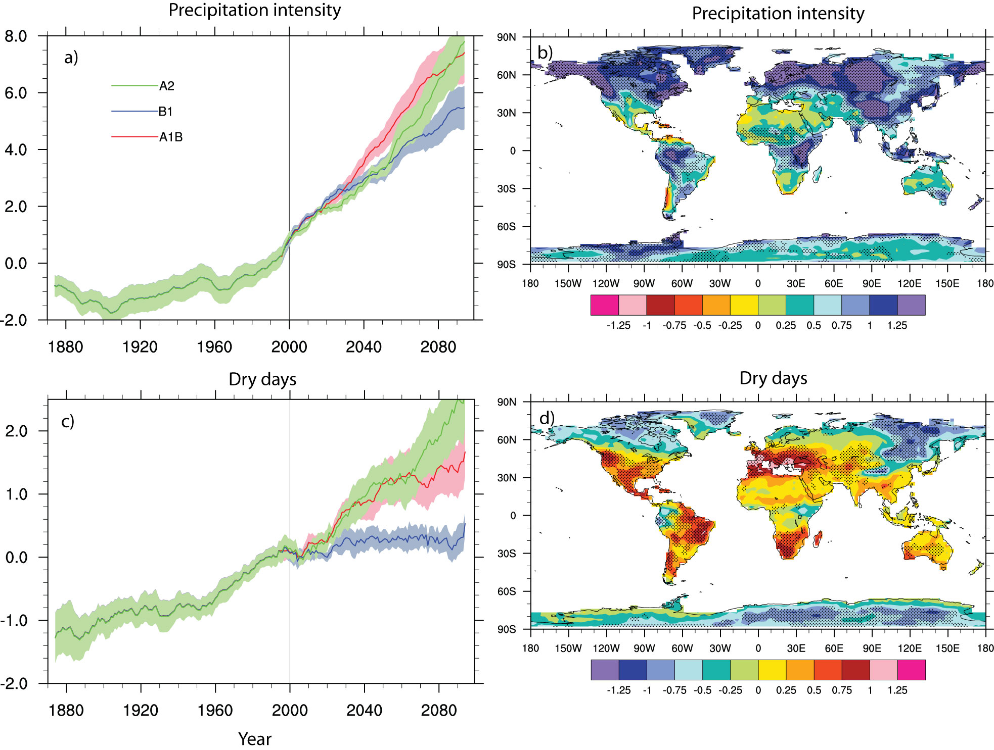
As the climate has warmed, precipitation has been observed to be more intense
With further warming, precipitation is projected to become even more intense almost everywhere
In some areas the projections show an increase of “dry days” (number of days between precipitation events)
(Tebaldi , C., J.M. Arblaster, K. Hayhoe, and G.A. Meehl, 2006: Going to the extremes: An intercomparison of model-simulated historical and future changes in extreme events. Clim. Change, 79, doi 10.1007/s10584-006-9051-4.)

Slide 31
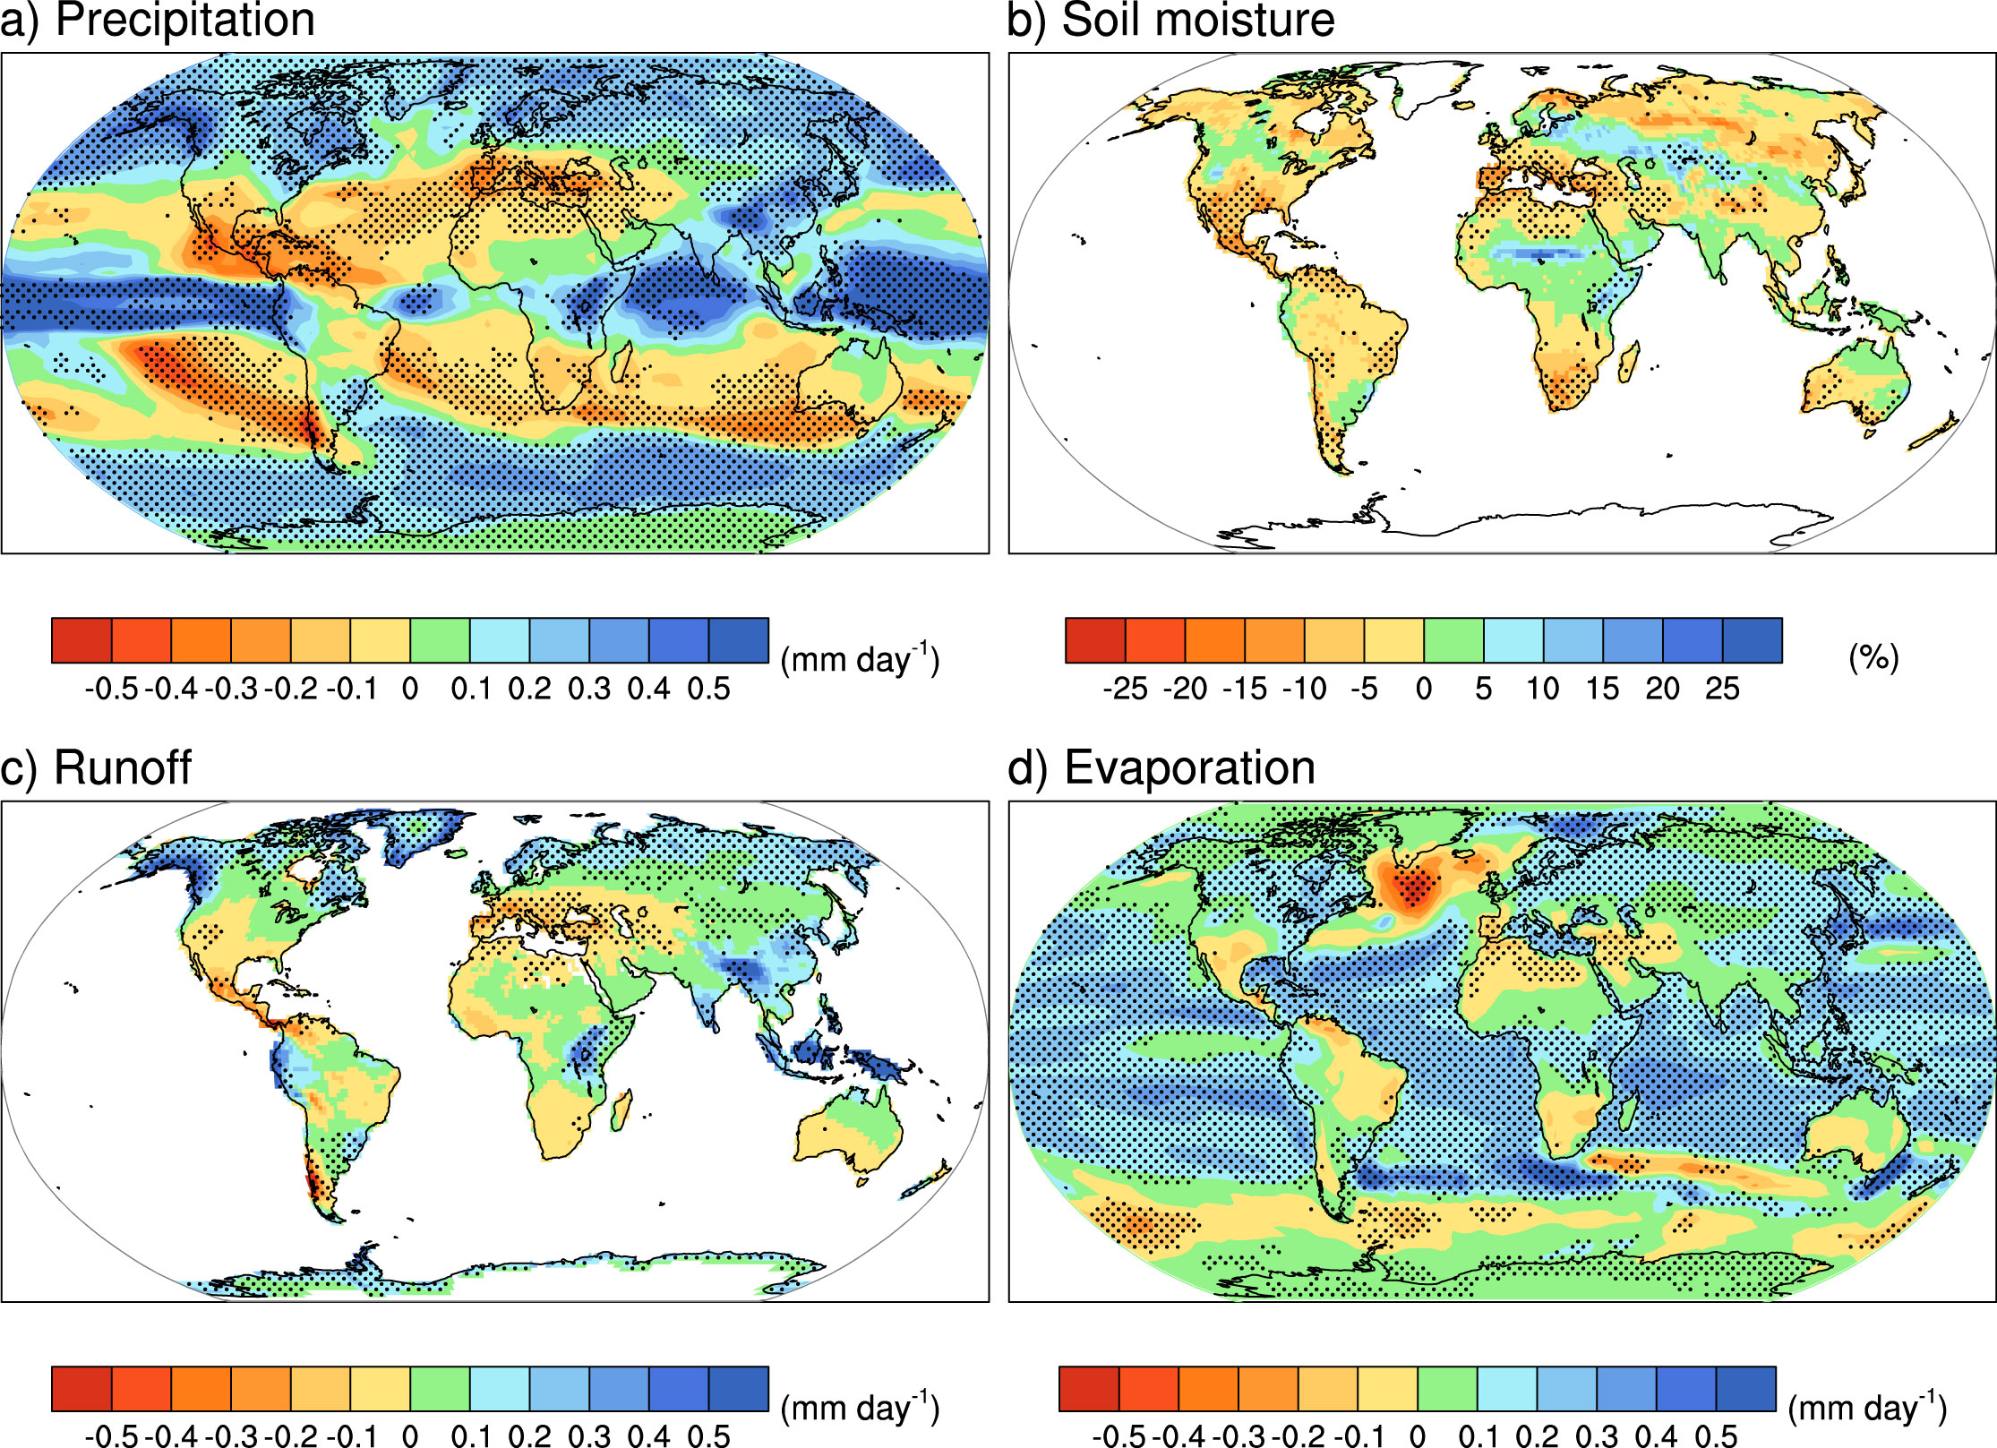
Combined effects of precipitation intensity and dry days contribute to average precipitation changes:
More precipitation in the deep tropics and mid- to high latitudes; less precipitation in the subtropics (“wet areas get wetter, dry areas get drier”)

Slide 32
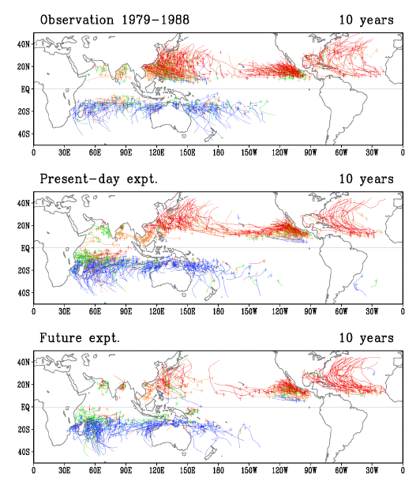
What about future hurricanes?
the indications so far: fewer total, but the ones that form will be more intense
(Tropical cyclone tracks from a global 20 km resolution atmospheric model)
(Oouchi et al., 2006)

Slide 33
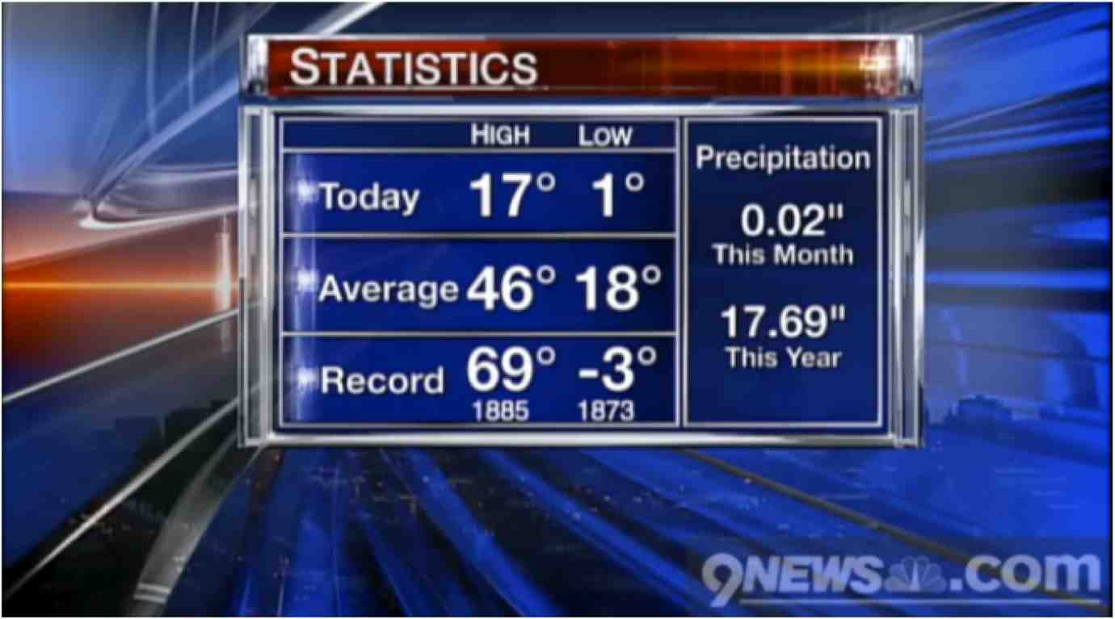
If the climate is warming, do daily temperature records show it?
A typical depiction of daily temperatures on a local newscast (in this case, December 3, 2009 from Denver during a cold snap)

Slide 34
In a warming climate, there should be more record hot weather and less record cold weather

Slide 35
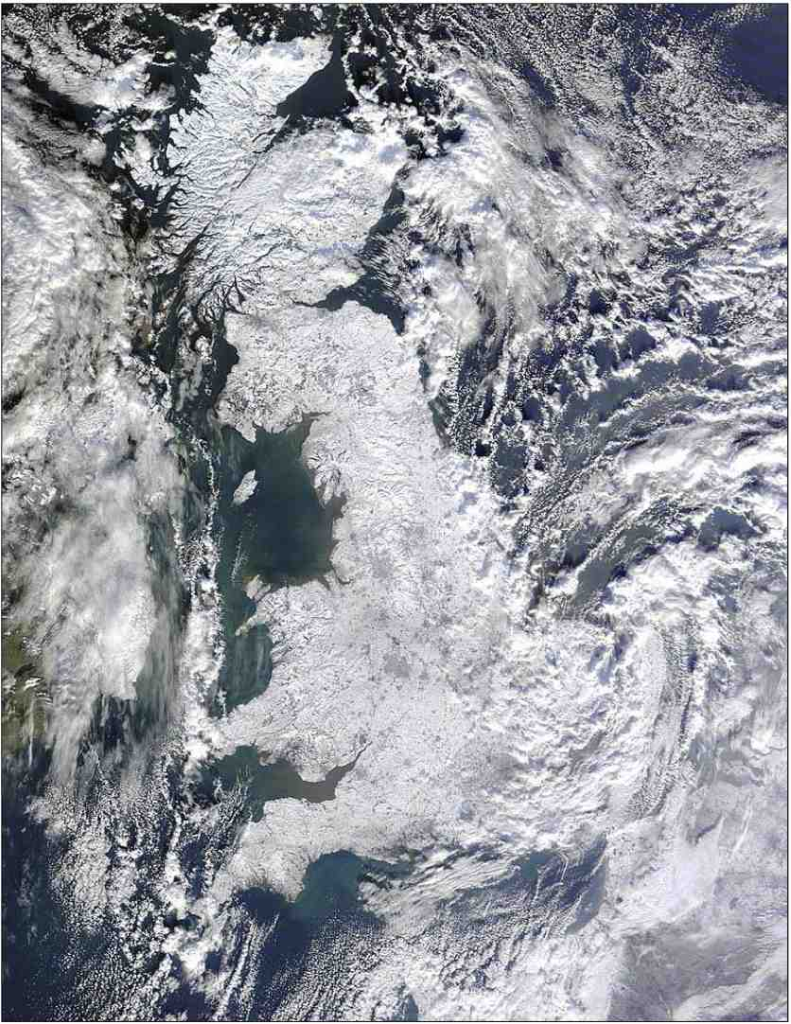
…but it seemed really cold last winter…
snow-covered Britain, January 7, 2010

Slide 36
National Climatic Data Center web site archives observed annual daily record high maximum and record low minimum temperatures from weather stations across the U.S. http://www.ncdc.noaa.gov/oa/climate/research/records/
As of October 18, 2010:
Since January 1, 2000: 310,437 record daily high maximum temperatures set, and 152,064 record daily low minimum temperatures, a ratio of roughly two to one.
Since January 1, 2010: 15,851 record highs and 6,050 record lows, a ratio of roughly two to one.
Is there something special about the two to one ratio of record high maximum temperatures to record low minimum temperatures?

Slide 37
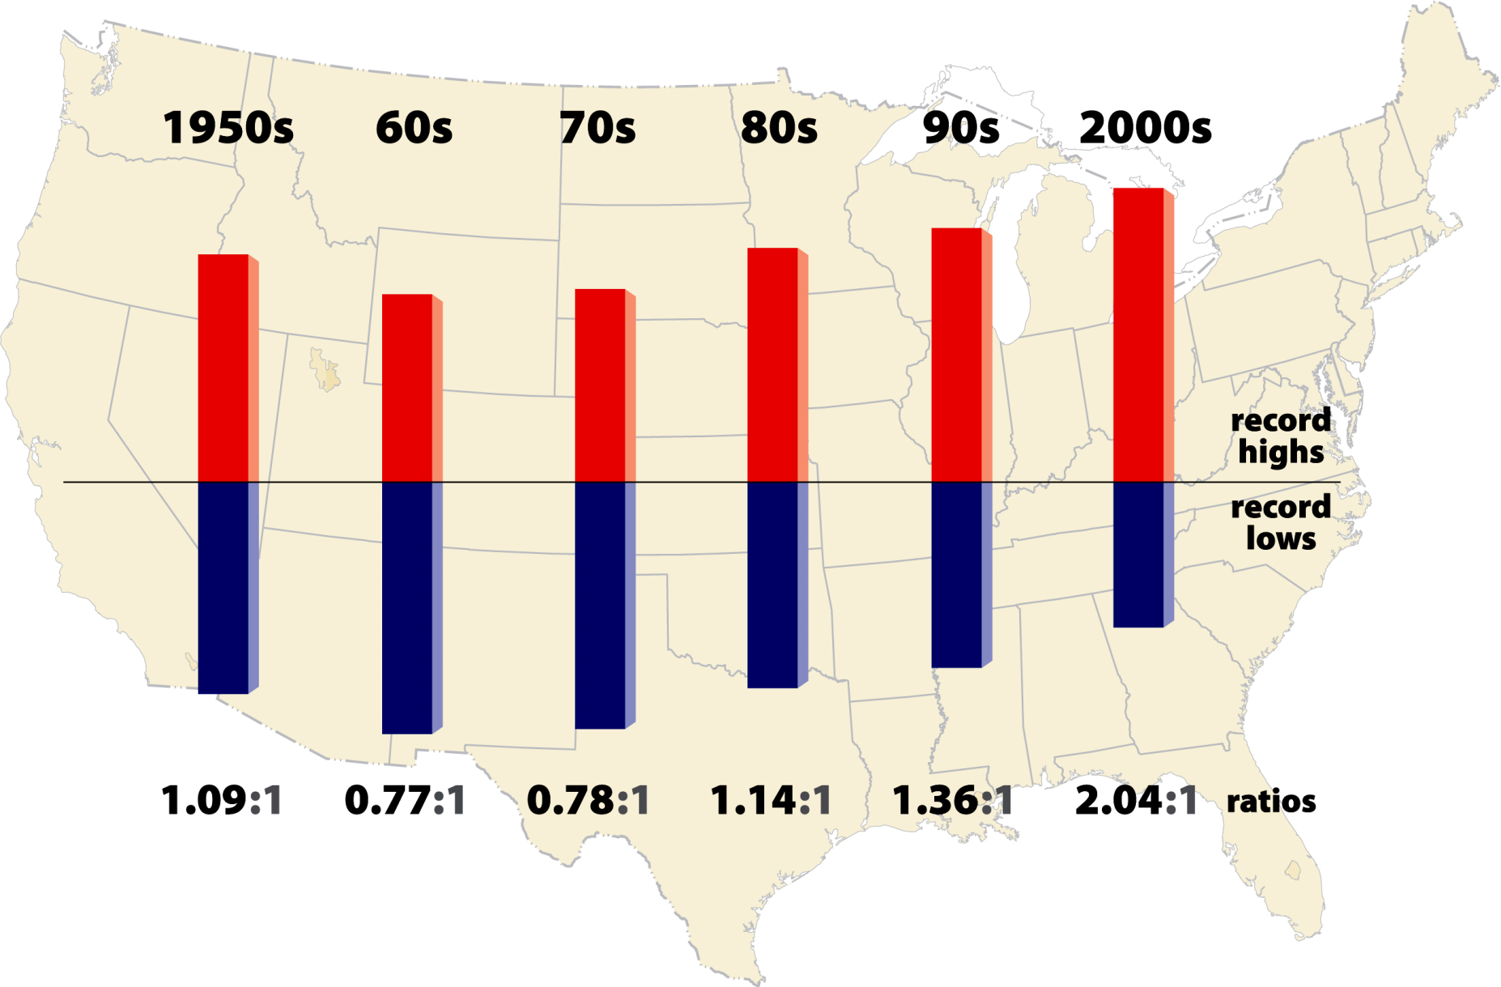

Slide 38
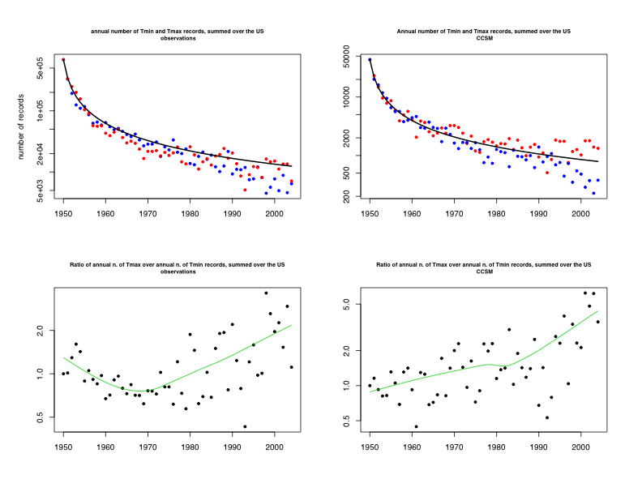
Records should decay by 1/n over time
In a stationary climate, ratio of record high maxima to record low minima should be roughly 1.0
However, average climate has been warming, and the ratio is now about 2 to 1
(Meehl, G.A., C. Tebaldi, G. Walton, D. Easterling, and L. McDaniel, 2009: The relative increase of record high maximum temperatures compared to record low minimum temperatures in the U.S. Geophys. Res. Lett., 36, L23701, doi:10.1029/2009GL040736.)

Slide 39
A climate model simulation of 20th century climate shows the ratio of record high maxima to record low minima to be about 4 to 1 at present
This is because:
The model has somewhat larger warming in the 20th century than observed
Observed warming has been greater in the western U.S. compared to the east; the model also shows that pattern, but with relatively greater warming in the east than in the model
Overall greater warming in the model produces a higher ratio compared to observations

Slide 40
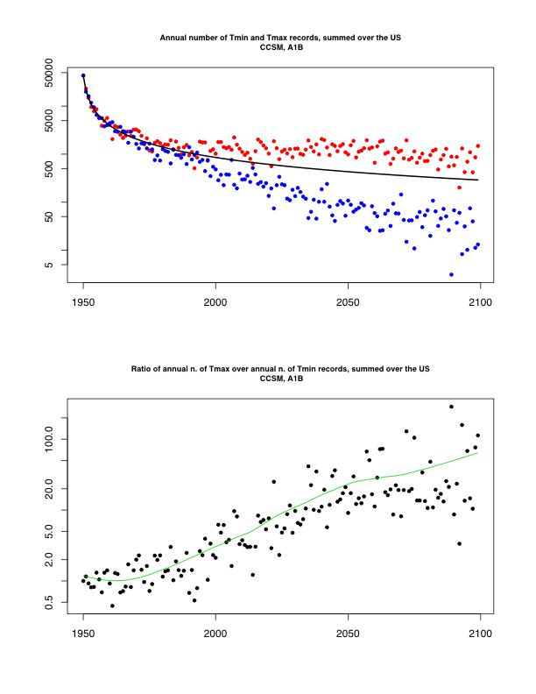
In the future:
Ratio of record high maxima to record low minima about 20 to 1 by mid-century, and roughly 50 to 1 by the end of the century
Even in a much warmer climate, some record low minimum temperatures still occur

Slide 41
Summary
A relatively small shift in the average produces a very large change in extremes—more extreme heat and less extreme cold, and more record high maximum temperatures and fewer record low minimum temperatures
Global warming by itself doesn’t cause extreme conditions, but it makes naturally occurring events even more extreme
In a future warmer climate:
Increased heat wave intensity, duration and frequency
Decreased frost days
Increased precipitation intensity, but increases in dry days in some locations combines to produce areas of both average increase (midlatitudes) and decrease (subtropics) of precipitation
Future hurricanes: indication so far is for fewer total, but the ones that form would be more intense, but better modeling tools needed
Current ratio of 2 to 1 for record high maximum temperatures to record low minimum temperatures over the U.S. is symptomatic of an ongoing warming of average temperatures; ratio projected to increase as the climate warms: about 20 to 1 by mid-century, 50 to 1 by late century

