Slide 1
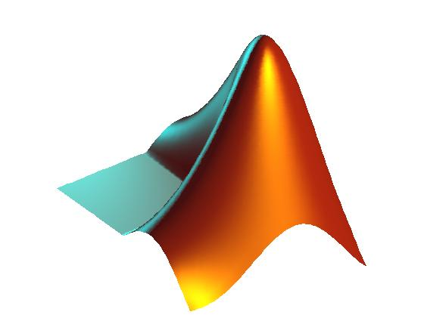
Using MatLab for in class exercises and student projects
Kristine DeLong
Geography and Anthropology
Louisiana State University

Slide 2
Background
Previous experience as a software trainer for an international manufacturer.
  I am comfortable with computers in the classroom for in class activities and hands on learning.
MatLab environment can be scaled for students with
  Minimal programming experience using toolkits and existing programs
  More experience using customize routines
  Variety of backgrounds

Slide 3
Quantitative Methods – Time Series
Required graduate level course
  Give students tools they can use in their research
Mixture of BA and BS students
Start with Excel and move to MatLab.
In class exercises
Data analysis projects

Slide 4
Classroom setup
LSU offers MatLab to students via Virtual Lab and Microsoft Remote Desktop
Student version $99
Request a professor evaluation copy of the student version – limited to length of course
Computer classroom for 26 students with Windows PCs
  Originally setup as a GIS classroom
Give yourself at least 2 hours for in class exercises.

Slide 5
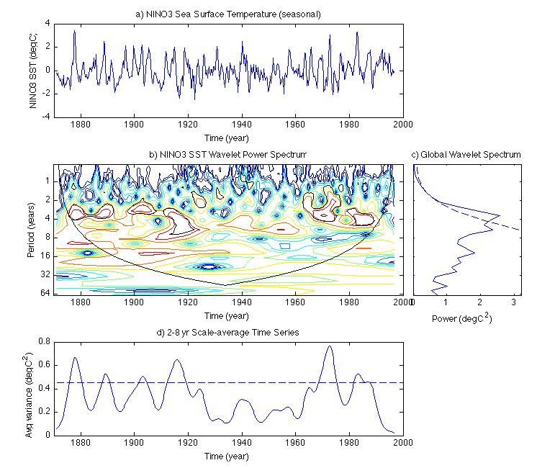
Example from Time Series Analysis
Wavelets program from
http://paos.colorado.edu/research/wavelets/software.html

