Slide 1
Susan Kaspari, Central Washington University, Geological Sci.
Goal: a 4°C temperature increase is abstract to most students. Students gain a more concrete understanding of how projected climate change will affect something of interest to them.
Research Project:
Choose a location (where you are from, a place that is of interest to you) and investigate how projected changes in climate will affect that area.
What are the expected changes in temperature, precipitation, storms, droughts, sea level, seasonality, etc?
How will this affect the habitat of the area (for humans, animals, and plants)?
How will this affect the local economy?
What actions can the people that live in this area take to lessen the impacts of changing climate?

Slide 2
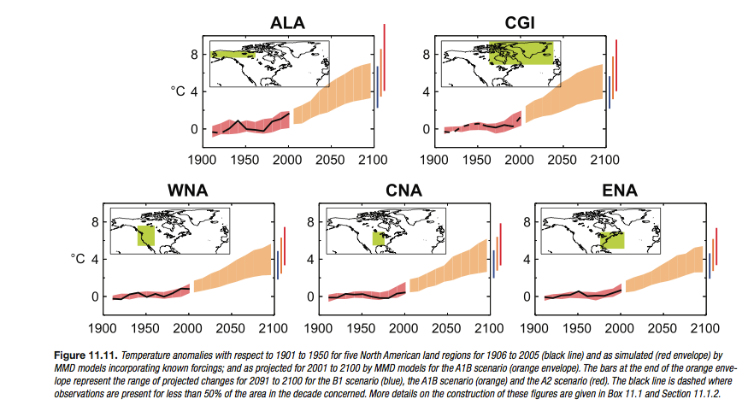
Students consult the IPCC report (Chapter 11: Regional Climate Projections), the primary scientific literature (minimum of 4 peer reviewed journal articles), regional reports, and conduct original research.

Slide 3
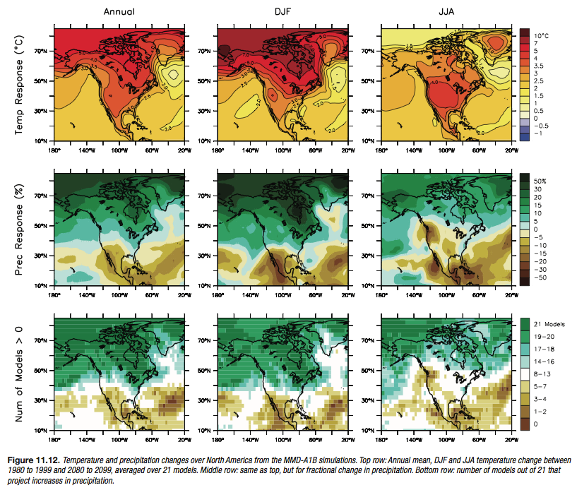

Slide 4
Example Topics from Prior Students
Effects of climate change on:
Potential reactivation of sand dunes, Sand Hills, Nebraska
Reduction in the natural snow reservoir of the Cascade Mountains
Salmonid species in Alaska
Caribbean coral reefs
Habitat change of the Black Howler monkey in Belize
The Vermont Maple Industry
Water sources in the Great Basin
Glaciers and water resources in the Himalaya

Slide 5
The Effects of Climate Change on Water Sources in the Great Basin:
A Look Forward to 2100
Caitlin Orem
Central Washington University

Slide 6
Research Goal
The goal was to understand the effects of climate change on drinking water sources in the Great Basin.
  Surface water response
  Drinking Water Sources of Reno, Las Vegas, and Salt Lake City
  Modern Analog for climate in 2100 of the Great Basin and Cities
Caitlin Orem

Slide 7
IPCC Predictions for 2100
Temperature
Annual + 3.4°C (WNA)
Winter + 3.5°C
Summer + 4.0°C
Increased temperature
Precipitation
Annual -5% to +5%
Winter + 0% to 15%
Summer – 0% to 20%
Increased seasonality
Wet/Warm Winters and Dry/Warm Summers
Caitlin Orem

Slide 8
Surface Water Response
More rain, less snow = less snowpack
Earlier snowmelt stream discharge events
Longer dry season (perhaps drought)
Very low/dry stream discharge in summer
Changing of lake levels
Sediment flux
Evaporation
Vegetation
Caitlin Orem

Slide 9
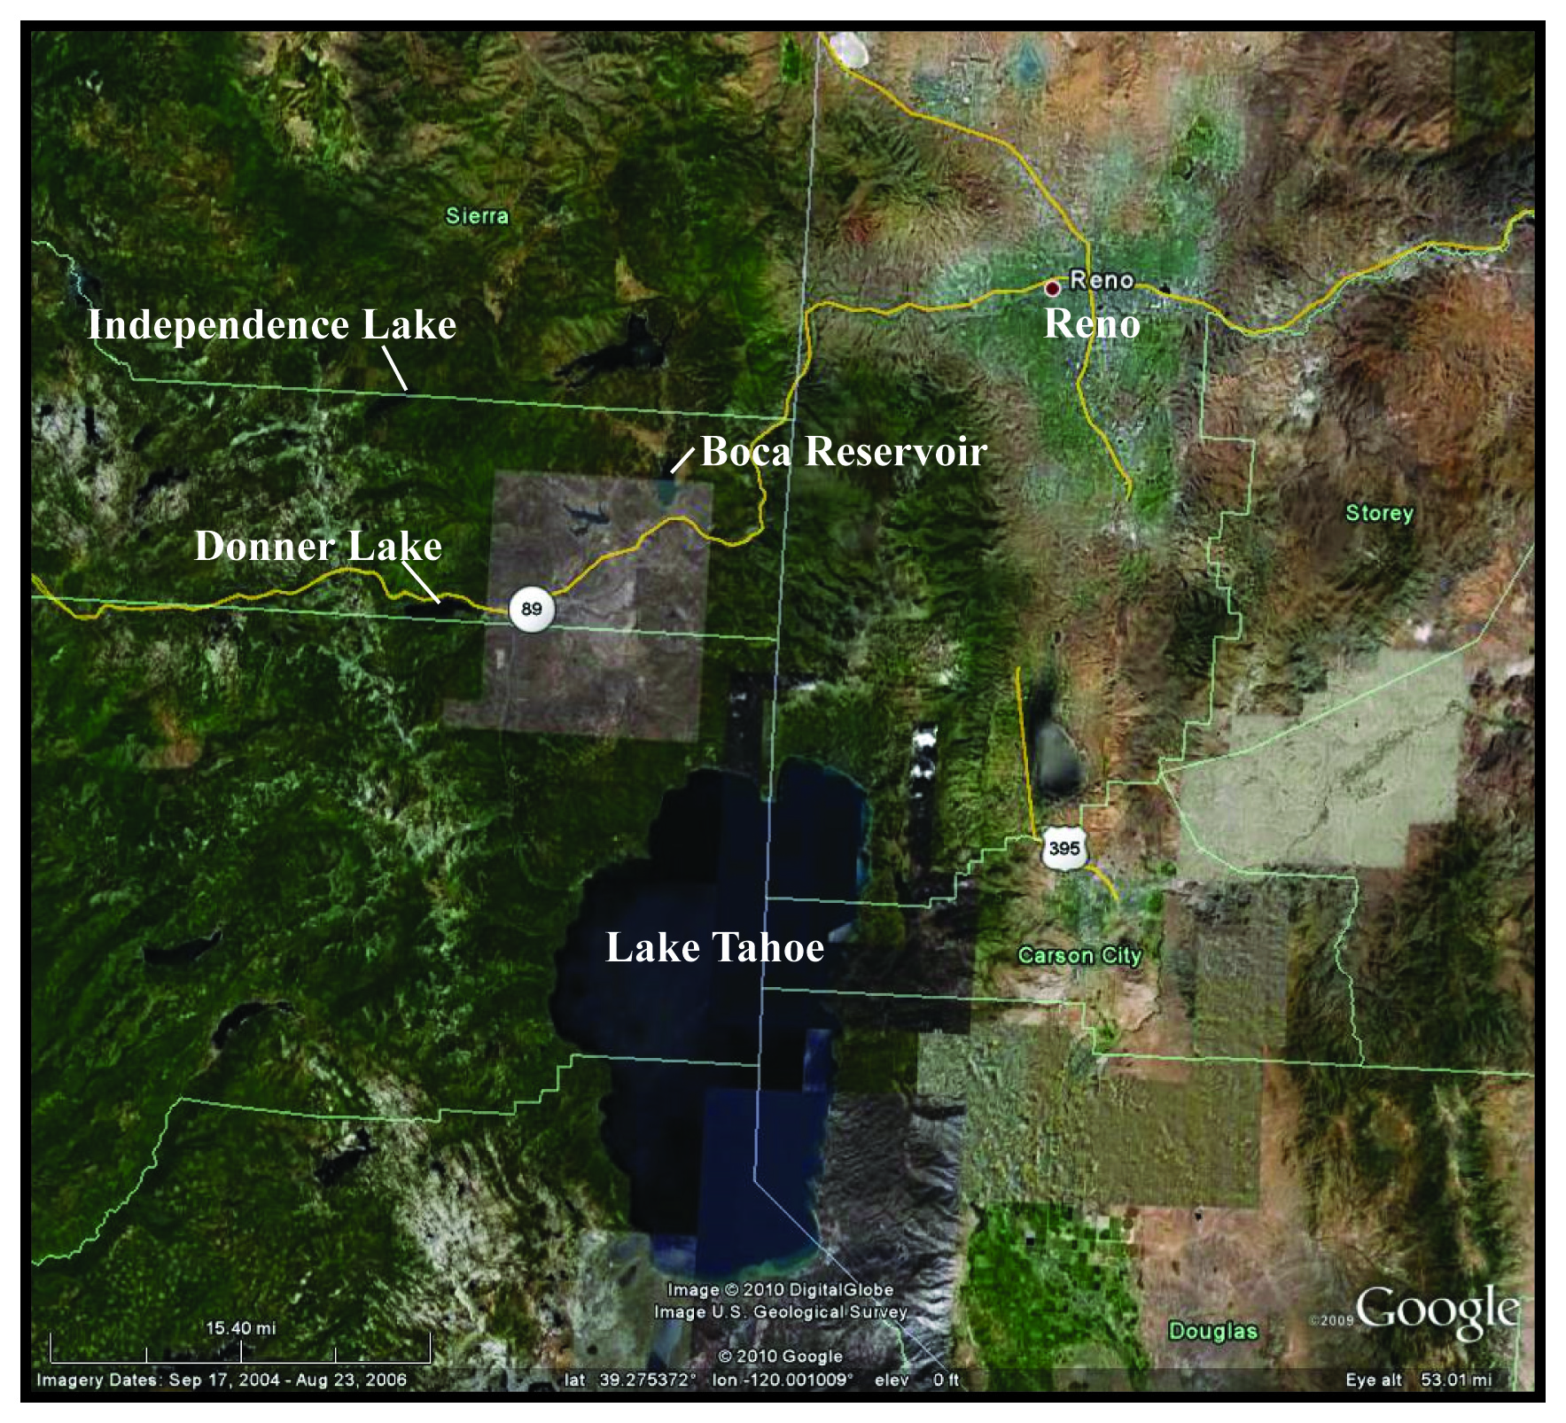
Reno, Nevada
85% Drinking Water from Truckee River
(Truckee Meadows Water Authority)
Decrease in snowpack;
Snowmelt one month earlier by 2100
(Steward et al., 2004; etc.)
Like Las Vegas in 2100
Caitlin Orem

Slide 10
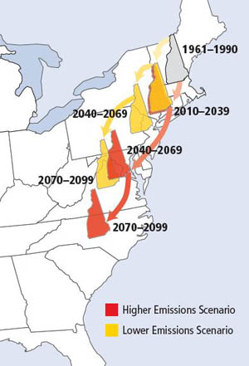
The concept:

Slide 11
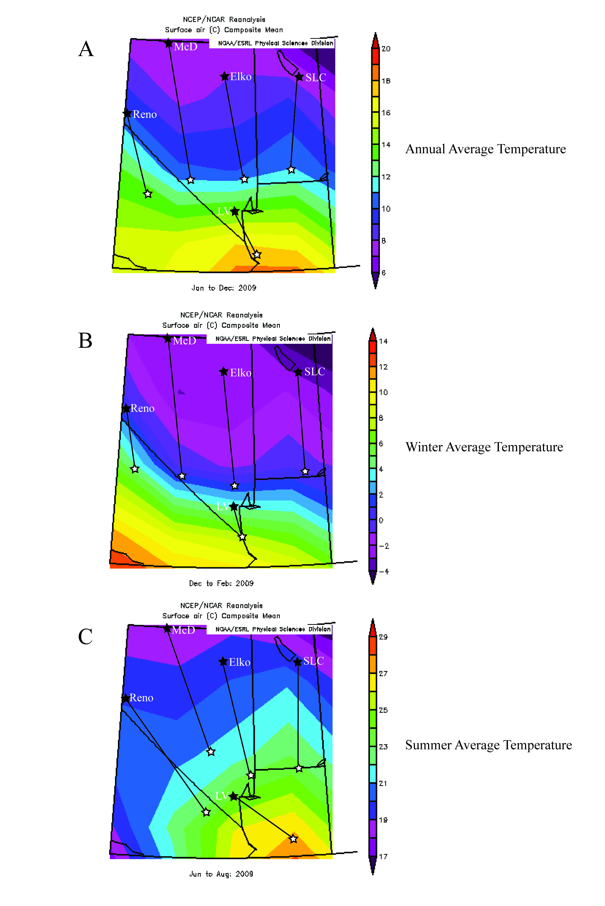
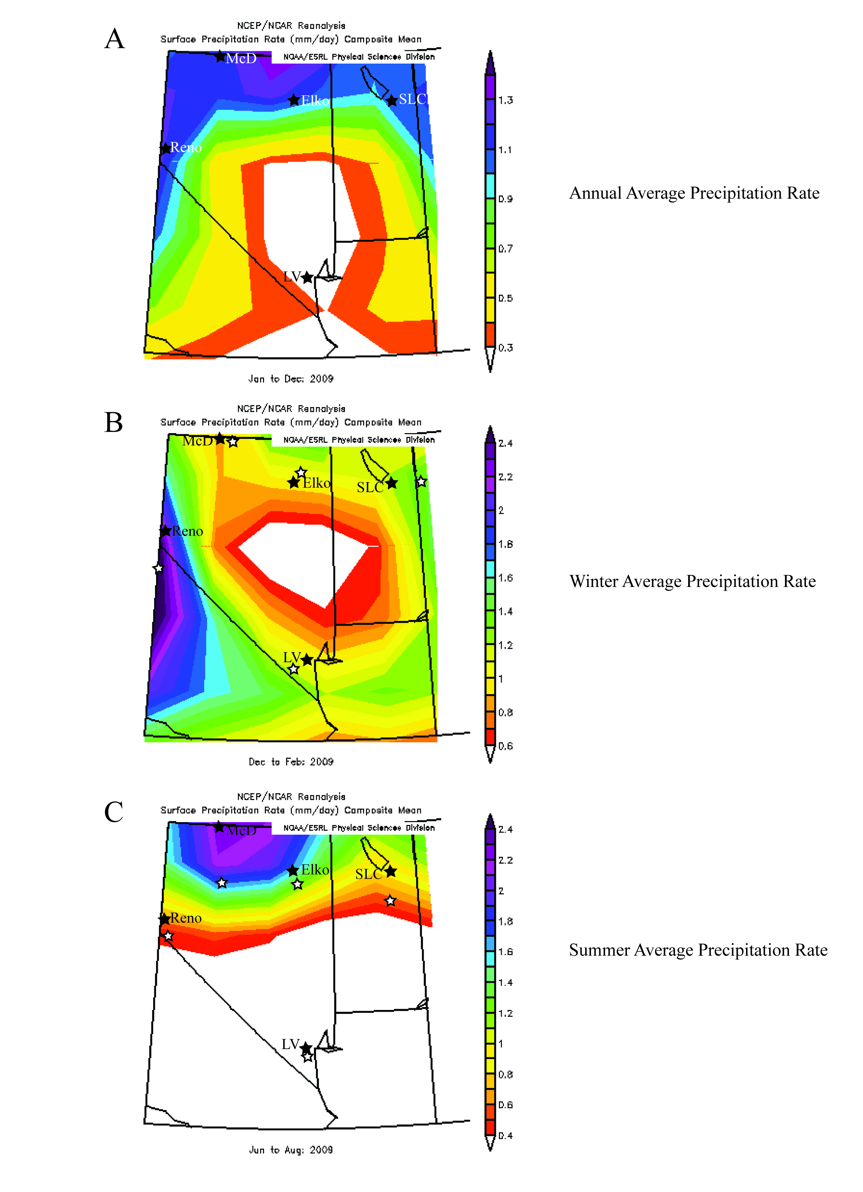
Figures from NCEP Reanalysis
Caitlin Orem

Slide 12
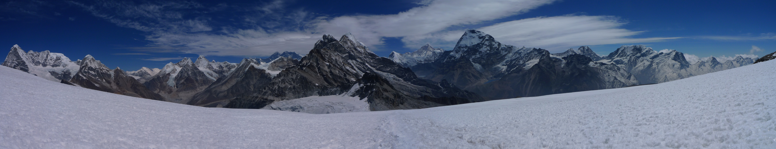
Climate Change in the Himalayas/Tibetan Plateau
Implications for glaciers and water resources
Kaspari/Cunningham photo
Matt Jenkins
Central Washington University
Notes:
I’m going to talk about CC in Him and TP
This is a photo from Susan’s most recent work in the Himalayas

Slide 13
Observed/Predicted Changes
Recently, temps are increasing at rates of 0.3°C per decade, twice the global mean.
By 2100, predicted rise of 3.8°C, compared to 2.8°C for global mean.
Overall 10% increase in precipitation.
Difficulties in modeling mountain environments.
Matt Jenkins
Notes:
TP /Himal is one of the most vulnerable regions to climate change.
You can see that with recent increases of twice the global mean per decade, and with a predicted increase of a full degree warmer than the rest of the world by 2100.
10% increase, mostly due to 19% increase during the winter.
Mountain environments are particularly difficult to model due to mostly to complex topography (different aspects, slopes, etc.).

Slide 14
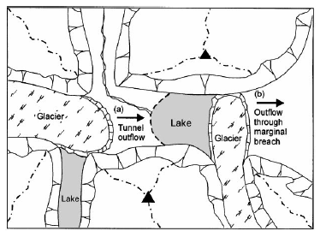
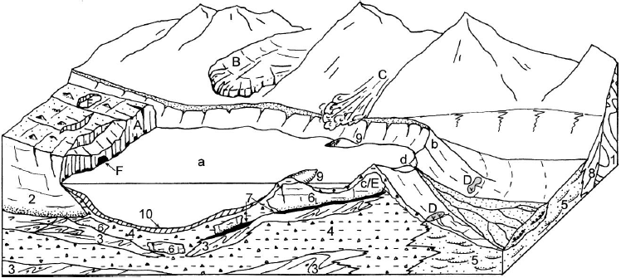
Glacial Lake Outburst Floods
Two types of glacial lakes: ice-dammed, moraine dammed.
Failure mechanisms differ for each.
From Walder and Costa (1996) in Richardson and Reynolds (2000).
Matt Jenkins
From Richardson and Reynolds (2000).
Notes:
As melting increases so does the risk of glacial hazards:
Ice-dammed: fails either by floating the ice dam or by overtopping the moraine and draining at the margins
Moraine dammed: occurs when displacement wave over-tops and erodes the dam (calving glacier, snow/ice/rock avalanches) or when the moraine collapses (seepage, melting of ice-cored, EQ). One study found that 53% of a survey of GLOFs were caused by ice avalanches from nearby glaciers or calving fronts.

Slide 15
Methods
Identify previously “unmapped” potentially dangerous glacial lakes.
Determined by:
  In a region of rapid glacial retreat.
  Ice- or moraine-dammed.
  One or more trigger mechanisms exist.
Limitations
Matt Jenkins
Notes:
Limitations: difficult to tell if populations live downstream on satellite imagery. Hard to tell “freeboard” or height to top of dam. Doesn’t appear that these have been mapped previously, but that’s probably not true.

Slide 16
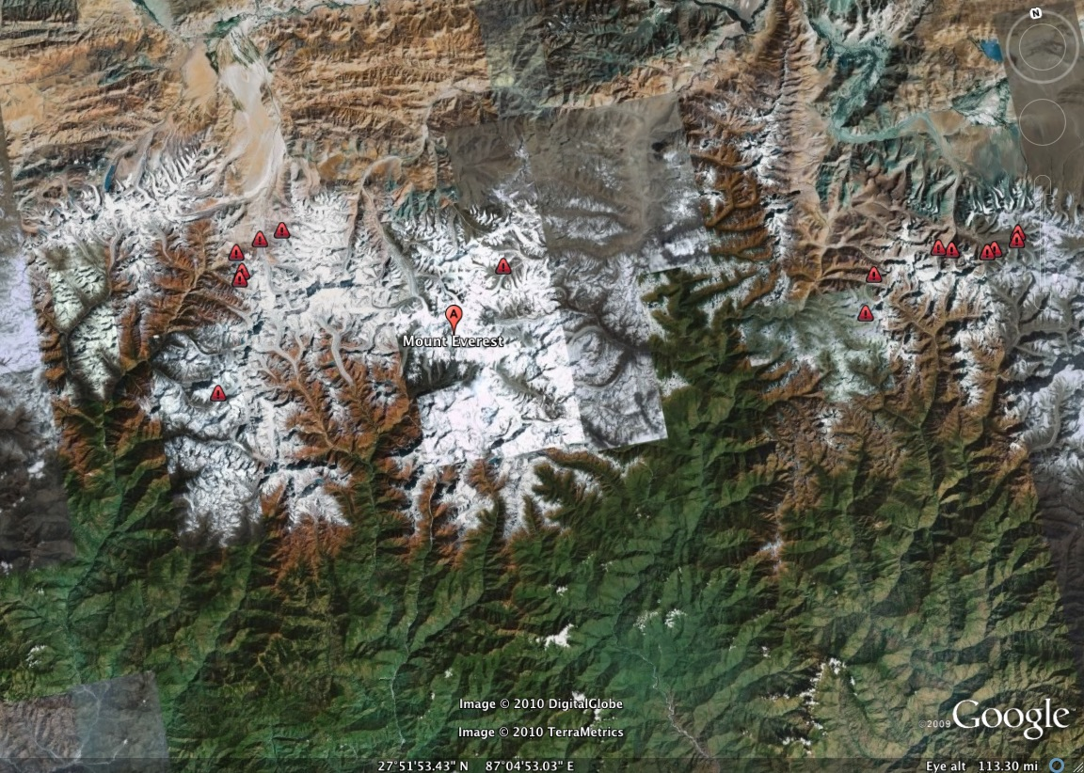
Glacial lake groups 1 through 5
4
3
1
2
5
50 km
Matt Jenkins

Slide 17
http://www.esrl.noaa.gov/psd/cgi-bin/data/composites/printpage.pl

