Slide 1

Welcome to:
Teaching About Earth's Climate Using Data and Numerical Models
A virtual workshop
October 21-22 and 25-27, 2010

Slide 2
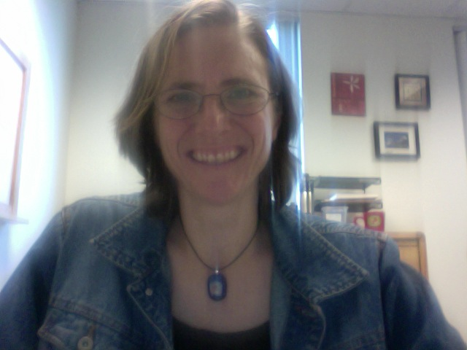
Conveners and Staff
Cindy Shellito (Colorado)
Cathy Manduca (Minnesota)
Monica Bruckner (Oregon)
Karin Kirk (Montana)

Slide 3
GOALS
Explore role of climate models in climate change research
Consider how climate models and model output can be used to teach climate change
Find data-rich resources for teaching
Develop and share strategies, activities, and assessments for using climate models and model results in the classroom
Create (or share) examples of activities or assessment plans for the Cutting Edge website

Slide 4
Participant Specified Goals
Introduce new activities/labs with paleoclimate and climate data
Give students hands-on experience with models
Find ways to introduce models (without overwhelming) students
Develop ways to assess modeling activities
Find ways to interest students, draw them in to scientific investigation

Slide 5
Schedule Overview
Day 1: Thursday, October 21
8:30 Pacific | 9:30 Mountain | 10:30 Central | 11:30 Eastern: Opening Session (2 hrs)
Cindy Shellito - Welcome - Introduction to Goals, Activities, Expected Outcomes
Monica Bruckner - Introduction to conferencing and workshop software
Talk: Jerry Meehl, NCAR - Using models to understand climate extremes and future climate changes
12:00 Pacific | 1:00 Mountain | 2:00 Central | 3:00 Eastern: Teaching with Climate Models (1 hr)
Talk: Bob MacKay, Clark College - Introducing students to climate models

Slide 6
Schedule Overview
Day 2: Friday, October 22
8:00 Pacific | 9:00 Mountain | 10:00 Central | 11:00 Eastern: Teaching with Numerical Models (2 hrs)
Short talks from participants: Examples of using numerical models/data in the classroom
10:00 Pacific | 11:00 Mountain | 12:00 Central | 1:00 Eastern (2 hrs)
Break and opportunity to explore/investigate models introduced by speakers - or others - available online
12:00 Pacific| 1:00 Mountain | 2:00 Central | 3:00 Eastern (1 hr)
Talk: Developing activities and assessments - Things to keep in mind

Slide 7
Schedule Overview
Day 3: Monday, October 25
8:30 Pacific | 9:30 Mountain | 10:30 Central | 11:30 Eastern: Opening Session (1 hr)
Review of activities/assessments (work individually to review work of other members in your group, then answer review questions)
9:30 Pacific | 10:30 Mountain | 11:30 Central | 12:30 Eastern: Opening Session (1 hr)
Be available to discuss your thoughts on the activity with the author of the work you reviewed
10:30 Pacific | 11:30 Mountain | 12:30 Central | 1:30 Eastern: Opening Session (1 hr)
Talk/synchronous discussion: How do we do research on our own teaching? How do we assess effectiveness of our activities
Afternoon: Revision of activities/assessments

Slide 8
Schedule Overview
Day 4: Tuesday, October 26
10:00 Pacific | 11:00 Mountain | 12:00 Central | 1:00 Eastern
Group Discussion : Opportunity for reflection: What have you learned? What do we still need to work on, as a group, in developing or utilizing materials to promote understanding of models and climate change?
Revise activities and work on assessments - post all finalized materials by 10am Wednesday morning.
Day 5: Wednesday, October 27
10:00 Pacific | 11:00 Mountain | 12:00 Central | 1:00 Eastern (2 hrs)
Post revised activities and assessments
Group Discussion: Wrap-up and next steps; Workshop evaluation; How to do activity reflections

Slide 9
Expectations
Come to all synchronous sessions
Participate at least once in each discussion thread
Contribute an activity idea and develop that activity
Review activities written by others
Contribute resources/references/websites
Provide feedback during the workshop and an evaluation at end

Slide 10
Workshop Outcomes
A new set of resources for teaching climate change
Collaborations in the development, implementation or assessment of new activities
**Let us know if you’d like a letter detailing your participation.

Slide 11
Things to do right now:
Listen as Monica fills us in on the workshop software and website
Introduce yourself!
Set up an activity page (if haven’t already done so)
Begin contributing resources

