Slide 1
Using EdGCM in the Classroom
Achim D. Herrmann
Barrett, the Honors College
School of Earth and Space Exploration
Arizona State University

Slide 2
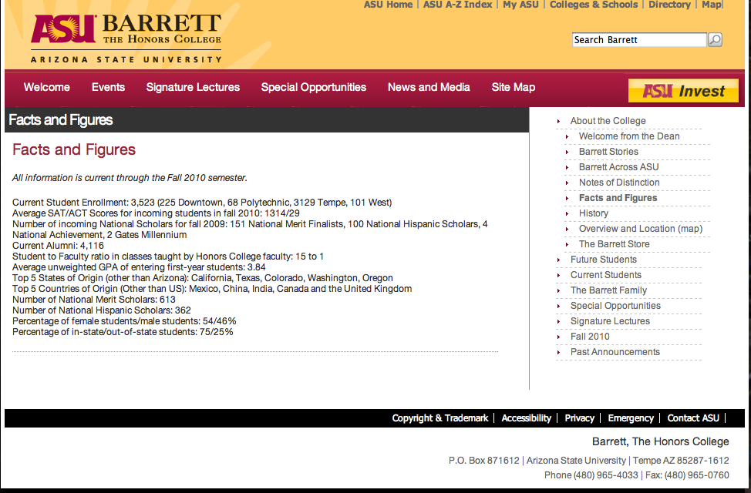
Barrett, the Honors College

Slide 3
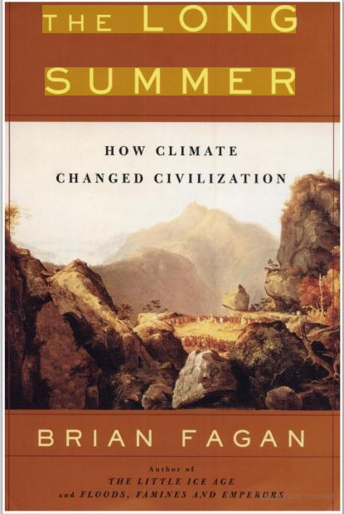
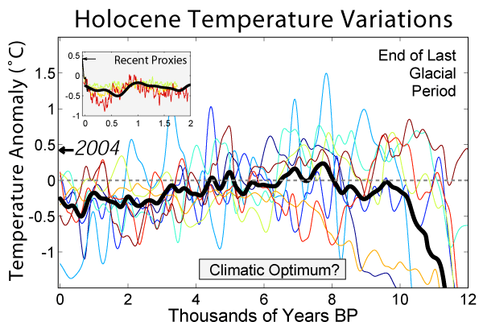
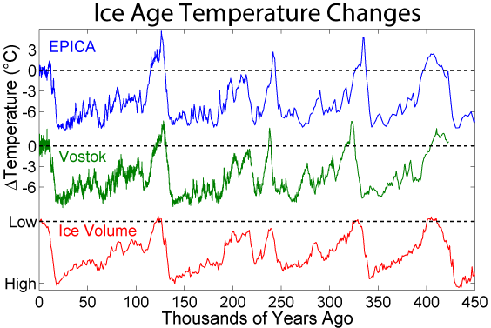
Human evolution and climate change
http://www.globalwarmingart.com/wiki/Image:Ice_Age_Temperature_png

Slide 4
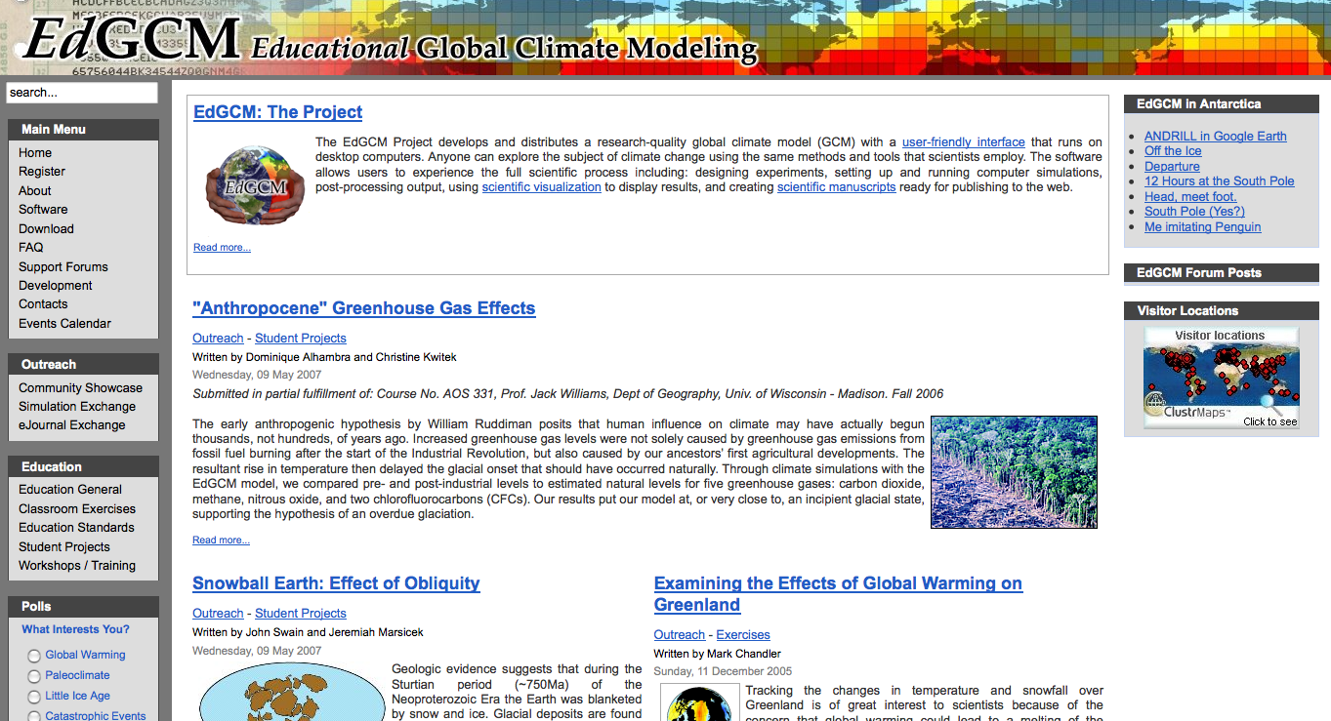
Project – doing science …

