Slide 1
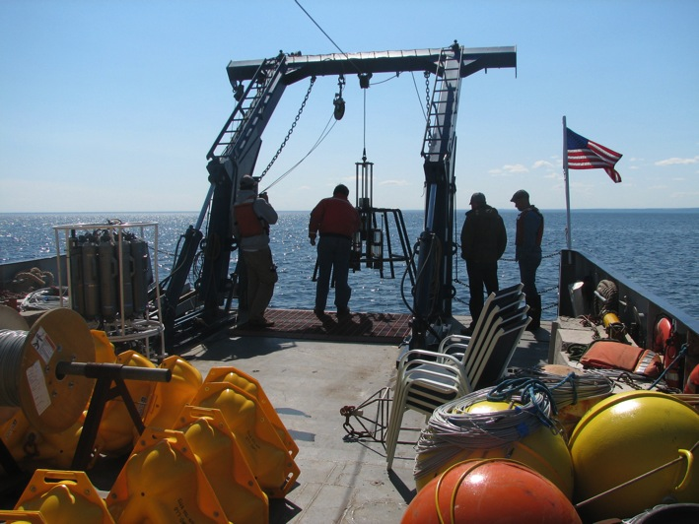


The Large Lakes Observatory and
The Science of Freshwater
Inland Seas
Steve Colman
Large Lakes Observatory
University of Minnesota Duluth
Notes:
Title slide

Slide 2
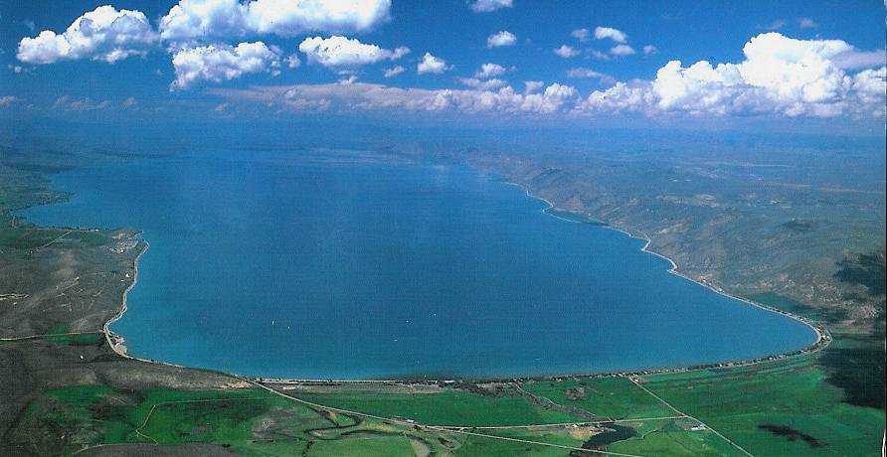
LLO and its Multiple Missions
Founded in 1994, largest academic program in limnology in the country
Unit of the Swenson College of Science and Engineering, UMD
Faculty have split appointments with LLO and other academic departments
Missions:
  Research dedicated to the science of inland seas
  Graduate program in limnology and oceanography,
  Undergraduate education, in partnership with UMD departments

Slide 3
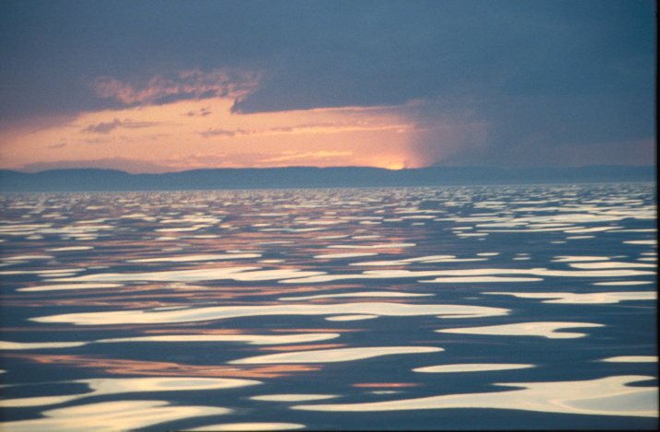
LLO is Unique
Focus on oceanographic research methods applied to inland seas
Global perspective: Large lakes of the world

Slide 4
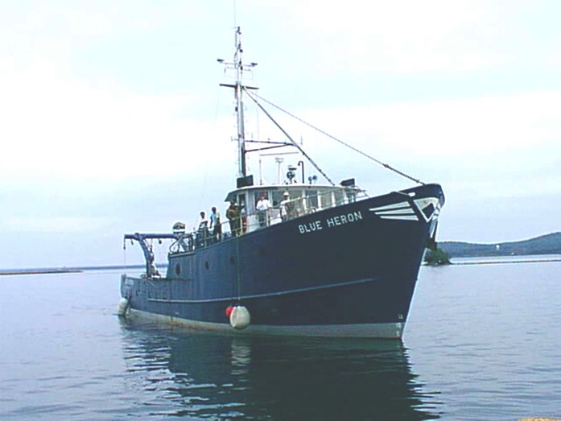
The Blue Heron
Largest university-owned research vessel on the Laurentian Great Lakes
Berths for 11
Part of the University National Oceanographic Laboratory System
Multiple types of SONAR, Seabird CTD & niskin bottle carousel, flow-through water system, corers, plankton nets, trawling capability

Slide 5
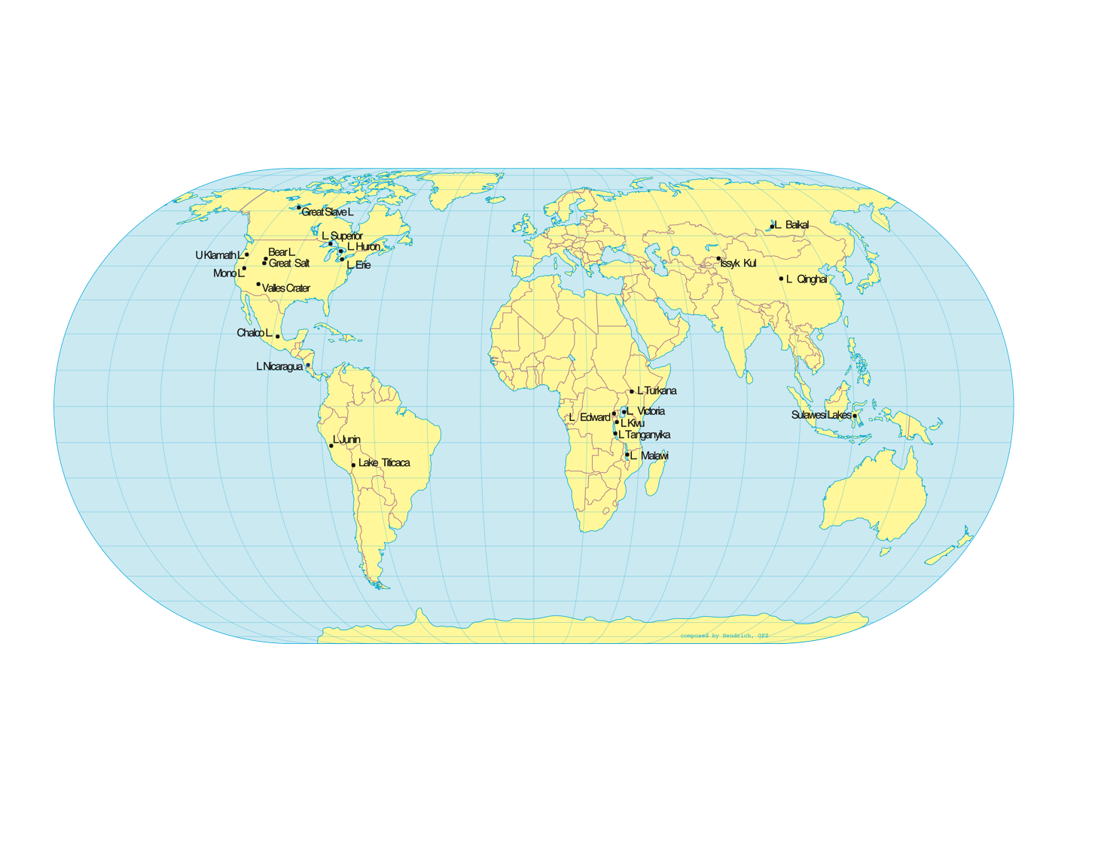
LLO’s Research Sites

Slide 6
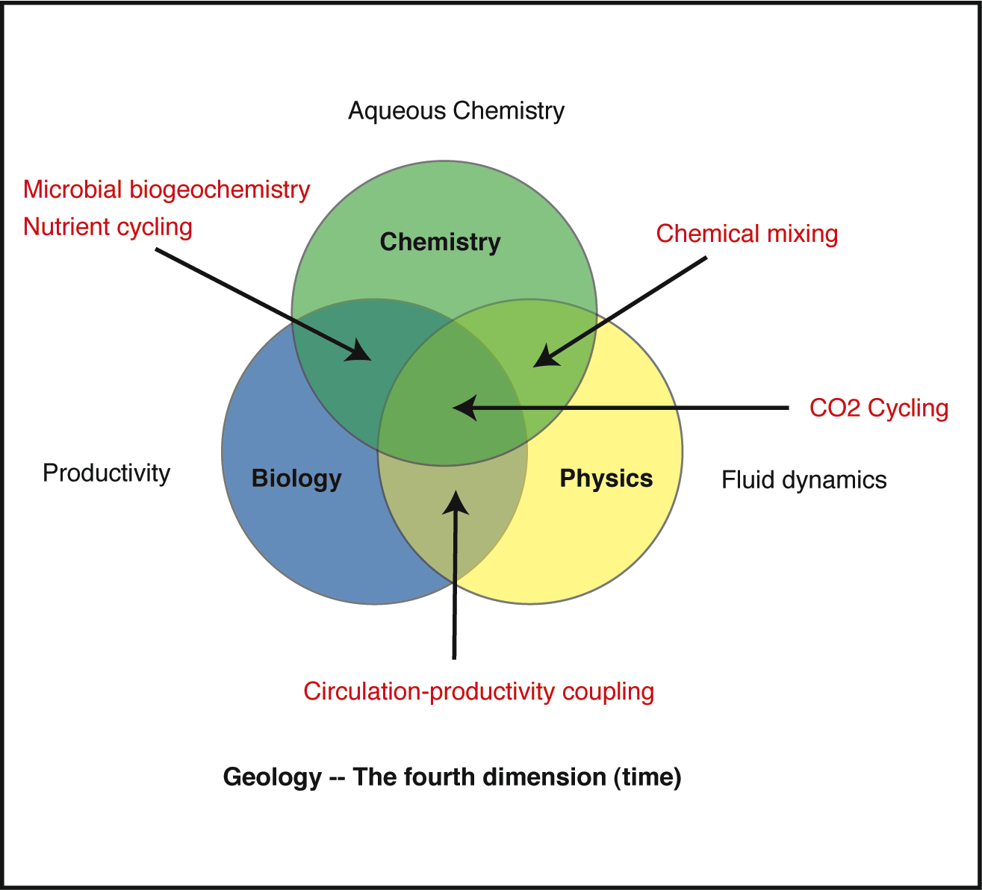
Interdisciplinary Research at LLO
Mathematics-- The foundation of all

Slide 7
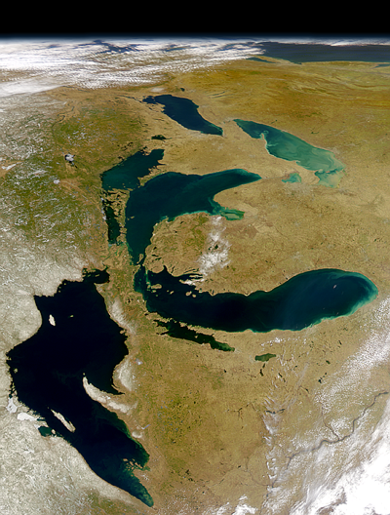
Satellite photo, why basic
Why basic research?
We need to understand how large lakes work
To be effective guardians
To anticipate and respond to surprises
To use them effectively
  Transportation
  Fisheries, commercial and sport
  Recreation
  Water supply

Slide 8
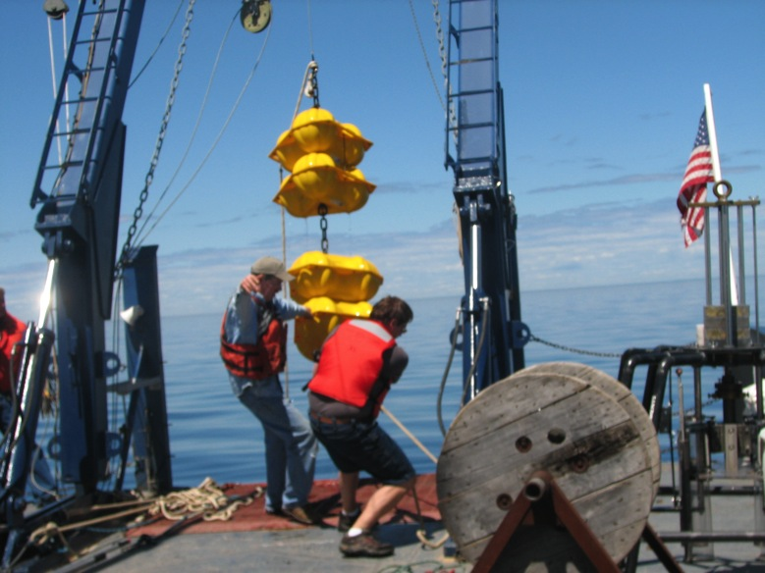
Great Lakes agencies and GLOS
GLOS: part of IOOS
  Focused on monitoring
  LLO maintains moorings and deploys an autonomous glider as part of this effort
  Also does modeling work

Slide 9
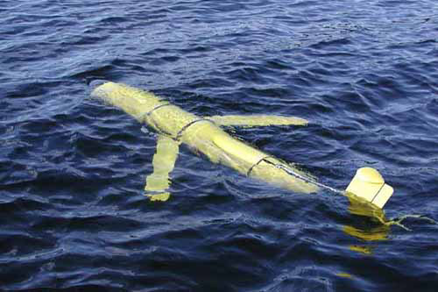
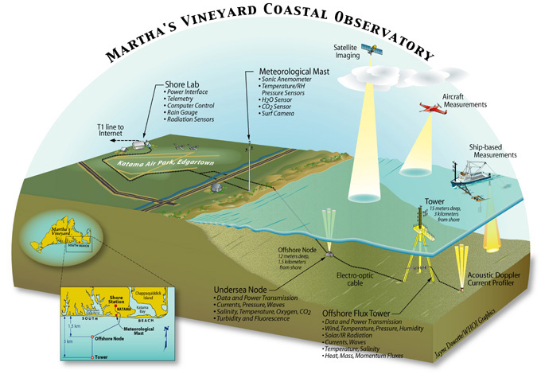
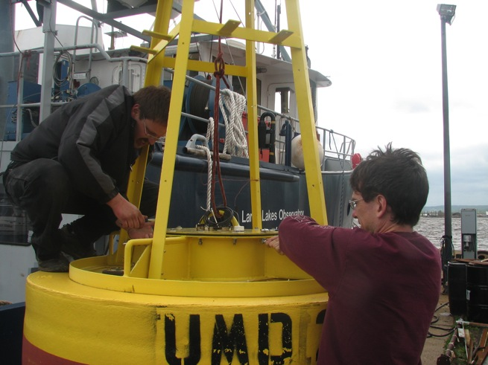
Coastal Observatories

Slide 10
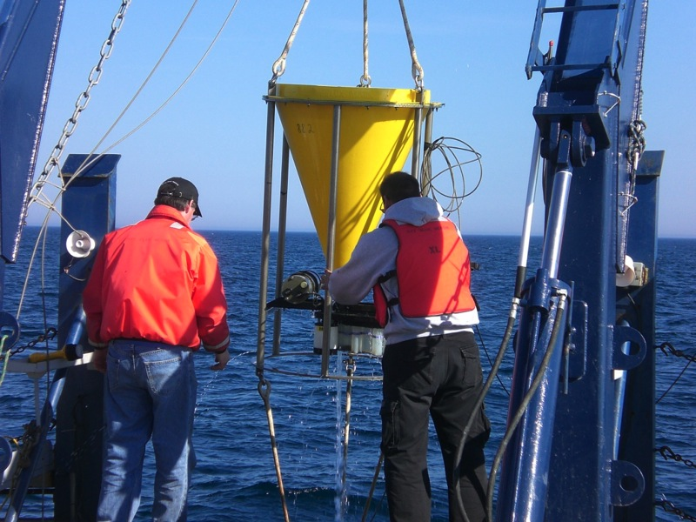

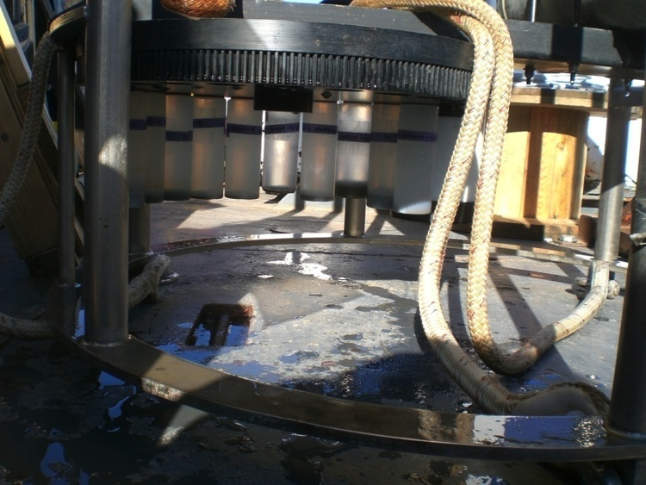
Some techniques for assessing lake productivity
Sediment traps similar to this one deployed in Lake Superior are being moored in Lake Malawi for several years
Sedimenting particles from phytoplankton productivity are collected sequentially
Notes:
10

Slide 11
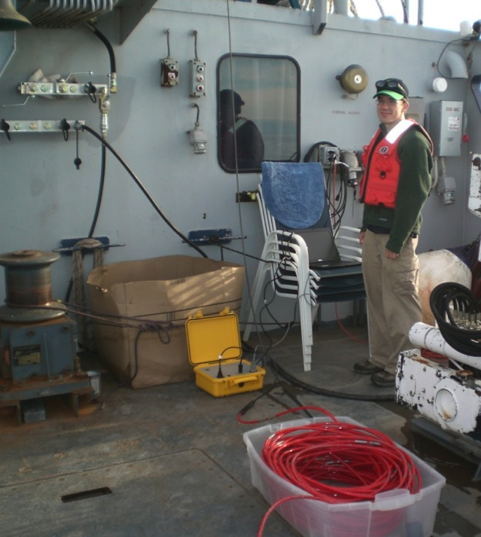
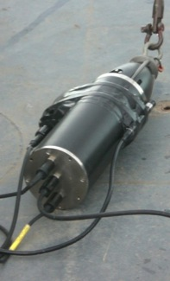
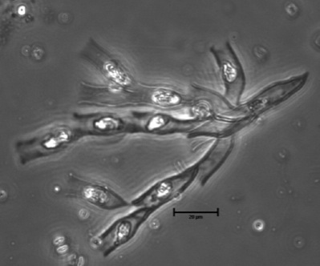
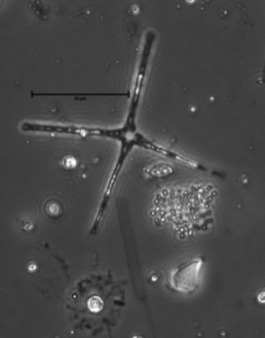
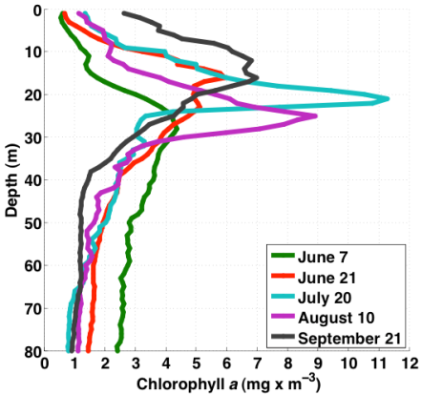
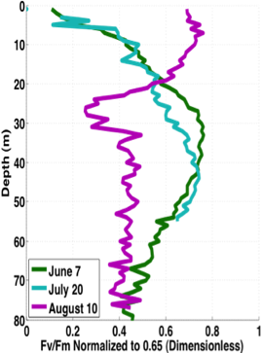
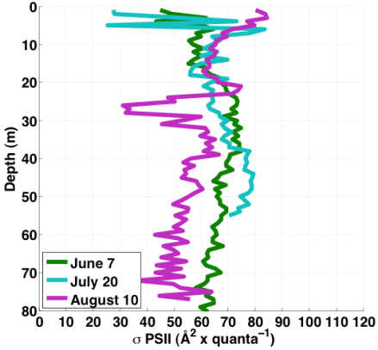
In-situ fluorometry used to estimate phytoplankton composition & productivity
Some of the instruments we use include FluoroProbe, Fast Repetition Rate Fluorometer, Flow Cytometer and Inverted Microscopy
Notes:
11

Slide 12
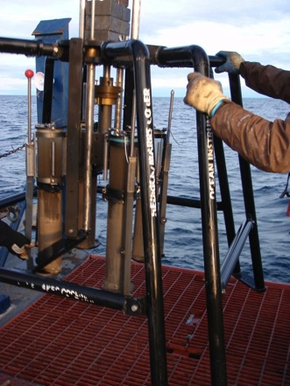
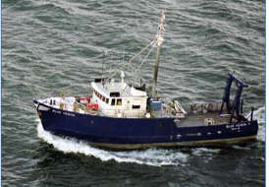
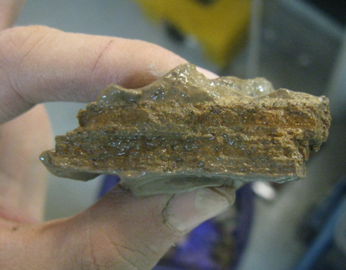
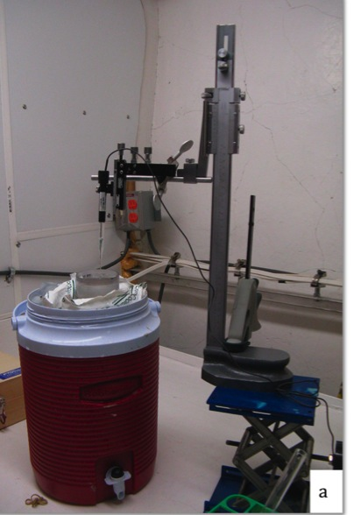
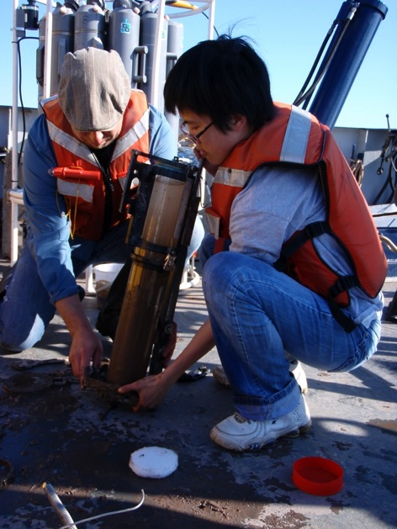
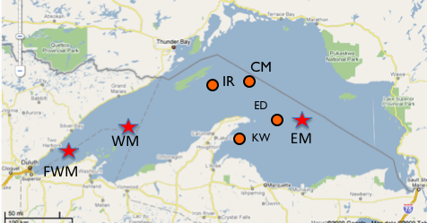
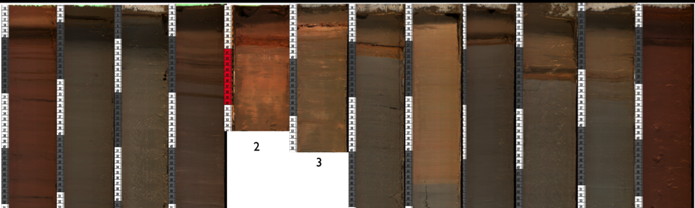
Sediment geochemistry in Lake Superior
Notes:
12

Slide 13
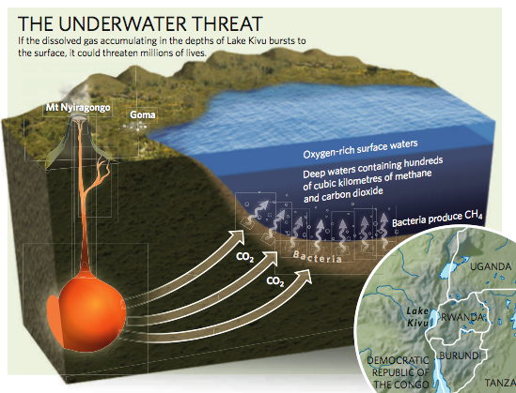
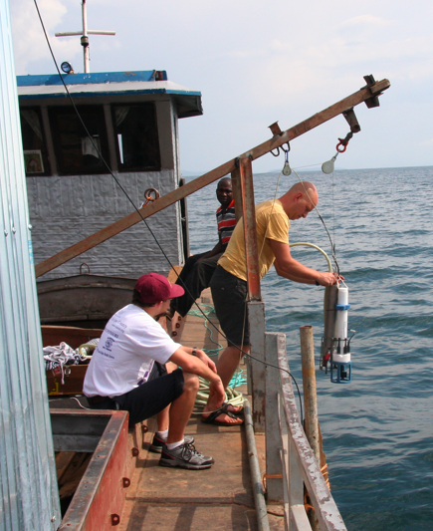
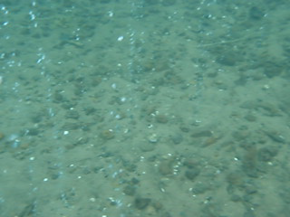
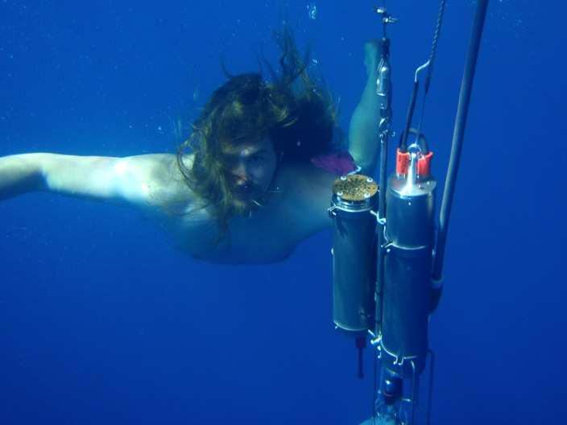
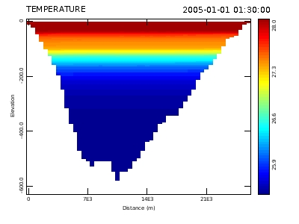
Physics and geochemistry of stratified tropical lakes
L. Kivu (Rwanda)
L. Matano (Indonesia)
L. Malawi (Malawi)

Slide 14
Some recent discoveries
Understanding the heat, carbon, and nutrient budgets of Lake Superior
  Circulation and ice modeling
  Radiocarbon budgets
  Fluxes at the sediment surface
Using Crenarchaeota lipids to investigate past lake temperatures
Mapping of lake floor features
Notes:
14

Slide 15
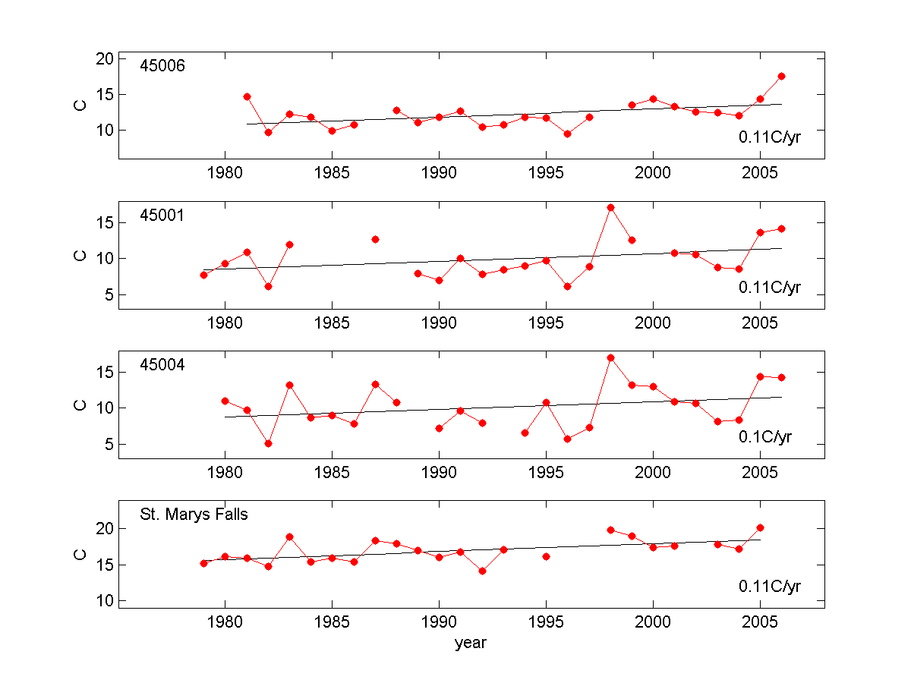
Lake Superior temperature trends

Slide 16
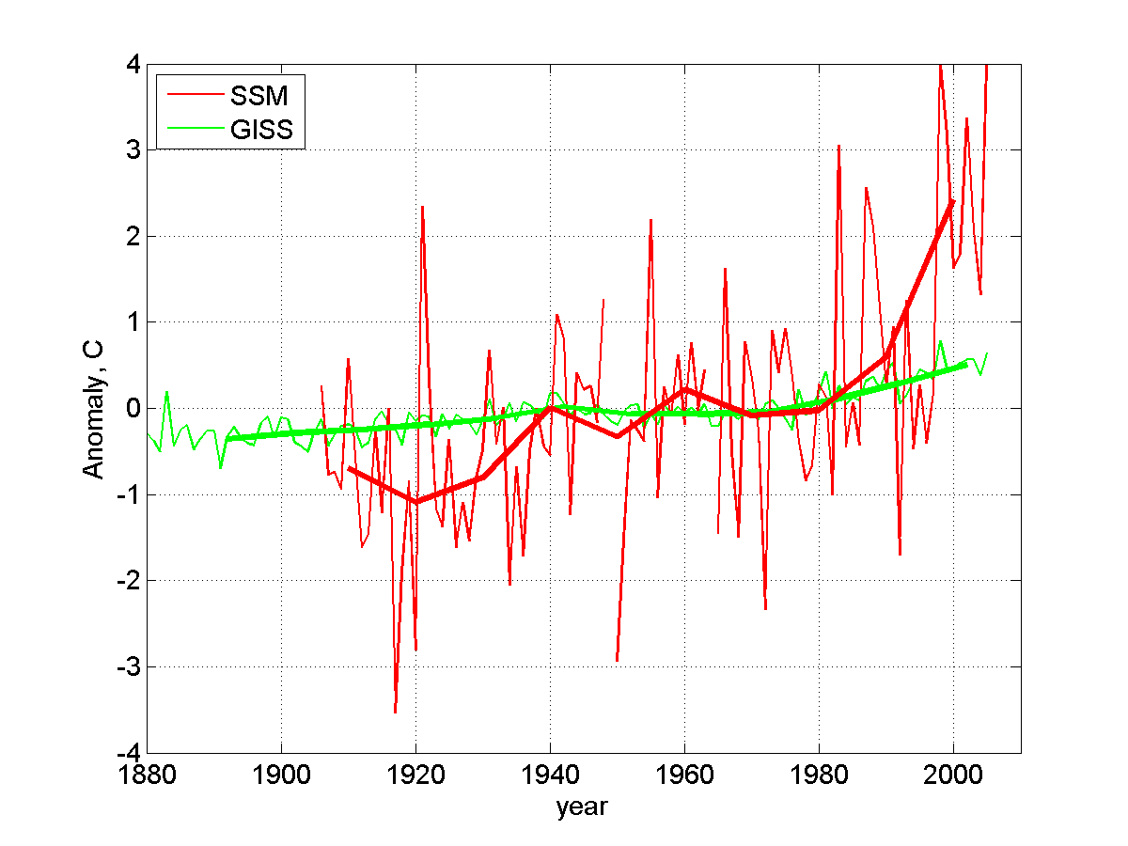

Slide 17
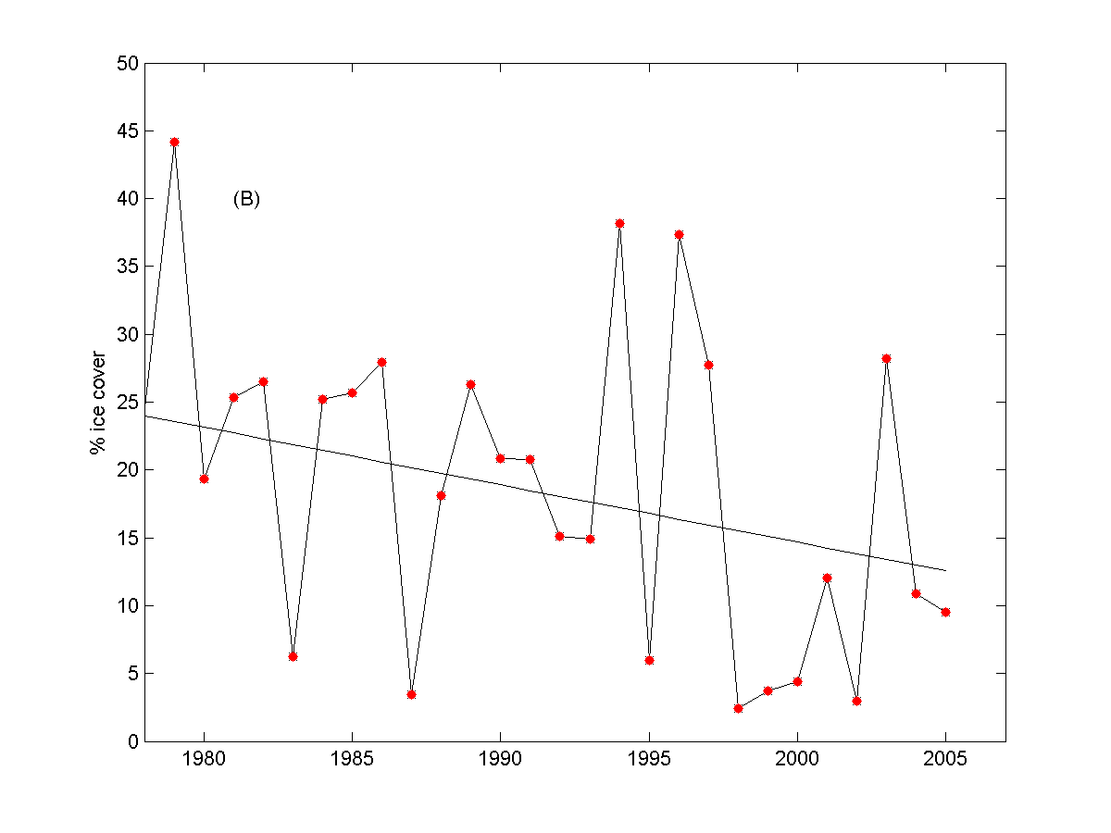
What about Ice?
Mean ice cover decreasing steadily over period of record:
~0.42%/yr

Slide 18
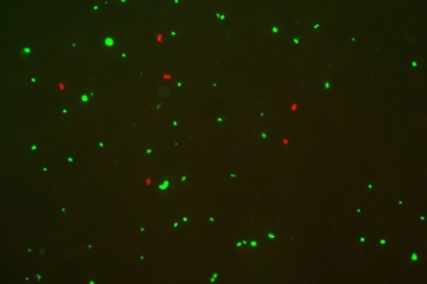
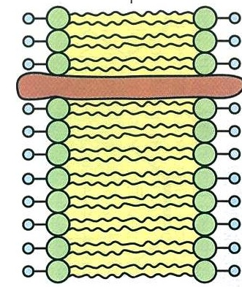
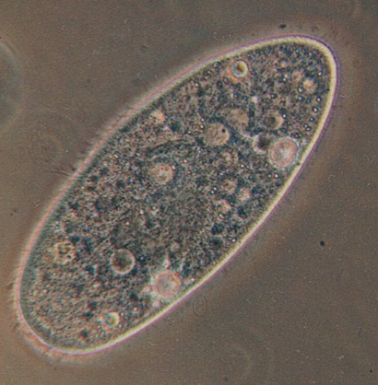
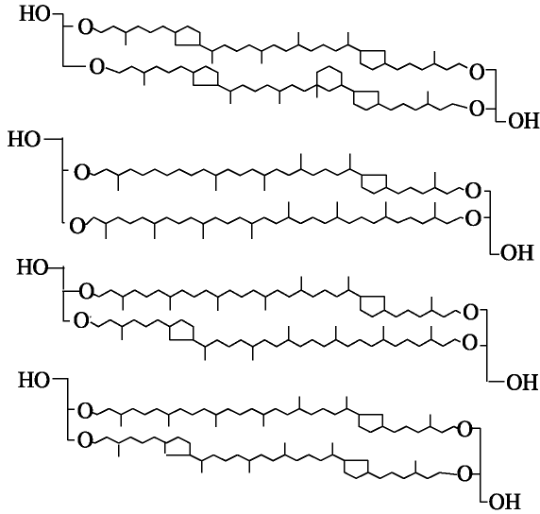
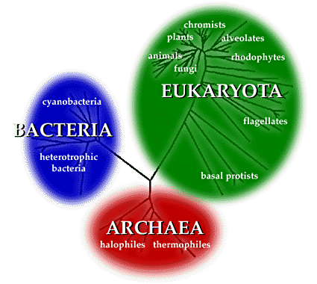
Crenarchaeota
marine Crenarchaeota (<1 μm)
bacteria
Hydrophilic head groups
Hydrophilic head groups
Hydrophobic interior
Slide courtesy of Johan Weijers

Slide 19
TEX₈₆ Global Lake Calibration
Mean Square Error = + 2 ºC
Powers et al. 2004

Slide 20
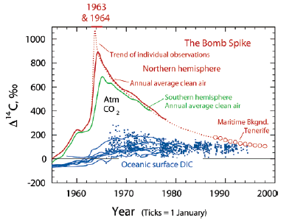
Radiocarbon and Lake Superior’s carbon cycle
McNichol and Aluwihare, 2007
Atmospheric Δ¹⁴C (2009) = 38‰
Lake Superior surface DIC Δ¹⁴C (2009) = 56.2 to 60.9‰

Slide 21
2009 corn Δ¹⁴C = 38±2

Slide 22
2009 corn Δ¹⁴C = 38±2

Slide 23
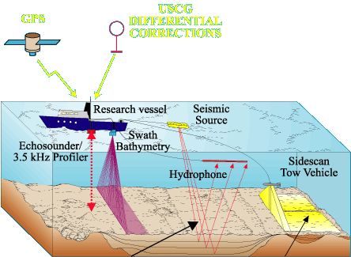
Sea Floor Mapping Tools
Surficial and Sub-bottom Systems
Sidescan-sonar
Seismic Reflection
Swath Bathymetry
Notes:
23

Slide 24
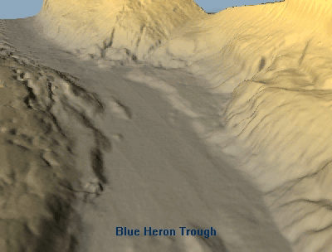
Blue Heron Trough
Notes:
24

Slide 25
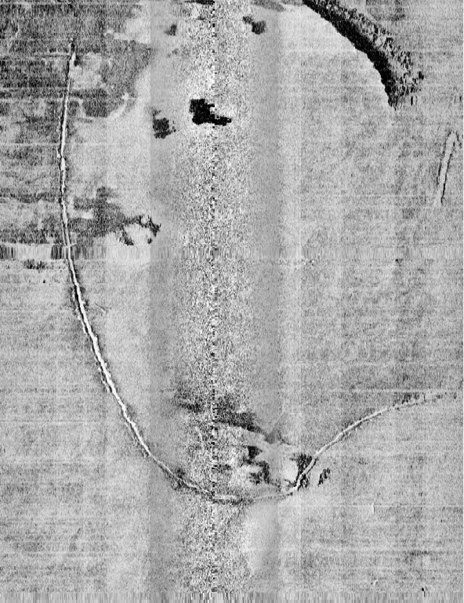
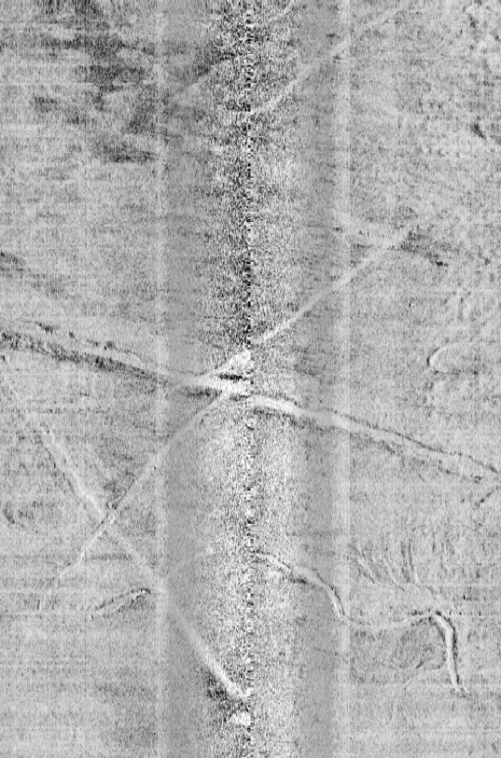
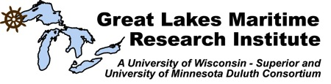
Sidescan sonar images, off Superior Entry
N
Sand wave
field
Glacial deposit
outcrop
100m
N
100m
Anchor drag marks
Notes:
25
Title slide

Slide 26
Current LLO projects include
Studying the role of zooplankton migration and its effects on Lake Superior’s chlorophyll maximum
Looking at the effects of climate change on Lake Malawi’s productivity
Investigating the climate change history of the Tibetan Plateau
Identifying methane resources and hazards in Lake Kivu

Slide 27
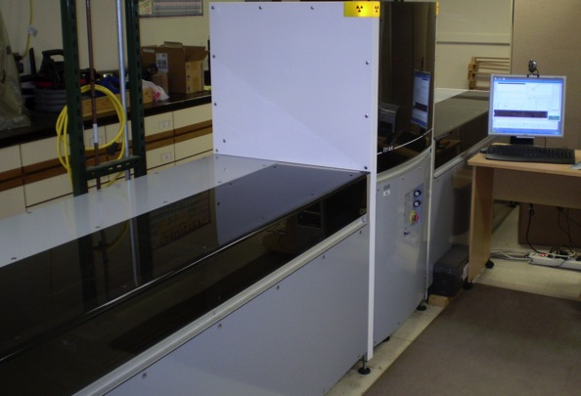
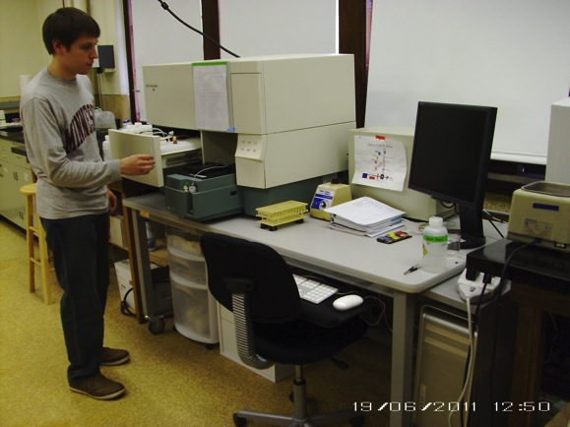
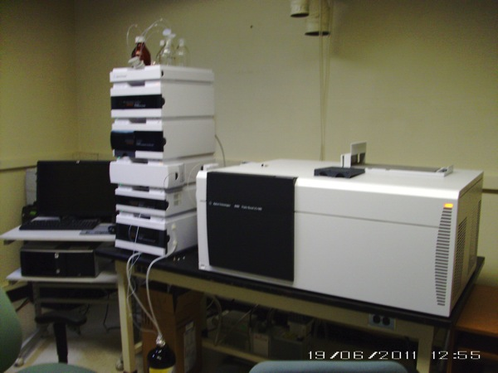
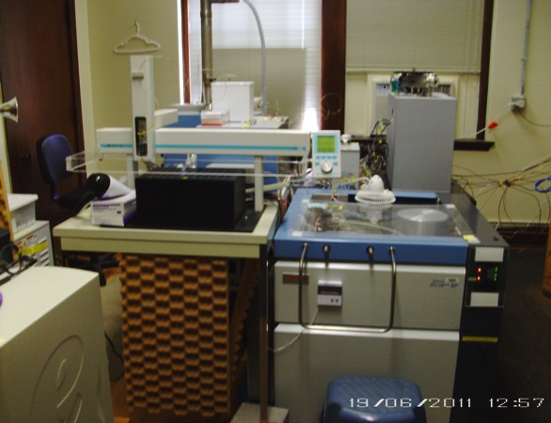
LLO facilities
Flow cytometer
(BD FACSCaliber)
Itrax XRF scanner
IR-MS (ThermoFinnegan
Delta Plus XP)
LC-MS(Agilent triplequad)

Slide 28

Lake Effect
Thank you!

