Slide 1
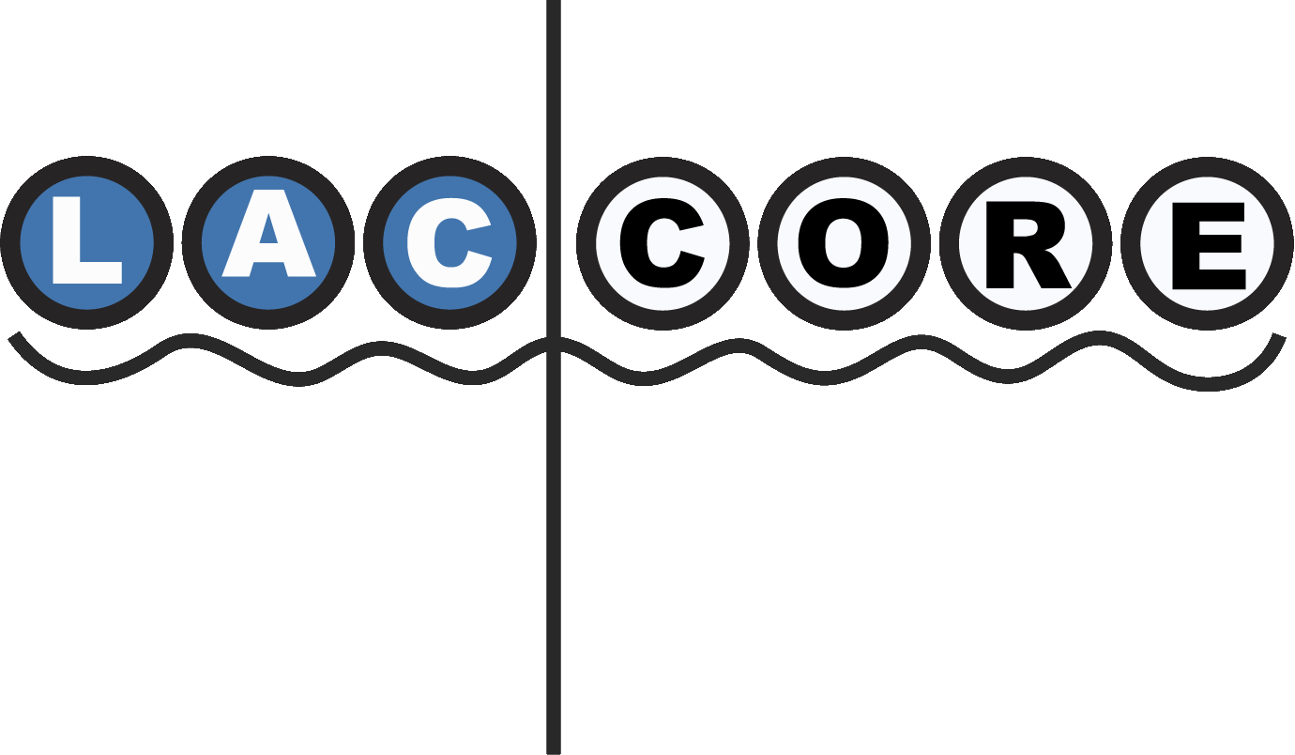

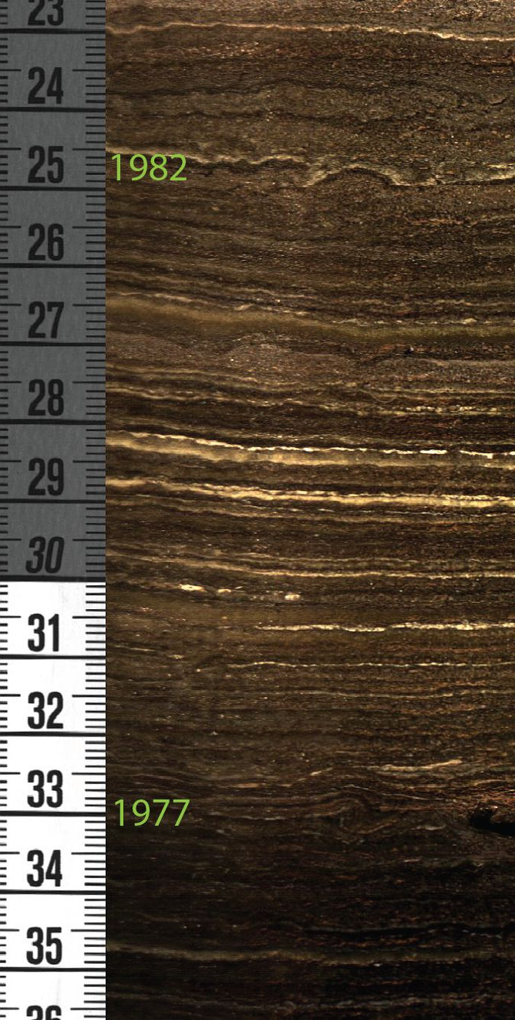
Neopaleolimnology of urban and suburban lakes in multidisciplinary geoscience education, training, and outreach
Amy Myrbo
LacCore/Limnological Research Center
Department of Earth Sciences
University of Minnesota – Minneapolis
INQUA/SERC Workshop, June 20, 2012
Please do not distribute or use any of these slides without express permission

Slide 2
What do I mean by . . . ?
“Neopaleolimnology”
“Urban and Suburban”
“Geoscience”

Slide 3
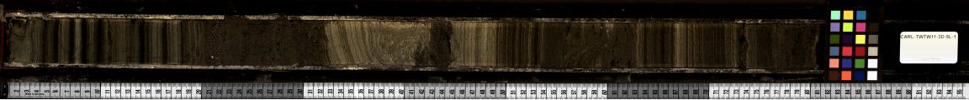
2011
~10,000 yr ago

Slide 4
Neopaleolimnology
~10,000 yr ago

Slide 5
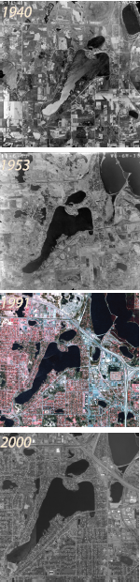
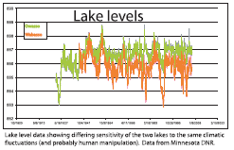
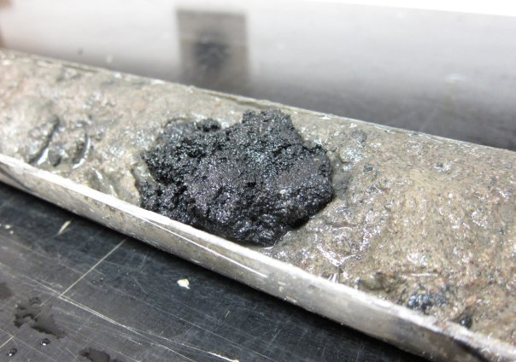
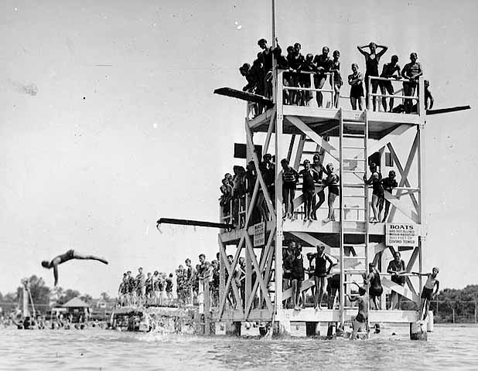
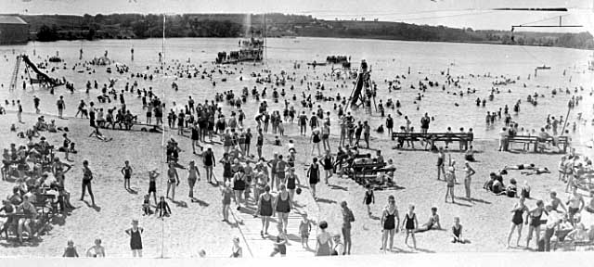
Historical context; neopaleolimnology
Plat maps etc.

Slide 6
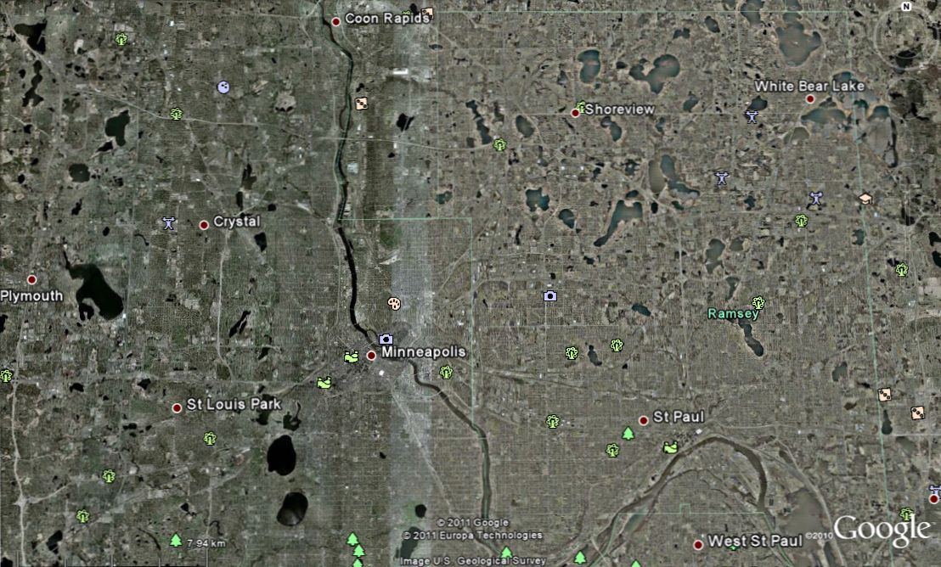
Urban and suburban lakes
Focal points of communities . . .
. . . and remediation efforts
Really any lake that has a relationship with people

Slide 7
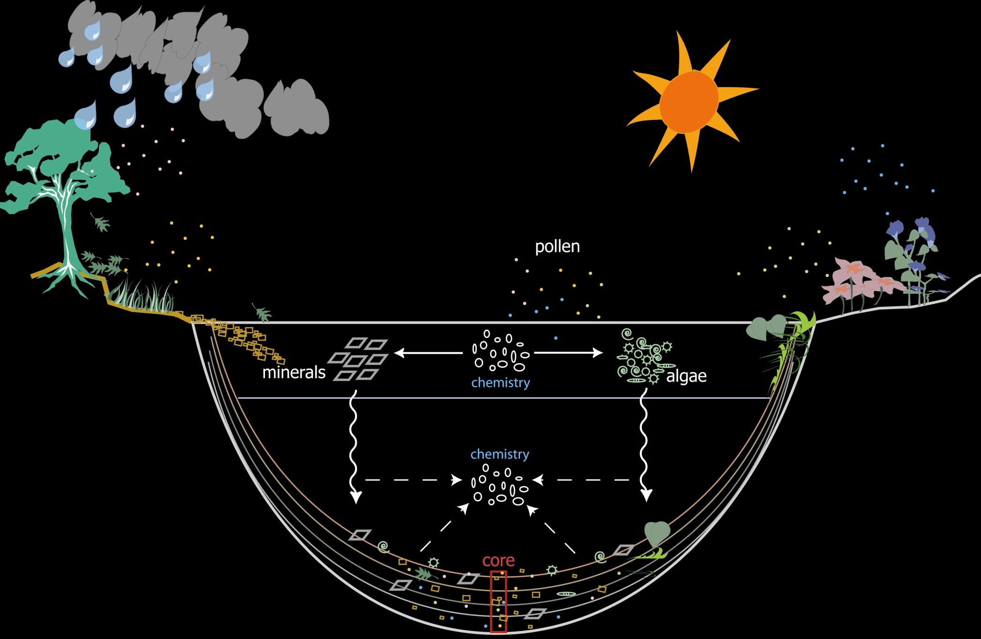
Geoscience

Slide 8
Lakes as recorders of their environments
core
Younger (newer) mud at top
Older mud at bottom

Slide 9
Why lakes?
Familiar landscape features
Integrating scientific disciplines and liberal arts
Scalable to grade level and time available

Slide 10
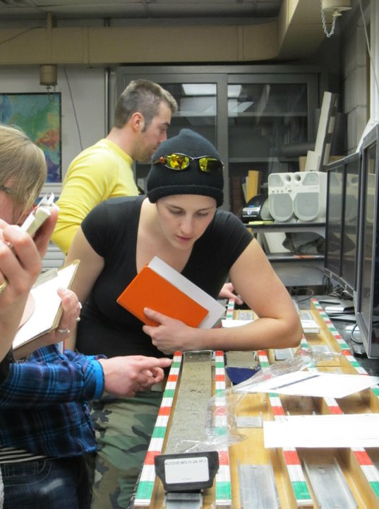
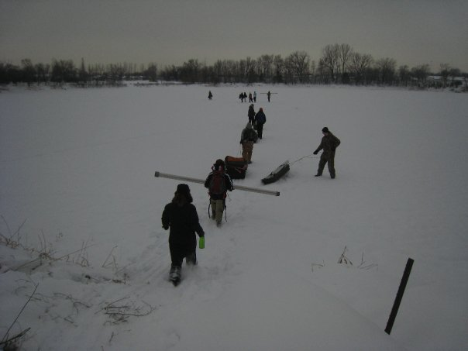
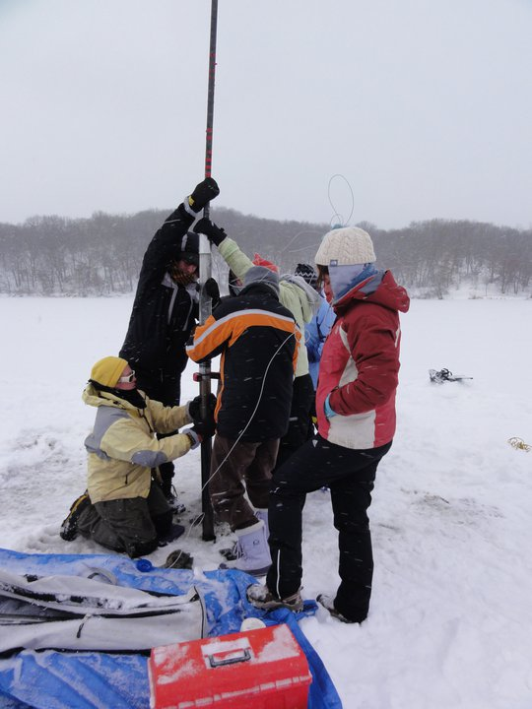
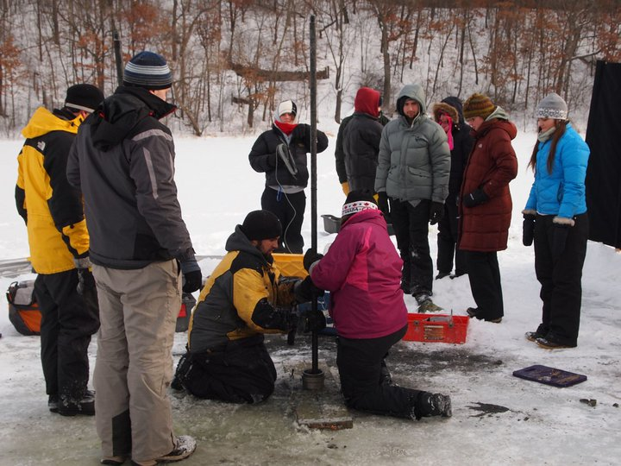
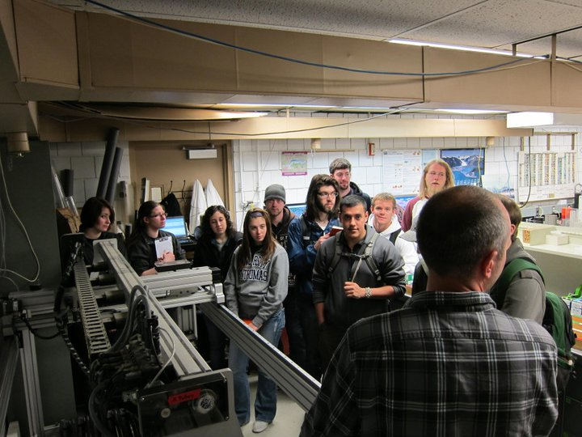
St. Cloud State
Macalester
Gustavus
Carleton
St. Thomas

Slide 11
How-to
Lake choice: interesting questions
Hypotheses: think about sedimentary processes
Transects: teaching facies
Chronology: critical!
Analyses: keep it simple
Group poster session: leave enough time
Support available from LacCore

Slide 12
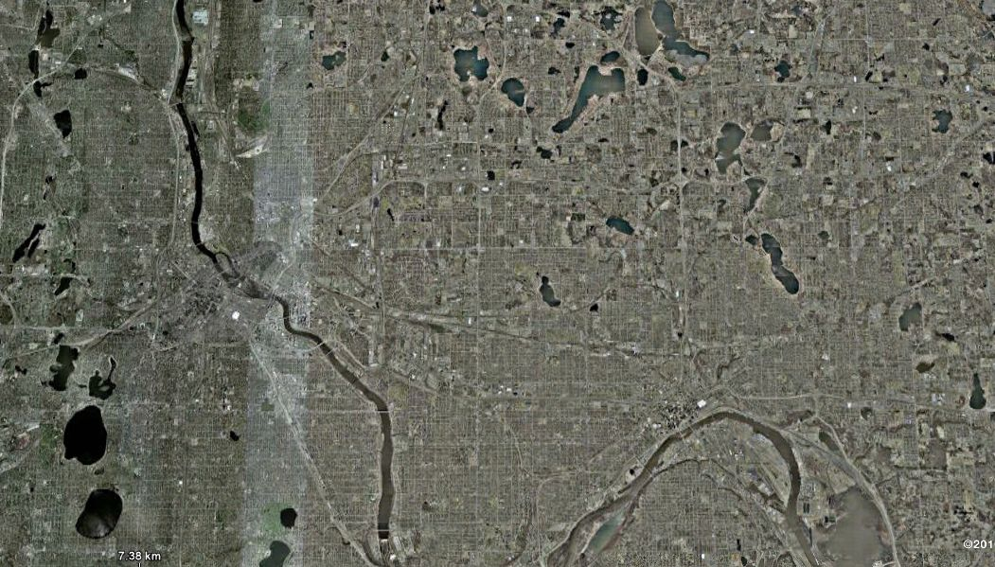
Core Lab Workshop
Owasso & Wabasso
Twin
McCarrons
Brownie
Tanners
Harriet

Slide 13
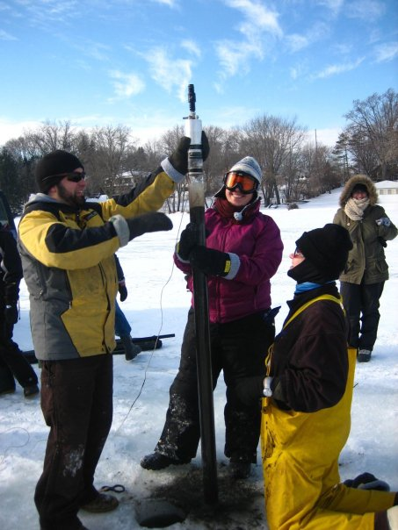
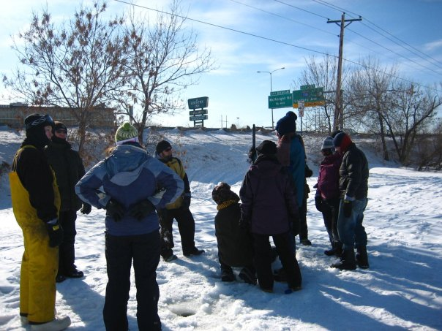
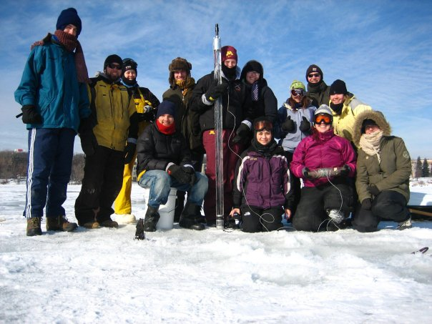

Slide 14
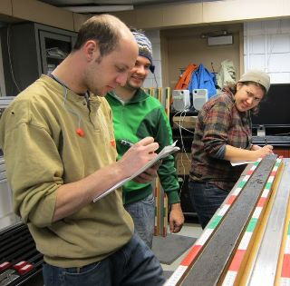
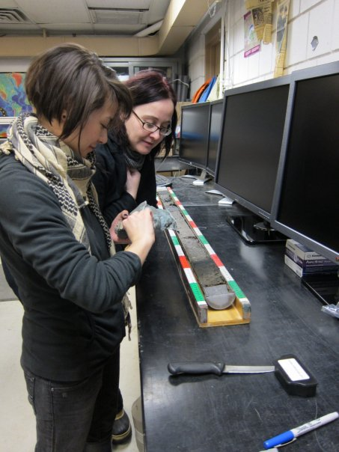
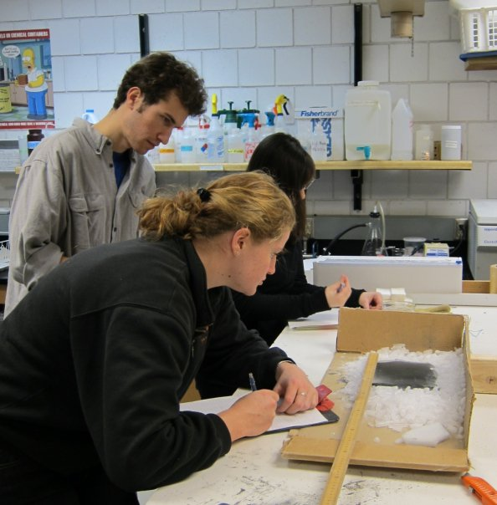
Core Lab Workshop

Slide 15
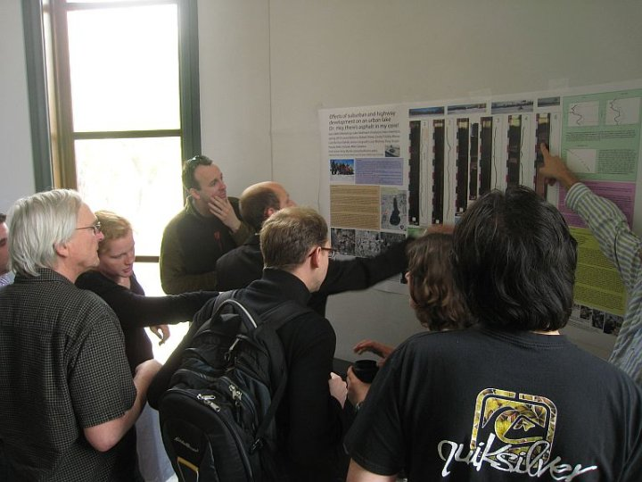
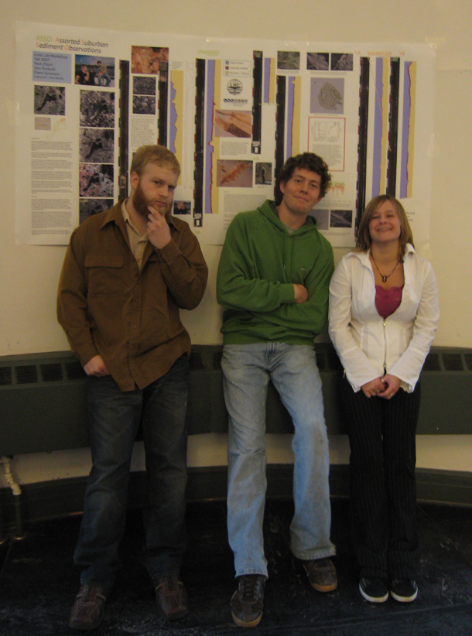
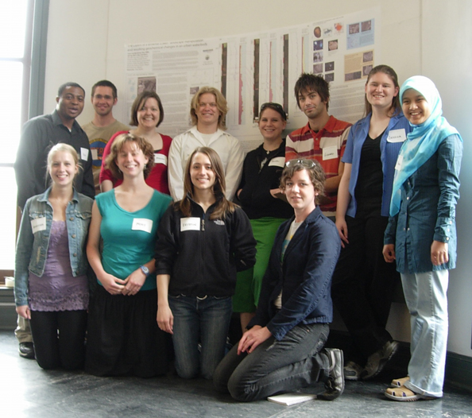
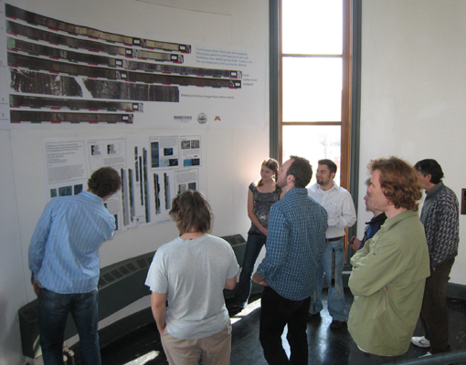

Slide 16
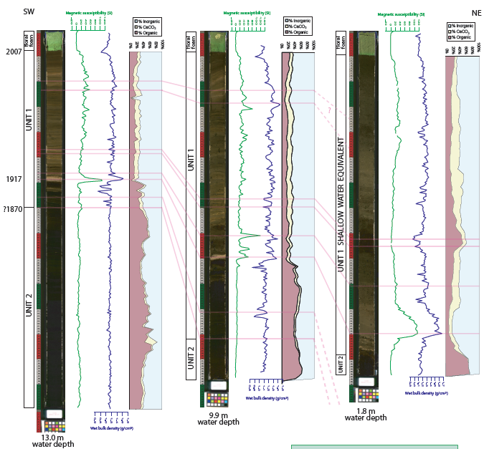
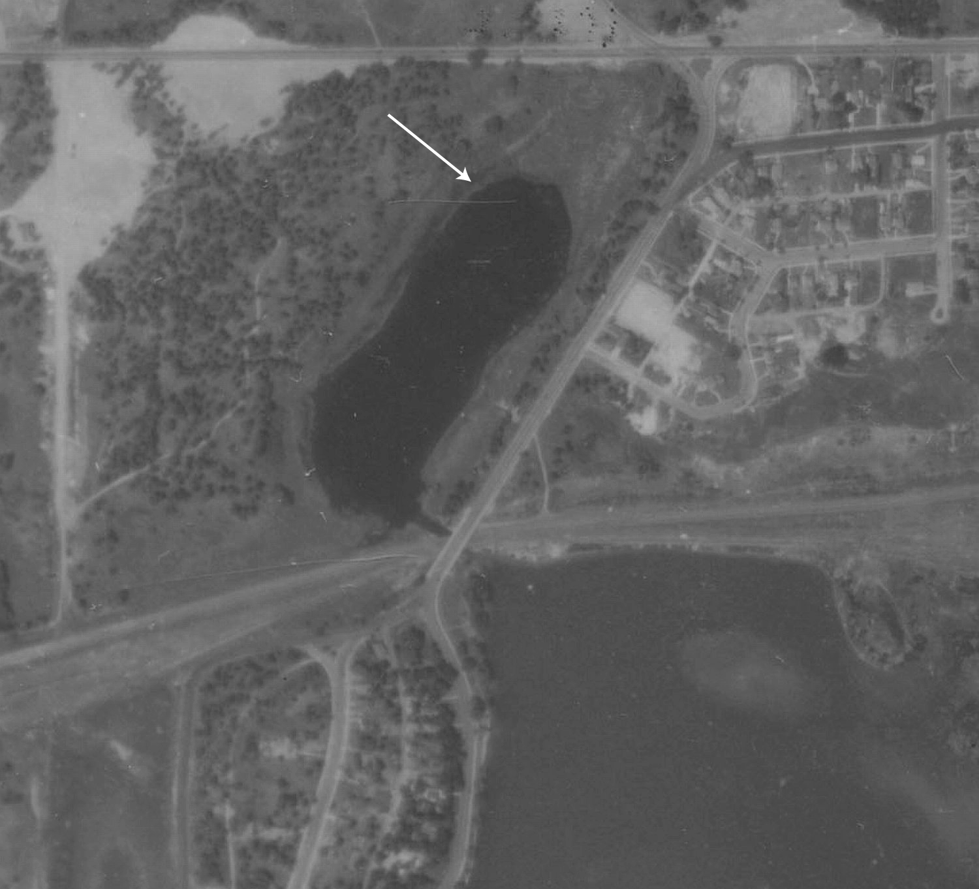

Slide 17
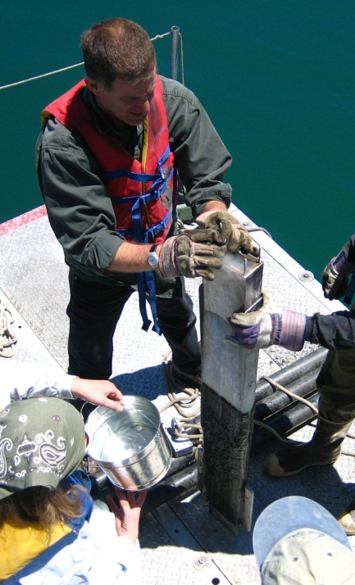
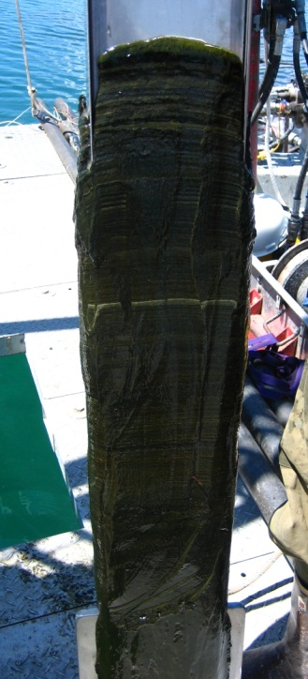
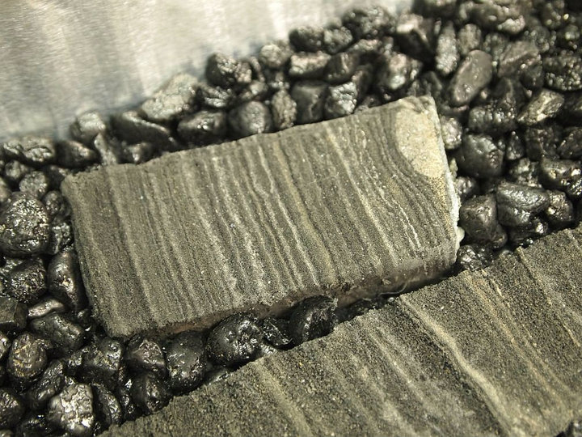

Slide 18





Nanda-gikendaasowin
Naawij Gaa-izhiwebakin
Manoomini-zaaga’iganiing
Studying what happened out in the rice lakes
-OEDG
-REU
Otherwise known as “Manoomin”

Slide 19
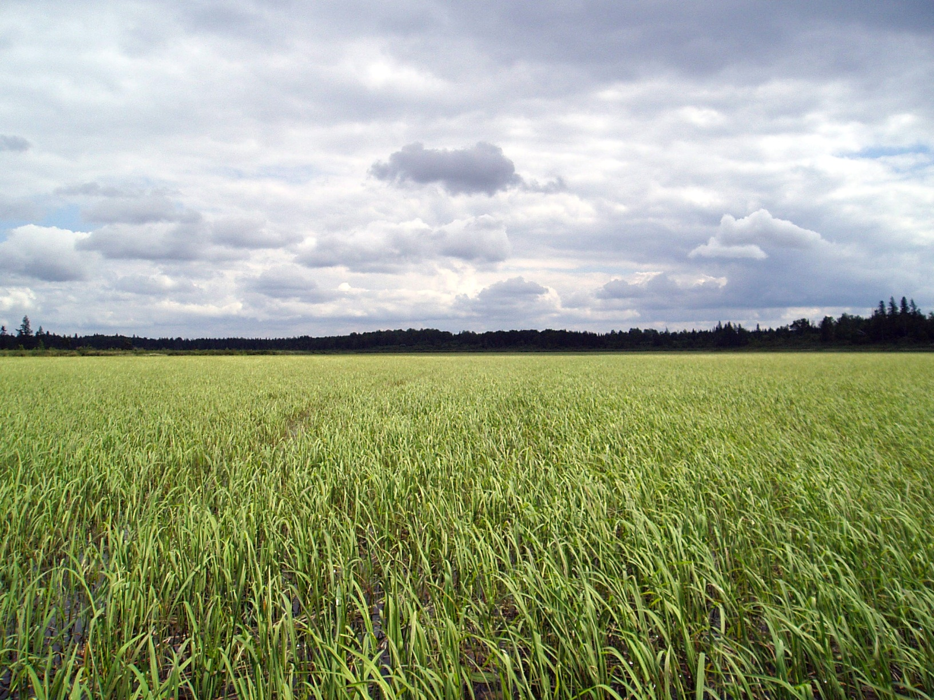
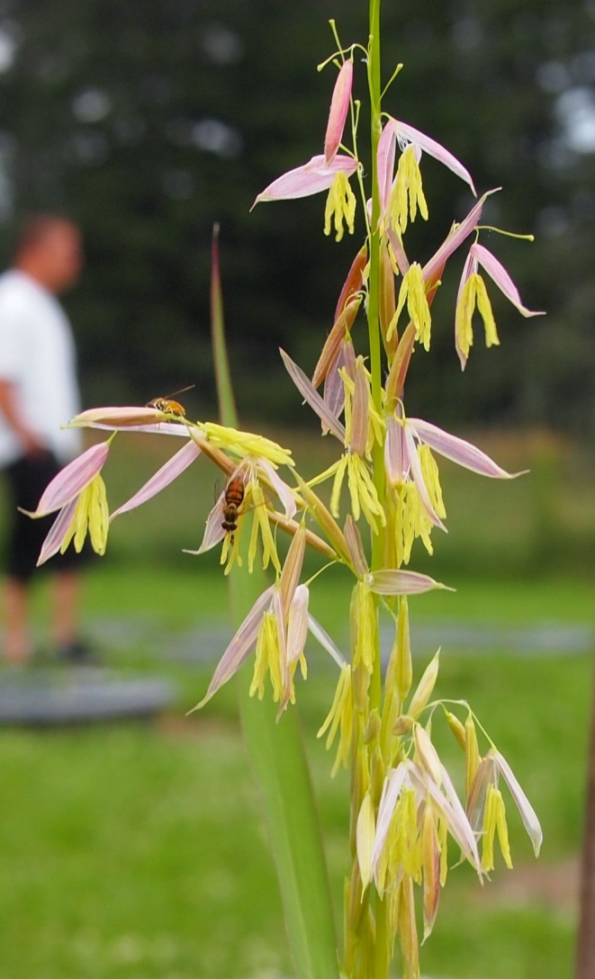
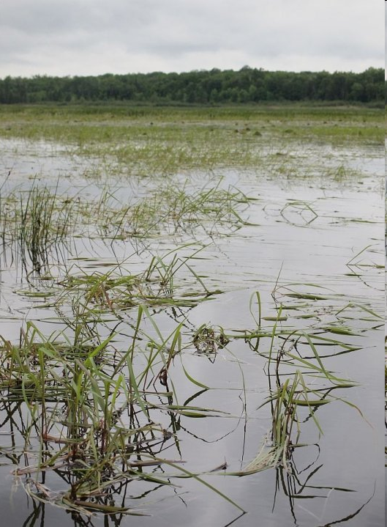
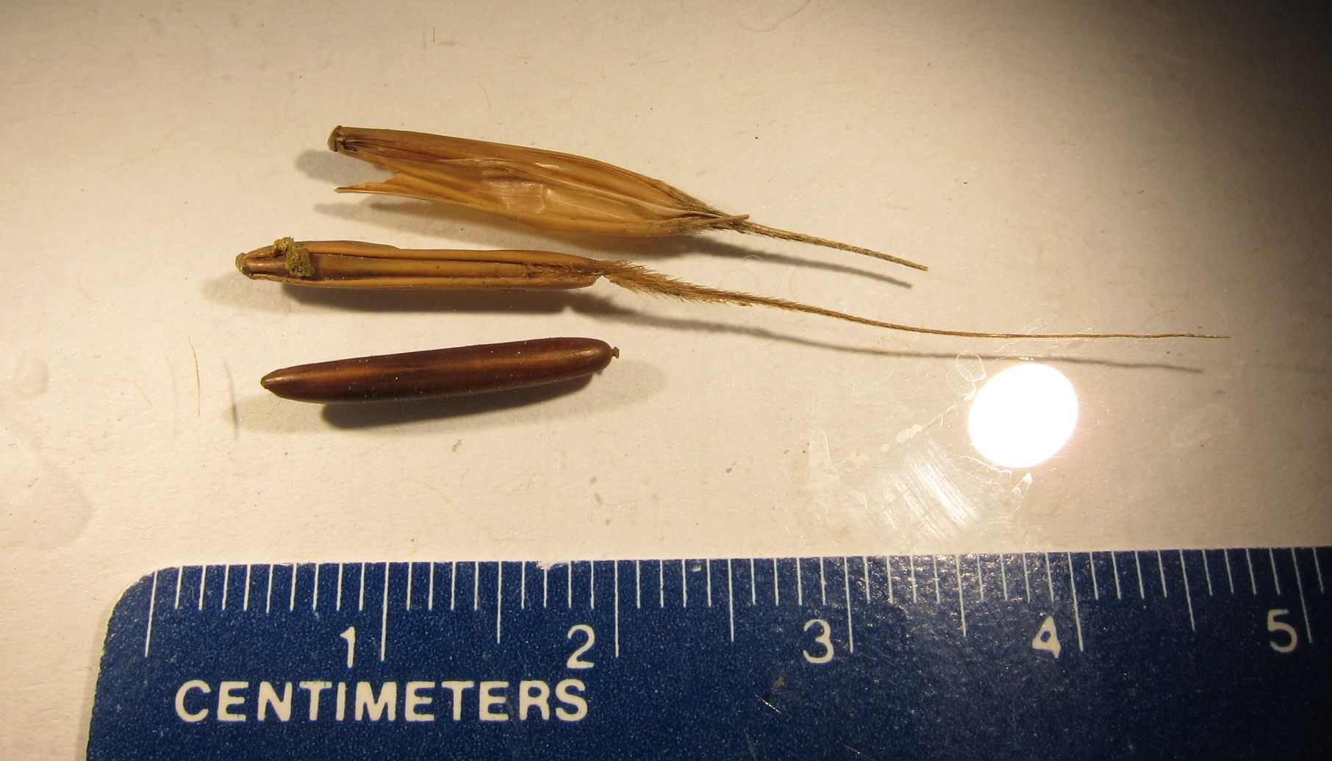
Photo courtesy of Thomas Howes

Slide 20
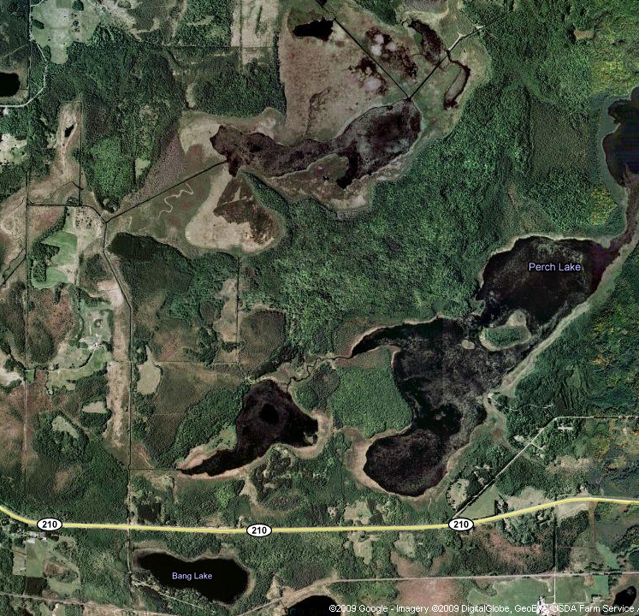

Slide 22
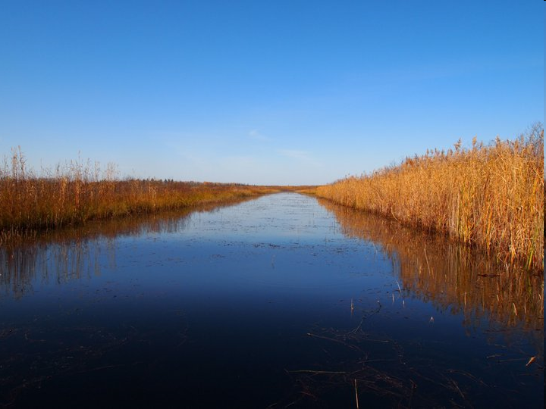
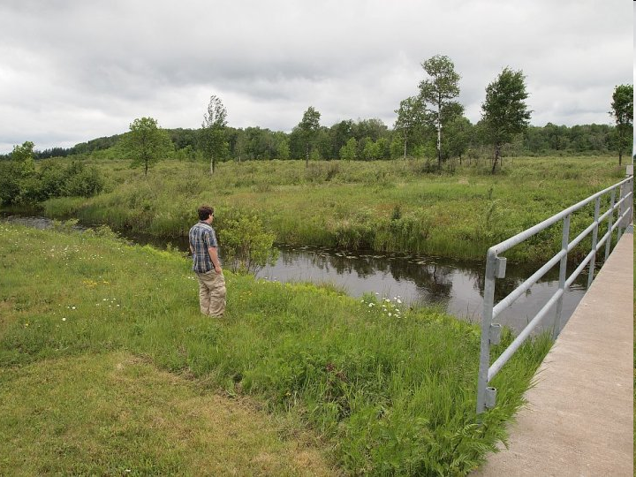
Ditch picture

Slide 23
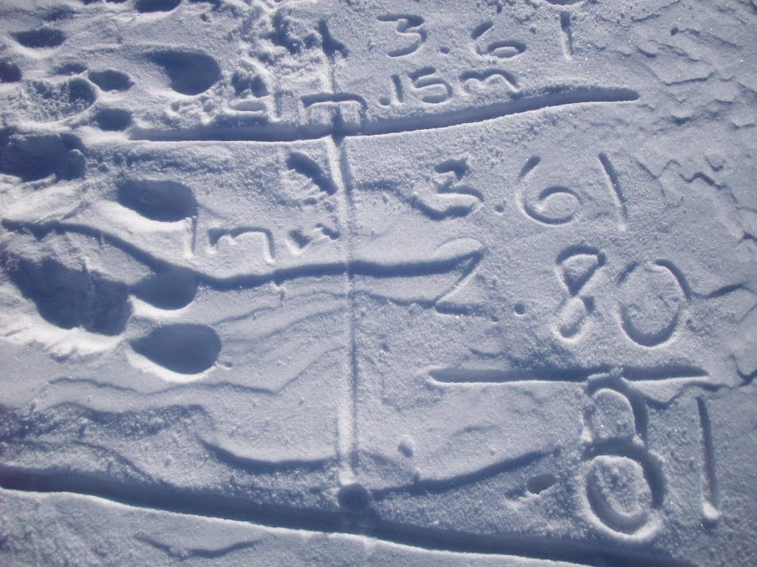

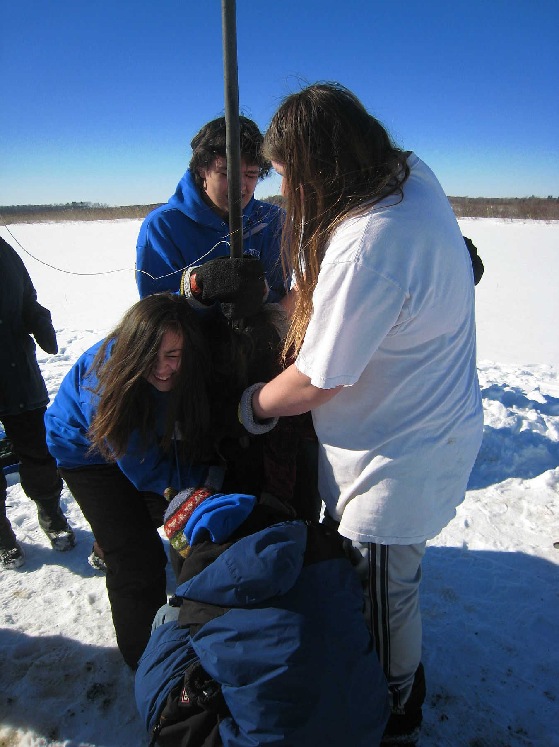
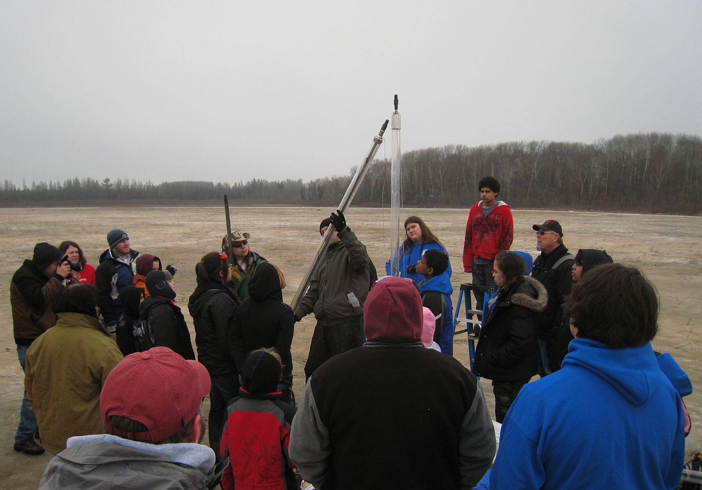
Coring at weekend science camps

Slide 24
Activities with grades 5-12 and up
Walking to GPS locations on lakes
Core collection
Initial core description
Core correlation
Sieving for plant macrofossils (especially wild rice), invertebrate remains, sometimes live ones . . .
SEM
Light microscopy
Diatom identification and counting (!)
Writing
Presenting (oral and poster)

Slide 25
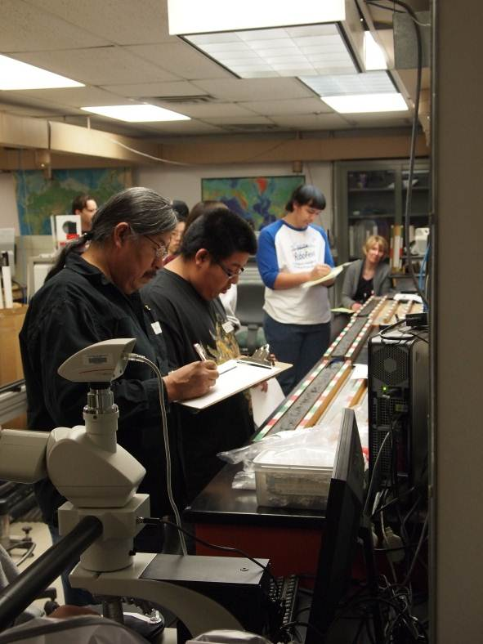
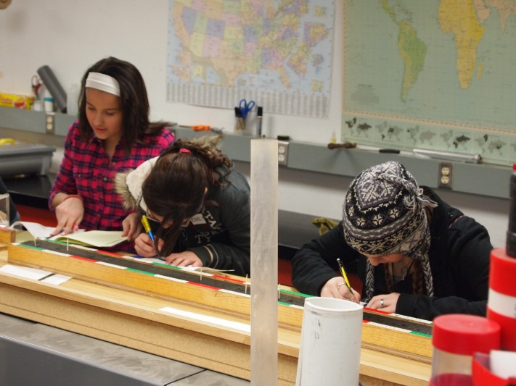
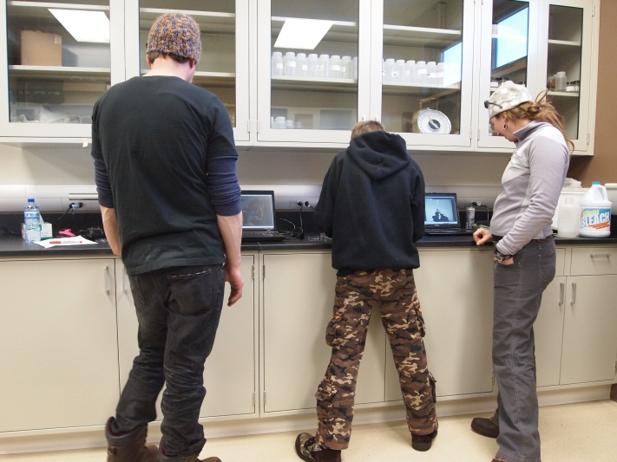
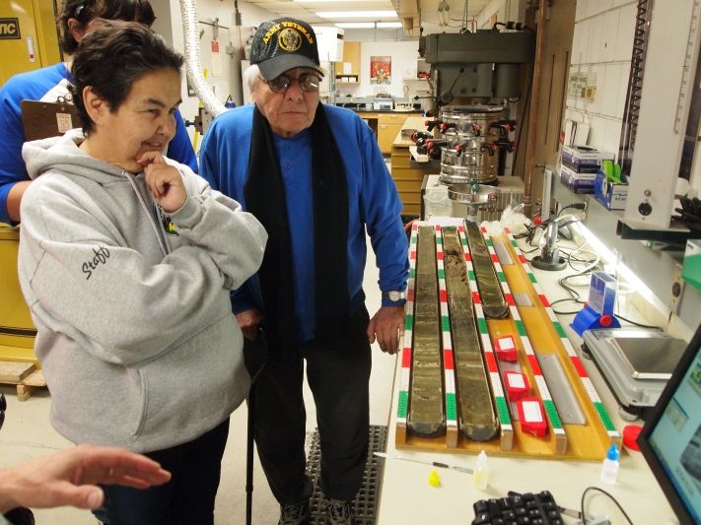
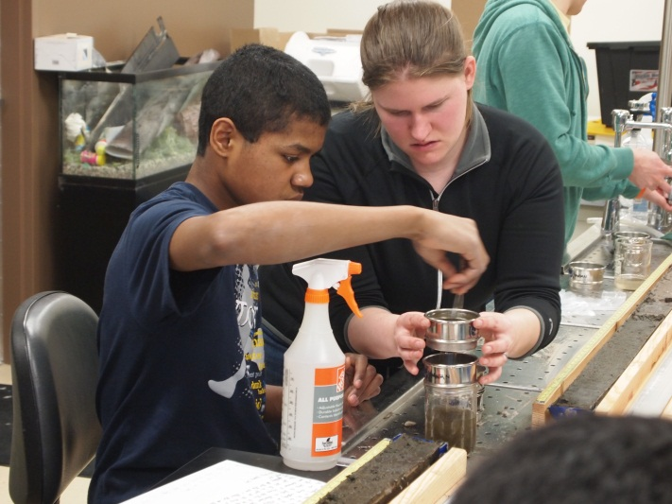
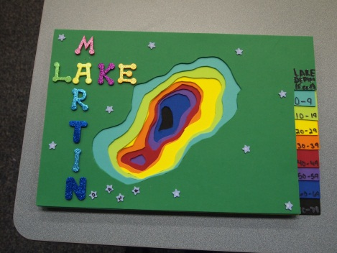
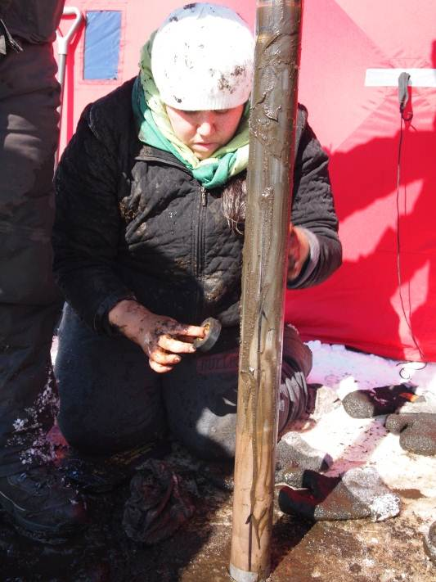
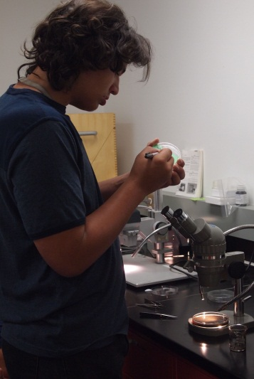
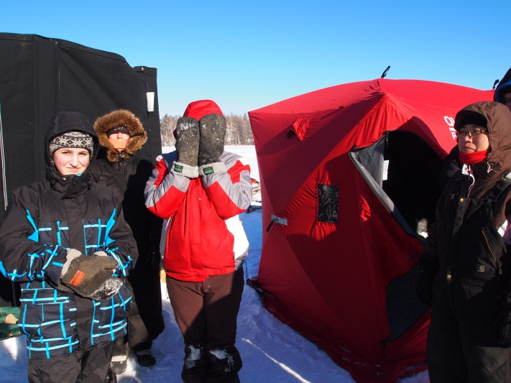

Manoomin camps and LacCore visits

Slide 26










Summer research internships for Native and other students

Slide 27





National Lacustrine Core Facility
Department of Earth Sciences, University of Minnesota-Minneapolis
Assistant Curator
Kristina Brady
Lab Manager
Amy Myrbo
Curator
Anders Noren

Slide 28









Figure by Billy D’Andrea

Slide 29


Equipment training, rental, sales, field assistance

Slide 30




Initial core description (ICD)
Multisensor logger
Core splitter
Description of lithology and sedimentary components
Digital core imager

Slide 31

Using lakes with existing chronology

Slide 32

Mud Ed!
“What to do with ten 10-year-olds in ten minutes”
Avery Shinneman
(U. Wash.) and Myrbo

Slide 33

A new web-based resource for the identification and classification of
lacustrine sedimentary components and lithologies in smear slide
Funded by the University of Minnesota
Interdisciplinary Informatics Seed Grant Program

Slide 34



Lacustrine smear slides
Simple, quick, and powerful technique
Bulk composition, mineralogy, grain size distribution, biological components
Characterization of depositional environment
No reference work exists
  (Rothwell 1989 for marine sediments is out of print and goes for $1000 on Amazon . . .)
Need accurate sediment description as part of repository core data

Slide 36

Dating and chronology
2010-
2010-
1960-
1930-
1910-
1890-
1860-
1860-
How long is “long”? How long a record do you need?
“Natural state” (baseline) vs. current conditions
Lead-210 dating
  About 150 years
  $2500/core gets you all dates in last 150 yr
Radiocarbon dating
  Up to 40,000 years
  $500/sample gets you one date
1,000 years ago-
CORE
5,000 years ago-
10,000 years ago-

