Slide 1

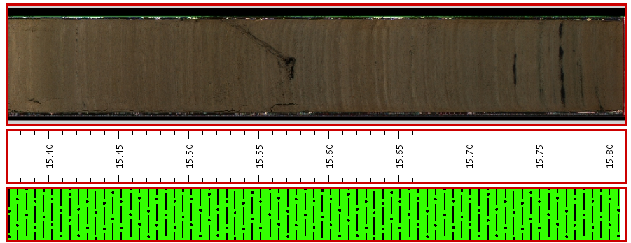
Initial Core Descriptions
On the Cutting Edge-Teaching Climate Change: Lessons from the Past
Introduction to making physical observations and documenting a stratigraphic sequence
Julie Brigham-Grette
UMass- Amherst
June 20, 2012 AMQUA
http://lrc.geo.umn.edu/laccore/assets/pdf/sops/icd.pdf
Notes:
From Mud to wiggles!

Slide 2
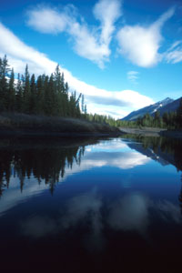
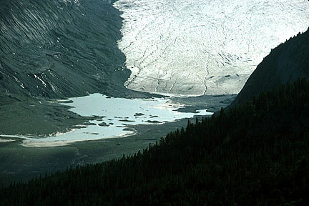
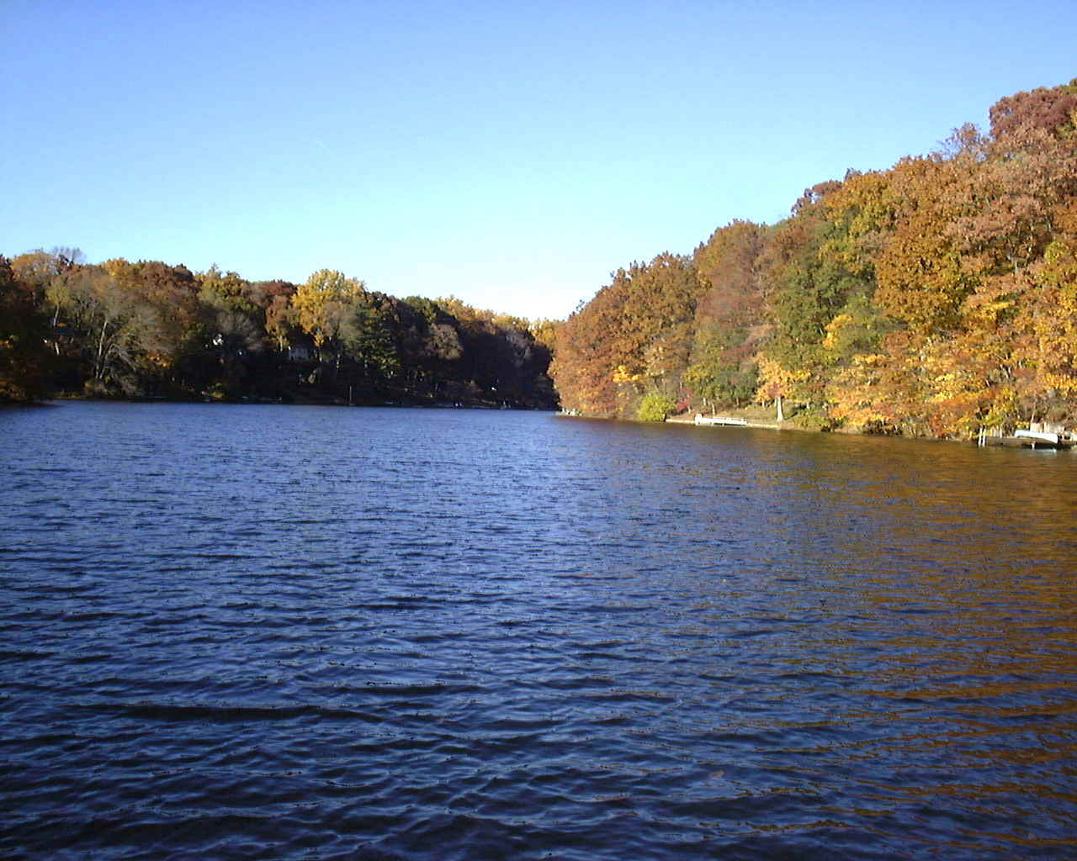
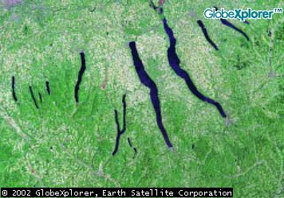
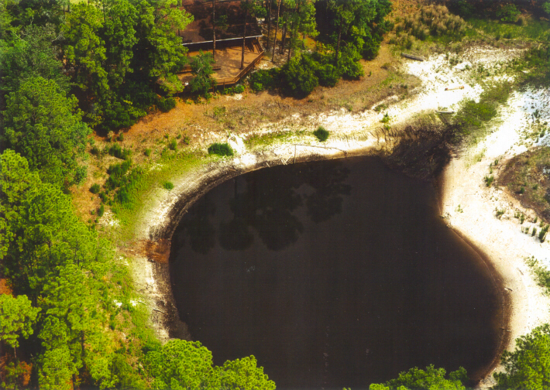
Why study lakes
Lakes found in a variety of environments
Dynamic environmental systems
Integrate environmental and climatic change on a variety of time scales
They collect sediments, organic matter in response to their surroundings
Sediments produce a continuous archive of change; layer upon layer, they record of Earth’s natural experiments in change.

Slide 3

Earth Scientists – Time lords!
Sediment cores allow one to understand past change and system dynamics and to use this information to improve predictions about the future!
If men could learn from history, what lessons it might teach us! But passion and party blind our eyes, and the light which experience gives is a lantern on the stern, which shines only on the waves behind us!
Samuel Taylor Coleridge, 1831
www.bbc.co.uk/doctorwho
Notes:
Samuel Taylor Coleridge was an English poet, critic, and philosopher who was, along with his friend William Wordsworth, one of the founders of the Romantic Movement in England and one of the Lake Poets. He is probably best known for his poems The Rime of the Ancient Mariner and Kubla Khan, as well as his major prose work Biographia Literaria.

Slide 4


Today
Geochronology
Age/Time
Resolution
years
decades
Length of core
centuries
Back in
Time
Millennia
Notes:
Most people do not understand geologic time.

Slide 5
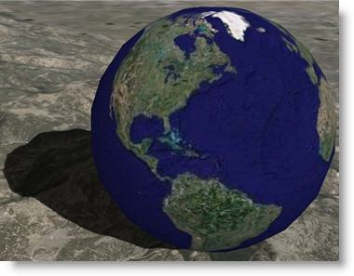
Learning Goals
Concepts of the recent geologic record
  causality at a distance, cyclic causality, environmental time delays
How to describe sediments – standardized approach to physical descriptions
  Photographic and written documentation
  Making observations and documenting those observations in meaningful way
  Concept of particle size and sedimentary structures for understanding depositional environments
  Facies model development
Develop stratigraphic column, (Psicat)
Quantitative image analysis (Image J)
Notes:
Grotzer, T., and Bell, B., 2004, How does grasping the underlying casual structures of ecosystems impact students' understanding? J. Bio. Educ., 38, 16-29.

Slide 6
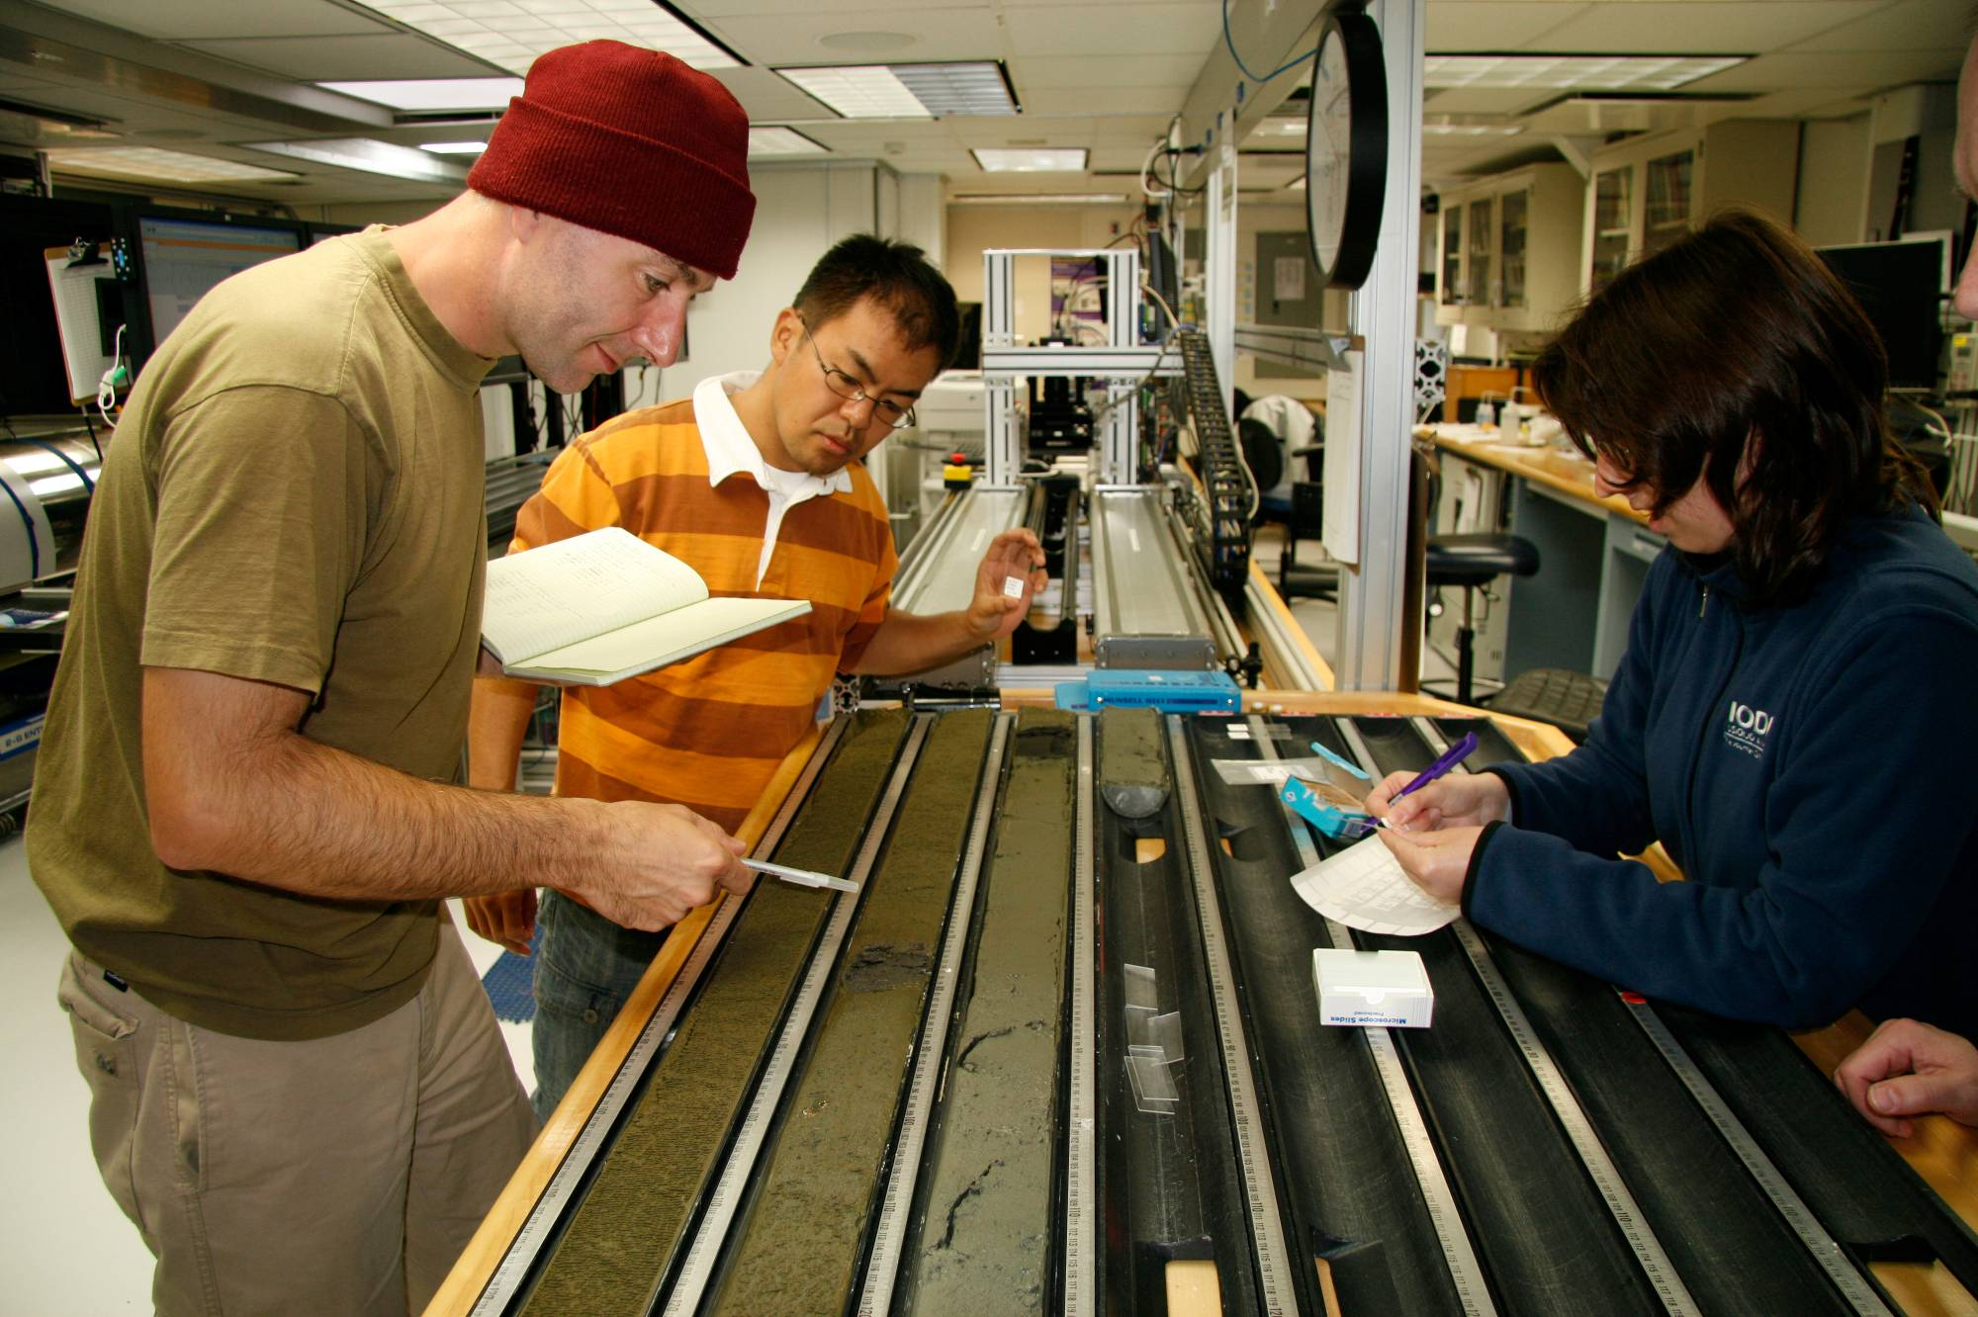
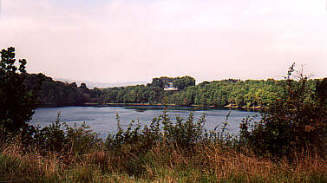
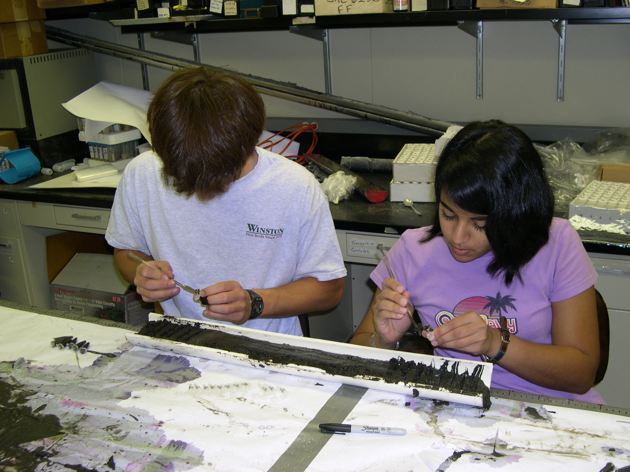
Science Goals
Difference between weather and climate (ave of > 3 decades)
Regional climate change vs global climate change

Slide 7
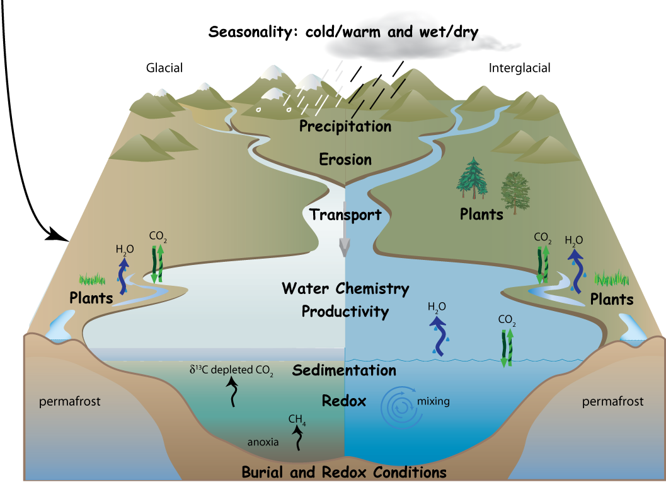

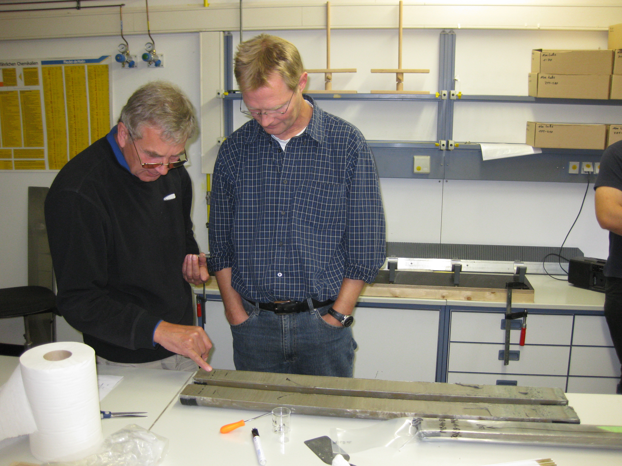
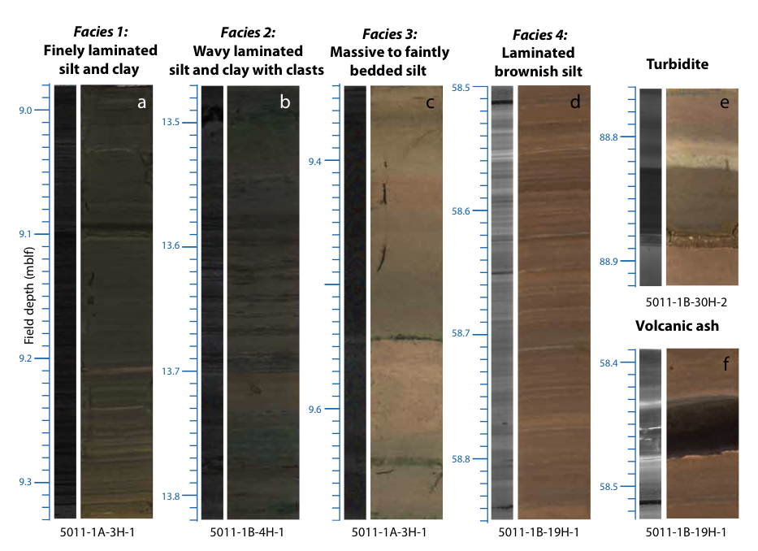
The approach – lake sediments (Lake E example)

Slide 8
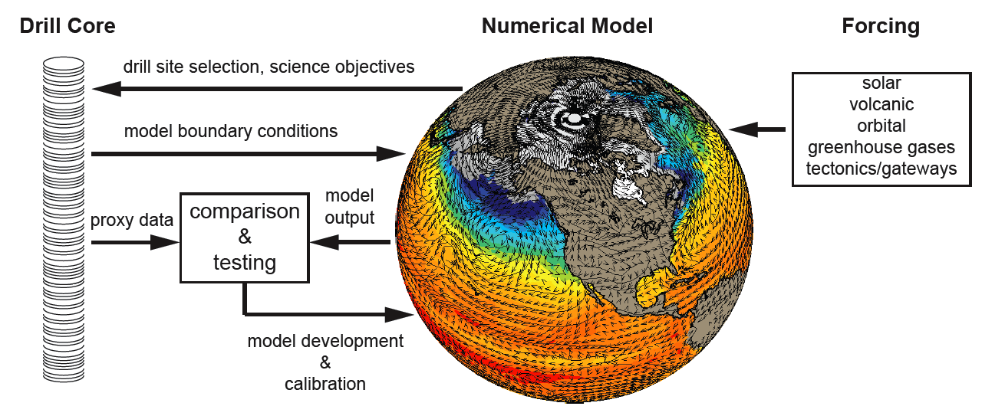
Proxies of climate → Modeling and prediction of future change
today
Back in time →

Slide 9
Science questions should drive analysis
(ask students to develop their own)
Sedimentation rates and the geochronology of the core are fundamental to understanding all of the physical properties and quantifying the climate/environmental history. How can studies of the sedimentology and sediment flux rates be used with other proxies to best constrain the chronology?
What are the hydrological, biological, and geochemical controls on changes in sediment texture as they relate to changes in climate?
What are the lake processes and climatic conditions that produce laminated, non-laminated and weakly laminated units throughout the core?

Slide 10
ADD YOUR OWN QUESTIONS:
How can the core stratigraphy be characterized into recognizable facies assemblages related to changes in climate?
What fundamental changes can we observe in the lake sedimentology .
What processes cause these changes as they relate to climate history and landscape change?
Is there a fundamental change in the sediment properties and biogenic sedimentation (or organic matter) with changes in land use, or external and internal forcing over time?
Characterization of primary controls on sediment character, flux rates and the proportions of clastic vs. biogenic deposition
Quantification of the relationship between sedimentology and climate change (hydrology, lake ice cover history, terrestrial vs aquatic inputs etc.)
Paleoclimate proxy development by comparisons between physical properties, sedimentology, and scanned data sets.

Slide 11
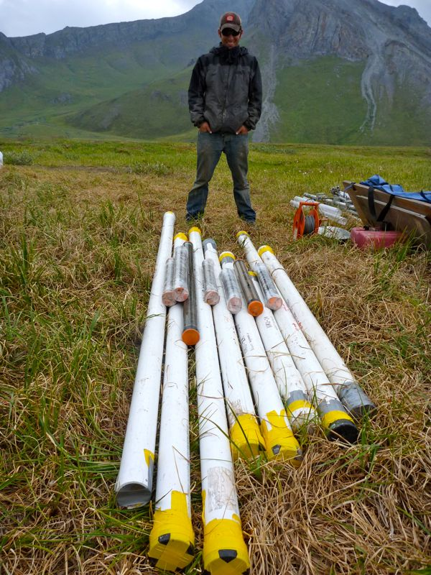
Terms - learning the lingo
Age resolution – years/cm
Lithostratigraphy
  layering based on physical, lithic properties and petrology
Particle size/grain size
Facies
  Sediments deposited in particular environment or process ; a vertical succession of facies suggest lateral migration of the depositional environment
Laminae/varves
  Thin layers, if annual = varves
Lets add more……..
Kurupa Lake core. Photo: Darrell Kaufman

Slide 12
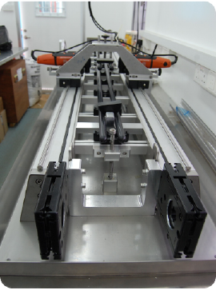
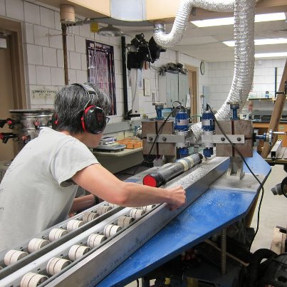
Initial core splitting
www.geotek.co.uk
Emi Ito photo

Slide 13
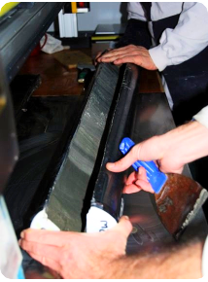
Initial core splitting
Blades cut only the core liner on either side. Sediment is cut with SS wire.
Split cores

Slide 14

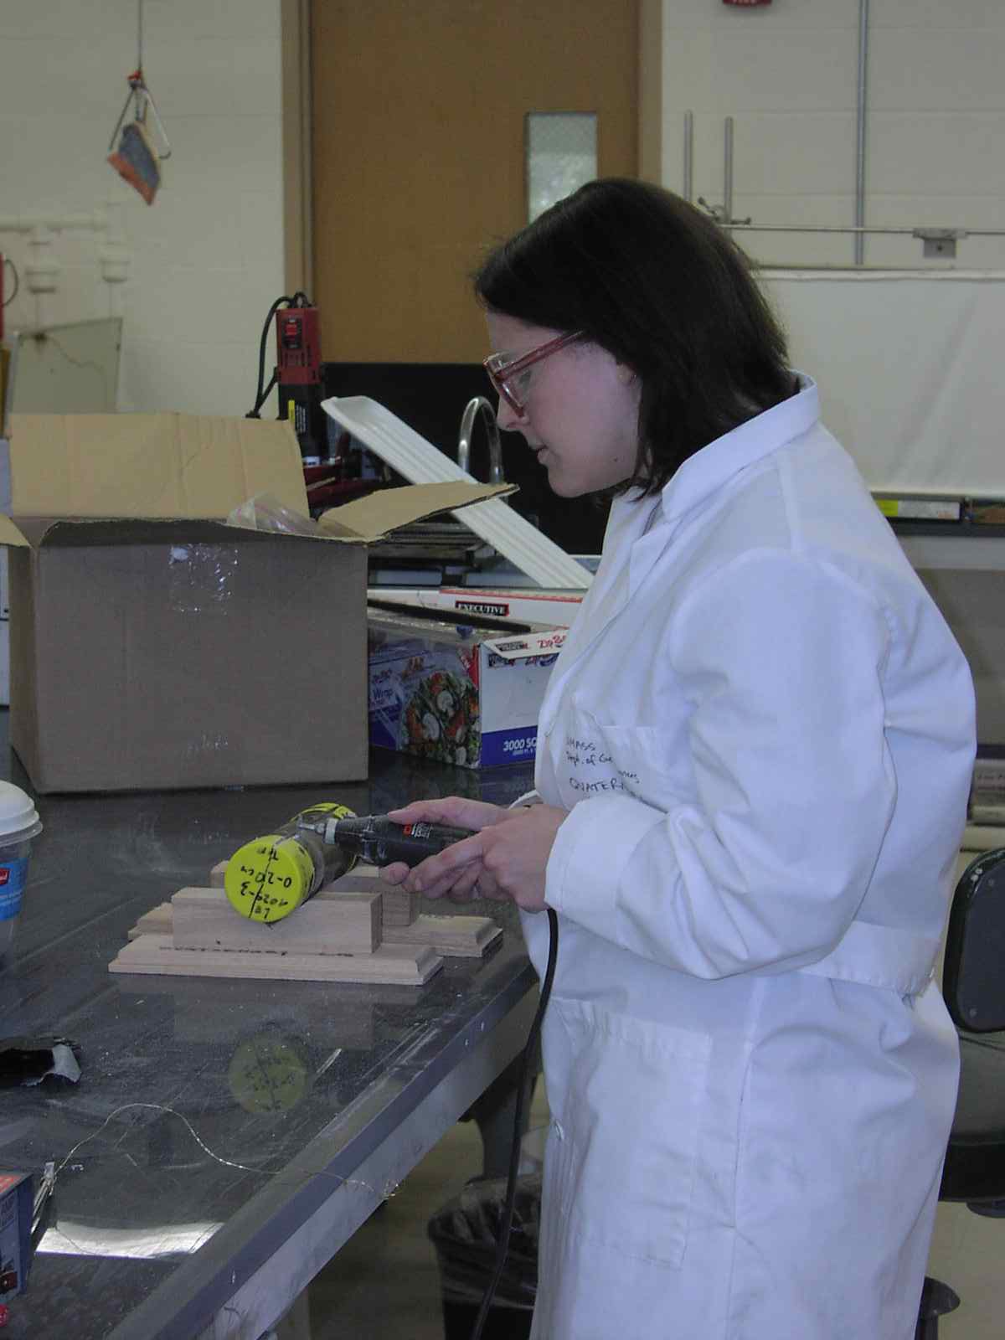
Cheap and easy too – skill saw?
Using a Dremel Tool

Slide 15
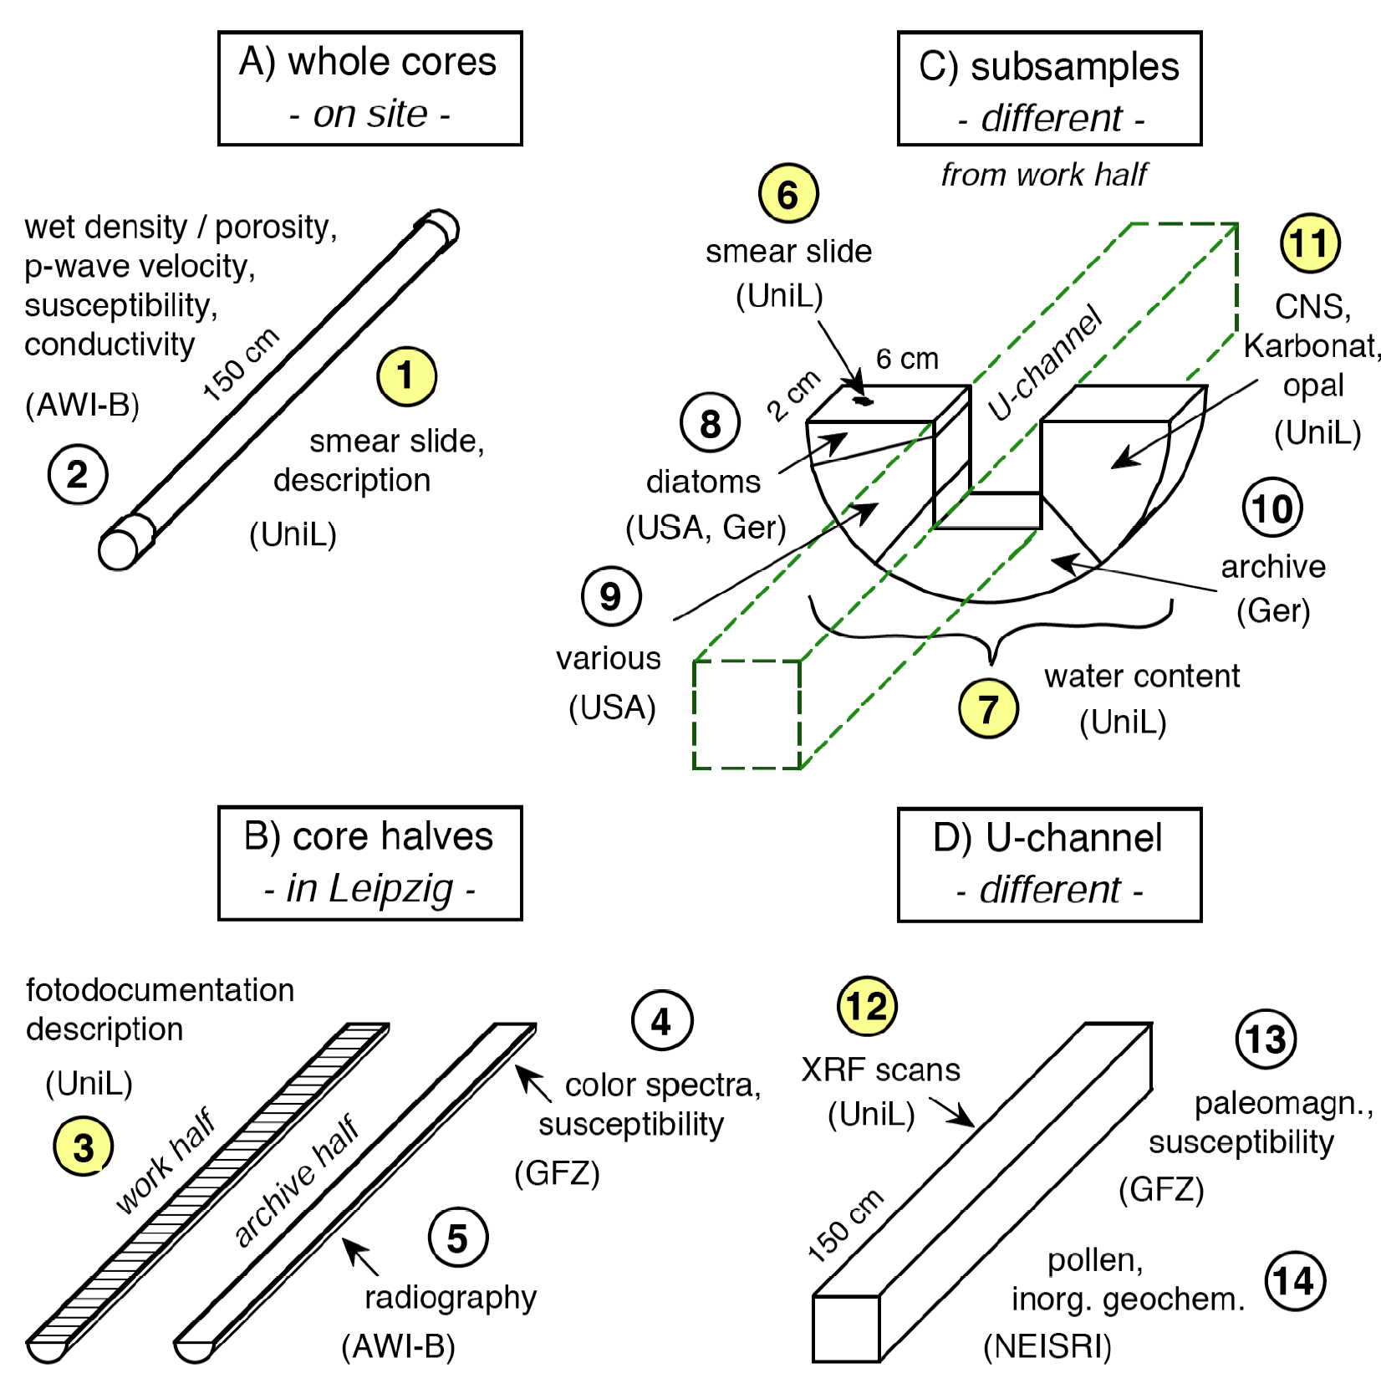
Lake Sediment Core Processing Scheme
Example from ICDP Lake El‘gygytgyn Project
surface
cleaning
whole-core
magn. suscept.
(on site)
100 cm
line scan pictures
with MSCL
susceptibility
and
color spectra
with SCLP3
core description
manual
core archiving
LacCore Repository
Duluth, U.S.A.
1. line scan picture & surface relief
2. XRF light elements
with ITRAX core scanner
3. X-radiography
4. XRF heavy elements
with ITRAX core scanner
p-wave velocity
Gamma-ray density
magn. susceptibility
with MSCL
core subsampling

Slide 16
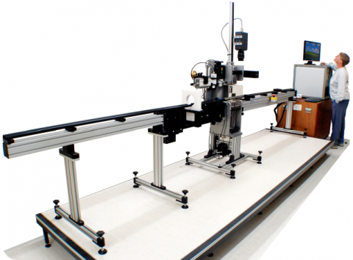
Initial core scanning
Magnetic susceptibility
Line scan (continuous photography)
  Good digital camera can do!
Gamma density
Color Spectrometer
  L*a*b* parameters
  http://www.hunterlab.com/appnotes/an07_96a.pdf
X-rays (use your univ clinic?)
XRF scanning for major elements (ITRAX)
Geotek.co.uk
Notes:
Add definitions of color

Slide 17
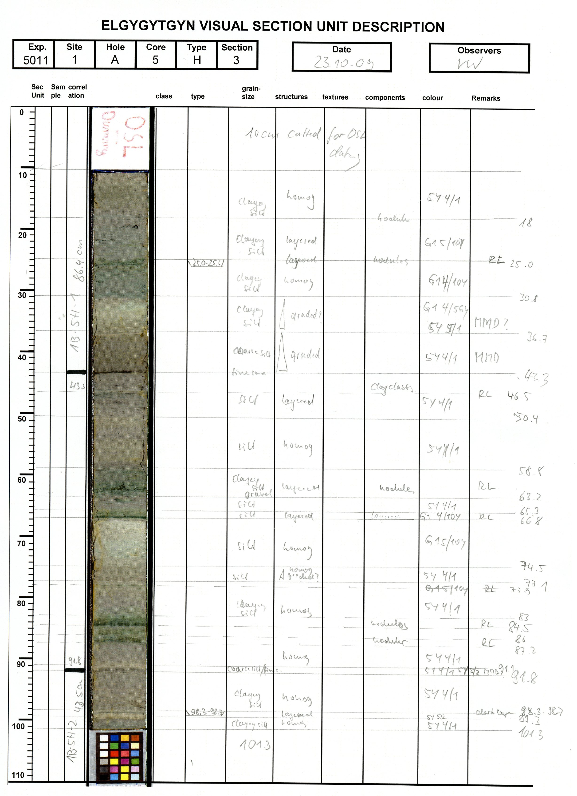
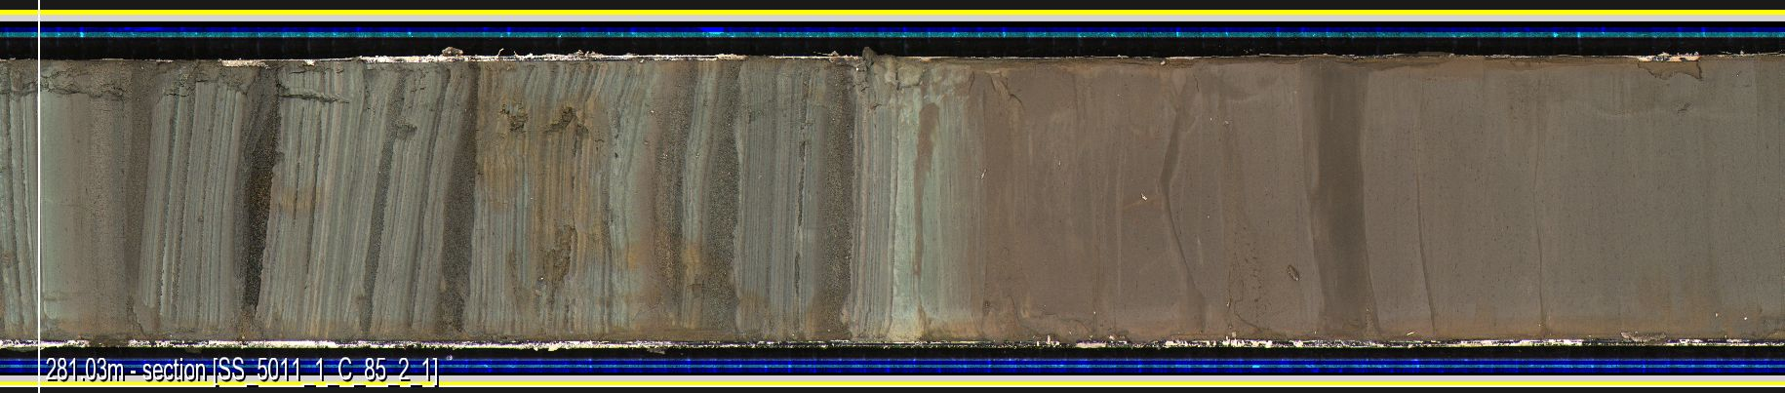
Filling out the Barrel sheet – what to look for, what to describe
Texture (grain size)
Color (munsell scheme)
Unit thicknesses
nature of contacts
clast lithology
Compaction (stiffness)
sedimentary structures
organic content
fossils
Defining Facies
Making Smear slides
http://lrc.geo.umn.edu/laccore/assets/pdf/sops/sedclass_basics.pdf

Slide 18
Sediment classification
Macroscopic structure of the sediment –
  structures and textures (bedding features, texture, color)
ID of major and minor components
  Eg. Clay, carbonate, peat, mud….)
Color + 2. Bedding + 3. Major Modifier + 4. Principal Name + 5. Minor Constituents
e.g Dark reddish brown, massive, feldspathic clay with carbonaceous debris and trace gastropod fragments
Schnurrenberger et al, 2003 at http://lrc.geo.umn.edu/laccore/assets/pdf/sops/sedclass.pdf

Slide 19
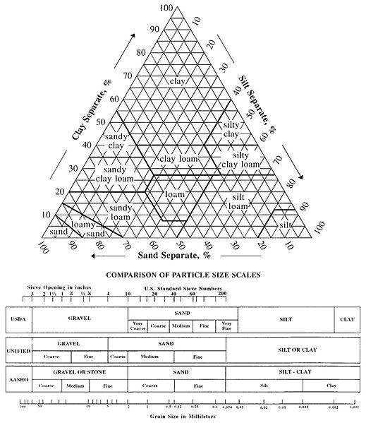
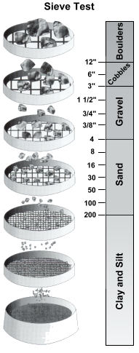
Classroom applications
Grain size charts
http://www.concrete-catalog.com/soil_compaction.html

Slide 20
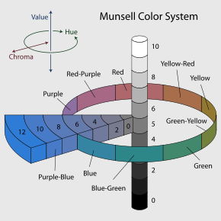
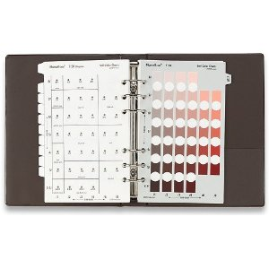
Classroom applications
Munsell Color Book
http://en.wikipedia.org/wiki/Munsell_color_system

Slide 21
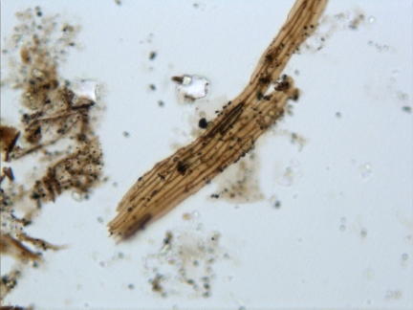
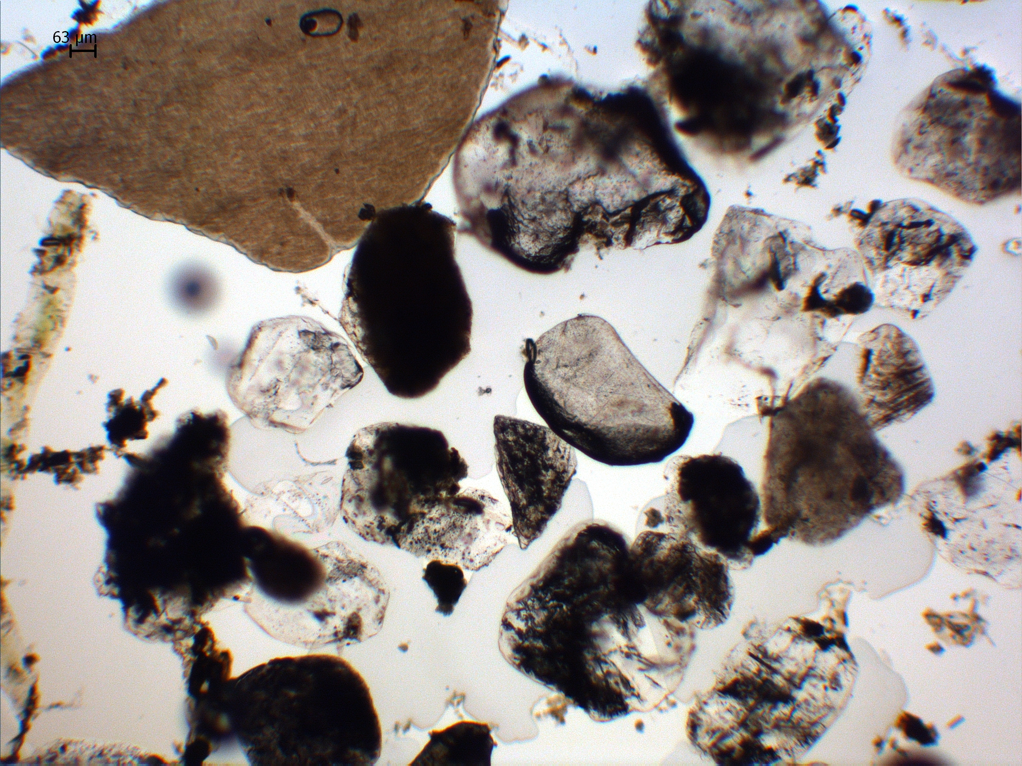
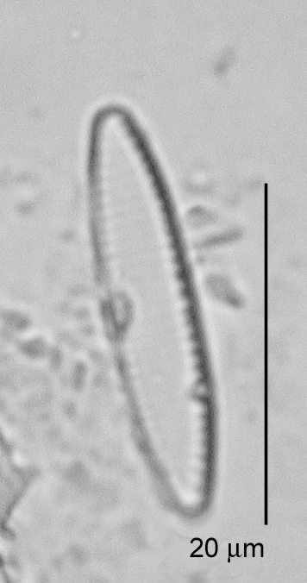
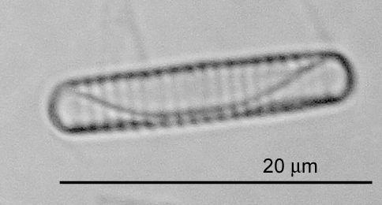
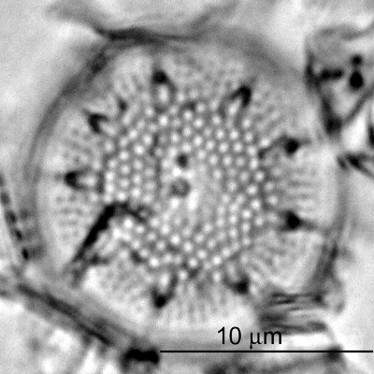
Smear Slides
Means of preparing a very thin layer of unconsolidated material embedded on a glass slide to examine mineralogy, provenance, grain shape, and identification of microfossils, even tephras.
Vascular (terrestrial or aquatic) organic matter
Quartz and/or feldspar, pitted and stained with . . . something
There is even a video tutorial !! AMY ROCKS!https://tmi.laccore.umn.edu/tutorial/preparation
http://lrc.geo.umn.edu/laccore/assets/pdf/sops/smearslides.pdf
http://lrc.geo.umn.edu/laccore/assets/pdf/sops/smear_slide_basics.pdf

Slide 22
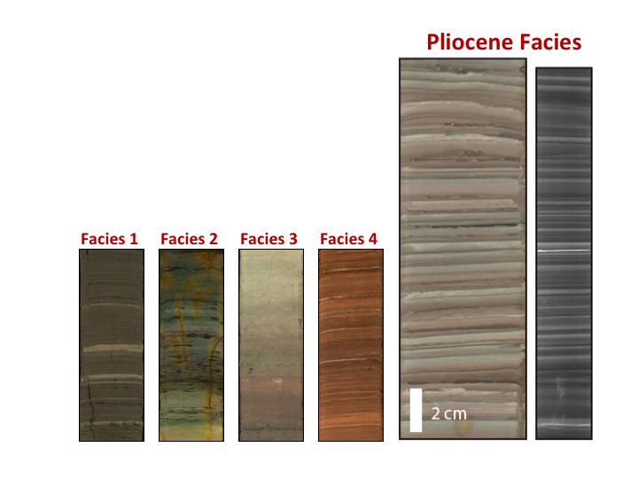
Objective is to define sediment facies
Lake El’gygytgyn Facies – related to ice cover duration
Among other changes in lake system
Melles et al. 2010
Melles et al. 2012
Brigham-Grette, in prep
Glacial/cold
warm
Super warm

Slide 23
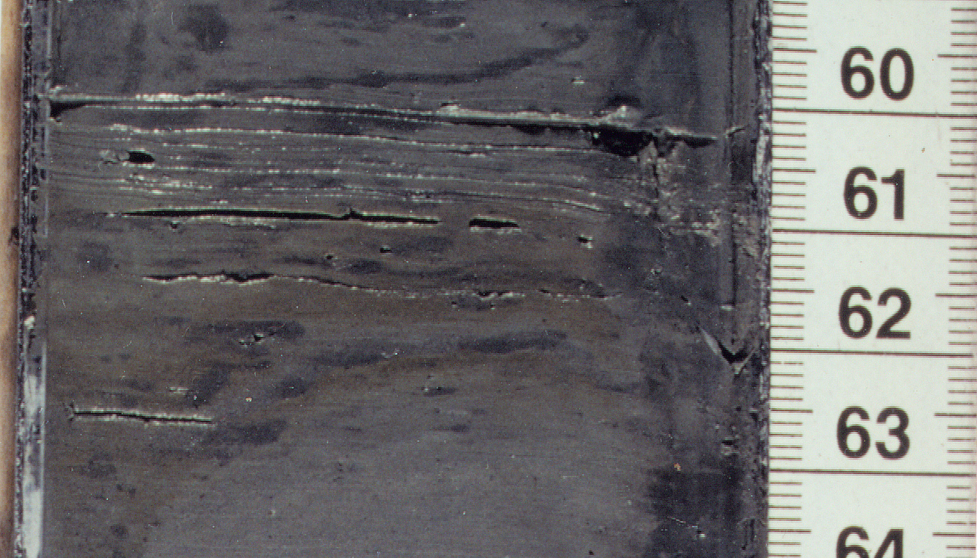
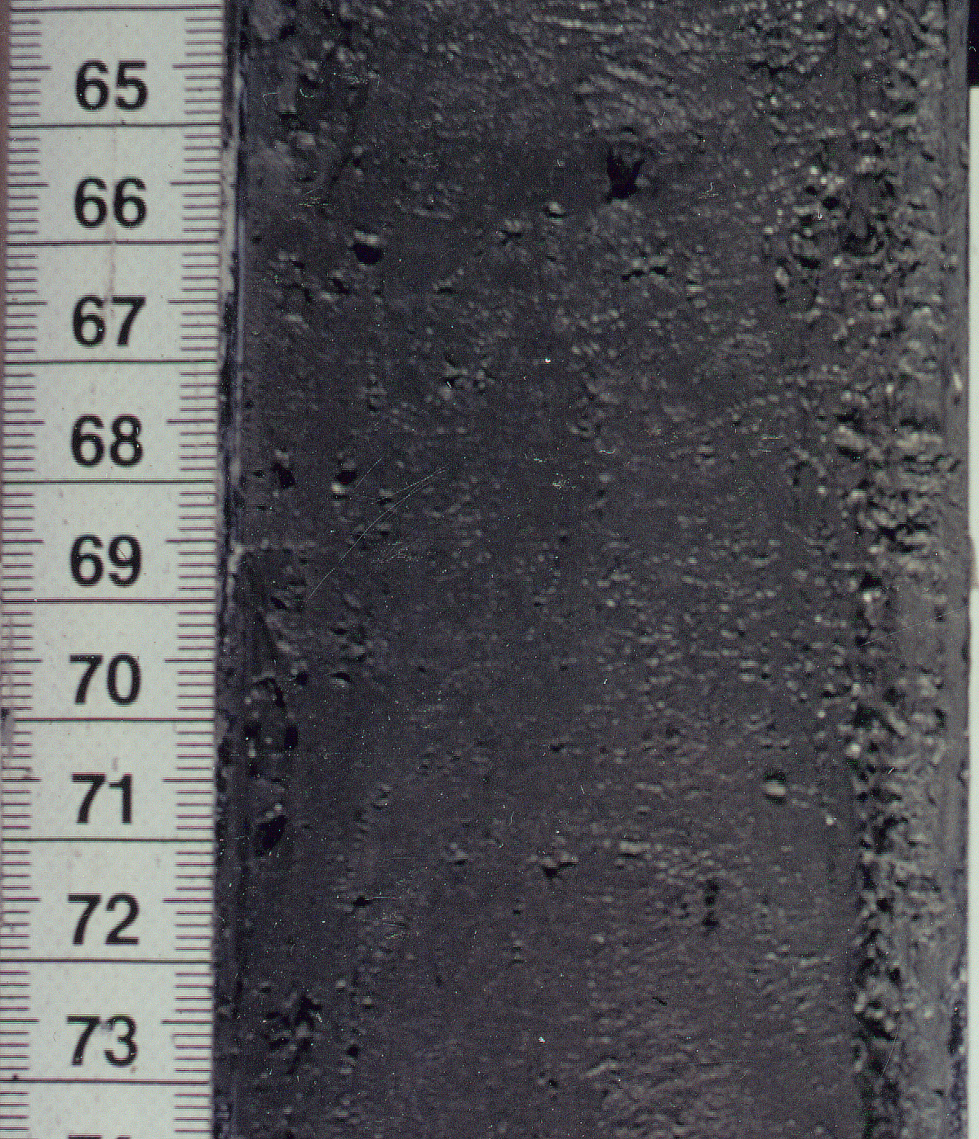
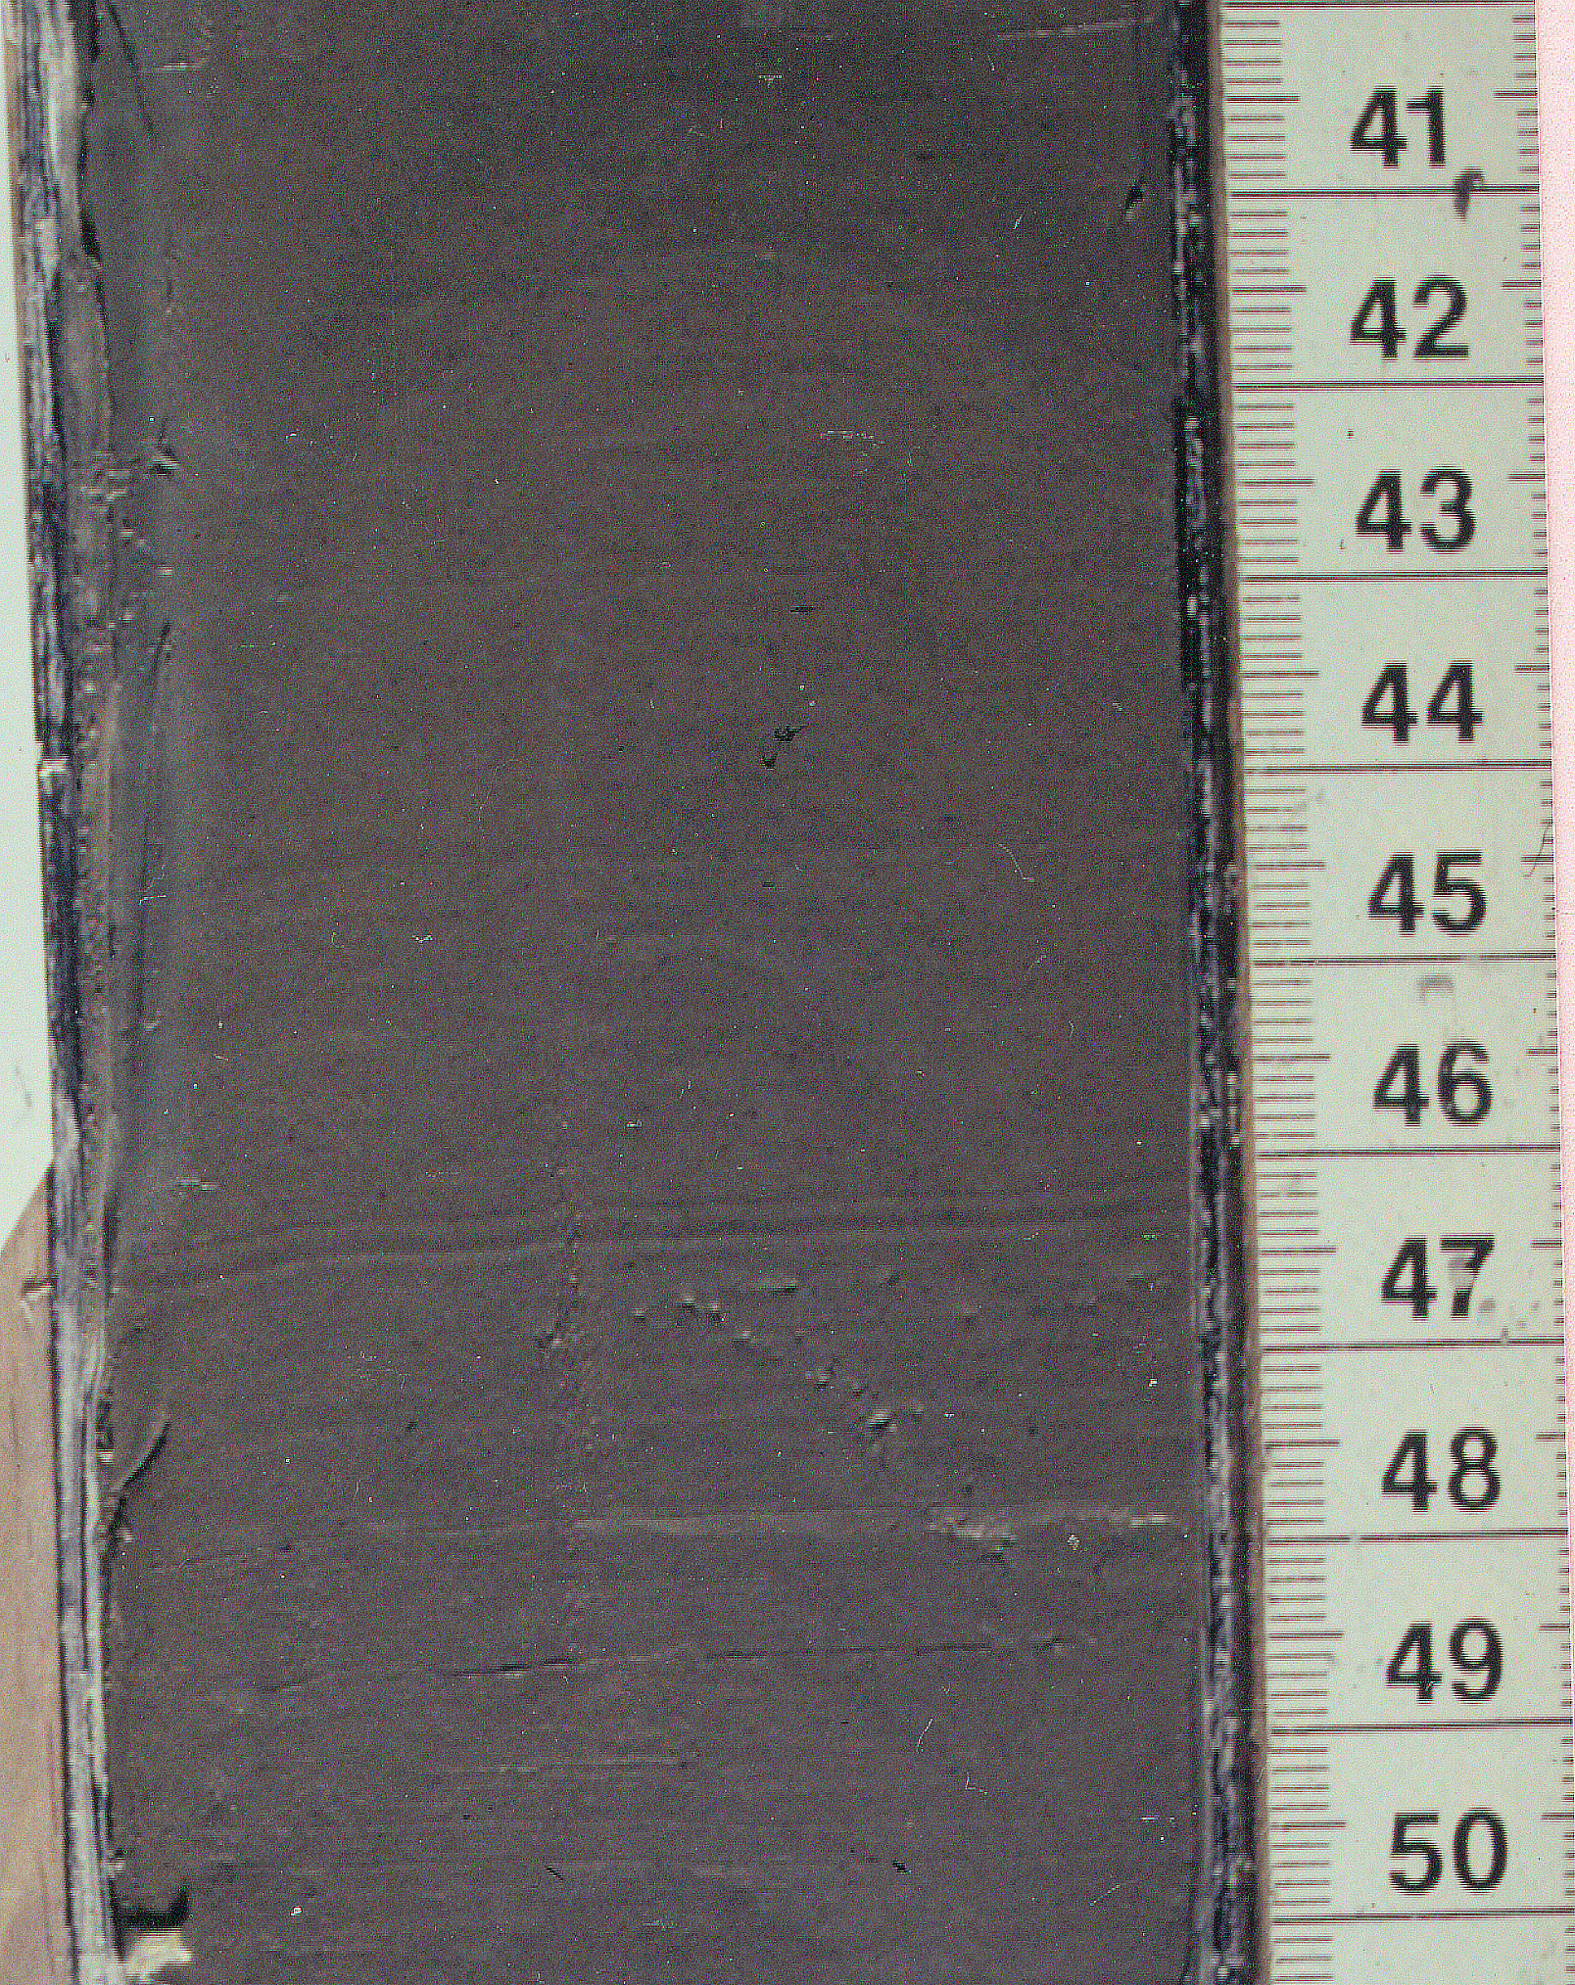
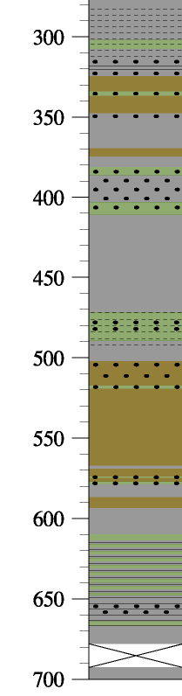
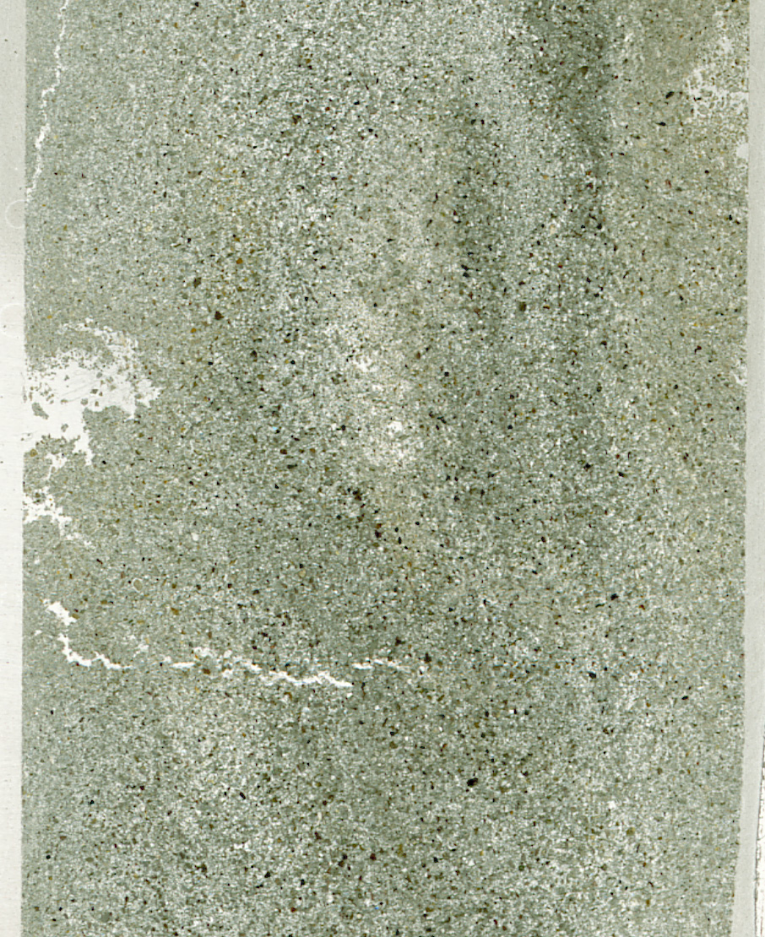
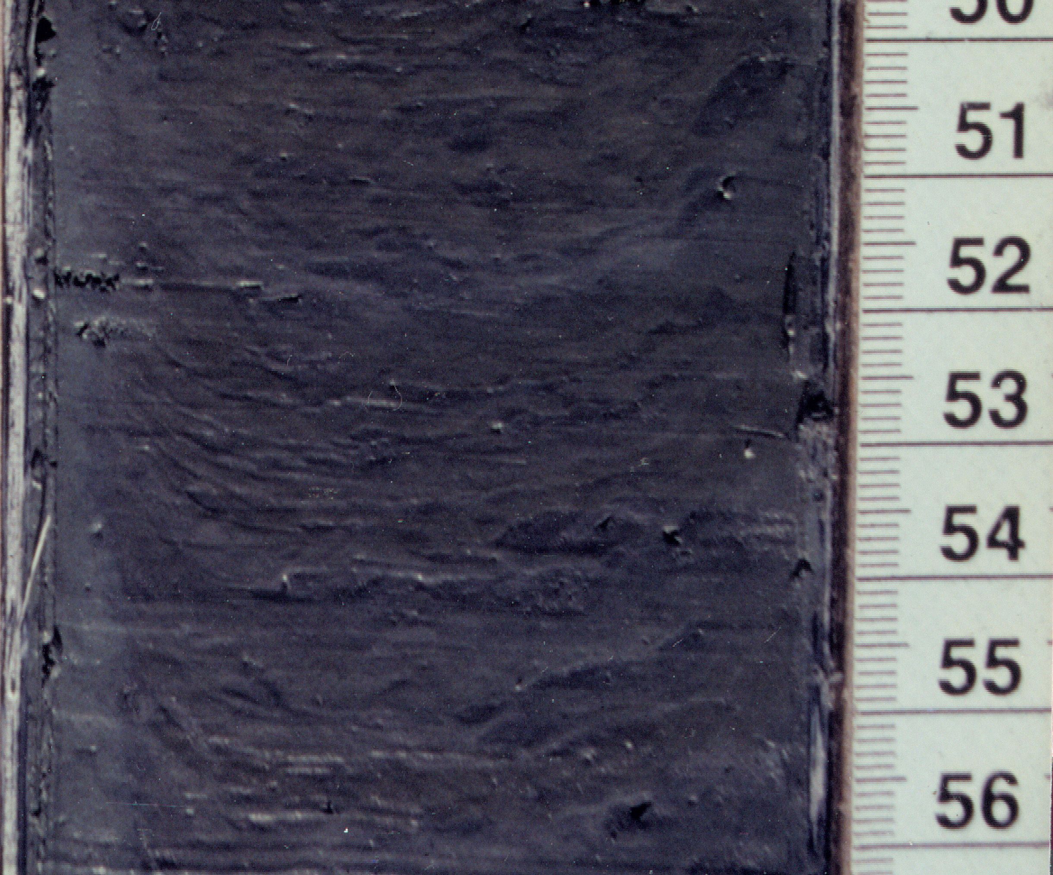
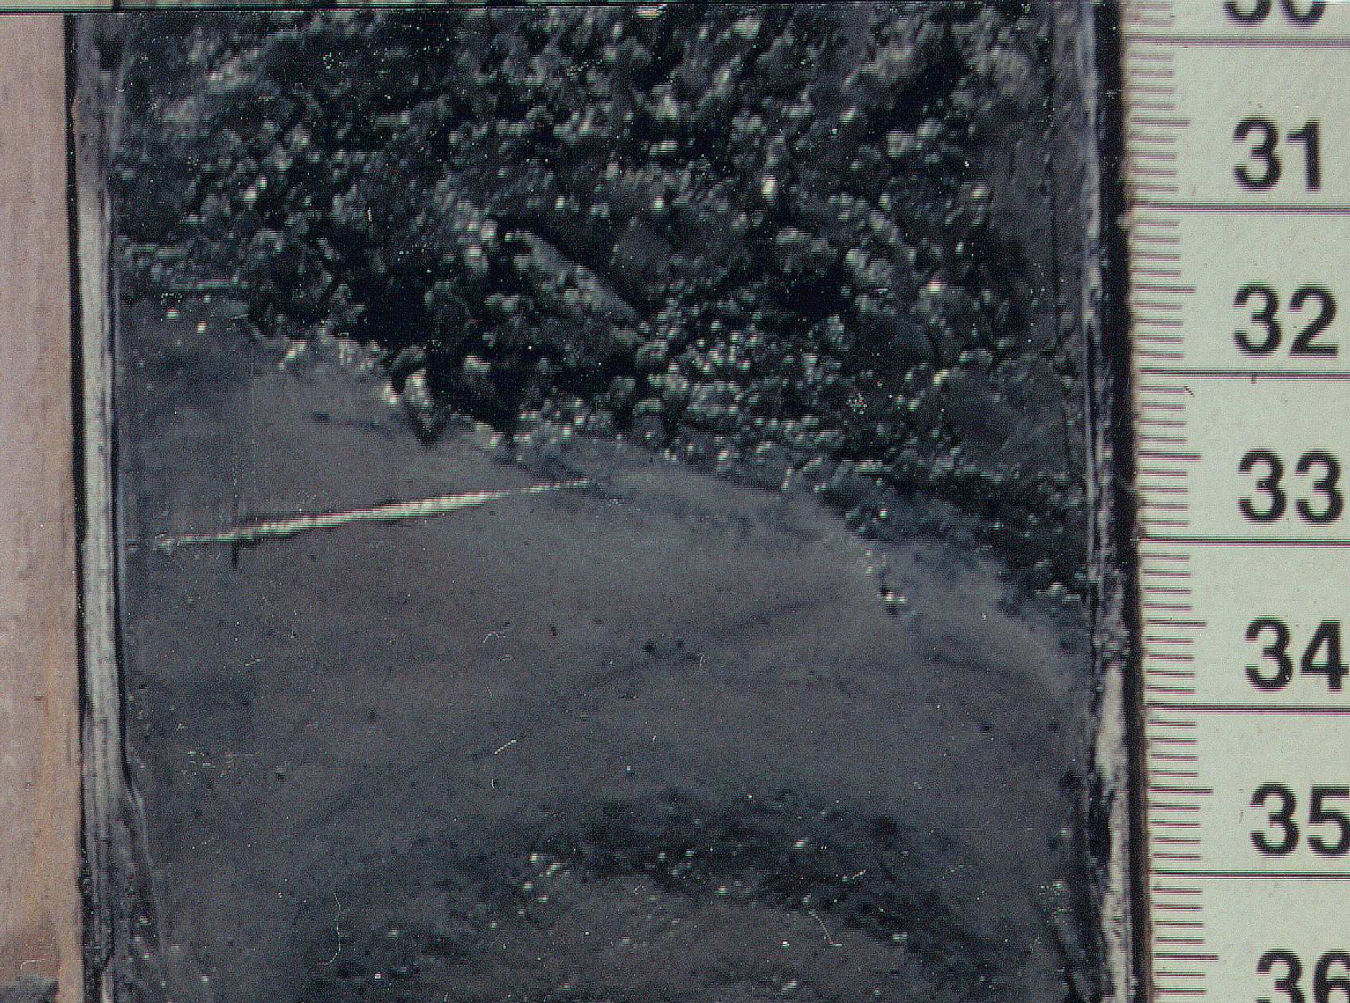
Core Lithology-PG1351 Lake El’gygytgyn
Lithology
Olive-Grey Laminae
Massive Grey Silty Clay
Brownish-Grey Silty Clay
Unit
Olive-Grey Silty Clay
Unit
Unit
Deposited under anoxic conditions
i.e. Glacial-type climate
Depth (cm)
Massive Interglacial-type sediments
Sandy Layer
Silty-Clastic Layer
Depth: 385 cm

Slide 24
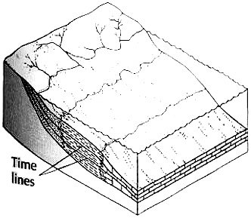
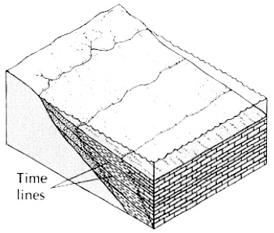
Transgressive – Regressive facies
With Lake level changes.
http://www.geol.umd.edu/~jmerck/geol342/lectures/16.html

Slide 25
Should develop a common language and facies description

Slide 26
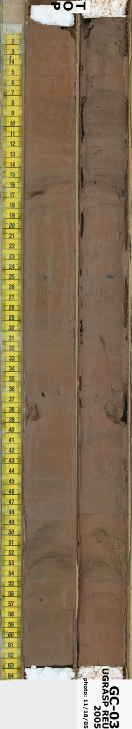
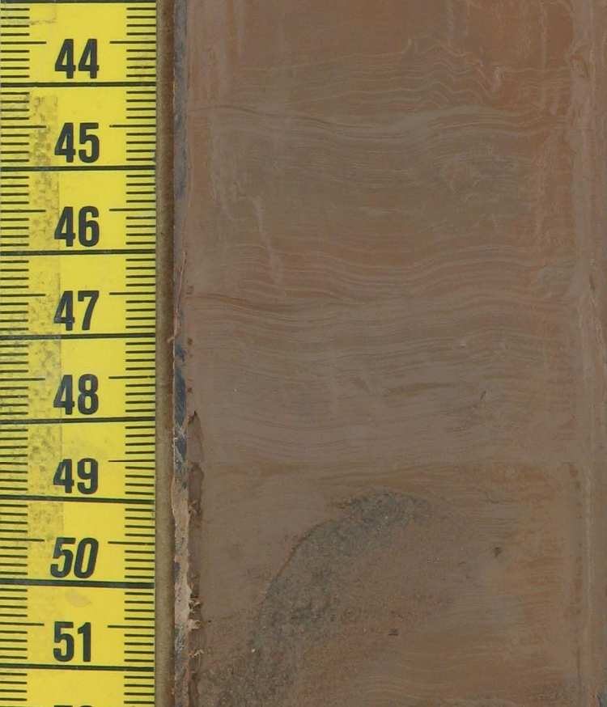
From mud to seeing fine laminae
Gravity Core GC-K05-03 Svalbard REU

Slide 27
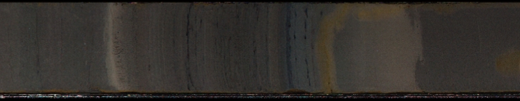
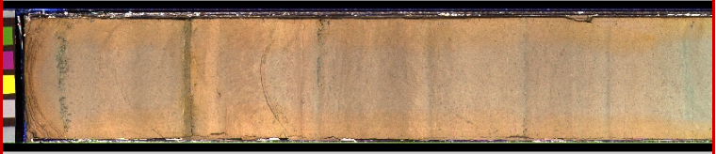
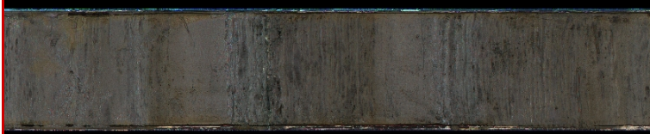
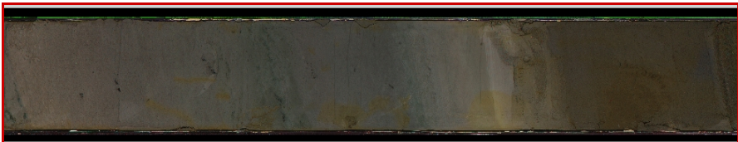
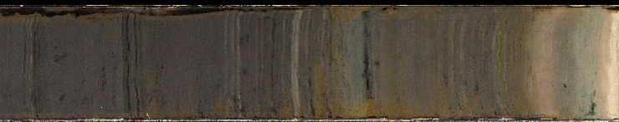

Slide 28
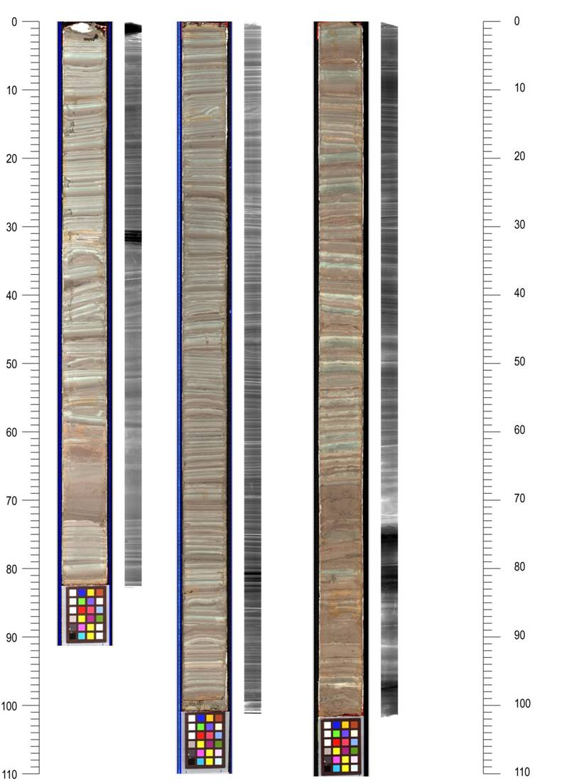

Lake E Pliocene and xrays
L Poppick, Bates
Xrays done at
Umass Health Center
1 yr?

Slide 30

Analytical Assignments
Lake Sediment Analyses and Sampling Scheme
Clastic sedimentology
U-channel
1. paleomagnetics
2. thin sections and archive
2 x 2 cm (ca. 15 g / 2 cm)
pretreatment of samples:
H₂O₂ (organic carbon)
NaOH (opal)
Acid (vivianite)
analyses of remaining fractions:
gravel/sand/silt/clay
lazer particle analysis
clay mineralogy
heavy minerals
sand grain surfaces (SEM/EDS)
Sedimentology and downhole logging
Analysis and
diatoms
0.5 g
10-20 g (rest after samples 1 - 8)

Slide 31


PSICAT – simple software for constructing stratigraphic columns
http://portal.chronos.org/psicat-site/
PSICAT, CHRONOS's Paleontological Stratigraphic Interval Construction and Analysis Tool, is a stand-alone Java based graphical editing tool for creating and viewing stratigraphic column diagrams from drill cores and outcrops. It is customized to the task of working with stratigraphic columns and captures data digitally as you draw and edit the diagram.
Initial developed by Josh Reed for ANDRILL Project.

Slide 32





`
PSICAT Stratigraphic Log Summary
1pm Awesome WOW!
2PM, better than 1PM
3 PM
4pm classy group

Slide 33

File → Export Summary Spreadsheet

Slide 34

Image J – simple analysis software
http://rsbweb.nih.gov/ij/
Allows simple or complex analysis of textures, layering, color
Runs on any platform, public domain
Allows statistics, histograms and surface profiles to transfer to excel.
Use your own core images or have students examine cores accessible at CoreRef.org

Slide 35

10 cm
289.00 m comp depth

Slide 36


Image J analysis of Lake El’gygytgyn thin section
without any enhancements to default settings.

Slide 37

Main Facies
Detailed Sedimentology via Image Analysis (Francus and Asikainen)
http://www.geo.umass.edu/climate/francus/ss1_slide_show.htm
Interglacial
  Non-laminated
  Lower TOC
  High Magnetic susceptibility (MS)
  Median Grain-size = 3.5 µm
Glacial
  Finely Laminated
  “Bleb” Structures
  Higher TOC, low MS
  Authigenic minerals
  Median Grain-size = 3.5 µm

Slide 38



SEM view

Slide 39


SEM view

Slide 40






On-line Data Archiving and Global Access

