Slide 1
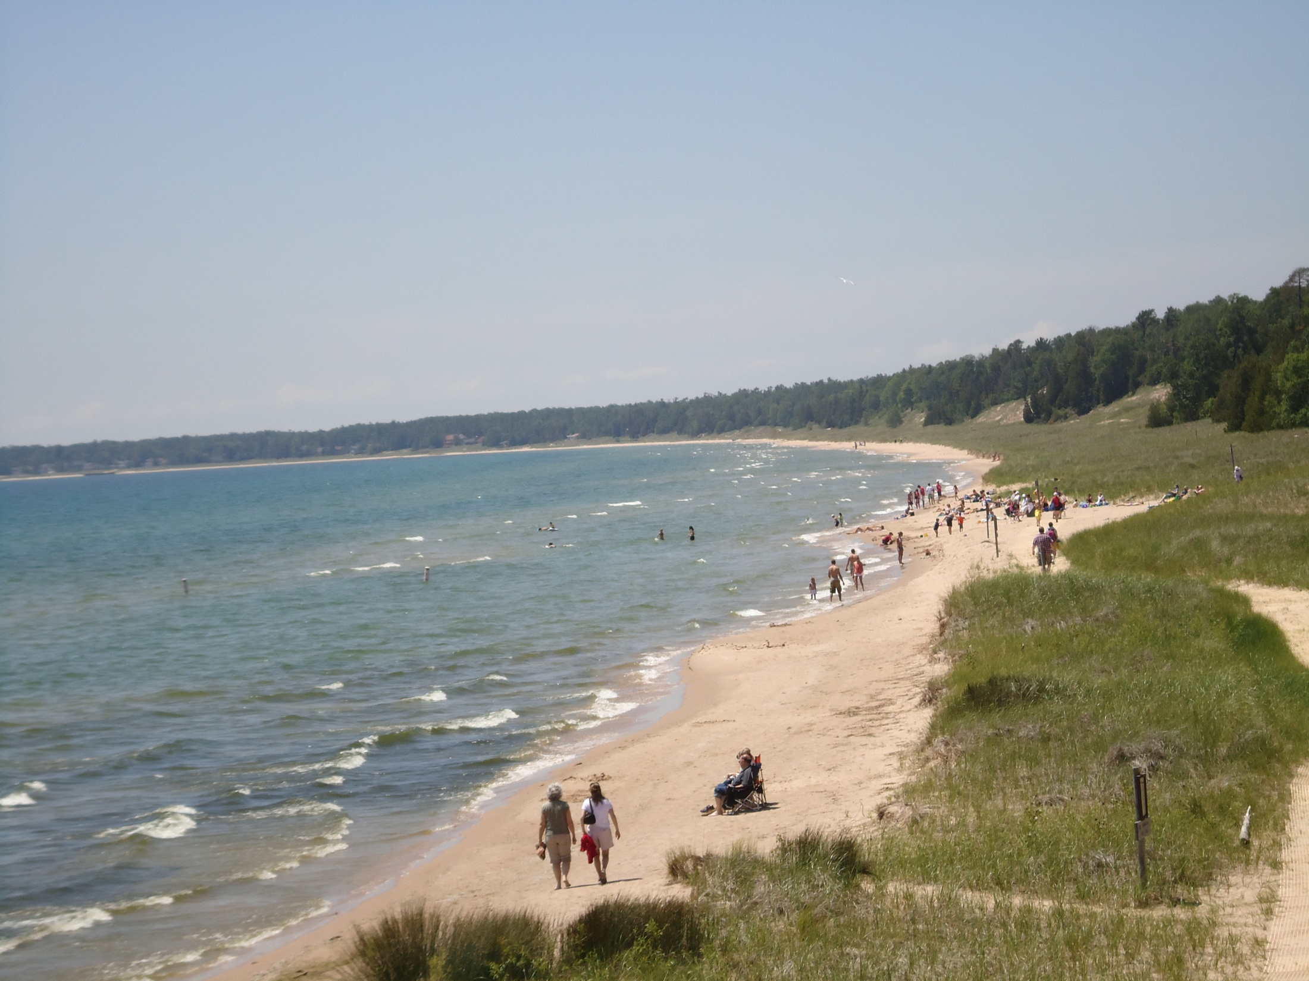

The Geomorphology of Dunes Along the Western Shoreline of Lake Michigan: Disseminating NSF-REU Data in the Classroom
J Elmo Rawling 3rd UW-Platteville
Paul Hanson UN-Lincoln
Dave Hart WGNHS
National Science Foundation Grant #EAR-0850024
Research Experience for Undergraduates Grant

Slide 2
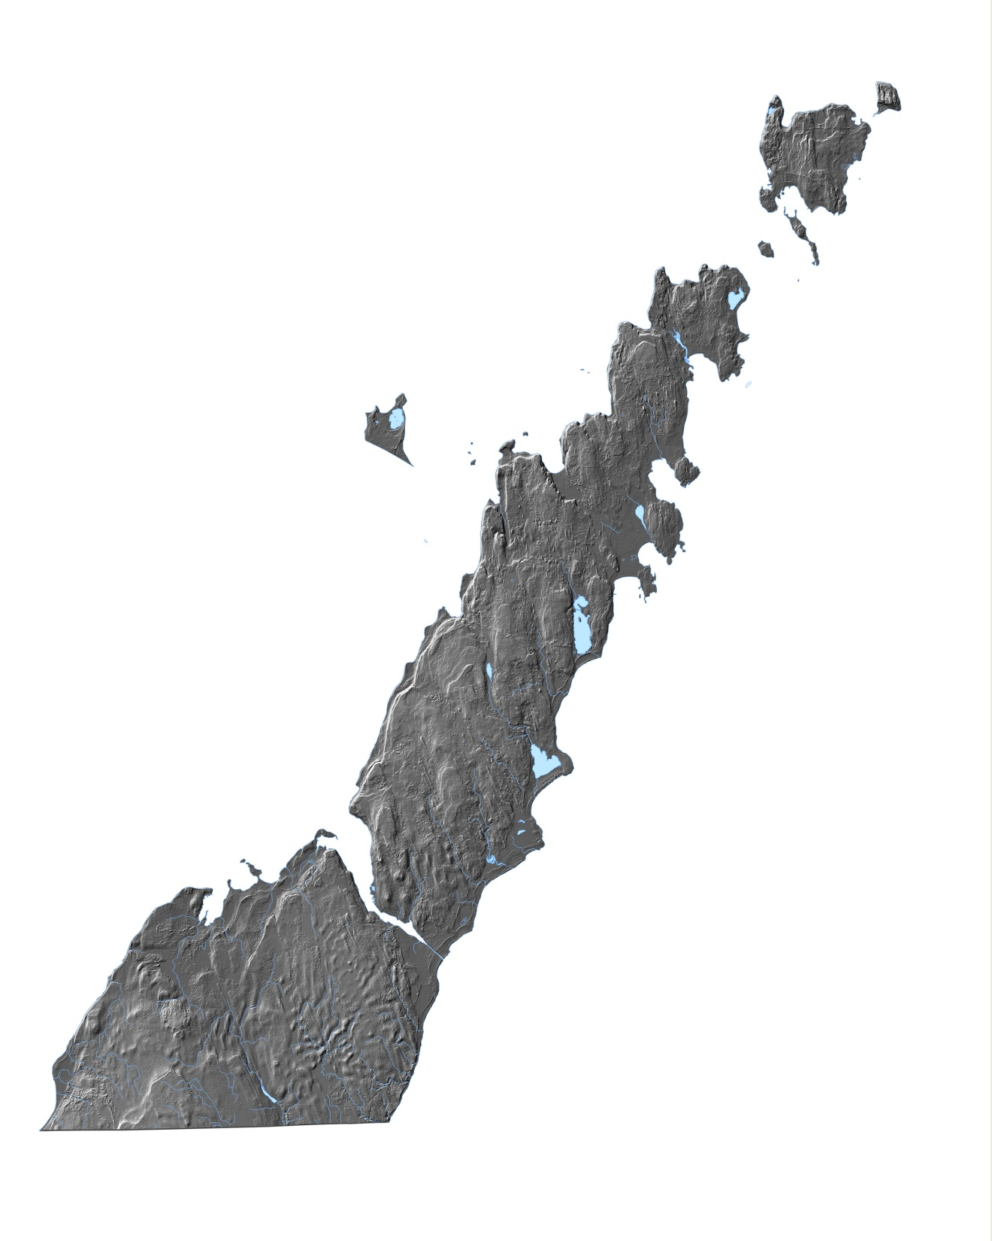
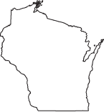
Study Area
All LiDAR Courtesy of Door County, WI
Notes:
bedrock

Slide 3
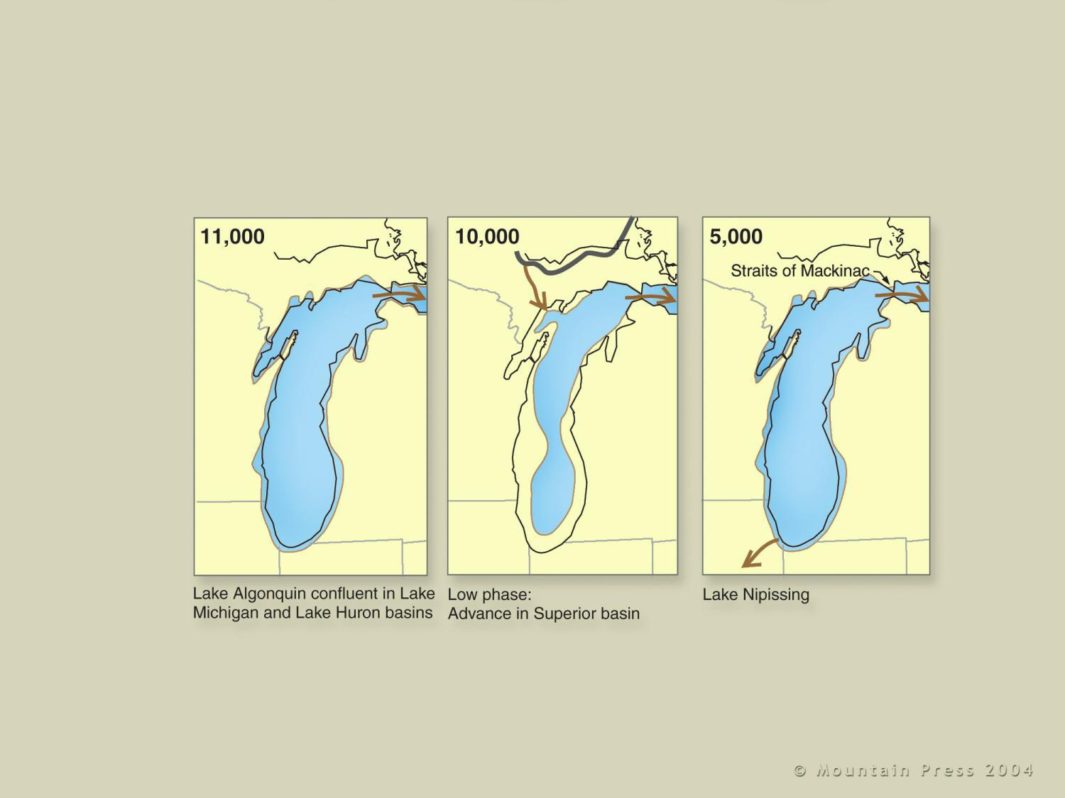
Dott and Attig
Notes:
5.12c. Sequence of lakes and ice advances in the Lake Michigan basin. … Dark gray line shows the southern extent of the Lake Michigan Lobe.—Modified from Hansel, Mickelson, Schneider, and Larsen, 1985 [p. 249]

Slide 4
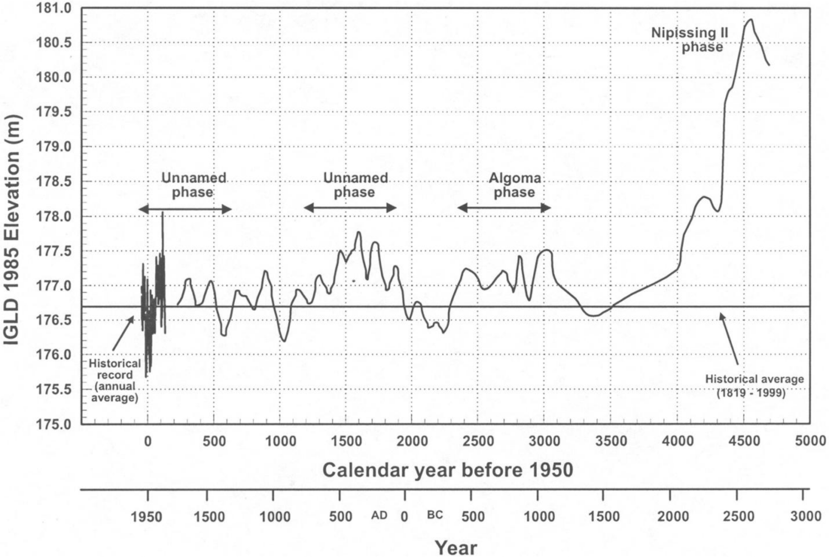
Baedke and Thompson 2000
Notes:
Need Date

Slide 5
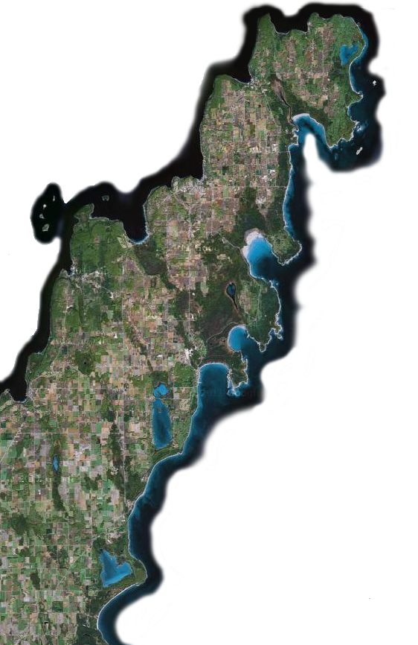
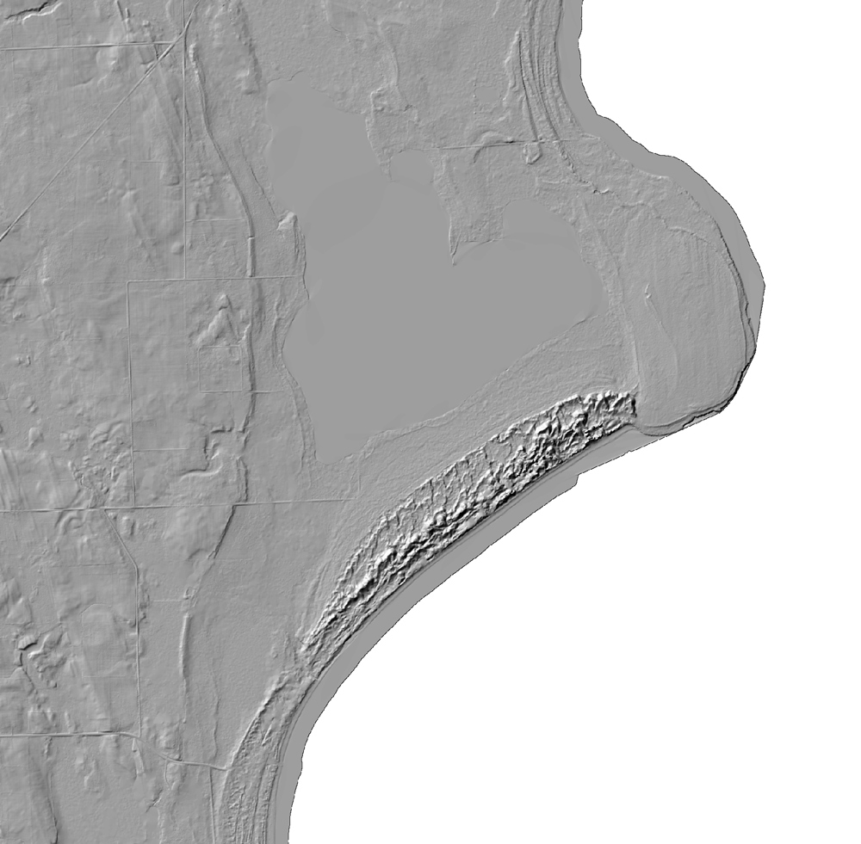
Clark
~1Km
Notes:
Need map of each bay

Slide 6
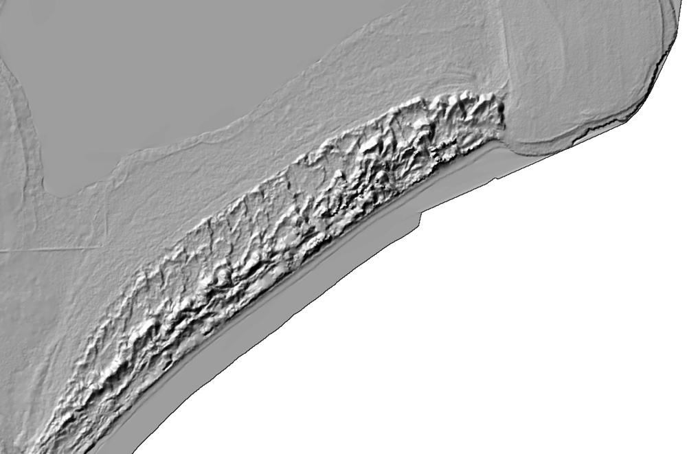
Clark Lake
~0.75 km wide
Small parabolic dunes (3-7 m)
Large parabolic dunes (18-24 m)
Notes:
Clark Lake Geomorph

Slide 7
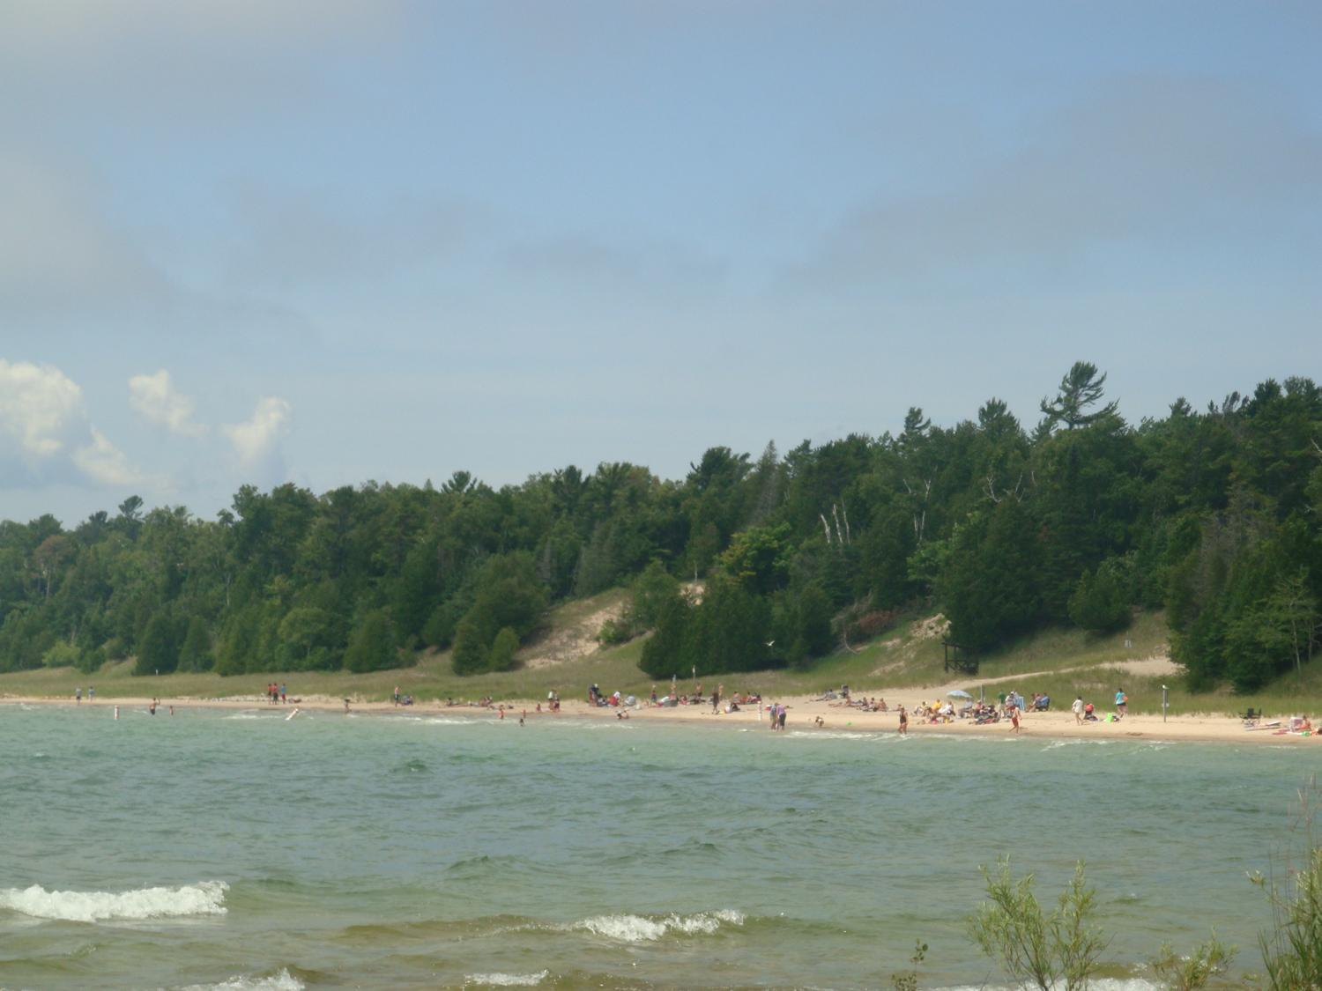

Slide 8
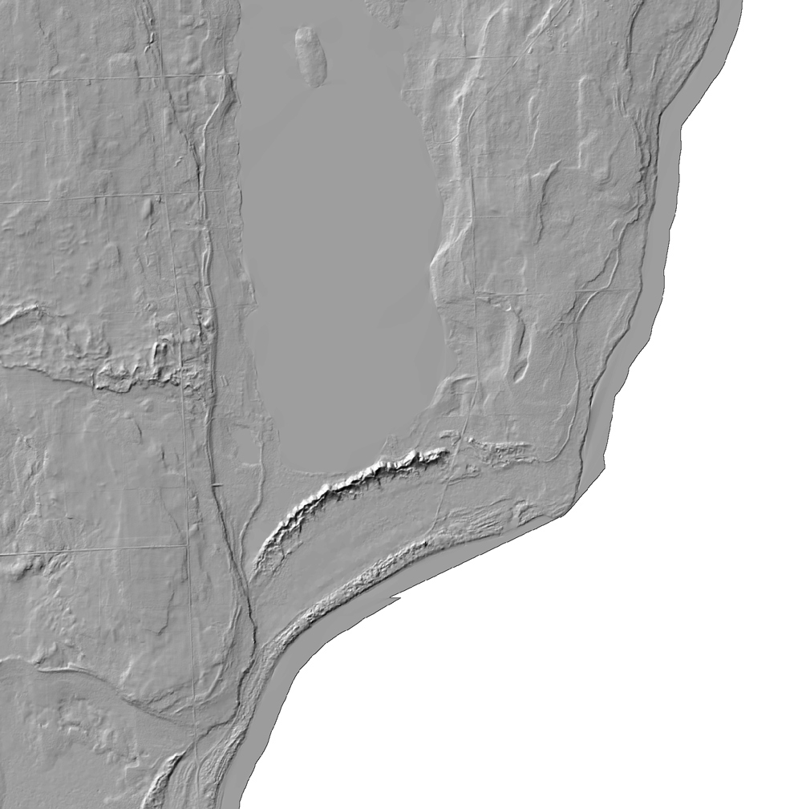
KANGAROO

Slide 9
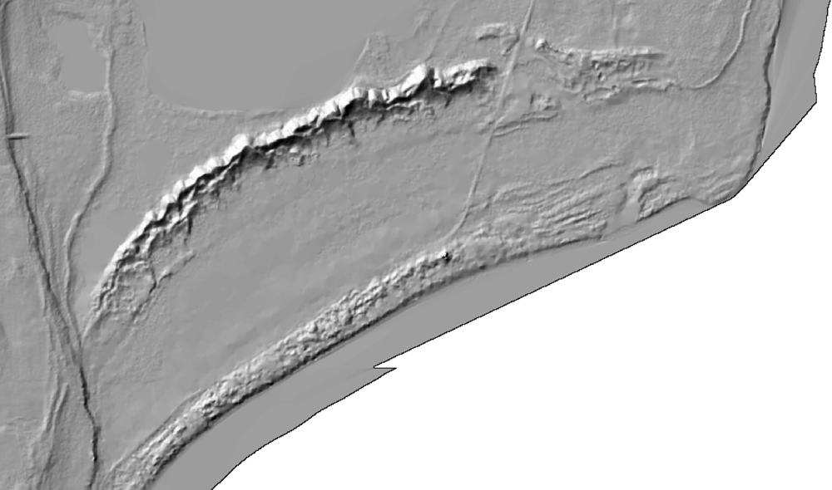
Kangaroo Lake
~0.8 km wide
0.35 km separating
Large Beach Ridge/Parabolic
Dune Complex
Lower Relief Dunes
Notes:
Need Relief

Slide 10
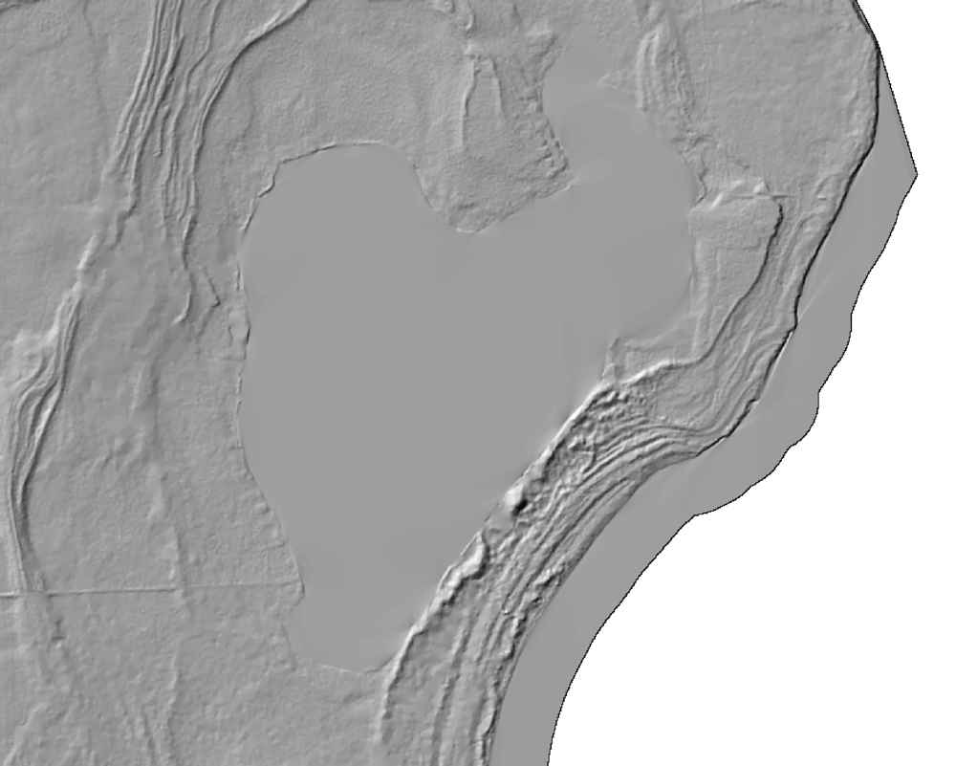
Europe

Slide 11
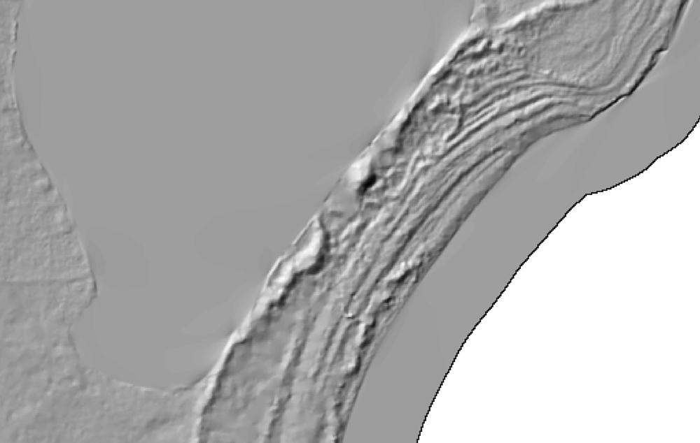
Europe Lake
~0.3 km wide
Large Beach Ridge
Smaller Beach Ridges
No Parabolic Dune Forms
Notes:
Need Relief

Slide 12
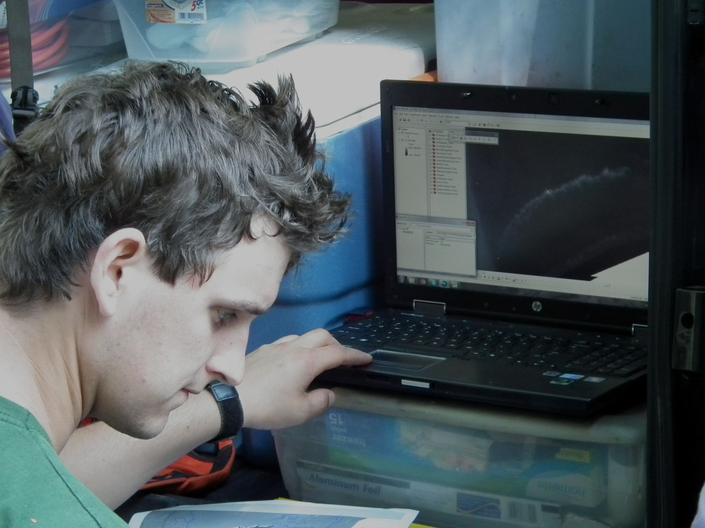
Elevations from LiDAR

Slide 13
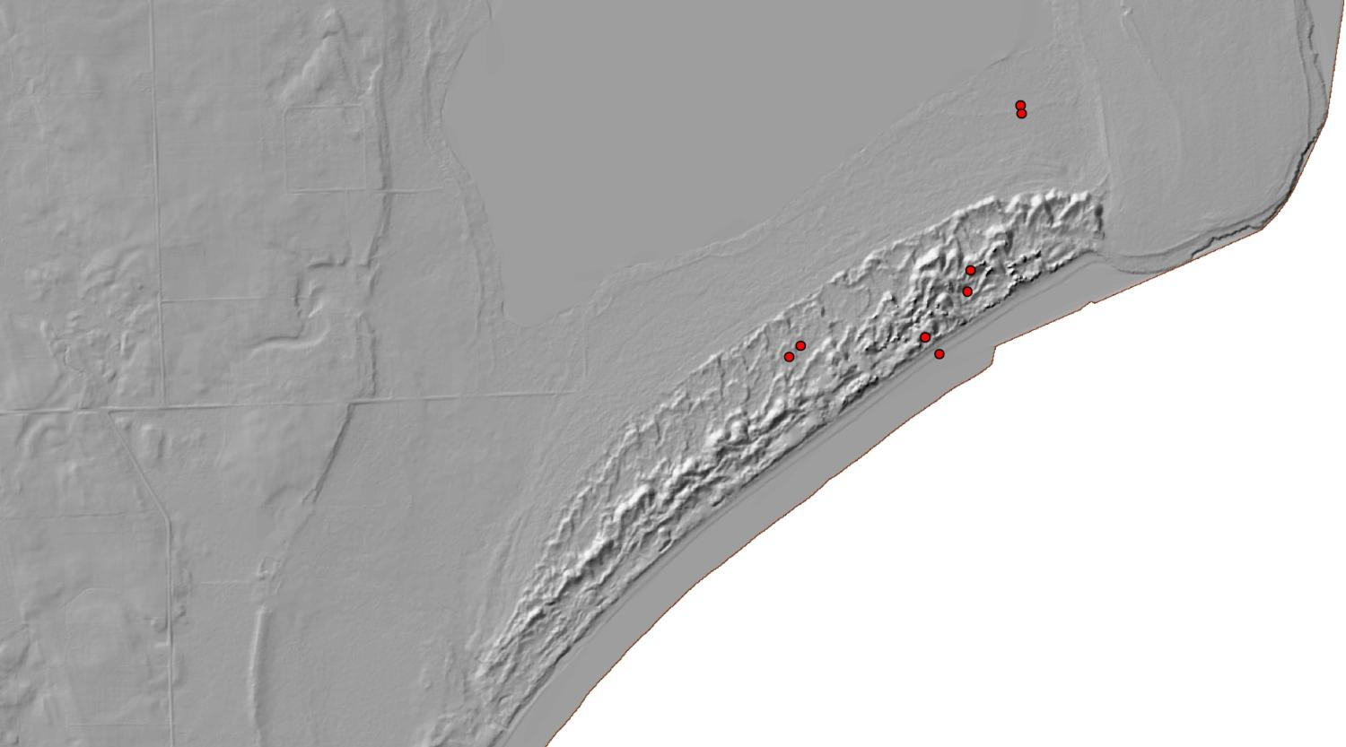
GPR Ground Penetrating Radar

Slide 14
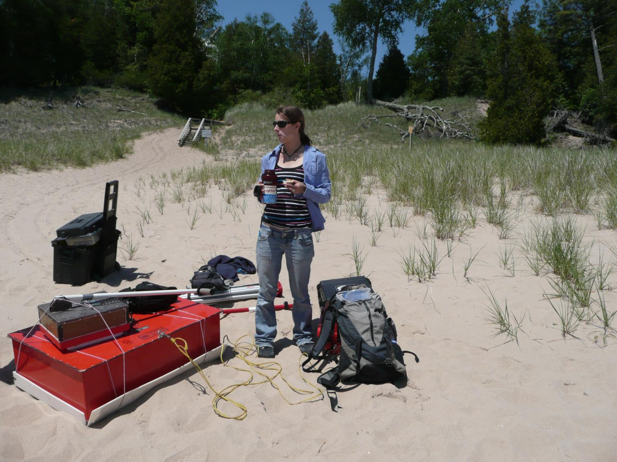

Slide 15
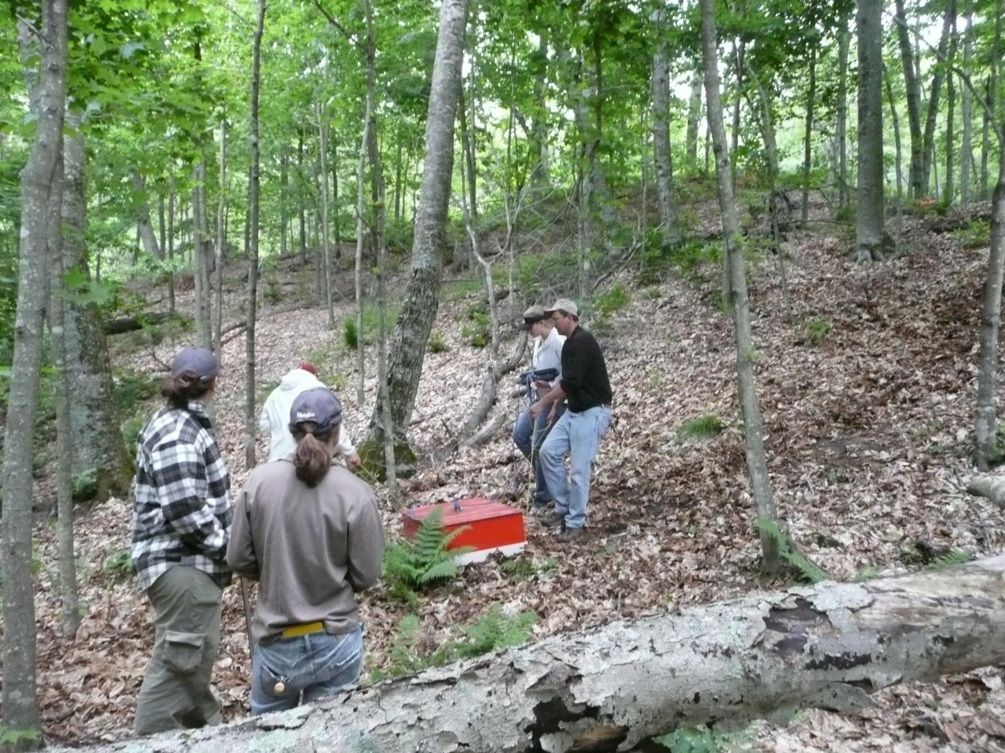

Slide 16

Dave Hart WGNHS

Slide 17
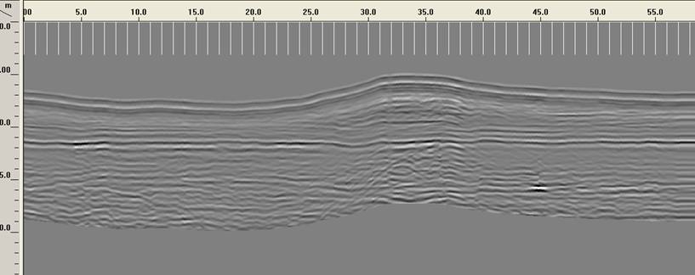
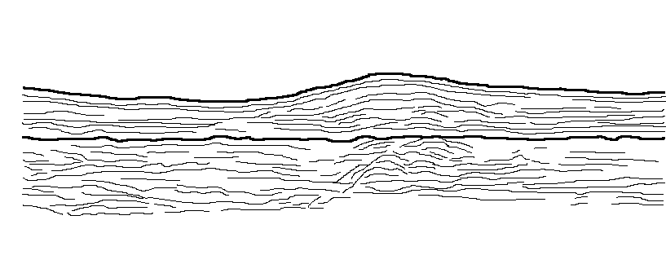

Slide 18
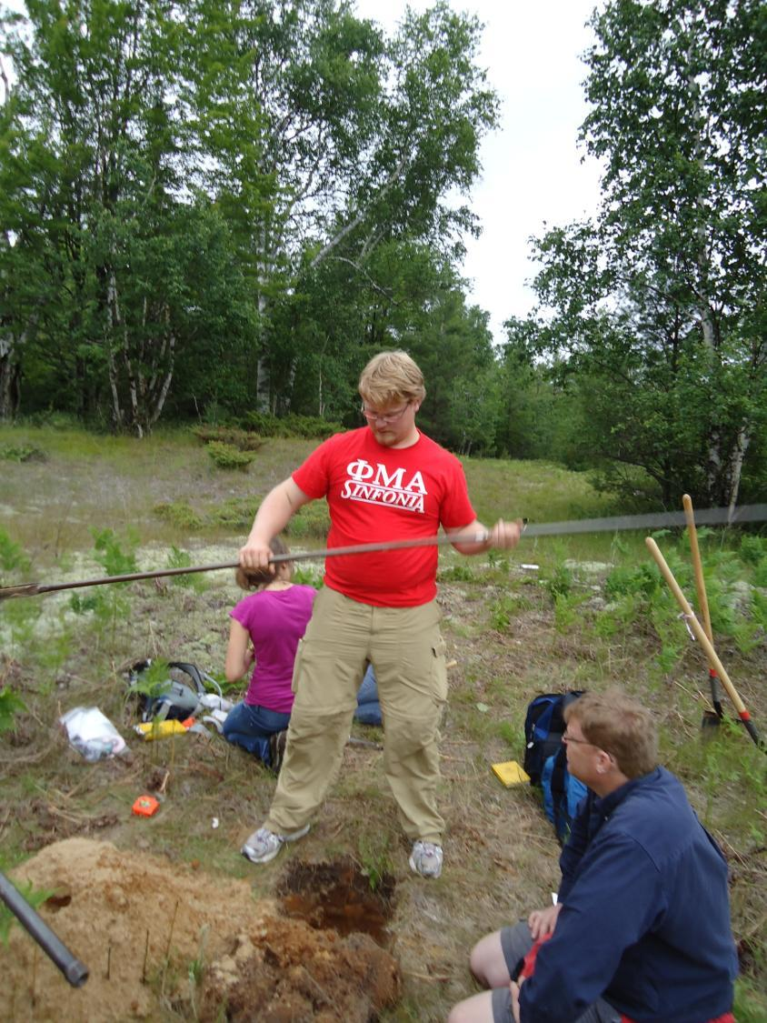
Bucket Augering
for Particle-Size
Analysis and
Stratigraphic
Interpretation of GPR

Slide 19
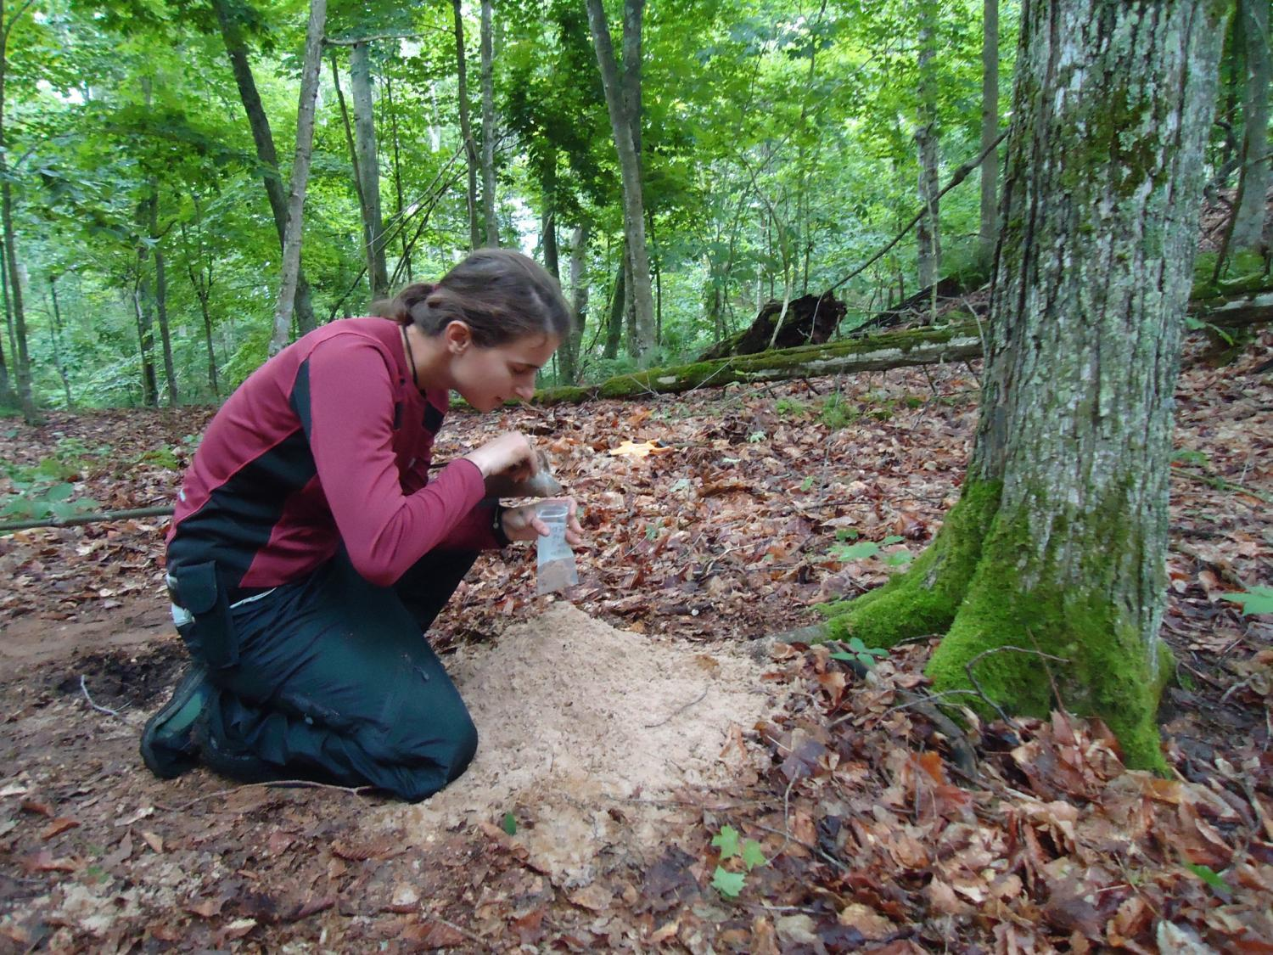

Slide 20
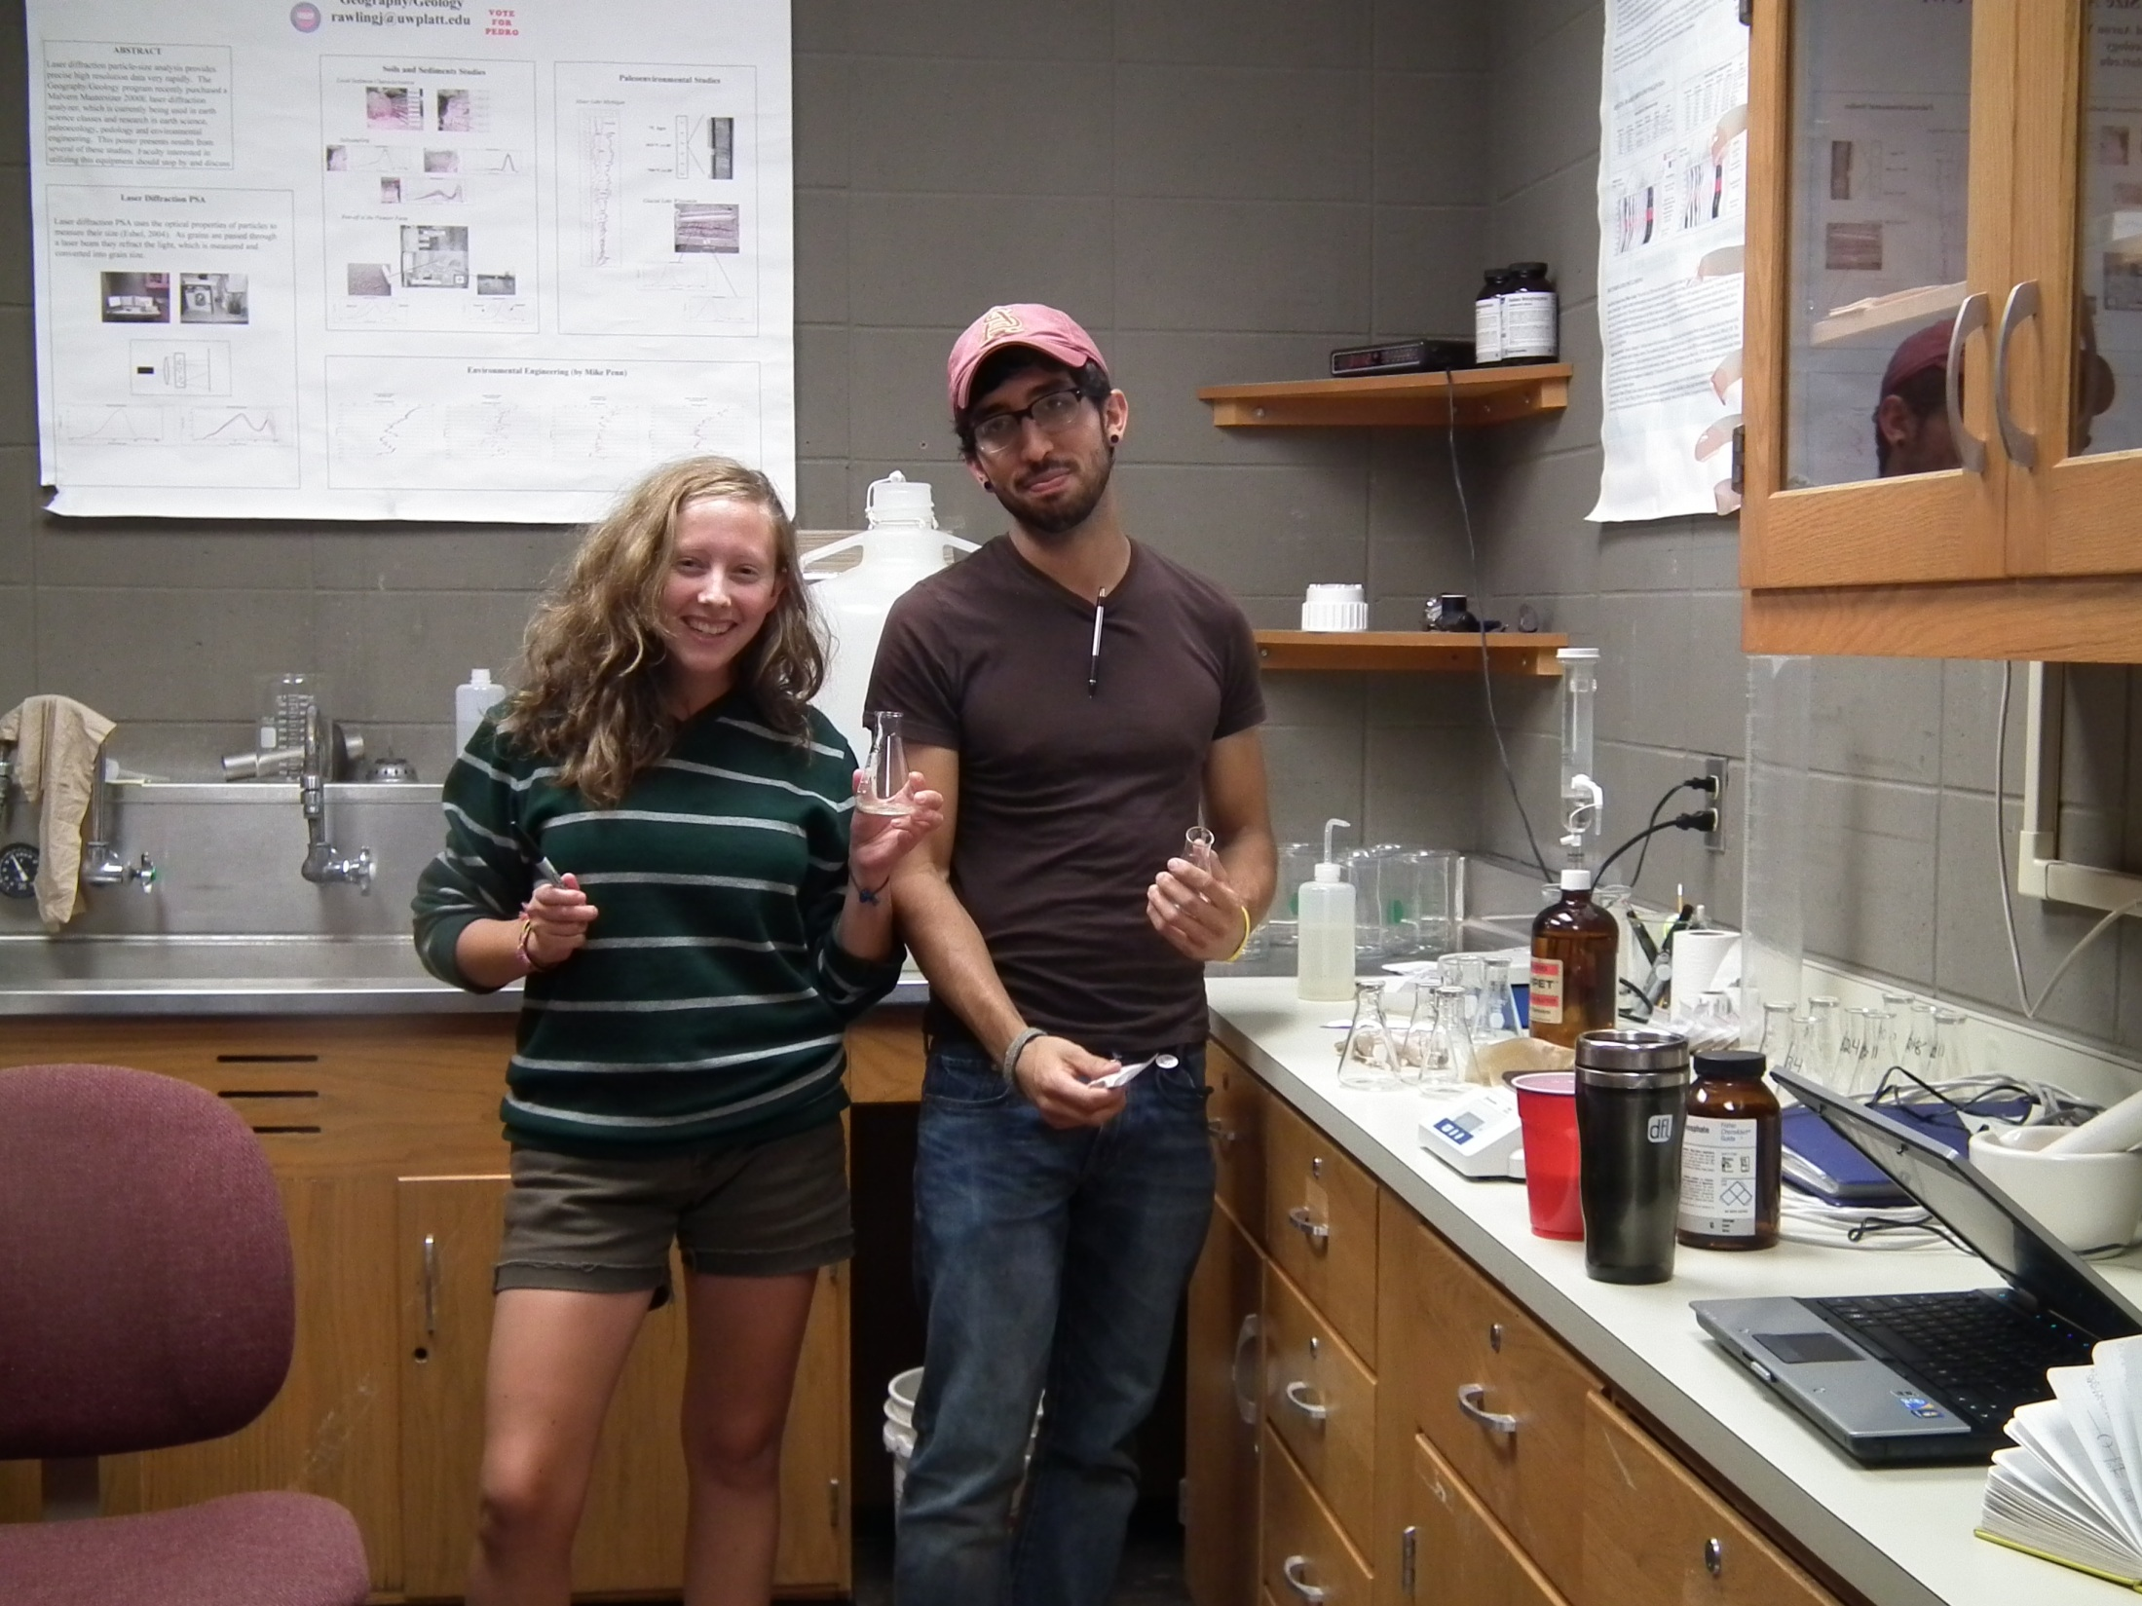
Laser Diffraction PSA

Slide 21
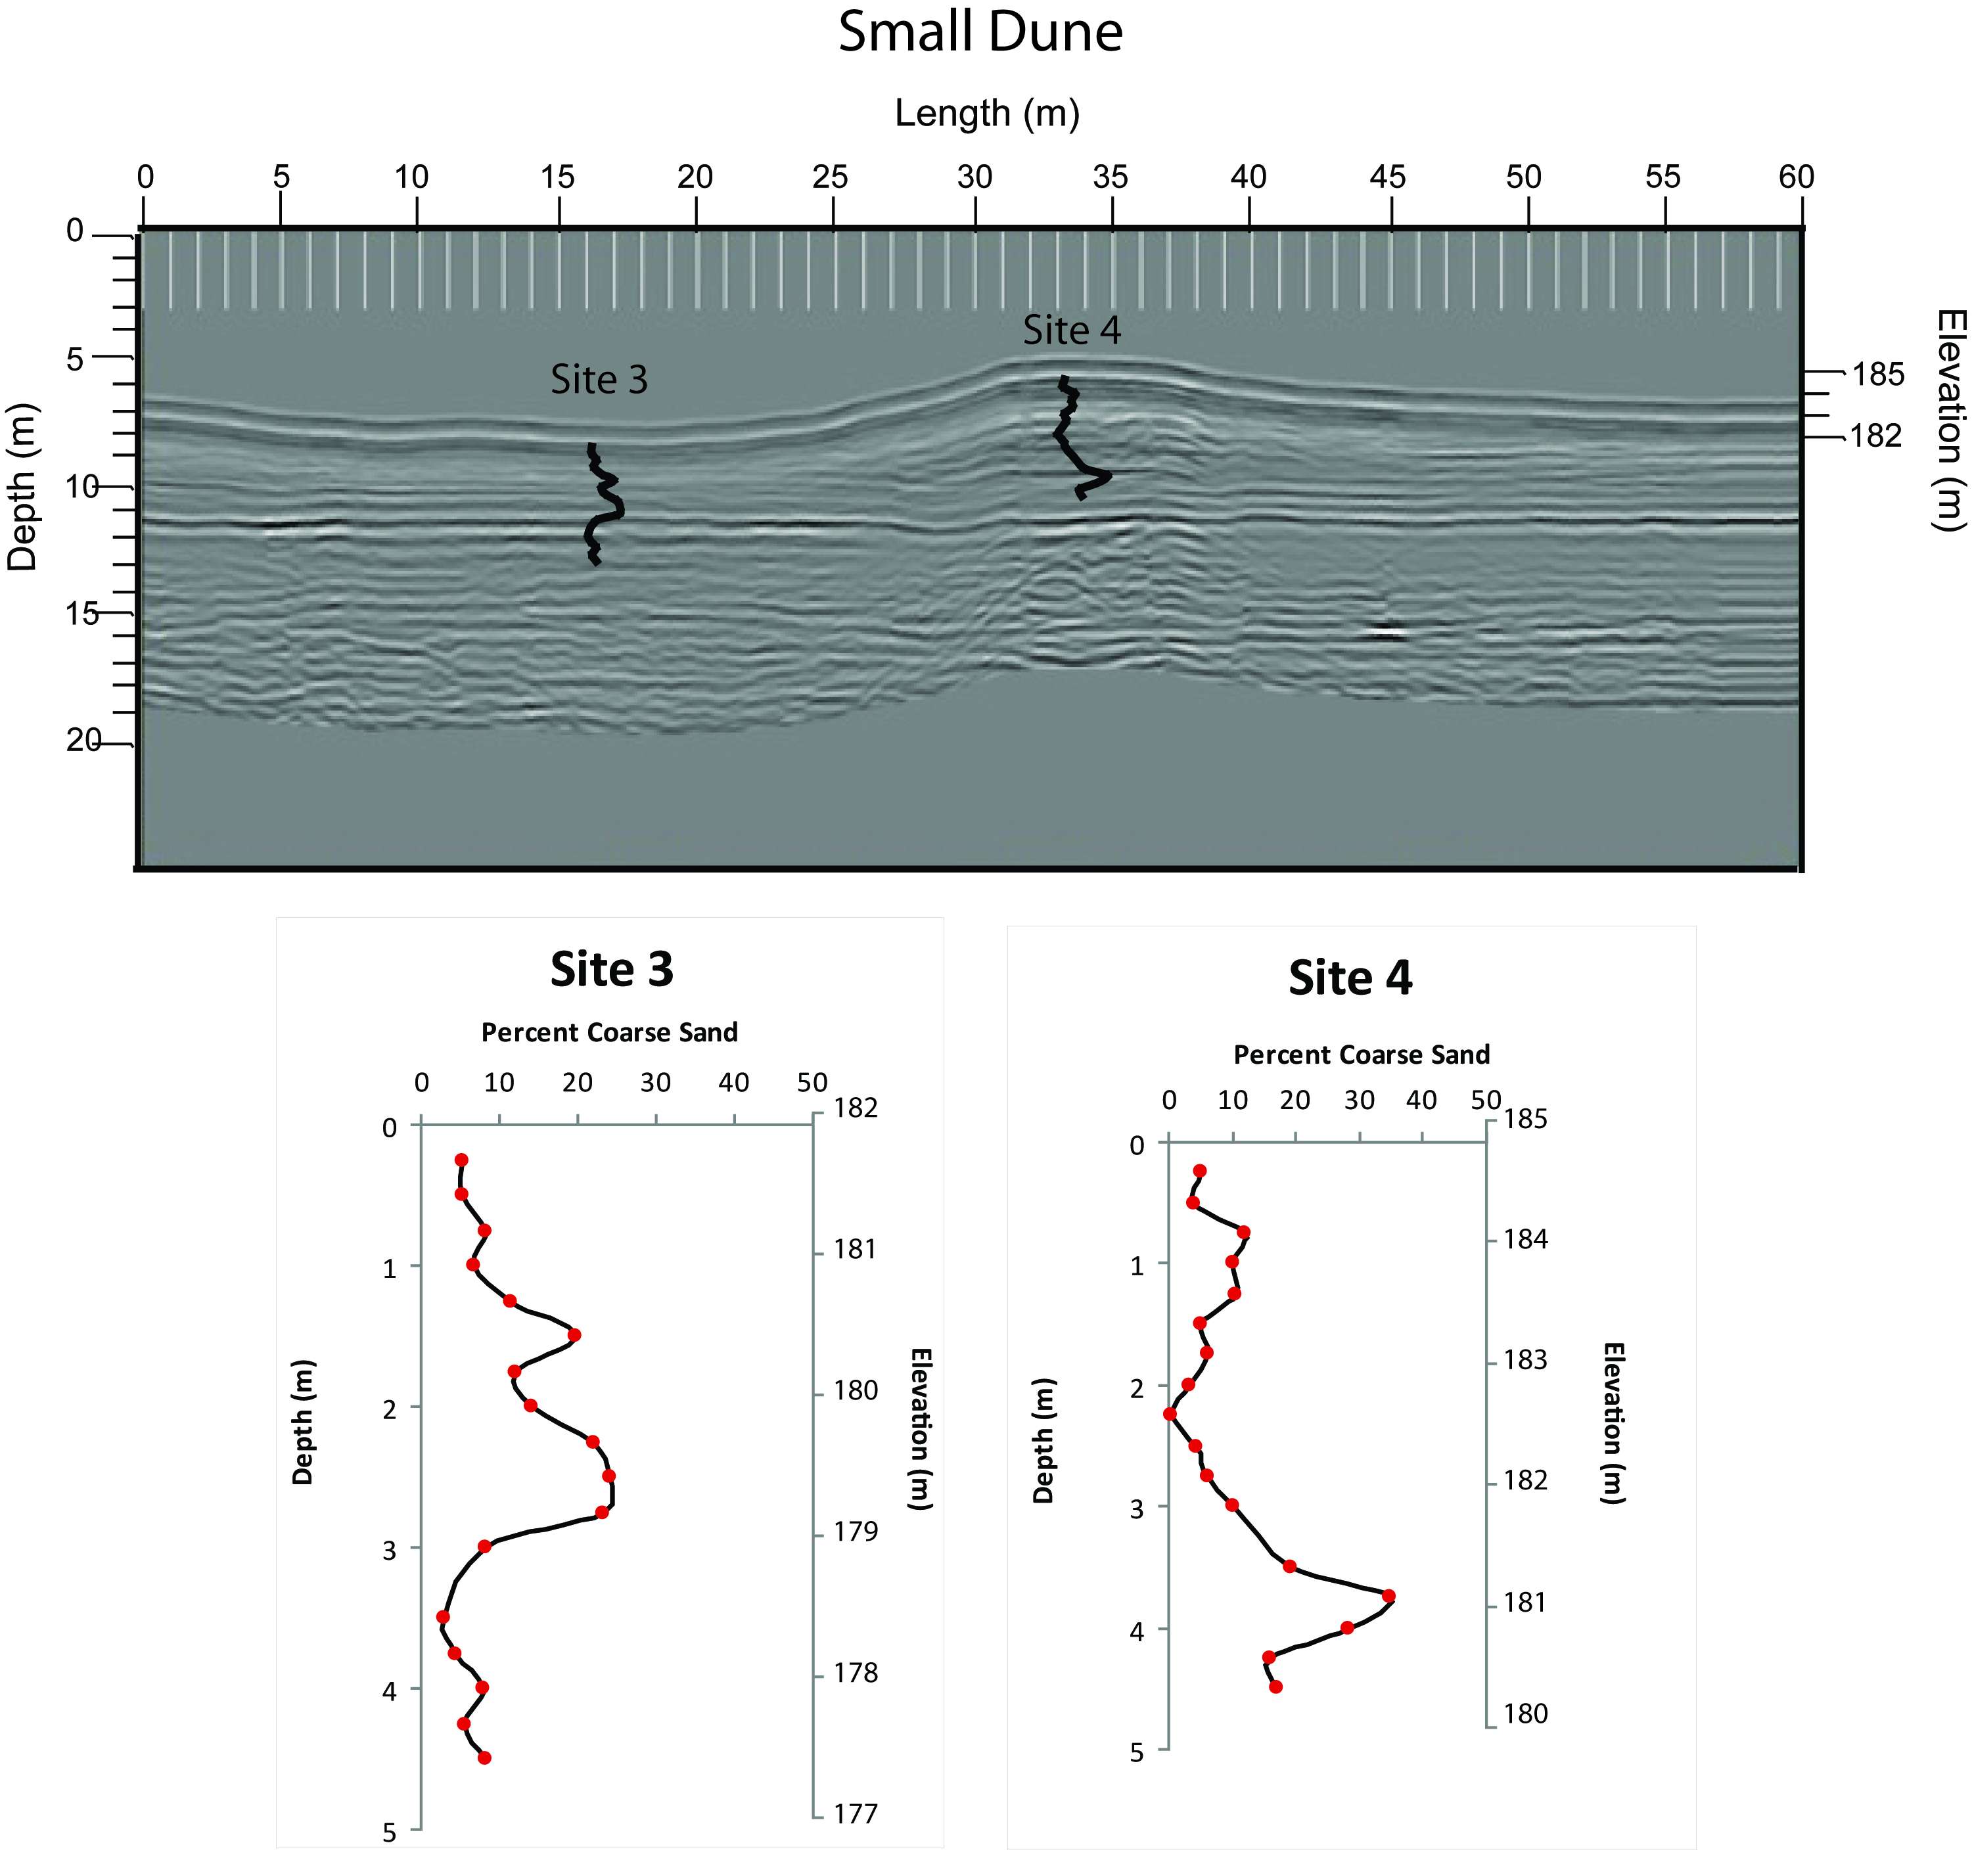

Slide 22

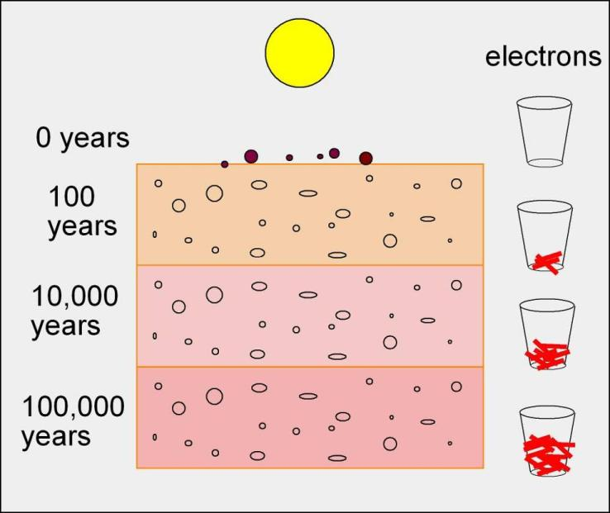
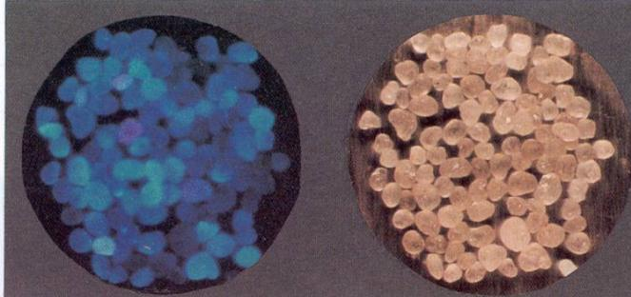
Optically Stimulated Luminescnce Age Estimate
Estimating burial ages based on the abundance of energy stored in sand grains.
Methods following Rawling et al 2008

Slide 23
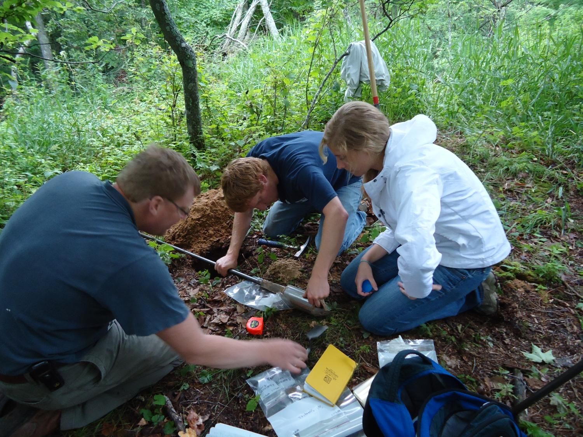

Slide 24
Optical Ages
samples from the same site

Slide 25
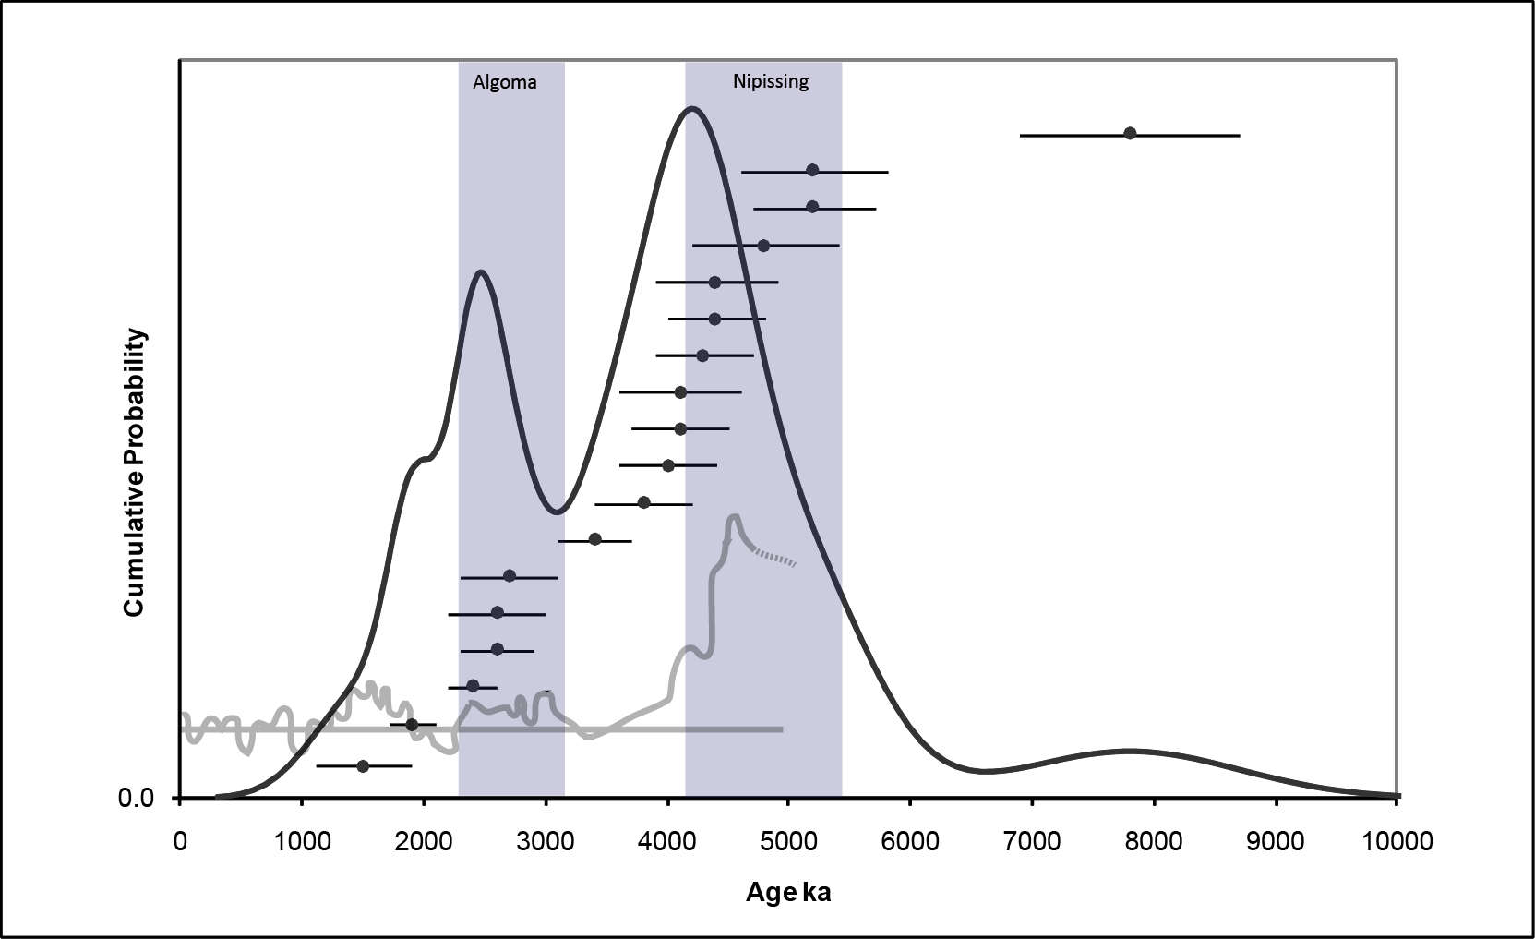

Probability Plot From Clark Lake

Slide 26
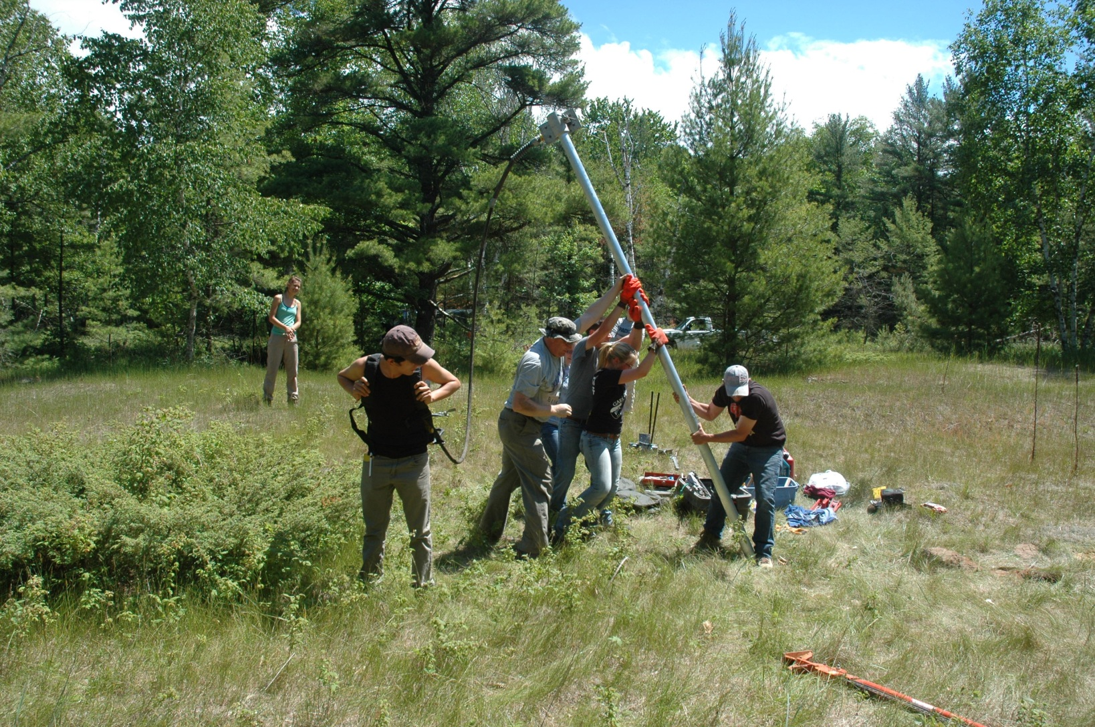
Vibracoring to reach underlying lake sediments below the water table

Slide 27


Slide 28
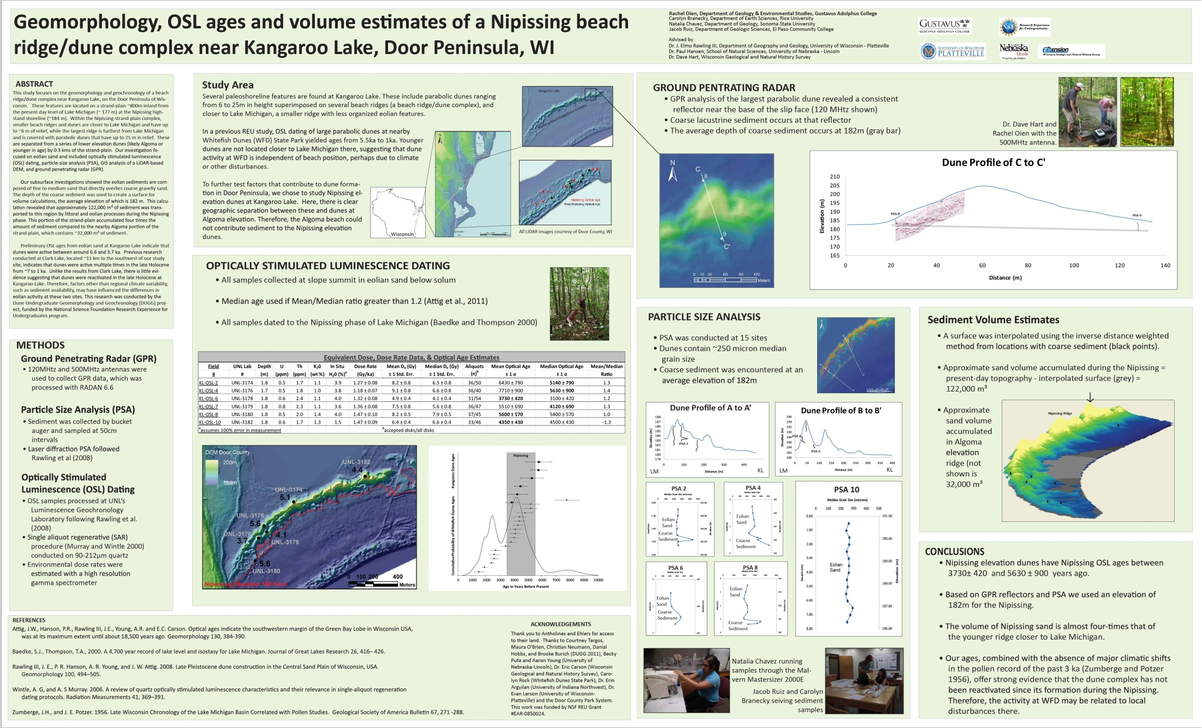
Dissemination…..

Slide 29
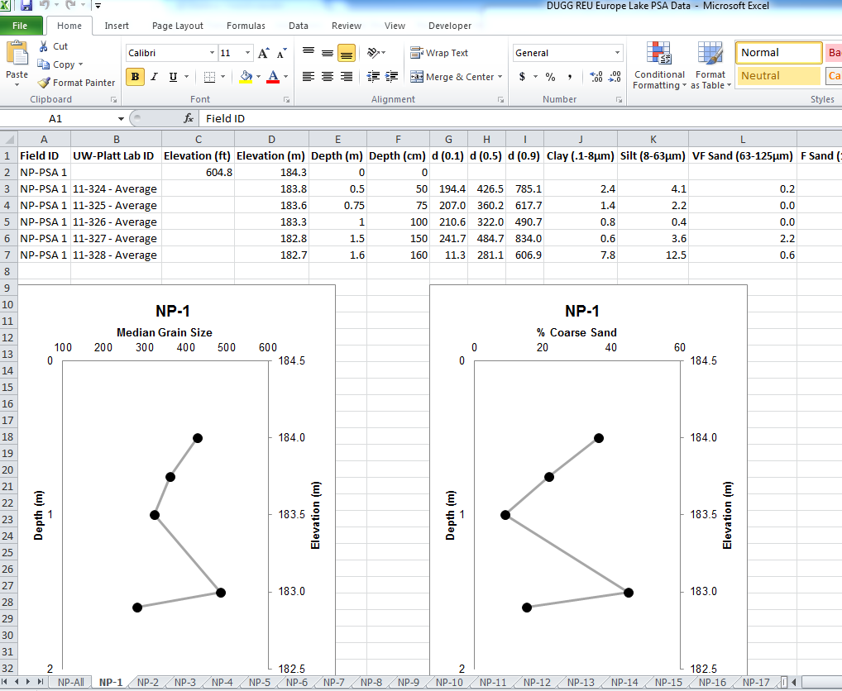
What’s the best format to get this information in the classroom?
Is the data provided here a good template for a future website?

Slide 30
Europe

Slide 32
Potential Assignment Topics =
Determining the Elevation of Past Lake Levels
Tracing Shorelines with LiDAR/Using LiDAR to get elevations
Combining LiDAR, PSD and GPR Data
Others?
OSL Dates

Slide 33

DUGG 2010 Crew

Slide 34
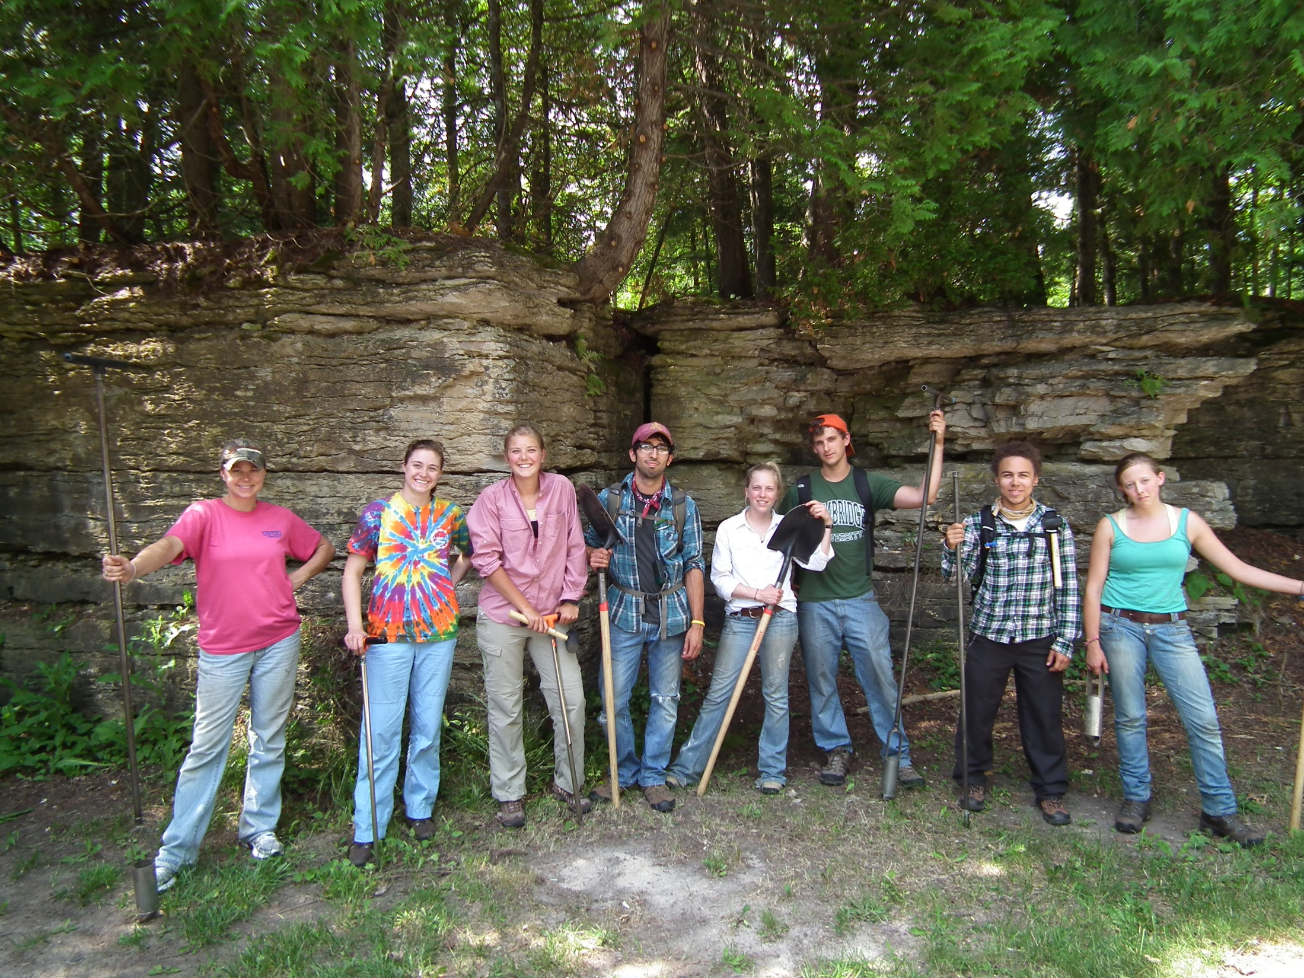
DUGG 2011 Crew

Slide 35
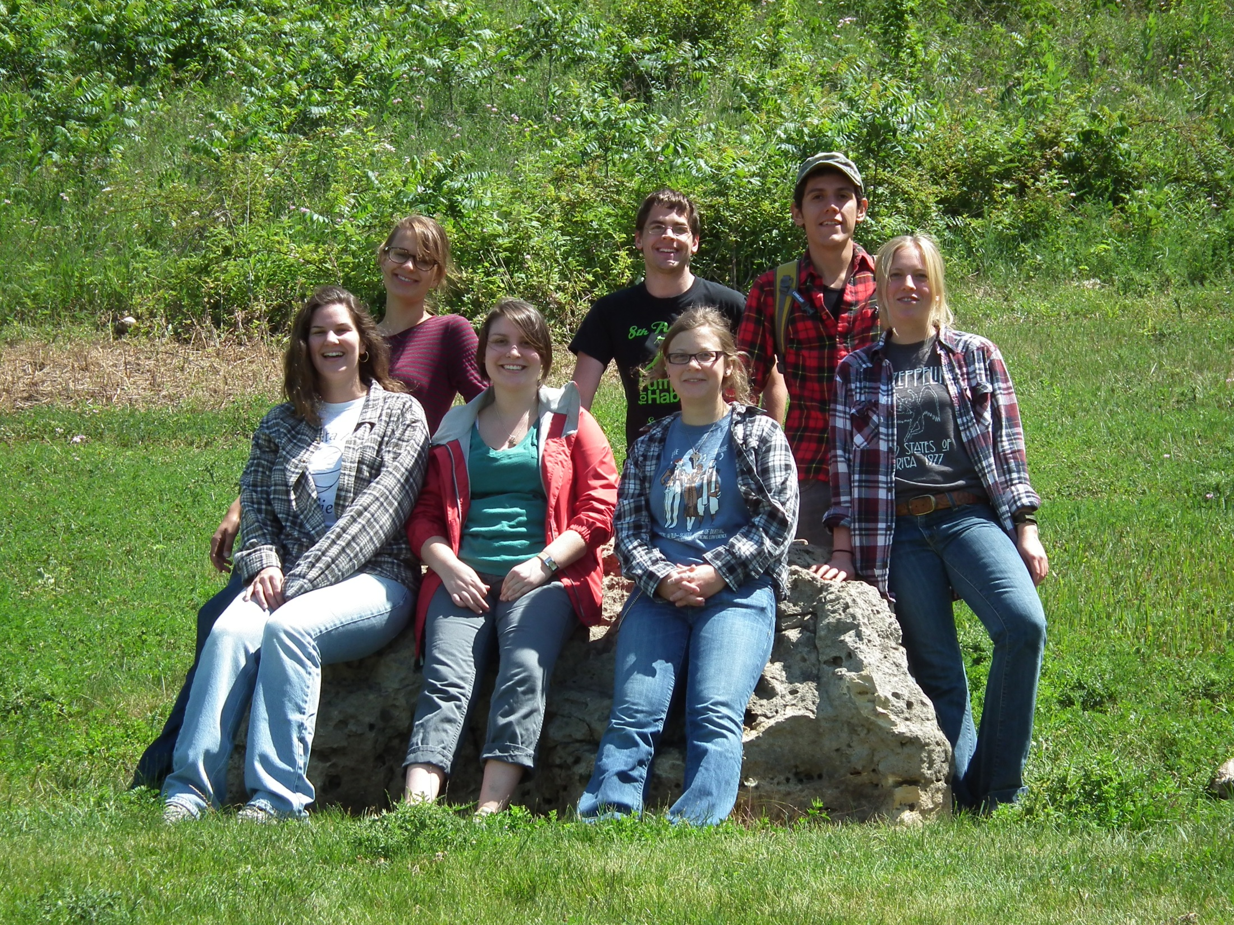
DUGG 2012 Crew

Slide 36
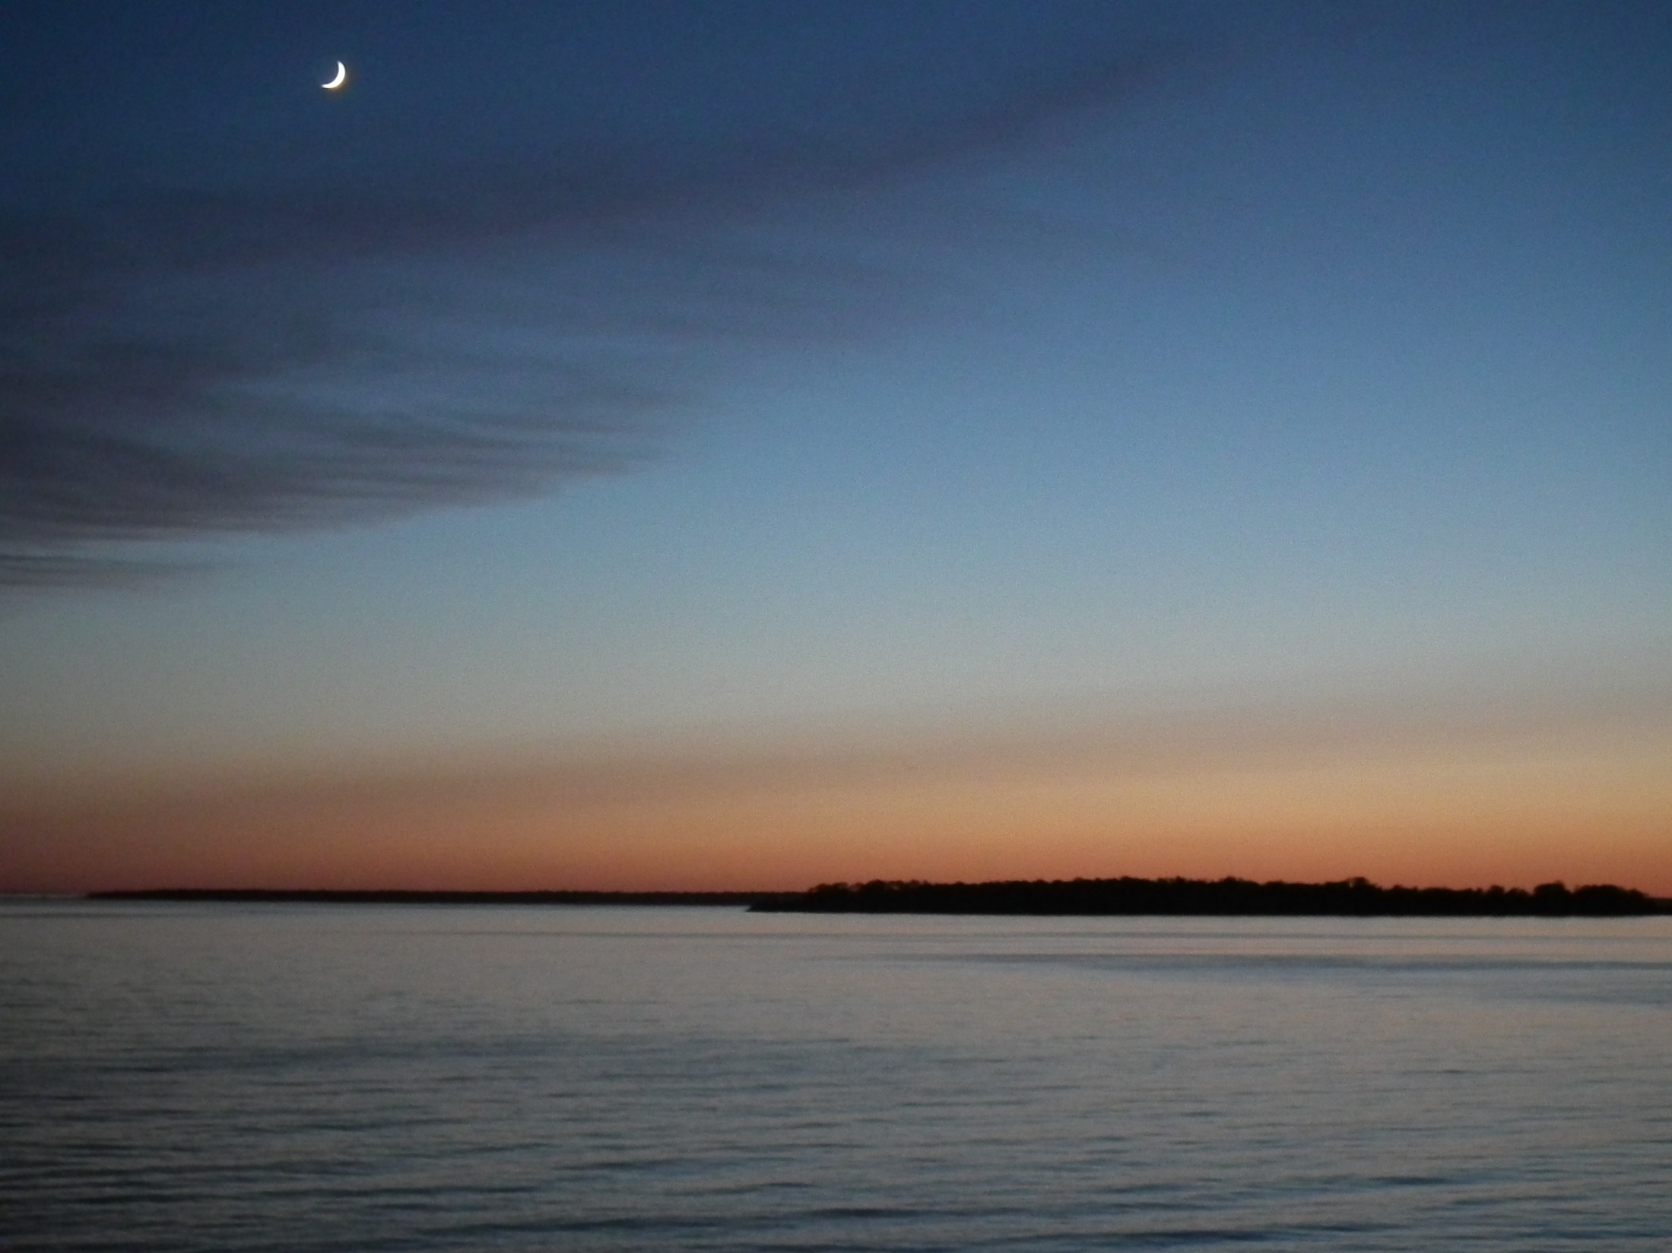
Baedke, S.J., Thompson, T.A., 2000.
A 4,700 year record of lake level and isostasy for Lake Michigan. J. Great Lakes Res. 26, 416– 426.
Dott, R.H., and Attig J.W. 2004.
Roadside Guide to the Geology of Wisconsin. Mountain Press.
Rawling III, J. E., P. R. Hanson, A. R. Young, and J. W. Attig. 2008.
Late Pleistocene dune construction in the Central Sand Plain of Wisconsin, USA. Geomorphology 100 (3-4): 494–505.
Thanks for listening.

