Slide 1
Engaging Students and Addressing Critical Thinking Skills via the Nuclear Debate
James D. Myers
Director, Wyoming CCS Technology Institute
Professor, Department of Geology & Geophysics
University of Wyoming

Slide 2
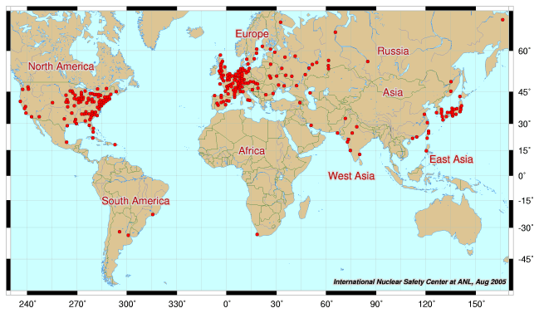
A Quick Look at Nuclear Power
Global Nuclear Power Industry

Slide 3
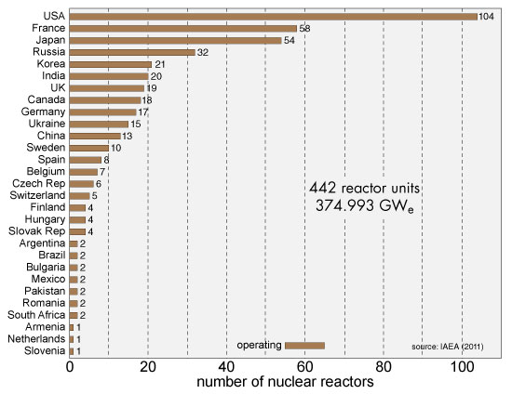
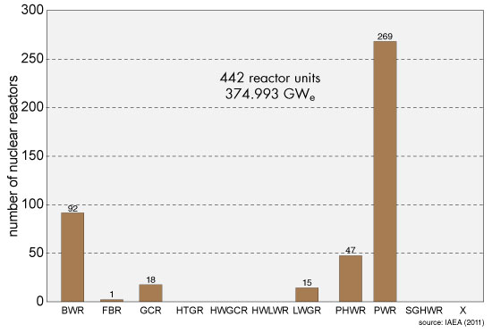
A Quick Look at Nuclear Power
Global Nuclear Power Industry

Slide 4
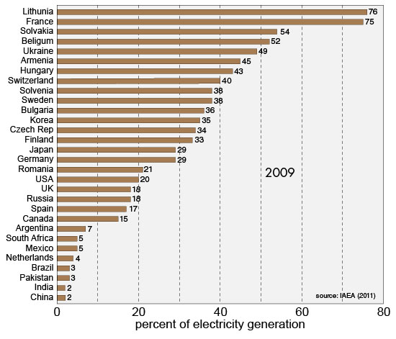
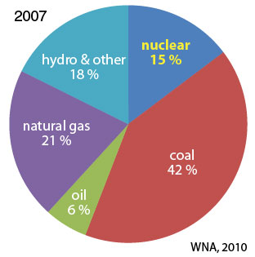
A Quick Look at Nuclear Power
Global Nuclear Power Industry

Slide 5
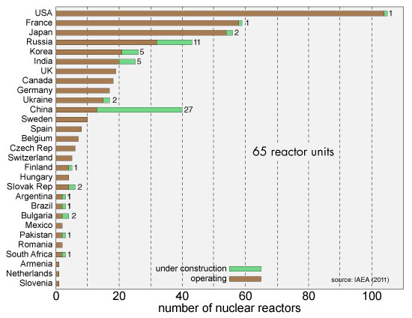
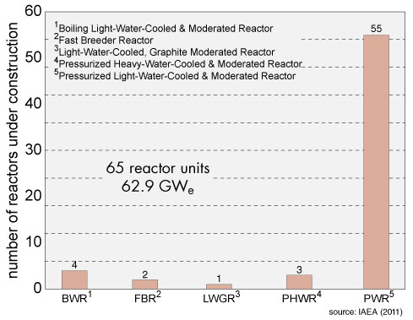
A Quick Look at Nuclear Power
Global Nuclear Power Industry

Slide 6
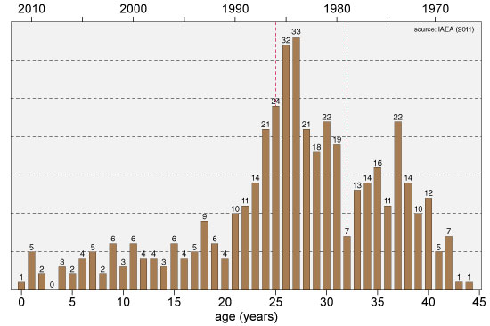
A Quick Look at Nuclear Power
Global Nuclear Power Industry

Slide 7
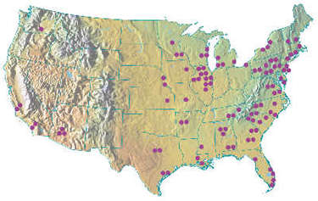
A Quick Look at Nuclear Power
U.S. Nuclear Power Industry

Slide 8
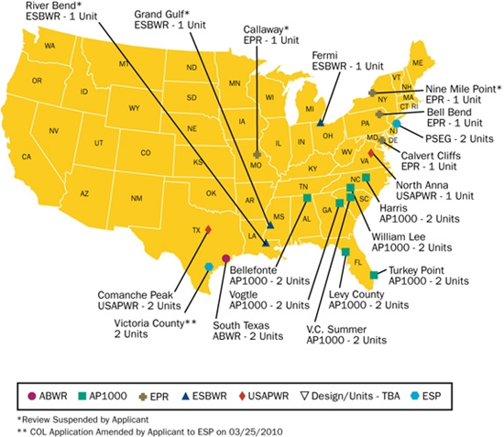
A Quick Look at Nuclear Power
U.S. Nuclear Power Industry
U.S. Nuclear Regulatory Commission has issued design certificates for:
  Advanced Boiling Water Reactor (ABWR)
  System 80+
  Advanced Passive 600 (AP600)
  Advanced Passive 1000 (AP1000)
considering applications for 4 other designs
certifies plant design independent of specific site

Slide 9
Nuclear Power
Important Topic Areas
overview of nuclear power industry
nuclear physics
reactor principles
fuel cycles
  uranium (U)-plutonium (Pu)
  thorium (Th)-uranium (U)-plutonium (Pu)
issues around nuclear power
  waste disposal
  radiation
  accidents & safety
  proliferation
  terrorism
  reactor decommissioning
future directions

Slide 10
Nuclear Physics
Nuclear Transformations: Mechanisms
the nuclear structure of atoms is changed by three different mechanisms:
  fission: splitting of heavy nuclei into two lighter ones with the releases of neutrons and energy
    spontaneous: naturally-occurring, long half-life (for U 10⁸⁻⁹ y)
    neutron-induced
  fusion: combining of two nuclei to make a new heavier nuclei
    new nuclei has less mass than sum of two original nuclei
  radioactive decay: spontaneous disintegration of a nucleus into a smaller, less energetic nucleus by emission of particle or electromagnetic radiation
    particle: alpha, beta, electron capture
    electromagnetic: gamma
these processes are not influenced by physical conditions, e.g. pressure, temperature, etc.

Slide 11
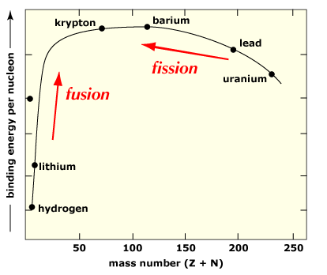
Nuclear Physics
Nuclear Transformations: Binding Curve

Slide 12
Nuclear Physics
Nuclide Chart: Periodic Table?

Slide 13
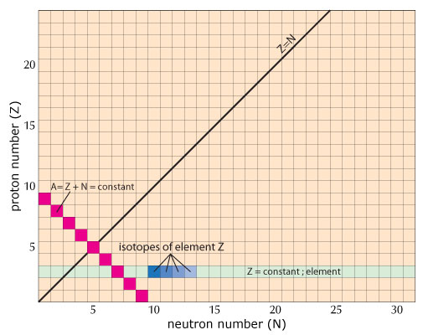
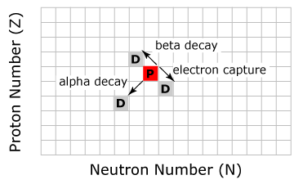
Nuclear Physics
Nuclide Chart: Systematics

Slide 14
Nuclear Physics
Nuclide Chart: Stable Isotope Band
Notes:
The nuclide shows the 254 naturally-occurring stable isotopes (black) that form the stable band. In addition, there are another about 46 radioactive isotopes with relatively long lives. In all the, nuclide chart depicts the 3,000 or so known isotopes. Of these the vast majority are human produced with very short half-lifes.

Slide 15
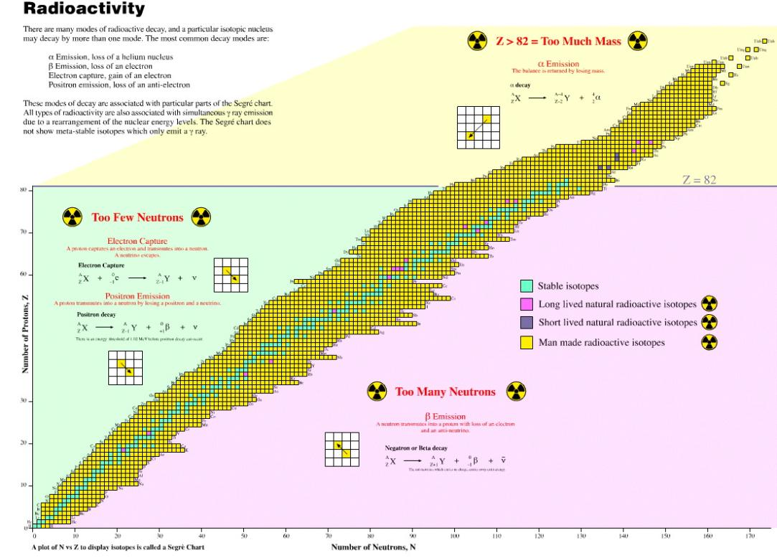
Nuclear Physics
Nuclide Chart: Stability Regions & Decay Mechanisms

Slide 16
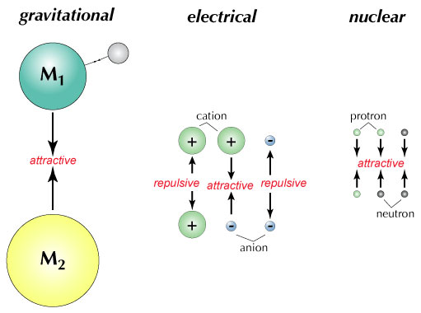
Nuclear Physics
Fission: Fundamental Forces

Slide 17
Nuclear Physics
Fission: Balancing Nuclear Forces

Slide 18
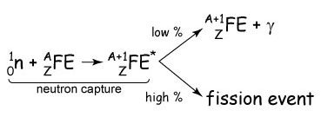
Nuclear Physics
Fission: Neutron Capture
neutron induced fission starts with neutron capture

Slide 19
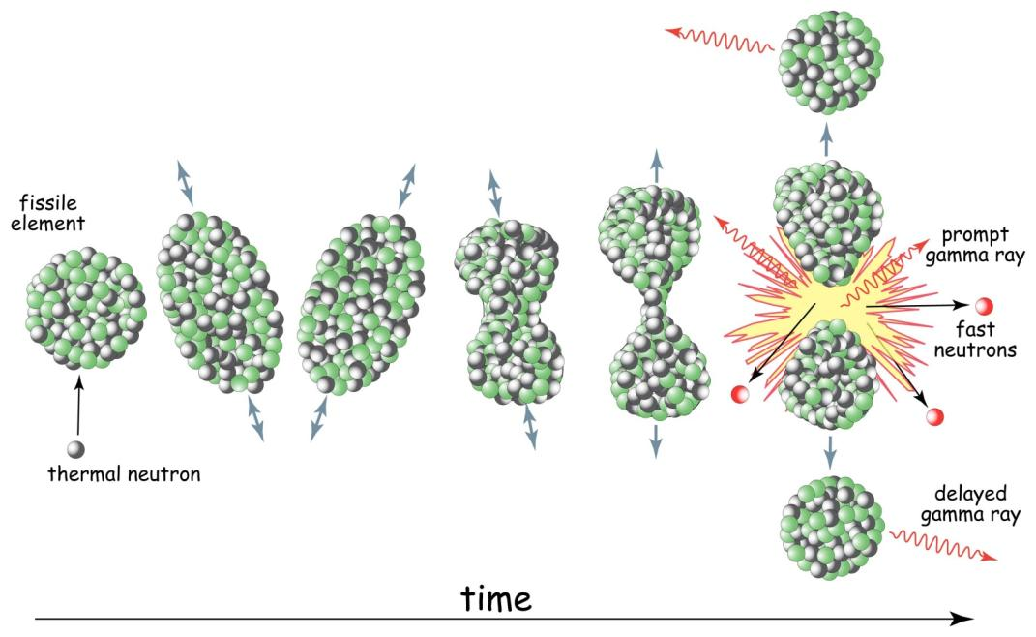
Nuclear Physics
Fission: Liquid Drop Model

Slide 20
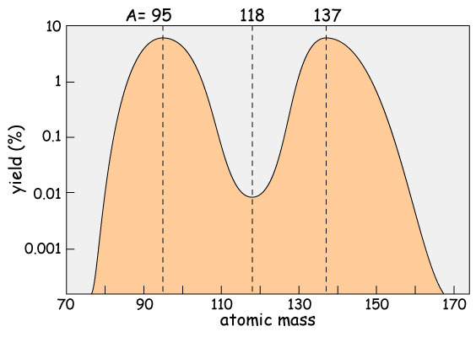
Nuclear Physics
Fission: Product Yield

Slide 21
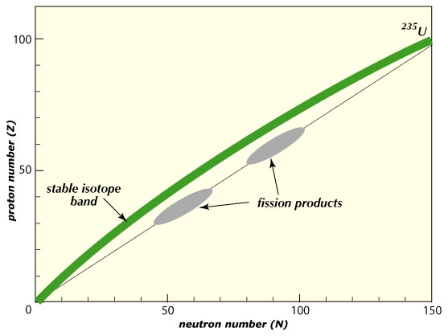
Nuclear Physics
Fission: Products
too many neutrons

Slide 22
Nuclear Physics
Fission: Fissile vs. Fertile Isotopes
fissile: isotopes that can sustain a chain reaction through fissions induced by thermal neutrons
  ²³⁵U: naturally-occurring
    0.7 % of natural U
  ²³³U: not naturally-occurring
  ²³⁹Pu: not naturally-occurring
fertile: isotope that can be converted to fissile isotope by neutron capture of a thermal neutron
  ²³²Th
  ²³⁸U

Slide 23
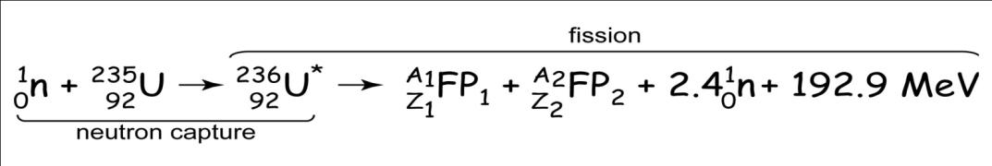
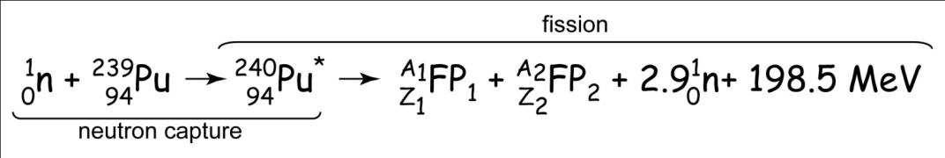
Nuclear Physics
Fission: Reactions
two primary fission reactions occurring in a light water reactor are:

Slide 24
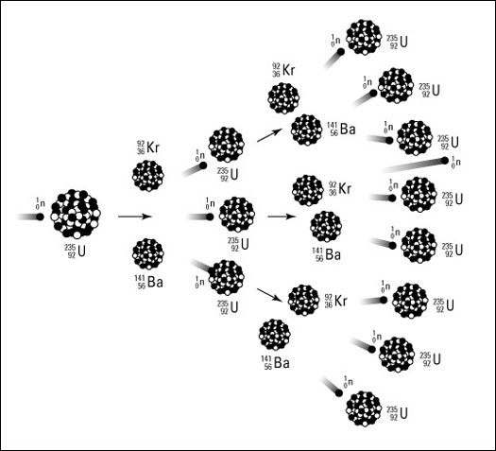
Nuclear Physics
Chain Reaction

Slide 25
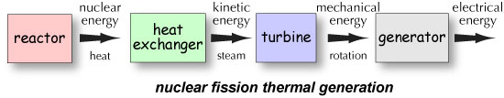
Reactor Design
Thermal Electricity Generation

Slide 26
Reactor Design
Component Systems
all reactors are characterized by fairly standard group of systems or components:
  moderator: slows fast neutrons to slow (thermal) neutrons (more efficient at fissioning ²³⁵U)
  coolant: liquid/gas circulated through reactor core to remove the heat
  control rods: neutron-absorbing cylinders to control chain reaction
  pressure vessels/tubes: steel vessel encapsulating reactor core, coolant or moderator
  steam generator: heat exchanger where the coolant heats water to steam and drives turbine
  contaminant system: reactor core housing to contain radioactive material in event of accident
  fuel: pellets of enriched or natural uranium or uranium /plutonium mix

Slide 27
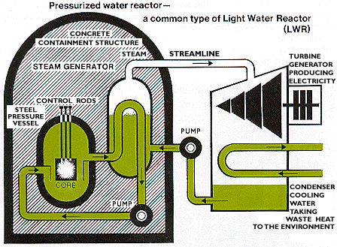
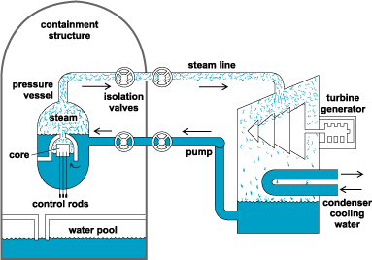
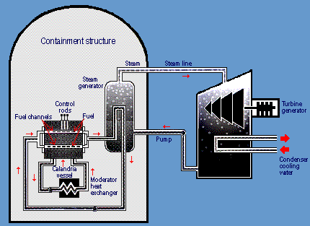
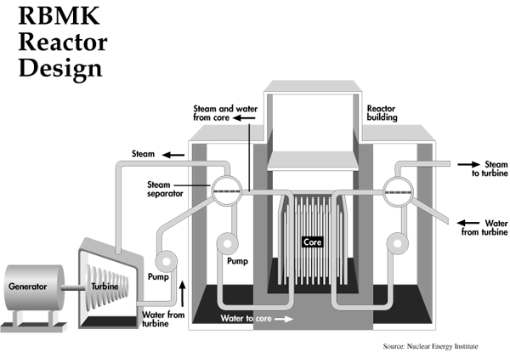
Reactor Design
Commercial GEN II Reactors
pressurized water reactor
boiling water reactor
CANDU reactor
RBMK reactor

Slide 28
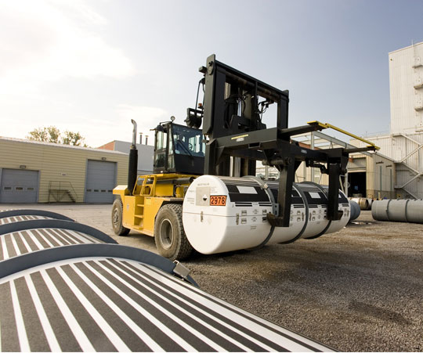
Nuclear Fuel Cycles: U-Pu
Purification
yellowcake is dissolved in nitric acid to produce uranyl nitrate (UO₂(NO₃)₂)
  reduced with hydrogen to UO₂
purified UO₂ reacted with hydrofluoric acid to produce uranium tetrafluoride (UF₄)
  oxidized with fluorine to yield uranium hexafluoride (UF₆)
  at standard p and T, a solid gray crystals
nasty stuff
  highly toxic, reacts violently with water, corrosive to metals

Slide 29
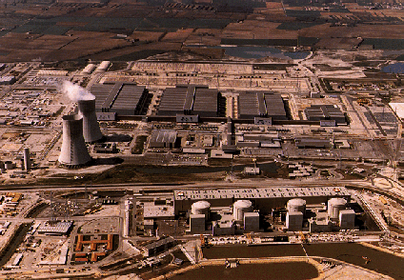
Nuclear Fuel Cycles: U-Pu
Enrichment
because fissile ²³⁵U is only 0.7 % of natural U, for many reactor designs must be enriched
  low-enriched uranium: < 20% ²³⁵U
    reactor grade: 3-4 %
  highly-enriched uranium: >20 % ²³⁵U
    weapons grade: >90 %
enrichment methods
  gaseous diffusion
  high-speed centrifuges
  dynamic separation
  laser enrichment

Slide 30
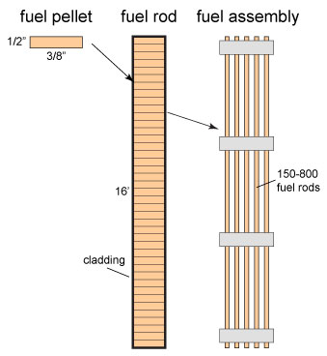
Nuclear Fuel Cycles: U-Pu
Fuel Fabrication
enriched uranium converted to UO₂
  fabricated into fuel pellets, which must:
    conduct heat
    contain fission products
  pellets assembled into fuel rods and rods combined to make fuel assemblies
  exact configuration depends on reactor
all of these elements can be handled safely without shielding

Slide 31
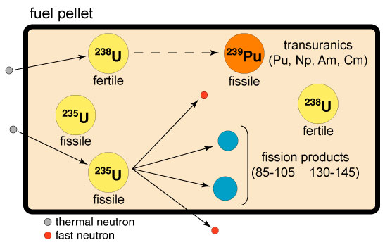
Nuclear Fuel Cycles: U-Pu
Irradiation
fuel pellet now contains:
    fission products
    transuranics (Z > 92)
    unfissioned ²³⁵U
    ²³⁸U (lots)
    new uranium isotopes: ²³³U
  when come out of reactor, pellets are:
    highly radioactive
    very hot

Slide 32
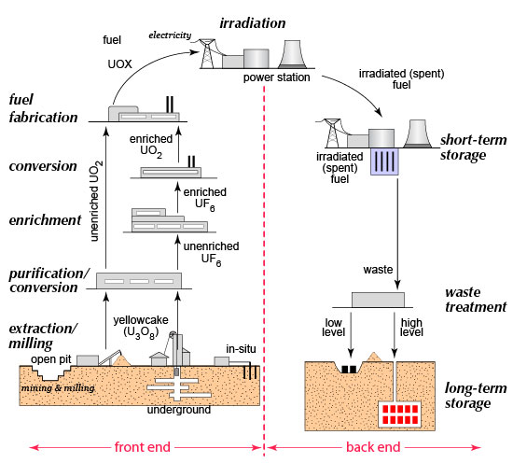
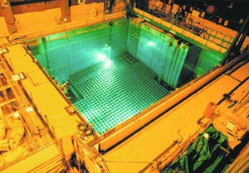
Nuclear Fuel Cycles: U-Pu
Storage
Once Through

Slide 33
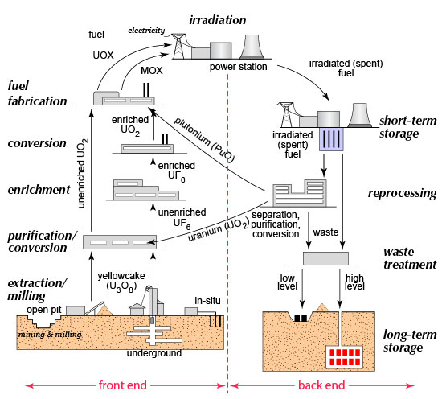
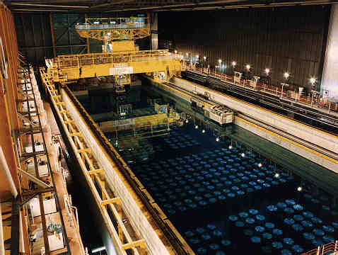
Nuclear Fuel Cycles: U-Pu
Reprocessing
Reprocessing
UK reprocessing facility

Slide 34
Issues and Concerns
Introduction
waste disposal
accidents
proliferation
terrorism
radiation
decommissioning

Slide 35
Issues and Concerns
Waste Disposal: Classes
there are four basic classes of radioactive waste
  very low-level waste (VLLW): very low levels of radiation which are not harmful to the biosphere
  low-level waste (LLW): low radioactive waste that does not require shielding during transport and can be buried at shallow depths
  intermediate-level waste (ILW): material with higher radioactivity that requires shielding
  high-level waste (HLW): waste that contains fission products and transuranics with high (often lethal) levels of radioactivity and heat that require shielding and cooling
all radioactive waste decays with time
  ultimately transmuted to non-radioactive elements

Slide 36
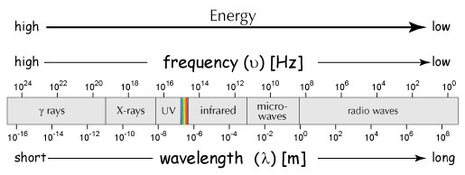
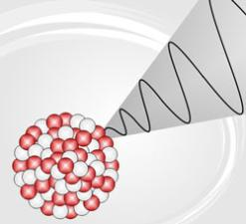
Issues and Concerns
Radiation
radiation is the movement of energy through space as waves or particles
two types: electromagnetic radiation, particle radiation
worry is ionizing radiation because can cause biological damage
electromagnetic radiation travels as waves
produced when energetically excited nuclei emit energy

Slide 37
Issues and Concerns
Radiation: Ionizing
ionizing radiation is radiation (particle or electromagnetic) that is energetic enough to detach electrons from atoms or molecules
  produces ions, i.e. charged particles
If energy not above threshold, no ionization
  regardless of the amount of radiation

Slide 38
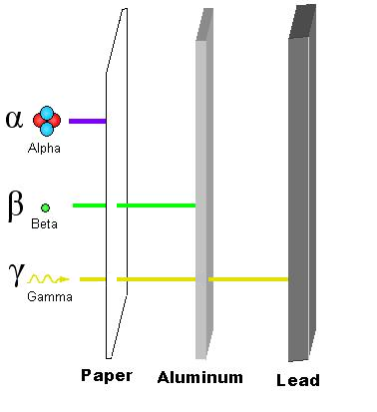
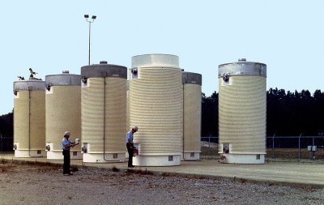
Issues and Concerns
Radiation: Shielding

Slide 39
Issues and Concerns
Accidents
three major commercial nuclear accidents:
  Windscale, U.K.: 1952, fire at AGR, small release of radioactivity
  Three Mile Island, U.S.: 1979, PWR, LOCA, 20% core meltdown, small release
  Chernobyl, U.S.S.R.: 1986, RMBK, steam explosion, large release, 50 deaths
major consequence of nuclear reactor accident include potential release of:
  radioactive material
  radiation
lots of potential sources of failure
  most serious is loss of coolant accident (LOCA)
  can lead to meltdown

Slide 40
Issues and Concerns
Accidents: LOCA
LOCA means no way to remove heat from reactor core
temperature can climb rapidly leading to a meltdown
  melts cladding of fuel pellets and fuel rods
  releases transuranics, fission products and fuel
lots of possible causes
  cannot anticipate all possible and engineer protection
create redundant systems for defense in depth

Slide 41
Issues and Concerns
Accidents: LOCA
engineered safety systems (ESS) have five major functions:
  reactor trip (RT): rapid shutdown of reactor's chain reaction
  emergency core cooling (ECC): flooding of the reactor vessel with cooling water from an independent supply
  post-accident radiation removal (PARR): a system that removes and captures any radioactive material (liquid, gas, solid) contained by the containment building
  post-accident heat removal (PAHR): removal of heat from core to return temperatures to safe levels
  containment integrity (CI): a structure designed to contain any radioactive material

Slide 42
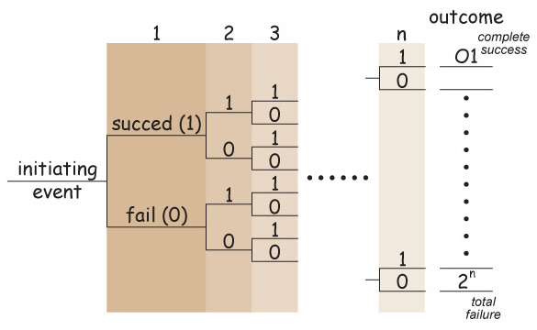
Issues and Concerns
Accidents: Fault Tree Analysis/Probability Risk Assessment
safety analysis is a fault tree analysis and is depicted by an event tree
traces the path of possible failures from initiating event to final outcome
each branching junction of the tree depicts a binary outcome:
  success (1); or
  failure (2)
more the levels of redundancy, the greater the possible number of outcomes

Slide 43
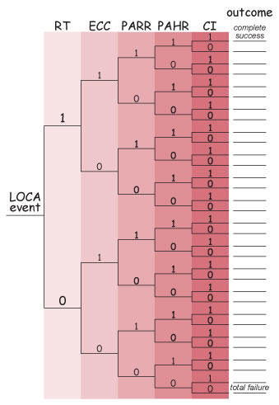
Issues and Concerns
Accidents: Fault Tree Analysis/Probability Risk Assessment
Rasmussen report (1975)
five event levels
  RT
  ECC
  PARR
  PAHR
  CI
32 possible outcomes
  1 - all systems successful
  32 – all systems fail
report is controversial and lead to PAR (probability risk assessment)

Slide 44
Issues and Concerns
Accidents: Liability
size of any subsequent claim from nuclear accident would bankrupt any responsible party
Congress passed Price-Anderson Act in 1957
limited operator responsible in the event of a nuclear accident thereby leaving the public at risk for huge uncompensated losses
  initial bill limited operator liability to $60 million
  additional $500 million from government
  only a thirtieth of the potential losses
extended three times: 1965, 1975 and 1988
  operator liability is still at $60 million
  nuclear industry has additional insurance up to $7 billion

Slide 45
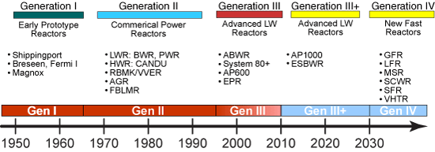
Nuclear’s Future
GIF
Generation IV International Forum (GIF)
13 nations
collaboratively development of next generation of reactors and power and safety systems
DOE, 2010

Slide 46
Nuclear’s Future
GIF: Reactor Missions
three primary missions envisioned for Gen IV reactors:
  electricity production: produce electricity by converting thermal energy from fission to kinetic energy to rotational to electrical energy
  nonelectricity missions:
    produce freshwater through desalination
    hydrogen production for energy
    process heat for a range of energy intensive industries
  actinide management:
    extend uranium supplies
    reduce amount of nuclear waste

Slide 47
Teaching About Nuclear Power
Goals and Methods
useful for:
  science and technology (STEM perspectives)
  non-STEM perspectives (economic, political, social, etc.)
  context for teaching:
    quantitative reasoning; and
    scientific literacy
  involves affective domain
    relevant & timely
    important as citizen
  tied to energy-water-climate grand challenge nexus
pedagogical tool/approaches:
  reading questionnaires: lab & lecture
  lecture activities: short, focused
  surveys: probe pre/mis/naïve conceptions & attitudes
  lab exercises: focused on key points, mostly single perspective, highly quantitative
  case studies: longer, multiple STEM/non-STEM perspectives, set in global context,

Slide 48
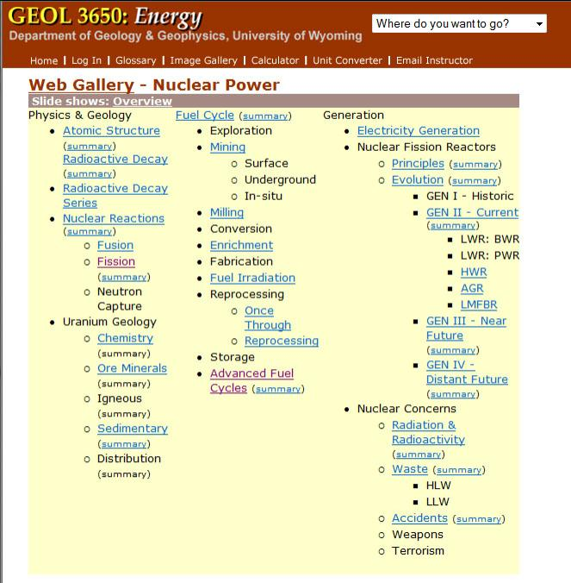
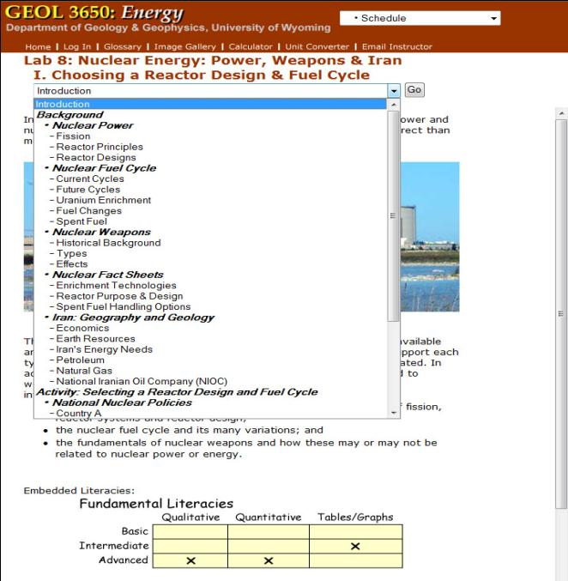
Teaching About Nuclear Power
Lecture & Lab

Slide 49
Teaching About Nuclear Power
Lecture Activities
worksheet students complete in class
available topics:
  Exploring Fission and Fusion
  Nuclide Chart, Radioactivity and Nuclear Reactions
  Investigating Plutonium Production
  The Alternative Thorium Fuel Cycle
  Nuclear Waste Storage Times

Slide 50
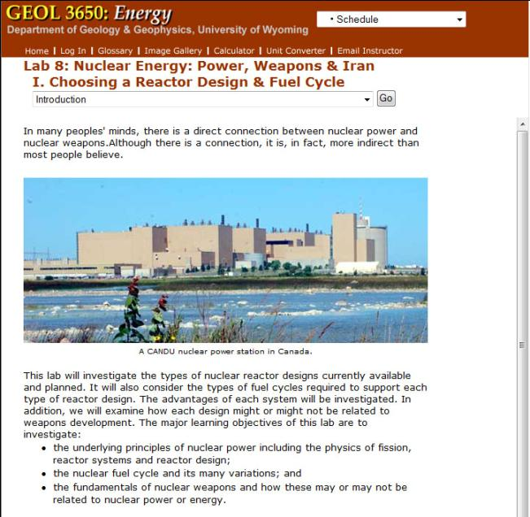
Teaching About Nuclear Power
Case Studies
3-week
geology, economics, social, political
Nuclear Energy: Power, Weapons & Iran
  I. Designing a Uranium Mine
  II. Choosing a Reactor Design & Fuel Cycles
  III. Iran, the West and Nuclear Non-proliferation
Coal: China, Energy & Climate Change
  Coal Power Plants – Maintain, Retrofit or Replace?

Slide 51
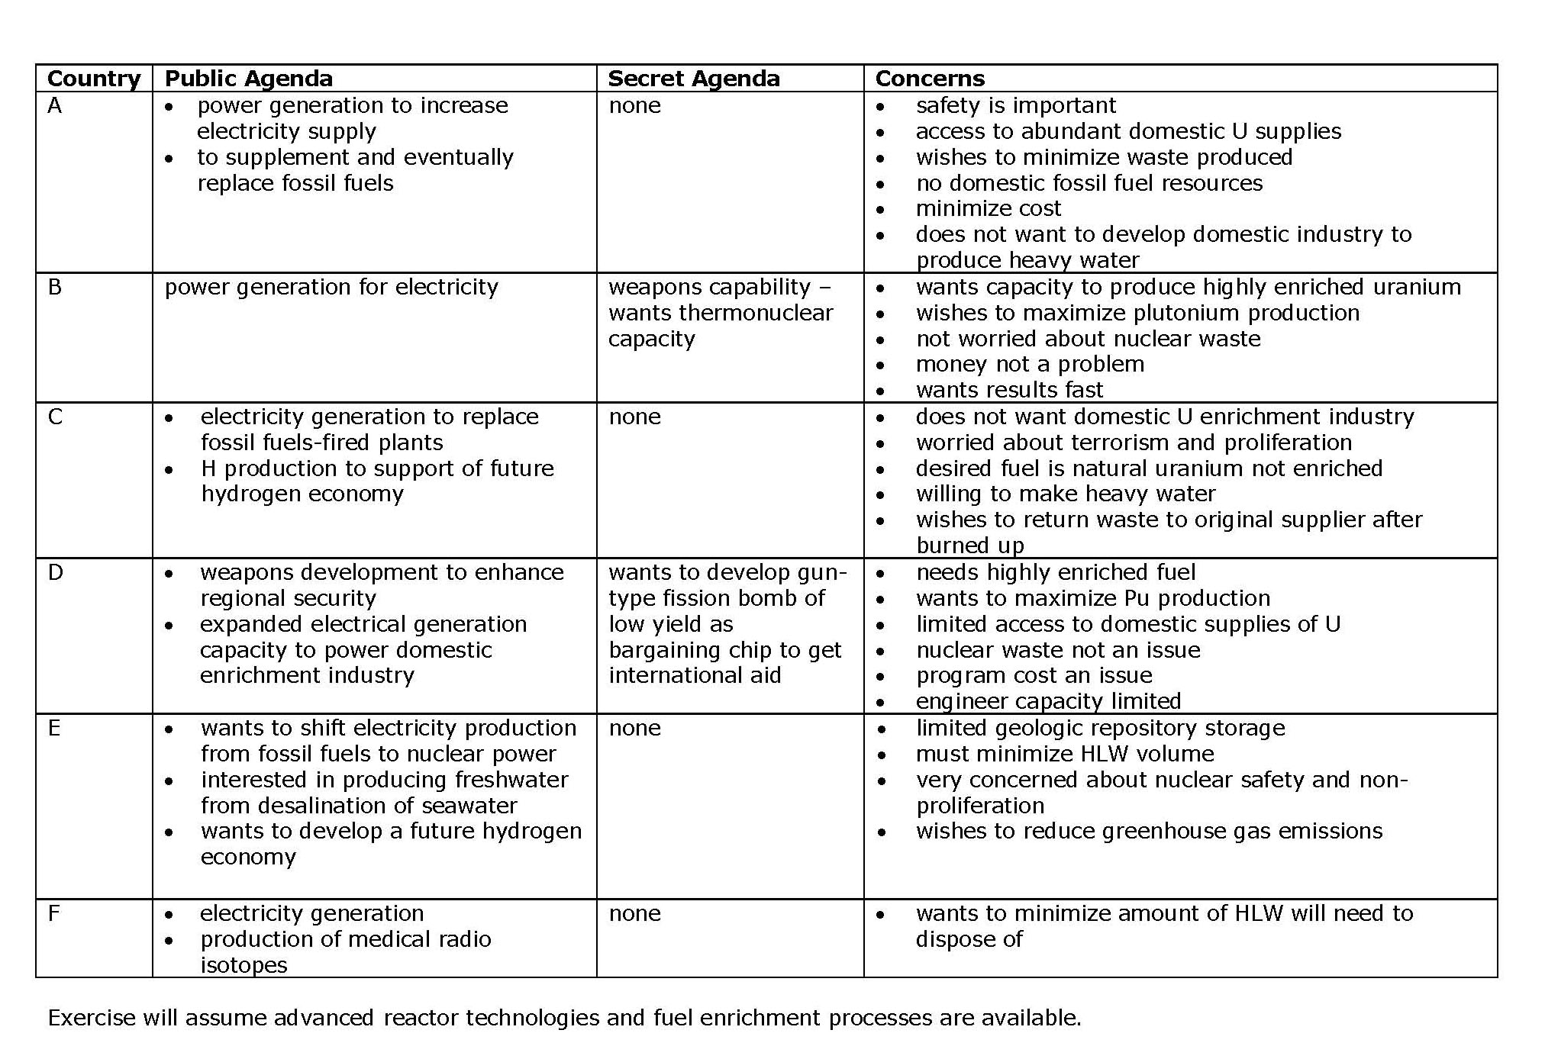
  Teaching About Nuclear Power
  II. Choosing a Reactor Design & Fuel Cycles

Slide 52
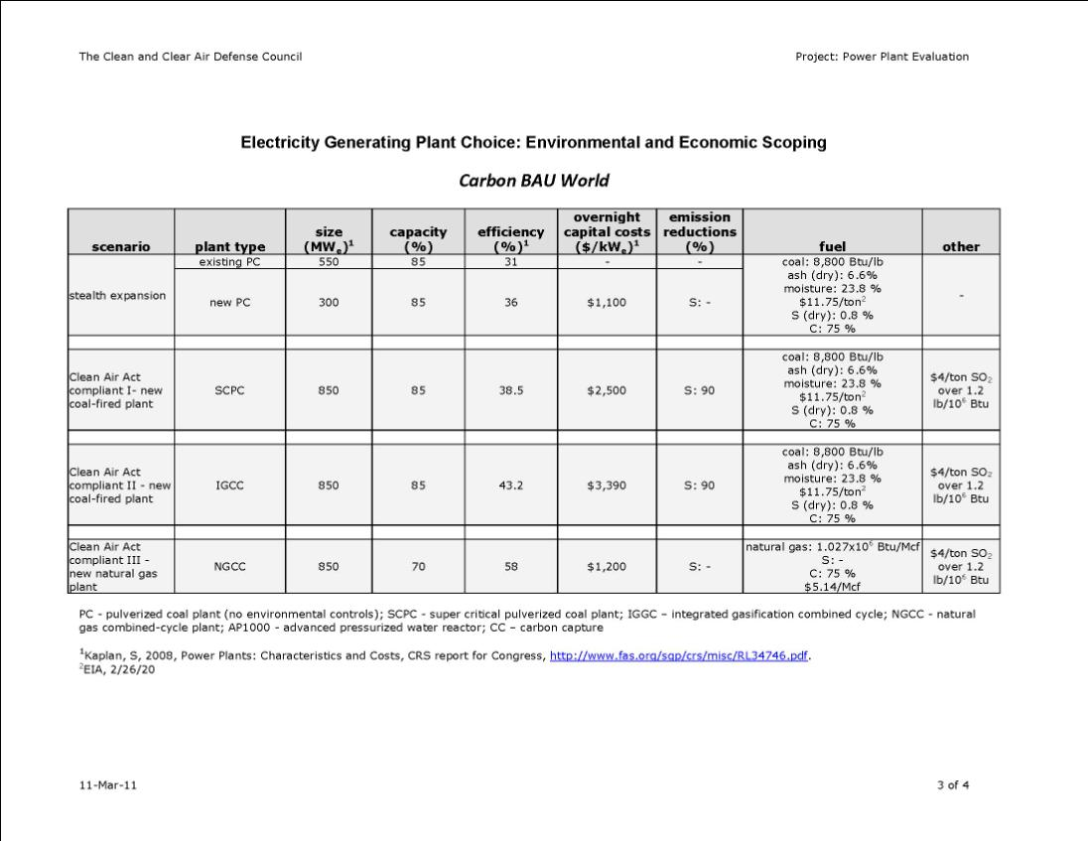
  Teaching About Nuclear Power
  II. Coal Power Plants – Maintain, Retrofit or Replace?

Slide 53
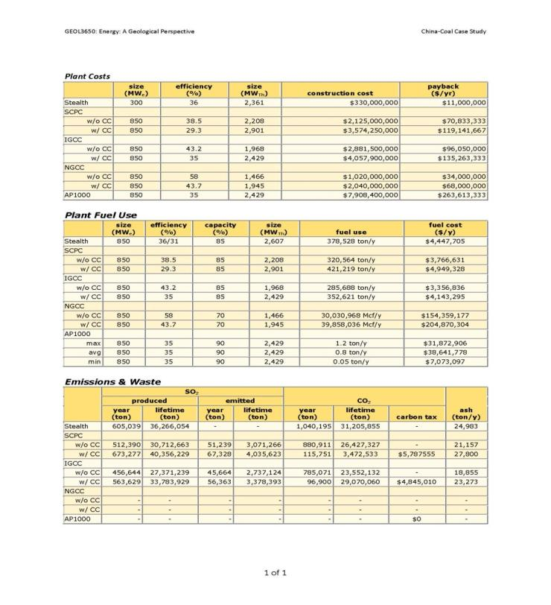
  Teaching About Nuclear Power
  II. Coal Power Plants – Maintain, Retrofit or Replace?

Slide 54
Summary
supplies ~15 % of global electricity and 19 % of U.S. electricity
based on fission (splitting of heavy nuclei into two lighter nuclei with release of radiation)
nuclear fuel cycle produces the fuel for reactors and disposes of waste
  milling and refining, purification, enrichment, fabrication, irradiation, storage, +reprocessing
  two main variations: once through, reprocessing
issues and concerns include: waste disposal, accidents, proliferation, terrorism, radiation, reactor decommissioning
good teaching tool: relevance, QR, critical thinking, science, policy, politics
  use in lecture and lab

