Slide 1
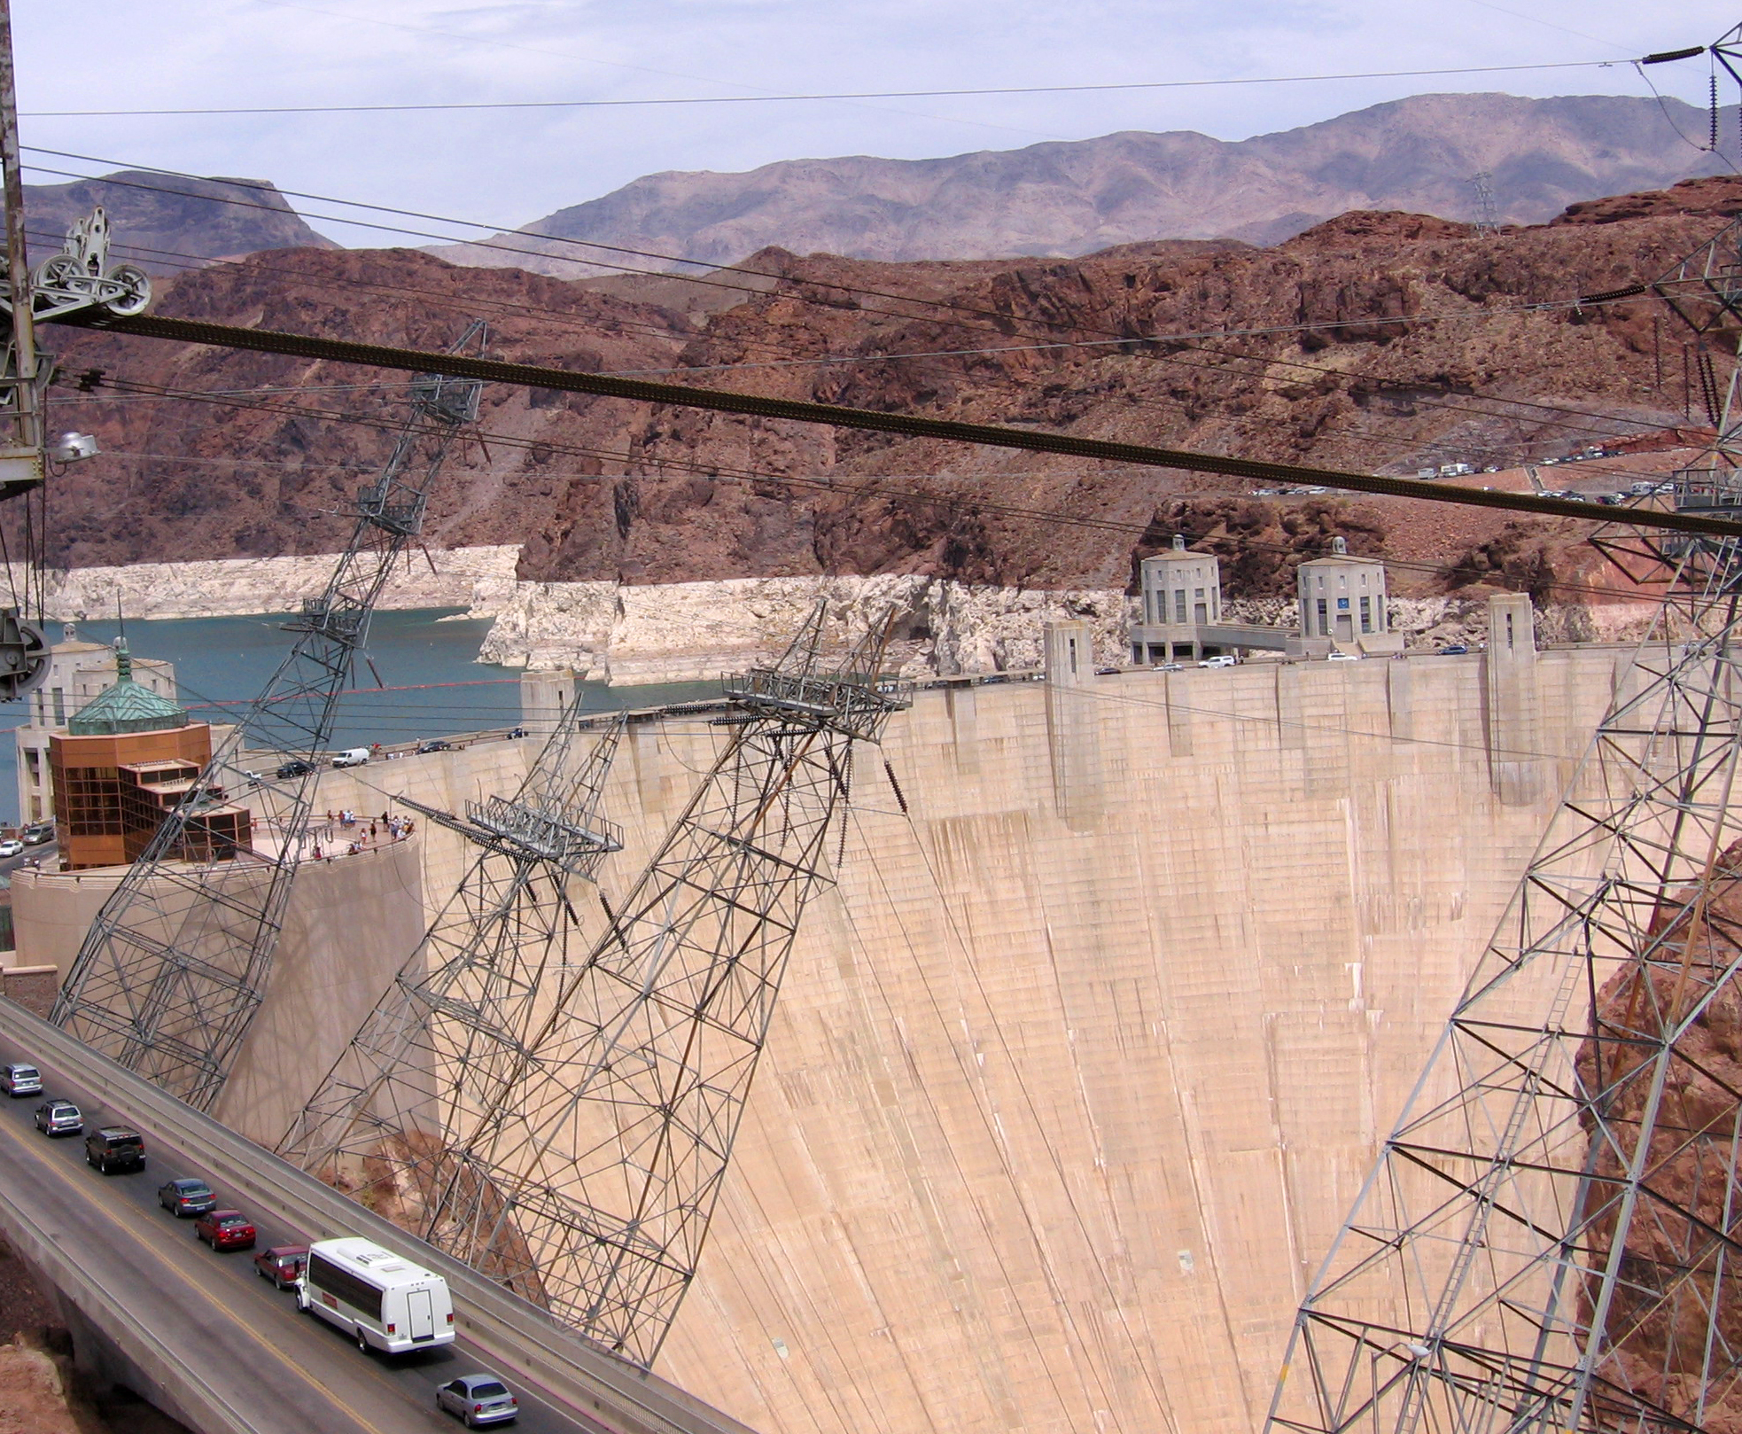

The Energy-Water Nexus: a theme for interdisciplinary Earth science inquiry
Steven Semken
Hoover Dam and hydropower plant,
Colorado River, Arizona-Nevada

Slide 2
The Energy-Water Nexus: a theme for interdisciplinary Earth science inquiry
An overview of the energy-water nexus concept as an Earth systems problem
Introduction of energy intensity and water intensity as metrics
Comparison of water intensities of important energy production and energy consumption systems
Brief discussion of the relevance of the energy-water nexus to sustainability
Vignettes of the energy-water nexus applied in Earth system science teaching (focused on the Southwest USA)
Discussion

Slide 3
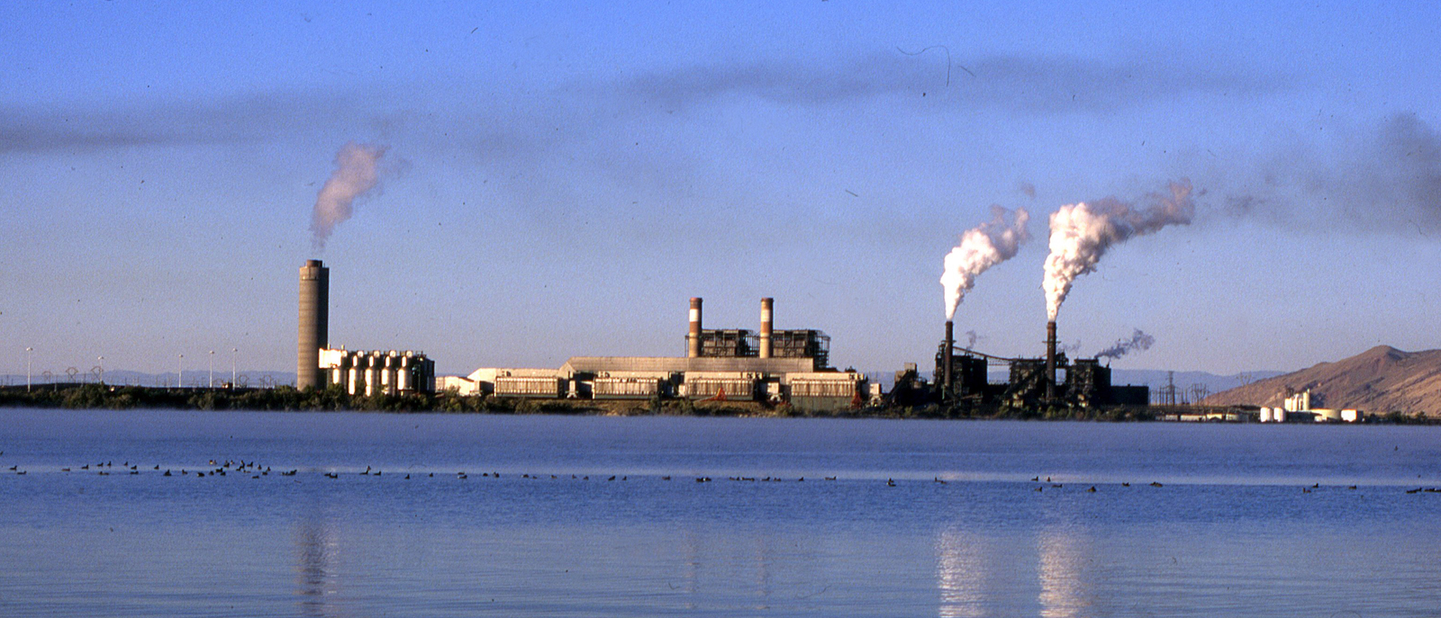
The Energy-Water Nexus*: an interrelationship of increasing concern.
These two critical resources are inextricably and reciprocally linked—the production of energy requires large volumes of water while the treatment and distribution of water is equally dependent upon readily available, low-cost energy. (US Department of Energy, n.d.)
27 % of all US water consumption outside of agriculture is for energy production.
(Electric Power Research Institute, 2008)
Four Corners Power Plant (2000 MW coal-fired) and Morgan Lake (artificial lake constructed for plant cooling)
near Shiprock, Navajo Nation, New Mexico
*Sometimes referred to as the Water-Energy Nexus (particularly by hydrologists).

Slide 4
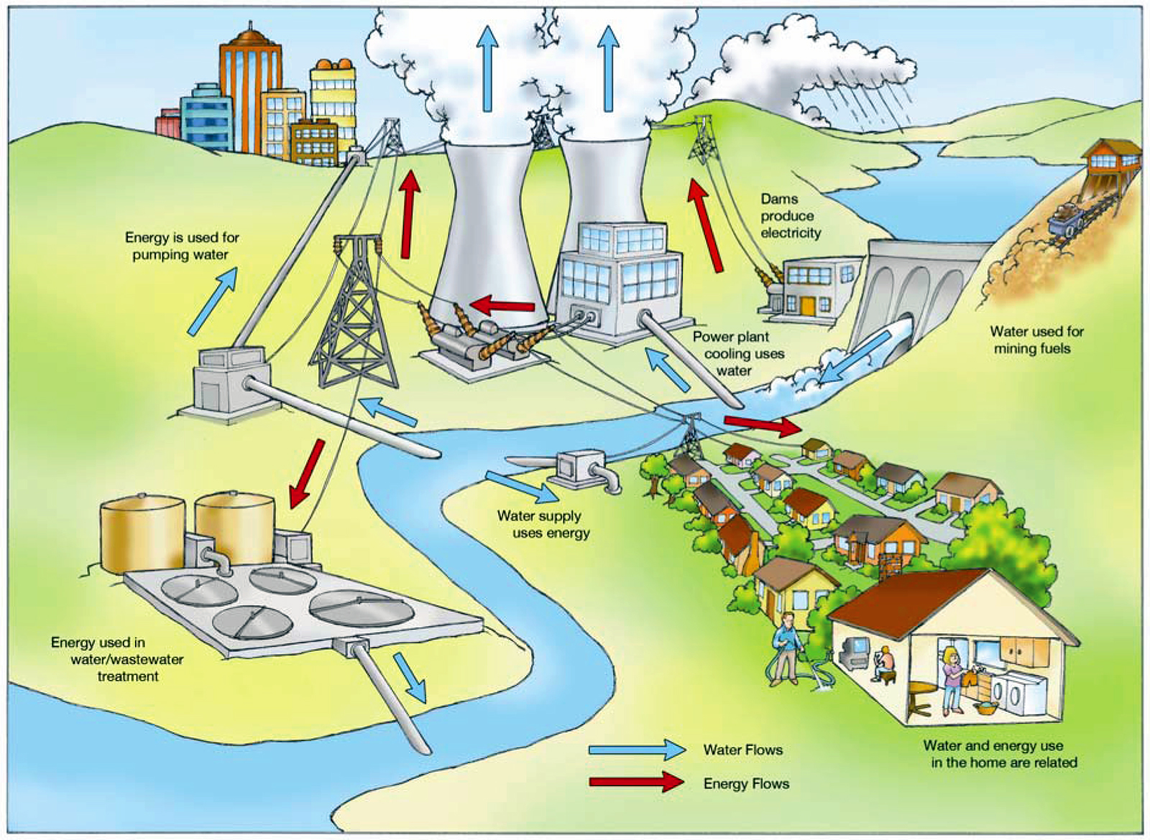
The geoscientific topics of energy resources and water resources have traditionally been taught in a decoupled manner, but energy and water systems are inextricably linked from the perspectives of environmental science, engineering, economics, and politics.
The energy-water nexus is an Earth systems problem with a significant anthropospheric component.
(US Dept. of Energy, 2006)

Slide 5
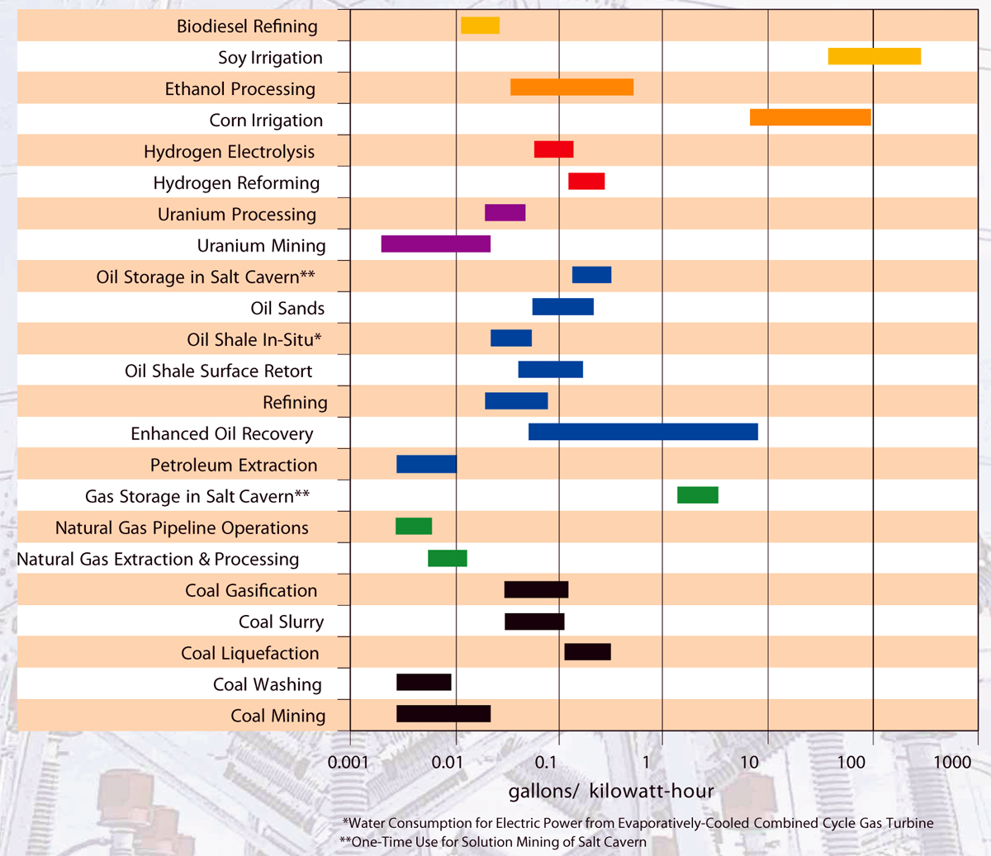
The energy-water interrelationship is quantified in two metrics that compare how much of one is required to produce a fixed amount of the other:
Energy intensity
The quantity of energy (commonly represented as power) consumed in providing water: typically in kWh/gal or MWh/gal
Water intensity
The quantity of water used to provide a quantity of power: typically in gal/kWh or gal/MWh
These values have already been determined by audits of various means of energy and water production, and studies continue.
The data are readily available from US DOE and other agencies.
Start by searching on “Energy-Water Nexus” or “Water-Energy Nexus.”
Water intensity for different types
of energy-resource production and storage
(Woodhouse, 2007, after US Department of Energy, 2006)

Slide 6
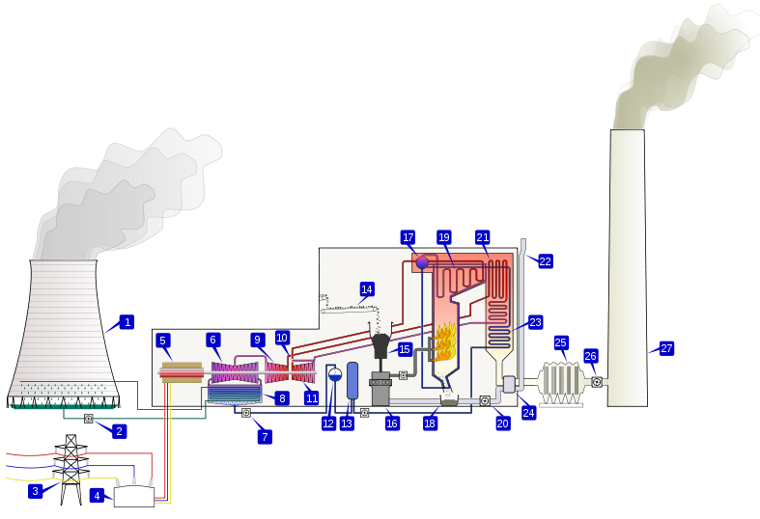
Most conventional turbine-based electricity production is thirsty!
1. Cooling tower. 2. Cooling water pump. 3. Transmission line (3-phase). 4. Unit transformer (3-phase). 5. Electric generator (3-phase). 6. Low pressure turbine. 7. Condensate extraction pump. 8. Condensor. 9. Intermediate pressure turbine. 10. Steam governor valve. 11. High pressure turbine. 12. Deaerator. 13. Feed heater. 14. Coal conveyor. 15. Coal hopper. 16. Pulverised fuel mill. 17. Boiler drum. 18. Ash hopper. 19. Superheater. 20. Forced draught fan. 21. Reheater. 22. Air intake. 23. Economiser. 24. Air preheater. 25. Precipitator. 26. Induced draught fan. 27. Chimney stack. en.wikipedia.org/wiki/File:PowerStation2.svg
Fuel type | Water intensity (gal/MWh)
Nuclear | 400 - 785
Coal | 200 - 610
Natural Gas | 100 - 514
(Lamberton et al., 2010)

Slide 7
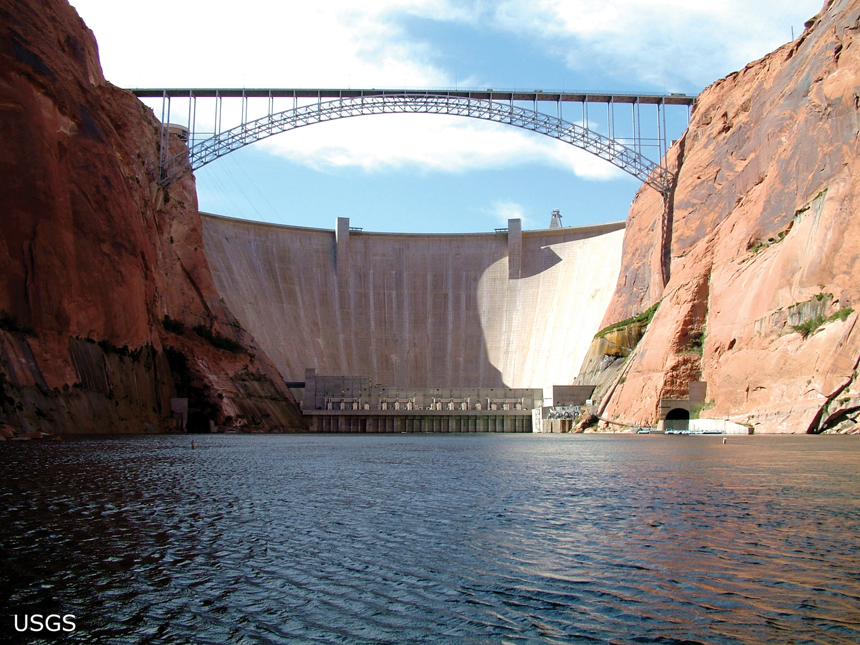
Surprisingly, so is hydroelectric power generation.
Water that turns turbines is sent on for other uses, but evaporative loss from reservoirs counts toward the water intensity of hydropower generation:
e.g., Lake Powell and Lake Mead on Colorado River, American Southwest:
65,000 gal/MWh (NREL) to 30,078 gal/MWh (Pasqualetti & Kelley, 2008)
Water intensity may be less if other reservoir uses like flood control are accounted for.
Glen Canyon Dam, Colorado River, Arizona (US Geological Survey)

Slide 8
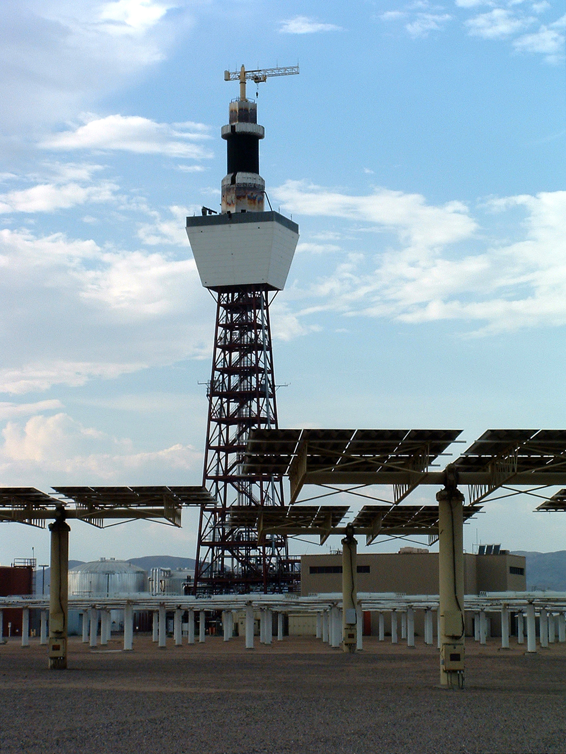
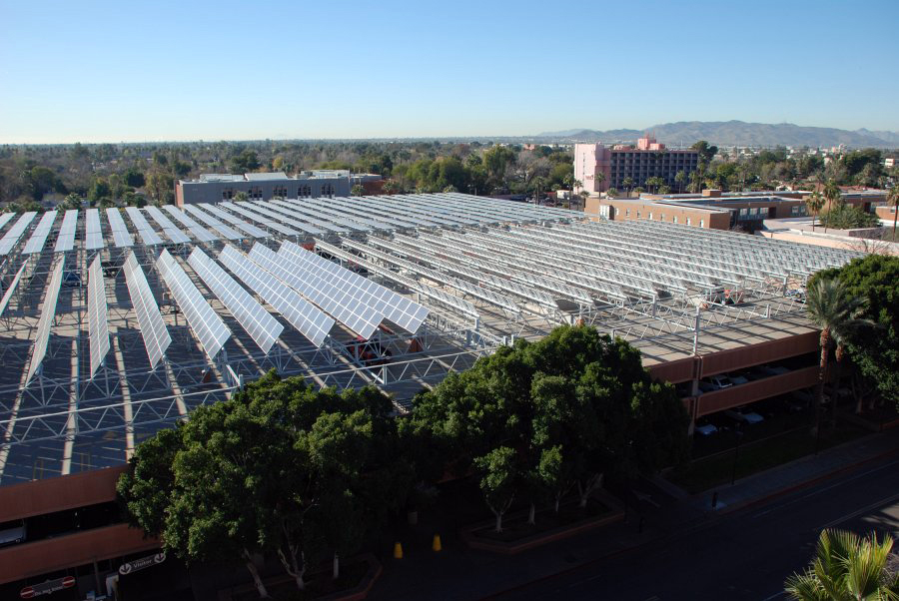
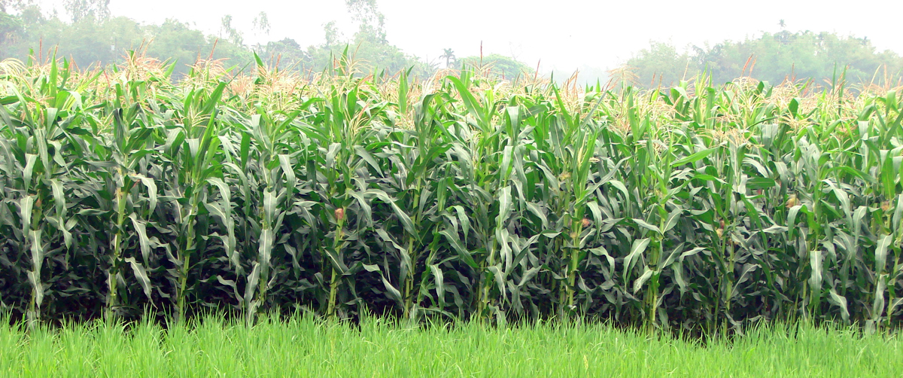
Renewable energy technologies vary in their water intensity.
(Lamberton et al., 2010; Woodhouse, 2007)
Photovoltaic solar, or wind
Negligible!
Crop-based biofuels
Enormous! 50,000-150,000 gal/MWh
Concentrating solar
300-1000 gal/MWh
Comparable to other
turbine-driven
generating methods.
Arrays of solar cells atop
ASU parking garage, Tempe, Arizona
(uabf.asu.edu/campus_solarization)
Solar Two solar-thermal power plant,
Daggett, California
(upload.wikimedia.org/wikipedia/commons/a/a9/Solar_Two_ 2003.jpg)
(Wikimedia.org, n.d.)

Slide 9
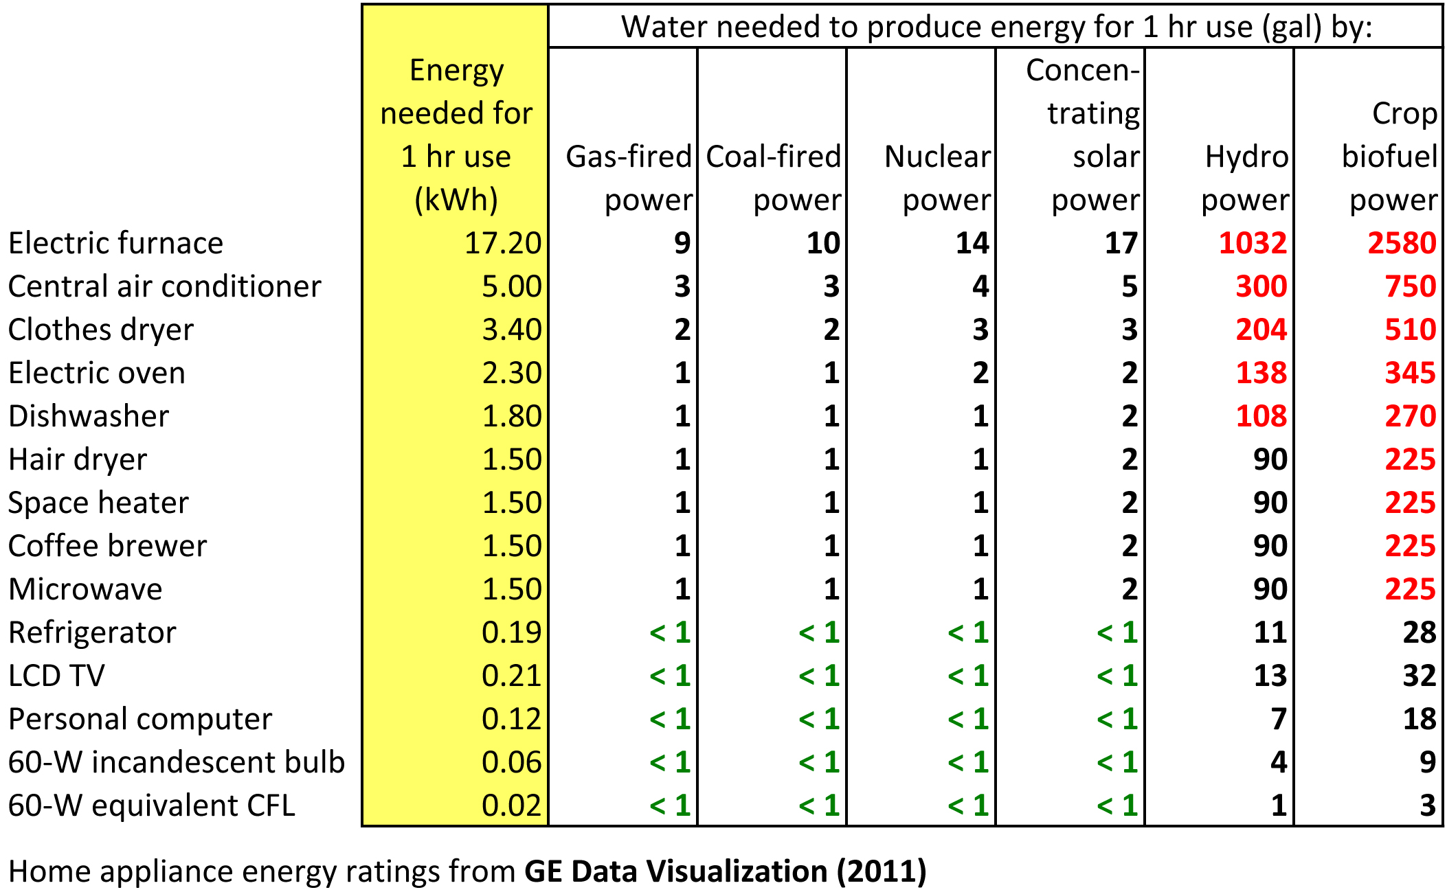
Calculating the water intensity of home appliance use for one hour !

Slide 10
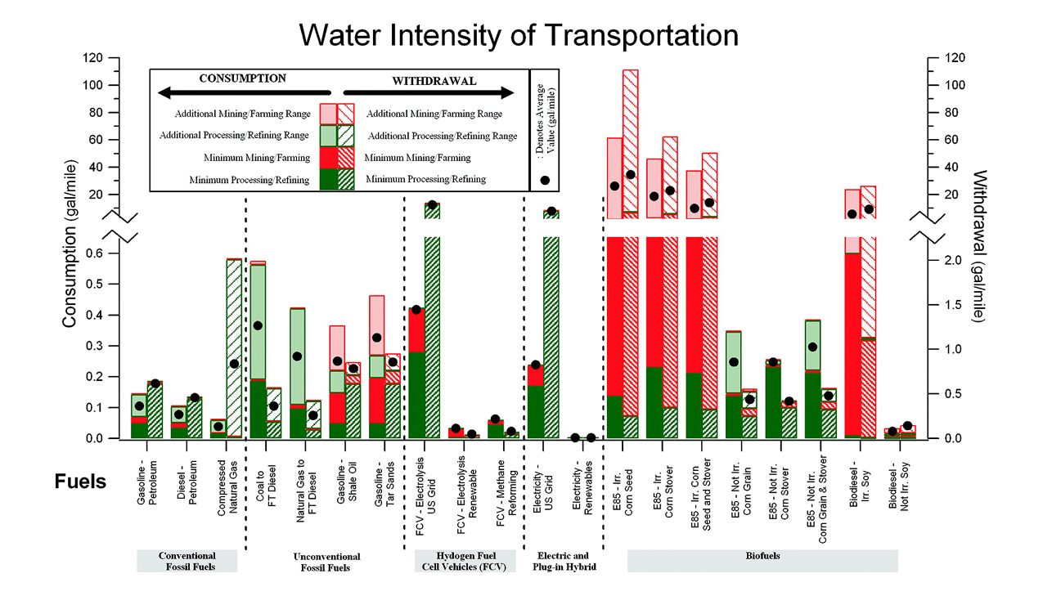

Water intensity of transportation using fueled light-duty vehicles (cars, light trucks, SUVs)
(King & Webber, 2008)
Note difference between
irrigated and non-irrigated
biofuel crops.
Unconventional
extraction is thirsty.
Consumption = Water consumed in process, not recycled to source
Withdrawal = Water used in process but recycled to source
Fuels derived directly from fossil fuels are generally less water-intensive than those derived indirectly from fossil fuels, or from biomass (King & Webber, 2008).

Slide 11
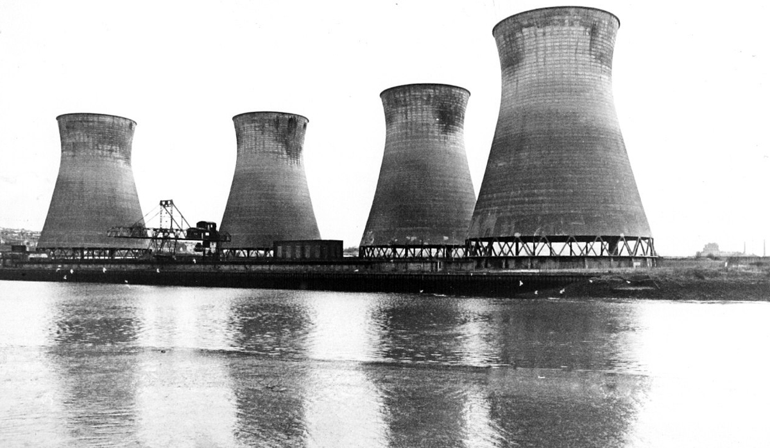
The energy-water nexus has manifold relevance to sustainability.
Population distribution and demand for energy do not necessarily correlate with abundance and availability of fresh water (consider the U.S. Southwest, Mountain West, Southeast).
Energy production and food production are the two largest consumers of water, and may come into direct competition in many regions.
Environmental regulations intended to protect water supplies and aquatic ecosystems could result in higher costs or shortages of energy.
Energy accounts for as much as 80% of the cost of treatment and delivery of water: more expensive energy means more expensive water.
Increased carbon emissions from electricity production using fossil fuels may, through climate change, variably and unpredictably change the future availability of water (for energy production as well as other uses).
The energy-water nexus is
also a rich topic for
Earth and environmental
science educators.
Stella Power Station,
River Tyne, Great Britain
(wikimedia.org)

Slide 12
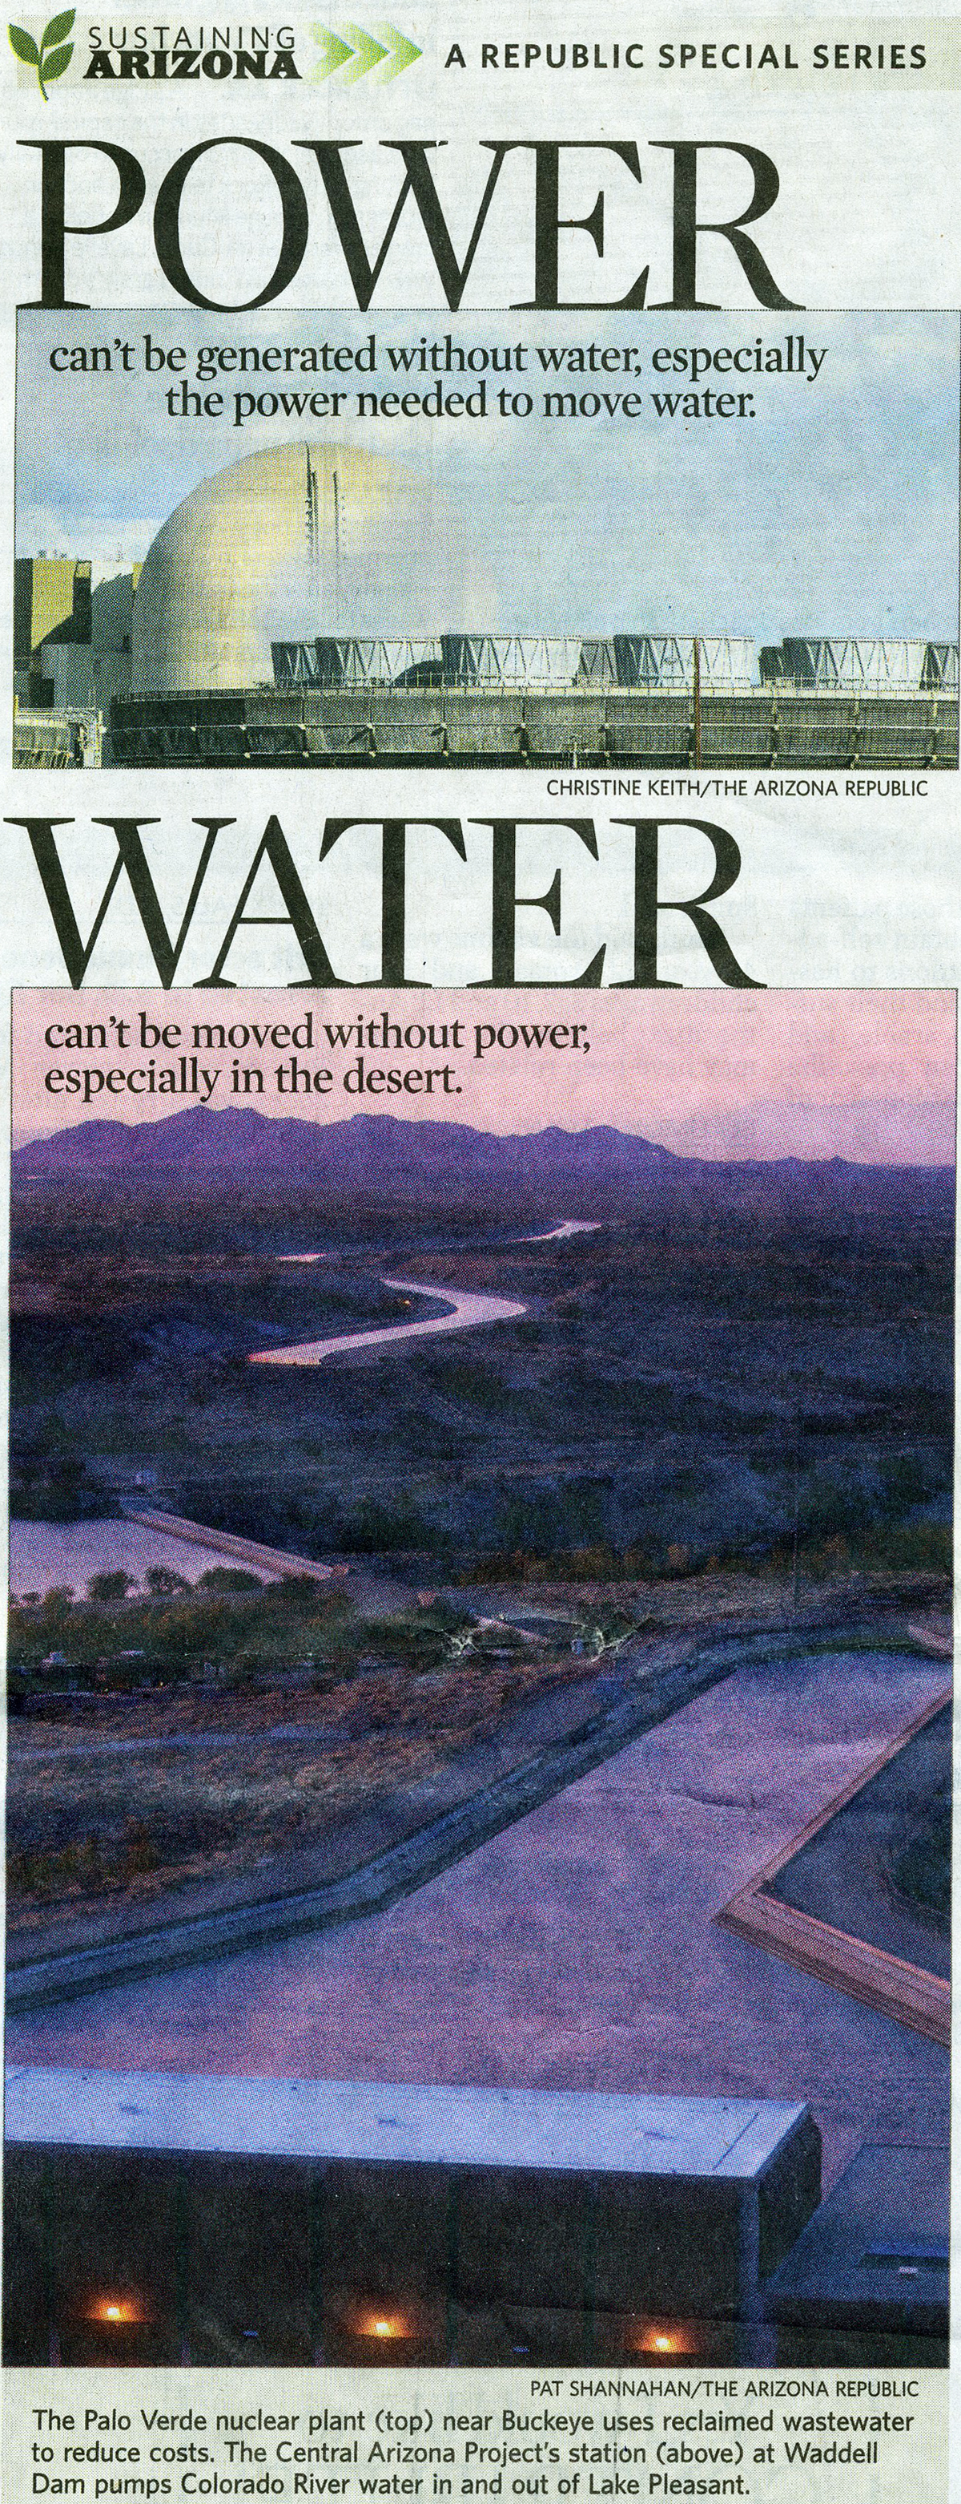
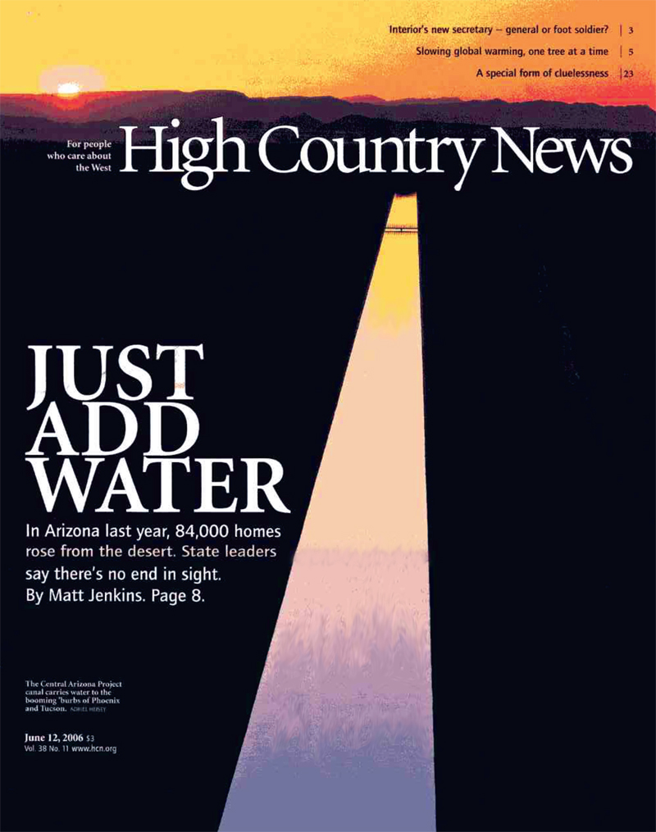
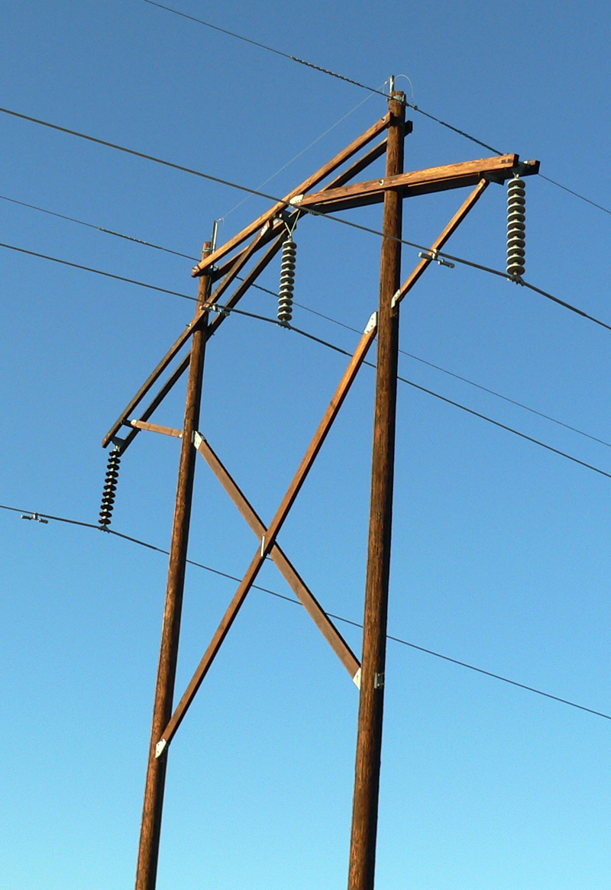
The energy-water nexus seizes our attention in the American Southwest, and is a rich topic for place-based Earth system science teaching.
ASU Geology 301
EARTH SCIENCE in ARIZONA and the SOUTHWEST
Integrated presentation of the energy-water nexus
Field trips to local water and power installations
Quantitative exercises comparing water intensity of different energy sources, or energy intensity of water production
Locally situated energy-water case studies encompassing:
  Reading assignments
  Lectures and class discussions
  Student position papers
(High Country News, 2006)
(McKinnon, Arizona Republic, 2008)

Slide 13
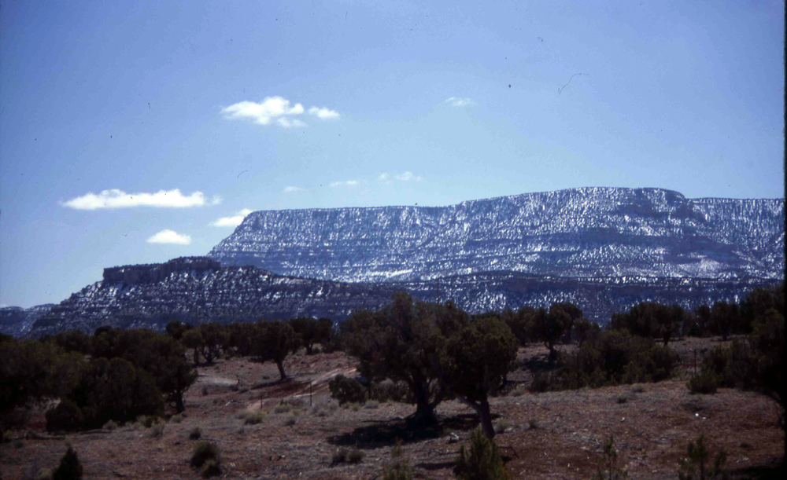
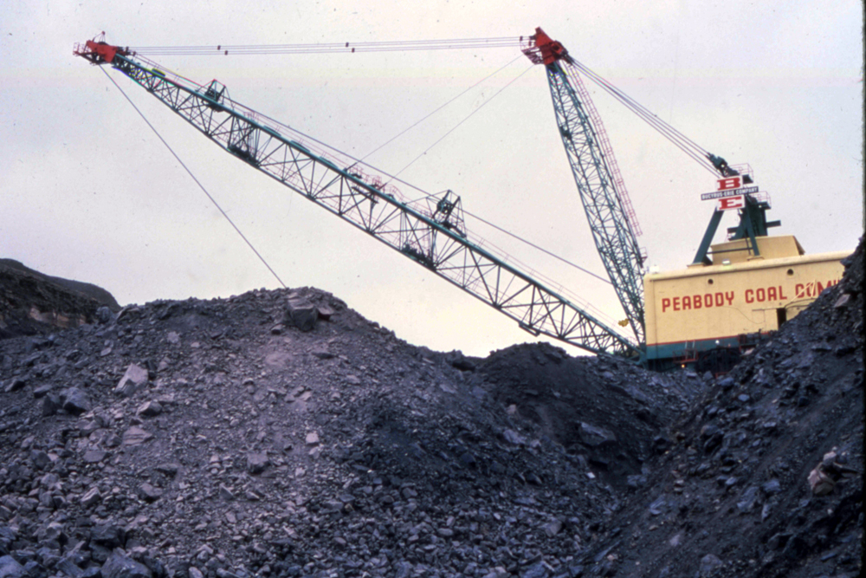
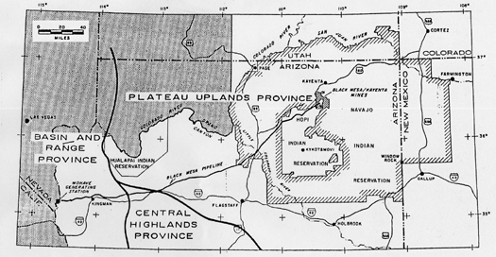
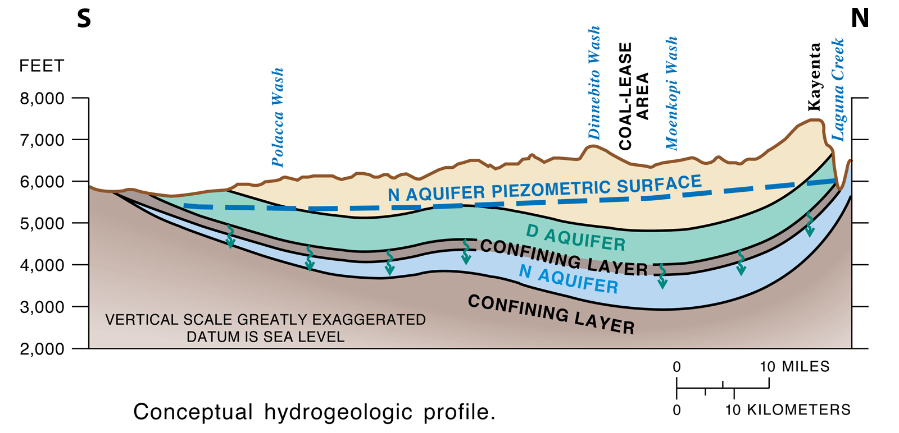
Southwest-based case studies on the energy-water nexus: I
Black Mesa coal-slurry pipeline, 1970-2005
Locally mined groundwater was used to transport subbituminous coal as a slurry in a pipeline running 273 mi (439 km) from a mine on Black Mesa, Arizona to a coal-fired power plant on the Colorado River at Laughlin, Nevada.
About 10⁹ gal of water were removed each year from the Navajo (N) Sandstone aquifer and not replaced.
Black Mesa: Hopi and Navajo Nations, Arizona
(US Geological Survey, 1999)

Slide 14
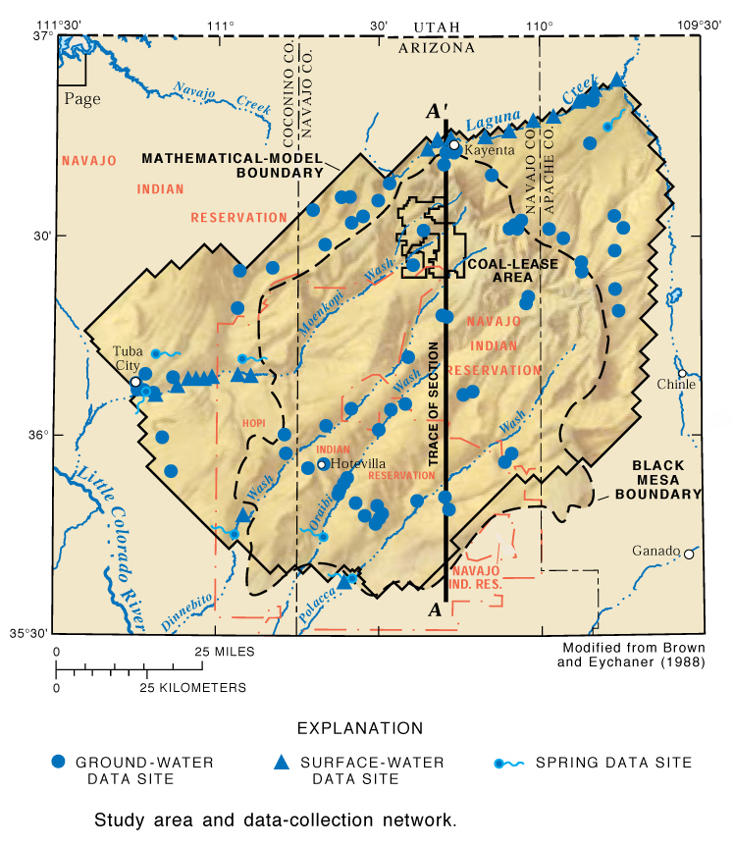

Southwest-based case studies on the energy-water nexus: I
Black Mesa coal-slurry pipeline, 1970-2005
The impact of the operation was hotly debated among the mine operator, USGS (finding minimal drawdown) and members of the Hopi and Navajo Nations (claiming loss of coupled spring and stream systems in the rural backcountry). Both sides have data (though not conclusive data) to support their positions.
“[N]o significant trend in the median winter flows for Moenkopi Wash from 1977 to 2000. The records for the other three streams are too short for a statistical analysis...Dinnebito Wash and Polacca Wash appear to have decreased during the last six years....”
(Thomas, USGS, 2002)
[With continued use of N aquifer] “Impacts on streams and springs [supplied by N aquifer]: negligible during mining, no impact after mining....”
(US Office of Surface Mining, 2006)

Slide 15
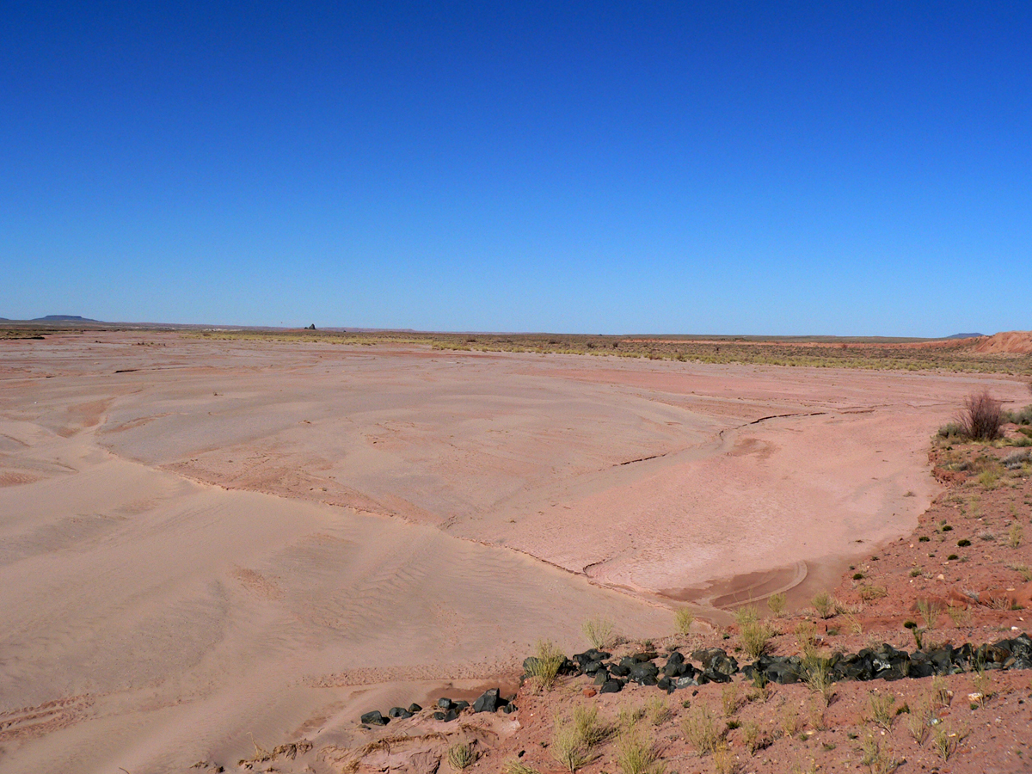
Southwest-based case studies on the energy-water nexus: I
Black Mesa coal-slurry pipeline, 1970-2005
The impact of the operation was hotly debated among the mine operator, USGS (finding minimal drawdown) and members of the Hopi and Navajo Nations (claiming loss of coupled spring and stream systems in the rural backcountry). Both sides have data (though not conclusive data) to support their positions.
“Groundwater level has periodically dropped below the top elevation of the [confined] Navajo aquifer, indicating structural damage....
Decline in discharge of 10% or more was indicated in three of four recently monitored springs....
Three of four continuously monitored wash gauging stations show decline of at least 50%....
Flawed hydrological modeling [by Peabody and US Geological Survey] obscures evidence of damage to the Navajo aquifer....”
(Grabiel, NRDC, 2000; updated 2006)
“You’re trying to predict the behavior of a system that you can’t feel and touch very easily. This one’s 3,000 feet beneath our feet.”
Brian Dunfee, Peabody Coal, quoted in Kraker (2002).
“Growing up, I thought this water [springs fed by the N aquifer] would never go away. Now, both combined, they’re probably less than 15 gallons per minute. We’re seeing the first signs of total drawdown.”
Leonard Selestewa, Hopi, quoted in Kraker (2002).

Slide 16
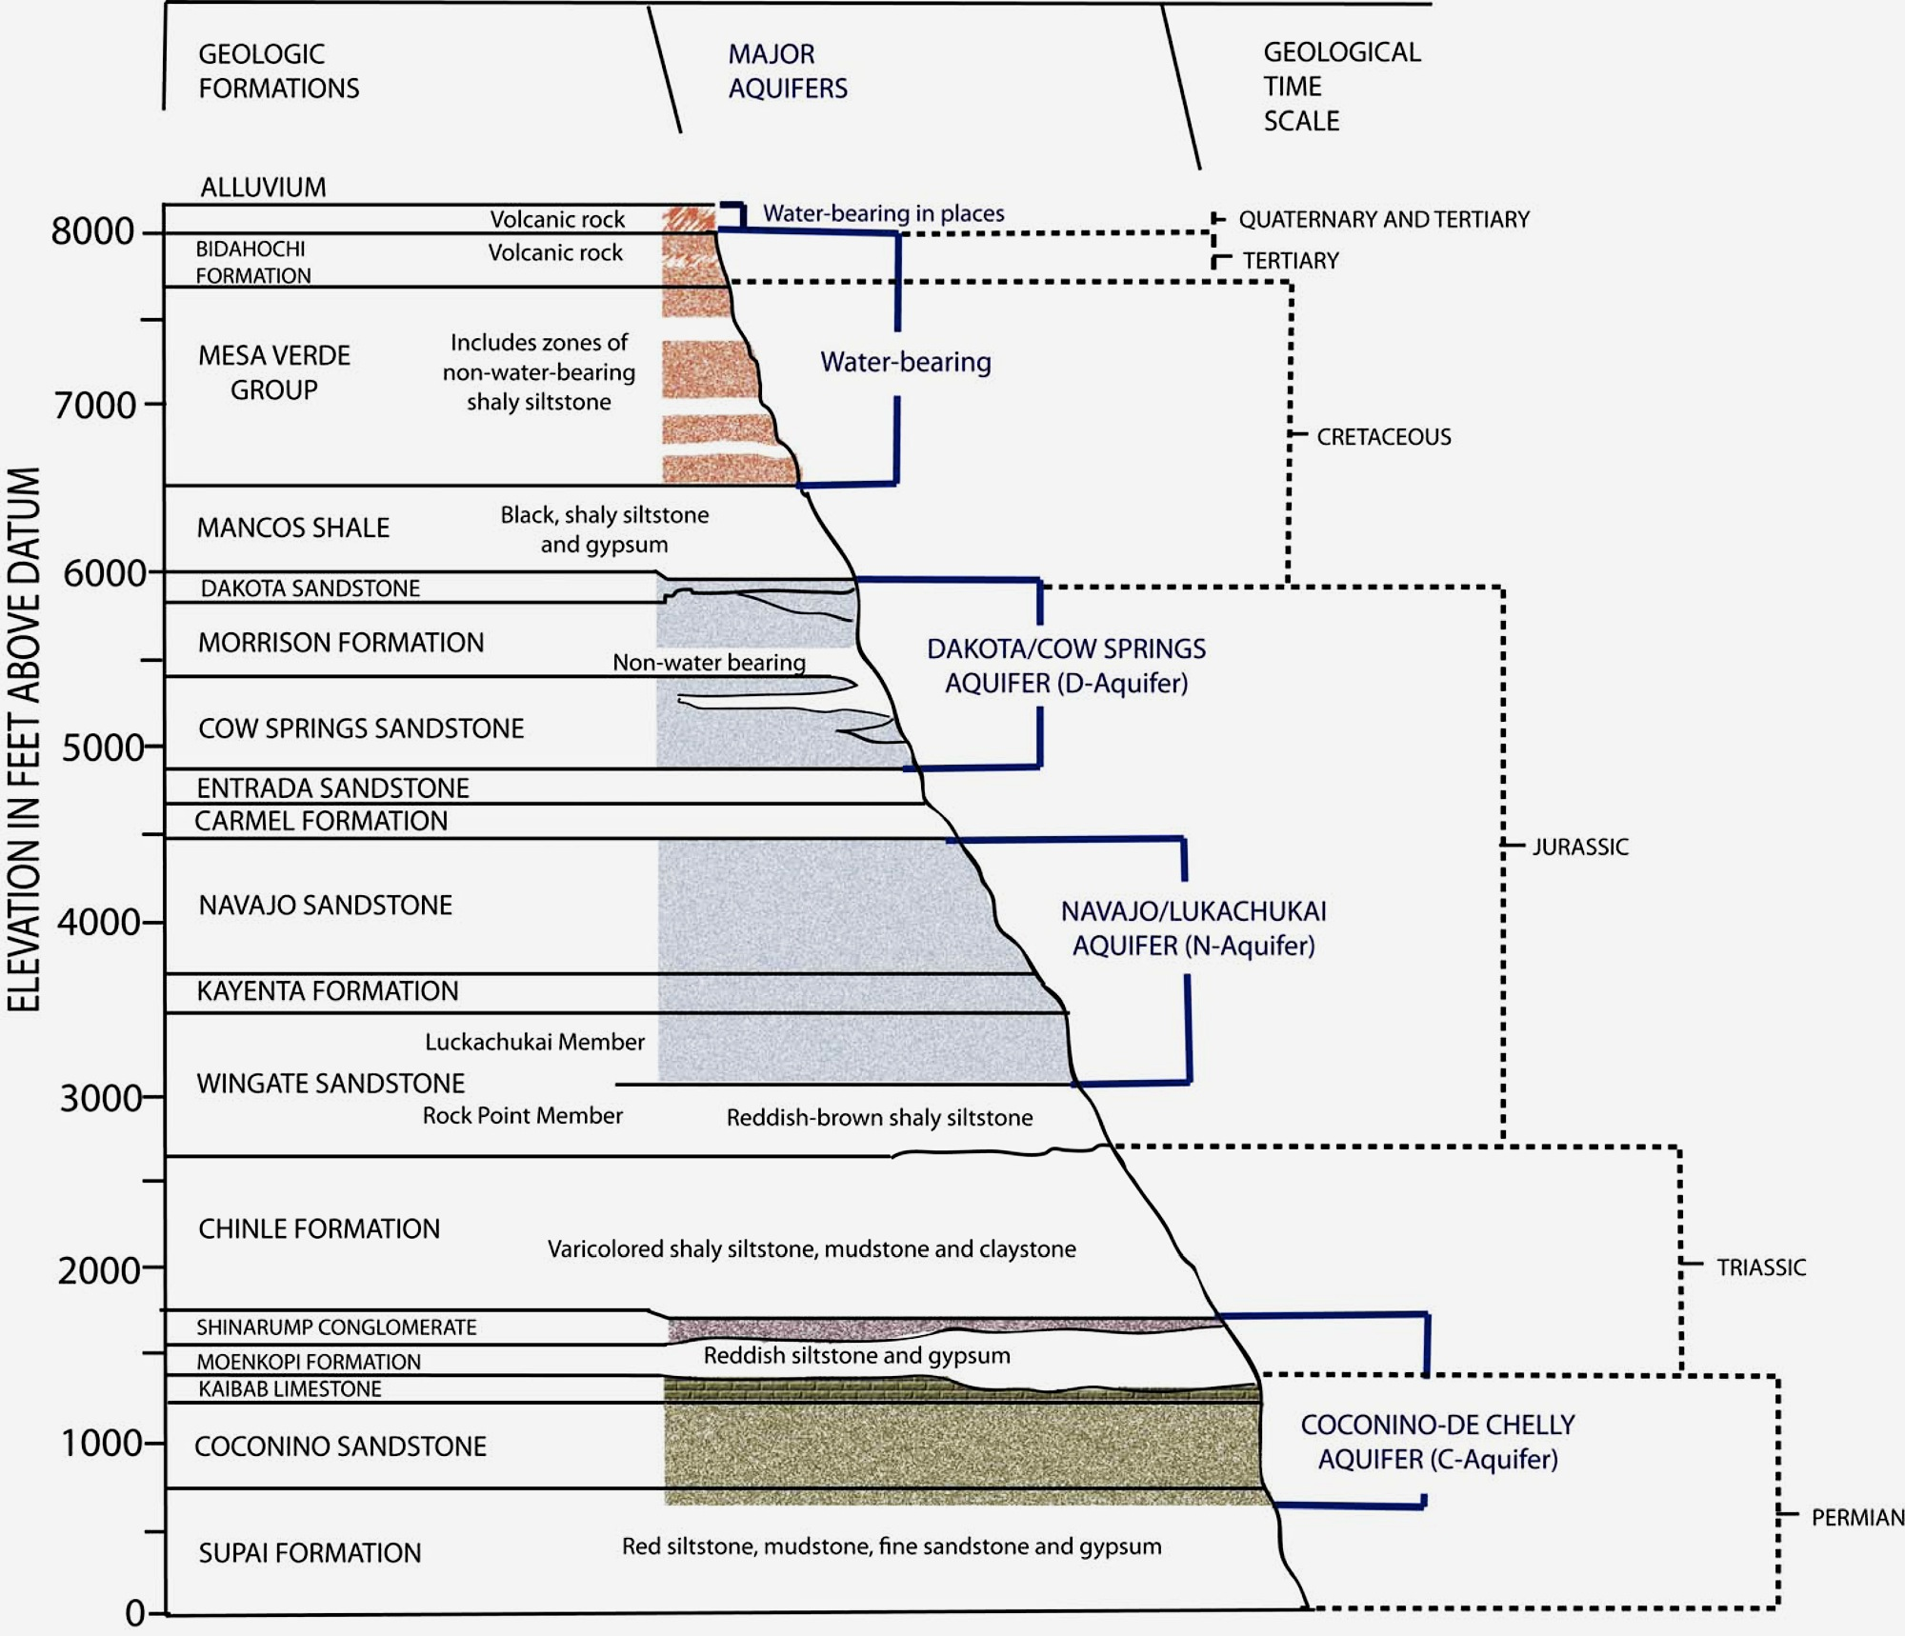
Southwest-based case studies on the energy-water nexus: I
Black Mesa coal-slurry pipeline, 1970-2005
A proposal to draw water from the deeper Coconino (C) Sandstone aquifer on and off Native lands was advanced but not implemented.
Coal seams are in the Mesa Verde Group.
N Aquifer
Supplies domestic wells for Hopi and Navajo communities and baseflow in Black Mesa drainages.
Water is prized for its quality.
Tapped to supply Black Mesa coal slurry pipeline 1970-2005.
C Aquifer
Deeper; not used for domestic
water supplies.
Poorer quality water (higher TDS, etc.)

Slide 17
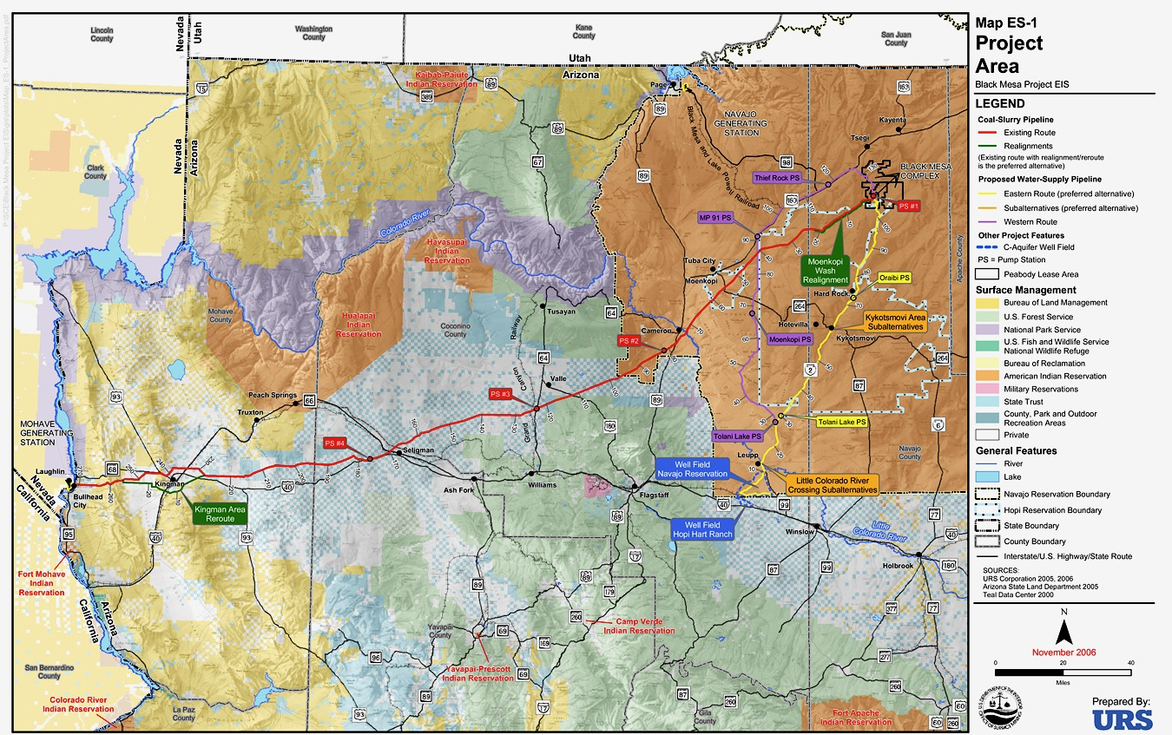
Southwest-based case studies on the energy-water nexus: I
Black Mesa coal-slurry pipeline, 1970-2005
A proposal to draw water from the deeper Coconino (C) Sandstone aquifer on and off Native lands was advanced but not implemented.
The Black Mesa pipeline was mothballed (not abandoned) in 2005 when the Laughlin power plant closed rather than meet new air-quality standards.
But it could be restarted.
(US Office of Surface Mining, 2006)

Slide 18
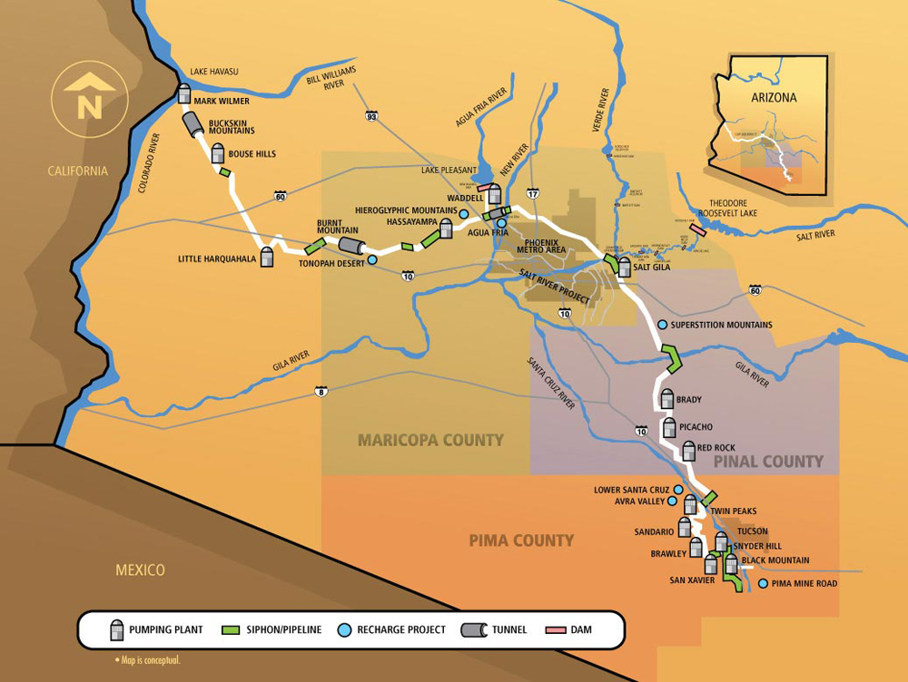
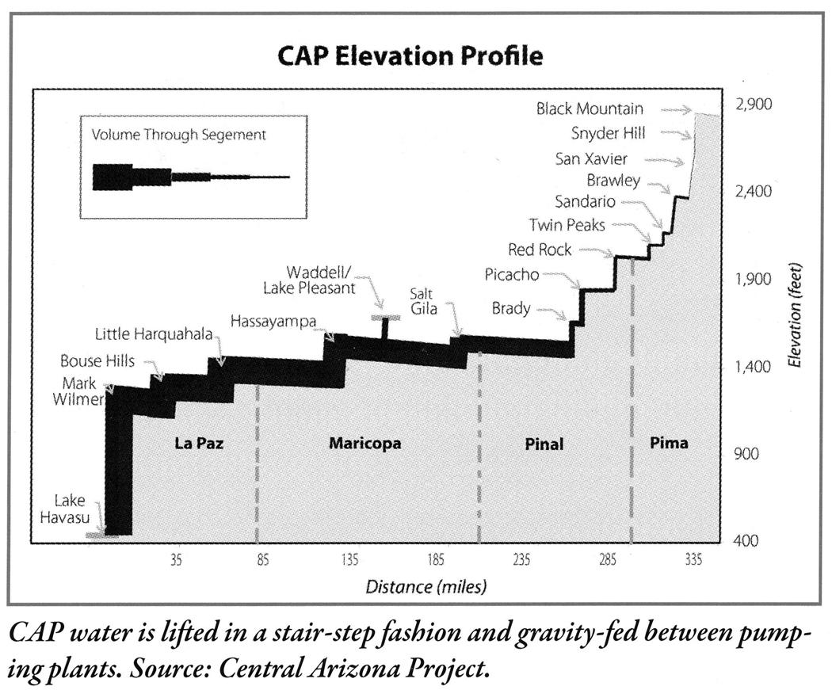
Southwest-based case studies on the energy-water nexus: II
“Water flows uphill toward money.”
Central Arizona Project
335 mi (536 km) run and 2500 ft (760 m) rise
Energy intensity of CAP water:
5 MWh/gal to Phoenix
10 MWh/gal to Tucson
(Lamberton et al., 2010)
(Central Arizona Project, 2010:
www.cap-az.com/about-cap/system-map)

Slide 19

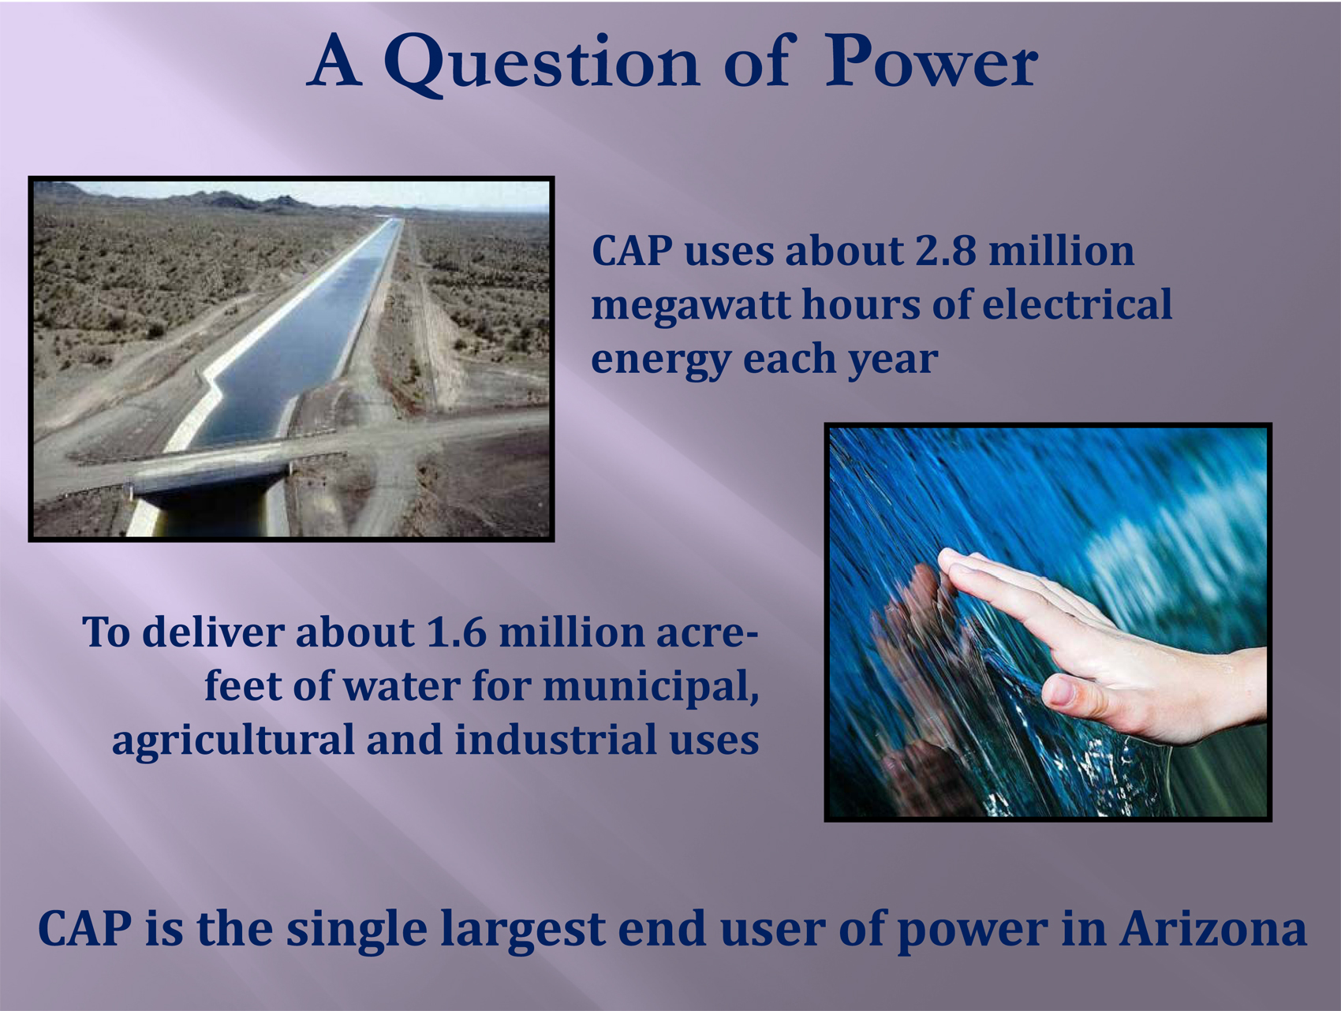
Southwest-based case studies on the energy-water nexus: II
“Water flows uphill toward money”—Central Arizona Project
CAP is managed by the Central Arizona Water Conservation District.
It was envisioned by Barry Goldwater and brought into existence by the Colorado River Basin Project Act of 1968.
Construction began in 1973 and was substantively complete by 1994 (some subsystems for Native nations have yet to be built).
(Central Arizona Project, 2009)

Slide 20
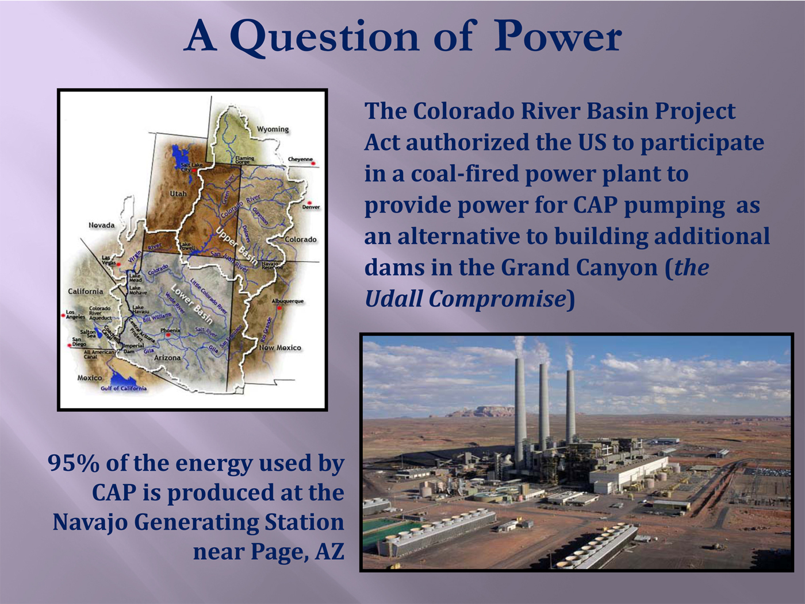
Southwest-based case studies on the energy-water nexus: II
“Water flows uphill toward money”—Central Arizona Project
(Central Arizona Project, 2009)

Slide 21
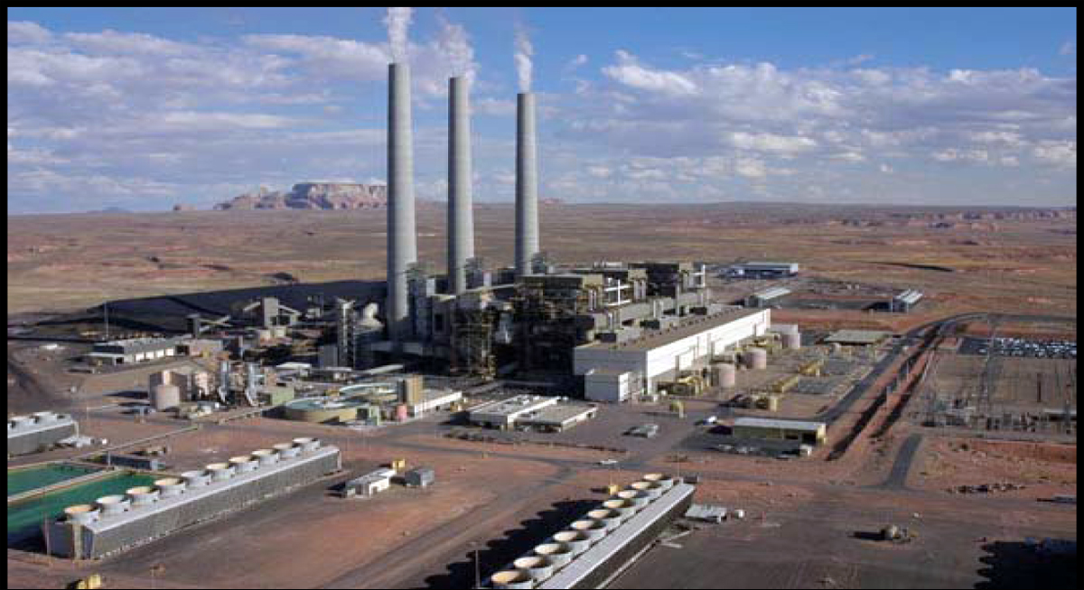
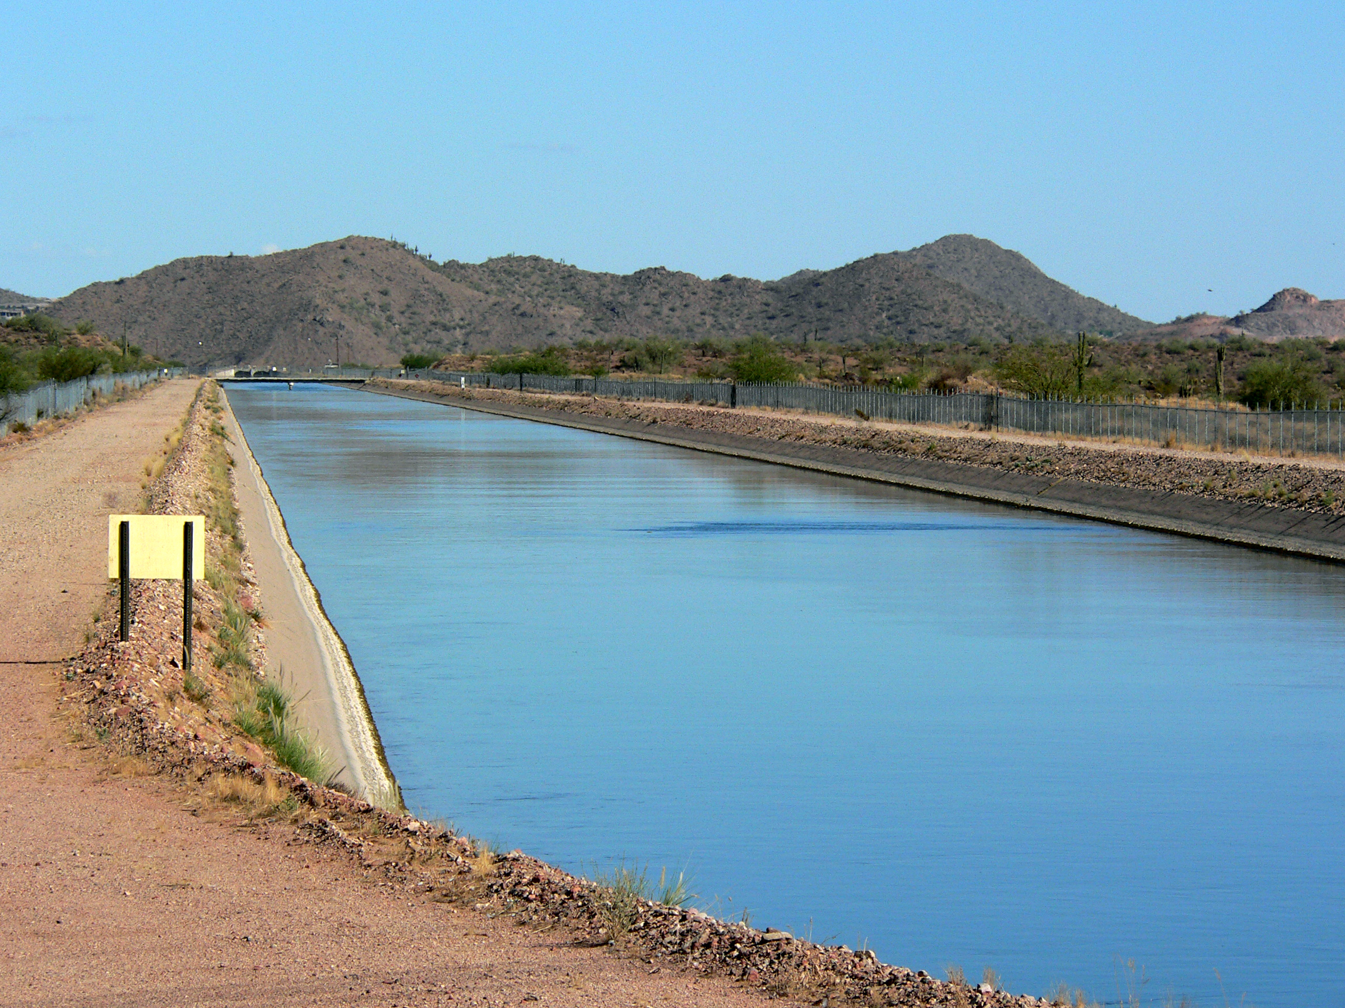
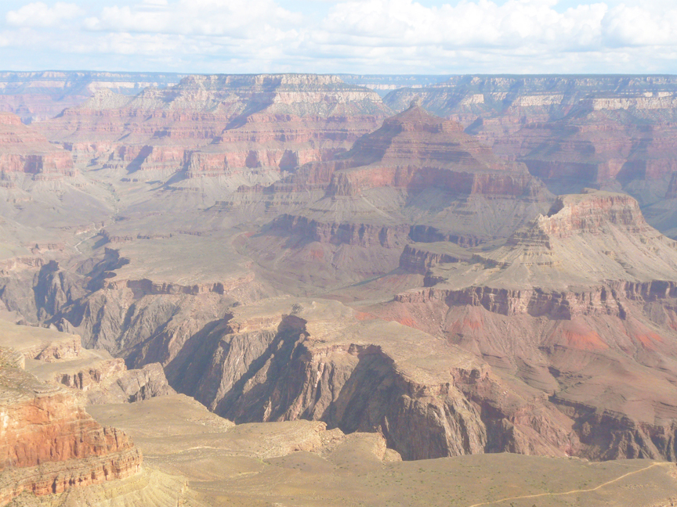
Southwest-based case studies on the energy-water nexus: II
“Water flows uphill toward money”—Central Arizona Project
NGS, Page, Arizona (CAP, n.d.)
95 % of the power used to move water up the CAP Canal comes from the coal-fired Navajo Generating Station in northern Arizona.
NGS emissions have been identified as a major contributor to poor air quality at surrounding Colorado Plateau National Parks, such as Grand Canyon.
Central Arizona Project Canal near Phoenix

Slide 22
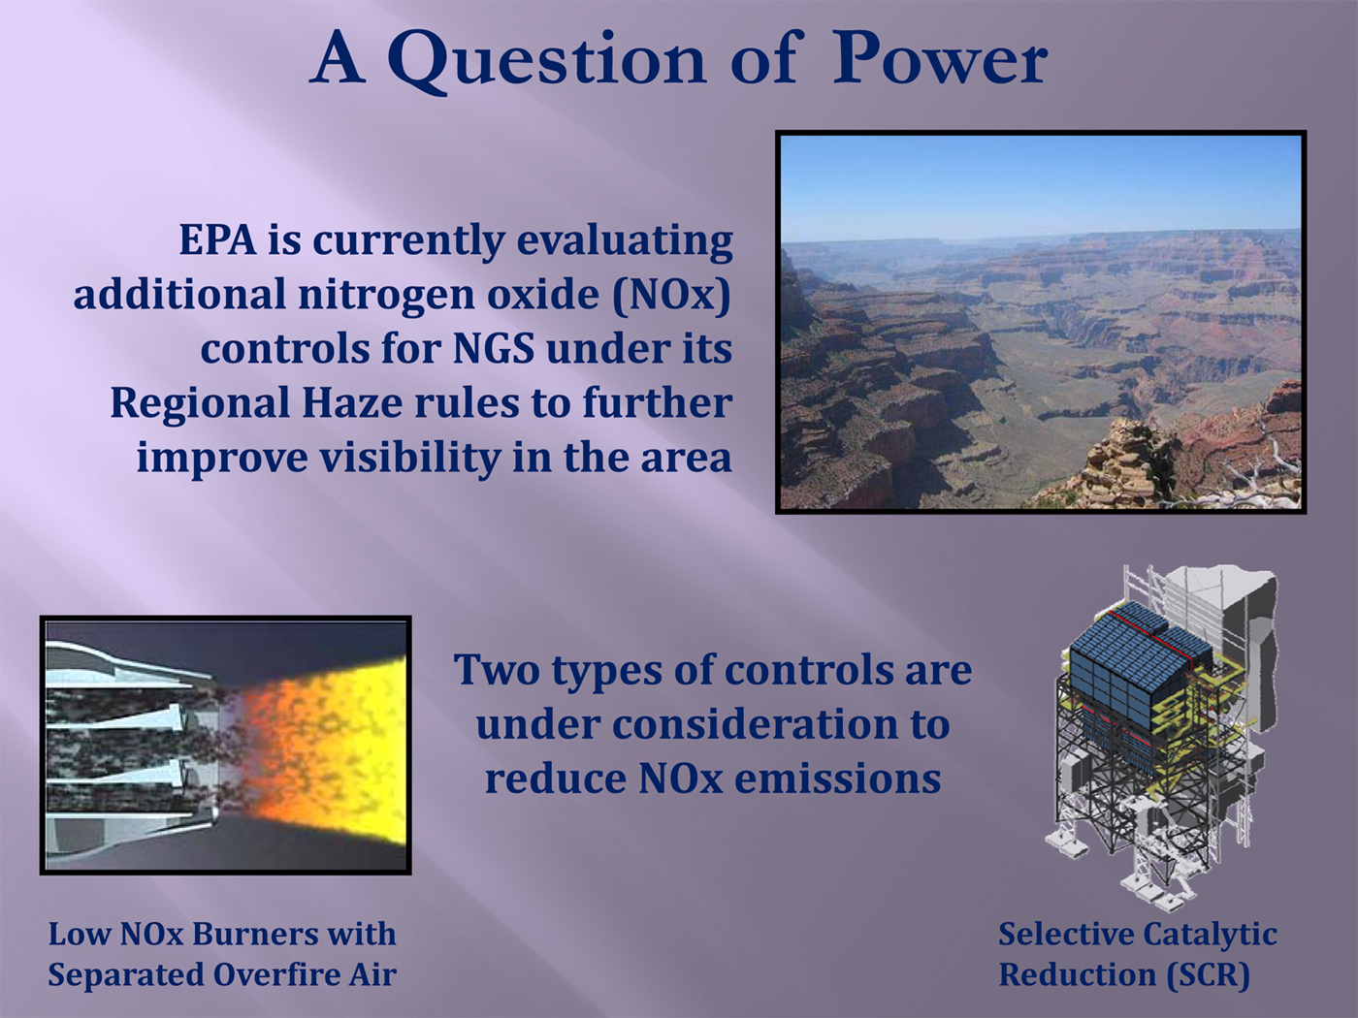
Southwest-based case studies on the energy-water nexus: II
“Water flows uphill toward money”—Central Arizona Project
Regional Haze Rule of 2005
(40 CFR Part 51): Class 1 Areas (National Parks, Wilderness Areas) must be returned to “natural background visibility” (defined by US EPA) by 2064.
Control air/fuel ratio to minimize
O₂ available to react with N₂ and form NO_{x}
Ammonia injection and catalytic reaction
of NO_{x} + NH₃ = N₂ + H₂O
(Central Arizona Project, 2009)

Slide 23
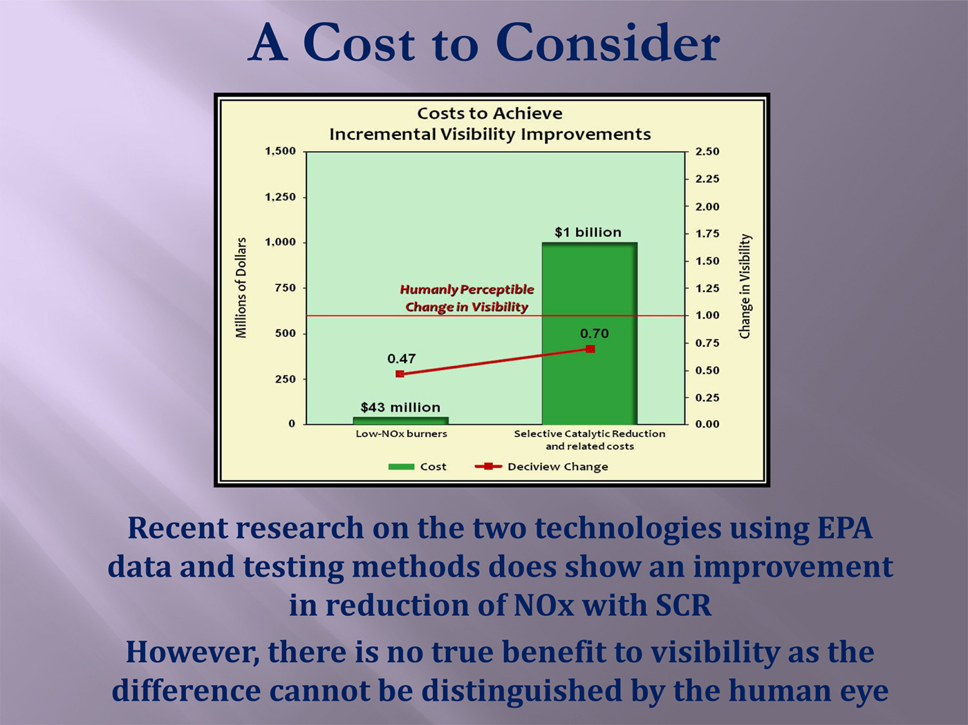
Southwest-based case studies on the energy-water nexus: II
“Water flows uphill toward money”—Central Arizona Project
(Central Arizona Project, 2009)

Slide 24
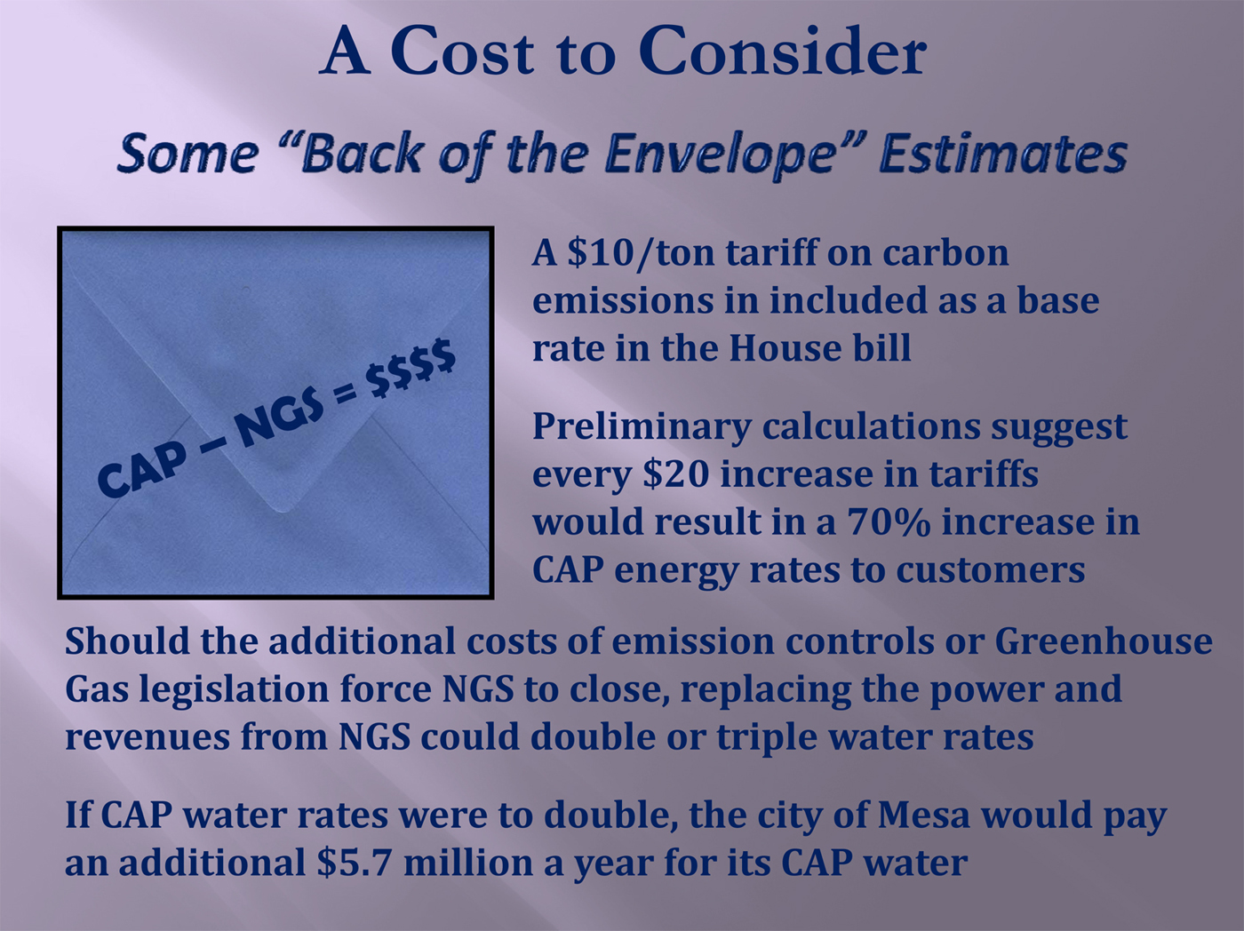
Southwest-based case studies on the energy-water nexus: II
“Water flows uphill toward money”—Central Arizona Project
(Central Arizona Project, 2009)

Slide 25
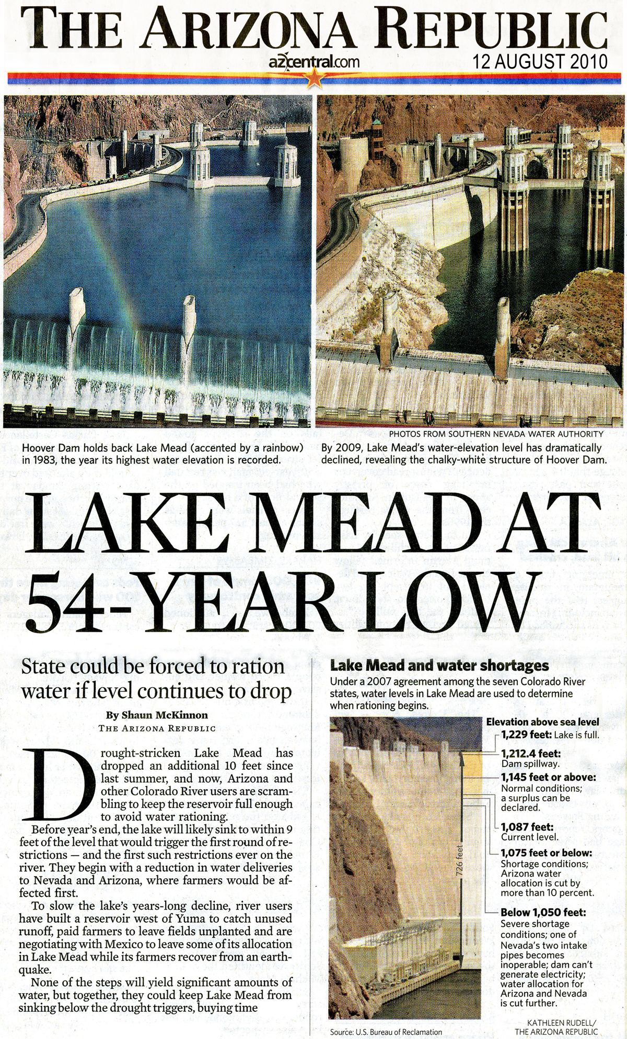
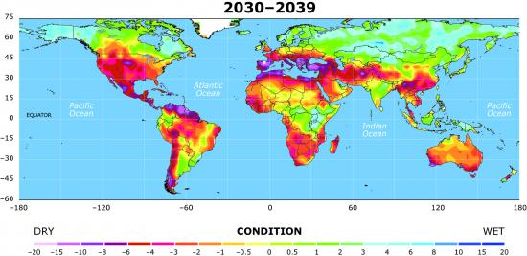
Southwest-based case studies on the energy-water nexus: III
Potential impact of future droughts on hydroelectric power production
Potential for future drought based on current projections of
future greenhouse gas emissions (Dai, UCAR, 2010)
Greenhouse gas emissions from conventional energy production are impacting climate.
Climate change research predicts that drylands such as the Southwest will become even more arid (National Research Council, 2010).
Hydropower production would increasingly compete with domestic, commercial, and agricultural demands on water supplies.
10% reduction in Colorado River streamflow could reduce hydropower productivity ~ 50% (Owen, 2008).
How should—or how will—we adapt to this…?
(McKinnon, Arizona Republic cover story, 12 August 2010)

Slide 26
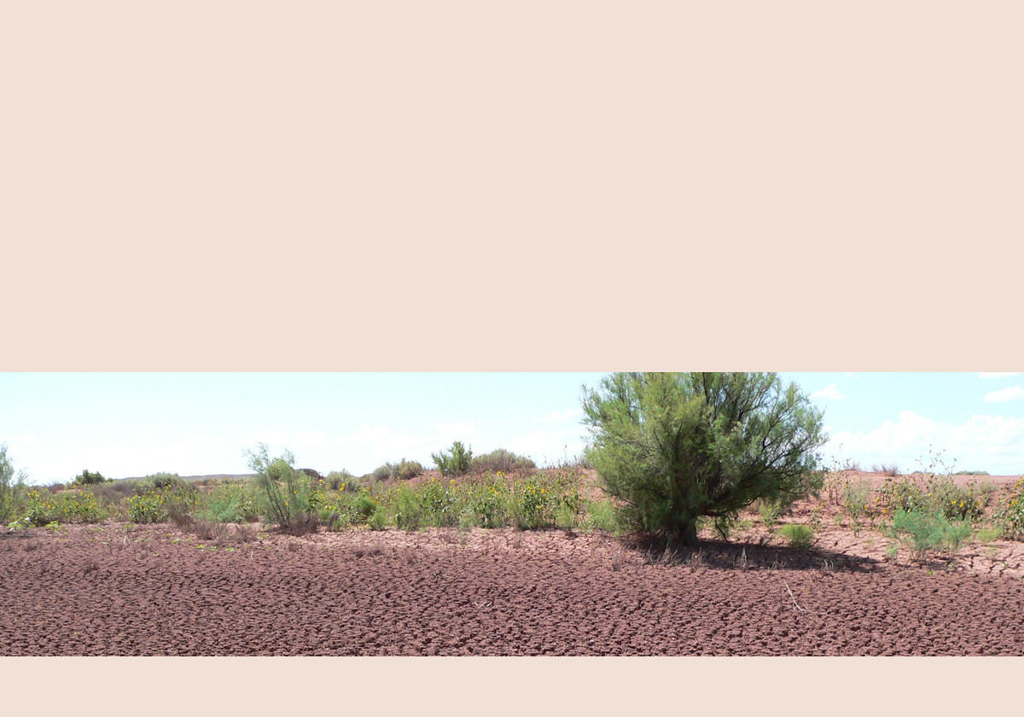
Electricity production directly impacted by water issues: a few examples
(Compiled by Dell, 2010)
2008, Southwest Europe | Summer drought forced cutbacks in hydropower generation, requiring increase in coal-fired power generation.
2008, Australia China Light and Power | Coal mine flooded and partially collapsed, while coal-fired power plant had insufficient cooling water for optimum operation.
2007, California, USA Pacific Gas & Electric | Drought decreased hydropower generation from 22% to 13% of energy delivery mix, and increased verified greenhouse gas emissions rate by 39%.
2007, Carolinas, USA Duke Energy | Extreme drought coupled with record heat required imposition of water restrictions and a 45% reduction in hydropower generation compared to that of the previous seven years.

Slide 27
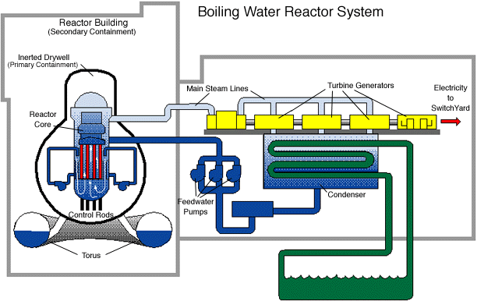
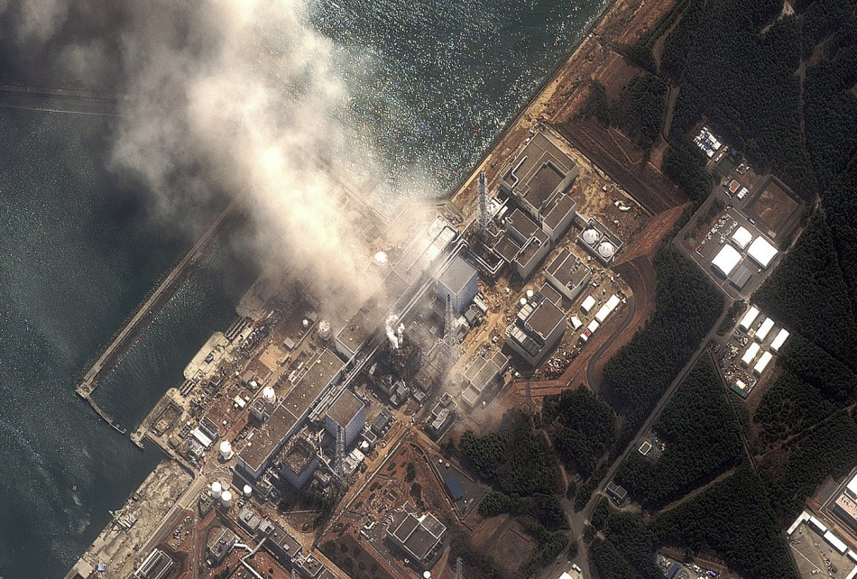
Fukushima Dai-ichi Nuclear Power Plant crisis, Japan: March-April 2011
GE Mark I boiling-water reactors (1970s vintage)
(GEreports.com, 2011)
International Business Times, 2011
http://africa.ibtimes.com/articles/126498/20110324/japan.htm

Slide 28

Teaching and learning about the
Energy-Water Nexus
Summary
(SAHRA, 2007)
Energy resources and water resources are inextricably linked from the perspectives of geoscience, environmental science, engineering, economics, and politics.
This energy-water nexus is receiving increasing attention from researchers, regulators, planners, decision-makers, and the media.
The energy-water nexus has manifold relevance to sustainability.
It is a rich topic for Earth and environmental science educators because of its global and personal relevance, and because of the wealth of accessible quantitative data and news that can be used in inquiry and discussion.
When teaching about energy, follow the water too!

Slide 29
Central Arizona Project. (2009). Ensuring reliable water supplies for central Arizona. http://www.cap-az.com/Portals/1/Skins/cap/files/Ensuring-Reliable-Water-Supplies.pdf.
Central Arizona Project. (2010). Central Arizona Project website. http://www.cap-az.com/.
Dell, J. (2010). Balancing the energy-water nexus. Proceedings, World Energy Conference, Toronto, Ontario, Canada.
Electric Power Research Institute (2008). Summary of presentations, EPRI advanced cooling technology workshop, Palo Alto, California.
General Electric Company. (2011). Home appliance energy use. http://visualization.geblogs.com/visualization/appliances.
Grabiel, T. (2006). Drawdown: An update on groundwater mining on Black Mesa. Natural Resources Defense Council Issue Paper. http://www.nrdc.org/water/conservation/draw/draw.pdf.
International Business Times. (2011). Update from IAEA on Fukushima Nuclear Plant. http://africa.ibtimes.com/articles/126498/20110324/japan.htm.
King, C. W., & Webber, M. E. (2008). Water intensity of transportation. Environmental Science and Technology, 42, 7866-7872.
Kraker, D. (2002). Is a coal mine pumping the Hopi dry? High Country News, http://www.hcn.org/issues/221/11049.
Lamberton, M., Newman, D., Eden, S., & Gelt, J. (2010). The water-energy nexus. Arroyohttp://ag.arizona.edu/azwater/arroyo/Arroyo_2010.pdf
Littin, G.R. (1999). Monitoring the effects of ground-water withdrawals from the N Aquifer in the Black Mesa area, northeastern Arizona. US Geological Survey Fact Sheet 064-99.
McKinnon, S. (2008, 07 December). Arizonas water and power supplies intertwined. Arizona Republic.
McKinnon, S. (2010, 12 August). Lake Mead at 54-year low. Arizona Republic.
National Research Council. (2010). Advancing the science of climate change. Washington, DC: National Research Council. http://www.nap.edu/catalog.php?record_id=12782.
Owen, G. (2008). Impacts: Drought and people. http://www.southwestclimatechange.org/impacts/people/drought.
Pasqualetti, M.J., & Kelley, S. (2008). The water costs of electricity in Arizona: Executive summary. Arizona Water Institute. http://www.azwaterinstitute.org/media/Cost%20of%20water%20and%20energy%20in%20az.
Sustainability of Semi-Arid Hydrology and Riparian Areas (SAHRA). (2007). The water-energy nexus. Southwest Hydrology, v. 6, no. 5. http://www.swhydro.arizona.edu/archive/V6_N5/.
Thomas, B. E. (2002). Ground-water, surface-water, and water-chemistry data, Black Mesa area, northeastern Arizona—2000-2001, and performance and sensitivity of the 1988 USGS numerical model of the N Aquifer. U.S. Geological Survey Water-Resources Investigations Report 02-4211. http://az.water.usgs.gov/pubs/WRIR02-4211intro.html.
US Department of Energy. (2006). Energy demands on water resources: Report to Congress on the interdependency of energy and water. http://www.sandia.gov/energy-water/docs/121-RptToCongress-EWwEIAcomments-FINAL.pdf.
US Department of Energy. (n.d.). The energy-water nexus. http://www.sandia.gov/energy-water/docs/NEXUS_v4.pdf.
US Geological Survey. (2004). Black Mesa monitoring program. http://az.water.usgs.gov/projects/az028.html.
US Office of Surface Mining. (2006). Black Mesa Project draft environmental impact statement. Office of Surface Mining Report DOI DS 06-48 OSM-EIS-33. http://budget.state.nv.us/clearinghouse/Notice/2007/E2007-148.pdf.
Woodhouse, B. (2007). Energy demands on water resources: The Federal perspective. Southwest Hydrology, v. 6, no. 5, p. 18. http://www.swhydro.arizona.edu/archive/V6_N5/feature2.pdf.

Slide 30
Thank you for your interest. semken@asu.edu

