Slide 1
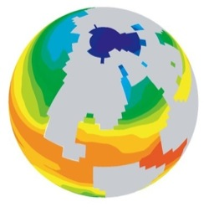
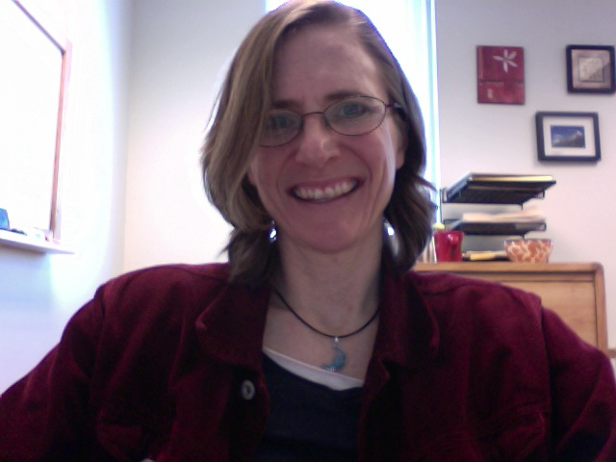
Welcome to:
A Climate Modeling Tutorial
Climate and Energy Webinar Series
February 18, 2010
Cindy Shellito
University of Northern Colorado

Slide 2
GOALS
Part I - Learn about how to use the UNEP Java Climate Model in a classroom setting
Part II - Follow-up with participants from the October 2010 Climate Modeling workshop, to hear how the development and implementation of new teaching materials is going.

Slide 3
Objectives for Part 1
Overview of climate models
Introduction to an interactive, easily accessible climate model
Provide opportunity to tinker with the model on your own
Discussion of ways to incorporate a model in your classroom

Slide 4
Global Climate Modeling: A very brief overview
What is a climate model?
Mathematical representation of climate system and system interaction – Based on our understanding of physics, chemistry, biology
Provide us with an independent way of testing whether a particular hypothesis can explain the data we have collected

Slide 5
The physics in the heart of every model…
Δ heat = energy absorbed – energy emitted
Outgoing longwave radiation
from Earth = σT_{earth}⁴
σ = Stefan-Boltzmann constant
σ = 5.67 x 10⁻⁸ W/m²K⁴
The Sun
Incoming shortwave at
top of atmosphere:
S_{o} = 1367 W/m²
Earth

Slide 6
Development and use of a model
Model Development
(driven by observations)
Laws of physics, principles of chemistry, biology, parameterizations
Analyze Results
Test model validity against observations
Make climate projections, Develop/test hypotheses
Simulation
Model => Results
Forcings
Boundary Conditions
Notes:
http://stratus.astr.ucl.ac.be/textbook/chapter3_node3.html

Slide 7
Range of complexity:
Energy Balance Models: simple models of Earth’s radiative balance (1-D & 2-D)
EMICs: Earth Models of Intermediate Complexity (2-D & 3-D)
3-D Global Climate Models
Regional Climate Models
Geochemical Models

Slide 8
Which model to use?
EBMs
EMiCs
GCMs:
Includes Atmosphere, Ocean, Earth System Models
Depends on:
Assumptions we choose to make
Knowledge of external forcing factors, response and interactions of Earth System Components
Which questions we would like to answer
Notes:
Also: Computing Power!

Slide 9
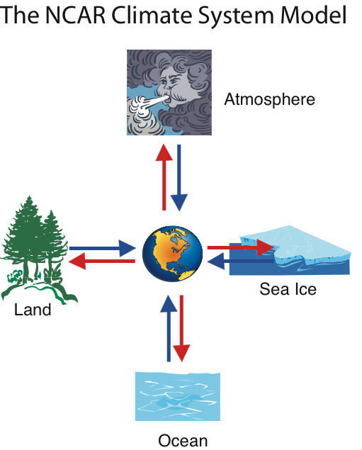
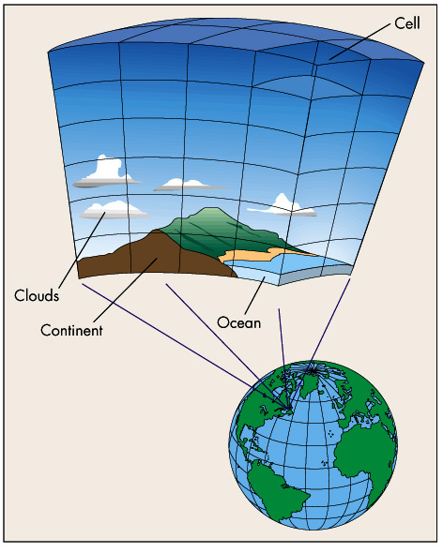
GCM Resolution:
Depends on size of grid cells

Slide 10
Advantages of using GCMs in the classroom
Allows students to use authentic ‘research’ tool
Promotes inquiry
Students consider climate system complexity
Visualization may enhance understanding of system dynamics

Slide 11
Challenges of using GCMs in the classroom
Most models are NOT USER-FRIENDLY! (Require extensive setup and advanced computing skills – for instructor AND students)
User-friendly models tend to cost more than many departments can afford.

Slide 12
UNEP Java Climate Model
http://www.climate.unibe.ch/jcm/
(JCM Version 4)
Developed by Dr. Ben Matthews with KUP Bern
Danish Energy Agency, UNEP/GRID-Arendal
Fundamentals
It’s interactive
Allows students to tinker with a ‘model’, but provides immediate results
No tedious set up
No technical issues
Students can work with it at home – works in a web browser
It’s FREE!!

Slide 13
UNEP Java Climate Model
http://www.climate.unibe.ch/jcm/
(JCM Version 4)
Challenges
Not always user-friendly (not like EdGCM)
Revisions are ongoing, and documentation is still being developed
You must place the model in context for your students (provide background, ‘recipe’ for initial experiments, determine the level of background to discuss with your students)

Slide 14
UNEP Java Climate Model
Many versions – older version is all online
Results calculated through Java implementation of simple carbon & climate models based on those used in IPCC (but don’t use same computer code – no time integration)

Slide 15
Layout of JCM4 – Simple Version

Slide 16
How it works:
Model Component Modules -
Carbon cycle
Other GHGs and aerosols
Radiative forcing
Climate (temperature)
Sea Level
Regional climate
Based on Bern Carbon Cycle Model
Based on Upwelling-diffusion EBM (Wigley)
Scales a map of GCM regional output to new JCM results
Systems of eqns solved using eigenvector method (more efficient than direct integration – allows exact analytical solutions & instant results)

Slide 17
Example - Carbon Module
Change in atm [CO₂] = (fossil & land use emissions) – (ocn & biosphere sinks)
Module affected by: Mitigation, SRES, Climate modules
Module affects: Radiative forcing, mitigation, carbon cycle plot & storage

Slide 18
How it works:
Emission and Stabilization Scenarios
Users have the option to explore Emission Scenarios developed for the IPCC (e.g., SRES A1B, A2, B1, B2, etc), as well as various mitigation or stabilization scenarios (e.g, what would be necessary to stabilize CO₂ emissions, CO₂ concentration, temperature, etc)

Slide 19
How it works:
NOTE: This is a SIMPLE model!!
Creates curves/results for comparing scenarios – doesn’t include climate variability or regional climate variations explicitly
Components of model only calculated if they are needed for output
Model and graphics are one tool

Slide 20
JCM4 – ‘Normal’ Version

Slide 21
JCM4 – ‘Expert’ Version

Slide 22
JCM4 – ‘Experimental’ Version

Slide 23
JCM4 – 9-panel View

Slide 24
JCM4 – Model Flow Chart

Slide 25
Using JCM to explore uncertainties
Component | Better Understood | Less well understood
Emissions | CO2, F-gases | CH4, N2O, other gases (especially from soils)
Carbon Cycle | Ocean sink (physical and chemical) | Biosphere sink (climate feedback effects)
Atmosphere Chemistry | F-gases, CH4, N2O | Ozone and OH feedbacks
Radiative Forcing | Well-mixed greenhouse gases | Solar Variability and Aerosols
Temperature | Ocean warming (except surprise circulation changes) | Cloud processes and feedbacks ("climate sensitivity")
Sea-level | Thermal Expansion | Polar icecaps
Table from JCM 4 Documentation

Slide 26
JCM – Version 5
Most Recent version:
http://www.astr.ucl.ac.be/users/matthews/jcm/
Download a zip package to run offline
Includes:
More parameters to tinker with
Larger number of emission scenarios
Ability to change look and feel of the interface
Ability to save plots

Slide 27
JCM5 – ‘Normal’ Version

Slide 28
JCM5 – ‘Internal Windows’ Format

Slide 29
Possible applications in the classroom
Could be used:
In connection with discussion of IPCC
Introduction to models
Introduction to scientific process (develop a questions/pursue and answer)

Slide 30
Opportunity to play with the model!
Follow along, or try it on your own…

