Slide 1

Misconceptions about Climate Science
Susan Buhr
CIRES Education and Outreach
University of Colorado, Boulder

Slide 2
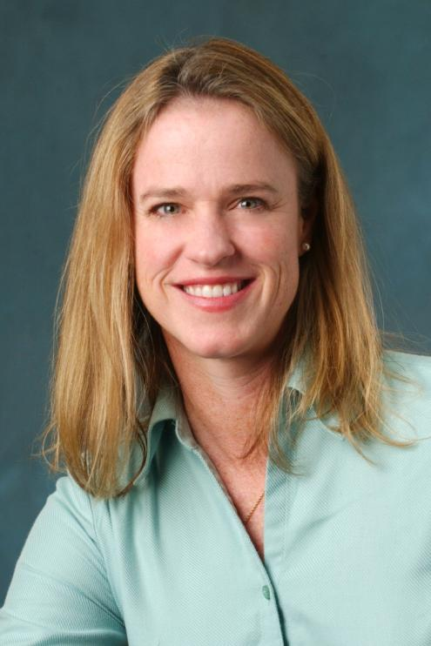
Introduction
CIRES Outreach climate education
http://cires.colorado.edu/education/outreach/

Slide 3

Goals for this Webinar
Learn about common climate misconceptions
Learn strategies for identifying and addressing misconceptions

Slide 4
Guiding Questions
What is meant by “misconceptions”?
Where do misconceptions originate?
How do I identify misconceptions?
What are some common climate misconceptions?
How do I address misconceptions?
Resources

Slide 5

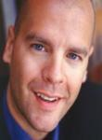
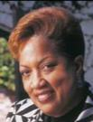


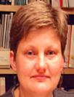
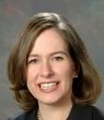
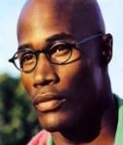

Who are your students?
Introductory course students
Prospective teachers
Upper level undergraduate students
Classroom teachers
Other
Know thy audience

Slide 6
Who are your students?
Students probably did not learn geoscience in high school
Undergraduate conceptions similar to secondary students and public
Other faculty or colleagues?
Know thy audience
Notes:
Less than 25% of students take a geoscience course in high school
Often, these are not the college-bound students
Less than 1.2% of college bound seniors identify physical or interdisciplinary science as their intended major (sources AGI Workforce report)

Slide 7

What is meant by “misconception”?
mis·con·cep·tion
–noun
: a mistaken idea or view resulting from a misunderstanding of something
Related terms: “naïve idea”, “pre-conception”, “alternate conception”, “weak conception”
Prior conceptions are strongly held
Even correct concepts are likely to be fragmented
Distinction: Cognition vs. misinformation

Slide 8
Challenges to climate change education
barriers to understanding science:
climate science is non-intuitive:
geological time, complex interactions, non-linear processes
formal public media has portrayed “two sides” in the past
climate science and scientific uncertainty has been mischaracterized in popular media, politicized
Fortner et al., 2000
Introduction, Dilling and Moser, 2007
Leiserowitz, in Dilling and Moser, 2007

Slide 9
More challenges to climate education
barriers to taking action:
perceived to affect people and animals far away
solutions not known, or may be perceived as threats
fear of problem may result in “shut down mode”
mass communication engenders awareness without action
Leiserowitz, in Dilling and Moser, 2007 | Moser, in Dilling and Moser, 2007 | Ungar, in Dilling and Moser, 2007 | Dunwoody, in Dilling and Moser, 2007

Slide 10
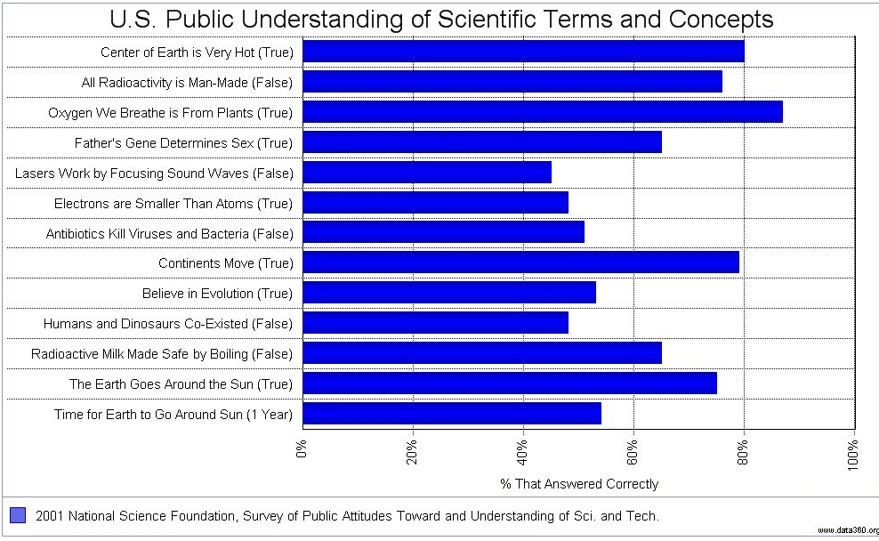
How long does it take for the Earth to go around the Sun? Answer: 1 year
Percent answering correctly?
~53% US

Slide 11
Two types of publicly controversial topics
how to apply science
  human reproduction
  embryonic stem cells
  endangered species
  nuclear energy
  responding to climate change
validity of the science
  origin of life
  evolution
  human-caused
  climate change
How should you approach these two types?
For a more detailed description see: http://undsci.berkeley.edu/article/0_0_0/sciencetoolkit_06
Notes:
finer breakdown: http://undsci.berkeley.edu/article/0_0_0/sciencetoolkit_06
Fundamental scientific controversy
Peripheral scientific controversy
Controversy over ethics
Controversy of practical applications
Controversy between science and nonscientific viewpoints
Manufactured controversy

Slide 12
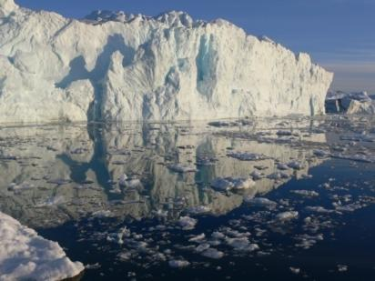
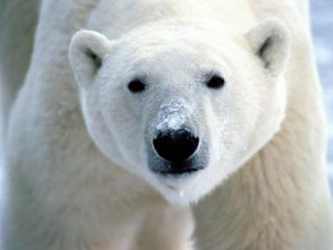
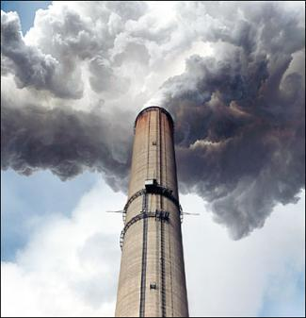
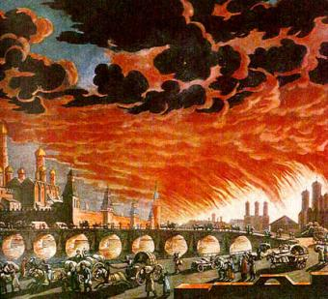
Do misconceptions matter?
happening far away (it’s not urgent)
happening to non-humans (it’s low priority)
it’s pollution (don’t use spray bottles)
it’s weather (can’t affect it)
it’s an apocalypse (it’s too late!)
appropriate mental
models involve a
global systems
perspective
Notes:
We can try to address each climate misconception individually, or we can listen closely to what our audience knows, and try to frame our response in a way that will help them build a more inclusive mental model.
Misconceptions lead to lack of concern, wrong ideas about what can be done.

Slide 13
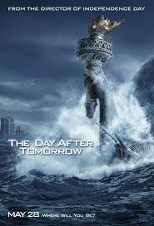
Sources of climate concepts (good, bad and ugly)
“The greatest obstacle to new learning often is not the student’s lack of prior knowledge but, rather, the existence of prior knowledge” Angelo and Cross, Classroom Assessment Techniques, 1993
Everyday experience
Parents, friends
Vicarious experience- movies
Internet-blogs, websites
School, textbook graphics
Help or hindrance?

Slide 14
Sound climate conceptions
Climate Literacy framework
AAAS Benchmarks Weather and Climate
Alignment at middle school through upper level undergraduate
Climate Literacy and Energy Awareness Network (CLEAN)
Download brochure at: http://www.climatescience.gov/Library/Literacy/

Slide 15
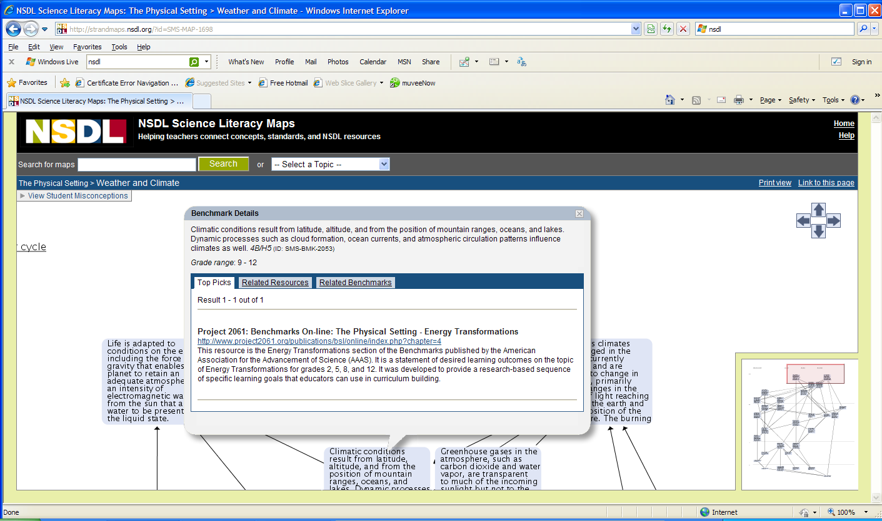
AAAS strand maps
http://strandmaps.nsdl.org/

Slide 16
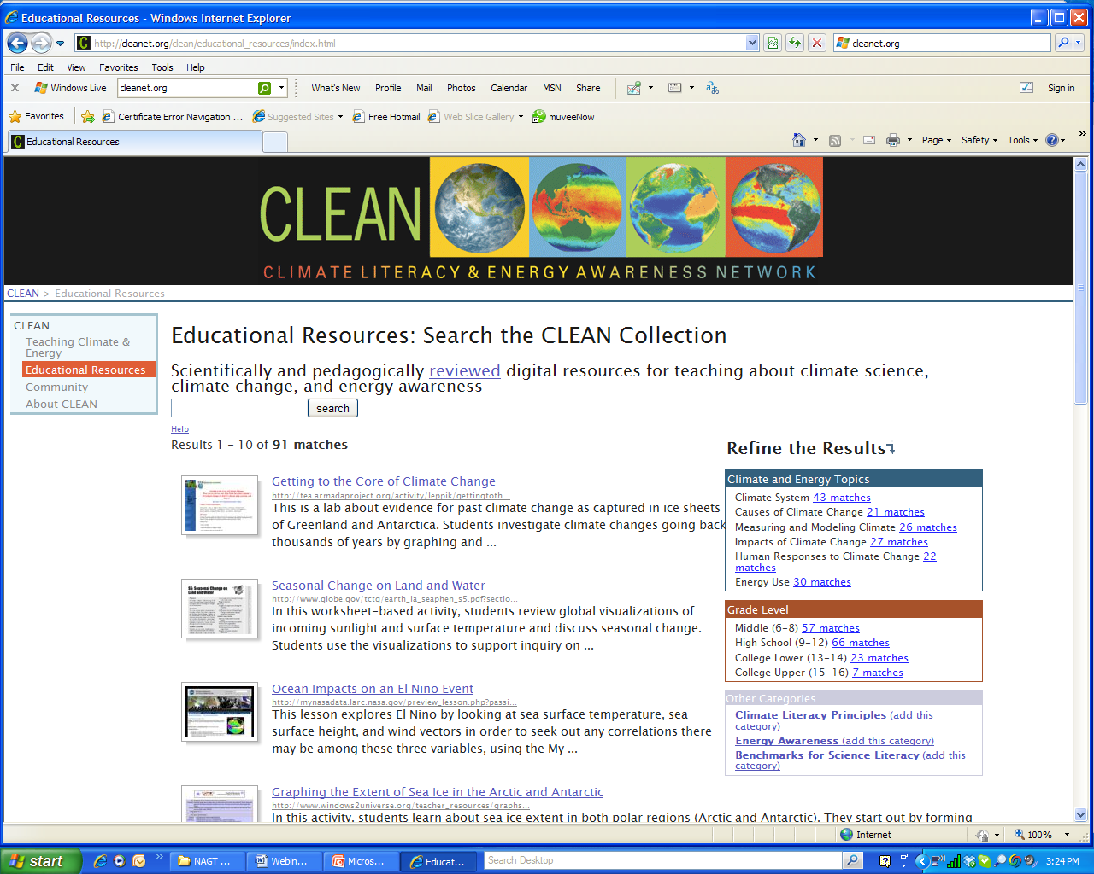
CLEAN collection
http://cleanet.org/

Slide 17

How do you identify misconceptions?
Open ended probe questions
Concept mapping
Multiple choice quizzes
Nothing formal; I note misconceptions as they come up
Other (write in chat box)

Slide 18
Classroom Assessment Techniques
Prior conception probes
Concept maps-shows fragmentation
Class discussion
Multiple choice quizzes- caveat
What else?
Resources:
Angelo and Cross (1993) Classroom Assessment Techniques,
Cutting Edge concept mapping (Gautier, Dempsey)
Cutting Edge list of misconceptions (Kirby)

Slide 19
What misconceptions are common?
Misconceptions based in everyday experience-sun closer in summer, weather
Talking points in the public media
Less common: Niceties of climate science

Slide 20
Which have you encountered?
The ozone hole is causing climate change
Not using aerosol bottles (or polluting) leads to less climate change
Any changes will be tiny and gradual
The Earth is too big for humans to change it
Nothing can be done-we’re all going to die

Slide 21
Ozone and climate change
The ozone hole is causing climate change
Global warming is causing the ozone hole
The ozone hole lets in more heat/radiation
Not using aerosol bottles (or polluting) leads to less climate change
Fossil fuel use leads to ozone destruction.
Global warming causes skin cancer
Constructs are fuzzy

Slide 22
Stasis-things don’t change
Any changes will be tiny and gradual
Global warming means incremental warming uniformly
Also seen in other earth phenomena
Artifact of the term “global warming”

Slide 23
Limits to human agency
Because climate has changed in the past when humans weren’t around, recent climate change is part of a natural cycle
The Earth is too big for humans to change it
The climate system is too complex for humans to understand it (scientific abdication)
Nothing can be done

Slide 24
Which have you encountered?
Since other greenhouse gases exist (water, methane), CO2 is not responsible for recent climate change
The greenhouse effect is bad
Increased sun spots cause recent climate change
Weather is the same as climate-if we have a blizzard, so much for global warming
CO2 is a plant nutrient, so more CO2 is good for crops.

Slide 25
Greenhouse effect
Greenhouse effect is the same as albedo or reflectivity
If other greenhouse gases exist, CO2 is not responsible for recent climate change
Greenhouse effect is same mechanism as a physical greenhouse
Greenhouse effect is bad
Greenhouse effect is due to humans
Greenhouse effect is not proven (less of this one)

Slide 26
It’s the Sun, stupid!
Increased radiation causes recent climate change
Increased sun spots cause recent climate change
Changes in Earth’s orbit causes recent climate change
Warming is due directly to sunlight.

Slide 27
Misunderstanding variability
Seasonal: The Equator is warmer because it is closer to the Sun
Seasonal: Summer is warmer because the Earth is closer to the Sun.
Weather is the same as climate-if we have a blizzard, so much for global warming
Sea ice is recovering so climate change isn’t happening

Slide 28
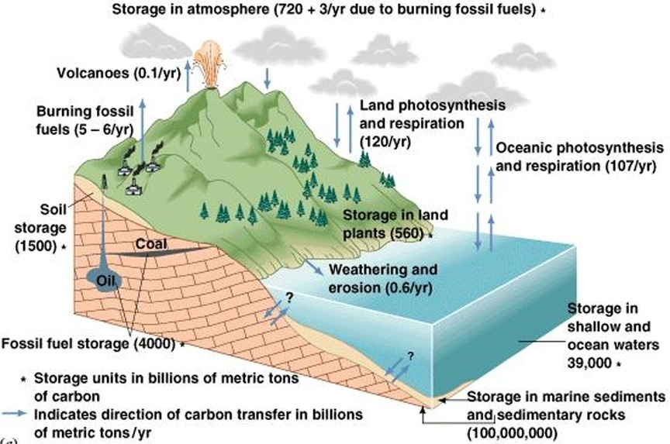
carbon concepts study
Q: How might human activities affect the carbon cycle?
Source of Diagram: The Blue Planet, Skinner et al., 1999
courtesy of Dr. John Madsen, U. of Delaware

Slide 29
carbon concepts study
39% of undergrads held some misconception(s)
misconceptions fell into 4 categories:
  carbon equated with all pollutants
  total carbon is increasing, decreasing, or rate of movement is changing
  carbon thins atmosphere or destroys ozone
  carbon creates a catastrophe

Slide 30
How do you address misconceptions?
I tell students what is right
Students predict, observe, explain
Metacognition exercises
Other (write in chat)

Slide 31
How to Address
It’s not easy.
People are attached to their ideas.
Instruction can improve conceptions
Time, talk, tools

Slide 32
Classroom Assessment Techniques
Conceptual change models, inquiry, dialogue, time
Allow conceptions to be made explicit
Allow experiences to build cognitive dissonance
Time, talk, tools

Slide 33
If time permits…..
A brief look beyond misconceptions
What works?
What about controversy?
What if my students think we are all going to die?

Slide 34
what conveys climate change effectively?
hearing the consensus repeated:
“human activities cause global warming”
clarification about the scientific process*
scientific uncertainty, role of peer review
clear, relevant evidence for change*
respectful responses to disagreement*
exposure to information about solutions*
Vedantam, 2007
Union of Concerned Scientists

Slide 35
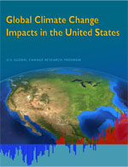
making evidence relevant
Regional assessments are available
  Colorado
  Utah
  New Mexico
  California
  Global Climate Change Impacts in the US
Notes:
US Global change research program (USGCRP)
Get references on regional assessments

Slide 36

respectfully responding to
disagreement
be patient: misinformation comes from trusted sources
use dialogue: listen to understand root concerns, defuse emotions.
your viewpoints might overlap
resources:
  RealClimate.org-”Start Here”
  Skeptical Science
  Agencies, IPCC
  Climate Denial Crock of the Week
McCright, in Dilling and Moser 2007 | Regan, in Dilling and Moser 2007

Slide 37
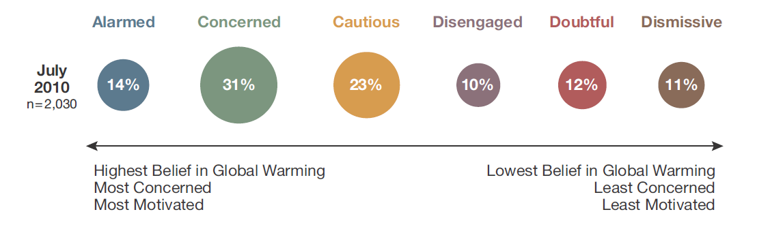
respectfully responding to
disagreement
What do Americans know?
http://environment.yale.edu/climate/files/Knowledge_Across_Six_Americas.pdf
Leiserowitz et al., 2010

Slide 38
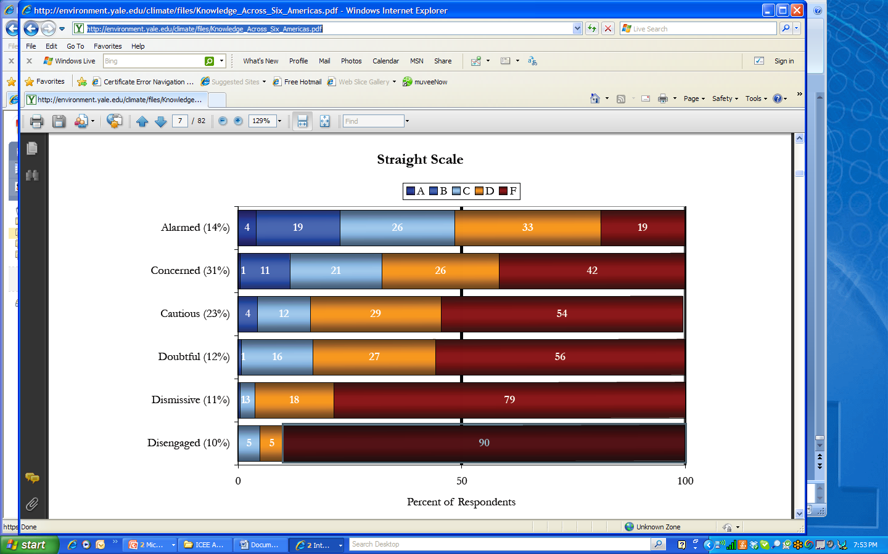
More literate are more concerned, but….
http://environment.yale.edu/climate/files/Knowledge_Across_Six_Americas.pdf

Slide 39
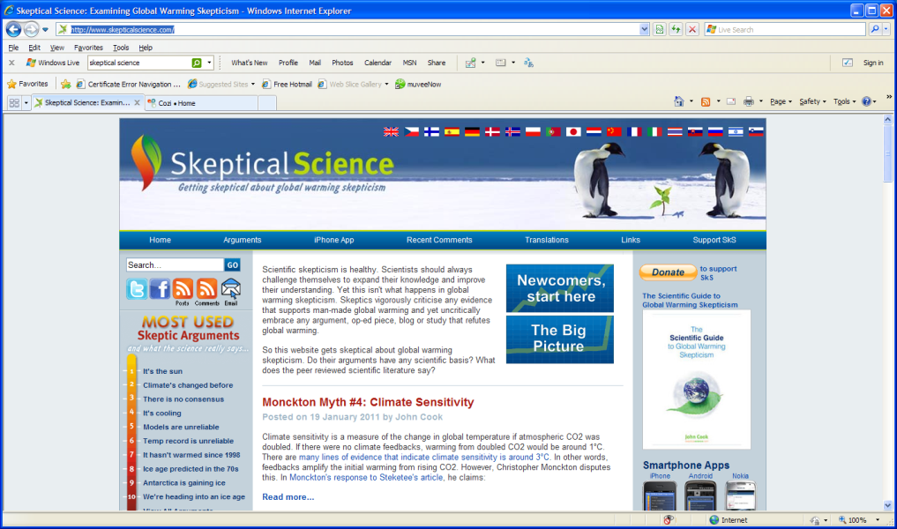
Sources for sound information
Agencies, IPCC
Skeptical Science
Real Climate “Start Here”
Reviewed Cutting Edge resources
CLEAN collection

Slide 40
talking about solutions
Leiserowitz et al., 2008
Leiserowitz et al., 2008

Slide 41
talking about solutions
“A father came in and said ‘What are you teaching? My daughter has been home crying because of climate change.’ I had been teaching three weeks on causes, four weeks on effects, and we were getting to two weeks on solutions. Now, every week, I do something on cause/effect and solutions so we are always doing something positive.”
    - Teacher from Heritage M.S., Longmont, CO

Slide 42
effective climate pedagogy
is:
is not:
Integrated throughout
Inquiry and evidence-based
Relevant to audience
Dialogue focused
Examines learning
Includes solution info
Ancillary
Superficial reasoning
Privileging authority over reasoning
Intended to trigger fear, guilt
Thank you!

Slide 43
Questions?

Slide 44
Contact information
http://cires.colorado.edu/education/k12/
Susan.buhr@colorado.edu/303-492-5657

Slide 45
Further Discussion
What climate misconceptions have you noted?
What do you do to identify them?
How do you address climate misconceptions?
What else do you need?
To login: Get a SERC account (it’s free, it’s fast, it’s worth it)
http://serc.carleton.edu/NAGTWorkshops/climatechange/webinar/discussions.html

