Slide 1
Preparing Now for Your Future Academic Career in the Geosciences
Heather Macdonald, College of William & Mary
Rachel O’Brien, Allegheny College

Slide 2
The academic enterprise
Various options *
  Research ~125
  Doctorate ~110
  Master’s granting ~530
  Baccalaureate ~630
  Two-year colleges ~1,100
  Other academic options
* Richard Reis’s presentation at the 2006 Preparing for an Academic Career workshop

Slide 3
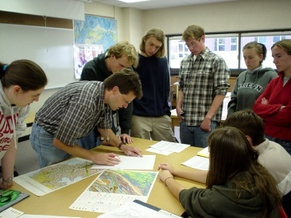
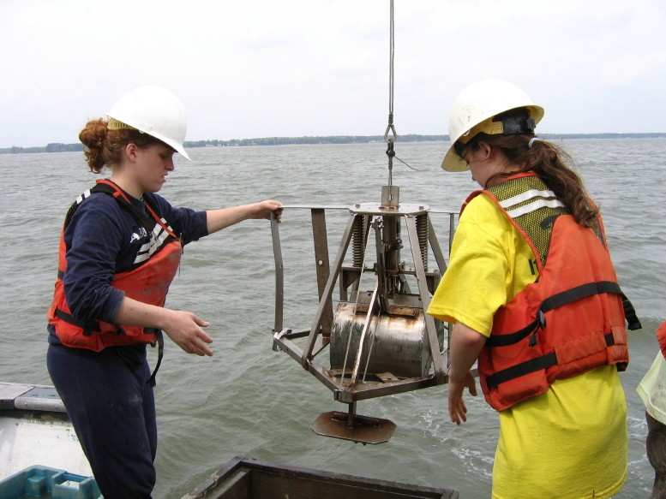
Academic careers
Teaching, research, service
Freedom and responsibility
Tenure or equivalent
Change
Choices!
From Cutting Edge website
Photo by Rowan Lockwood

Slide 4
Intellectual entrepreneurs
The personal driver: Curiosity coupled with the joy of generating and sharing new knowledge
PLUS
The academy: Intellectual autonomy with a foundation of financial and logistical support
EQUALS
An opportunity to take charge and run with your ideas and imagination.

Slide 5
Strategic career planning
Who am I as a professional?
Where do I want to be?
What do I want to accomplish?
Notes:
First task is what they’re working on right now. Kudos!
Second task is equally important (from a strategic standpoint) and thinking about it may inform the first task.
We have much more freedom and flexibility in answering these questions than we usually allow ourselves. Be proactive; be creative; be authentic; be visionary.

Slide 6
The next-stage strategy (Part 1)
Look ahead, think ahead
  Ask questions and make observations
  Read pertinent literature, attend professional workshops, join/build networks, find and use mentors
What are the characteristics of various institutional options?
What’s right for you (work/self/home)?

Slide 7
Finding and getting an academic position that’s right for you
What departments look for in new faculty
  Overall promise
  General teaching ability, ability to teach courses needed by the department
  Ability to do research, specific research area
  Potential for securing funding (depends on dept)
  A good “fit” with department and institution
What are you looking for in a department?
Modified from Richard Reis’s presentation in 2006

Slide 8
The next-stage strategy (Part 2)
Act ahead to develop early career skills:
  Teaching
  Research
  Service?
Document your accomplishments (career inventory)

Slide 9
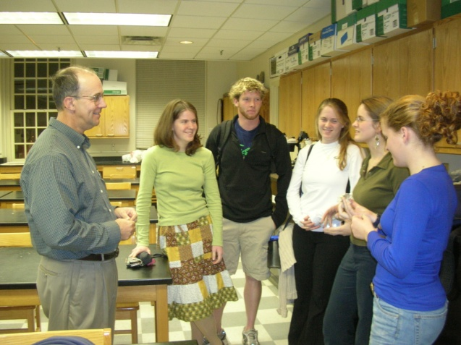
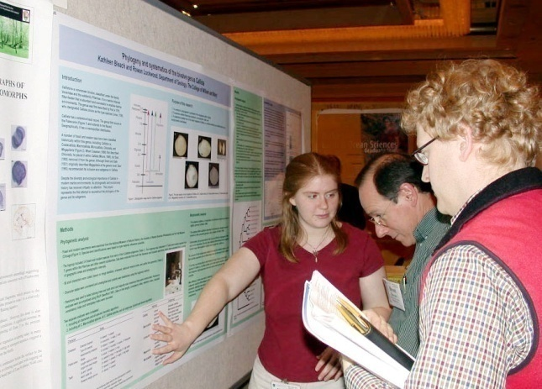
Develop your early career skills
  Write papers and give presentations
  Review manuscripts
  Submit grant proposals
  Get teaching experience – courses, guest lectures, outreach programs
  Mentor undergraduate research students
  Serve on committees (cautiously)

Slide 11
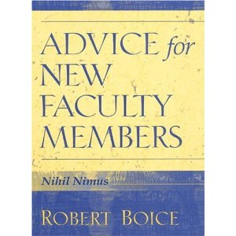
Advice for the next stage
Faculty who did well early in their career
  Published more
  Received better teaching evaluations
  Were happier than their stressed-out peers
These “Quick Starters”
  Avoided procrastination
  Developed consistent work habits (including regular writing)
  Balanced teaching with other work activities
  Sought help from colleagues early
Results of research: 415 early career faculty from two institutions

Slide 12
You have the power and privilege of navigating
Move forward intentionally, mindfully,
strategically
Remember your responsibility to
others
Enjoy the journey!

