Slide 1
Class 1
Lecture on Lecturing
Drs. Erin Kraal and Joshua Villalobos

Slide 2
Important Topics
What is an interactive lecture?
Interactive techniques
Challenges to implementation

Slide 3
Write your answer:
Define ‘interactive lecture’

Slide 4
Technique:
Think-Pair-Share
Think – Individual response (mental, written)
Pair – Discussion with a person next to you (private, opportunity to change answer/ask questions)
Share – In groups (how big? From the groups around to the whole class – opens up ‘calling on’ students because they are sharing a group answer)

Slide 5
Required Pieces:
Interactive lectures
Intellectual engagement
Student participation
Activity based
Student centered vs. instructor centered

Slide 6
The average attention span is
Less than 2 minutes
Around 15 minutes
Constantly declines
Remains constant
Fluctuates
I was checking my facebook
Technique:
Example clicker question, voting with hands, even modified think-pair-share…

Slide 7
Draw a graph of how you think attention span changes with time
100%
Attention Span
Example using graphical response
0%
Time (minutes)
Notes:
Examples related to geology
Temperature vs time of day
Weather cycles
Slip rates on a fault
Etc…
Basically anything that can be vs time (or vs. distance)

Slide 8
Interactive Techniques
An activity where students directly participate in an intellectually challenging problem to learn new material that is integrated into a lecture.

Slide 9
Example activity:
Age of the Solar System / Radioactive Decay
General education students
100 person lecture
Students have read (hopefully) a chapter that includes a short section on radioactive decay but I assume this is their first ‘real’ introduction.

Slide 10
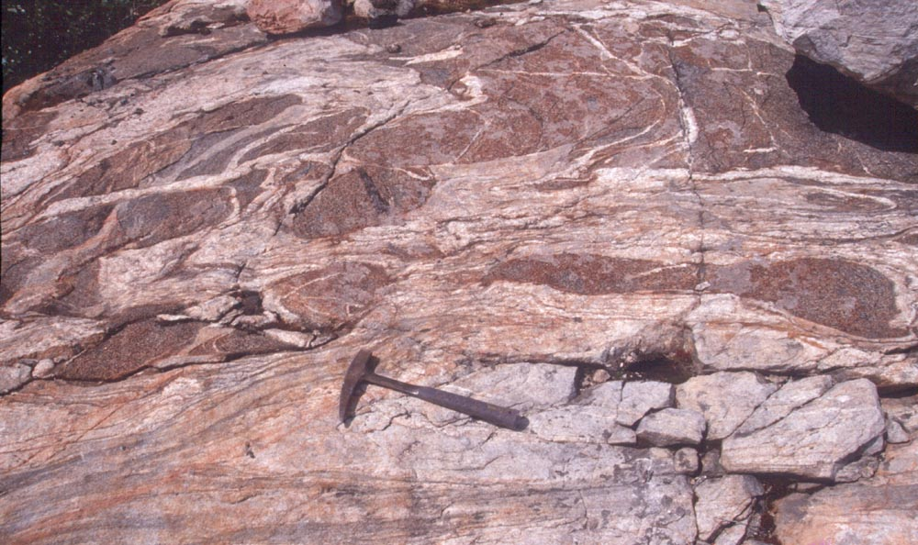
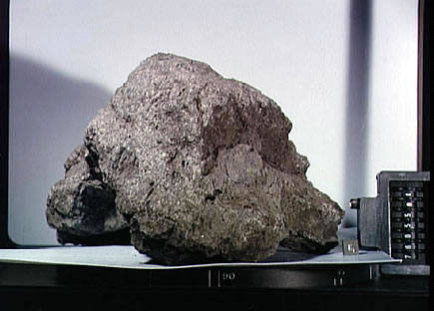
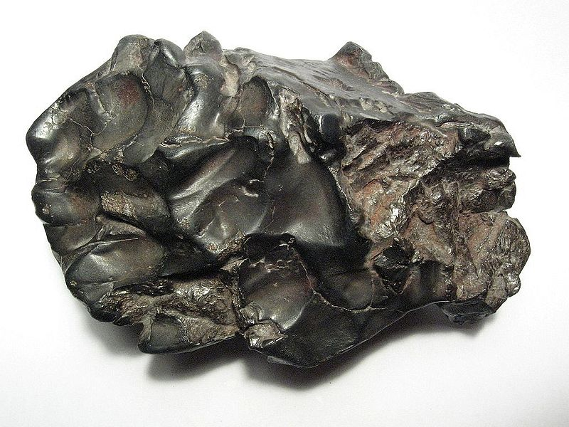
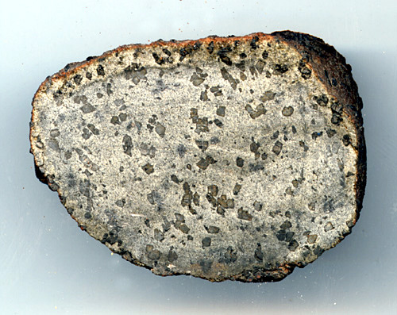
How old is our solar system?
Ages from radioactive decay from all over the solar system indicate ~4.5 billion years ago.
Lunar rocks from Apollo mission
(up to 4.5 billion years)
Earth rocks – Oldest rocks on earth – Southern Australia (~4.01 billion years)
Meteorites
(oldest ones ~4.5 billion years ago)
Martian meteorites
(~3.9 billion)

Slide 11

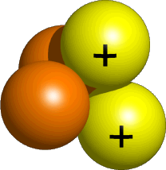
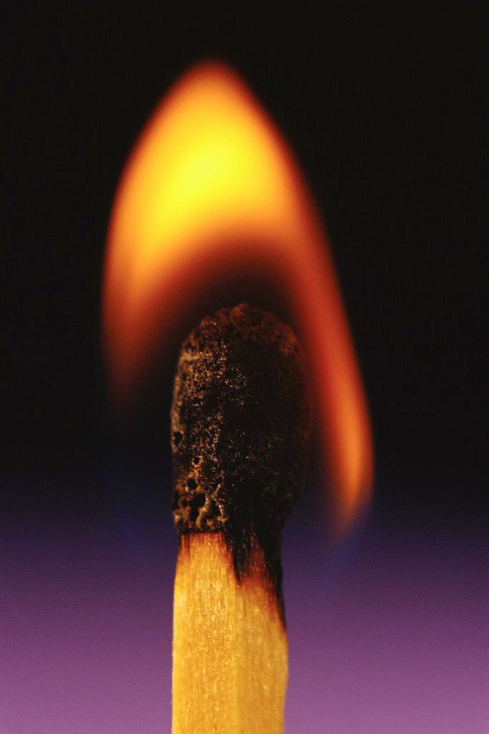
Radioactive decay
Certain atoms break apart into smaller atoms. This is spontaneous and releases heat and radiation.
Th (Thorium)
Unstable atom
Radioactive decay
He (Helium)
Radiation (fragments)
U - Uranium
Heat
Half life – the time it takes for half of the original element to change

Slide 12
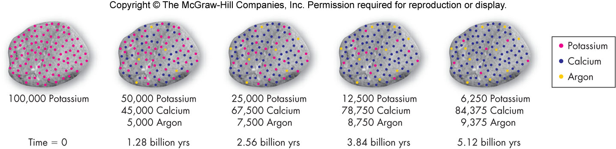
Half-lives
Time it takes for HALF of the parent to decay into the daughter

Slide 13
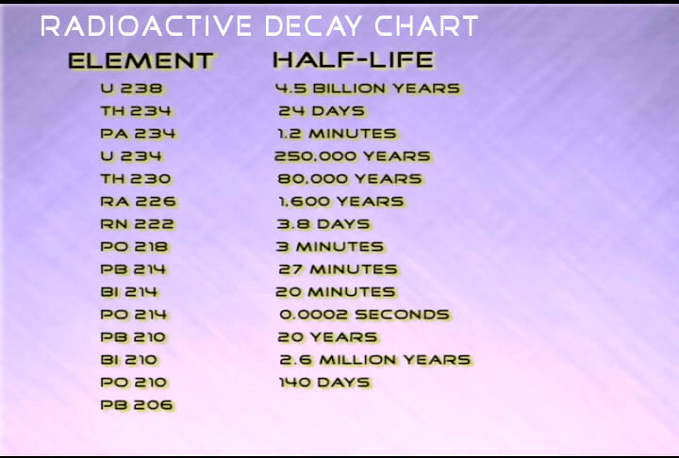
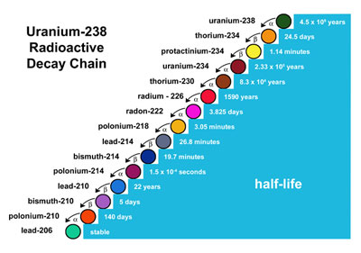
If you know how much of each parent vs. daughter – you can tell how old!

Slide 14
Radio Active Decay
Internal heat source
Method for determining age of objects
Uses ratios of parent to daughter to determine the age
Rate of decay is call HALF LIFE
AVERAGE time it takes for a single radioactive atom decay (from parent to daughter)
  OR-
AVERAGE time it takes for half of the atoms to decay

Slide 15
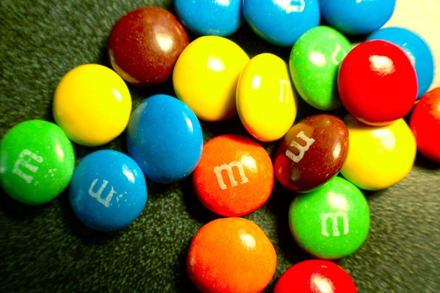
Radioactive Decay Activity
Directions:
Each row is a group. Each row gets 1 bag of 100 M&M’s, paper plate, and data sheet. Put all names on the data sheet.
We will keep track of how the M&M’s decay from parents to daughters. Dump the M&M’s onto the plate. All those that land with no M showing – are daughters and ‘decay’ – remove them from the plate. Record the number of parents and daughters (the total will always equal 100! Return the ‘parents’ to the bag and dump them again.
M (or bunny symbol) Showing = Parent (leave it)
No M (or bunny symbol) = Daughter – it just ‘decayed’ (remove it)

Slide 16
Data
Dump | Parent M&M’s (M’s showing) | Daughter M&M’s (no M showing)
0 - Starting | 100 | 0
1
2
3
4
5
6
7

Slide 17
Graphing Results
Graph lines for the
- Parent
- Daughter
100
Number of M&M’s
50
0
Number of Dumps

Slide 18
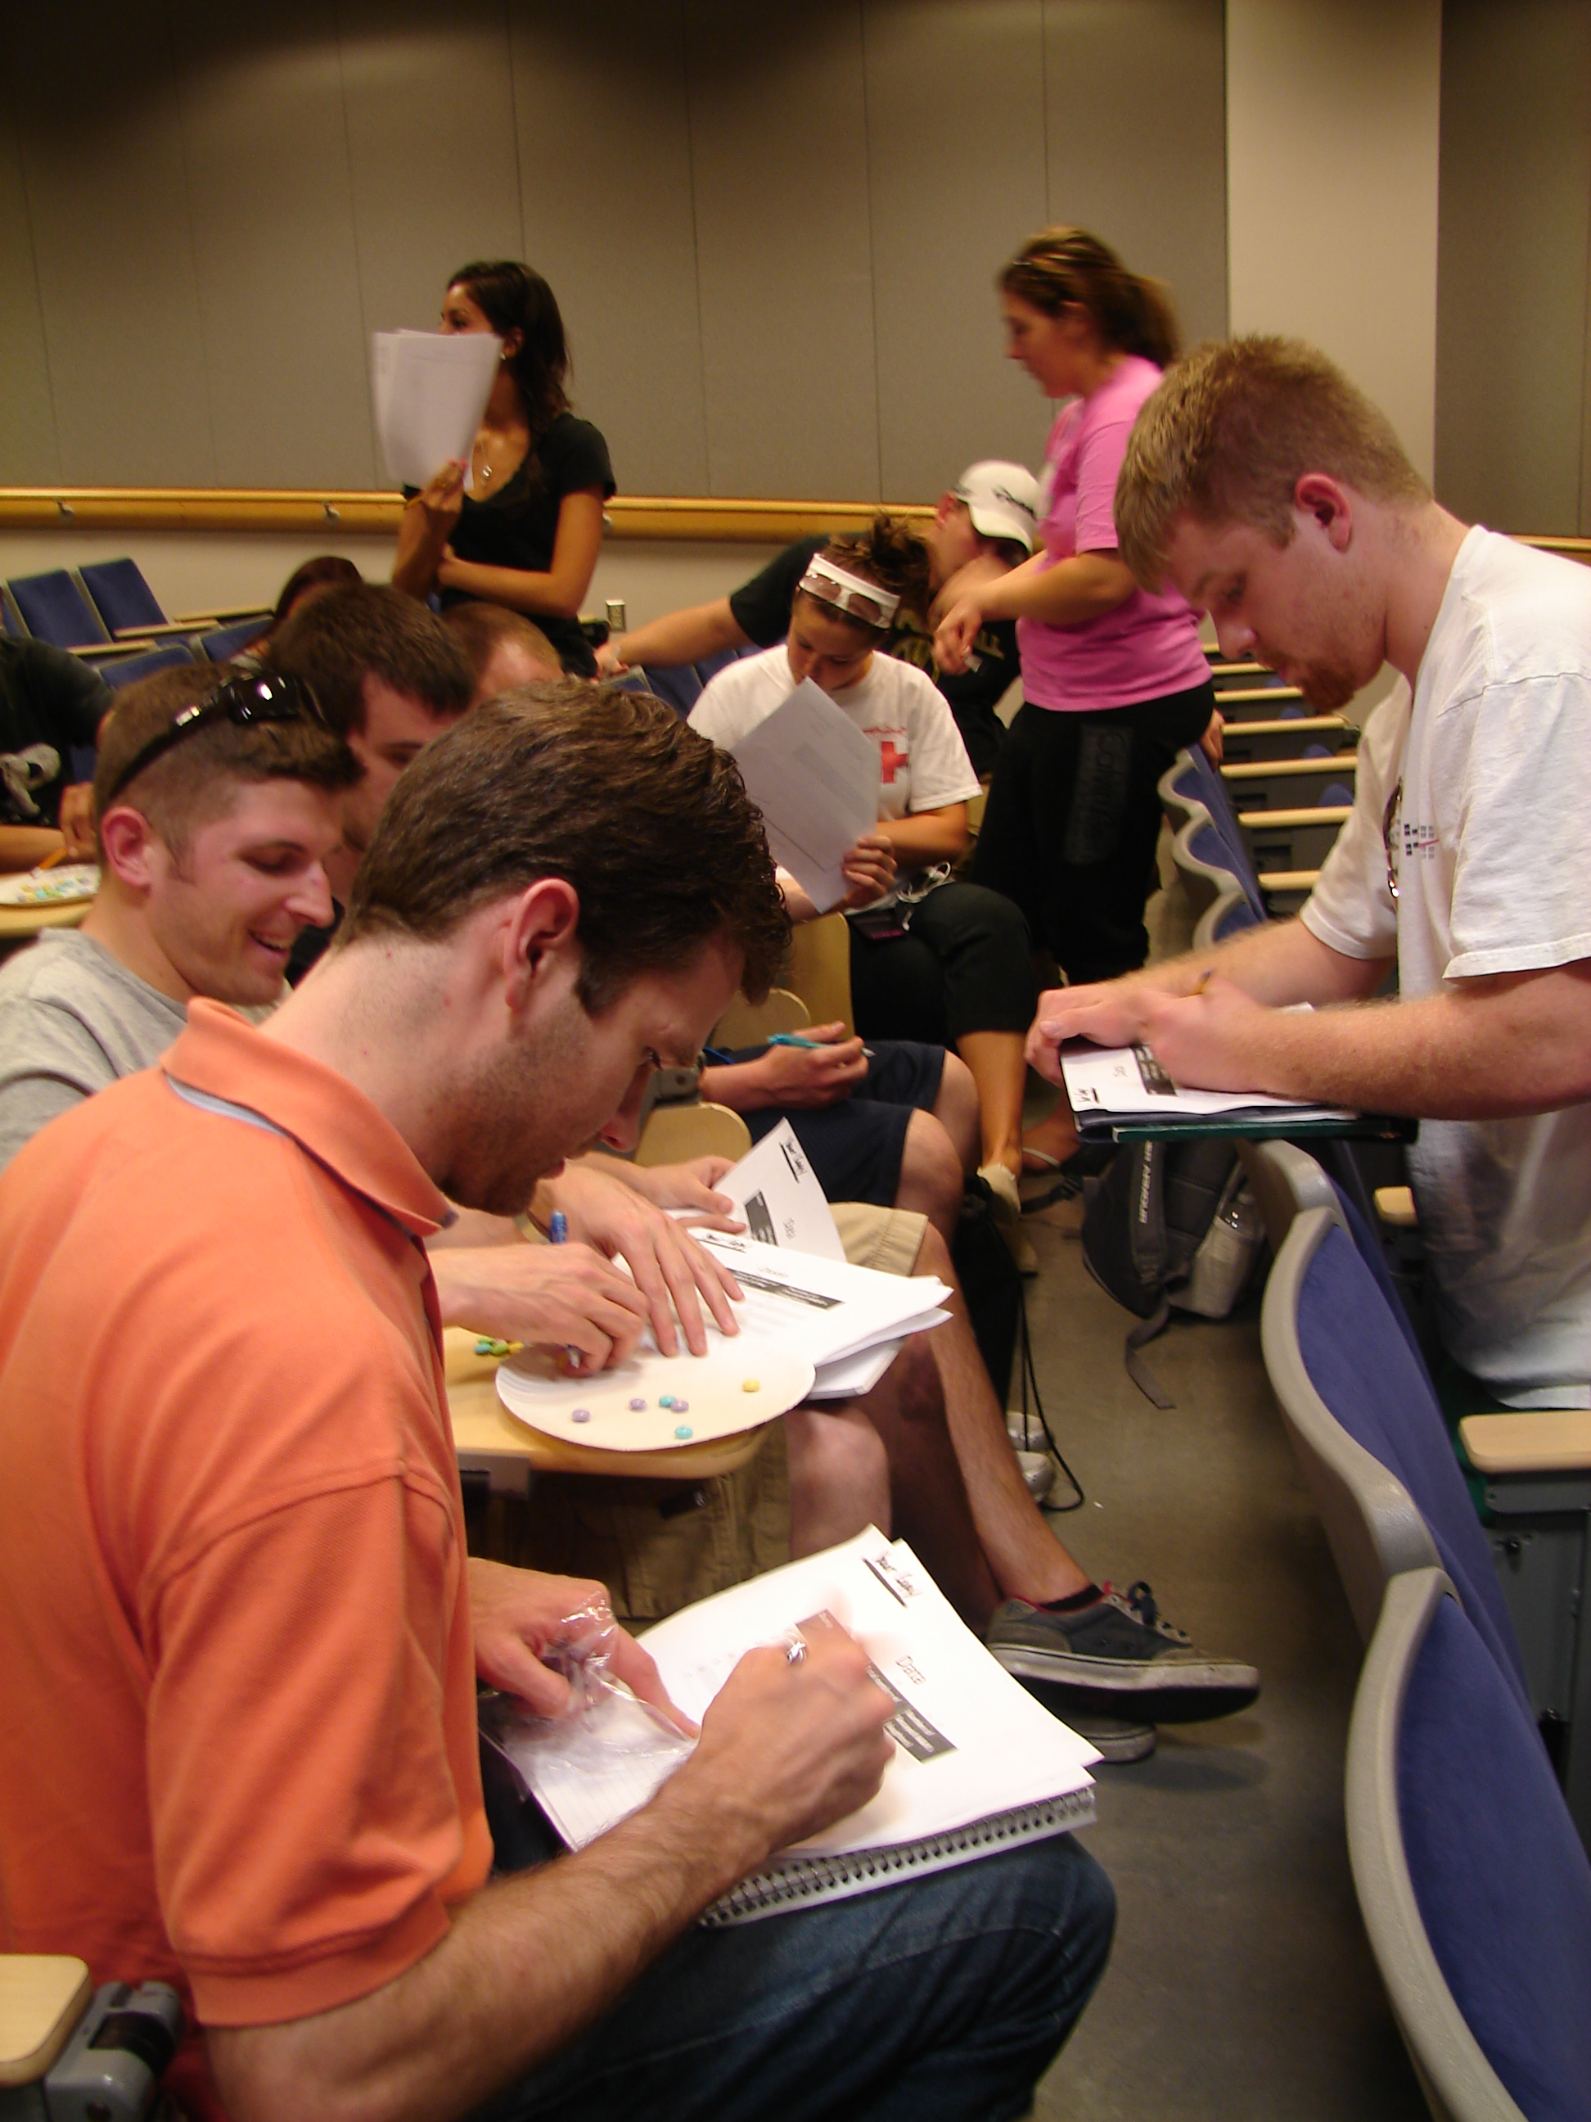
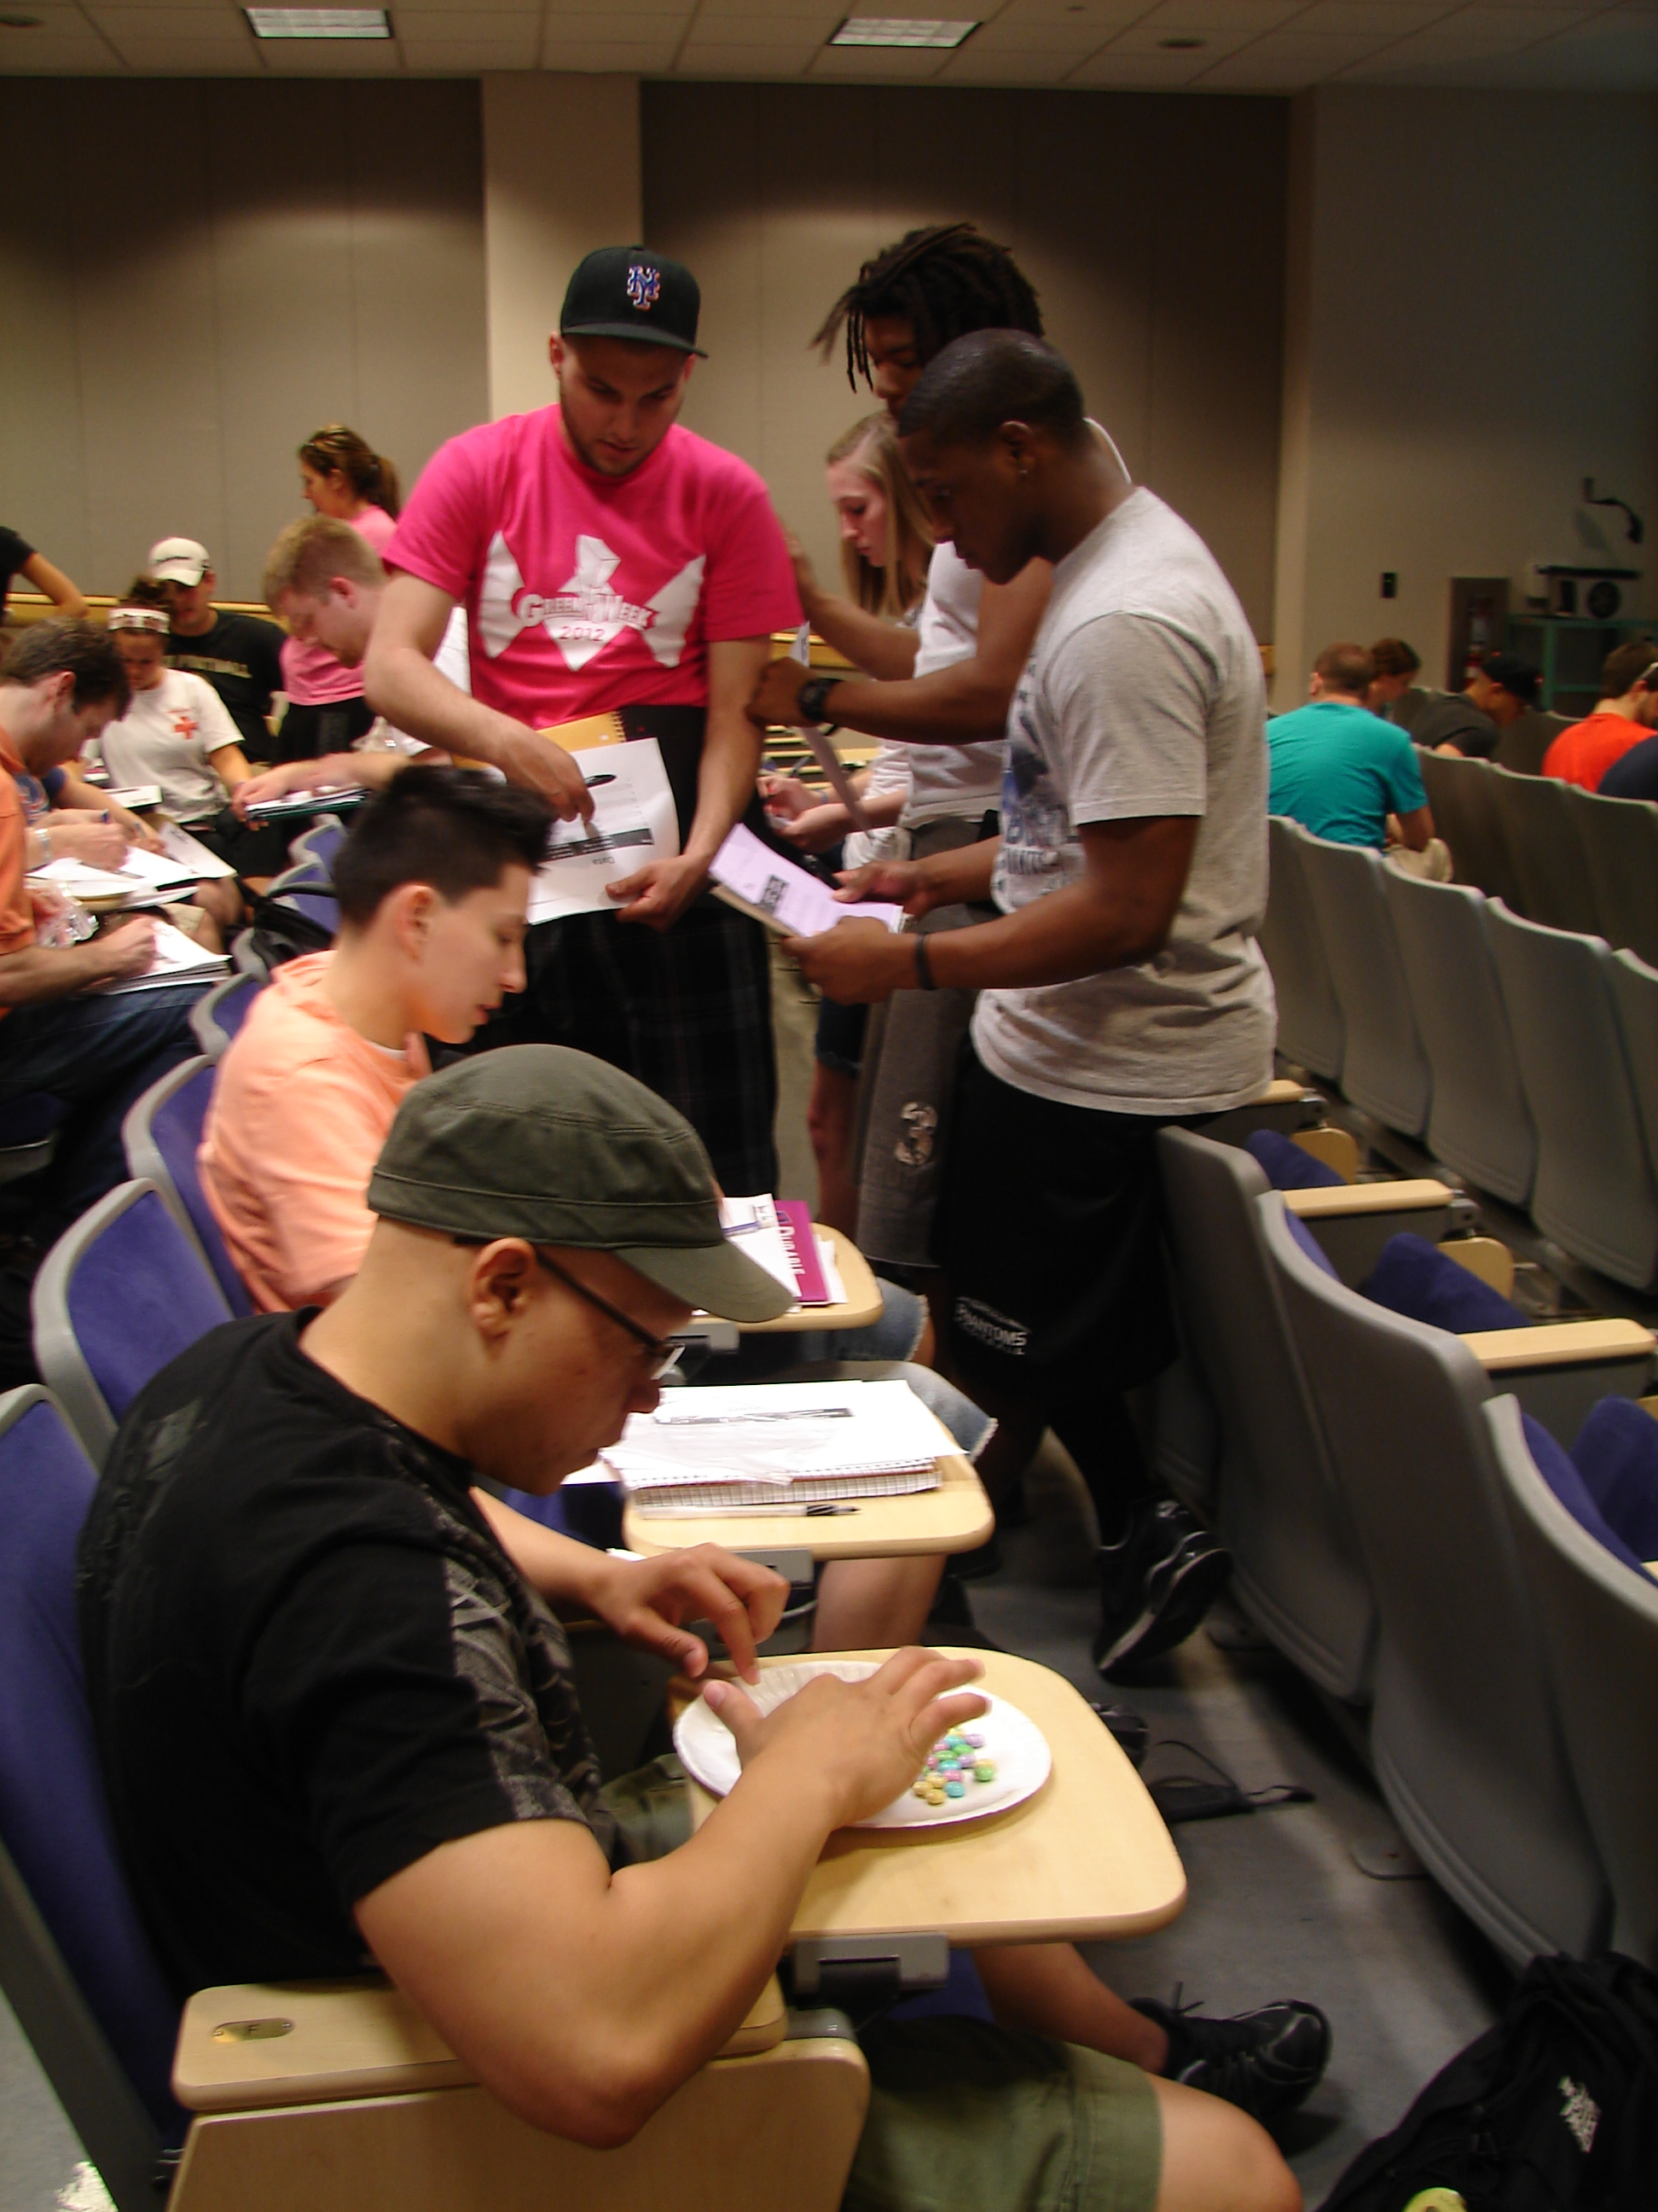
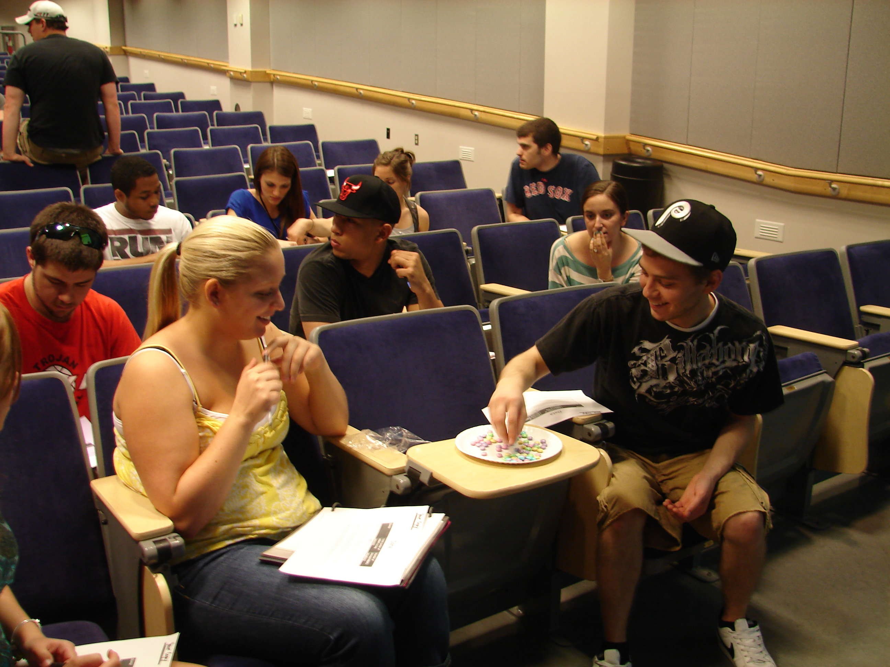
Total time is about 15 – 20 minutes including graphing.

Slide 19
Rate of decay is call HALF LIFE
AVERAGE time it takes for a single radioactive atom decay (from parent to daughter)
  OR-
AVERAGE time it takes for half of the atoms to decay

Slide 20
Calculating Half-lives
Fraction =
(of radio active atoms remaining )
τ = half life
t = time passed
(1 Dump)
(Number of Dumps)

Slide 21
Design an interactive activity on the SCIENTIFIC METHOD for an introductory/general education class
Directions: Get into groups of ~3. A notecard will tell you what size/type of classroom. Design an interactive component to a traditional lecture. Present your activity on the provided sheets.
Title of activity
Brief description of activity (3-4 sentences)
Time length
Supplies/Pre-class preparation

Slide 22
Challenges
There are challenges to interactive lectures.
Brainstorm challenge-
In your notes – write down all the challenges involved with interactive lecturing.
Time: 1 minute

Slide 23
Challenge Activity
Directions:
Get one notecard – write your name on the upper right corner.
Look through the list you wrote of all of the challenges. Pick one and write it on the front of the card.
Exchange notecards with another person. Read the challenge on the front and write one solution to the challenge on the back.

Slide 24
Helpful Hints
Initially develop a plan for interaction
  Every 5 slides a ‘clicker’ question
  One activity per 50 minute class
  Help students transition into interactive lectures, they may not be used to this type of learning.
Don’t be afraid to try new things once
Interactive doesn’t have to be elaborate!
Use writing / groups to your advantage

Slide 25
Resources
Textbook – clicker questions / problems
Blogs
Google searches when you are putting together your lecture
Lab manuals (removing one figure from another lab for an activity)

